Slide 1
More Greedy Algorithms
CSE 421 22AU
Lecture 7

Slide 2
Trip Planning
Your goal is to follow a pre-set route from New York to Los Angeles.
You can drive 500 miles in a day, but you need to make sure you can stop at a hotel every night (all possibilities premarked on your map)
You’d like to stop for the fewest number of nights possible – what should you plan?
Greedy: Go as far as you can every night.
Is greedy optimal?
Or is there some reason to “stop short” that might let you go further the next night?

Slide 3
Outline
Last Time
  Practice with proofs for greedy algorithms (already knew the algorithm)
Today
  Practice with generating greedy algorithms itself.
  and maybe the proof at the end.
Section Tomorrow
  Practice yourself; general problem solving process you’ll continue to use all quarter.

Slide 4
Interval Scheduling
You have a single processor, and a set of jobs with fixed start and end times.
Your goal is to maximize the number of jobs you can process.
I.e. choose the maximum number of non-overlapping intervals.

Slide 5
Interval Scheduling
You have a single processor, and a set of jobs with fixed start and end times.
Your goal is to maximize the number of jobs you can process.
I.e. choose the maximum number of non-overlapping intervals.
3 non-overlapping intervals

Slide 6
Interval Scheduling
You have a single processor, and a set of jobs with fixed start and end times.
Your goal is to maximize the number of jobs you can process.
I.e. choose the maximum number of non-overlapping intervals.
3 other non-overlapping intervals

Slide 7
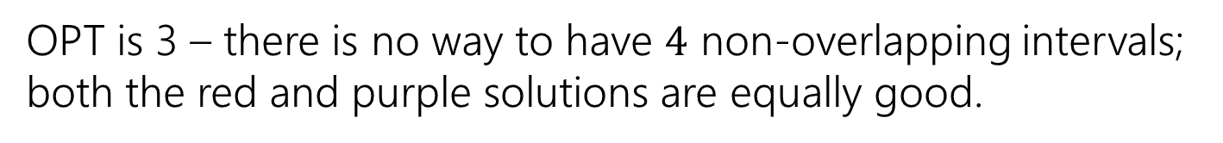
Interval Scheduling
You have a single processor, and a set of jobs with fixed start and end times.
Your goal is to maximize the number of jobs you can process.
I.e. choose the maximum number of non-overlapping intervals.
OPT is 3 – there is no way to have $4$ non-overlapping intervals; both the red and purple solutions are equally good.

Slide 8
Greedy Ideas
To specify a greedy algorithm, we need to:
Order the elements (intervals)
Choose a rule for deciding whether to add.
Rule: Add interval as long as it doesn’t overlap with those we’ve already selected.
What ordering should we use?
Think of at least two orderings you think might work.

Slide 9
Greedy Algorithm
Some possibilities
Earliest end time (add if no overlap with previous selected)
Latest end time
Earliest start time
Latest start time
Shortest interval
Fewest overlaps (with remaining intervals)

Slide 10
Greedy
That list slide is the real difficulty with greedy algorithms.
All of those look at least somewhat plausible at first glance.
With MSTs that was fine – those ideas all worked!
It’s not fine here.
They don’t all work.
As a first step – try to find counter-examples to narrow down

Slide 11
Greedy Algorithm
Earliest end time
Latest end time
Earliest start time
Latest start time
Shortest interval
Fewest overlaps (with remaining intervals)

Slide 12
Take Earliest Start Time – Counter Example

Slide 13
Take Earliest Start Time – Counter Example
Algorithm finds
Optimum
Taking the one with the earliest start time doesn’t give us the best answer.

Slide 14
Shortest Interval

Slide 15
Shortest Interval
Algorithm finds
Optimum
Taking the shortest interval first doesn’t give us the best answer

Slide 16
Greedy Algorithm
Earliest end time
Latest end time
Earliest start time
Latest start time
Shortest interval
Fewest overlaps (with remaining intervals)

Slide 17
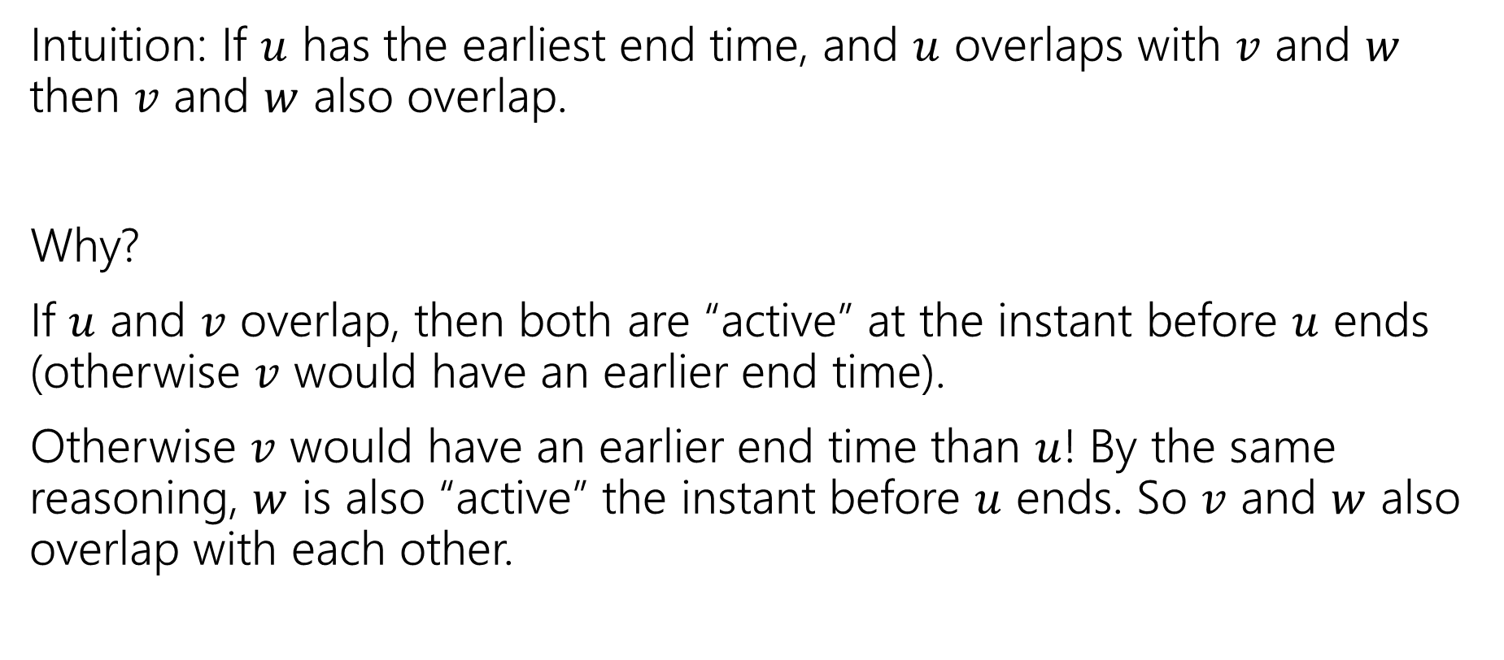
Earliest End Time
Intuition: If $u$ has the earliest end time, and $u$ overlaps with $v$ and $w$ then $v$ and $w$ also overlap.
Why?
If $u$ and $v$ overlap, then both are “active” at the instant before $u$ ends (otherwise $v$ would have an earlier end time).
Otherwise $v$ would have an earlier end time than $u$! By the same reasoning, $w$ is also “active” the instant before $u$ ends. So $v$ and $w$ also overlap with each other.

Slide 18
Earliest End Time
Can you prove it correct?
Do you want to use
Structural Result
Exchange Argument
Greedy Stays Ahead

Slide 19
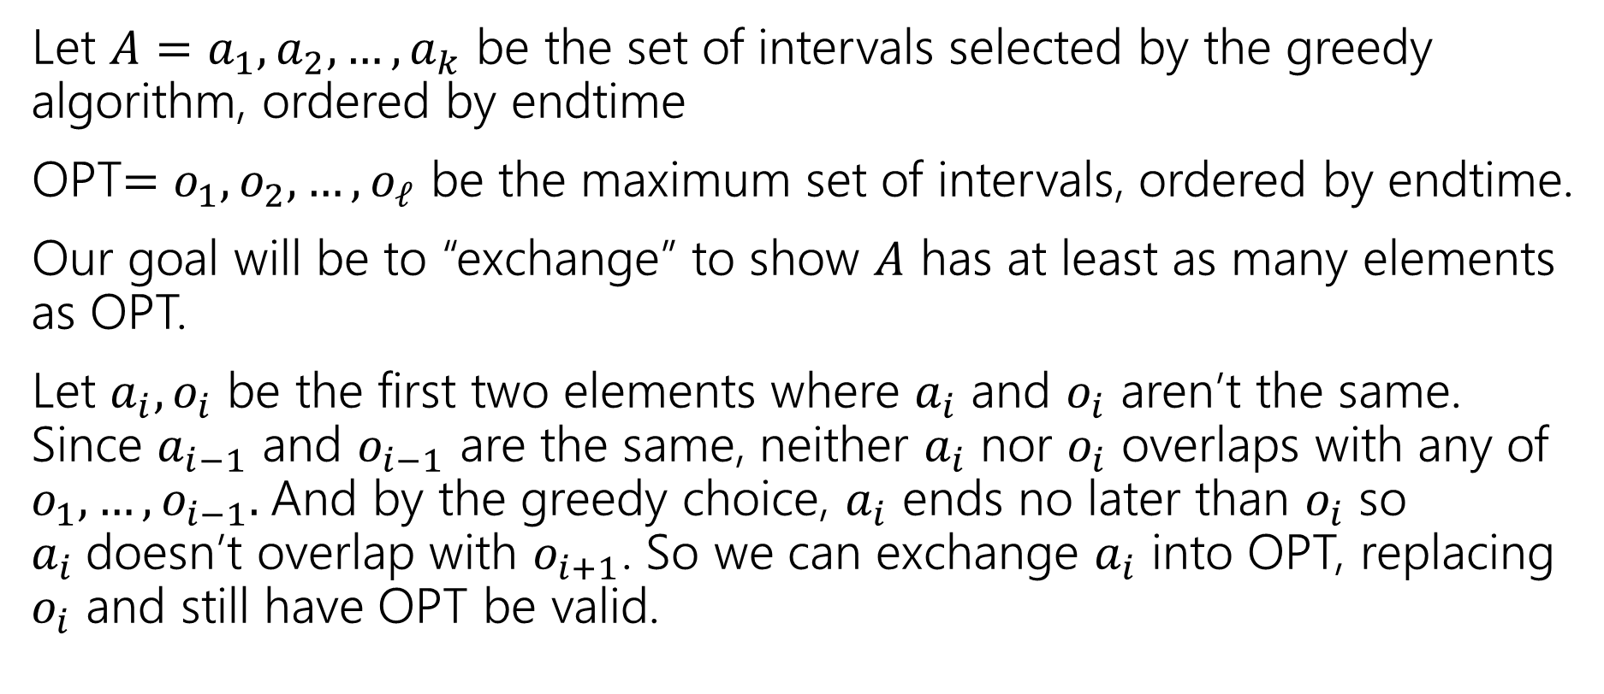
Exchange Argument
Let $A=a_{1},a_{2},…,a_{k}$ be the set of intervals selected by the greedy algorithm, ordered by endtime
OPT$=o_{1},o_{2},…,o_{ℓ}$ be the maximum set of intervals, ordered by endtime.
Our goal will be to “exchange” to show $A$ has at least as many elements as OPT.
Let $a_{i},o_{i}$ be the first two elements where $a_{i}$ and $o_{i}$ aren’t the same. Since $a_{i−1}$ and $o_{i−1}$ are the same, neither $a_{i}$ nor $o_{i}$ overlaps with any of $o_{1},…,o_{i−1}.$And by the greedy choice, $a_{i}$ ends no later than $o_{i}$ so $a_{i}$doesn’t overlap with $o_{i+1}$. So we can exchange $a_{i}$ into OPT, replacing $o_{i}$ and still have OPT be valid.

Slide 20
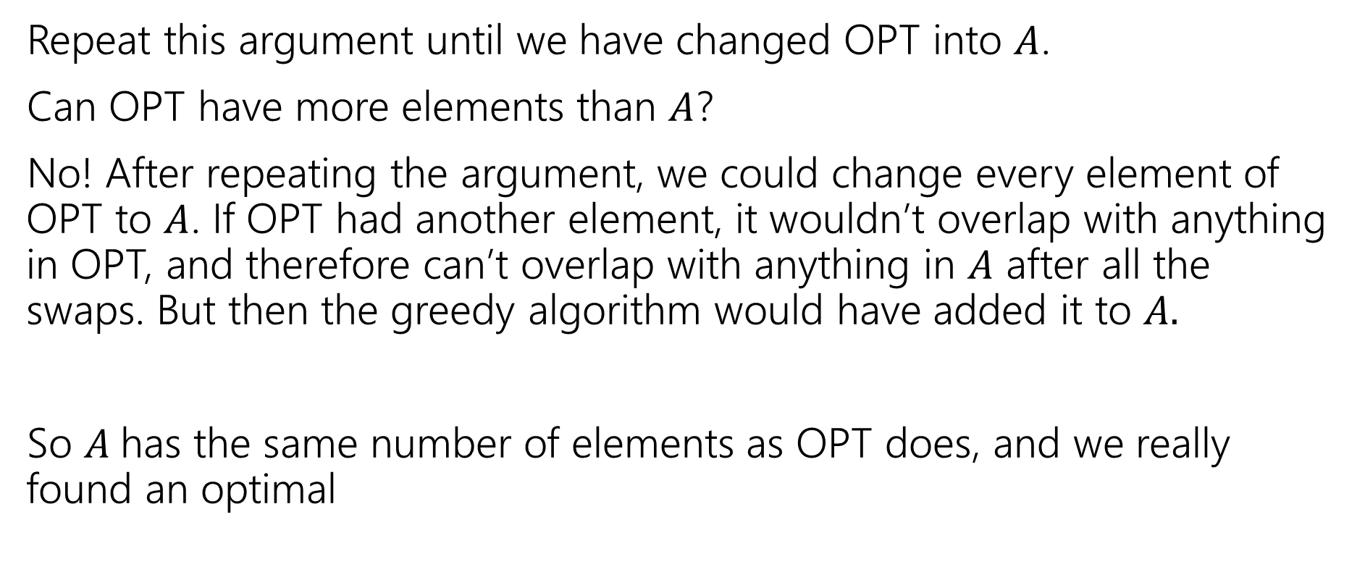
Exchange Argument
Repeat this argument until we have changed OPT into $A$.
Can OPT have more elements than $A$?
No! After repeating the argument, we could change every element of OPT to $A$. If OPT had another element, it wouldn’t overlap with anything in OPT, and therefore can’t overlap with anything in $A$ after all the swaps. But then the greedy algorithm would have added it to $A.$
So $A$has the same number of elements as OPT does, and we really found an optimal

Slide 21
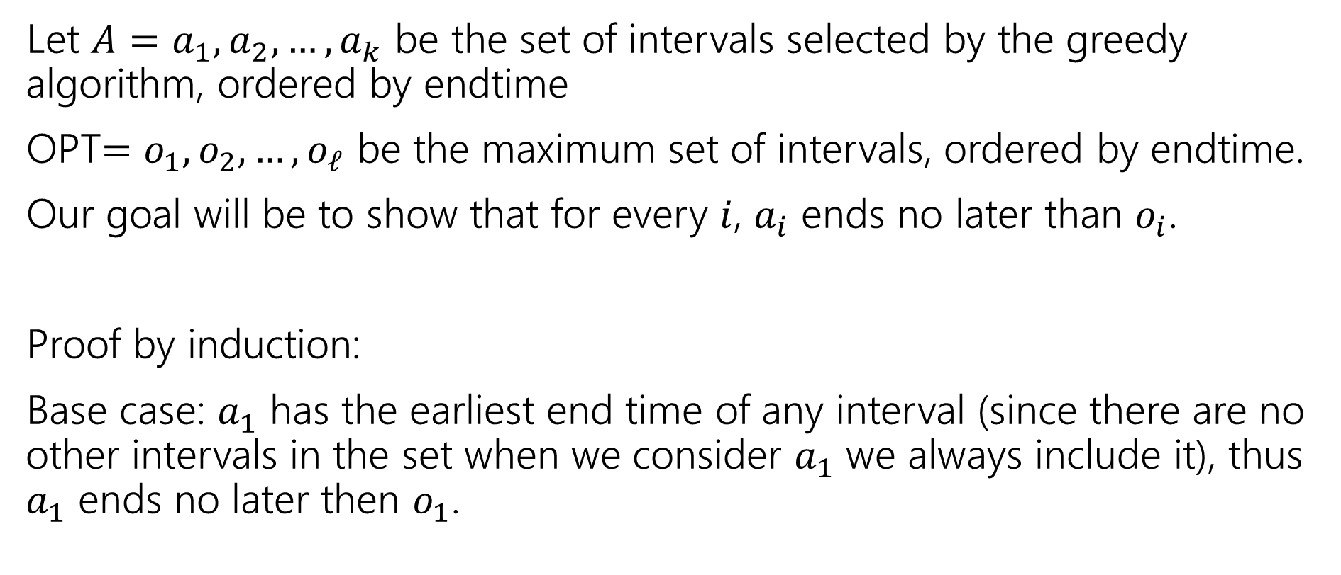
Greedy Stays Ahead
Let $A=a_{1},a_{2},…,a_{k}$ be the set of intervals selected by the greedy algorithm, ordered by endtime
OPT$=o_{1},o_{2},…,o_{ℓ}$ be the maximum set of intervals, ordered by endtime.
Our goal will be to show that for every $i$, $a_{i}$ ends no later than $o_{i}$.
Proof by induction:
Base case: $a_{1}$ has the earliest end time of any interval (since there are no other intervals in the set when we consider $a_{1}$ we always include it), thus $a_{1}$ ends no later then $o_{1}$.

Slide 22
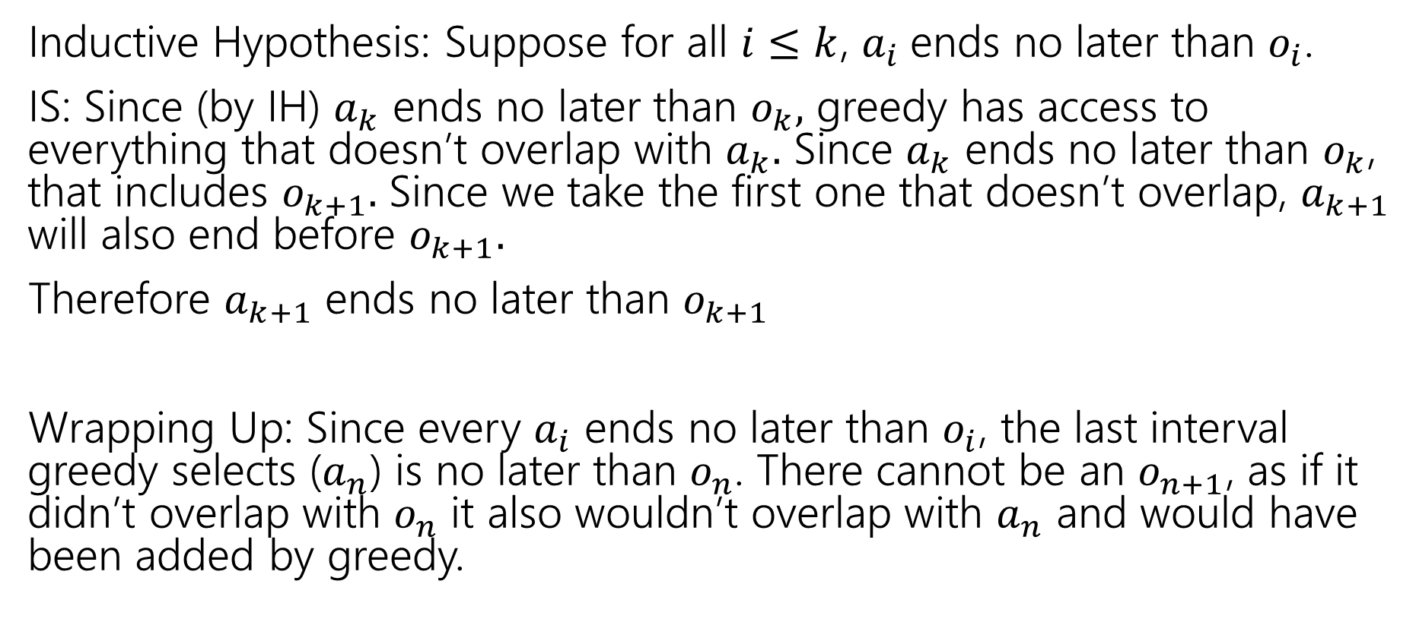
Greedy Stays Ahead
Inductive Hypothesis: Suppose for all $i≤k$, $a_{i}$ends no later than $o_{i}$.
IS: Since (by IH) $a_{k}$ ends no later than $o_{k},$ greedy has access to everything that doesn’t overlap with $a_{k}.$ Since $a_{k}$ ends no later than $o_{k}$, that includes $o_{k+1}.$ Since we take the first one that doesn’t overlap, $a_{k+1}$ will also end before $o_{k+1}.$
Therefore $a_{k+1}$ ends no later than $o_{k+1}$
Wrapping Up: Since every $a_{i}$ ends no later than $o_{i}$, the last interval greedy selects ($a_{n}$) is no later than $o_{n}$. There cannot be an $o_{n+1}$, as if it didn’t overlap with $o_{n}$ it also wouldn’t overlap with $a_{n}$ and would have been added by greedy.

Slide 23

Greedy Algorithm
Earliest end time
Latest end time
Earliest start time
Latest start time
Shortest interval
Fewest overlaps (with remaining intervals)

Slide 24
Other Greedy Algorithms
It turns out latest start time and fewest overlaps also work.
Latest start time is actually the same as earliest end time (imagine “reflecting” all the jobs along the time axis – the one with the earliest end time ends up having the last start time).
What about fewest overlaps?
Easiest proof Robbie knows observes that fewest overlaps means you have the earliest finish time (among a certain subset of the intervals)

Slide 25
Greedy Algorithm
Earliest end time
Latest end time
Earliest start time
Latest start time
Shortest interval
Fewest overlaps (with remaining intervals)
Retcon!
Robbie was wrong about this in lecture --- fewest overlaps isn’t optimal either!

Slide 26
Summary
Greedy algorithms
You’ll probably have 2 (or 3…or 6) ideas for greedy algorithms. Check some simple examples before you implement!
Greedy algorithms rarely work.
When they work AND you can prove they work, they’re great!
Proofs are often tricky
Structural results are the hardest to come up with, but the most versatile.
Greedy stays ahead usually use induction
Exchange start with the first difference between greedy and optimal.

