Slide 1
Graph Modeling
CSE 421 22AU
Lecture 5

Slide 2
Announcements
HW2 went out Wednesday night
Wednesdays will be our regular HW due/release date.
On the webpage, you can find:
A list of algorithms/data structures from 332
Homework formatting advice and a style guide
With high probability, your pseudocode is (if anything) too detailed.

Slide 3
More Graph Vocabulary
A
B
C
A cycle is a path, with an extra edge from the last vertex back to the first vertex.
D
F
E
A directed acyclic graph (DAG) is a directed graph that has no cycles.
B
C
D
F
E

Slide 4
Today
Use DFS to find cycles
More DFS applications (review from 373)
Graph practice

Slide 5
A
The orange edges (the ones where we discovered a new vertex) form a tree!*
We call them tree edges.
That blue edge went from a descendent to an ancestor
B was still on the stack when we found (B,D).
We call them back edges.
The green edge went from an ancestor to a descendant
F was put on and come off the stack between putting A on the stack and finding (A,F)
We call them forward edges.
The purple edge went…some other way.
D had been on and come off the stack before we found F or (F,D)
We call those cross edges.
1
12
2
11
B
3
6
C
E
4
5
D
7
10
F
*Conditions apply. Sometimes the graph is a forest. But we call them tree edges no matter what.
G
8
9

Slide 6
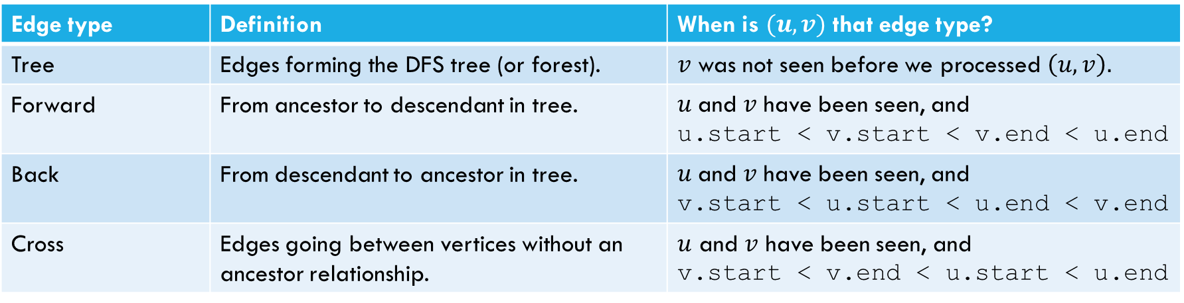
Edge Classification (for DFS on directed graphs)
Edge type | Definition | When is $(u,v)$ that edge type?
Tree | Edges forming the DFS tree (or forest). | $v$ was not seen before we processed $\left(u,v\right).$
Forward | From ancestor to descendant in tree. | $u$and $v$ have been seen, and u.start < v.start < v.end < u.end
Back | From descendant to ancestor in tree. | $u$and $v$ have been seen, and v.start < u.start < u.end < v.end
Cross | Edges going between vertices without an ancestor relationship. | $u$ and $v$ have been seen, and v.start < v.end < u.start < u.end
The third column doesn’t look like it encompasses all possibilities.
It does – the fact that we’re using a stack limits the possibilities:
e.g. u.start < v.start < u.end < v.end is impossible.
And the rules of the algorithm eliminate some other possibilities.

Slide 7
Actually Using DFS
Here’s a claim that will let us use DFS for something!
DFS run on a directed graph has a back edge if and only if it has a cycle.
Back Edge Characterization
A cycle is a path, with an extra edge from the last vertex back to the first vertex.

Slide 8
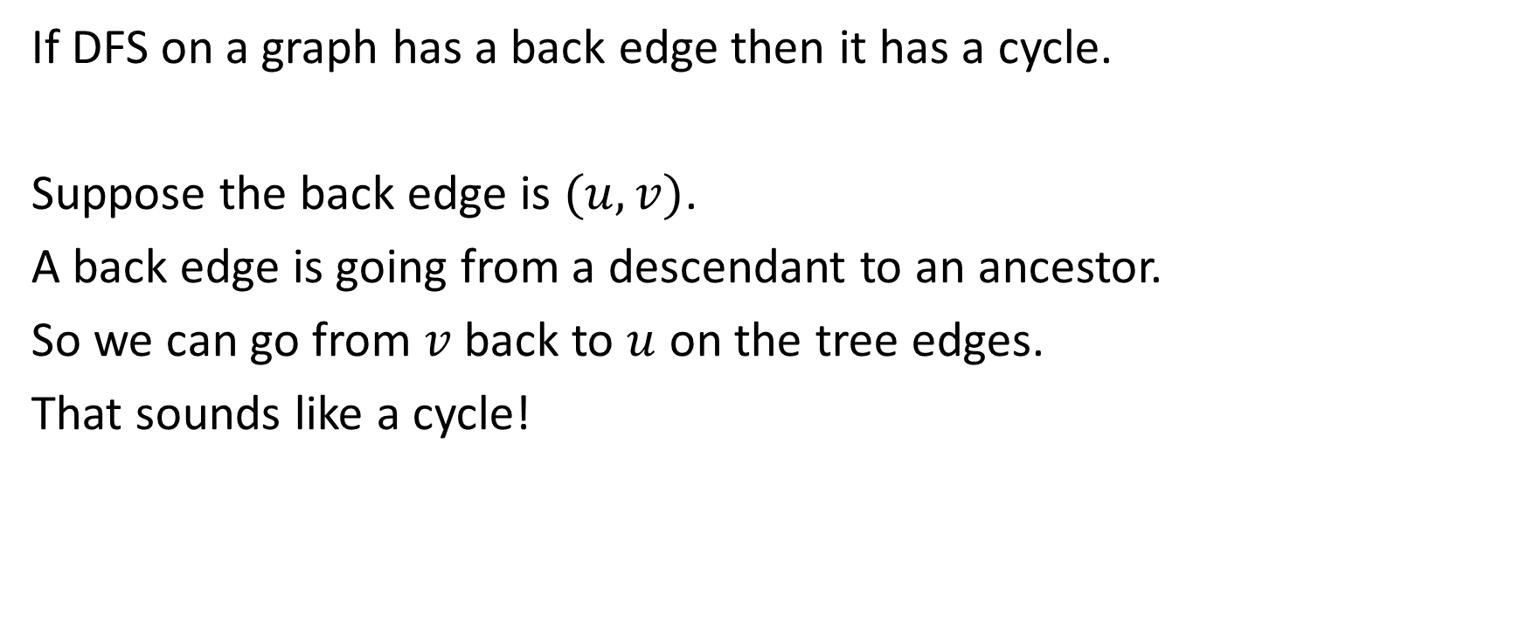
Forward Direction
If DFS on a graph has a back edge then it has a cycle.
Suppose the back edge is $(u,v)$.
A back edge is going from a descendant to an ancestor.
So we can go from $v$ back to $u$ on the tree edges.
That sounds like a cycle!

Slide 9
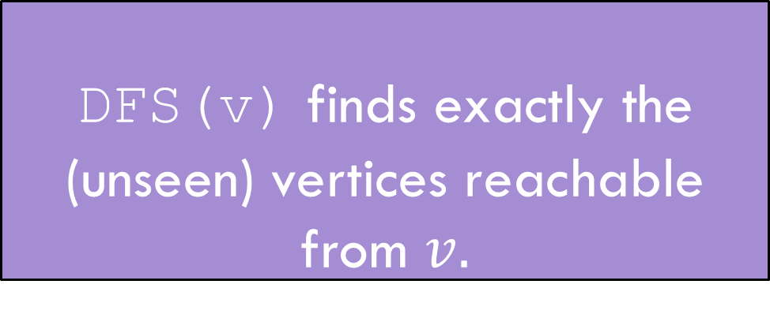
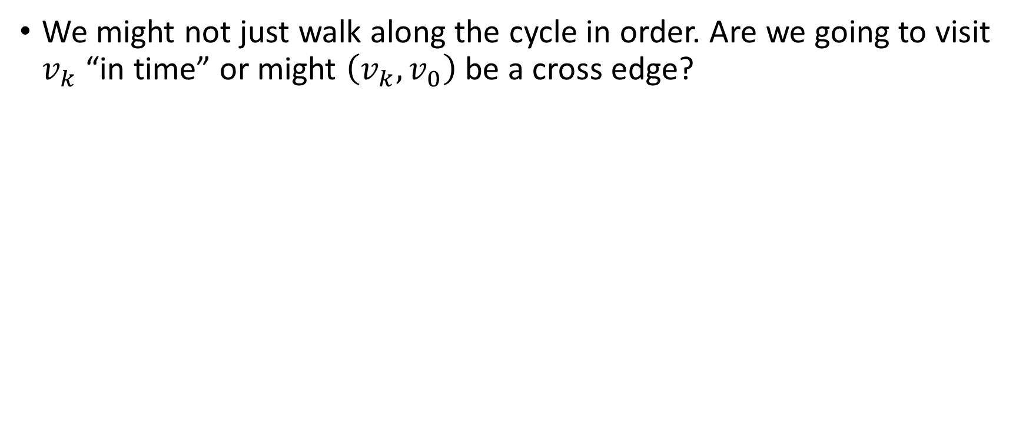
The Backward Direction
We might not just walk along the cycle in order. Are we going to visit $v_{k}$ “in time” or might $\left(v_{k}, v_{0}\right)$ be a cross edge?
DFS(v) finds exactly the (unseen) vertices reachable from $v.$
DFS discovery

Slide 10
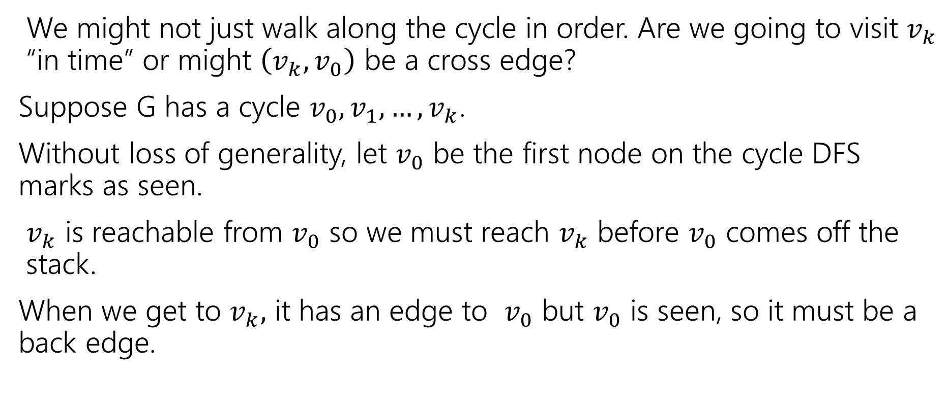
The Backward Direction
We might not just walk along the cycle in order. Are we going to visit $v_{k}$ “in time” or might $\left(v_{k}, v_{0}\right)$ be a cross edge?
Suppose G has a cycle $v_{0},v_{1},…,v_{k}$.
Without loss of generality, let $v_{0}$ be the first node on the cycle DFS marks as seen.
$v_{k}$ is reachable from $v_{0}$ so we must reach $v_{k}$ before $v_{0}$ comes off the stack.
When we get to $v_{k},$ it has an edge to $v_{0}$ but $v_{0}$ is seen, so it must be a back edge.

Slide 11
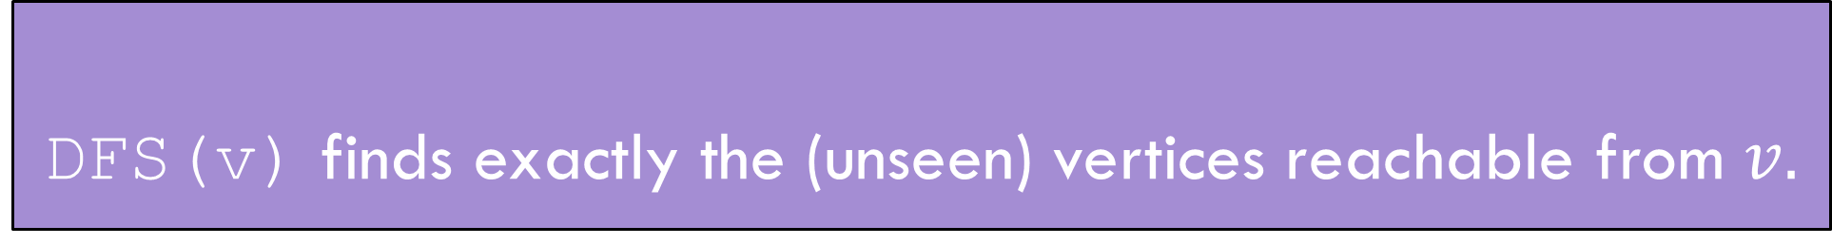
Summary
DFS(v) finds exactly the (unseen) vertices reachable from $v.$
DFS discovery
A directed graph has a back edge if and only if it has a cycle.
Back Edge Characterization

Slide 12
Edge Classification (for DFS on directed graphs)
Edge type | Definition | When is $(u,v)$ that edge type?
Tree | Edges forming the DFS tree (or forest). | $v$ was not seen before we processed $\left(u,v\right).$
Forward | From ancestor to descendant in tree. | $u$and $v$ have been seen, and u.start < v.start < v.end < u.end
Back | From descendant to ancestor in tree. | $u$and $v$ have been seen, and v.start < u.start < u.end < v.end
Cross | Edges going between vertices without an ancestor relationship. | $u$ and $v$ have been seen, and v.start < v.end < u.start < u.end
The third column doesn’t look like it encompasses all possibilities.
It does – the fact that we’re using a stack limits the possibilities:
e.g. u.start < v.start < u.end < v.end is impossible.
And the rules of the algorithm eliminate some other possibilities.

Slide 13
BFS/DFS caveats and cautions
Edge classifications are different for directed graphs and undirected graphs.
DFS in undirected graphs don’t have cross edges.
BFS in directed graphs can have edges skipping levels (only as back edges, skipping levels up though!)

Slide 14
Summary – Graph Search Applications
BFS
dfs
Shortest Paths (unweighted) graphs)
Cycle detection (directed graphs)
Topological sort
Strongly connected components
Cut edges (on homework)
EITHER
2-coloring
Connected components (undirected)
Usually use BFS – easier to understand.

Slide 15
Problem 1: Ordering Dependencies
Given a directed graph G, where we have an edge from u to v if u must happen before v.
We can only do things one at a time, can we find an order that respects dependencies?
Given: a directed graph G
Find: an ordering of the vertices so all edges go from left to right.
Topological Sort (aka Topological Ordering)
Uses:
Compiling multiple files
Graduating

Slide 16
Topological Ordering
A course prerequisite chart and a possible topological ordering.
Math 126
CSE 374
CSE 143
CSE 142
CSE 373
CSE 417
Math 126
CSE 142
CSE 143
CSE 373
CSE 374
CSE 417

Slide 17
Problem 2
Given a graph, find its strongly connected components
A set of vertices C such that every pair of vertices in C is connected via some path in both directions, and there is no other vertex which is connected to every vertex of C in both directions.
Strongly Connected Component
A
B
D
E
K
1
2
C
F
J
3
4

Slide 18
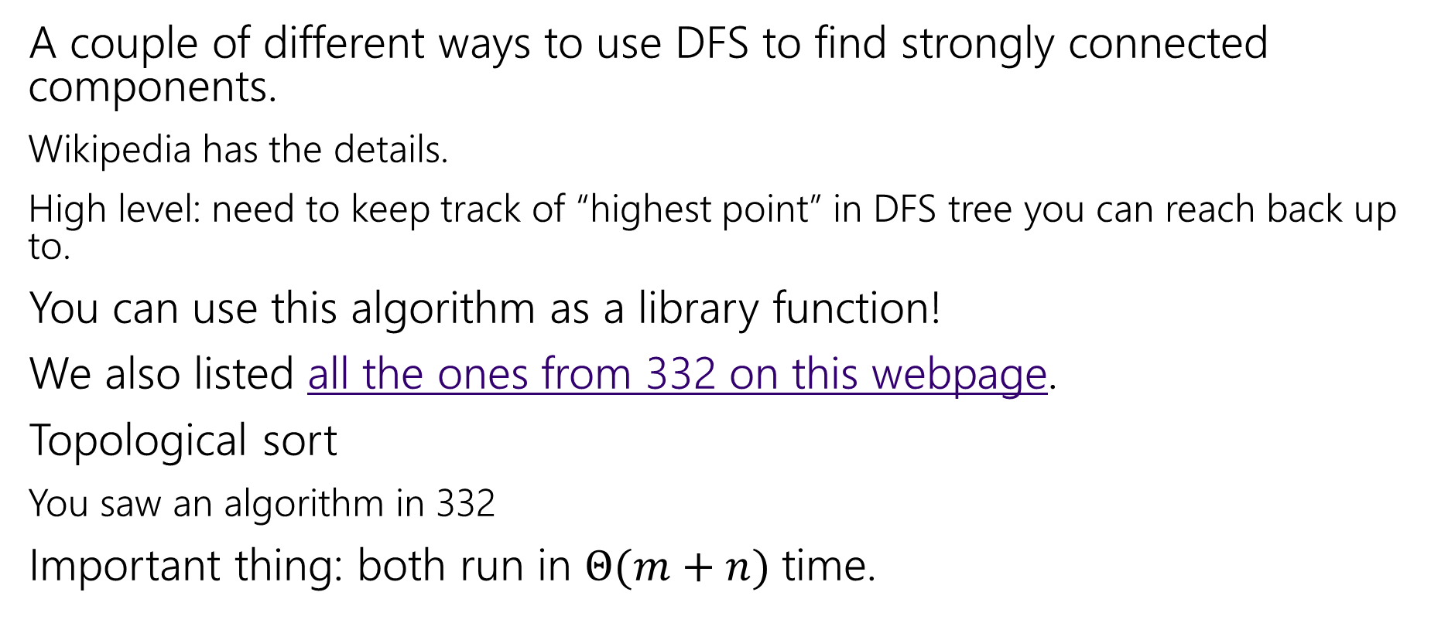
How do these work?
A couple of different ways to use DFS to find strongly connected components.
Wikipedia has the details.
High level: need to keep track of “highest point” in DFS tree you can reach back up to.
You can use this algorithm as a library function!
We also listed all the ones from 332 on this webpage.
Topological sort
You saw an algorithm in 332
Important thing: both run in $Θ(m+n)$ time.

Slide 19
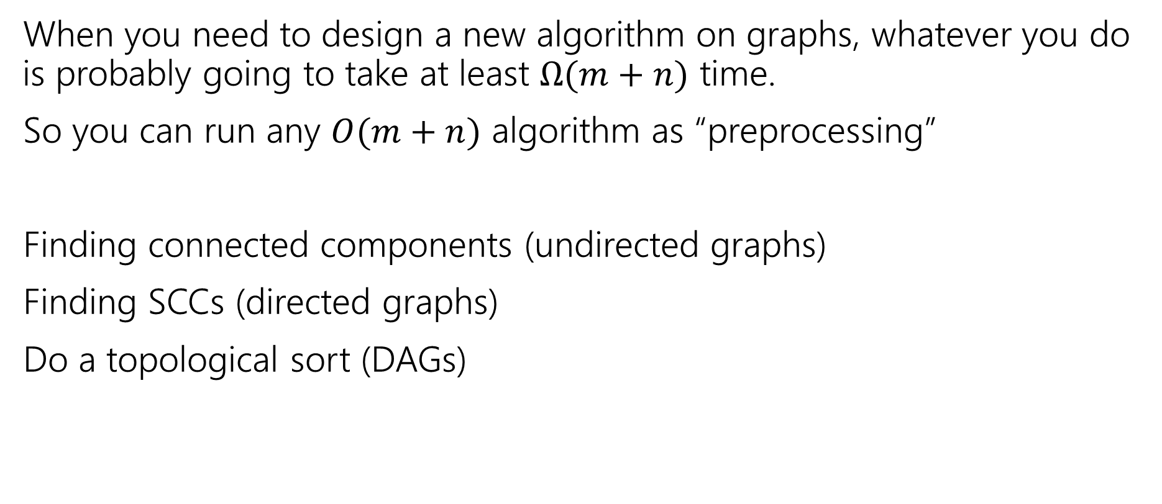
Designing New Algorithms
When you need to design a new algorithm on graphs, whatever you do is probably going to take at least $Ω(m+n)$ time.
So you can run any $O(m+n)$ algorithm as “preprocessing”
Finding connected components (undirected graphs)
Finding SCCs (directed graphs)
Do a topological sort (DAGs)

Slide 20
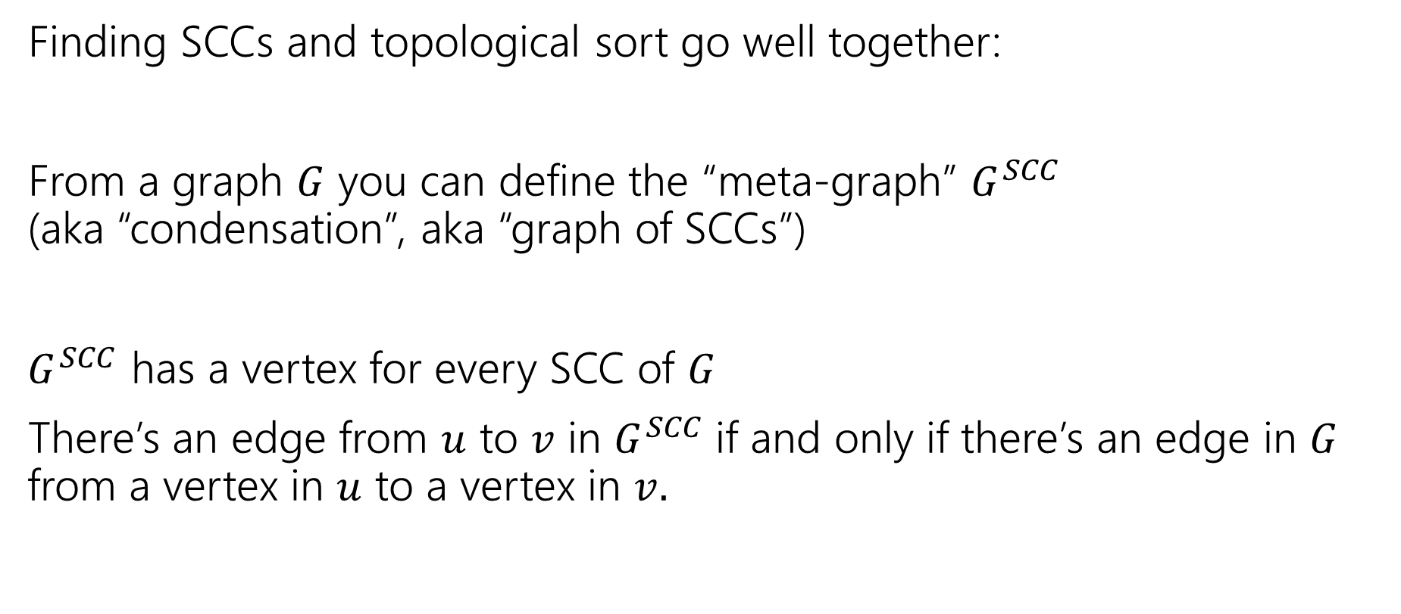
Designing New Algorithms
Finding SCCs and topological sort go well together:
From a graph $G$ you can define the “meta-graph” $G^{SCC}$
(aka “condensation”, aka “graph of SCCs”)
$G^{SCC}$ has a vertex for every SCC of $G$
There’s an edge from $u$ to $v$ in $G^{SCC}$if and only if there’s an edge in $G$ from a vertex in $u$ to a vertex in $v.$

Slide 21
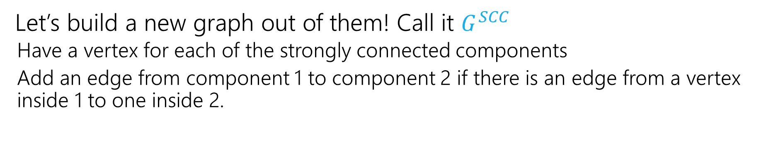
Why Find SCCs?
Let’s build a new graph out of them! Call it $G^{SCC}$
  Have a vertex for each of the strongly connected components
  Add an edge from component 1 to component 2 if there is an edge from a vertex inside 1 to one inside 2.
A
B
D
E
K
1
2
C
F
J
3
4

Slide 22
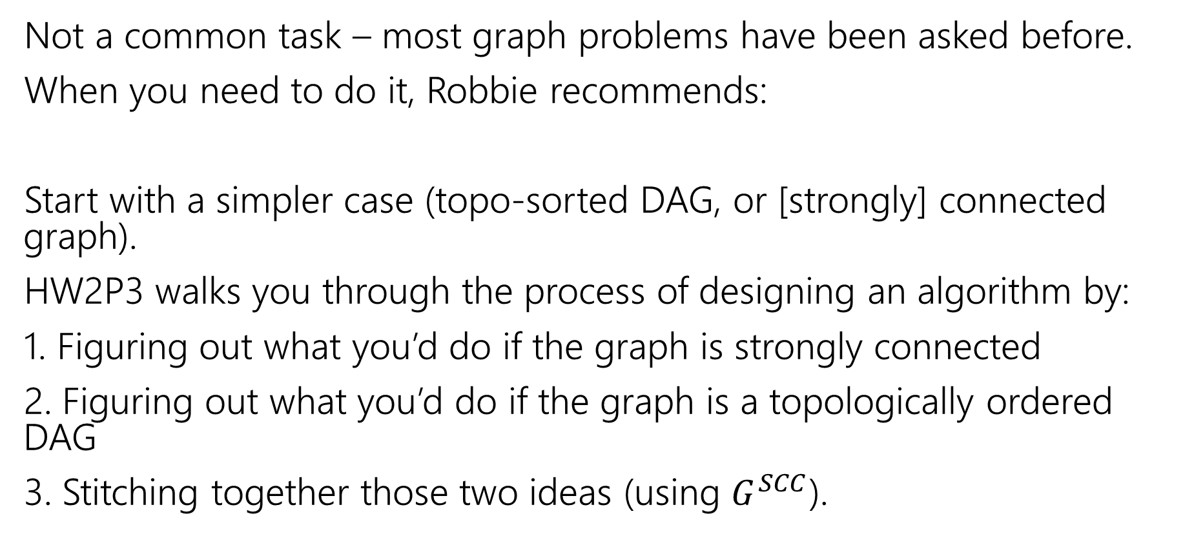
Designing New Graph Algorithms
Not a common task – most graph problems have been asked before.
When you need to do it, Robbie recommends:
Start with a simpler case (topo-sorted DAG, or [strongly] connected graph).
HW2P3 walks you through the process of designing an algorithm by:
1. Figuring out what you’d do if the graph is strongly connected
2. Figuring out what you’d do if the graph is a topologically ordered DAG
3. Stitching together those two ideas (using $G^{SCC}$).

Slide 23
Problem Solving Suggestions
Read the problem carefully.
  Are there any technical terms in the question? Any formulas?
  What kind of object will you get as input? What type is your output?
Do you understand it? Write sample inputs and outputs
  We’ll often give you samples, but it helps to add your own.
Now start thinking about solutions
  On those examples, how would you get the solution?
  Does this remind you of any algorithms from class?
  Can you think of a new idea?
  It’s ok to start with slow solutions and try to speed them up!
  Try the graph modeling process.

Slide 24
Graph Modeling
But…Most of the time you don’t need a new graph algorithm.
What you need is to figure out what graph to make and which graph algorithm to run.
“Graph modeling”
Going from word problem to graph algorithm.
Often finding a clever way to turn your requirements into graph features.
Mix of “standard bag of tricks” and new creativity.

Slide 25
Graph Modeling Process
1. What are your fundamental objects?
  Those will probably become your vertices.
2. How are those objects related?
  Represent those relationships with edges.
3. How is what I’m looking for encoded in the graph?
  Do I need a path from s to t? The shortest path from s to t? A minimum spanning tree? Something else?
4. Do I know how to find what I’m looking for?
  Then run that algorithm/combination of algorithms
  Otherwise go back to step 1 and try again.

Slide 26
Scenario #1
You’ve made a new social networking app, Convrs. Users on Convrs can have “asymmetric” following (I can follow you, without you following me). You decide to allow people to form multi-user direct messages, but only if people are probably in similar social circles (to avoid spamming).
You’ll allow a messaging channel to form only if for every pair of users a,b in the channel: a must follow b or follow someone who follows b or follow someone who follows someone who follows b, or …
And the same for b to a.
You’d like to be able to quickly check for any new proposed channel whether it meets this condition.
What are the vertices?
What are the edges?
What are we looking for?
What do we run?

Slide 27
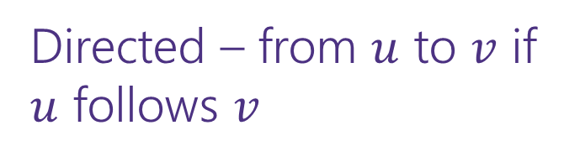
Scenario #1
You’ve made a new social networking app, Convrs. Users on Convrs can have “asymmetric” following (I can follow you, without you following me). You decide to allow people to form multi-user direct messages, but only if people are probably in similar social circles (to avoid spamming).
You’ll allow a messaging channel to form only if for every pair of users a,b in the channel: a must follow b or follow someone who follows b or follow someone who follows someone who follows b, or …
And the same for b to a.
You’d like to be able to quickly check for any new proposed channel whether it meets this condition.
What are the vertices?
What are the edges?
What are we looking for?
What do we run?
Users
Directed – from $u$ to $v$ if $u$ follows $v$
If everyone in the channel is in the same SCC.
Find SCCs, to test a new channel, make sure all are in same component.

Slide 28
Scenario #2
Sports fans often use the “transitive law” to predict sports outcomes --
In general, if you think A is better than B, and B is also better than C, then you expect that A is better than C.
Teams don’t all play each other – from data of games that have been played, determine if the “transitive law” is realistic, or misleading about at least one outcome.
What are the vertices?
What are the edges?
What are we looking for?
What do we run?

Slide 29
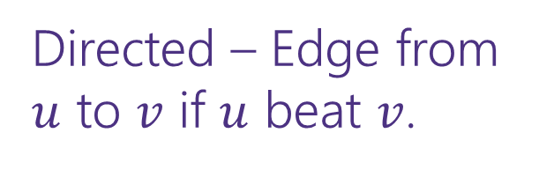
Scenario #2
What are the vertices?
What are the edges?
What are we looking for?
What do we run?
Sports fans often use the “transitive law” to predict sports outcomes -- .
In general, if you think A is better than B, and B is also better than C, then you expect that A is better than C.
Teams don’t all play each other – from data of games that have been played, determine if the “transitive law” is realistic, or misleading about at least one outcome.
Teams
Directed – Edge from $u$ to $v$ if $u$ beat $v$.
A cycle would say it’s not realistic.
OR a topological sort would say it is.
Cycle-detection DFS.
a topological sort algorithm (with error detection)

Slide 30
Scenario #3
It’s a
small
world
6
4
7
You are at Splash Mountain. Your best friend is at Space Mountain. You have to tell each other about your experiences in person as soon as possible. Where do you meet and how quickly can you get there?
What are the vertices?
What are the edges?
What are we looking for?
What do we run?
Dumbo
6
16
12
10
8
5
Matter-
horn
14
Thunder
Mtn
4
5
1
13
Splash
Mtn
Castle
9
7
15
17
11
9
3
Space
Mtn
Indiana
Jones
8
10
0
Star
Tours
1
2
Flag
Pole
2
Jungle
Cruise
3

Slide 31
Scenario #3
19
It’s a
small
world
15
6
4
7
You are at Splash Mountain. Your best friend is at Space Mountain. You have to tell each other about your experiences in person as soon as possible. Where do you meet and how quickly can you get there?
What are the vertices?
  Rides
What are the edges?
  Walkways with how long it would take to walk
What are we looking for?
  The “midpoint”
What do we run?
  Run Dijkstra’s from Splash Mountain, store distances
  Run Dijkstra’s from Space Mountain, store distances
  Iterate over vertices, for each vertex remember max of two
  Iterate over vertices, find minimum of remembered numbers
Dumbo
33
29
6
16
12
10
8
9
5
22
Matter-
horn
14
Thunder
Mtn
14
32
4
5
1
17
13
Splash
Mtn
Castle
36
19
9
0
7
15
17
0
11
9
3
29
Space
Mtn
Indiana
Jones
8
10
1
15
0
Star
Tours
Flag
Pole
28
1
36
2
2
31
Jungle
Cruise
20
3
37
17

Slide 32
Scenario #4
You’re a Disneyland employee, working the front of the Splash Mountain line. Suddenly, the crowd-control gates fall over and the line degrades into an unordered mass of people.
Sometimes you can tell who was in line before who; for other groups you aren’t quite sure.
You need to restore the line, while ensuring if you knew A came before B before the incident, they will still be in the right order afterward.
What are the vertices?
  People
What are the edges?
  Edges are directed, have an edge from X to Y if you know X came before Y.
What are we looking for?
  A total ordering consistent with all the ordering we do know.
What do we run?
  Topological Sort!

