Slide 1
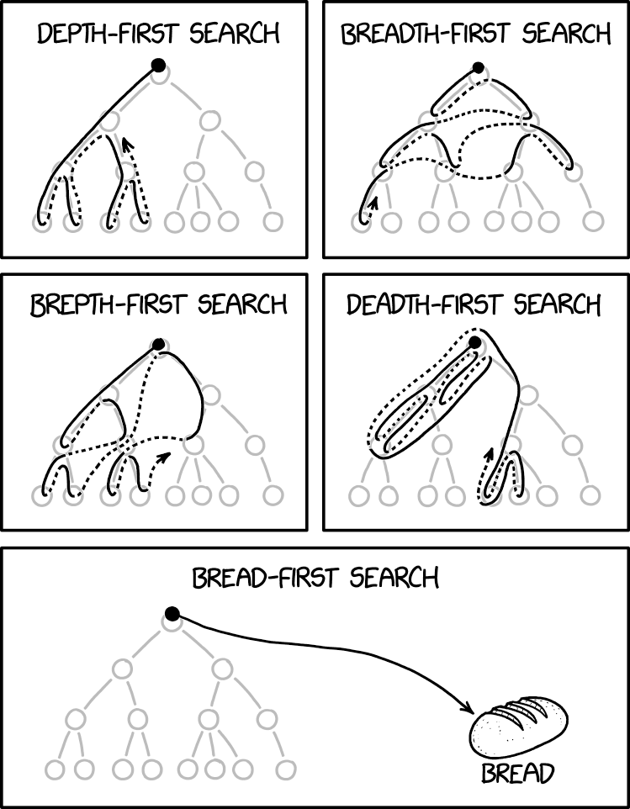
BFS and DFS
CSE 421 AU22
Lecture 4
xkcd.com/2407

Slide 2
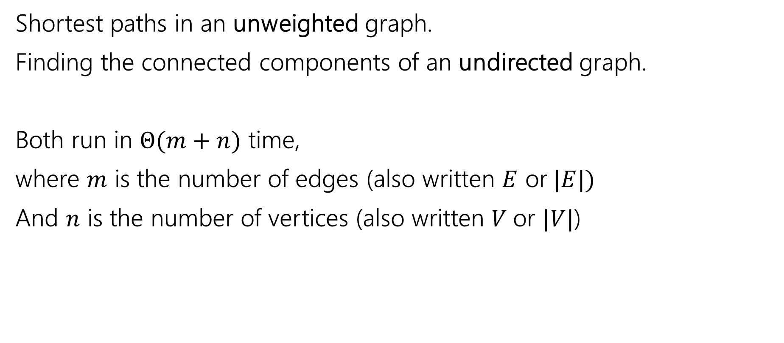
Old Breadth-First Search Application
Shortest paths in an unweighted graph.
Finding the connected components of an undirected graph.
Both run in $Θ(m+n)$ time,
where $m$ is the number of edges (also written $E$ or$|E|)$
And $n$ is the number of vertices (also written $V$or $|V|$)

Slide 3
Unweighted Graphs
If the graph is unweighted, how do we find a shortest paths?
What’s the shortest path from s to s?
  Well….we’re already there.
What’s the shortest path from s to u or v?
  Just go on the edge from s
From s to w,x, or y?
  Can’t get there directly from s, if we want a length 2 path, have to go through u or v.
u
w
s
y
t
v
x

Slide 4
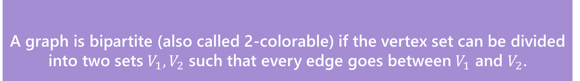
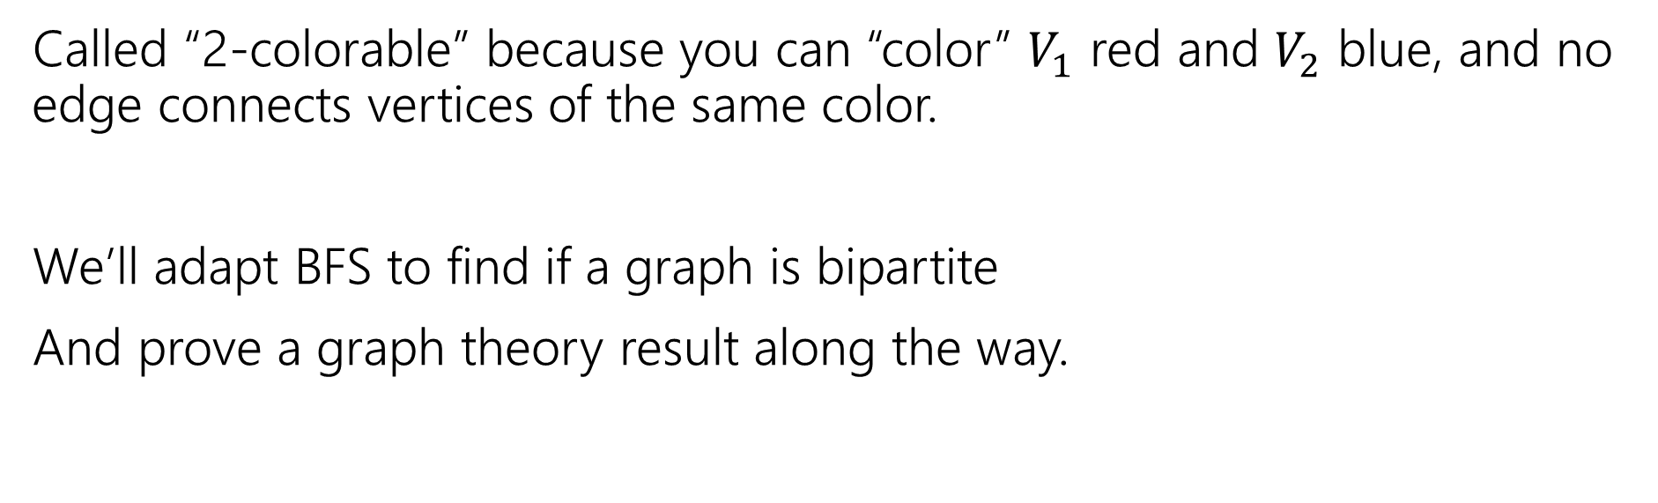
A new application
A graph is bipartite (also called 2-colorable) if the vertex set can be divided into two sets $V_{1},V_{2}$ such that every edge goes between $V_{1}$ and $V_{2}$.
Bipartite (also called “2-colorable”)
Called “2-colorable” because you can “color” $V_{1}$ red and $V_{2}$ blue, and no edge connects vertices of the same color.
We’ll adapt BFS to find if a graph is bipartite
And prove a graph theory result along the way.

Slide 5
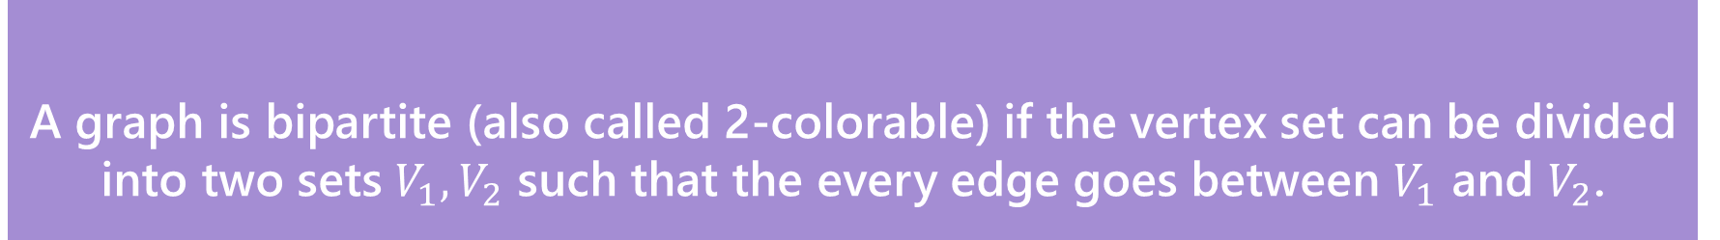
A new application
A graph is bipartite (also called 2-colorable) if the vertex set can be divided into two sets $V_{1},V_{2}$ such that the every edge goes between $V_{1}$ and $V_{2}$.
Bipartite (also called “2-colorable”)
Called “2-colorable” because you can “color” $V_{1}$ red and $V_{2}$ blue, and no edge connects vertices of the same color.
If a graph contains an odd cycle, then it is not bipartite.
Try the example on the right, then proving the general theorem in the light purple box.
Help Robbie figure out how long to make the explanation
Pollev.com/robbie

Slide 6
Lemma 1
If a graph contains an odd cycle, then it is not bipartite.
Start from any vertex, and give it either color.
Its neighbors must be the other color.
Their neighbors must be the first color
…
The last two vertices (which are adjacent) must be the same color.
Uh-oh.

Slide 7
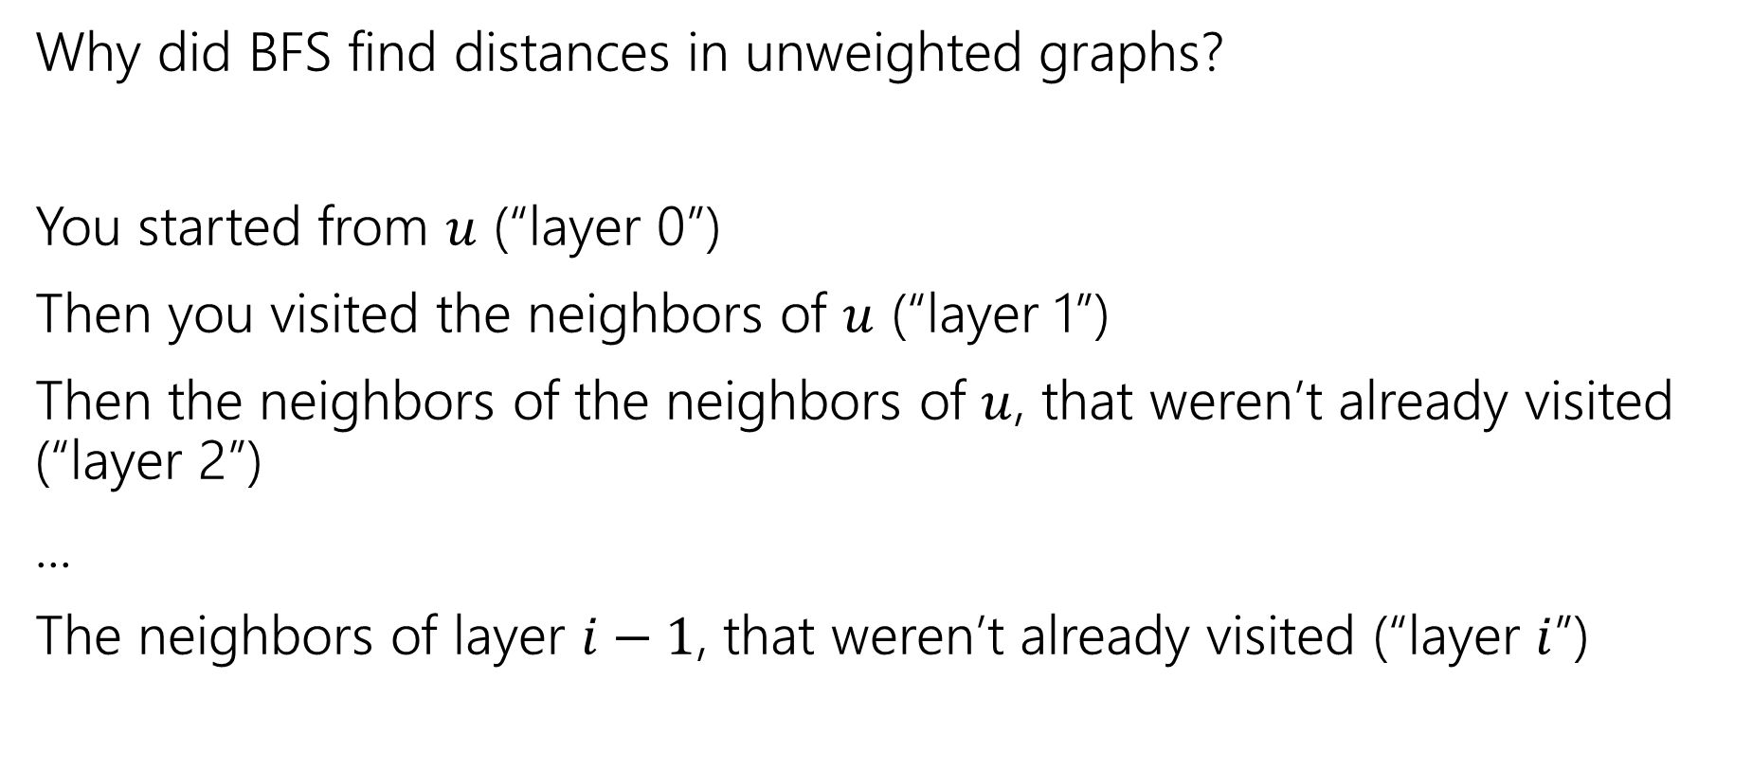
BFS with Layers
Why did BFS find distances in unweighted graphs?
You started from $u$ (“layer 0”)
Then you visited the neighbors of $u$ (“layer 1”)
Then the neighbors of the neighbors of $u$, that weren’t already visited (“layer 2”)
...
The neighbors of layer $i−1$, that weren’t already visited (“layer $i$”)

Slide 8
BFS With Layers
search(graph)
toVisit.enqueue(first vertex)
mark first vertex as seen
toVisit.enqueue(end-of-layer-marker)
l=1
while(toVisit is not empty)
current = toVisit.dequeue()
if(current == end-of-layer-marker)
l++
toVisit.enqueue(end-of-layer-marker)
current.layer = l
for (v : current.neighbors())
if (v is not seen)
mark v as seen
toVisit.enqueue(v)
It’s just BFS!
With some extra bells and whistles.

Slide 9
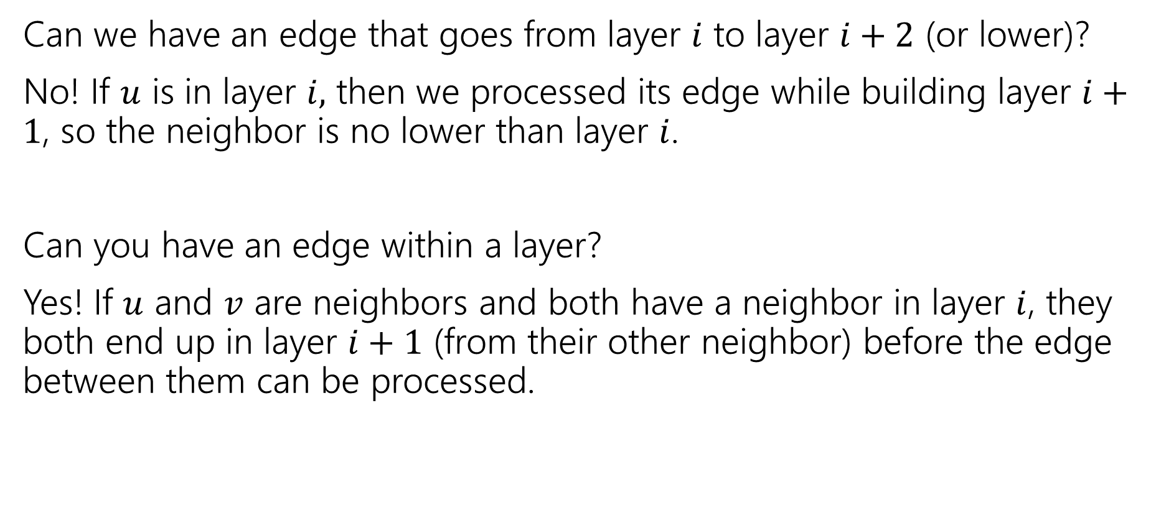
Layers
Can we have an edge that goes from layer $i$ to layer $i+2$ (or lower)?
No! If $u$ is in layer $i,$ then we processed its edge while building layer $i+1$, so the neighbor is no lower than layer $i$.
Can you have an edge within a layer?
Yes! If $u$ and $v$ are neighbors and both have a neighbor in layer $i$, they both end up in layer $i+1$ (from their other neighbor) before the edge between them can be processed.

Slide 10
Testing Bipartiteness
How can we use BFS with layers to check if a graph is 2-colorable?
Well, neighbors have to be “the other color”
Where are your neighbors?
Hopefully in the next layer or previous layer…
Color all the odd layers red and even layers blue.
Does this work?

Slide 11
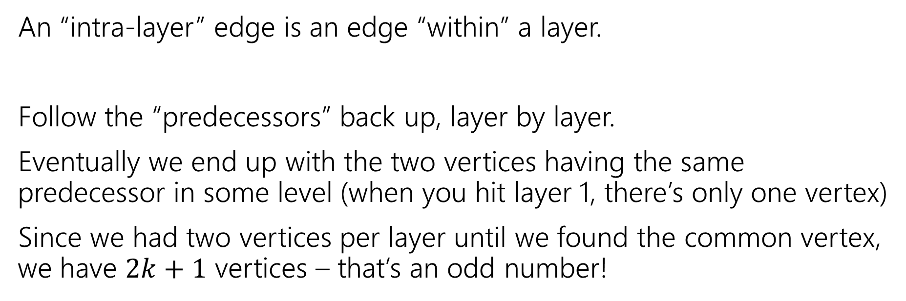
Lemma 2
If BFS has an intra-layer edge, then the graph has an odd-length cycle.
An “intra-layer” edge is an edge “within” a layer.
Follow the “predecessors” back up, layer by layer.
Eventually we end up with the two vertices having the same predecessor in some level (when you hit layer 1, there’s only one vertex)
Since we had two vertices per layer until we found the common vertex, we have $2k+1$ vertices – that’s an odd number!

Slide 12
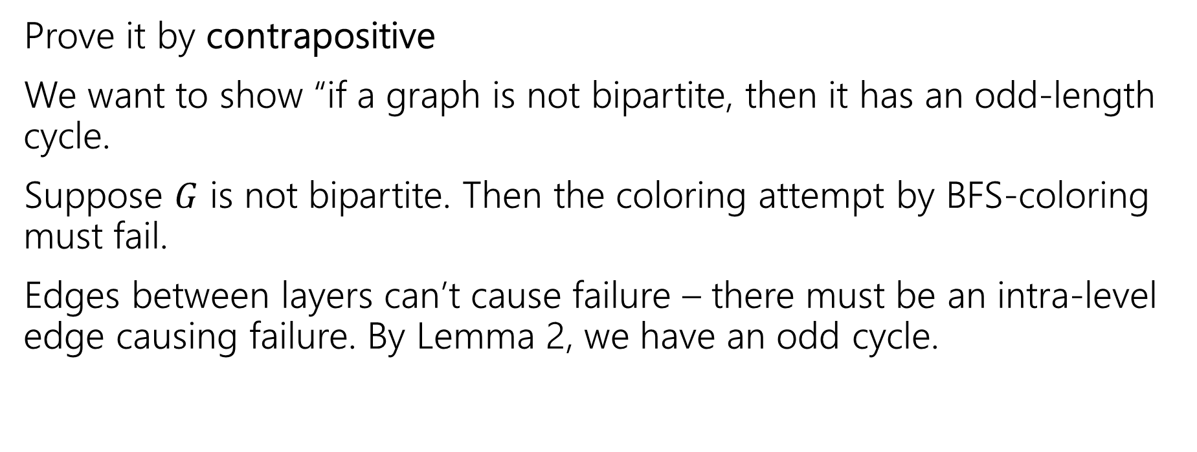
Lemma 3
If a graph has no odd-length cycles, then it is bipartite.
Prove it by contrapositive
We want to show “if a graph is not bipartite, then it has an odd-length cycle.
Suppose $G$ is not bipartite. Then the coloring attempt by BFS-coloring must fail.
Edges between layers can’t cause failure – there must be an intra-level edge causing failure. By Lemma 2, we have an odd cycle.

Slide 13
The Big Result
A graph is bipartite if and only if it has no odd cycles.
Bipartite (also called “2-colorable”)
Proof:
Lemma 1 says if a graph has an odd cycle, then it’s not bipartite (or in contrapositive form, if a graph is bipartite, then it has no odd cycles)
Lemma 3 says if a graph has no odd cycles then it is bipartite.
Lemma 1: If a graph contains an odd cycle, then it is not bipartite.
Lemma 3: If a graph has no odd-length cycles, then it is bipartite.

Slide 14
The Big Result
The final theorem statement doesn’t know about the algorithm – we used the algorithm to prove a graph theory fact!

Slide 15
Wrapping it up
BipartiteCheck(graph) //assumes graph is connected!
toVisit.enqueue(first vertex)
mark first vertex as seen
toVisit.enqueue(end-of-layer-marker)
l=1
while(toVisit is not empty)
current = toVisit.dequeue()
if(current == end-of-layer-marker)
l++
toVisit.enqueue(end-of-layer-marker)
current.layer = l
for (v : current.neighbors())
if (v is not seen)
mark v as seen
toVisit.enqueue(v)
else //v is seen
if(v.layer == current.layer)
return “not bipartite” //intra-level edge
return “bipartite” //no intra-level edges

Slide 16
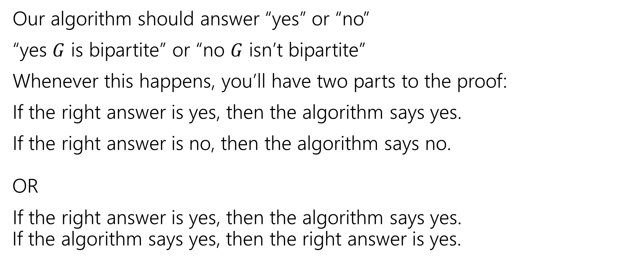
Testing Bipartiteness
Our algorithm should answer “yes” or “no”
“yes $G$ is bipartite” or “no $G$ isn’t bipartite”
Whenever this happens, you’ll have two parts to the proof:
If the right answer is yes, then the algorithm says yes.
If the right answer is no, then the algorithm says no.
OR
If the right answer is yes, then the algorithm says yes.
If the algorithm says yes, then the right answer is yes.

Slide 17
Proving Algorithm Correct
If the graph is bipartite, then by Lemma 1 there is no odd cycle. So by the contrapositive of lemma 2, we get no intra-level edges when we run BFS, thus the algorithm (correctly) returns the graph is bipartite.
If the algorithm returns that the graph is bipartite, then we cannot have any intra-level edges (since we check every edge in the course of the algorithm). We proved earlier that there are no edges skipping more than one level. So if we assign odd levels to “red” and even levels to “blue” the algorithm has verified that there are no edges between vertices of the same color. So the graph is bipartite by definition.

Slide 18
DFS vs. BFS
In BFS, we explored a graph “level-wise”
We explored everything next to the starting vertex.
Then we explored everything one step further away.
Then everything one step further
…

Slide 19
DFS vs. BFS
In DFS, we explore deep into the graph.
We try to find new (undiscovered) nodes, then “backtrack” when we’re out of new ones.

Slide 20
DFS – pseudocode
In 332, you took your BFS code, replaced the queue with a stack and said “that’s the pseudocode.”
That’s a really nice object lesson in stacks.
No one actually writes DFS that way (except in data structures courses).
You’ll basically always see the recursive version instead. (using the call stack instead of a user-created stack data structure)

Slide 21
DFS – pseudocode
Instead of using an explicit stack, we’re going to use recursion
  The call stack is going to be our stack.
We want to explore as deeply as possible from each of our outgoing edges
DFS(u)
Mark u as “seen”
For each edge (u,v) //leaving u
If v is not “seen”
DFS(v)
End If
End For

Slide 22
DFS – pseudocode
Both the explicit stack version and the recursive version “are” DFS.
For example, they can both traverse through the graph in the same fundamental way. You can use them for similar applications.
But they’re not identical – they actually use the stack in different ways. If you’re trying to convert from one to the other, you’ll have to think carefully to do it.

Slide 23
Running DFS
DFS(u)
Mark u as “seen”
For each edge (u,v) //leaving u
If v is not “seen”
DFS(v)
End If
End For
Start from A
F
G
A
Vertex: D
Last edge used: --
Vertex: D
Last edge used: (D,B)
Vertex: F
Last edge used: ---
E
Vertex: F
Last edge used: (F,D)
Vertex: E
Last edge used: (E,F)
Vertex: C
Last edge used: (C,D)
Vertex: E
Last edge used: ---
Vertex: C
Last edge used: --
B
Vertex: B
Last edge used: --
Vertex: B
Last edge used: (B,C)
Vertex: B
Last edge used: (B,E)
D
C
Vertex: A
Last edge used: (A,F)
Vertex: A
Last edge used: ---
Vertex: A
Last edge used: (A,B)

Slide 24
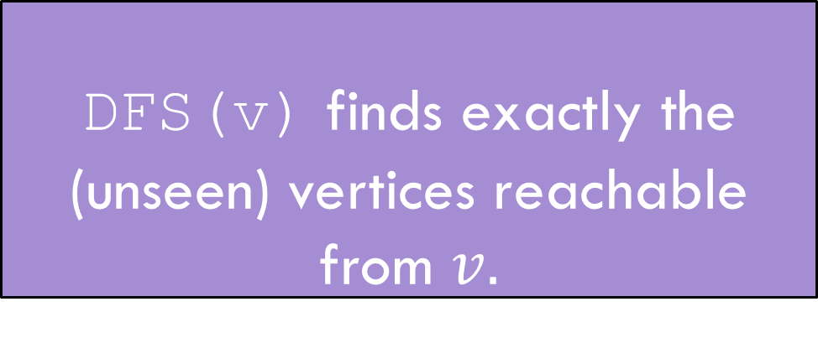
Running DFS
DFS(u)
Mark u as “seen”
For each edge (u,v) //leaving u
If v is not “seen”
DFS(v)
End If
End For
F
G
HEY!
We missed something!
A
E
DFS(v) finds exactly the (unseen) vertices reachable from $v.$
DFS discovery
B
D
C

Slide 25
Reaching Everything
One possible use of DFS is visiting every vertex
How can we make sure that happens?
  What did you do for BFS when you had this problem?
Add a while loop, and call DFS from each vertex.
DFSWrapper(G)
For each vertex u of G
If u is not “seen”
DFS(u)
End If
End For
DFS(u)
Mark u as “seen”
For each edge (u,v) //leaving u
If v is not “seen”
DFS(v)
End If
End For

Slide 26
Bells and Whistles
Depending on your application, you may add a few extra lines to the DFS code to compute the thing you want.
  Usually just an extra variable or two per vertex.
For today’s application, we need to know what order vertices come onto and off of the stack.
DFS(u)
Mark u as “seen”
u.start = counter++
For each edge (u,v) //leaving u
If v is not “seen”
DFS(v)
End If
End For
u.end = counter++
DFSWrapper(G)
counter = 1
For each vertex u of G
If u is not “seen”
DFS(u)
End If
End For

Slide 27
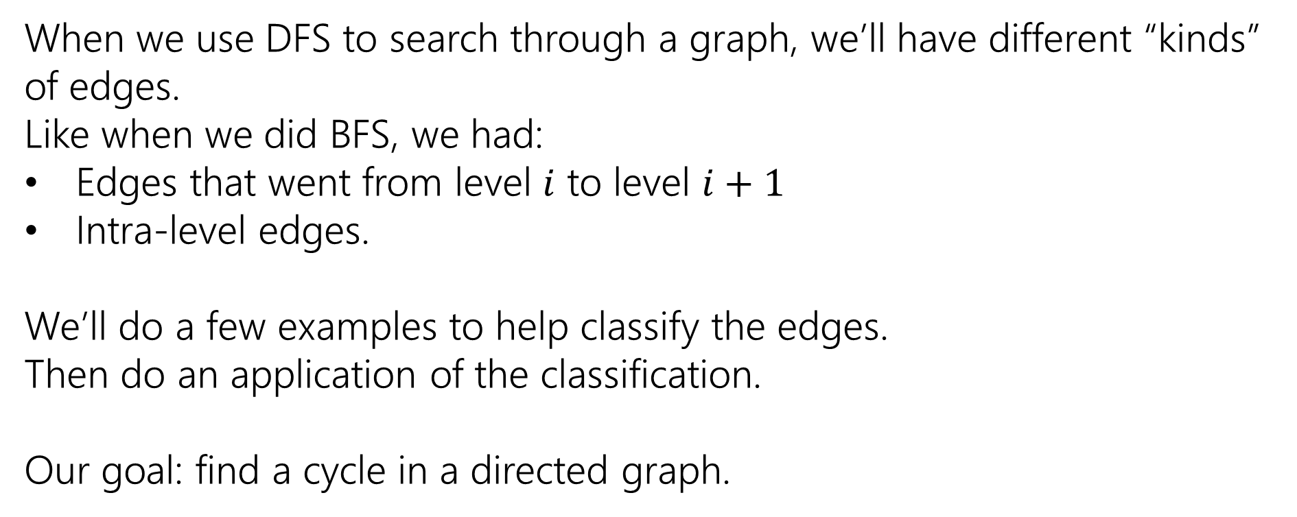
Edge Classification
When we use DFS to search through a graph, we’ll have different “kinds” of edges.
Like when we did BFS, we had:
Edges that went from level $i$ to level $i+1$
Intra-level edges.
We’ll do a few examples to help classify the edges.
Then do an application of the classification.
Our goal: find a cycle in a directed graph.

Slide 28
Running DFS
DFS(u)
Mark u as “seen”
u.start = counter++
For each edge (u,v) //leaving u
If v is not “seen”
DFS(v)
End If
End For
u.end = counter++
Start from A
F
G
A
E
B
D
C

Slide 29
Running DFS
DFS(u)
Mark u as “seen”
u.start = counter++
For each edge (u,v) //leaving u
If v is not “seen”
DFS(v)
End If
End For
u.end = counter++
8
9
Start from A
F
G
1
12
A
Vertex: D
Last edge used: --
Vertex: D
Last edge used: (D,B)
Vertex: F
Last edge used: ---
E
Vertex: F
Last edge used: (F,D)
7
10
Vertex: E
Last edge used: (E,F)
Vertex: C
Last edge used: (C,D)
Vertex: E
Last edge used: ---
Vertex: C
Last edge used: --
B
Vertex: B
Last edge used: --
Vertex: B
Last edge used: (B,C)
Vertex: B
Last edge used: (B,E)
2
11
D
C
Vertex: A
Last edge used: (A,F)
Vertex: A
Last edge used: ---
4
5
Vertex: A
Last edge used: (A,B)
3
6

Slide 30
DFS(u)
Mark u as “seen”
u.start = counter++
For each edge (u,v) //leaving u
If v is not “seen”
DFS(v)
End If
End For
u.end = counter++
F
G
A
E
B
D
C

Slide 31
A
The orange edges (the ones where we discovered a new vertex) form a tree!*
We call them tree edges.
That blue edge went from a descendent to an ancestor
B was still on the stack when we found (B,D).
We call them back edges.
The green edge went from an ancestor to a descendant
F was put on and come off the stack between putting A on the stack and finding (A,F)
We call them forward edges.
The purple edge went…some other way.
D had been on and come off the stack before we found F or (F,D)
We call those cross edges.
1
12
2
11
B
3
6
C
E
4
5
D
7
10
F
*Conditions apply. Sometimes the graph is a forest. But we call them tree edges no matter what.
G
8
9

Slide 32
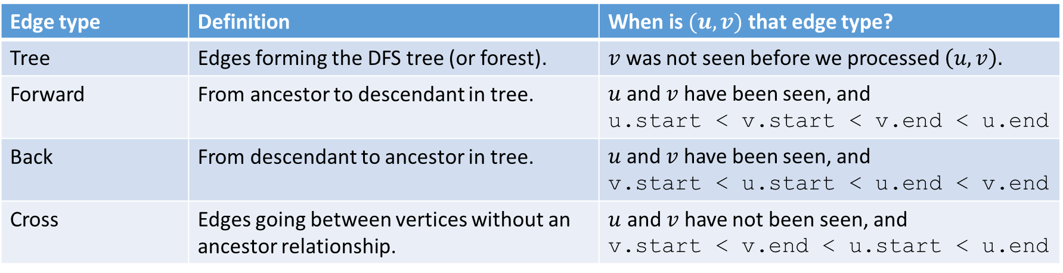
Edge Classification (for DFS on directed graphs)
Edge type | Definition | When is $(u,v)$ that edge type?
Tree | Edges forming the DFS tree (or forest). | $v$ was not seen before we processed $\left(u,v\right).$
Forward | From ancestor to descendant in tree. | $u$and $v$ have been seen, and u.start < v.start < v.end < u.end
Back | From descendant to ancestor in tree. | $u$and $v$ have been seen, and v.start < u.start < u.end < v.end
Cross | Edges going between vertices without an ancestor relationship. | $u$ and $v$ have not been seen, and v.start < v.end < u.start < u.end
The third column doesn’t look like it encompasses all possibilities.
It does – the fact that we’re using a stack limits the possibilities:
e.g. u.start < v.start < u.end < v.end is impossible.
And the rules of the algorithm eliminate some other possibilities.

Slide 33
Try it Yourselves!
DFSWrapper(G)
counter = 0
For each vertex u of G
If u is not “seen”
DFS(u)
End If
End For
1
12
A
back
2
B
C
7
8
11
forward
4
5
3
10
D
cross
DFS(u)
Mark u as “seen”
u.start = counter++
For each edge (u,v) //leaving u
If v is not “seen”
DFS(v)
End If
End For
u.end = counter++
F
E
6
9

Slide 34
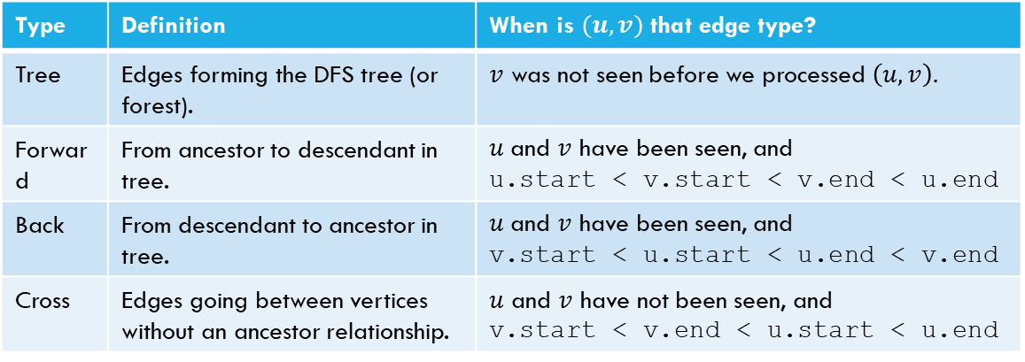
Try it Yourselves!
Type | Definition | When is $(u,v)$ that edge type?
Tree | Edges forming the DFS tree (or forest). | $v$ was not seen before we processed $\left(u,v\right).$
Forward | From ancestor to descendant in tree. | $u$and $v$ have been seen, and u.start < v.start < v.end < u.end
Back | From descendant to ancestor in tree. | $u$and $v$ have been seen, and v.start < u.start < u.end < v.end
Cross | Edges going between vertices without an ancestor relationship. | $u$ and $v$ have not been seen, and v.start < v.end < u.start < u.end
DFSWrapper(G)
counter = 0
For each vertex u of G
If u is not “seen”
DFS(u)
End If
End For
A
DFS(u)
Mark u as “seen”
u.start = counter++
For each edge (u,v) //leaving u
If v is not “seen”
DFS(v)
End If
End For
u.end = counter++
B
C
D
F
E

Slide 35
Actually Using DFS
Here’s a claim that will let us use DFS for something!
DFS run on a directed graph has a back edge if and only if it has a cycle.
Back Edge Characterization

Slide 36
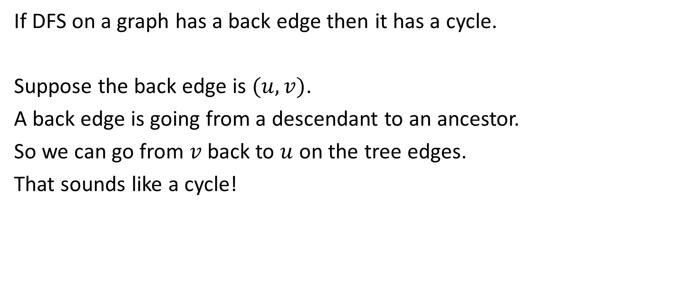
Forward Direction
If DFS on a graph has a back edge then it has a cycle.
Suppose the back edge is $(u,v)$.
A back edge is going from a descendant to an ancestor.
So we can go from $v$ back to $u$ on the tree edges.
That sounds like a cycle!

Slide 37
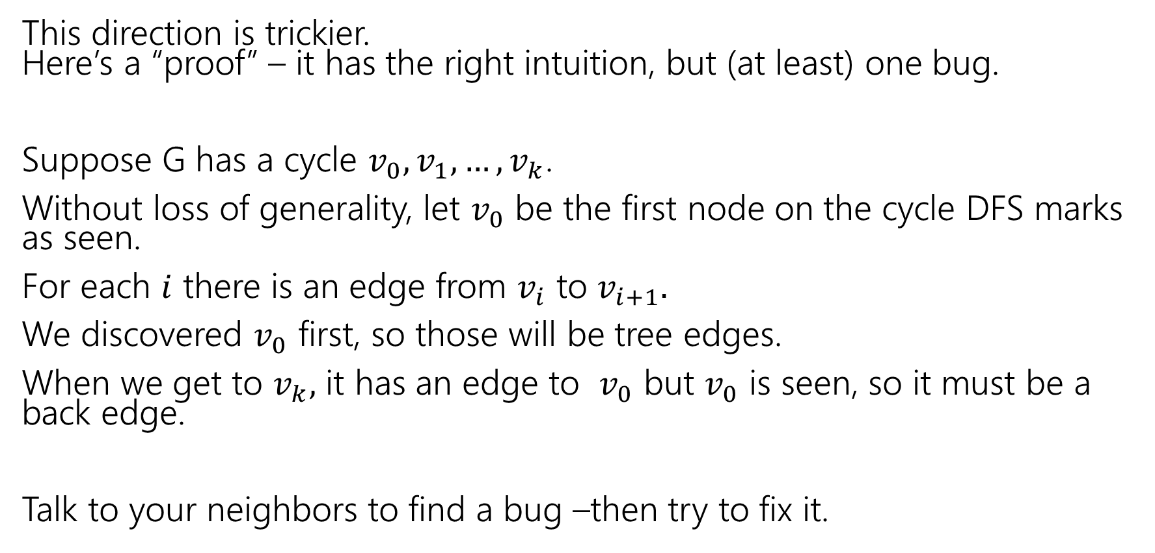
Backward direction
This direction is trickier.
Here’s a “proof” – it has the right intuition, but (at least) one bug.
Suppose G has a cycle $v_{0},v_{1},…,v_{k}$.
Without loss of generality, let $v_{0}$ be the first node on the cycle DFS marks as seen.
For each $i$ there is an edge from $v_{i}$ to $v_{i+1}.$
We discovered $v_{0}$ first, so those will be tree edges.
When we get to $v_{k},$ it has an edge to $v_{0}$ but $v_{0}$ is seen, so it must be a back edge.
Talk to your neighbors to find a bug –then try to fix it.

Slide 38
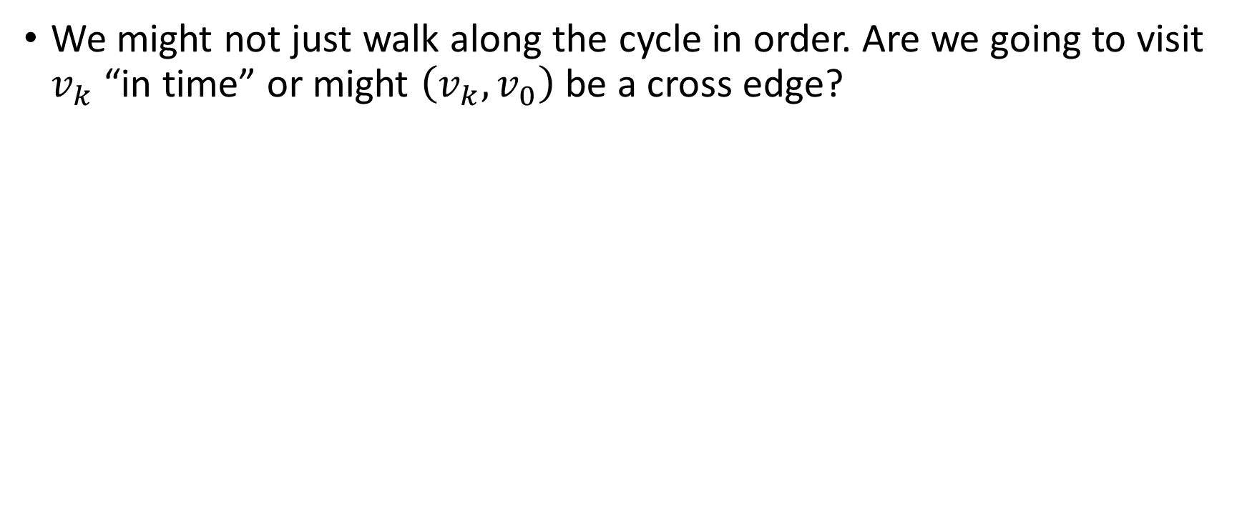
Fixing the Backward Direction
We might not just walk along the cycle in order. Are we going to visit $v_{k}$ “in time” or might $\left(v_{k}, v_{0}\right)$ be a cross edge?
DFS(v) finds exactly the (unseen) vertices reachable from $v.$
DFS discovery

Slide 39
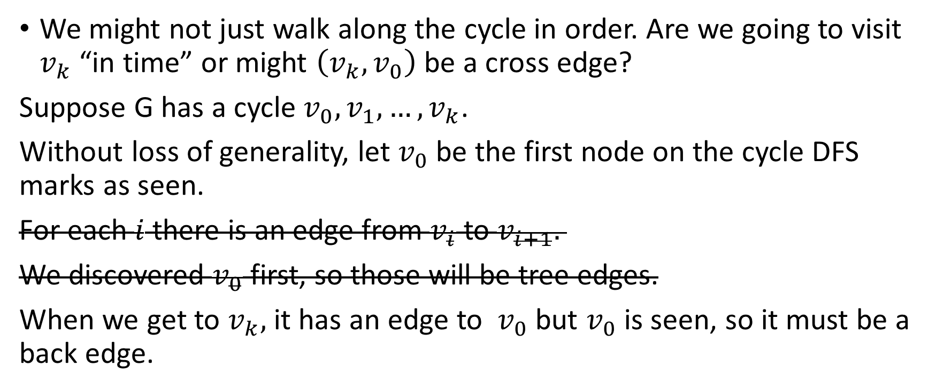
Fixing the Backward Direction
We might not just walk along the cycle in order. Are we going to visit $v_{k}$ “in time” or might $\left(v_{k}, v_{0}\right)$ be a cross edge?
Suppose G has a cycle $v_{0},v_{1},…,v_{k}$.
Without loss of generality, let $v_{0}$ be the first node on the cycle DFS marks as seen.
For each $i$ there is an edge from $v_{i}$ to $v_{i+1}.$
We discovered $v_{0}$ first, so those will be tree edges.
When we get to $v_{k},$ it has an edge to $v_{0}$ but $v_{0}$ is seen, so it must be a back edge.
$v_{k}$ is reachable from $v_{0}$ so we must reach $v_{k}$ before $v_{0}$ comes off the stack.

Slide 40
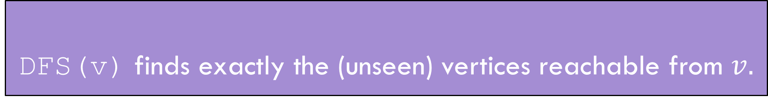
Summary
DFS(v) finds exactly the (unseen) vertices reachable from $v.$
DFS discovery
A directed graph has a back edge if and only if it has a cycle.
Back Edge Characterization

Slide 41
Edge Classification (for DFS on directed graphs)
Edge type | Definition | When is $(u,v)$ that edge type?
Tree | Edges forming the DFS tree (or forest). | $v$ was not seen before we processed $\left(u,v\right).$
Forward | From ancestor to descendant in tree. | $u$and $v$ have been seen, and u.start < v.start < v.end < u.end
Back | From descendant to ancestor in tree. | $u$and $v$ have been seen, and v.start < u.start < u.end < v.end
Cross | Edges going between vertices without an ancestor relationship. | $u$ and $v$ have not been seen, and v.start < v.end < u.start < u.end
The third column doesn’t look like it encompasses all possibilities.
It does – the fact that we’re using a stack limits the possibilities:
e.g. u.start < v.start < u.end < v.end is impossible.
And the rules of the algorithm eliminate some other possibilities.

Slide 42
BFS/DFS caveats and cautions
Edge classifications are different for directed graphs and undirected graphs.
DFS in undirected graphs don’t have cross edges.
BFS in directed graphs can have edges skipping levels (only as back edges, skipping levels up though!)

Slide 43
Your Takeaways
When searching through a graph, order matters!
BFS and DFS do different things!
BFS/DFS algorithms usually keep track of extra information/calculate something at each vertex/use edge classification to solve the problem.
  A few extra bells and whistles in the code, but usually little more.
DFS can solve a wide-variety of problems, but the algorithms tend to be subtle (example in section handout).
BFS a lot more intuitive, start there if you can.
BE CAREFUL with directed/undirected graphs. The algorithms aren’t always easy to convert.

Slide 44
Summary – Graph Search Applications
BFS
dfs
Shortest Paths (unweighted) graphs)
Cycle detection (directed graphs)
Topological sort
Strongly connected components
Cut edges (on homework)
EITHER
2-coloring
Connected components (undirected)
Usually use BFS – easier to understand.

