Slide 1
Here Early?
Here for CSE 421?
Welcome! You’re early!
Want a copy of these slides to take notes?
  You can download them from the webpage cs.uw.edu/421

Slide 2
Stable Matchings
CSE 421 Fall 22
Lecture 1

Slide 3
Today
Logistics
What is this course?
Start of the content

Slide 4
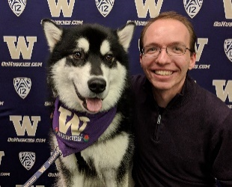
Staff
TAs
Abhinav Bandari
Daniel Cheng
Kai Daniels
Airei Fukuzawa
Anna Goncharenko
Allie Pfleger
Alicia Stepin
Alice Wang
Jack Zhang
Muru Zhang
Instructor: Robbie Weber
Ph.D. from UW CSE in theory
Third year as teaching faculty
Office: CSE2 311
Email: rtweber2@cs.washington.edu

Slide 5
Classroom Logistics
We’re in-person :D
Masks are “strongly recommended” (but not required) by university policy.
Please speak loudly for questions
I’ll repeat questions into the microphone (so everyone can hear/for the recording).

Slide 6
TODO List
Make sure you’re on Ed! (check your spam folder for an invite, if not there send an email to Robbie).
Go to section tomorrow.
Homework 1 is out (should be able to start after section).

Slide 7
Syllabus
It’s all on the webpage: https://courses.cs.washington.edu/courses/cse421/22au
In general, we’re designing lecture to be synchronous (taking questions live, time for student discussions).
But we’re trying to make sure if you need to stay home for a few days on short notice the effect will be minimal.

Slide 8
Textbook
Optional: Algorithm Design by Kleinberg & Tardos
It’s a good introduction, and nice as a reference.
There are lots of other books:
  Introduction to algorithms by Cormen, Leiserson, Rivest, Stein
  One free reference: Algorithms by Jeff Erickson Algorithms.wtf

Slide 9
Logistics – Lecture Activities
I’m going to be teaching with active learning in this course.
  Why? Because it works.
  https://www.pnas.org/content/111/23/8410 a meta-analysis of 225 studies.
  Just listening to me isn’t as good for you as listening to me then trying problems on your own and with each other.
The answers live help me adjust explanations.
There aren’t points associated with completing the activities.

Slide 10
Logistics – where to go?
Slides, homework problems, etc. go up on the webpage
Homework submission on gradescope
Live lecture activities on polleverywhere
Questions on Ed discussion board
Don’t trust canvas – we won’t be updating frequently. We’ll tell you when we’re using it for specific purposes.

Slide 11
Late Policy
A little different from what you’re used to!
We’re counting late problems instead of late days.
You can use a “late problem” to turn in a problem up to 48 hours late.
  That applies to one problem not the other 3 on the assignment
  But you can use more than one per assignment
You have 5 to use.
We’ll also drop a few of your lowest scores. Details on the syllabus.

Slide 12
Logistics – Work
8 (approximately) weekly homework assignments
A midterm exam
  In the evening of Monday November 7th.
  We’ll have alternate exams for people celebrating Diwali, or other immovable conflicts, but please put that date on your calendar now!
  A final exam
  (as on the official schedule, Monday Dec. 12, 2:30 PM)

Slide 13
Hey, We’re in a pandemic
The staff is going to do our best to help you learn.
Real life is going to get in the way. If it does, tell us as soon as possible, and we’ll work with you.
I don’t need to know private details, just enough to know it’s an emergency and how to help.
We will endeavor not to make any substantial changes to the syllabus.
  But if something extremely unexpected happens we reserve the right to make changes.
  Generally prefer individual accommodations, rather than course-wide ones.

Slide 14
What is this course?
Algorithms
themes:
“Design Techniques” – not just “here’s an algorithm” but “here’s a way of thinking about a class of algorithms”
“Modeling” – In the real world, no one will say “I need you to run Prim’s algorithm on this graph” they will say “I need you to choose where to build electrical wires so every town is connected to the power plant as cheaply as possible
“Set realistic expectations” – there are some things we (think/know) computers can’t do efficiently. How do you recognize these problems?
“Reductions” – if you’ve already solved a problem, don’t solve it again (reuse ideas) and if you know you can’t solve a problem, what else can’t you solve.

Slide 15
What is this course not
NOT: A list of the fastest-known algorithms for common problems.
I’m not concerned with which library is best.
  The best library changes over time and by language.
  I’m not qualified to keep a list.
  I want you to find this course useful 5 years from now.
And the best theoretical algorithms probably aren’t practical…
  and when they are, it’s often clever combinations/complicated variants of big ideas that we’ll see.

Slide 16
Course Topics (Tentative)
Stable Matchings
Graph Algorithms from 332 (BFS/DFS)
Greedy Algorithms
Divide & Conquer
Dynamic Programming
Network Flow
Linear Programming
P/NP

Slide 17
What’s Coming Up
This week: An extremely useful algorithm.
That has had lots of effect on the real world.
Along the way:
Examples of what we mean by an algorithm description
  We won’t use Java
How do we prove algorithms correct? Resetting expectations on proofs.

Slide 18
Stable Matchings

Slide 19
Stable Matchings
Motivation:
You have to assign TAs to instructors.
Two groups of people you need to pair off, with preferences about their matches.
You can’t make everyone happy…so at least ensure that everyone listens to you.
There are lots of other similar applications
  Assign doctors to the hospitals where they do residency.
  Assign high schoolers to magnet schools.
  Among many, many other applications.
Purpose of the example: new, interesting problem, show how different ideas apply

Slide 20
Motivation
The real world is complicated.
  Students shouldn’t TA a course they haven’t taken.
  Instructors need varying numbers of TAs.
  There are more TA applicants than positions.
  Doctors might want to be in the same city as their partner.
We’re going to simplify away the real world constraints.
  The core ideas have been adapted to all of these scenarios.

Slide 21



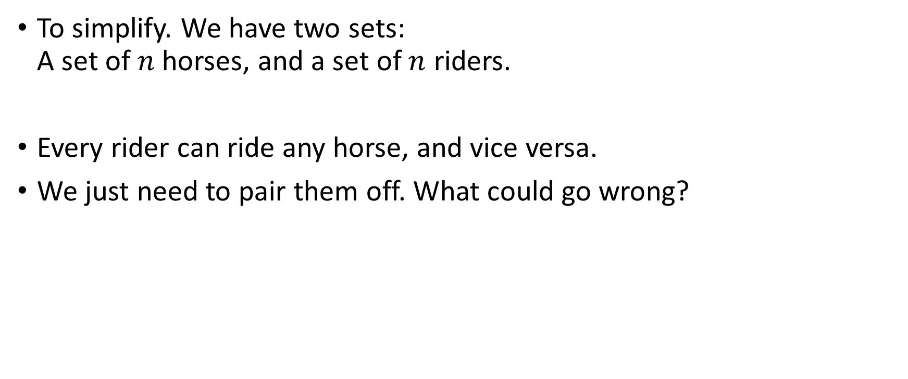
Stable Matching Problem
To simplify. We have two sets:
A set of $n$horses, and a set of $n$ riders.
Every rider can ride any horse, and vice versa.
We just need to pair them off. What could go wrong?

Slide 22



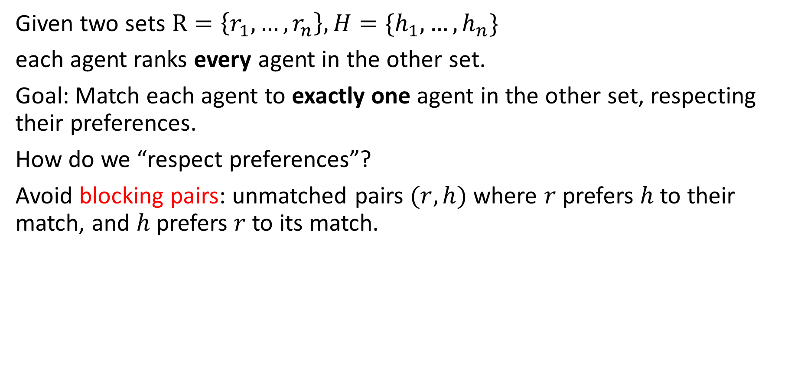



Stable Matching Problem
Given two sets $R=\left\{r_{1}, …,r_{n}\right\}, H=\{h_{1},…,h_{n}\}$
each agent ranks every agent in the other set.
Goal: Match each agent to exactly one agent in the other set, respecting their preferences.
How do we “respect preferences”?
Avoid blocking pairs: unmatched pairs $(r,h)$ where $r$prefers $h$ to their match, and $h$ prefers $r$to its match.
$$h$$
$$h , h’$$
$$r, r’$$
$$r$$
$$r′$$
$$h′$$

Slide 23
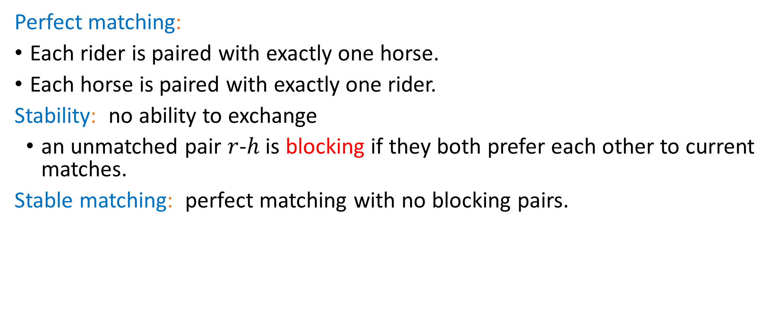
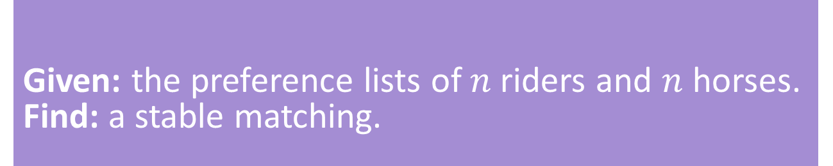
Stable Matching, More Formally
Perfect matching:
Each rider is paired with exactly one horse.
Each horse is paired with exactly one rider.
Stability: no ability to exchange
an unmatched pair $r$-$h$ is blocking if they both prefer each other to current matches.
Stable matching: perfect matching with no blocking pairs.
Stable Matching Problem
Given: the preference lists of $n$riders and $n$ horses.
Find: a stable matching.

Slide 24
Lecture Activity
To make sure you’ve got the definition:
1. Download the activity pdf from the webpage (it’s just the next slide in this slide deck) or look at the physical handout.
2. Introduce yourself to those around you.
3. Try the problem.
4. Fill out the polleverywhere

Slide 25




























Try it!
Why are these not stable matchings?
$$h_{1} , h_{2}$$
$$r_{1}$$
$$h_{1}$$
$$r_{1} , r_{2}$$
$$h_{1} , h_{2}$$
$$r_{1}$$
$$h_{1}$$
$$r_{1} , r_{2}$$
$$h_{1} , h_{2}$$
$$r_{2}$$
$$h_{2}$$
$$r_{1} , r_{2}$$
$$h_{1} , h_{2}$$
$$r_{2}$$
$$h_{2}$$
$$r_{1} , r_{2}$$
Find a stable matching for this instance.
$$h_{1} , h_{2},h_{3}$$
$$r_{1}$$
$$h_{1}$$
$$r_{1} , r_{2},r_{3}$$
$$h_{2} , h_{1}, h_{3}$$
$$r_{2}$$
$$h_{2}$$
$$r_{1} , r_{2}, r_{3}$$
pollev.com/robbie
$$h_{1} , h_{2},h_{3}$$
$$r_{3}$$
$$h_{3}$$
$$r_{1} , r_{2},r_{3}$$

Slide 26
Questions
Does a stable matching always exist?
Can we find a stable matching efficiently?
We’ll answer both of those questions in the next few lectures.
Let’s start with the second one.

Slide 27
Idea for an Algorithm
Key idea
Unmatched riders “propose” to the highest horse on their preference list that they have not already proposed to.
Send in a rider to walk up to their favorite horse.
Everyone in front of a different horse? Done!
If more than one rider is at the same horse, let the horse decide its favorite.
Rejected riders go back outside.
Repeat until you have a perfect matching.

Slide 28
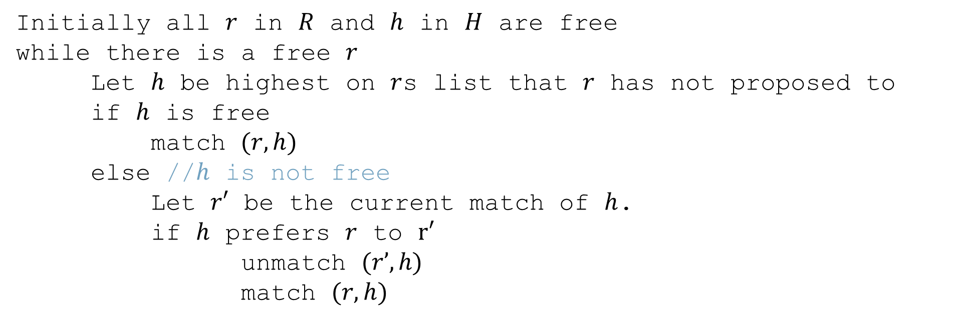
Gale-Shapley Algorithm
Initially all $r$ in $R$ and $h$ in $H$ are free
while there is a free $r$
Let $h$ be highest on $r$s list that $r$ has not proposed to
if $h$ is free
match $(r, h)$
else //$h$ is not free
Let $r′$ be the current match of $h$.
if $h$ prefers $r$ to $r′$
unmatch $(r’, h)$
match $(r, h)$

Slide 29












Algorithm Example
$$h_{1} , h_{2},h_{3}$$
$$r_{1}$$
$$h_{1}$$
$$r_{2} , r_{3},r_{1}$$
$$h_{1} , h_{3}, h_{2}$$
$$r_{2}$$
$$h_{2}$$
$$r_{3} , r_{1}, r_{2}$$
$$h_{1} , h_{2},h_{3}$$
$$r_{3}$$
$$h_{3}$$
$$r_{3} , r_{1},r_{2}$$
Proposals: $r_{1},r_{2},r_{1},r_{3},r_{3},r_{1}$

Slide 30
Does this algorithm work?
Does it run in a reasonable amount of time?
Is the result correct (i.e. a stable matching)?
Begin by identifying invariants and measures of progress
  Observation A: r’s proposals get worse for them.
  Observation B: Once h is matched, h stays matched.
  Observation C: h’s partners get better.
How do we justify these? A one-sentence explanation would suffice for each of these on the homework.
How did we know these were the right observations? Practice. And editing – we wouldn’t have found these the first time, but after reading through early proof attempts.

Slide 31
Does this algorithm work?
Want to show two things:
1. The code produces the right output (i.e., you get a stable matching)
2. The code runs in a reasonable amount of time.
We’ll start with question 2.

Slide 32

Claim 1: If $r$ proposed to the last horse on their list, then all the horses are matched.

Slide 33
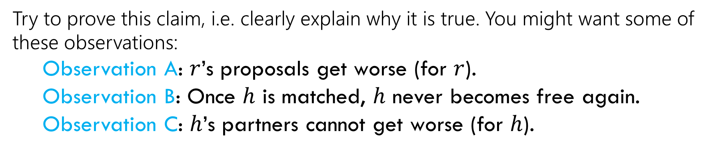
Claim 1: If $r$ proposed to the last horse on their list, then all the horses are matched.
Try to prove this claim, i.e. clearly explain why it is true. You might want some of these observations:
  Observation A: $r$’s proposals get worse (for $r$).
  Observation B: Once $h$ is matched, $h$ never becomes free again.
  Observation C: $h$’s partners cannot get worse (for $h$).
Hint: $r$ must have been rejected a lot – what does that mean?

Slide 34
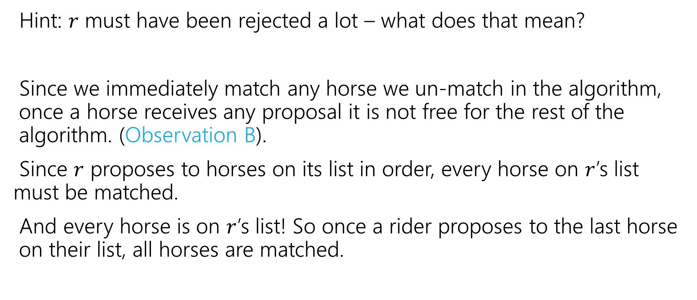
Claim 1: If $r$ proposed to the last horse on their list, then all the horses are matched.
Hint: $r$ must have been rejected a lot – what does that mean?
Since we immediately match any horse we un-match in the algorithm, once a horse receives any proposal it is not free for the rest of the algorithm. (Observation B).
Since $r$ proposes to horses on its list in order, every horse on $r$’s list must be matched.
And every horse is on $r$’s list! So once a rider proposes to the last horse on their list, all horses are matched.

Slide 35


Claim 2: The algorithm stops after $O\left(n^{2}\right)$ iterations.
Hint: When do we exit the loop? (Use claim 1).
If every horse is matched, every rider must be matched too.
  Because each horse is matched to exactly one rider and there are an equal number of riders and horses.
Since we don’t repeat a proposal, and each of the $n$ riders have lists of length $n$, It takes at most $O\left(n^{2}\right)$ proposals to get to the end of some rider’s list.
  Claim 2 now follows from Claim 1.
  That’s the number of iterations. What about time per iteration?
Each m asks each w at most once

Slide 36
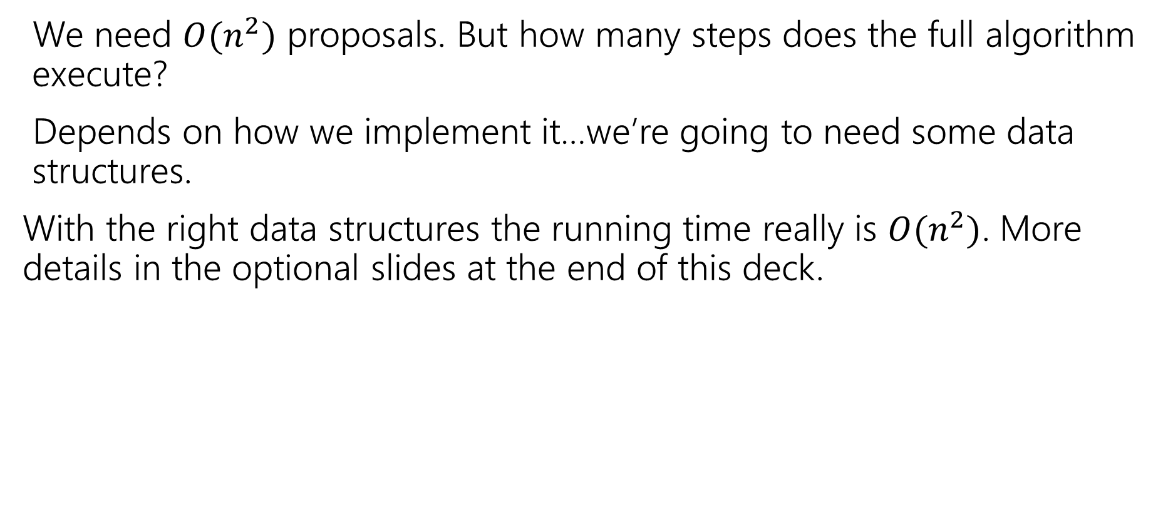
Wrapping up the running time
We need $O(n^{2})$ proposals. But how many steps does the full algorithm execute?
Depends on how we implement it…we’re going to need some data structures.
With the right data structures the running time really is $O(n^{2})$. More details in the optional slides at the end of this deck.

Slide 37
TODO List
Make sure you’re on Ed! (check your spam folder for an invite, if not there send an email to Robbie).
Go to section tomorrow
Start on HW1

Slide 38
Optional Content
Data Structure Tricks to run Gale-Shapley in $O(n^{2})$ time.

Slide 39


Gale-Shapley Algorithm
Initially all $r$ in $R$ and $h$ in $H$ are free
while there is a free $r$
Let $h$ be highest on $r$’s list that $r$ has not proposed to
if $h$ is free
match $(r, h)$
else //$h$ is not free
Let $r′$ be the current match of $h$.
if $h$ prefers $r$ to $r′$
unmatch $(r’, h)$
match $(r, h)$
Are each of these operations really $O(1)$?
Assume that you get two int[][] with the preferences.

Slide 40

Wrapping up the running time
We need $O(n^{2})$ proposals. But how many steps does the full algorithm execute?
Depends on how we implement it…we’re going to need some data structures.

Slide 41
Gale-Shapley Algorithm
Initially all $r$ in $R$ and $h$ in $H$ are free
while there is a free $r$
Let $h$ be highest on $r$’s list that $r$ has not proposed to
if $h$ is free
match $(r, h)$
else //$h$ is not free
Let $r′$ be the current match of $h$.
if $h$ prefers $r$ to $r′$
unmatch $(r’, h)$
match $(r, h)$
Are each of these operations really $O(1)$?
Assume that you get two int[][] with the preferences.

Slide 42
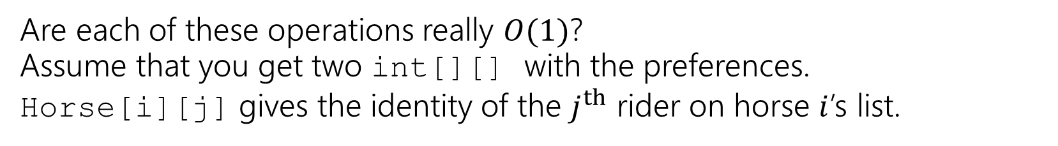
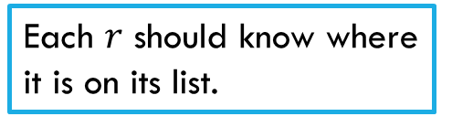
Gale-Shapley Algorithm
Initially all $r$ in $R$ and $h$ in $H$ are free
while there is a free $r$
Let $h$ be highest on $r$’s list that $r$ has not proposed to
if $h$ is free
match $(r, h)$
else //$h$ is not free
Let $r′$ be the current match of $h$.
if $h$ prefers $r$ to $r′$
unmatch $(r’, h)$
match $(r, h)$
Need to maintain free $r$. What can insert and remove in $O\left(1\right)$ time?
Each $r$ should know where it is on its list.
Maintain partial matching
Given two riders, which horse is preferred?
Maintain partial matching
Are each of these operations really $O(1)$?
Assume that you get two int[][] with the preferences.
Horse[i][j] gives the identity of the $j^{th}$ rider on horse $i$’s list.

Slide 43

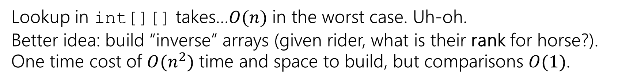
What data structures?
Need to maintain free $r$. What can insert and remove in $O\left(1\right)$ time?
Queue, stack, or list (inserting at end) all would be fine.
Maintain partial matching
Two arrays (index i has number for partner of agent i.
Each $r$ should know where it is on its list.
int for each rider (likely store in an array)
Given two riders, which is preferred?
Lookup in int[][] takes…$O(n)$ in the worst case. Uh-oh.
Better idea: build “inverse” arrays (given rider, what is their rank for horse?).
One time cost of $O(n^{2})$ time and space to build, but comparisons $O(1)$.

Slide 44
What data structures?
These aren’t the only options – you might decide on an object-based approach (can meet same time bounds up to constant factors)
How do we handle the lookup?
Need to maintain free $r$. What can insert and remove in $O\left(1\right)$ time?
Queue, stack, or list (inserting at end) all would be fine.
Maintain partial matching
Two arrays (index i has number for partner of agent i).
Each $r$ should know where it is on its list.
int for each rider (likely store in an array)
Given two riders, which is preferred?
Lookup in int[][] takes…$O(n)$ in the worst case. Uh-oh.
Better idea: build “inverse” arrays (given rider, what is their rank for horse?).
One time cost of $O(n^{2})$ time and space to build, but comparisons $O(1)$.
Notes:
Object approach adds a lot of dictionaries, but since we have ID numbers for everyone, operations really can be O(1).

Slide 45
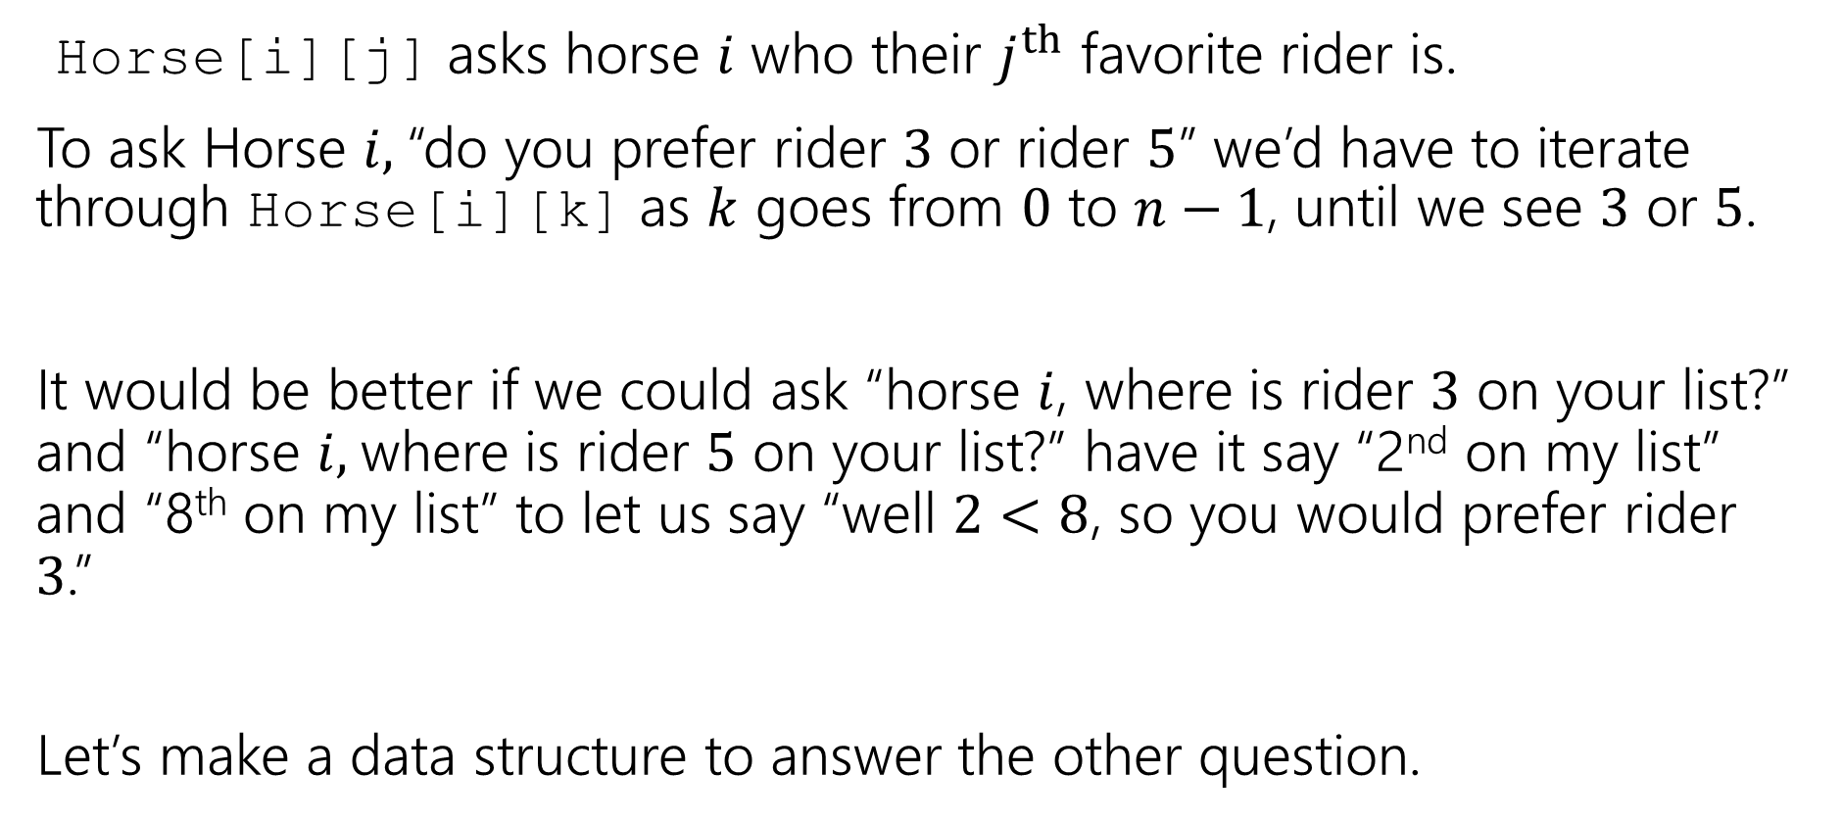
Changing The Question
Horse[i][j] asks horse $i$ who their $j^{th}$ favorite rider is.
To ask Horse $i,$“do you prefer rider $3$ or rider $5$” we’d have to iterate through Horse[i][k] as $k$ goes from $0$ to $n−1$, until we see $3$ or $5$.
It would be better if we could ask “horse $i$, where is rider $3$ on your list?” and “horse $i,$where is rider $5$ on your list?” have it say “2nd on my list” and “8th on my list” to let us say “well $2<8$, so you would prefer rider $3$.”
Let’s make a data structure to answer the other question.

Slide 46
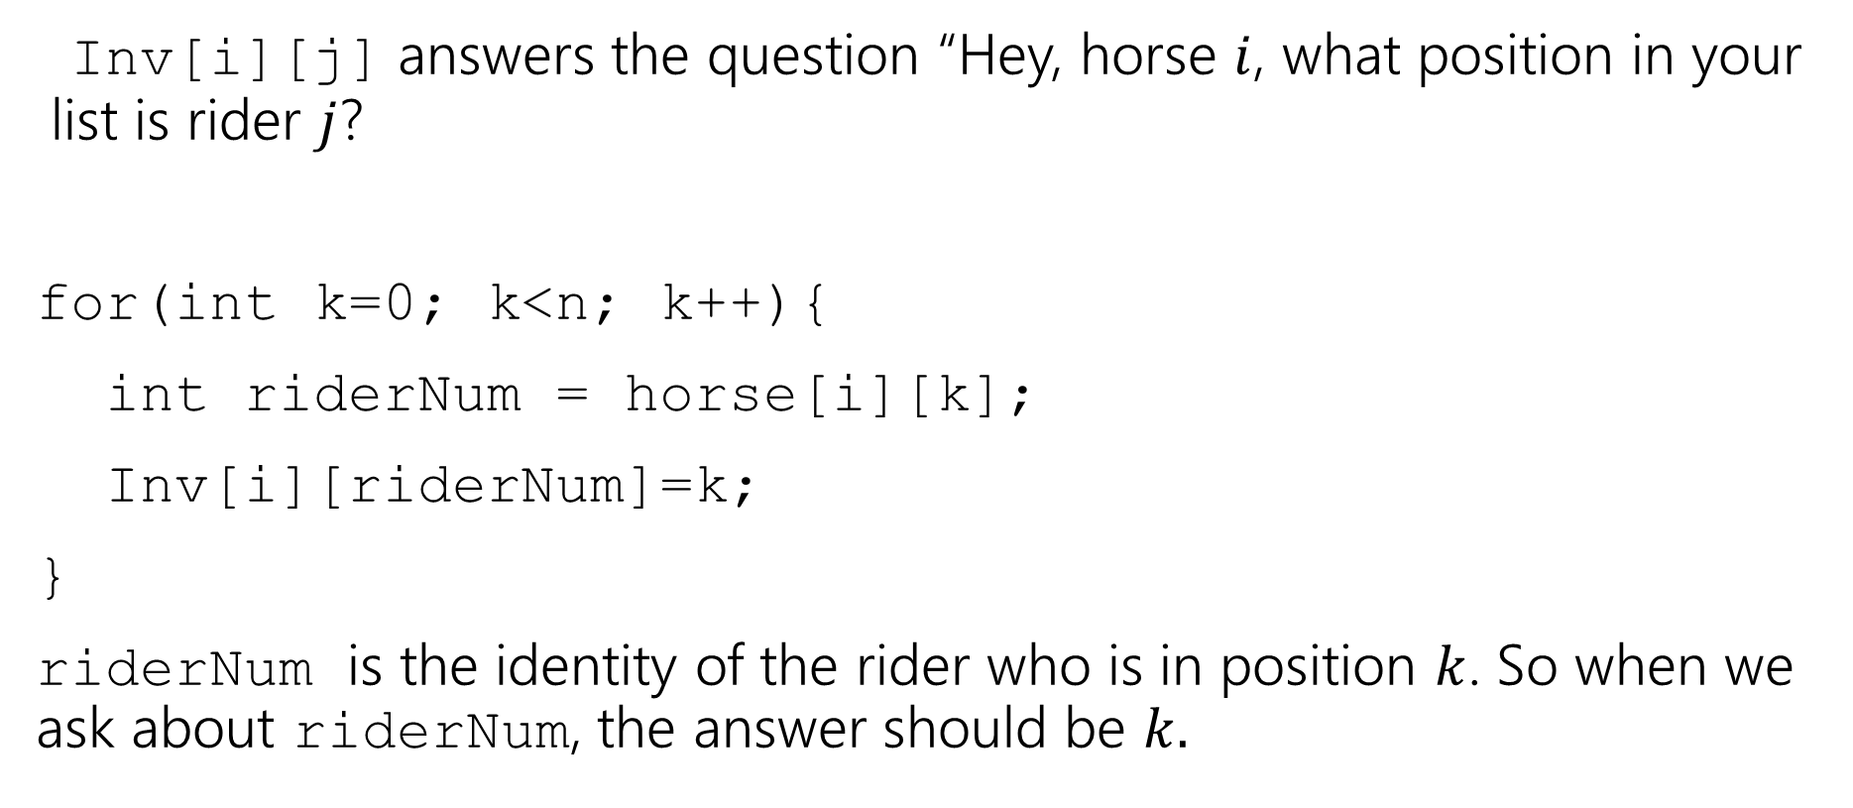
Inverse Array
Inv[i][j] answers the question “Hey, horse $i$, what position in your list is rider $j$?
for(int k=0; k<n; k++){
int riderNum = horse[i][k];
Inv[i][riderNum]=k;
}
riderNum is the identity of the rider who is in position $k$. So when we ask about riderNum, the answer should be $k.$

Slide 47
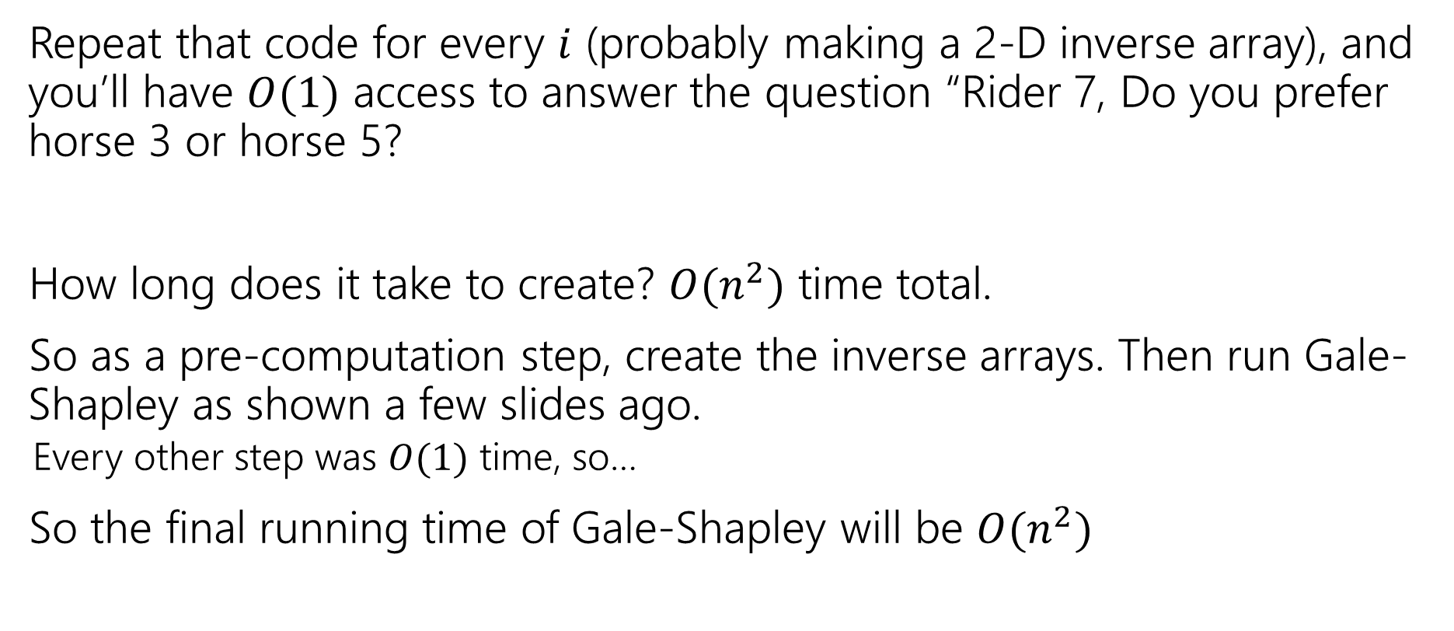
Inverse Array
Repeat that code for every $i$ (probably making a 2-D inverse array), and you’ll have $O(1)$ access to answer the question “Rider 7, Do you prefer horse 3 or horse 5?
How long does it take to create? $O(n^{2})$ time total.
So as a pre-computation step, create the inverse arrays. Then run Gale-Shapley as shown a few slides ago.
  Every other step was $O(1)$ time, so…
So the final running time of Gale-Shapley will be $O(n^{2})$

