Slide 1
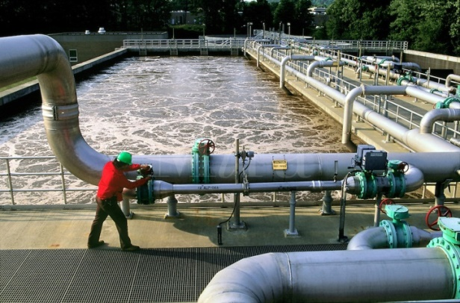
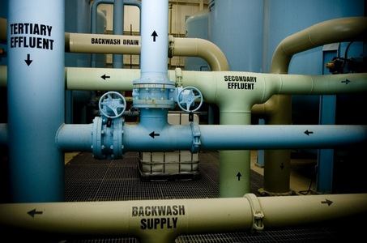
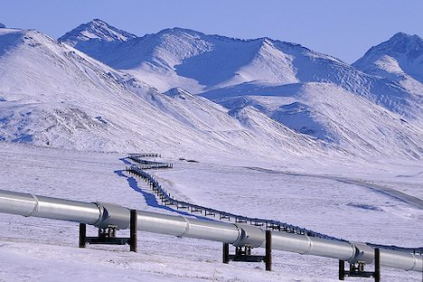
CSE 421 Algorithms
Richard Anderson
Lecture 23
Network Flow Applications

Slide 2
Announcements
Final Exam, March 18, 2:30-4:20 pm
Practice Exams available

Slide 3
Today’s topics
Network flow reductions
Multi source flow
Reviewer Assignment
Baseball Scheduling
Image Segmentation
Reading: 7.5, 7.6, 7.10-7.12

Slide 4
Network Flow Definitions
Review
Flowgraph: Directed graph with distinguished vertices s (source) and t (sink)
Capacities on the edges, c(e) >= 0
Problem, assign flows f(e) to the edges such that:
0 <= f(e) <= c(e)
Flow is conserved at vertices other than s and t
Flow conservation: flow going into a vertex equals the flow going out
The flow leaving the source is a large as possible

Slide 5
Key Ideas for Network Flow
Review
Residual Graph for a Flow
Augmenting a flow
Ford Fulkerson Algorithm
Max Flow / Min Cut Theorem
Practical Flow Algorithms
Modelling problems as Network Flow or Minimum Cut

Slide 6
Max Flow / Min Cut
Review
20/20
20/30
a
d
g
0/5
0/5
20/20
20/30
5/5
0/5
0/5
5/5
0/20
s
25/30
b
20/20
e
h
30/30
t
20/20
0/5
5/5
20/25
0/5
0/5
15/20
15/25
c
f
i
20/20
10/10

Slide 7
Multi-source network flow
Multi-source network flow
Sources s₁, s₂, . . ., s_{k}
Sinks t₁, t₂, . . . , t_{j}
Solve with Single source network flow

Slide 8
Bipartite Matching
Review
A graph G=(V,E) is bipartite if the vertices can be partitioned into disjoints sets X,Y
A matching M is a subset of the edges that does not share any vertices
Find a matching as large as possible

Slide 9
Converting Matching to Network Flow
s
t

Slide 10
Integrality Theorem
1:1
1:0.5
1:1
1:0
1:1
1:1
1:0.5
1:1
s
t
s
t
1:0
1:0.5
1:1
1:1
1:1
1:1
1:1
1:0.5
Theorem: If all capacities are integers, then there exists a maximum flow where all edges are assigned integer valued flows

Slide 11
Resource Allocation: Assignment of reviewers
A set of papers P₁, . . ., P_{n}
A set of reviewers R₁, . . ., R_{m}
Paper P_{i} requires A_{i} reviewers
Reviewer R_{j} can review B_{j} papers
For each reviewer R_{j}, there is a list of paper L_{j1}, . . ., L_{jk} that R_{j} is qualified to review

Slide 12
Baseball elimination
Can the Dinosaurs win the league?
Remaining games:
AB, AC, AD, AD, AD, BC, BC, BC, BD, CD
 | W | L
Ants | 4 | 2
Bees | 4 | 2
Cockroaches | 3 | 3
Dinosaurs | 1 | 5
A team wins the league if it has strictly more wins than any other team at the end of the season
A team ties for first place if no team has more wins, and there is some other team with the same
number of wins

Slide 13
Baseball elimination
Can the Fruit Flies win or tie the league?
Remaining games:
AC, AD, AD, AD, AF, BC, BC, BC, BC, BC, BD, BE, BE, BE, BE, BF, CE, CE, CE, CF, CF, DE, DF, EF, EF
 | W | L
Ants | 17 | 12
Bees | 16 | 7
Cockroaches | 16 | 7
Dinosaurs | 14 | 13
Earthworms | 14 | 10
Fruit Flies | 12 | 15

Slide 14
Assume Fruit Flies win remaining games
Fruit Flies are tied for first place if no team wins more than 19 games
Allowable wins
Ants (2)
Bees (3)
Cockroaches (3)
Dinosaurs (5)
Earthworms (5)
18 games to play
AC, AD, AD, AD, BC, BC, BC, BC, BC, BD, BE, BE, BE, BE, CE, CE, CE, DE
 | W | L
Ants | 17 | 13
Bees | 16 | 8
Cockroaches | 16 | 9
Dinosaurs | 14 | 14
Earthworms | 14 | 12
Fruit Flies | 19 | 15

Slide 15
Remaining games
AC, AD, AD, AD, BC, BC, BC, BC, BC, BD, BE, BE, BE, BE, CE, CE, CE, DE
s
AC
AD
BC
BD
BE
CE
DE
A
B
C
D
E
T

Slide 16
Minimum Cut Applications
Image Segmentation
Open Pit Mining / Task Selection Problem
Reduction to Min Cut problem
S, T is a cut if S, T is a partition of the vertices with
s in S and t in T
The capacity of an S, T cut is the sum of the capacities of
all edges going from S to T

Slide 17
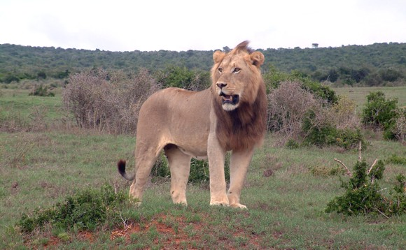
Image Segmentation
Separate foreground from background

Slide 18
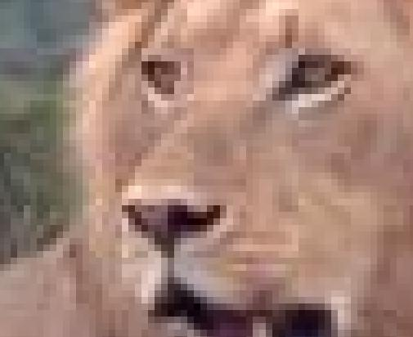

Slide 19
Image analysis
a_{i}: value of assigning pixel i to the foreground
b_{i}: value of assigning pixel i to the background
p_{ij}: penalty for assigning i to the foreground, j to the background or vice versa
A: foreground, B: background
Q(A,B) = Σ_{{i in A}}a_{i} + Σ_{{j in B}}b_{j} - Σ_{{(i,j) in E, i in A, j in} _{B}}p_{ij}

Slide 20
Pixel graph to flow graph
s
t

Slide 21
Mincut Construction
s
a_{v}
p_{vu}
u
v
p_{uv}
b_{v}
t

