Slide 1
CSE 421 Algorithms
Richard Anderson
Lecture 17, Winter 2019
Dynamic Programming

Slide 2
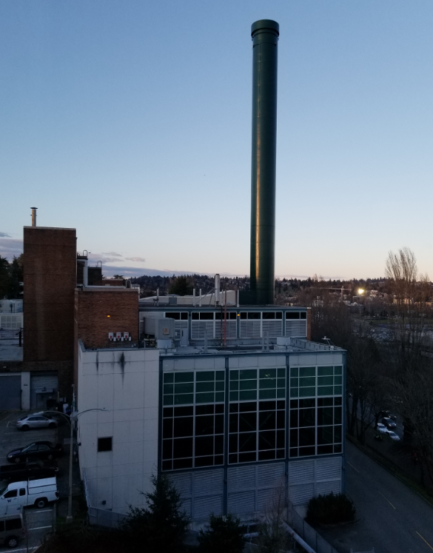
Announcements
HW 7. Partially Posted
I’ve moved
My new office: CSE2 344

Slide 3
Optimal linear interpolation
Optimal linear interpolation with K segments
Error = Σ(y_{i} –ax_{i} – b)²

Slide 4
Opt_{k}[ j ] = min _{i} { Opt_{k-1}[ i ] + E_{i,j} } for 0 < i < j
Optimal solution with k segments extends an optimal solution of k-1 segments on a smaller problem

Slide 5
Variable number of segments
Segments not specified in advance
Penalty function associated with segments
Cost = Interpolation error + C x #Segments

Slide 6
Penalty cost measure
Opt[ j ] = min(E_{1,j}, min_{i}(Opt[ i ] + E_{i,j} + P))

Slide 7
Subset Sum Problem
Let w₁,…,w_{n} = {6, 8, 9, 11, 13, 16, 18, 24}
Find a subset that has as large a sum as possible, without exceeding 50
6, 8, 9, 11, 16

Slide 8
Adding a variable for Weight
Opt[ j, K ] the largest subset of {w₁, …, w_{j}} that sums to at most K
{2, 4, 7, 10}
Opt[2, 7] =
Opt[3, 7] =
Opt[3,12] =
Opt[4,12] =

Slide 9
Subset Sum Recurrence
Opt[ j, K ] the largest subset of {w₁, …, w_{j}} that sums to at most K
Opt[ j, K] = max(Opt[ j – 1, K], Opt[ j – 1, K – w_{j}] + w_{j})

Slide 10
Subset Sum Grid
Opt[ j, K] = max(Opt[ j – 1, K], Opt[ j – 1, K – w_{j}] + w_{j})
4
3
2
1
 | 0 | 0 | 0 | 0 | 0 | 0 | 0 | 0 | 0 | 0 | 0 | 0 | 0 | 0 | 0 | 0 | 0
{2, 4, 7, 10}

Slide 11
Subset Sum Code
for j = 1 to n
for k = 1 to W
Opt[j, k] = max(Opt[j-1, k], Opt[j-1, k-w_{j}] + w_{j})
Opt[ j, K] = max(Opt[ j – 1, K], Opt[ j – 1, K – w_{j}] + w_{j})

Slide 12
Knapsack Problem
Items have weights and values
The problem is to maximize total value subject to a bound on weght
Items {I₁, I₂, … I_{n}}
Weights {w₁, w₂, …,w_{n}}
Values {v₁, v₂, …, v_{n}}
Bound K
Find set S of indices to:
Maximize Σ_{iεS}v_{i} such that Σ_{iεS}w_{i} <= K

Slide 13
Knapsack Recurrence
Subset Sum Recurrence:
Opt[ j, K] = max(Opt[ j – 1, K], Opt[ j – 1, K – w_{j}] + w_{j})
Knapsack Recurrence:

Slide 14
Knapsack Grid
Opt[ j, K] = max(Opt[ j – 1, K], Opt[ j – 1, K – w_{j}] + v_{j})
4
3
2
1
 | 0 | 0 | 0 | 0 | 0 | 0 | 0 | 0 | 0 | 0 | 0 | 0 | 0 | 0 | 0 | 0 | 0
Weights {2, 4, 7, 10} Values: {3, 5, 9, 16}

Slide 15
Dynamic Programming Examples
Examples
Optimal Billboard Placement
Text, Solved Exercise, Pg 307
Linebreaking with hyphenation
Compare with HW problem 6, Pg 317
String approximation
Text, Solved Exercise, Page 309

Slide 16
Billboard Placement
Maximize income in placing billboards
b_{i} = (p_{i}, v_{i}), v_{i}: value of placing billboard at position p_{i}
Constraint:
At most one billboard every five miles
Example
{(6,5), (8,6), (12, 5), (14, 1)}

Slide 17
Design a Dynamic Programming Algorithm for Billboard Placement
Compute Opt[1], Opt[2], . . ., Opt[n]
What is Opt[k]?
Input b₁, …, b_{n}, where b_{i} = (p_{i}, v_{i}), position and value of billboard i

Slide 18
Opt[k] = fun(Opt[0],…,Opt[k-1])
How is the solution determined from sub problems?
Input b₁, …, b_{n}, where b_{i} = (p_{i}, v_{i}), position and value of billboard i

Slide 19
Solution
j = 0; // j is five miles behind the current position
// the last valid location for a billboard, if one placed at P[k]
for k := 1 to n
while (P[ j ] < P[ k ] – 5)
j := j + 1;
j := j – 1;
Opt[ k] = Max(Opt[ k-1] , V[ k ] + Opt[ j ]);

