Slide 1
CSE 421 Algorithms
Lecture 15, Winter 2019
Closest Pair, Multiplication

Slide 2
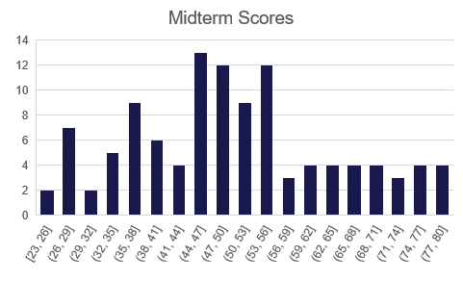
Announcements
Midterm returned with solution set
Next week, Dynamic Programming
Chapter 6
Midterm Average: 50.5

Slide 3
Divide and Conquer Algorithms
Mergesort, Quicksort
Strassen’s Algorithm
Inversion counting
Median
Closest Pair Algorithm (2d)
Integer Multiplication (Karatsuba’s Algorithm)
FFT
Polynomial Multiplication
Convolution

Slide 4
Median: BFPRT Algorithm
Select(A, k){
x = BFPRT(A)
S₁ = {y in A | y < x}; S₂ = {y in A | y > x}; S₃ = {y in A | y = x}
if (|S₂| >= k)
return Select(S₂, k)
else if (|S₂| + |S₃| >= k)
return x
else
return Select(S₁, k - |S₂| - |S₃|)
}
S₁
S₃
S₂
BFPRT(A){
n = |A|
Split A into n/5 sets of size 5
M be the set of medians of these sets
x = Select(M, n/10) /* x is the median of M */
return x
}

Slide 5
BFPRT Recurrence
T(n) <= T(3n/4) + T(n/5) + c n
Prove that T(n) <= 20 c n

Slide 6
Median
In practice, select the pivot by choosing an element at random
Heuristics such as median-of-three gives improved performance
BFPRT is NOT a practical algorithm
Why groups of five?
Odd number
Three does not allow linear bound to be proven
Seven gives a worse constant factor

Slide 7
Closest Pair Problem (2D)
Given a set of points find the pair of points p, q that minimizes dist(p, q)

Slide 8
Divide and conquer
If we solve the problem on two subsets, does it help? (Separate by median x coordinate)
δ₁
δ₂

Slide 9
Packing Lemma
Suppose that the minimum distance between points is at least δ, what is the maximum number of points that can be packed in a ball of radius δ?

Slide 10
Combining Solutions
Suppose the minimum separation from the sub problems is δ
In looking for cross set closest pairs, we only need to consider points with δ of the boundary
How many cross border interactions do we need to test?

Slide 11
A packing lemma bounds the number of distances to check
δ

Slide 12
Details
Preprocessing: sort points by y
Merge step
Select points in boundary zone
For each point in the boundary
Find highest point on the other side that is at most δ above
Find lowest point on the other side that is at most δ below
Compare with the points in this interval (there are at most 6)

Slide 13
Identify the pairs of points that are compared in the merge step following the recursive calls

Slide 14
Algorithm run time
After preprocessing:
T(n) = cn + 2 T(n/2)

Slide 15
Integer Arithmetic
9715480283945084383094856701043643845790217965702956767
+ 1242431098234099057329075097179898430928779579277597977
Runtime for standard algorithm to add two n digit numbers:
2095067093034680994318596846868779409766717133476767930
X 5920175091777634709677679342929097012308956679993010921
Runtime for standard algorithm to multiply two n digit numbers:

Slide 16
Recursive Multiplication Algorithm (First attempt)
x = x₁ 2^{n/2} + x₀
y = y₁ 2^{n/2} + y₀
xy = (x₁ 2^{n/2} + x₀) (y₁ 2^{n/2} + y₀)
= x₁y₁ 2^{n} + (x₁y₀ + x₀y₁)2^{n/2} + x₀y₀
Recurrence:
Run time:

Slide 17
Simple algebra
x = x₁ 2^{n/2} + x₀
y = y₁ 2^{n/2} + y₀
xy = x₁y₁ 2^{n} + (x₁y₀ + x₀y₁) 2^{n/2} + x₀y₀
p = (x₁ + x₀)(y₁ + y₀) = x₁y₁ + x₁y₀ + x₀y₁ + x₀y₀

Slide 18
Karatsuba’s Algorithm
Multiply n-digit integers x and y
Let x = x₁ 2^{n/2} + x₀ and y = y₁ 2^{n/2} + y₀
Recursively compute
a = x₁y₁
b = x₀y₀
p = (x₁ + x₀)(y₁ + y₀)
Return a2^{n} + (p – a – b)2^{n/2} + b
Recurrence: T(n) = 3T(n/2) + cn
log₂ 3 = 1.58496250073…

Slide 19
Next week
Dynamic Programming!

