Slide 1
CSE 421 Algorithms
NP-Complete
P
Richard Anderson
Lecture 29
Coping with NP-Completeness Complexity Theory

Slide 2
Announcements
Final exam,
Monday, December 9, 2:30-4:20 pm
Comprehensive (2/3 post midterm, 1/3 pre midterm)
Old finals / answers on course website
Material covered in lecture
Kleinberg, Tardos, Sections 1.1 – 8.10
Unlikely to be on the exam
2.5, 4.8, 5.6, 6.9, 7.3, 7.4, 7.13, 8.9

Slide 3
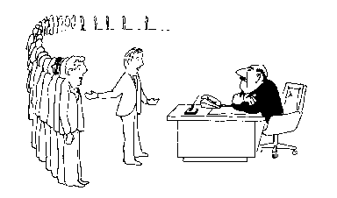
Coping with NP-Completeness
Approximation Algorithms
Exact solution via Branch and Bound
Local Search
I can’t find an efficient algorithm, but neither can all these famous people.

Slide 4
Multiprocessor Scheduling
Unit execution tasks
Precedence graph
K-Processors
Polynomial time for k=2
Open for k = constant
NP-complete is k is part of the problem

Slide 5
Highest level first is 2-Optimal
Choose k items on the highest level
Claim: number of rounds is at least twice the optimal.

Slide 6
Christofides TSP Algorithm
Undirected graph satisfying triangle inequality
Find MST
Add additional edges so that all vertices have even degree
Build Eulerian Tour
4
3
4
1
2
5
5
3/2 Approximation
3
6
4
3
4
3
2
5
6

Slide 7
Christofides Algorithm
4
3
4
3
4
1
4
1
2
2
5
5
5
3
5
3
6
6
4
4
3
3
4
3
4
3
2
2
5
6
5
6
3
4
1
2
5
3
4
4
3
2
6

Slide 8
Bin Packing
Given N items with weight w_{i}, pack the items into as few unit capacity bins as possible
Example: .3, .3, .3, .3, .4, .4

Slide 9
First Fit Packing
First Fit
Theorem: FF(I) is at most 17/10 Opt(I) + 2
First Fit Decreasing
Theorem: FFD(I) is at most 11/9 Opt (I) + 4

Slide 10
Branch and Bound
Brute force search – tree of all possible solutions
Branch and bound – compute a lower bound on all possible extensions
Prune sub-trees that cannot be better than optimal

Slide 11
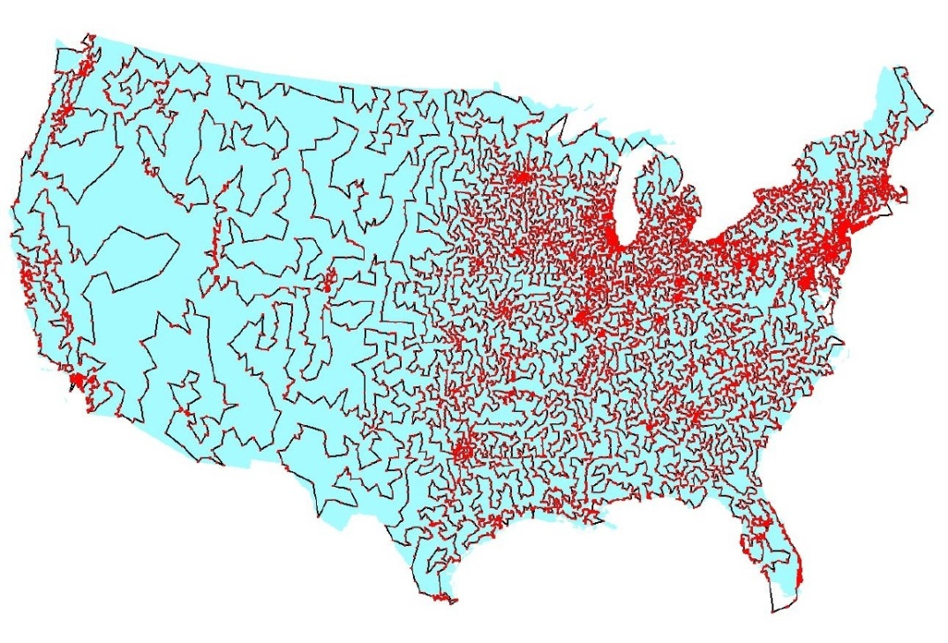
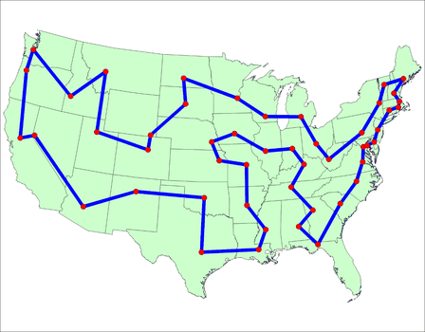
Branch and Bound for TSP
Enumerate all possible paths
Lower bound, Current path cost plus MST of remaining points
Euclidean TSP
Points on the plane with Euclidean Distance
Sample data set: State Capitals

Slide 12
Local Optimization
Improve an optimization problem by local improvement
Neighborhood structure on solutions
Travelling Salesman 2-Opt (or K-Opt)
Independent Set Local Replacement

Slide 13
What we don’t know
P vs. NP
NP-Complete
P = NP
P

Slide 14
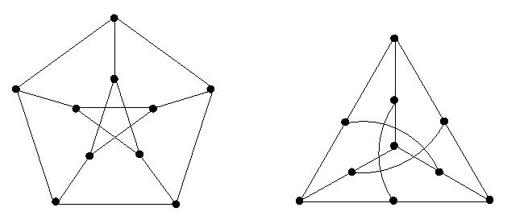
If P != NP, is there anything in between
Yes, Ladner [1975]
Problems not known to be in P or NP Complete
Factorization
Discrete Log
Graph Isomorphism
Solve g^{k} = b over a finite group

Slide 15
Complexity Theory
Computational requirements to recognize languages
Models of Computation
Resources
Hierarchies
All Languages
Decidable Languages
Context Free Languages
Regular Languages

Slide 16
Time complexity
P: (Deterministic) Polynomial Time
NP: Non-deterministic Polynomial Time
EXP: Exponential Time

Slide 17
Space Complexity
Amount of Space (Exclusive of Input)
L: Logspace, problems that can be solved in O(log n) space for input of size n
Related to Parallel Complexity
PSPACE, problems that can be required in a polynomial amount of space

Slide 18
So what is beyond NP?

Slide 19
NP vs. Co-NP
Given a Boolean formula, is it true for some choice of inputs
Given a Boolean formula, is it true for all choices of inputs

Slide 20
Problems beyond NP
Exact TSP, Given a graph with edge lengths and an integer K, does the minimum tour have length K
Minimum circuit, Given a circuit C, is it true that there is no smaller circuit that computes the same function a C

Slide 21
Polynomial Hierarchy
Level 1
∃X₁ Φ(X₁), ∀X₁ Φ(X₁)
Level 2
∀X₁∃X₂ Φ(X₁,X₂), ∃X₁∀X₂ Φ(X₁,X₂)
Level 3
∀X₁∃X₂∀X₃ Φ(X₁,X₂,X₃), ∃X₁∀X₂∃X₃ Φ(X₁,X₂,X₃)

Slide 22
Polynomial Space
Quantified Boolean Expressions
∃X₁∀X₂∃X₃...∃X_{n-1}∀X_{n} Φ(X₁,X₂,X₃…X_{n-1}X_{n})
Space bounded games
Competitive Facility Location Problem
N x N Chess
Counting problems
The number of Hamiltonian Circuits
PSpace-Complete
Log Space
P

