Slide 1
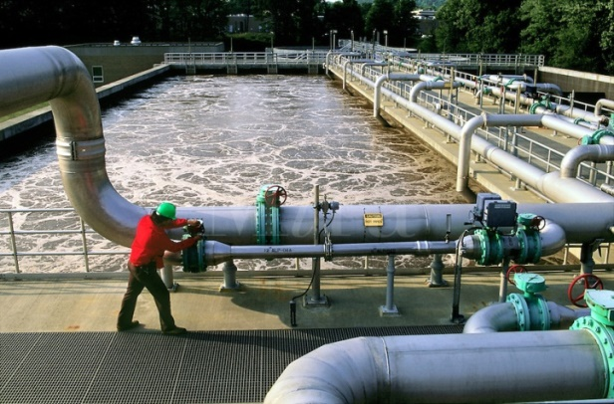
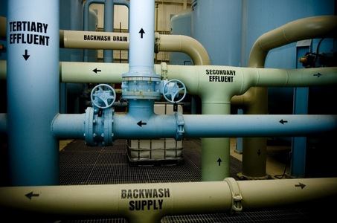
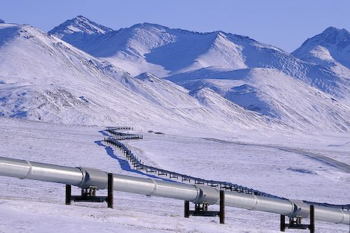
CSE 421 Algorithms
Autumn 2019
Lecture 24
Network Flow Applications

Slide 2
Announcements
Homework 9: Due Wednesday, Nov 27
Homework 10: Due Friday, Dec 6
Final Exam: Monday, Dec 9, 2:30 PM
Fri, Nov 22 | Net Flow Applications
Mon, Nov 25 | Net Flow Applications
Wed, Nov 27 | NP-Completeness
Fri, Nov 29 | Holiday
Mon, Dec 2 | NP-Completeness
Wed, Dec 4 | NP-Completeness
Fri, Dec 6 | Beyond NP-Completeness

Slide 3
Today’s topics
Network flow reductions
Multi source flow
Reviewer Assignment
Baseball Scheduling
Image Segmentation
Reading: 7.5, 7.6, 7.10-7.12

Slide 4
Network Flow Definitions
Review
Flowgraph: Directed graph with distinguished vertices s (source) and t (sink)
Capacities on the edges, c(e) >= 0
Problem, assign flows f(e) to the edges such that:
0 <= f(e) <= c(e)
Flow is conserved at vertices other than s and t
Flow conservation: flow going into a vertex equals the flow going out
The flow leaving the source is a large as possible

Slide 5
Key Ideas for Network Flow
Review
Residual Graph for a Flow
Augmenting a flow
Ford Fulkerson Algorithm
Max Flow / Min Cut Theorem
Practical Flow Algorithms
Modelling problems as Network Flow or Minimum Cut

Slide 6
Max Flow / Min Cut
Review
20/20
20/30
a
d
g
0/5
0/5
20/20
20/30
5/5
0/5
0/5
5/5
0/20
s
25/30
b
20/20
e
h
30/30
t
20/20
0/5
5/5
20/25
0/5
0/5
15/20
15/25
c
f
i
20/20
10/10

Slide 7
Undirected Network Flow
Undirected graph with edge capacities
Flow may go either direction along the edges (subject to the capacity constraints)
u
10
20
s
5
t
20
10
v
Construct an equivalent flow problem

Slide 8
Bipartite Matching
A graph G=(V,E) is bipartite if the vertices can be partitioned into disjoints sets X,Y
A matching M is a subset of the edges that does not share any vertices
Find a matching as large as possible

Slide 9
Application
A collection of teachers
A collection of courses
And a graph showing which teachers can teach which courses
RA
311
PB
331
ME
332
DG
401
AK
421

Slide 10
Converting Matching to Network Flow
s
t

Slide 11
Finding edge disjoint paths
t
s
Construct a maximum cardinality set of
edge disjoint paths

Slide 12
Multi-source network flow
Multi-source network flow
Sources s₁, s₂, . . ., s_{k}
Sinks t₁, t₂, . . . , t_{j}
Solve with Single source network flow

Slide 13
Resource Allocation: Assignment of reviewers
A set of papers P₁, . . ., P_{n}
A set of reviewers R₁, . . ., R_{m}
Paper P_{i} requires A_{i} reviewers
Reviewer R_{j} can review B_{j} papers
For each reviewer R_{j}, there is a list of paper L_{j1}, . . ., L_{jk} that R_{j} is qualified to review

Slide 14
Resource Allocation: Illegal Campaign Donations
Candidates C_{i}, . . ., C_{n}
Donate b_{i} to C_{i}
With a little help from your friends
Friends F₁, . . ., F_{m}
F_{i} can give a_{ij} to candidate C_{j}
You can give at most M_{i} to F_{i}

Slide 15
Baseball elimination
Can the Dinosaurs win the league?
Remaining games:
AB, AC, AD, AD, AD, BC, BC, BC, BD, CD
 | W | L
Ants | 4 | 2
Bees | 4 | 2
Cockroaches | 3 | 3
Dinosaurs | 1 | 5
A team wins the league if it has strictly more wins than any other team at the end of the season
A team ties for first place if no team has more wins, and there is some other team with the same
number of wins

Slide 16
Baseball elimination
Can the Fruit Flies win or tie the league?
Remaining games:
AC, AD, AD, AD, AF, BC, BC, BC, BC, BC, BD, BE, BE, BE, BE, BF, CE, CE, CE, CF, CF, DE, DF, EF, EF
 | W | L
Ants | 17 | 12
Bees | 16 | 7
Cockroaches | 16 | 7
Dinosaurs | 14 | 13
Earthworms | 14 | 10
Fruit Flies | 12 | 15

Slide 17
Assume Fruit Flies win remaining games
Fruit Flies are tied for first place if no team wins more than 19 games
Allowable wins
Ants (2)
Bees (3)
Cockroaches (3)
Dinosaurs (5)
Earthworms (5)
18 games to play
AC, AD, AD, AD, BC, BC, BC, BC, BC, BD, BE, BE, BE, BE, CE, CE, CE, DE
 | W | L
Ants | 17 | 13
Bees | 16 | 8
Cockroaches | 16 | 9
Dinosaurs | 14 | 14
Earthworms | 14 | 12
Fruit Flies | 19 | 15

Slide 18
Remaining games
AC, AD, AD, AD, BC, BC, BC, BC, BC, BD, BE, BE, BE, BE, CE, CE, CE, DE
s
AC
AD
BC
BD
BE
CE
DE
A
B
C
D
E
t

Slide 19
Minimum Cut Applications
Image Segmentation
Open Pit Mining / Task Selection Problem
Reduction to Min Cut problem
S, T is a cut if S, T is a partition of the vertices with
s in S and t in T
The capacity of an S, T cut is the sum of the capacities of
all edges going from S to T

Slide 20
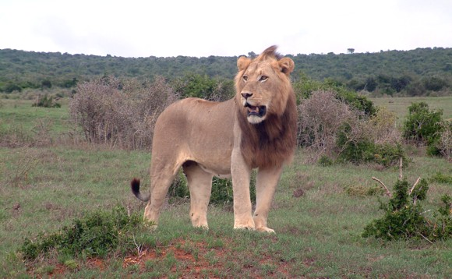
Image Segmentation
Separate foreground from background

Slide 22
Image analysis
a_{i}: value of assigning pixel i to the foreground
b_{i}: value of assigning pixel i to the background
p_{ij}: penalty for assigning i to the foreground, j to the background or vice versa
A: foreground, B: background
Q(A,B) = Σ_{{i in A}}a_{i} + Σ_{{j in B}}b_{j} - Σ_{{(i,j) in E, i in A, j in} _{B}}p_{ij}

Slide 23
Pixel graph to flow graph
s
t

Slide 24
Mincut Construction
s
a_{v}
p_{vu}
u
v
p_{uv}
b_{v}
t

