Slide 1
CSE 421 Algorithms
Richard Anderson
Autumn 2019
Lecture 1
Announcements only

Slide 2
CSE 421 Course Introduction
CSE 421, Introduction to Algorithms
MWF, 1:30-2:20 pm
Sieg 134
Instructor
Richard Anderson, anderson@cs.washington.edu
Office hours:
CSE2 344
Office hours: Monday 2:30-3:30, Wednesday 2:30-3:30
Getting back from Malaysia tomorrow
Teaching Assistants
Yuqing Ai
Anny Kong
Kaidi Pei
Jainul Vaghasia
Ivy Wang
Galen Weld
Xin Yang
Leiyi Zhang

Slide 3
Announcements
It’s on the web.
Homework due Wednesdays
HW 1, Due January 16
It’s on the web
Submit solutions on canvas
You should be on the course mailing list
But it will probably go to your uw.edu account

Slide 4
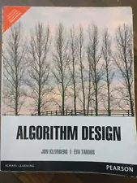
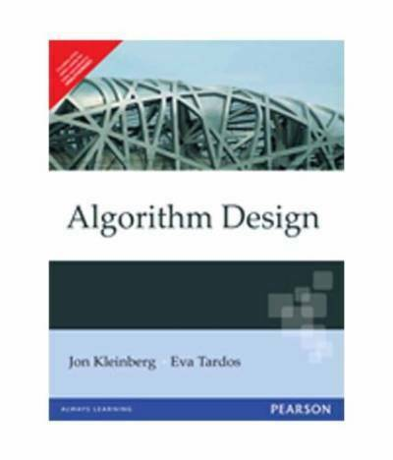
Textbook
Algorithm Design
Jon Kleinberg, Eva Tardos
Read Chapters 1 & 2
Expected coverage:
Chapter 1 through 7
Book available at:
UW Bookstore ($174)
Ebay ($17.95 to $155.95)
Amazon ($17.83 to $ 298.84)
Kindle ($105.99)
PDF (Google Search)
There is only one edition of this book, and the international versions are fine

Slide 5
Course Mechanics
Homework
Due Wednesdays
About 5 problems, sometimes programming
Target: 1 week turnaround on grading
Exams (In class)
Midterm, Wednesday, October 30, 2019
Final, Monday, December 9, 2:30-4:20 pm
Approximate grade weighting
HW: 50, MT: 15, Final: 35
Course web
Slides, Handouts

Slide 6
Guest Lecturer Wednesday, September 25, 2019
Anna Karlin

