Slide 1
CSE 421
Max Flow Min Cut, Bipartite Matching
Yin Tat Lee

Slide 2
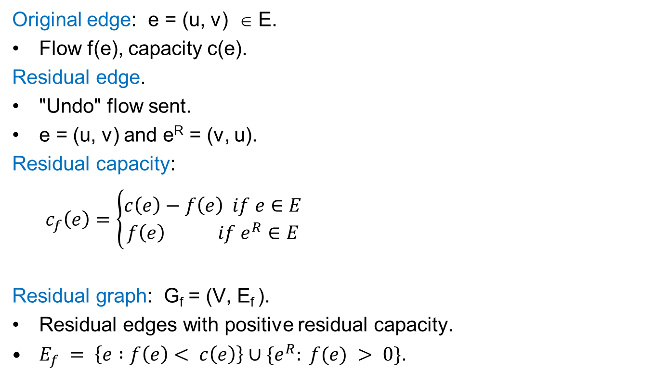
Residual Graph
capacity
Original edge: e = (u, v) ∈ E.
Flow f(e), capacity c(e).
Residual edge.
"Undo" flow sent.
e = (u, v) and e^{R} = (v, u).
Residual capacity:
$c_{f}\left(e\right)=\left\{\begin{aligned}c\left(e\right)−f\left(e\right) if e∈E \\ f\left(e\right) if e^{R}∈E\end{aligned}\right.$
Residual graph: G_{f} = (V, E_{f} ).
Residual edges with positive residual capacity.
$E_{f} = \left\{e :f\left(e\right)< c\left(e\right)\right\}∪\{e^{R}: f(e) > 0\}$.
u
17
v
6
flow
residual capacity
u
11
v
6
residual capacity

Slide 3
Augmenting Path Algorithm
Augment(f, c, P) {
b ← bottleneck(P)
foreach e ∈ P {
if (e ∈ E) f(e) ← f(e) + b
else f(e^{R}) ← f(e) - b
}
return f
}
Smallest capacity edge on P
Forward edge
Reverse edge
Ford-Fulkerson(G, s, t, c) {
foreach e ∈ E f(e) ← 0
G_{f} ← residual graph
while (there exists augmenting path P) {
f ← Augment(f, c, P)
update G_{f}
}
return f
}

Slide 4
Max Flow Min Cut Theorem
Augmenting path theorem. Flow f is a max flow iff there are no augmenting paths.
Max-flow min-cut theorem. [Ford-Fulkerson 1956] The value of the max s-t flow is equal to the value of the min s-t cut.
Proof strategy. We prove both simultaneously by showing the TFAE:
(i) There exists a cut (A, B) such that v(f) = cap(A, B).
(ii) Flow f is a max flow.
(iii) There is no augmenting path relative to f.
(i) ⇒ (ii) This was the corollary to weak duality lemma.
(ii) ⇒ (iii) We show contrapositive.
Let f be a flow. If there exists an augmenting path, then we can improve f by sending flow along that path.

Slide 5

Pf of Max Flow Min Cut Theorem
(iii) => (i)
No augmenting path for f => there is a cut (A,B): v(f)=cap(A,B)
Let f be a flow with no augmenting paths.
Let A be set of vertices reachable from s in residual graph.
By definition of A, s ∈ A.
By definition of f, t ∉ A.
$$v\left(f\right)=\sum_{e out of A}{f\left(e\right)−\sum_{e in to A}{f(e)}}$$
$$=\sum_{e out of A}{c\left(e\right)}$$
$$=cap(A,B)$$

Slide 6
Running Time
Assumption. All capacities are integers between 1 and C.
Invariant. Every flow value $f(e)$ and every residual capacities $cf (e)$ remains an integer throughout the algorithm.
Theorem. The algorithm terminates in at most $v(f^{∗})  nC$iterations, if $f^{∗}$ is optimal flow.
Pf. Each augmentation increase value by at least 1.
Corollary. If C = 1, Ford-Fulkerson runs in O(mn) time.
Integrality theorem. If all capacities are integers, then there exists a max flow f for which every flow value f(e) is an integer.
Pf. Since algorithm terminates, theorem follows from invariant.

Slide 7
Applications of Max Flow: Bipartite Matching

Slide 8
Maximum Matching Problem
Given an undirected graph G = (V, E).
A set $M⊆E$ is a matching if each node appears in at most edge in M.
Goal: find a matching with largest cardinality.

Slide 9
Bipartite Matching Problem
Given an undirected bipartite graph $G=(X∪Y,E)$
A set $M⊆E$ is a matching if each node appears in at most edge in M.
Goal: find a matching with largest cardinality.
1
1'
2
2'
3
3'
X
Y
4
4'
5
5'

Slide 10
Bipartite Matching using Max Flow
In some proof
In algorithm
Create digraph H as follows:
Orient all edges from X to Y, and assign infinite (or unit) capacity.
Add source s, and unit capacity edges from s to each node in L.
Add sink t, and unit capacity edges from each node in R to t.
H
1
$$∞$$
1'
1
2
2'
1
s
3
3'
t
4
4'
X
5
5'
Y

Slide 11
Bipartite Matching: Proof of Correctness
Thm. Max cardinality matching in G = value of max flow in H.
Pf. (matching val ≤ maxflow val)
Given max matching M of cardinality k.
Consider flow f that sends 1 unit along each of k edges of M.
f is a flow, and has cardinality k. ▪
1
1'
1
$$∞$$
1'
H
G
2
2'
1
2
2'
1
3
3'
s
3
3'
t
4
4'
4
4'
5
5'
5
5'

Slide 12
Bipartite Matching: Proof of Correctness
Thm. Max cardinality matching in G = value of max flow in H.
Pf. (of matching val $≥$ flow val) Let f be a max flow in H of value k.
Integrality theorem ⇒ k is integral and we can assume f is 0-1.
Consider M = set of edges from X to Y with f(e) = 1.
each node in X and Y participates in at most one edge in M
|M| = k
G
1
$$∞$$
1'
H
1
1'
1
2
2'
1
2
2'
s
3
3'
t
3
3'
4
4'
4
4'
5
5'
5
5'

Slide 13
Perfect Bipartite Matching

Slide 14
Perfect Bipartite Matching
Def. A matching M ⊆ E is perfect if each node appears in exactly one edge in M.
Q. When does a bipartite graph have a perfect matching?
Structure of bipartite graphs with perfect matchings:
Clearly we must have |X| = |Y|.
What other conditions are necessary?
What conditions are sufficient?

Slide 15
Perfect Bipartite Matching: N(S)
N(S)
Def. Let S be a subset of nodes,
and let N(S) be the set of nodes
adjacent to nodes in S.
Observation. If a bipartite graph G has a
perfect matching, then |N(S)| ≥ |S| for all subsets $S⊆X$.
Pf. Each $v∈S$ has to be matched to a unique node in N(S).
S
N(S)
S

Slide 16
Marriage Theorem
Thm: [Frobenius 1917, Hall 1935] Let $G = (X∪Y, E)$ be a bipartite graph with |X| = |Y|.
Then, G has a perfect matching iff $\left|N\left(S\right)\right|≥\left|S\right|$ for all subsets $S⊆X$.
Pf. ⇒
This was the previous observation.
If |N(S)| < |S| for some S, then there is no perfect matching.

Slide 17
Marriage Theorem
Pf. $∃S⊆X$ s.t., $|N\left(S\right)|<|S|$ $⇐$ G does not a perfect matching
Formulate as a max-flow and let $(A,B)$ be the min s-t cut
G has no perfect matching => $v\left(f^{∗}\right)<|X|$. So, $cap\left(A,B\right)<|X|$
Define $X_{A}=X∩A,X_{B}=X∩B,Y_{A}=Y∩A$
Then, $cap\left(A,B\right)≥\left|X_{B}\right|+|Y_{A}|$
Since min-cut does not use $∞$ edges, $N\left(X_{A}\right)⊆Y_{A}$
$$\left|N\left(X_{A}\right)\right|≤\left|Y_{A}\right|≤cap\left(A,B\right)−\left|X_{B}\right|=cap\left(A,B\right)−\left|X\right|+\left|X_{A}\right|<|X_{A}|$$
$$X_{B}$$
$$Y_{B}$$
$$∞$$
s
t
$$X_{A}$$
$$Y_{A}$$

Slide 18
Bipartite Matching Running Time
Which max flow algorithm to use for bipartite matching?
Generic augmenting path: O(m val(f*) ) = O(mn).
Capacity scaling: O(m² log C ) = O(m²).
Shortest augmenting path: O(m n^{1/2}).
Non-bipartite matching.
Structure of non-bipartite graphs is more complicated, but well-understood. [Tutte-Berge, Edmonds-Galai]
Blossom algorithm: O(n⁴). [Edmonds 1965]
Best known: O(m n^{1/2}). [Micali-Vazirani 1980]

