Slide 1
CSE 421
Dynamic Programming
Longest Path in a DAG,
Yin Tat Lee

Slide 2
Longest Path in a DAG

Slide 3
Longest Path in a DAG
Goal: Given a DAG G, find the longest path.
Recall: A directed graph G is a DAG if it has no cycle.
This problem is NP-hard for general
directed graphs:
It has the Hamiltonian Path as a
special case
₂
₃
₆
₅
₄
₇
₁

Slide 4
DP for Longest Path in a DAG
Q: What is the right ordering?
Remember, we have to use that G is a DAG, ideally in defining the ordering
We saw that every DAG has a topological sorting
So, let’s use that as an ordering.
₂
₃
₆
₅
₄
₁
₂
₃
₄
₅
₆
₇
₇
₁

Slide 5
DP for Longest Path in a DAG
Suppose we have labelled the
vertices such that $(i,j)$ is a
directed edge only if $i<j.$
Let $OPT(j)$ = length of the longest path ending at $j$
Suppose OPT(j) is $\left(i_{1},i_{2}\right),\left(i_{2},i_{3}\right),…,\left(i_{k−1},i_{k}\right),\left(i_{k},j\right),$ then
Obs 1: $i_{1}≤i_{2}≤…≤i_{k}≤j.$
Obs 2: $\left(i_{1},i_{2}\right),\left(i_{2},i_{3}\right),…,\left(i_{k−1},i_{k}\right)$ is the longest path ending at $i_{k}.$
$$OPT\left(j\right)=1+OPT\left(i_{k}\right).$$
₁
₂
₃
₄
₅
₆
₇

Slide 6
DP for Longest Path in a DAG
Suppose we have labelled the vertices such that $(i,j)$ is a directed edge only if $i<j.$
Let $OPT(j)$ = length of the longest path ending at $j$
$OPT\left(j\right)=\left\{\begin{aligned}0 \\ 1+\max_{i:\left(i,j\right) an edge}{OPT(i)}\end{aligned}\right.$
If $j$ is a source
o.w.

Slide 7
Outputting the Longest Path
Let G be a DAG given with a topological sorting: For all edges $(i,j)$ we have i<j.
Initialize Parent[j]=-1 for all j.
Compute-OPT(j){
if (in-degree(j)==0)
return 0
if (M[j]==empty)
M[j]=0;
for all edges (i,j)
if (M[j] < 1+Compute-OPT(i))
M[j]=1+Compute-OPT(i)
Parent[j]=i
return M[j]
}
Let M[k] be the maximum of M[1],…,M[n]
While (Parent[k]!=-1)
Print k
k=Parent[k]
Record the entry that
we used to compute OPT(j)

Slide 8
Exercise: Longest Increasing Subsequence

Slide 9

Longest Increasing Subsequence
Given a sequence of numbers
Find the longest increasing subsequence in $O(n^{2})$ time
41, 22, 9, 15, 23, 39, 21, 56, 24, 34, 59, 23, 60, 39, 87, 23, 90
41, 22, 9, 15, 23, 39, 21, 56, 24, 34, 59, 23, 60, 39, 87, 23, 90

Slide 10
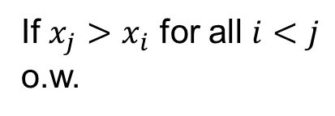
DP for LIS
Let OPT(j) be the longest increasing subsequence ending at j.
Observation: Suppose the OPT(j) is the sequence
$$x_{i_{1}}, x_{i_{2}},…,x_{i_{k}},x_{j}$$
Then, $x_{i_{1}}, x_{i_{2}},…,x_{i_{k}}$ is the longest increasing subsequence ending at $x_{i_{k}},$i.e., $OPT\left(j\right)=1+OPT(i_{k})$
$OPT\left(j\right)=\left\{\begin{aligned}1 \\ 1+\max_{i:x_{i}<x_{j}}{OPT(i)}\end{aligned}\right.$
Alternative Soln: This is a special case of Longest path in a DAG: Construct a graph 1,…n where $(i,j)$ is an edge if $i<j$ and $x_{i}<x_{j}.$
If $x_{j}>x_{i}$ for all $i<j$
o.w.

Slide 11
Shortest Paths with Negative Edge Weights

Slide 12
Shortest Paths with Neg Edge Weights
Given a weighted directed graph $G=\left(V,E\right)$ and a source vertex $s,$ where the weight of edge (u,v) is $c_{u,v}$ (that can be negative)
Goal: Find the shortest path from s to all vertices of G.
Recall that Dikjstra’s Algorithm fails when weights are negative
1
1
3
-2
3
-2
source
s
2
3
s
2
3
2
-1
-1
2
4
4

Slide 13
Impossibility on Graphs with Neg Cycles
Observation: No solution exists if G has a negative cycle.
This is because we can minimize the length by going over the cycle again and again.
So, suppose G does not have a negative cycle.
1
3
-2
s
2
3
2
-1
4

Slide 14
DP for Shortest Path (First Attempt)
Def: Let $OPT(v)$ be the length of the shortest $s$ - $v$ path
$$OPT\left(v\right)=\left\{\begin{matrix}0 if v=s \\ \min_{u:\left(u,v\right) an edge}{OPT\left(u\right)+c_{u,v}}\end{matrix}\right.$$
The formula is correct. But it is not clear how to compute it.

Slide 15
DP for Shortest Path
Def: Let $OPT(v,i)$ be the length of the shortest $s$ - $v$ path with at most $i$ edges.
Let us characterize $OPT(v,i).$
Case 1: $OPT(v,i)$ path has less than $i$ edges.
Then, $OPT\left(v,i\right)=OPT\left(v,i−1\right).$
Case 2: $OPT(v,i)$ path has exactly $i$ edges.
Let $s,v_{1},v_{2},…,v_{i−1},v$ be the $OPT(v,i)$path with $i$ edges.
Then, $s,v_{1},…,v_{i−1}$ must be the shortest $s$ - $v_{i−1}$ path with at most $i−1$ edges. So,
$$OPT\left(v,i\right)=OPT\left(v_{i−1},i−1\right)+c_{v_{i−1},v}$$

Slide 16
DP for Shortest Path
Def: Let $OPT(v,i)$ be the length of the shortest $s$ - $v$ path with at most $i$ edges.
$$OPT\left(v,i\right)=\left\{\begin{aligned}0 if v=s \\ ∞ if v≠s,i=0 \\ \min{(OPT\left(v,i−1\right),\min_{u:\left(u,v\right) an edge}{OPT\left(u,i−1\right)+c_{u,v}})}\end{aligned}\right.$$
So, for every v, $OPT\left(v,?\right)$ is the shortest path from s to v.
But how long do we have to run?
Since G has no negative cycle, it has at most $n−1$ edges. So,
$OPT(v,n−1)$ is the answer.

Slide 17
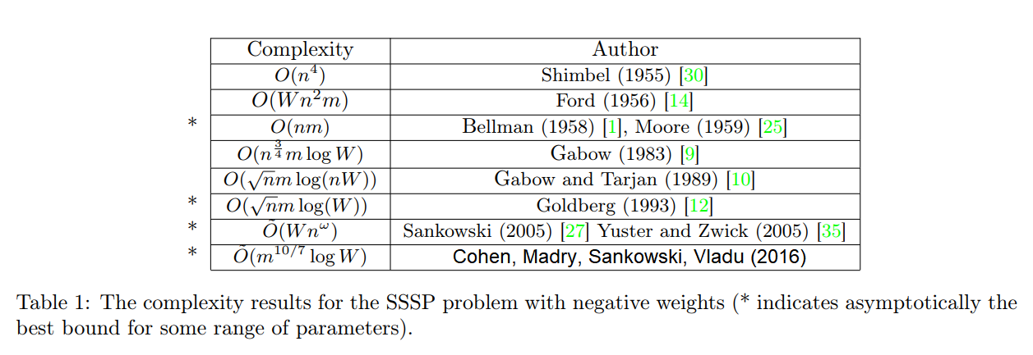
Bellman Ford Algorithm
for v=1 to n
if $v≠s$ then
M[v,0]=$∞$
M[s,0]=0.
for i=1 to n-1
for v=1 to n
M[v,i]=M[v,i-1]
for every edge (u,v)
M[v,i]=min(M[v,i], M[u,i-1]+c_{u,v})
Running Time: $O\left(nm\right)$
Can we test if G has negative cycles?
Yes, run for i=1…3n and see if the M[v,n-1] is different from M[v,3n]

Slide 18
DP Techniques Summary
Recipe:
Follow the natural induction proof.
Find out additional assumptions/variables/subproblems that you need to do the induction
Strengthen the hypothesis and define w.r.t. new subproblems
Dynamic programming techniques.
Whenever a problem is a special case of an NP-hard problem an ordering is important:
Adding a new variable: knapsack.
Dynamic programming over intervals: RNA secondary structure.
Top-down vs. bottom-up:
Different people have different intuitions
Bottom-up is useful to optimize the memory

