Slide 1
CSE 421 Algorithms
Richard Anderson
Lecture 18
Dynamic Programming

Slide 2
Announcements
Nov 11, No class (holiday)
HW 7 is available
5 dynamic programming problems

Slide 3
One dimensional dynamic programming: Interval scheduling
Opt[ j ] = max (Opt[ j – 1], w_{j} + Opt[ p[ j ] ])

Slide 4
Two dimensional dynamic programming
K-segment linear approximation
Opt_{k}[ j ] = min _{i} { Opt_{k-1}[ i ] + E_{i,j} } for 0 < i < j
4
3
2
1
 | 0 | 0 | 0 | 0 | 0 | 0 | 0 | 0 | 0 | 0 | 0 | 0 | 0 | 0 | 0 | 0 | 0

Slide 5
Two dimensional dynamic programming
Subset sum and knapsack
Opt[ j, K] = max(Opt[ j – 1, K], Opt[ j – 1, K – w_{j}] + w_{j})
Opt[ j, K] = max(Opt[ j – 1, K], Opt[ j – 1, K – w_{j}] + v_{j})
4
3
2
1
 | 0 | 0 | 0 | 0 | 0 | 0 | 0 | 0 | 0 | 0 | 0 | 0 | 0 | 0 | 0 | 0 | 0

Slide 6
Alternate approach for Subset Sum
Alternate formulation of Subset Sum dynamic programming algorithm
Sum[i, K] = true if there is a subset of {w₁,…w_{i}} that sums to exactly K, false otherwise
Sum [i, K] = Sum [i -1, K] OR Sum[i - 1, K - w_{i}]
Sum [0, 0] = true; Sum[i, 0] = false for i != 0
To count the number of solutions
Count [i, K] = Count [i -1, K] + Count[i - 1, K - w_{i}]
Count [0, 0] = 1; Count[i, 0] = 0 for i != 0
To allow for negative numbers, we need to fill in the array between K_{min} and K_{max}

Slide 7
Run time for Subset Sum
With n items and target sum K, the run time is O(nK)
If K is 1,000,000,000,000,000,000,000,000 this is very slow
Alternate brute force algorithm: examine all subsets: O(n2^{n})

Slide 8
Dynamic Programming Examples
Examples
Optimal Billboard Placement
Text, Solved Exercise, Pg 307
Linebreaking with hyphenation
Compare with HW problem 6, Pg 317
String approximation
Text, Solved Exercise, Page 309

Slide 9
Billboard Placement
Maximize income in placing billboards
b_{i} = (p_{i}, v_{i}), v_{i}: value of placing billboard at position p_{i}
Constraint:
At most one billboard every five miles
Example
{(6,5), (8,6), (12, 5), (14, 1)}

Slide 10
Design a Dynamic Programming Algorithm for Billboard Placement
Compute Opt[1], Opt[2], . . ., Opt[n]
What is Opt[k]?
Input b₁, …, b_{n}, where b_{i} = (p_{i}, v_{i}), position and value of billboard i

Slide 11
Solution
j = 0; // j is five miles behind the current position
// the last valid location for a billboard, if one placed at P[k]
for k := 1 to n
while (P[ j ] < P[ k ] – 5)
j := j + 1;
j := j – 1;
Opt[ k] = Max(Opt[ k-1] , V[ k ] + Opt[ j ]);

Slide 12
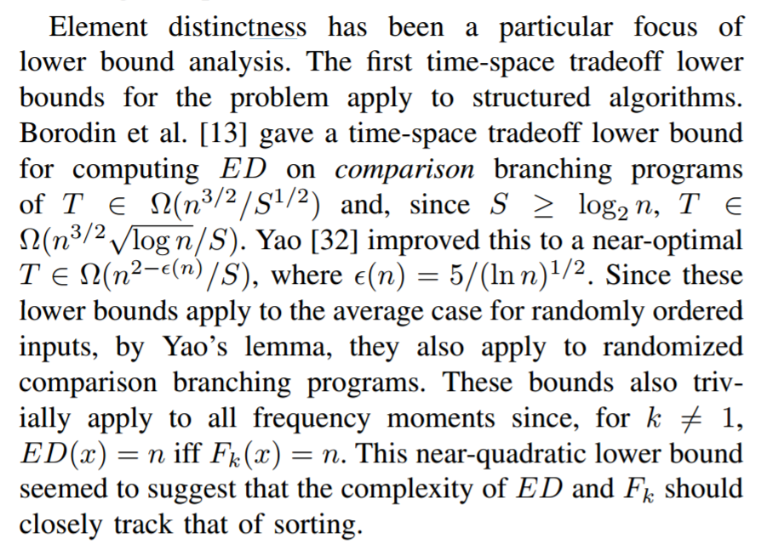
Optimal line breaking

Slide 13
String approximation
Given a string S, and a library of strings B = {b₁, …b_{m}}, construct an approximation of the string S by using copies of strings in B.
B = {abab, bbbaaa, ccbb, ccaacc}
S = abaccbbbaabbccbbccaabab

Slide 14
Formal Model
Strings from B assigned to non-overlapping positions of S
Strings from B may be used multiple times
Cost of δ for unmatched character in S
Cost of γ for mismatched character in S
MisMatch(i, j) – number of mismatched characters of b_{j}, when aligned starting with position i in s.

Slide 15
Design a Dynamic Programming Algorithm for String Approximation
Compute Opt[1], Opt[2], . . ., Opt[n]
What is Opt[k]?
Target string S = s₁s₂…s_{n}
Library of strings B = {b_{1,}…,b_{m}}
MisMatch(i,j) = number of mismatched characters with b_{j} when aligned
starting at position i of S.

Slide 16
Opt[k] = fun(Opt[0],…,Opt[k-1])
How is the solution determined from sub problems?
Target string S = s₁s₂…s_{n}
Library of strings B = {b_{1,}…,b_{m}}
MisMatch(i,j) = number of mismatched characters with b_{j} when aligned
starting at position i of S.

Slide 17
Solution
for i := 1 to n
Opt[k] = Opt[k-1] + δ;
for j := 1 to |B|
p = i – len(b_{j});
Opt[k] = min(Opt[k], Opt[p-1] + γ MisMatch(p, j));

Slide 18
Longest Common Subsequence
C=c₁…c_{g} is a subsequence of A=a₁…a_{m} if C can be obtained by removing elements from A (but retaining order)
LCS(A, B): A maximum length sequence that is a subsequence of both A and B
ocurranec
occurrence
attacggct
tacgacca

Slide 19
Determine the LCS of the following strings
BARTHOLEMEWSIMPSON
KRUSTYTHECLOWN

Slide 20
String Alignment Problem
Align sequences with gaps
Charge δ_{x} if character x is unmatched
Charge γ_{xy} if character x is matched to character y
CAT TGA AT
CAGAT AGGA
Note: the problem is often expressed as a minimization problem,
with γ_{xx} = 0 and δ_{x} > 0

Slide 21
LCS Optimization
A = a₁a₂…a_{m}
B = b₁b₂…b_{n}
Opt[ j, k] is the length of LCS(a₁a₂…a_{j}, b₁b₂…b_{k})

Slide 22
Optimization recurrence
If a_{j} = b_{k}, Opt[ j,k ] = 1 + Opt[ j-1, k-1 ]
If a_{j} != b_{k}, Opt[ j,k] = max(Opt[ j-1,k], Opt[ j,k-1])

Slide 23
Give the Optimization Recurrence for the String Alignment Problem
Charge δ_{x} if character x is unmatched
Charge γ_{xy} if character x is matched to character y
Opt[ j, k] =
Let a_{j} = x and b_{k} = y
Express as minimization
Opt[j,k] = max(γ_{xy} + Opt[j-1,k-1], δ_{x} + Opt[j-1, k], δ_{y} + Opt[j, k-1])

Slide 24
Dynamic Programming Computation

Slide 25
Code to compute Opt[j,k]

Slide 26
Storing the path information
A[1..m], B[1..n]
for i := 1 to m Opt[i, 0] := 0;
for j := 1 to n Opt[0,j] := 0;
Opt[0,0] := 0;
for i := 1 to m
for j := 1 to n
if A[i] = B[j] { Opt[i,j] := 1 + Opt[i-1,j-1]; Best[i,j] := Diag; }
else if Opt[i-1, j] >= Opt[i, j-1]
{ Opt[i, j] := Opt[i-1, j], Best[i,j] := Left; }
else { Opt[i, j] := Opt[i, j-1], Best[i,j] := Down; }
b₁…b_{n}
a₁…a_{m}

Slide 27
How good is this algorithm?
Is it feasible to compute the LCS of two strings of length 300,000 on a standard desktop PC? Why or why not.

