Slide 1
CSE 421 Algorithms
NP-Complete
P
Richard Anderson
Lecture 28
Survey of NP Complete Problems

Slide 2
Announcements
Final exam,
Monday, December 14, 2:30-4:20 pm
Comprehensive (2/3 post midterm, 1/3 pre midterm)
Review session
Friday, 3:30 – 5:00 pm. More 220
Online course evaluations available

Slide 3
NP Complete Problems
Circuit Satisfiability
Formula Satisfiability
3-SAT
Graph Problems
Independent Set
Vertex Cover
Clique
Path Problems
Hamiltonian cycle
Hamiltonian path
Partition Problems
Three dimensional matching
Exact cover
Graph Coloring
Number problems
Subset sum
Integer linear programming
Scheduling with release times and deadlines

Slide 4
Hamiltonian Circuit Problem
Hamiltonian Circuit – a simple cycle including all the vertices of the graph

Slide 5
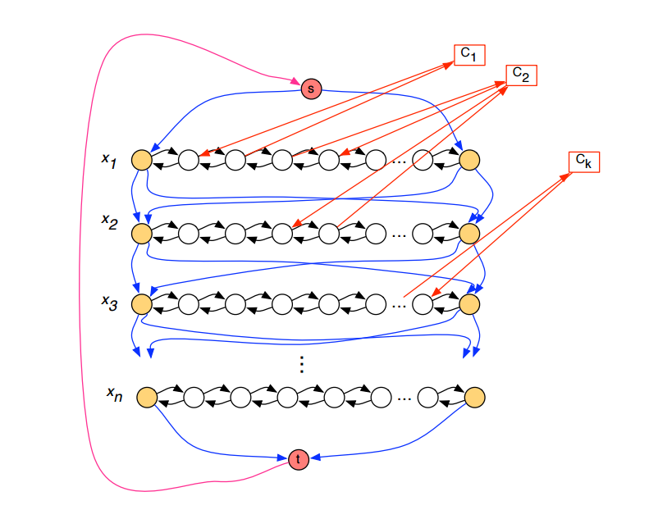
Thm: Hamiltonian Circuit is NP Complete
Reduction from 3-SAT

Slide 6
Reduce Hamiltonian Circuit to Hamiltonian Path
G₂ has a Hamiltonian Path iff G₁ has a Hamiltonian Circuit
s
t
v
v₁
v₂
x
y
z
x
y
z

Slide 7
Traveling Salesman Problem
Minimum cost tour highlighted
Given a complete graph with edge weights, determine the shortest tour that includes all of the vertices (visit each vertex exactly once, and get back to the starting point)
3
7
7
2
2
5
1
4
1
4
Find the minimum cost tour

Slide 8
Thm: HC <_{P} TSP

Slide 9
Matching
Two dimensional matching
Three dimensional matching (3DM)

Slide 10
3-SAT <_{P} 3DM
X
X
X
X
X
X
X
X
X True
X False
Truth Setting Gadget

Slide 11
3-SAT <_{P} 3DM
X
Y
Z
Clause gadget for (X OR Y OR Z)
Garbage Collection Gadget (Many copies)

Slide 12
Exact Cover (sets of size 3) XC3
Given a collection of sets of size 3 of a domain of size 3N, is there a sub-collection of N sets that cover the sets
(A, B, C), (D, E, F), (A, B, G), (A, C, I), (B, E, G), (A, G, I), (B, D, F), (C, E, I), (C, D, H), (D, G, I), (D, F, H), (E, H, I),
(F, G, H), (F, H, I)
3DM <_{P} XC3

Slide 13
Graph Coloring
NP-Complete
Graph K-coloring
Graph 3-coloring
Polynomial
Graph 2-Coloring

Slide 14
3-SAT <_{P} 3 Colorability
T
F
B
X
X
Y
Y
Y
Z
Z
X
T
Z
F
Truth Setting Gadget
Clause Testing Gadget

Slide 15
Number Problems
Subset sum problem
Given natural numbers w₁,. . ., w_{n} and a target number W, is there a subset that adds up to exactly W?
Subset sum problem is NP-Complete
Subset Sum problem can be solved in O(nW) time

Slide 16
XC3 <_{P} SUBSET SUM
Idea: Represent each set as a bit vector, then interpret the bit vectors as integers. Add them up to get the all one’s vector.
{x3, x5, x9} => 001010001000
Does there exist a subset that sums to exactly 111111111111?
Annoying detail: What about the carries?

Slide 17
Integer Linear Programming

Slide 18
Scheduling with release times and deadlines

