Slide 1
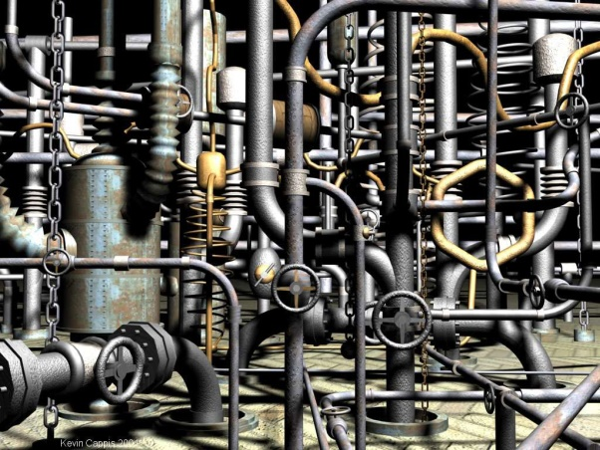
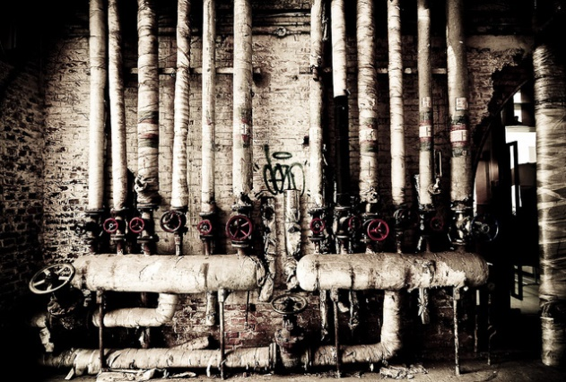
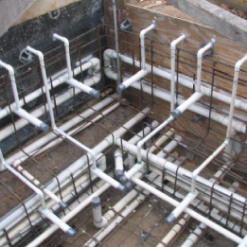
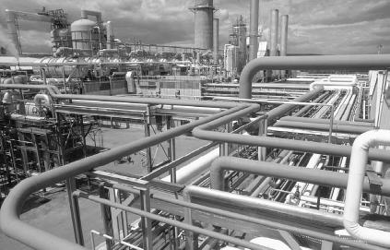
CSE 421 Algorithms
Richard Anderson
Lecture 22
Network Flow

Slide 2
Outline
Network flow definitions
Flow examples
Augmenting Paths
Residual Graph
Ford Fulkerson Algorithm
Cuts
Maxflow-MinCut Theorem

Slide 3
Network Flow Definitions
Capacity
Source, Sink
Capacity Condition
Conservation Condition
Value of a flow

Slide 4
Network Flow Definitions
Flowgraph: Directed graph with distinguished vertices s (source) and t (sink)
Capacities on the edges, c(e) >= 0
Problem, assign flows f(e) to the edges such that:
0 <= f(e) <= c(e)
Flow is conserved at vertices other than s and t
Flow conservation: flow going into a vertex equals the flow going out
The flow leaving the source is a large as possible

Slide 5
Find a maximum flow
Value of flow:
20
20
a
d
g
5
20
5
5
20
5
5
5
20
s
30
b
20
e
h
30
t
20
10
5
5
20
5
25
20
c
f
i
20
10
Construct a maximum flow and indicate the flow value

Slide 6
Find a maximum flow
20/20
20/20
a
d
g
0/5
0/5
20/20
20/20
5/5
0/5
0/5
5/5
0/20
s
25/30
b
20/20
e
h
30/30
t
20/20
0/5
5/5
20/20
0/5
0/5
15/20
15/25
c
f
i
20/20
10/10

Slide 7
Flow Example
u
u
20
10
20
10
s
30
t
s
30
t
10
20
10
20
v
v

Slide 8
Residual Graph
Flow graph showing the remaining capacity
Flow graph G, Residual Graph G_{R}
G: edge e from u to v with capacity c and flow f
G_{R}: edge e’ from u to v with capacity c – f
G_{R}: edge e’’ from v to u with capacity f

Slide 9
Flow assignment and the residual graph
u
u
15/20
0/10
5
10
15
s
15/30
t
15
15
s
t
5
5/10
20/20
5
20
v
v

Slide 10
Augmenting Path Algorithm
Augmenting path
Vertices v₁,v₂,…,v_{k}
v₁ = s, v_{k} = t
Possible to add b units of flow between v_{j} and v_{j+1} for j = 1 … k-1
u
10/20
0/10
s
10/30
t
5/10
15/20
v

Slide 11
Build the residual graph
3/5
d
g
2/4
3/3
s
1/5
1/5
1/1
t
3/3
e
h
2/5
1/1
Residual graph:
d
g
s
t
e
h

Slide 12
Find two augmenting paths
2/5
2/2
0/1
2/4
3/4
3/4
3/3
1/3
1/3
3/3
s
t
3/3
2/2
3/3
1/3
3/3
1/3
2/2
1/3

Slide 13
Augmenting Path Lemma
Let P = v₁, v₂, …, v_{k} be a path from s to t with minimum capacity b in the residual graph.
b units of flow can be added along the path P in the flow graph.
u
u
5
10
15/20
0/10
15
s
15
15
t
s
15/30
t
5
5
20
5/10
20/20
v
v

Slide 14
Proof
Add b units of flow along the path P
What do we need to verify to show we have a valid flow after we do this?

Slide 15
Ford-Fulkerson Algorithm (1956)
while not done
Construct residual graph G_{R}
Find an s-t path P in G_{R} with capacity b > 0
Add b units along in G
If the sum of the capacities of edges leaving S is at most C, then the algorithm takes at most C iterations

Slide 16
Cuts in a graph
Cut: Partition of V into disjoint sets S, T with s in S and t in T.
Cap(S,T): sum of the capacities of edges from S to T
Flow(S,T): net flow out of S
Sum of flows out of S minus sum of flows into S
Flow(S,T) <= Cap(S,T)

Slide 17
What is Cap(S,T) and Flow(S,T)
S={s, a, b, e, h}, T = {c, f, i, d, g, t}
20/20
20/20
a
d
g
0/5
0/5
20/20
20/20
5/5
0/5
0/5
5/5
0/20
s
25/30
b
20/20
e
h
30/30
t
20/20
0/5
5/5
20/20
0/5
0/10
15/20
15/25
c
f
i
20/20
10/10

Slide 18
Minimum value cut
u
40
10
s
10
t
10
40
v

Slide 19
Find a minimum value cut
6
6
5
8
10
3
6
s
7
2
t
4
5
3
8
5
4

Slide 20
MaxFlow – MinCut Theorem
There exists a flow which has the same value of the minimum cut
Proof: Consider a flow where the residual graph has no s-t path with positive capacity
Let S be the set of vertices in G_{R} reachable from s with paths of positive capacity
s
t

Slide 21
Let S be the set of vertices in G_{R} reachable from s with paths of positive capacity
s
u
v
t
S
T
Cap(u,v) = 0 in G_{R}
Cap(u,v) = Flow(u,v) in G
Flow(v,u) = 0 in G
What can we say about the flows and capacity
between u and v?

Slide 22
Max Flow - Min Cut Theorem
Ford-Fulkerson algorithm finds a flow where the residual graph is disconnected, hence FF finds a maximum flow.
If we want to find a minimum cut, we begin by looking for a maximum flow.

Slide 23
Performance
The worst case performance of the Ford-Fulkerson algorithm is horrible
u
1000
1000
s
1
t
1000
1000
v

Slide 24
Better methods of finding augmenting paths
Find the maximum capacity augmenting path
O(m²log(C)) time algorithm for network flow
Find the shortest augmenting path
O(m²n) time algorithm for network flow
Find a blocking flow in the residual graph
O(mnlog n) time algorithm for network flow

