Slide 1
CSE 421 Algorithms
Autumn 2015
Lecture 9
Dijkstra’s algorithm

Slide 2
Last Week – Greedy Algorithms
Task scheduling to minimize maximum lateness
Interchange lemma
Farthest in the future algorithm for optimal caching
Discard element whose first occurrence is last in the sequence
j
i
i
j
d_{i} d_{j}
d_{i} d_{j}
A, B, C, A, C, D, C, B, C, A, D

Slide 3
Announcement
Collaboration Policy
Discussing problems with other students is okay
Write ups must be done independently
Acknowledge people you work with

Slide 4
This week
Topics
Dijkstra’s Algorithm (Section 4.4)
Wednesday: Shortest Paths / Minimum Spanning Trees
Friday: Minimum Spanning Trees
Reading
4.4, 4.5, 4.7, 4.8

Slide 5
Single Source Shortest Path Problem
Given a graph and a start vertex s
Determine distance of every vertex from s
Identify shortest paths to each vertex
Express concisely as a “shortest paths tree”
Each vertex has a pointer to a predecessor on shortest path
1
u
u
1
2
3
5
s
x
s
x
3
4
3
v
v

Slide 6
Construct Shortest Path Tree from s
2
d
d
a
1
5
a
4
4
4
e
e
-3
c
s
-2
c
3
s
3
2
6
g
g
b
b
7
3
f
f

Slide 7
Warmup
If P is a shortest path from s to v, and if t is on the path P, the segment from s to t is a shortest path between s and t
WHY?
v
t
s

Slide 8
Dijkstra’s Algorithm
Assume all edges have non-negative cost
S = {}; d[s] = 0; d[v] = infinity for v != s
While S != V
Choose v in V-S with minimum d[v]
Add v to S
For each w in the neighborhood of v
d[w] = min(d[w], d[v] + c(v, w))
4
3
y
1
1
u
1
0
1
s
4
2
2
x
2
2
v
2
3
z
5

Slide 9
Simulate Dijkstra’s algorithm (starting from s) on the graph
Round
Vertex Added
s
a
b
c
d
1
c
1
2
3
4
5
a
1
3
2
s
4
1
4
6
1
b
d
3

Slide 10
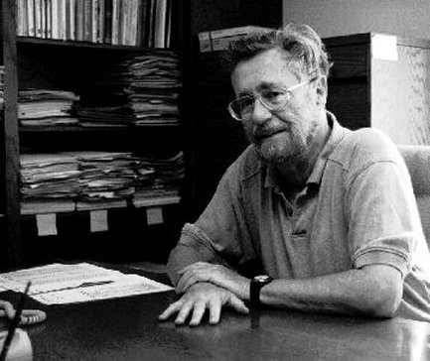
Who was Dijkstra?
What were his major contributions?

Slide 11
http://www.cs.utexas.edu/users/EWD/
Edsger Wybe Dijkstra was one of the most influential members of computing science's founding generation. Among the domains in which his scientific contributions are fundamental are
algorithm design
programming languages
program design
operating systems
distributed processing
formal specification and verification
design of mathematical arguments

Slide 12
Dijkstra’s Algorithm as a greedy algorithm
Elements committed to the solution by order of minimum distance

Slide 13
Correctness Proof
Elements in S have the correct label
Key to proof: when v is added to S, it has the correct distance label.
y
x
s
u
v

Slide 14
Proof
Let v be a vertex in V-S with minimum d[v]
Let P_{v} be a path of length d[v], with an edge (u,v)
Let P be some other path to v. Suppose P first leaves S on the edge (x, y)
P = P_{sx} + c(x,y) + P_{yv}
Len(P_{sx}) + c(x,y) >= d[y]
Len(P_{yv}) >= 0
Len(P) >= d[y] + 0 >= d[v]
y
x
s
u
v

Slide 15
Negative Cost Edges
Draw a small example a negative cost edge and show that Dijkstra’s algorithm fails on this example

Slide 16
Bottleneck Shortest Path
Define the bottleneck distance for a path to be the maximum cost edge along the path
u
6
5
s
2
5
x
3
4
v

Slide 17
Compute the bottleneck shortest paths
6
d
d
a
6
5
a
4
4
4
e
e
-3
c
s
-2
c
3
s
3
2
6
g
g
b
b
7
4
f
f

Slide 18
How do you adapt Dijkstra’s algorithm to handle bottleneck distances
Does the correctness proof still apply?

