Slide 1
Lecture 28: Final Exam Review
Nathan Brunelle & Glenn Sun

Slide 2
Final reminders
HW8 due Today 12/05 @ 11:59pm
Final Exam on Monday 12/08 at 8:30am in CSE2 G10 (this room!)
Practice Final is available
We’re discussing it today!
I have OH now-12:30pm:
Meet at front of classroom, we’ll walk over together
CSE (Allen) 434 if you’re coming later
Glenn has online OH 12–1pm

Slide 3
What to expect on the final
8 questions worth 8 ESNU grades
1:50 minutes to complete (from 8:30am-10:20am)
Averages just under 14 minutes per question
Questions roughly parallel those in the practice exam (same focal topics, same types of tasks, different details and/or secondary concepts included)
2 Pages of references allowed! (at request of one of your classmates)

Slide 4
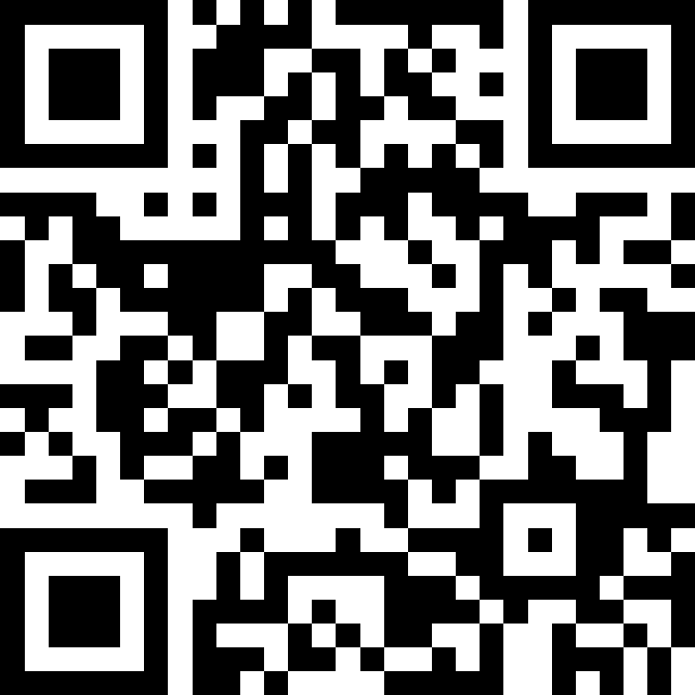
Ask Questions on Slido!
sli.do
#cse417

