Slide 1
Lecture 27: Proving things hard
Glenn Sun

Slide 2
Logistics
Practice final has been released!
This Friday’s lecture: Review session
The last Concept Check quiz is to complete the course evaluation.
Is anonymous (we see who completed it, but not who said what)
Due Monday night (after finals) 11:59pm
Not open yet (?)

Slide 3
What is an algorithm?

Slide 4
What is an algorithm?
First day of class:
​Algorithm: A list of unambiguous instructions to solve a class of computational problems.
If our goal is to prove something about “all algorithms”, we need to know precisely what an algorithm formally is.
What does it mean for a problem to be computational?
What are instructions?

Slide 5
Rigorously defining “algorithm”
Here are a modern-day attempt:
An algorithm is a Java program that successfully compiles (possibly non-terminating or having runtime errors)
A problem is a mathematical function that maps binary strings to binary strings. (Inputs/outputs encoded in binary.)
The algorithm solves the problem if for all inputs, when running the algorithm, it terminates, has no runtime errors, and matches the expected output of the problem.
🤔
✅
🤔

Slide 6
Rigorously defining “algorithm”
Our first definition required:
Understanding the Java spec
Understanding how a computer runs Java code
This is mathematically rigorous.
But this is extraordinarily complicated for defining “algorithm”!
1936: Alan Turing invents the Turing machine!

Slide 7
Turing machines
page 3
In step [A], given that [X] is written on the page, the “algorithm” tells me:
What to write on the page
If I should turn the page forward/backwards
What step to go to next
👀
page 4
✏️
page 5

Slide 8
Turing machines
1
page 32495
In step [A], given that [X] is written on the page, the “algorithm” tells me:
What to write on the page
If I should turn the page forward/backwards
What step to go to next
0
👀
page 32496
✏️
0
page 32497

Slide 9
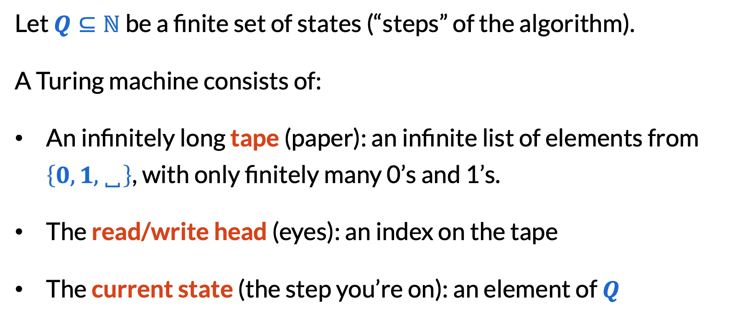
Mathematical formalism of Turing machines
Let $Q⊆ℕ$ be a finite set of states (“steps” of the algorithm).
A Turing machine consists of:
An infinitely long tape (paper): an infinite list of elements from $\left\{0, 1,␣\right\}$, with only finitely many 0’s and 1’s.
The read/write head (eyes): an index on the tape
The current state (the step you’re on): an element of $Q$

Slide 10

Mathematical formalism of Turing machines
An algorithm or program on a Turing machine is a function (often called a transition function):
$δ :Q × \left\{0, 1,␣\right\}→\left\{0, 1,␣\right\} × \left\{L,R,N\right\} × Q$
Inputs:
current state
what’s written on the tape at the read/write head
Outputs:
what to write
how to move the read/ write head
new state

Slide 11
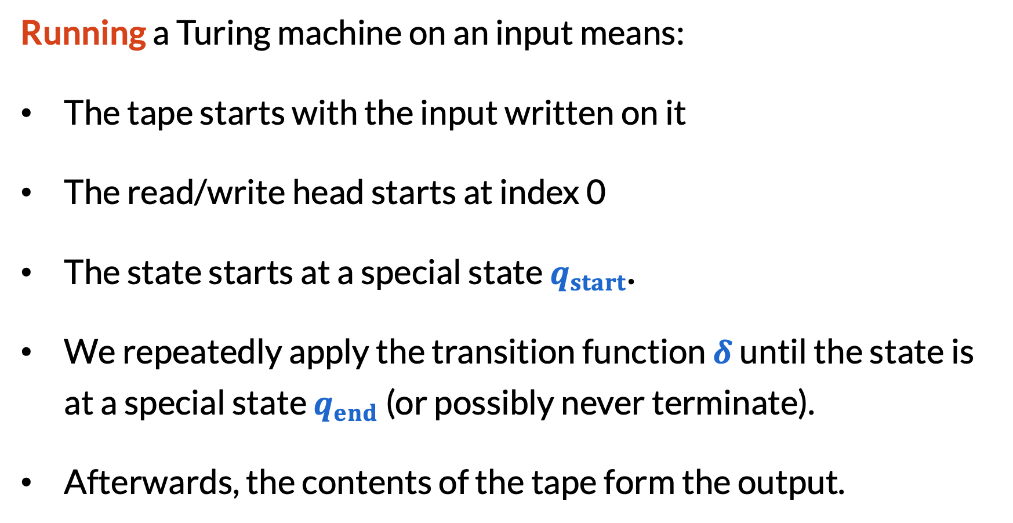
Mathematical formalism of Turing machines
Running a Turing machine on an input means:
The tape starts with the input written on it
The read/write head starts at index 0
The state starts at a special state $q_{start}$.
We repeatedly apply the transition function $δ$until the state is at a special state $q_{end}$ (or possibly never terminate).
Afterwards, the contents of the tape form the output.

Slide 12
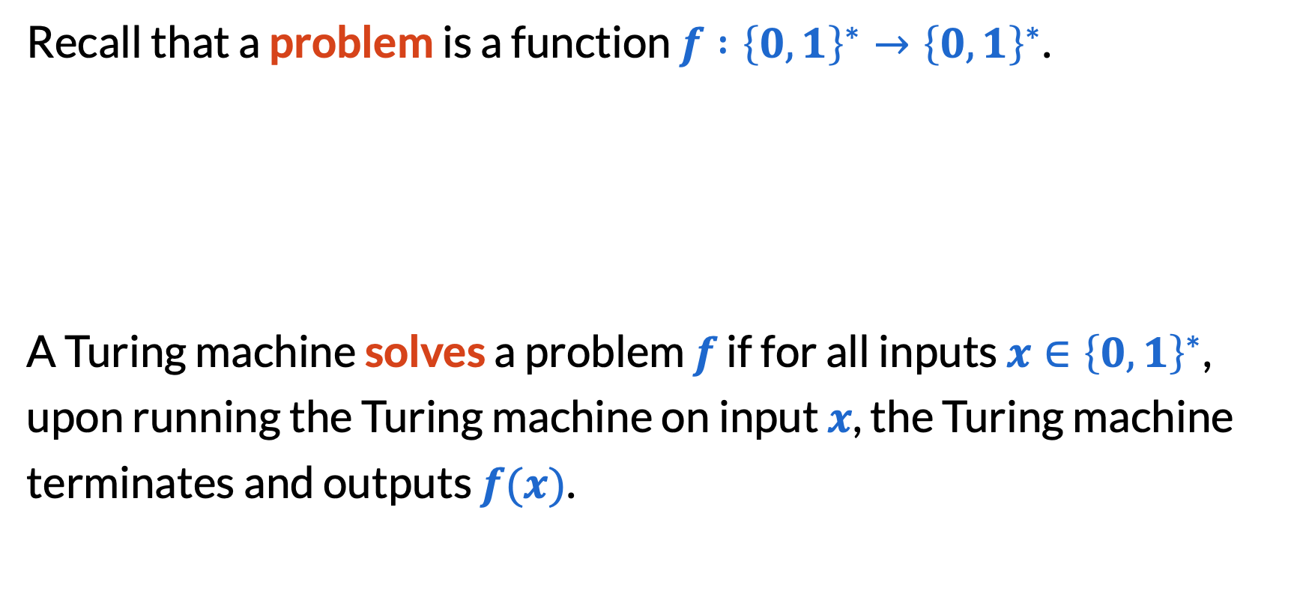
Mathematical formalism of Turing machines
Recall that a problem is a function $f :{\left\{0, 1\right\}}^{∗}→{\left\{0,1\right\}}^{∗}$.
A Turing machine solves a problem $f$ if for all inputs ${x∈\left\{0, 1\right\}}^{∗}$, upon running the Turing machine on input $x$, the Turing machine terminates and outputs $f(x)$.
set of all binary strings

Slide 13
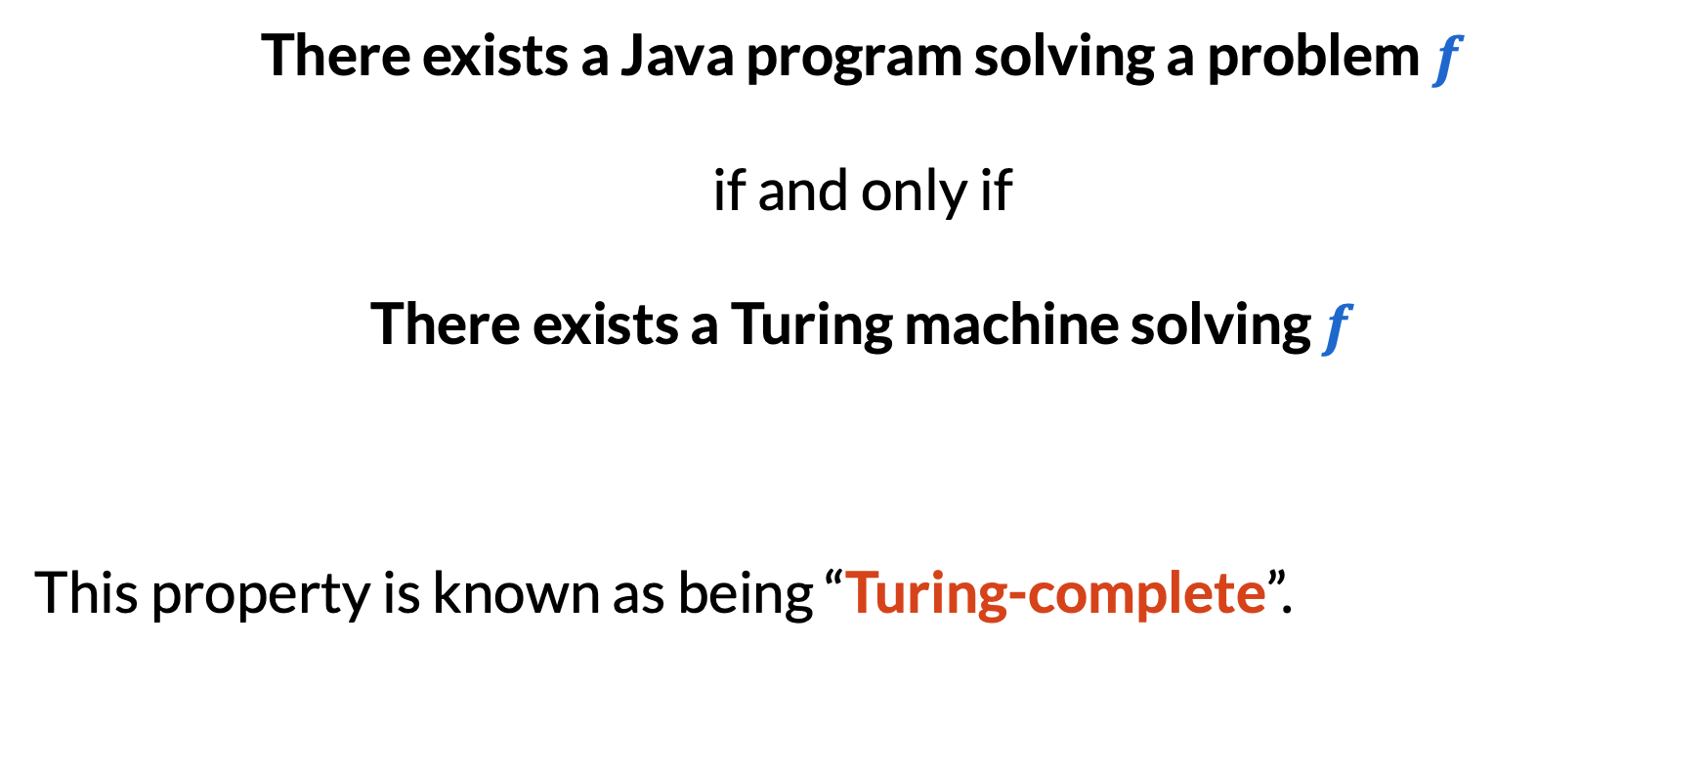
Equivalence of computational models
There exists a Java program solving a problem $f$
if and only if
There exists a Turing machine solving $f$
This property is known as being “Turing-complete”.

Slide 14
Why Turing machines?
A Turing machine is a simple model of a computer.
Hard to write algorithms for, because there are so few features.
Easy (-er) to use whenever talking about “all algorithms”, because there are so few features!

Slide 15
NP-hardness

Slide 16
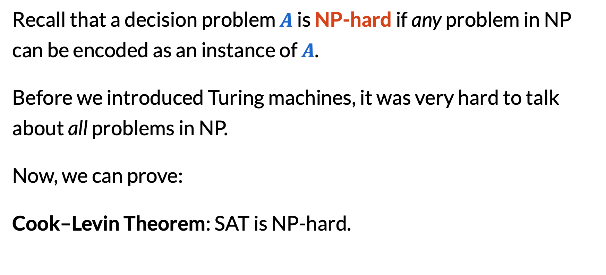
SAT is NP-hard
Recall that a decision problem $A$ is NP-hard if any problem in NP can be encoded as an instance of $A$.
Before we introduced Turing machines, it was very hard to talk about all problems in NP.
Now, we can prove:
Cook–Levin Theorem: SAT is NP-hard.

Slide 17
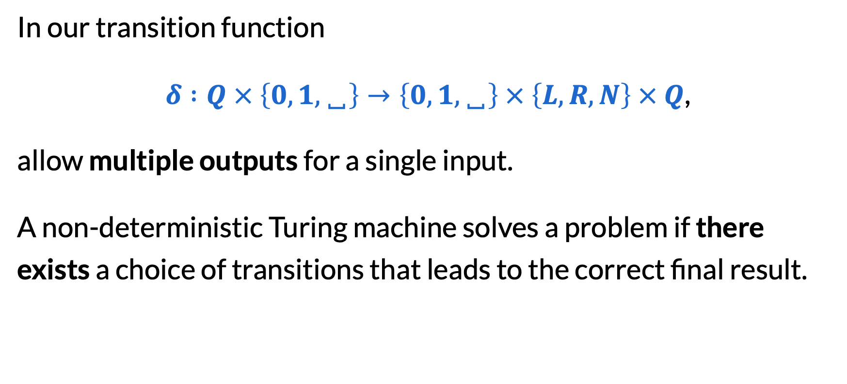
Non-deterministic Turing machines
In our transition function
$δ :Q × \left\{0, 1,␣\right\}→\left\{0, 1,␣\right\} × \left\{L,R,N\right\} × Q$,
allow multiple outputs for a single input.
A non-deterministic Turing machine solves a problem if there exists a choice of transitions that leads to the correct final result.

Slide 18
Two definition of NP
The following are equivalent definitions for a decision problem being in NP:
Sample solutions can be checked in polynomial time.
A non-deterministic TM solves it in polynomial time.
Intuitively:
guessing a sample solution ≈ guessing the right transitions

Slide 19
Cook–Levin theorem
Theorem. SAT is NP-hard.
Consider a non-deterministic Turing machine solving a problem in polynomial time, and run it on a sample input.
Construct a circuit that: given a record of the Turing machine’s tape/state over time, check that (1) it followed the transition function and (2) ended up returning “yes”.
Use Tseitin transformations to turn it into a SAT formula.
The SAT formula is satisfiable iff the original input is “yes”!

Slide 20
Proving NP-hardness after SAT
No more need to reason about all algorithms: use reductions!
A reduction from A to B is a way of solving A using B.
We’ve done:
Reductions to graph problems
Reductions to network flows
Reductions to SAT

Slide 21
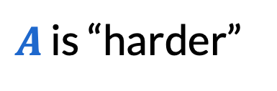
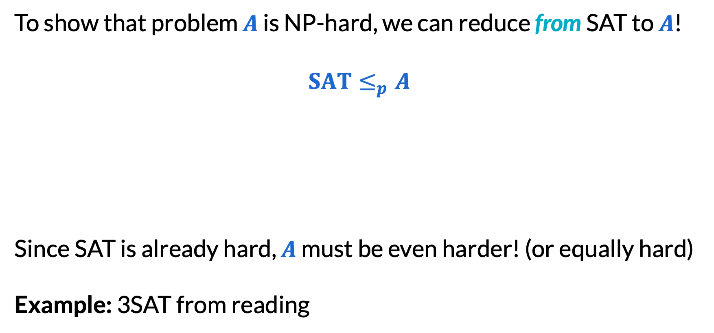
Proving NP-hardness after SAT
To show that problem $A$ is NP-hard, we can reduce from SAT to $A$!
$SAT≤_{p}A$
Since SAT is already hard, $A$ must be even harder! (or equally hard)
Example: 3SAT from reading
SAT is “easier”
$A$ is “harder”

Slide 22
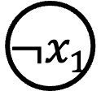
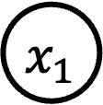
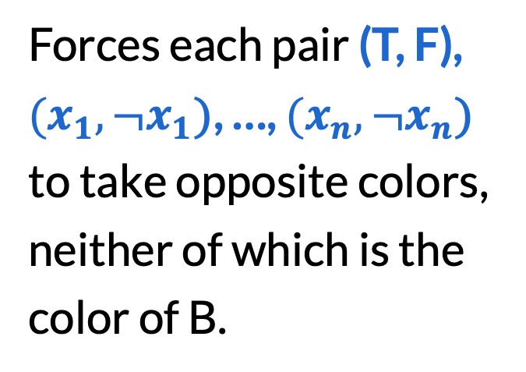
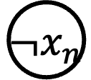
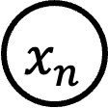
3-coloring is NP-hard
We need to solve SAT using 3-coloring.
T
F
Forces each pair (T, F), $(x_{1},{¬x}_{1}\text{)}$, …, $(x_{n},{¬x}_{n}\text{)}$ to take opposite colors, neither of which is the color of B.
B
${¬x}_{n}$
$x_{1}$
$x_{n}$
${¬x}_{1}$
…

Slide 23
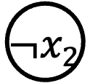
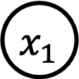
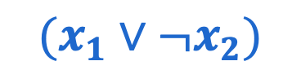
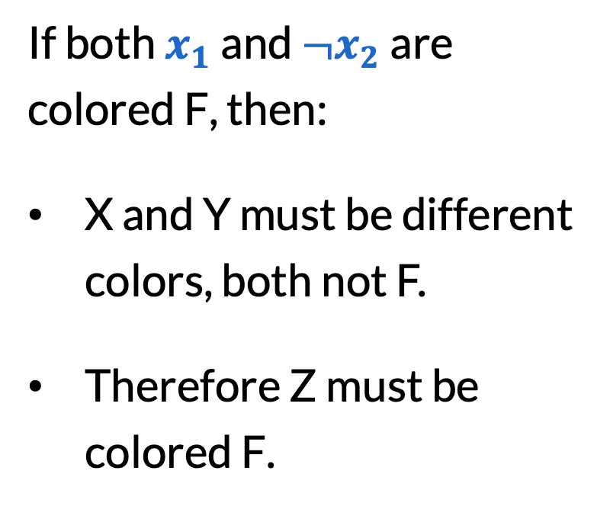
3-coloring is NP-hard
Imagine you had a clause $(x_{1}∨¬x_{2})$.
If both $x_{1}$ and ${¬x}_{2}$ are colored F, then:
X and Y must be different colors, both not F.
Therefore Z must be colored F.
$x_{1}$
X
Z
${¬x}_{2}$
Y
$$(x_{1}∨¬x_{2})$$

Slide 24
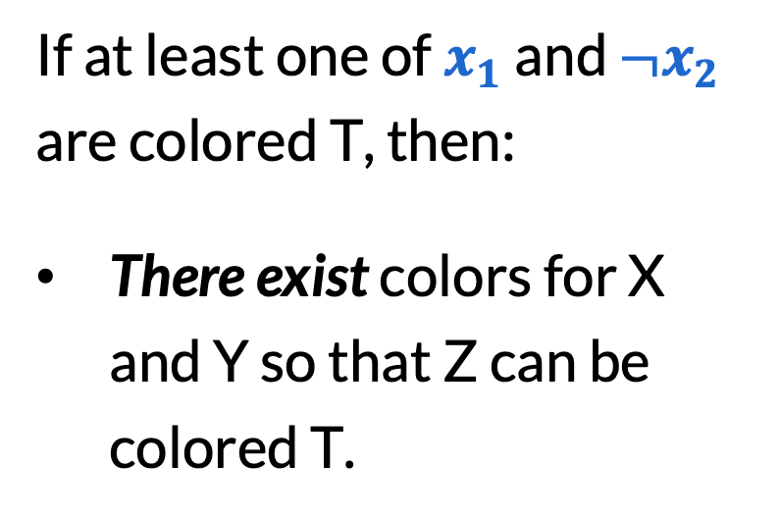
3-coloring is NP-hard
Imagine you had a clause $(x_{1}∨¬x_{2})$.
If at least one of $x_{1}$ and ${¬x}_{2}$ are colored T, then:
There exist colors for X and Y so that Z can be colored T.
$x_{1}$
X
Z
${¬x}_{2}$
Y
$$(x_{1}∨¬x_{2})$$

Slide 25
3-coloring is NP-hard
Imagine you had a clause $(x_{1}∨¬x_{2})$.
T
F
$x_{1}$
A
These connections mean: C must be colored T!
C
B
${¬x}_{2}$
B
The final graph after converting all clauses is 3-colorable iff the original SAT instance is satisfiable. Thus, 3-coloring is NP-complete!

Slide 26
Uncomputability

Slide 27
Some infinities are larger than others
Q: Are there more even numbers or natural numbers?
A: Both sets are infinite. Because we can pair them up, we say they are the same size:
0 | 1 | 2 | 3 | 4 | 5 | 6 | 7 | 8 | 9
0 | 2 | 4 | 6 | 8 | 10 | 12 | 14 | 16 | 18

Slide 28
Some infinities are larger than others
Q: Are there more real numbers or natural numbers?
A: Although both sets are infinite, there are more real numbers!
In fact, there are more real numbers just between 0 and 1 than there are natural numbers!

Slide 29
Some infinities are larger than others
Suppose for contradiction, I could pair up real numbers between 0 and 1 with the natural numbers.
0 | 0. | 5 | 2 | 4 | 1 | 3 | 5 | …
1 | 0. | 8 | 2 | 3 | 7 | 2 | 3 | …
2 | 0. | 9 | 4 | 0 | 5 | 0 | 7 | …
3 | 0. | 6 | 8 | 0 | 5 | 1 | 3 | …
4 | 0. | 4 | 8 | 2 | 1 | 8 | 0 | …
5 | 0. | 9 | 4 | 6 | 2 | 2 | 4 | …
The number 0.631695… is missing from this list, contradiction!

Slide 30
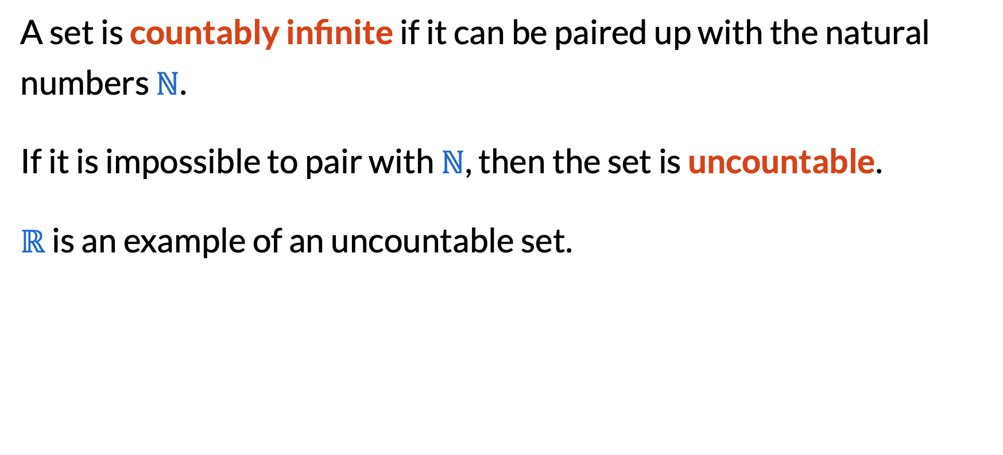
Countable vs. uncountable infinity
A set is countably infinite if it can be paired up with the natural numbers $ℕ$.
If it is impossible to pair with $ℕ$, then the set is uncountable.
$ℝ$ is an example of an uncountable set.

Slide 31
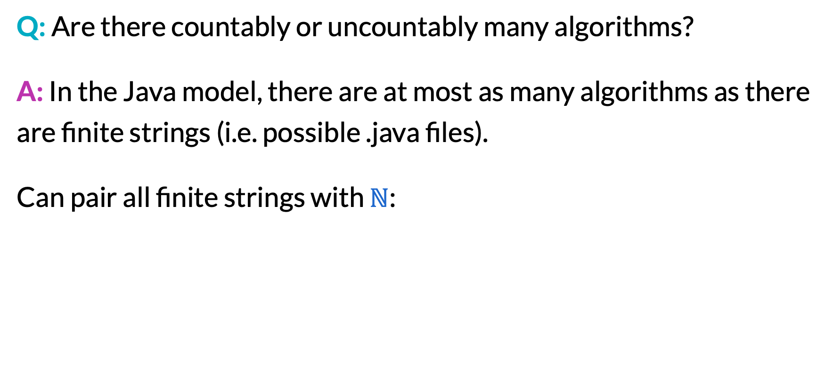
Infinities in computability
Q: Are there countably or uncountably many algorithms?
A: In the Java model, there are at most as many algorithms as there are finite strings (i.e. possible .java files).
Can pair all finite strings with $ℕ$:
0 | 1 | 2 | 3 | 4 | 5 | 6 | 7 | 8 | 9 | 10 | …
0 | 1 | 00 | 01 | 10 | 11 | 000 | 001 | 010 | 011 | 100 | …

Slide 32
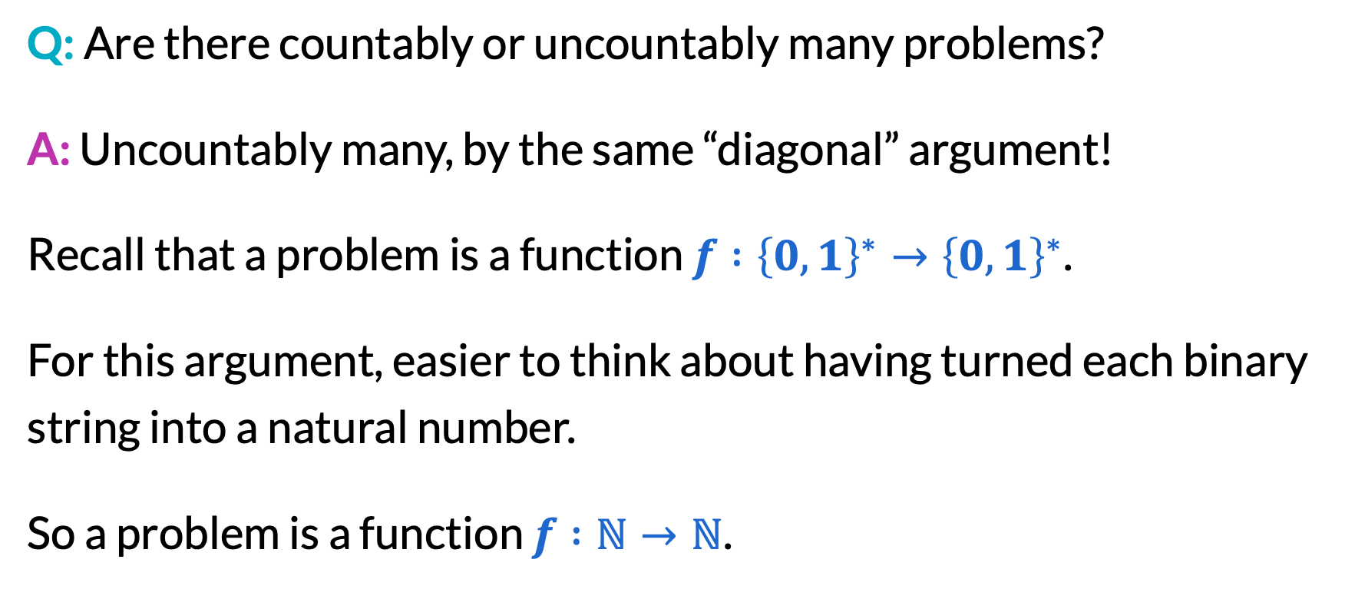
Infinities in computability
Q: Are there countably or uncountably many problems?
A: Uncountably many, by the same “diagonal” argument!
Recall that a problem is a function $f :{\left\{0, 1\right\}}^{∗}→{\left\{0,1\right\}}^{∗}$.
For this argument, easier to think about having turned each binary string into a natural number.
So a problem is a function $f :ℕ→ℕ$.

Slide 33
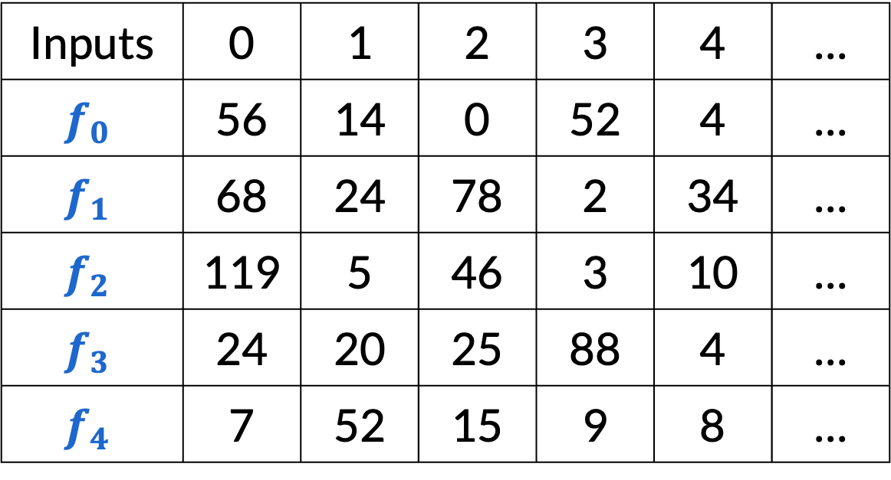


Infinities in computability
Suppose for contradiction, I could pair up all functions $f :ℕ→ℕ$ with the natural numbers.
Inputs | 0 | 1 | 2 | 3 | 4 | …
$$f_{0}$$ | 56 | 14 | 0 | 52 | 4 | …
$$f_{1}$$ | 68 | 24 | 78 | 2 | 34 | …
$$f_{2}$$ | 119 | 5 | 46 | 3 | 10 | …
$$f_{3}$$ | 24 | 20 | 25 | 88 | 4 | …
$$f_{4}$$ | 7 | 52 | 15 | 9 | 8 | …
The function $f\left(x\right)=f_{x}\left(x\right)+1$ is missing from this list, contradiction!

Slide 34
Most problems are not computable!
Because there are countably many algorithms and uncountably many problems, “most” problems are actually not computable!
But: Luckily, most “interesting” problems are computable, as we saw throughout this course.

Slide 35
Halting problem
Explicit example of an uncomputable problem:
Input: A description of an algorithm (i.e. Java file) that takes all binary strings as possible input.
Goal: Does the algorithm terminate (halt) for all inputs?
You can prove this with a “diagonal argument” similar to before.

Slide 36
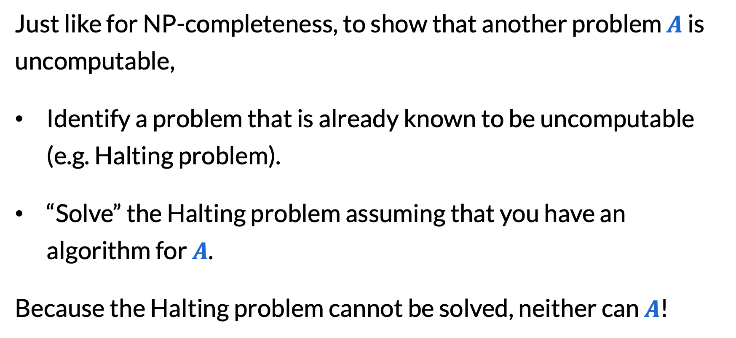
Reductions for uncomputability
Just like for NP-completeness, to show that another problem $A$ is uncomputable,
Identify a problem that is already known to be uncomputable (e.g. Halting problem).
“Solve” the Halting problem assuming that you have an algorithm for $A$.
Because the Halting problem cannot be solved, neither can $A$!

Slide 37
Final reminders
All homework/resubmissions due Friday @ 11:59pm!
Final exam review on Friday.
I have OH now-12:30pm:
Meet at front of classroom, we’ll walk over together
CSE (Allen) 214 if you’re coming later
Nathan has online OH 12–1pm:
https://washington.zoom.us/my/nathanbrunelle

