Slide 1
Lecture 26: How SAT solvers work
Glenn Sun

Slide 2
Review of last lecture

Slide 3
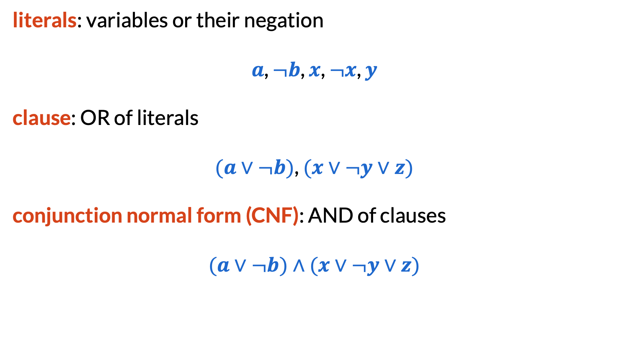
SAT (Satisfiability)
literals: variables or their negation
$a$, $¬b$, $x$, $¬x$, $y$
clause: OR of literals
$(a∨¬b)$, $(x∨¬y∨z)$
conjunction normal form (CNF): AND of clauses
$(a∨¬b)∧(x∨¬y∨z)$

Slide 4
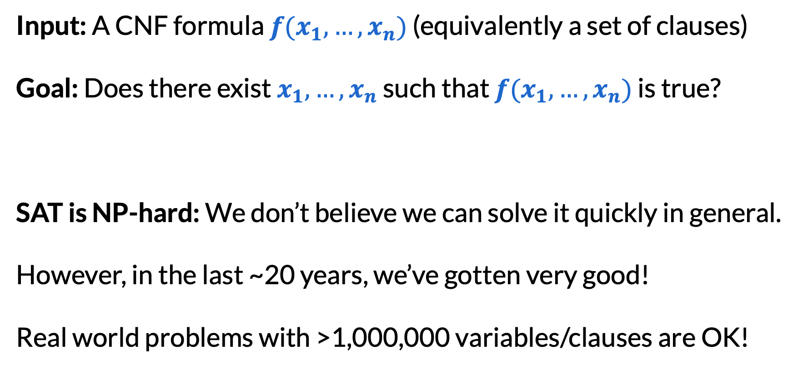
SAT (Satisfiability)
Input: A CNF formula $f(x_{1},…,x_{n})$ (equivalently a set of clauses)
Goal: Does there exist $x_{1},…,x_{n}$ such that $f(x_{1},…,x_{n})$ is true?
SAT is NP-hard: We don’t believe we can solve it quickly in general.
However, in the last ~20 years, we’ve gotten very good!
Real world problems with >1,000,000 variables/clauses are OK!

Slide 5
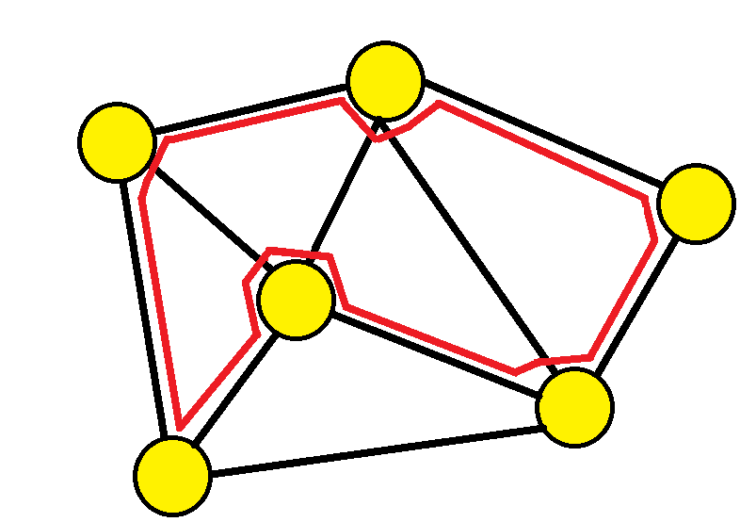

Hamiltonian path
Input: An undirected graph with vertices $V$ and edges $E$
Goal: Is there a path that uses every vertex exactly once?
Also an NP-hard problem!

Slide 6
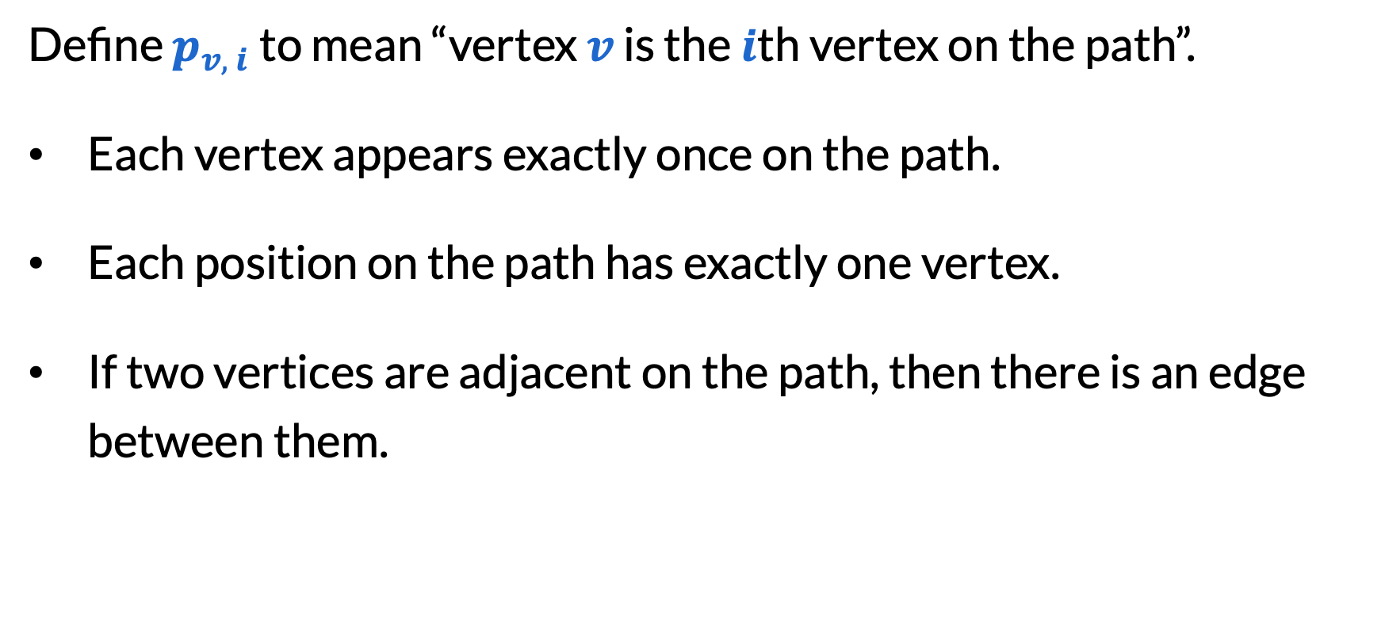
Hamiltonian path
Define $p_{v, i}$ to mean “vertex $v$ is the $i$th vertex on the path”.
Each vertex appears exactly once on the path.
Each position on the path has exactly one vertex.
If two vertices are adjacent on the path, then there is an edge between them.

Slide 7
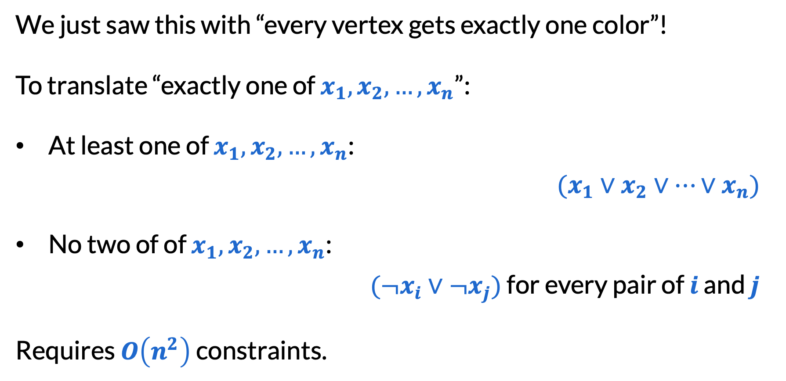
“Exactly one” constraints
We just saw this with “every vertex gets exactly one color”!
To translate “exactly one of $x_{1},x_{2},…,x_{n}$”:
At least one of $x_{1},x_{2},…,x_{n}$:
$(x_{1}∨x_{2}∨…∨x_{n})$
No two of of $x_{1},x_{2},…,x_{n}$:
$(¬x_{i}∨¬x_{j})$ for every pair of $i$ and $j$
Requires $O\left(n^{2}\right)$ constraints.

Slide 8
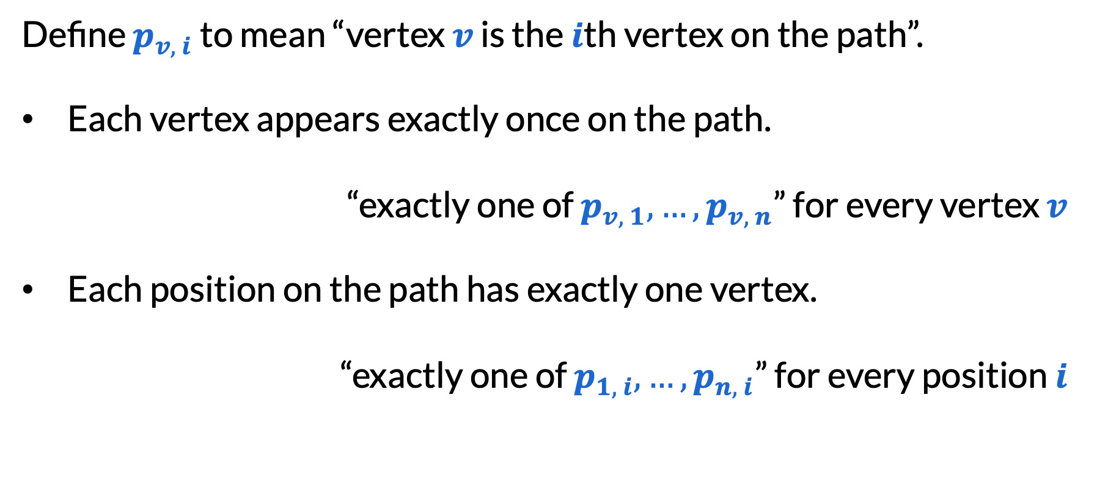
Hamiltonian path
Define $p_{v, i}$ to mean “vertex $v$ is the $i$th vertex on the path”.
Each vertex appears exactly once on the path.
“exactly one of $p_{v, 1},…,p_{v, n}$” for every vertex $v$
Each position on the path has exactly one vertex.
“exactly one of $p_{1, i},…,p_{n, i}$” for every position $i$

Slide 9
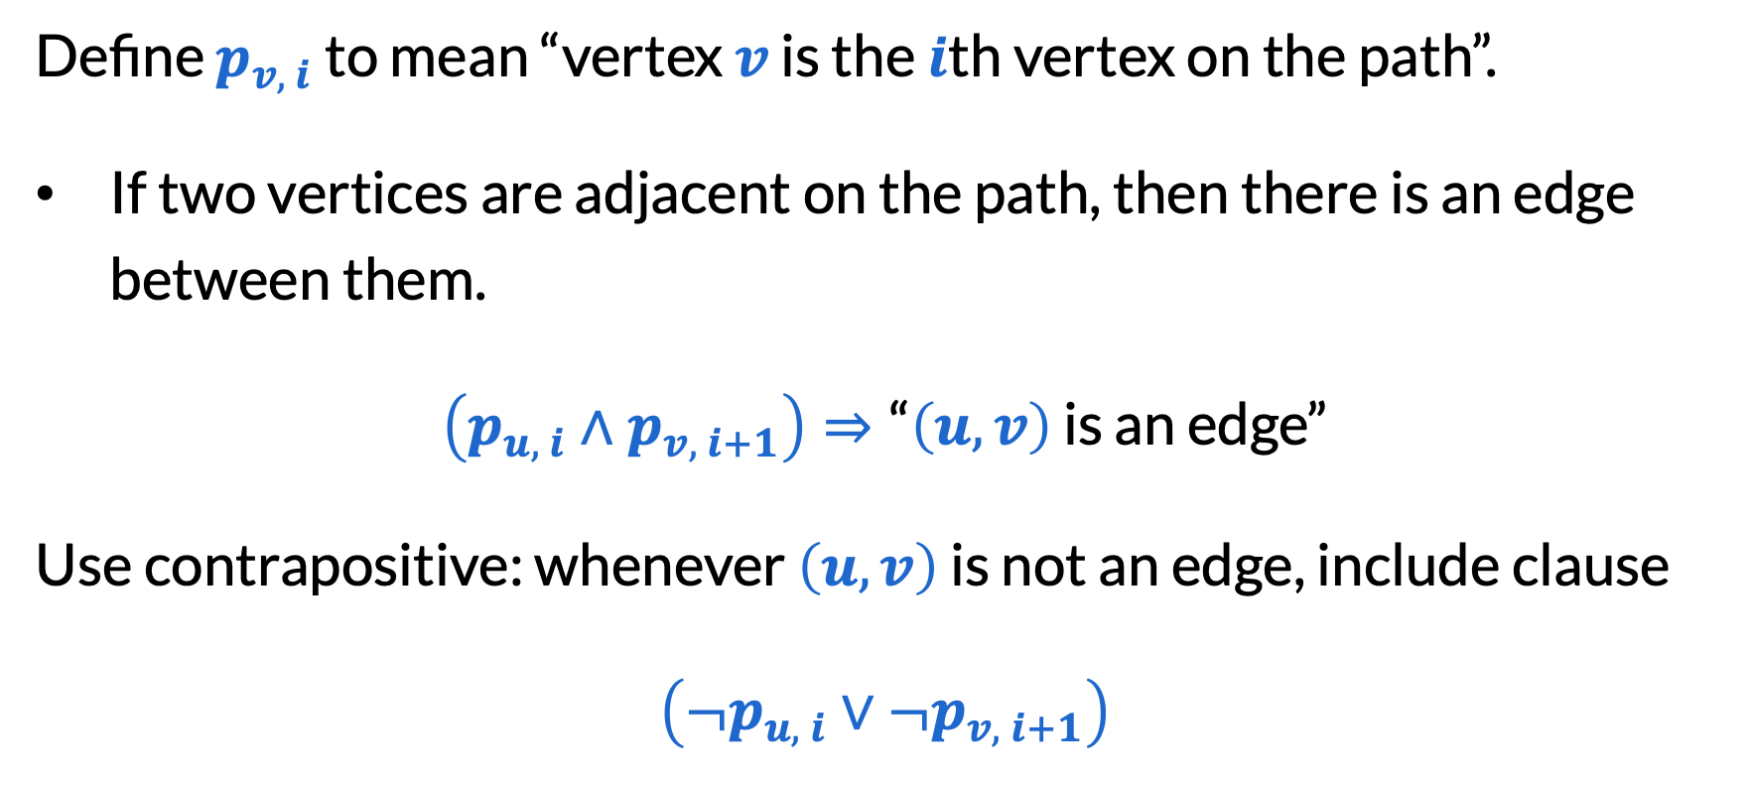
Hamiltonian path
Define $p_{v, i}$ to mean “vertex $v$ is the $i$th vertex on the path”.
If two vertices are adjacent on the path, then there is an edge between them.
$\left(p_{u, i}∧p_{v, i+1}\right)⇒\text{“}\left(u, v\right)$ is an edge”
Use contrapositive: whenever $\left(u, v\right)$ is not an edge, include clause
$\left({¬p}_{u, i}∨{¬p}_{v, i+1}\right)$

Slide 10
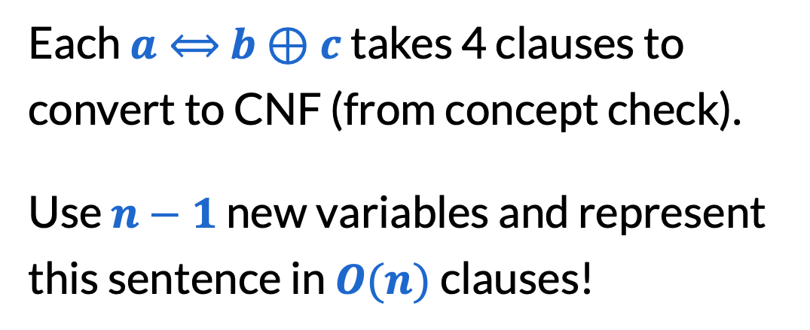
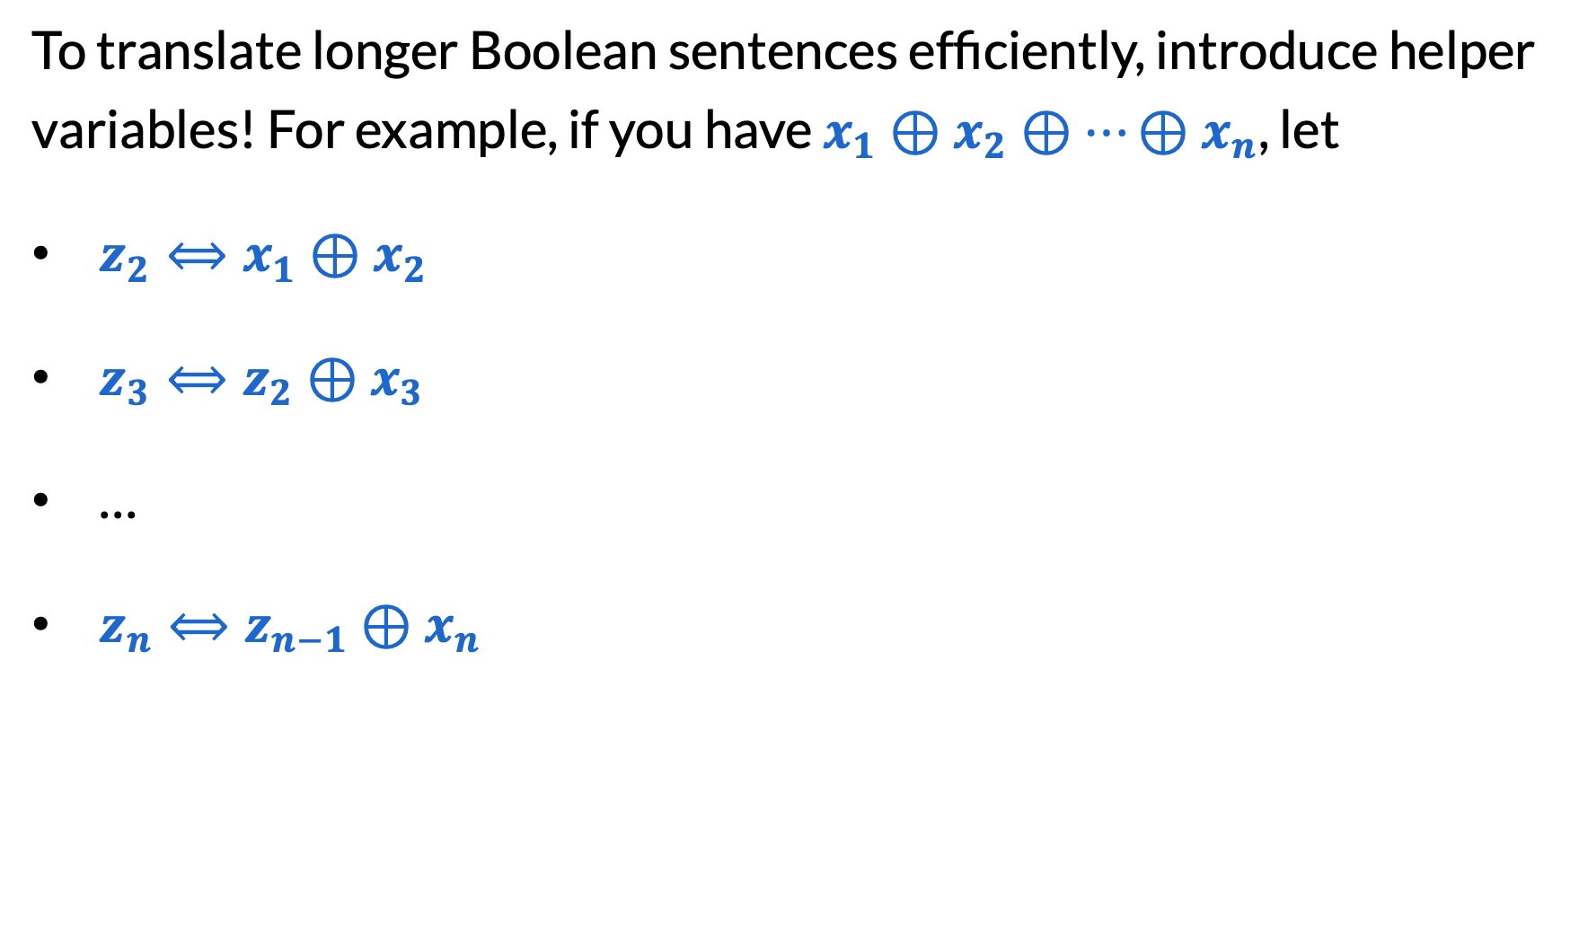
Tseitin transformations
To translate longer Boolean sentences efficiently, introduce helper variables! For example, if you have $x_{1}⊕x_{2}⊕…⊕x_{n}$, let
​$z_{2}⟺x_{1}⊕x_{2}$
​$z_{3}⟺z_{2}⊕x_{3}$
​…
​$z_{n}⟺z_{n−1}⊕x_{n}$
Each $a⟺$ $b⊕c$ takes 4 clauses to convert to CNF (from concept check).
Use $n−1$ new variables and represent this sentence in $O(n)$ clauses!

Slide 11
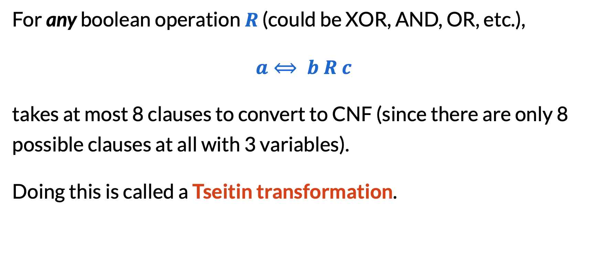
Tseitin transformations
For any boolean operation $R$ (could be XOR, AND, OR, etc.),
$a⟺ b R c$
takes at most 8 clauses to convert to CNF (since there are only 8 possible clauses at all with 3 variables).
Doing this is called a Tseitin transformation.

Slide 12
Program verification
Input: A computer program written in some language and a formal specification
Goal: Does the program meet the spec for all inputs?

Slide 13
Program verification
division(int x, int y) {
int r = x;
int q = 0;
while (r >= y) {
r = r - y;
q++;
}
assert x == y * q + r;
assert r >= 0 && r < Math.abs(y);
code
spec

Slide 14
Program verification
The basic idea is to convert our program into single static assignment form, where it will only have:
Basic functions like +, >, and _ ? _ : _
Assignment to variables
“Assume” statements
“Assert” statements
Kind of like OR, AND, XOR, etc?
Kind of like Tseitin transformations, except not just bools!
“The spec is satisfied for all small inputs that don’t result in long loops.”

Slide 15
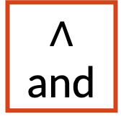



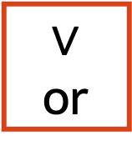
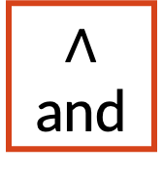
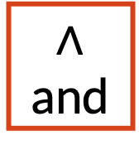
Circuits
a1
a0
b1
b0
In a class on digital design (CSE 369/EE 271), you would learn how to implement all these basic functions with circuits!
$∧$ and
$⊕$ xor
$∧$ and
$⊕$ xor
$∧$ and
$⊕$ xor
a1
a0
$∨$ or
+
b1
b0
c
s1
s0
c
s1
s0

Slide 16
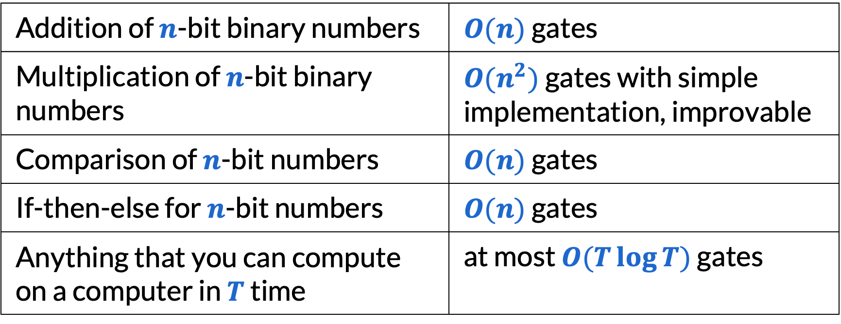
Some things you can do with circuits
Addition of $n$-bit binary numbers | $O(n)$ gates
Multiplication of $n$-bit binary numbers | $O(n^{2})$ gates with simple implementation, improvable
Comparison of $n$-bit numbers | $O(n)$ gates
If-then-else for $n$-bit numbers | $O(n)$ gates
Anything that you can compute on a computer in $T$ time | at most $O(T\log{T})$ gates
By Tseitin transformations: # new clauses ≈ # new variables = # gates!

Slide 17
The DPLL algorithm

Slide 18
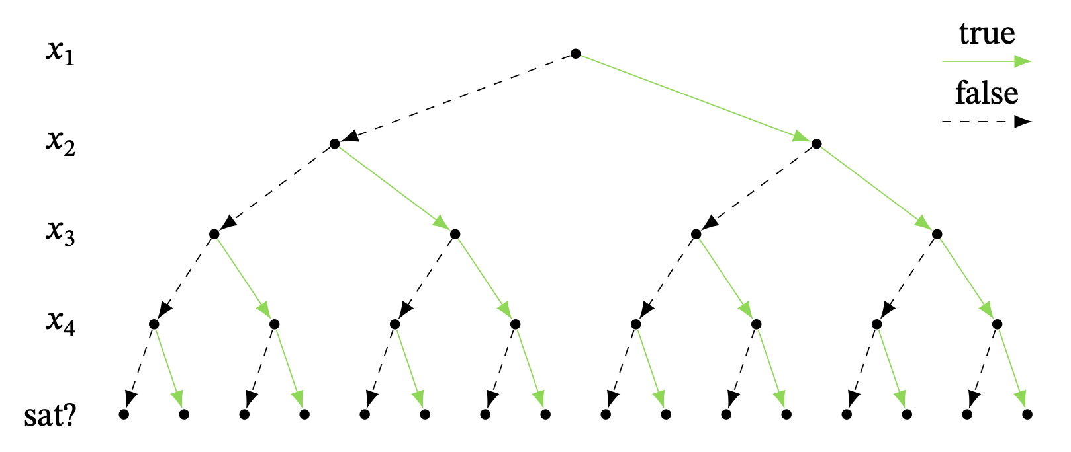
First idea: brute force
To solve SAT via brute force, we try every assignment.

Slide 19
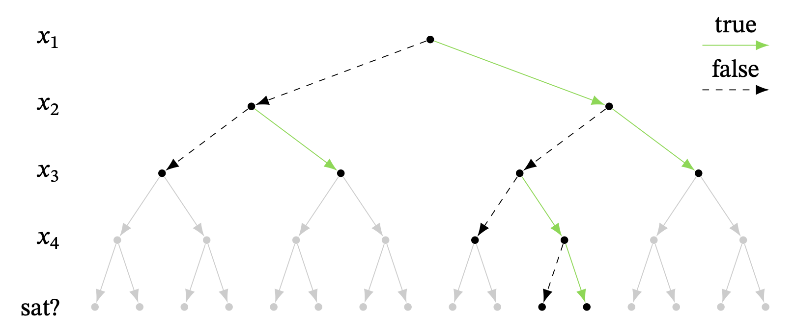
Second idea: check unsatisfiability earlier
At every node, check if we’ve already made the things unsatisfiable.

Slide 20
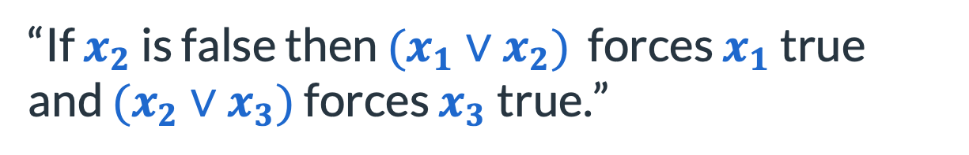
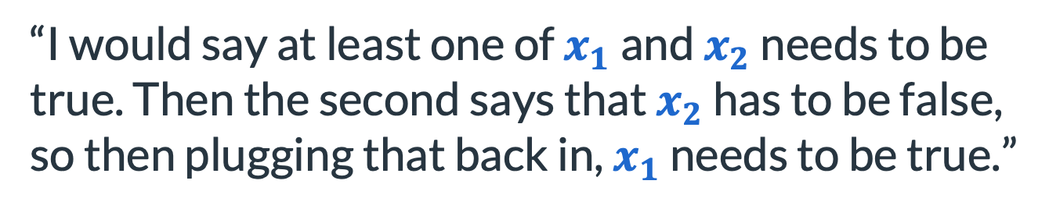
Even faster: Your ideas
“As a human, I would find the clauses with only one variable, which could easily tell whether the variable should be true or false.”
“I would say at least one of $x_{1}$ and $x_{2}$ needs to be true. Then the second says that $x_{2}$ has to be false, so then plugging that back in, $x_{1}$ needs to be true.”
“If $x_{2}$ is false then $(x_{1}∨x_{2})$ forces $x_{1}$ true and $(x_{2}∨x_{3})$ forces $x_{3}$true.”

Slide 21
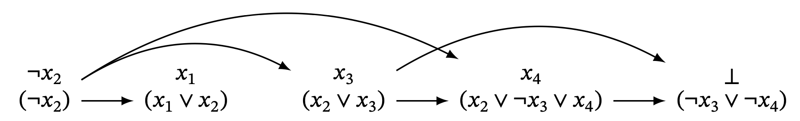
Unit propagation
A unit is a clause with one literal.
If you know a unit, simplify other clauses with this knowledge!

Slide 22
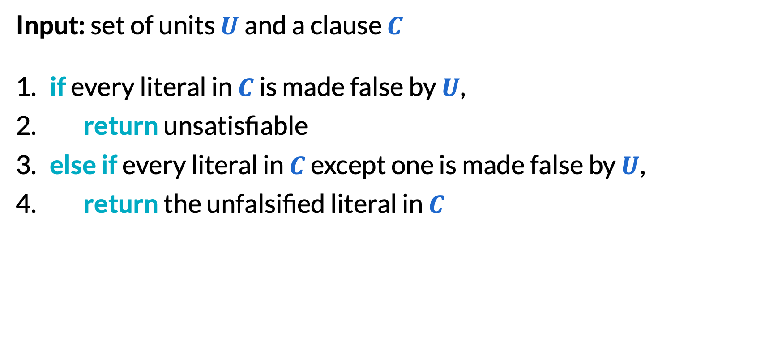
Unit propagation
Input: set of units $U$ and a clause $C$
​if every literal in $C$ is made false by $U$,
​return unsatisfiable
​else if every literal in $C$ except one is made false by $U$,
​return the unfalsified literal in $C$

Slide 23
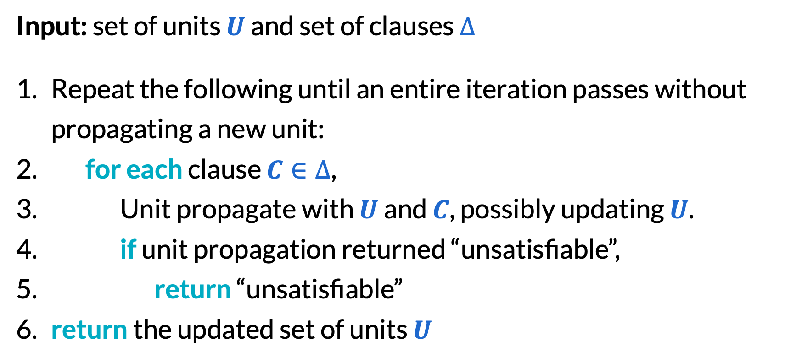
Unit propagation
Input: set of units $U$ and set of clauses $∆$
Repeat the following until an entire iteration passes without propagating a new unit:
​for each clause $C∈∆$,
Unit propagate with $U$ and $C$, possibly updating $U$.
​if unit propagation returned “unsatisfiable”,
​return “unsatisfiable”
​return the updated set of units $U$

Slide 24
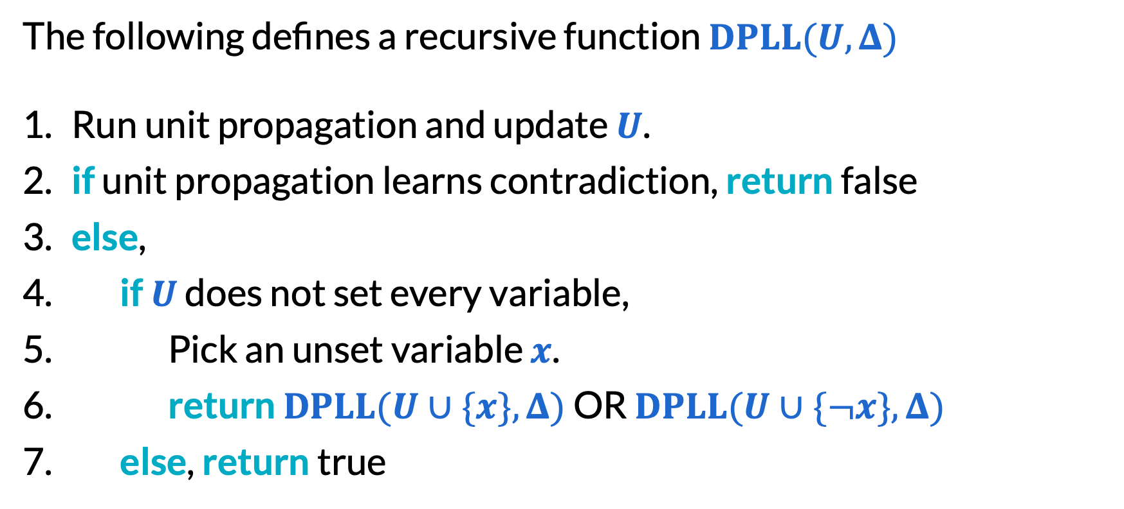
DPLL algorithm (Davis–Putnam–Logemann–Loveland, 1961)
The following defines a recursive function $DPLL(U,Δ)$
Run unit propagation and update $U$.
​if unit propagation learns contradiction, return false
​else,
​if $U$ does not set every variable,
Pick an unset variable $x$.
​return $DPLL(U∪\{x\},Δ)$ OR $DPLL(U∪\{¬x\},Δ)$
​else, return true

Slide 25
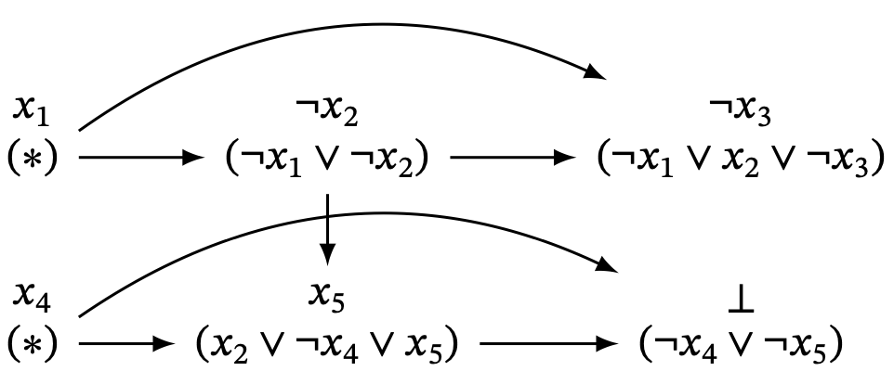
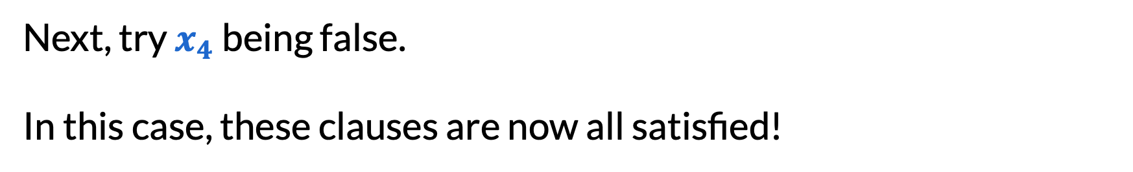
DPLL algorithm
Next, try $x_{4}$ being false.
In this case, these clauses are now all satisfied!

Slide 26
The CDCL algorithm

Slide 27
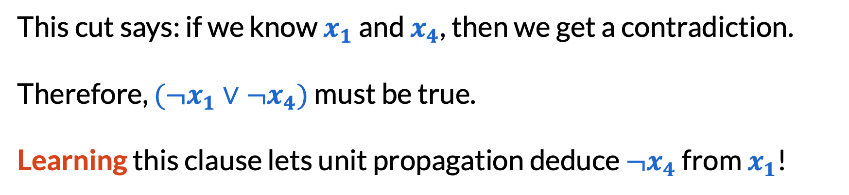
Cuts in an implication graph
This cut says: if we know $x_{1}$ and $x_{4}$, then we get a contradiction.
Therefore, $(¬x_{1}∨¬x_{4})$ must be true.
Learning this clause lets unit propagation deduce $¬x_{4}$ from $x_{1}$!

Slide 28
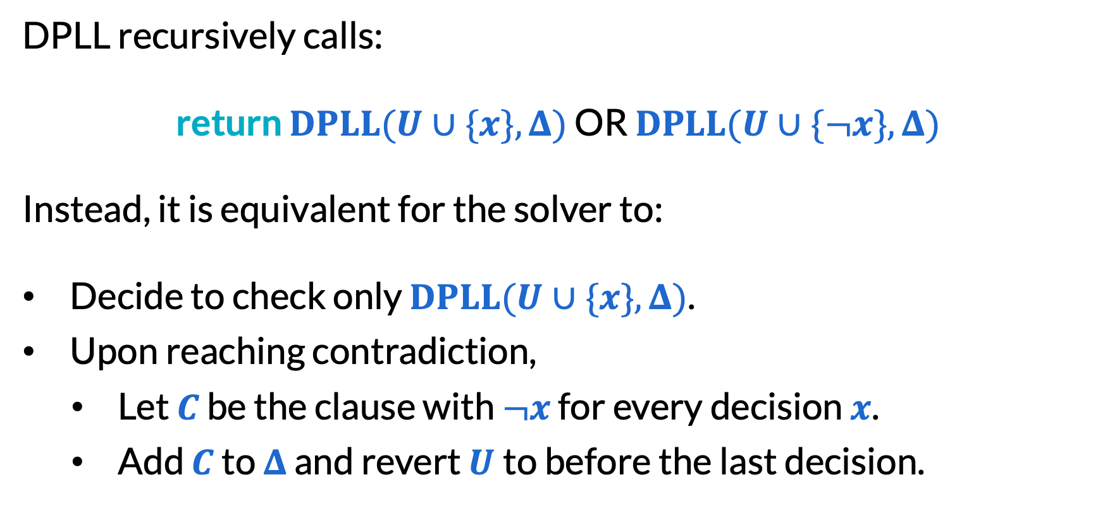
Clause learning view of DPLL
DPLL recursively calls:
​return $DPLL(U∪\{x\},Δ)$ OR $DPLL(U∪\{¬x\},Δ)$
Instead, it is equivalent for the solver to:
Decide to check only $DPLL(U∪\{x\},Δ)$.
Upon reaching contradiction,
Let $C$ be the clause with $¬x$ for every decision $x$.
Add $C$ to $Δ$ and revert $U$to before the last decision.
call this the DPLL clause

Slide 29
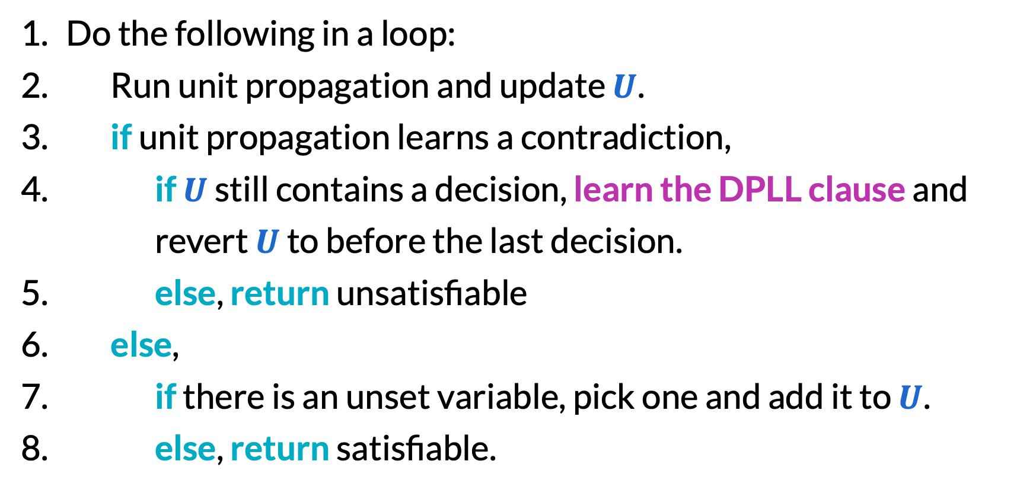
Clause learning view of DPLL
Do the following in a loop:
Run unit propagation and update $U$.
​if unit propagation learns a contradiction,
​if $U$ still contains a decision, learn the DPLL clause and revert $U$ to before the last decision.
​else, return unsatisfiable
​else,
​if there is an unset variable, pick one and add it to $U$.
​else, return satisfiable.

Slide 30
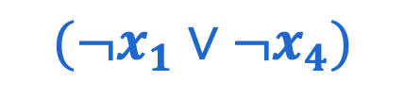
Cuts in an implication graph
Take any cut separating the decisions from the contradiction.
The conflict clause associated with this cut has the negation of everything immediately before the cut.
$(¬x_{1}∨¬x_{4})$

Slide 31
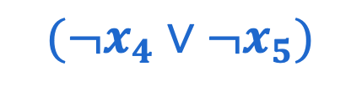
Cuts in an implication graph
Take any cut separating the decisions from the contradiction.
The conflict clause associated with this cut has the negation of everything immediately before the cut.
$(¬x_{4}∨¬x_{5})$

Slide 32
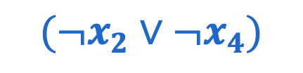
Cuts in an implication graph
Take any cut separating the decisions from the contradiction.
The conflict clause associated with this cut has the negation of everything immediately before the cut.
$(¬x_{2}∨¬x_{4})$

Slide 33
Cuts in an implication graph
A conflict clause is asserting if it can be used for unit propagation with fewer decisions.
Any asserting clause can be learned!
$(¬x_{2}∨¬x_{4})$

Slide 34
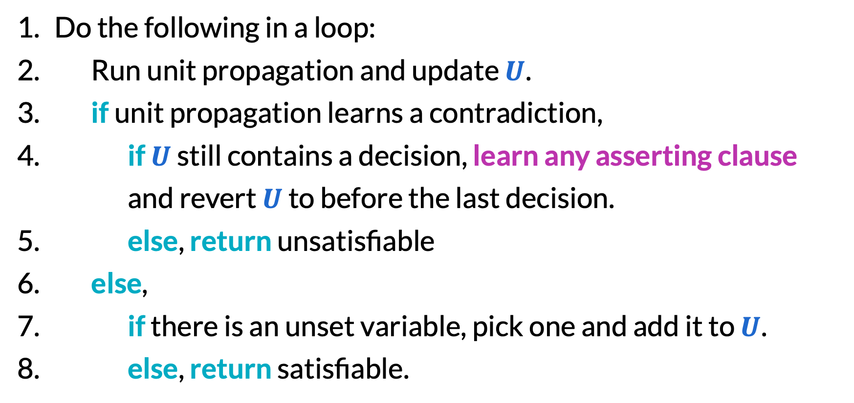
CDCL (conflict-driven clause learning)
Do the following in a loop:
Run unit propagation and update $U$.
​if unit propagation learns a contradiction,
​if $U$ still contains a decision, learn any asserting clause and revert $U$ to before the last decision.
​else, return unsatisfiable
​else,
​if there is an unset variable, pick one and add it to $U$.
​else, return satisfiable.

Slide 35
More improvements
Improved heuristics for choosing the next variable to branch on
Improved heuristics for choosing which conflict clause to learn
Faster unit propagation with watched literals
Random restarts
Clause deletion
Improving SAT solvers remains an active area of research.

Slide 36
Final reminders
HW6 (Greedy) resubmissions close tonight @ 11:59pm!
HW7 (Flows) due tonight @ 11:59pm!
I have OH now-12:30pm:
Meet at front of classroom, we’ll walk over together
CSE (Allen) 214 if you’re coming later
Nathan has online OH 12–1pm:
https://washington.zoom.us/my/nathanbrunelle

