Slide 1
Lecture 25: Using SAT solvers
Glenn Sun

Slide 2
HW8 releasing today
Problem 15: Solving Killer Sudoku
Problem 15X.1: Generating Sudoku puzzles
Problem 15X.2: Writing a Sudoku solver in Java
Problem 16: True/False/Unknown questions about P and NP

Slide 3
Encoding problems in SAT

Slide 4
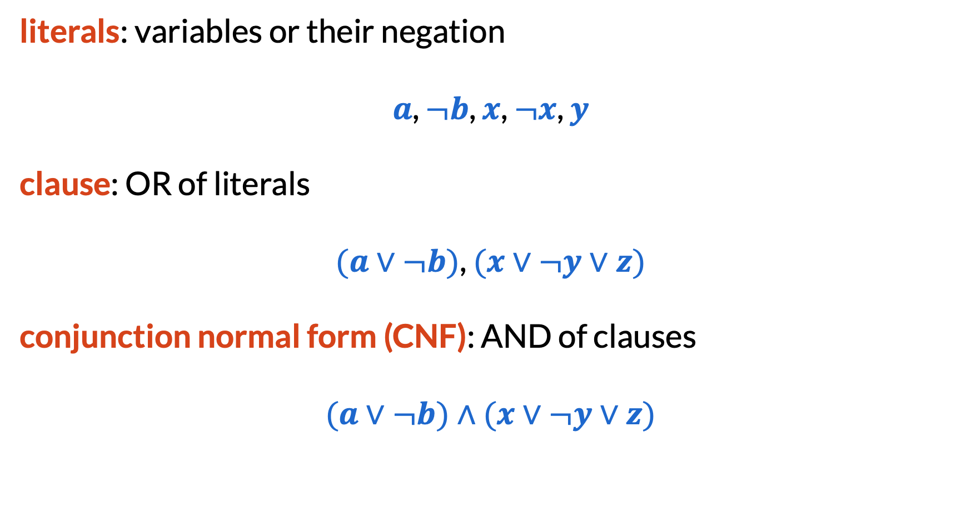
SAT (Satisfiability)
literals: variables or their negation
$a$, $¬b$, $x$, $¬x$, $y$
clause: OR of literals
$(a∨¬b)$, $(x∨¬y∨z)$
conjunction normal form (CNF): AND of clauses
$(a∨¬b)∧(x∨¬y∨z)$

Slide 5
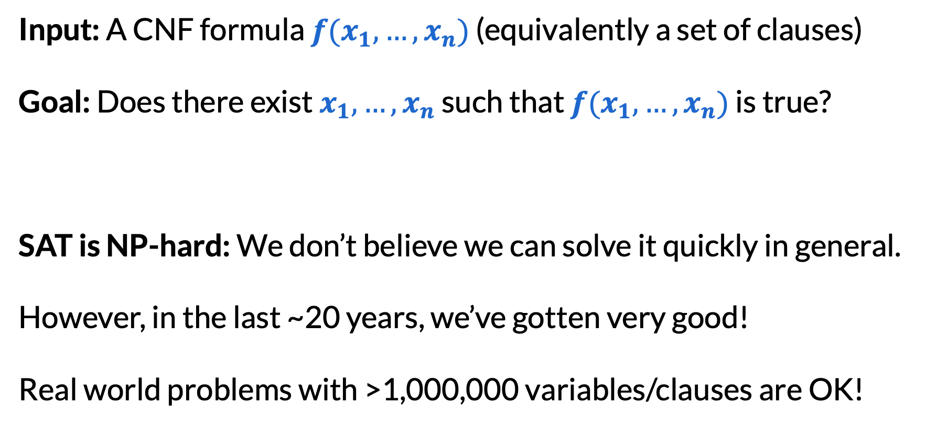
SAT (Satisfiability)
Input: A CNF formula $f(x_{1},…,x_{n})$ (equivalently a set of clauses)
Goal: Does there exist $x_{1},…,x_{n}$ such that $f(x_{1},…,x_{n})$ is true?
SAT is NP-hard: We don’t believe we can solve it quickly in general.
However, in the last ~20 years, we’ve gotten very good!
Real world problems with >1,000,000 variables/clauses are OK!

Slide 6
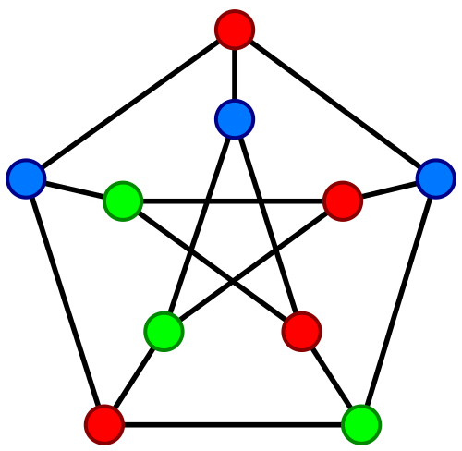
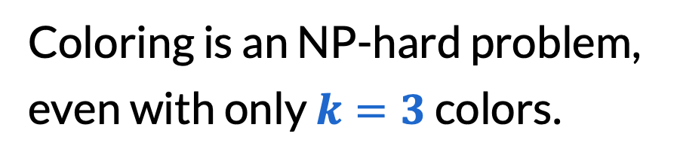

3-coloring
Input: An undirected graph with vertices $V$ and edges $E$
Goal: Can you color the vertices using $k$ colors so that no edge has the same color on both ends?
Coloring is an NP-hard problem, even with only $k=3$ colors.

Slide 7
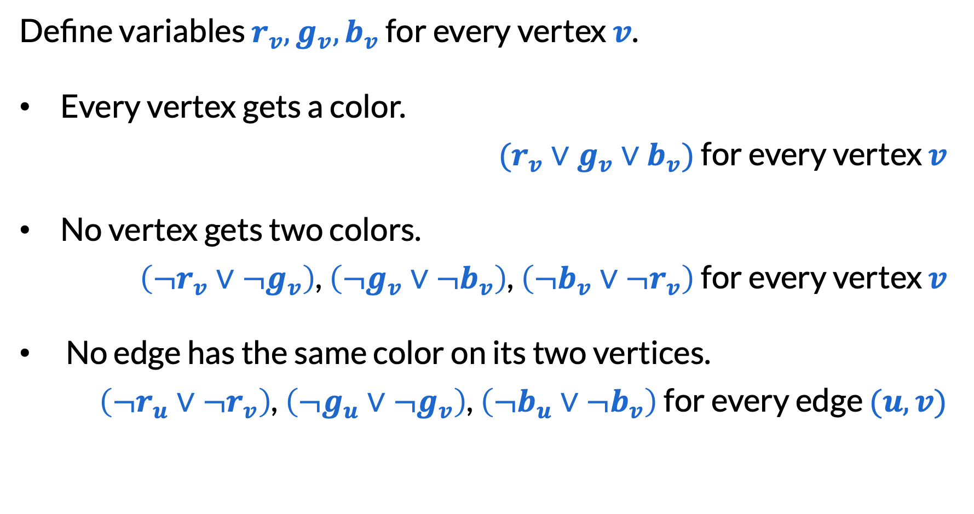
3-coloring
Define variables $r_{v}, g_{v}, b_{v}$ for every vertex $v$.
Every vertex gets a color.
$(r_{v}∨g_{v}∨b_{v})$ for every vertex $v$
No vertex gets two colors.
$\left({¬r}_{v}∨{¬g}_{v}\right)$, $\left({¬g}_{v}∨{¬b}_{v}\right)$, $\left({¬b}_{v}∨{¬r}_{v}\right)$ for every vertex $v$
No edge has the same color on its two vertices.
$\left({¬r}_{u}∨{¬r}_{v}\right)$, $\left({¬g}_{u}∨{¬g}_{v}\right)$, $\left({¬b}_{u}∨{¬b}_{v}\right)$ for every edge $(u, v)$

Slide 8
What SAT solvers are available?
Z3 | Giant software package that provides a neat interface for SAT solvers and other solvers. Can use with Python, C++, Java, JavaScript, etc. Often default choice for real-world work.
CaDiCaL, Kissat, Glucose | Pure SAT solvers written in C++
Sat4J (on your homework) | Pure SAT solver written in Java

Slide 9
An example with Sat4J
public static int[] solve3Coloring(int n, List<int[]> E) {
ISolver s = SolverFactory.newDefault();
s.newVar(n*3);
for (int v=0; v<n; v++) {
int r=v*3+1, g=v*3+2, b=v*3+3;
s.addClause(new VecInt(new int[]{ r, g, b }));
s.addClause(new VecInt(new int[]{ -r, -g }));
s.addClause(new VecInt(new int[]{ -g, -b }));
s.addClause(new VecInt(new int[]{ -b, -r }));
}
// Similar things for the edge constraints
return s.isSatisfiable() ? s.model() : null;
}

Slide 10
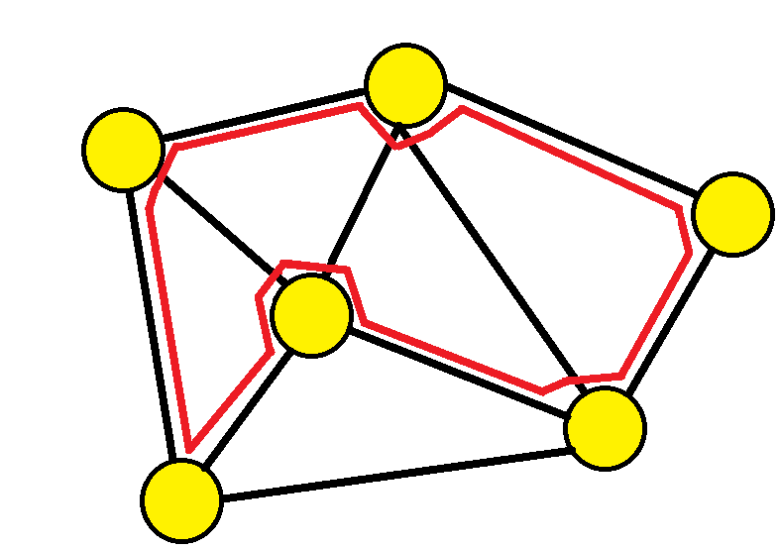

Hamiltonian path
Input: An undirected graph with vertices $V$ and edges $E$
Goal: Is there a path that uses every vertex exactly once?
Also an NP-hard problem!

Slide 11
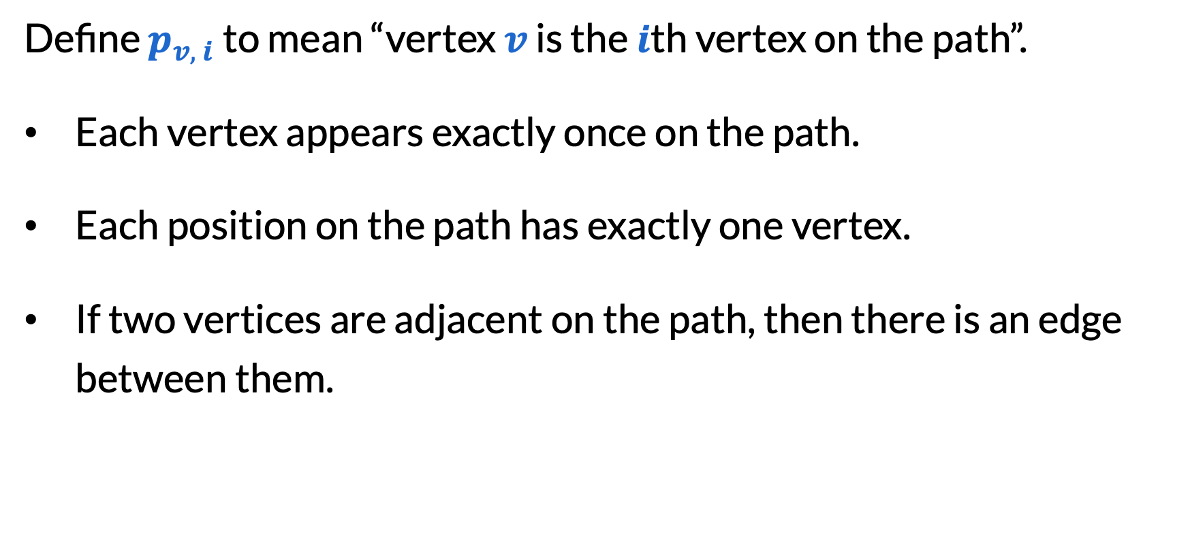
Hamiltonian path
Define $p_{v, i}$ to mean “vertex $v$ is the $i$th vertex on the path”.
Each vertex appears exactly once on the path.
Each position on the path has exactly one vertex.
If two vertices are adjacent on the path, then there is an edge between them.

Slide 12
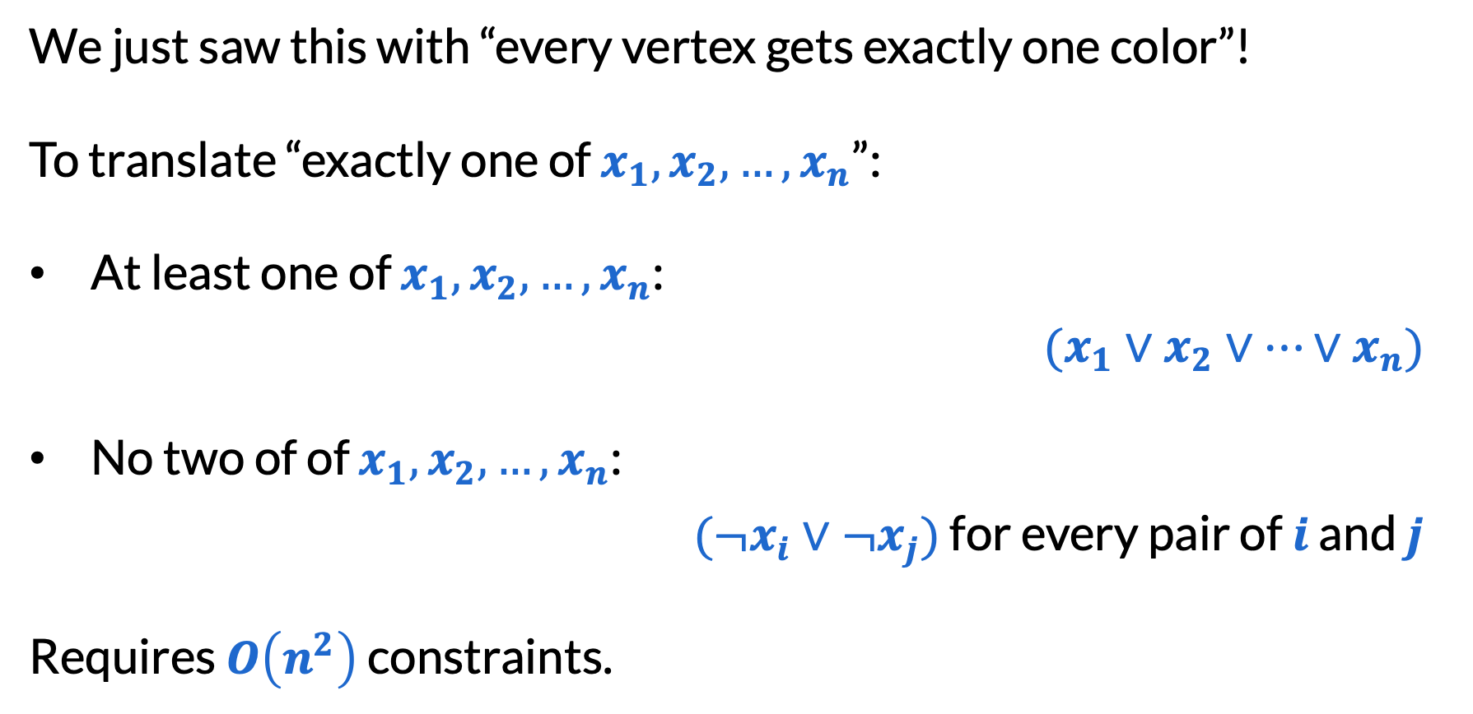
“Exactly one” constraints
We just saw this with “every vertex gets exactly one color”!
To translate “exactly one of $x_{1},x_{2},…,x_{n}$”:
At least one of $x_{1},x_{2},…,x_{n}$:
$(x_{1}∨x_{2}∨…∨x_{n})$
No two of of $x_{1},x_{2},…,x_{n}$:
$(¬x_{i}∨¬x_{j})$ for every pair of $i$ and $j$
Requires $O\left(n^{2}\right)$ constraints.

Slide 13
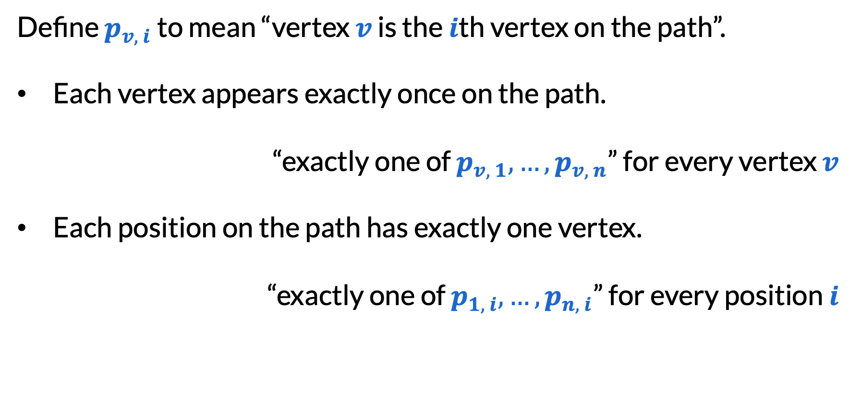
Hamiltonian path
Define $p_{v, i}$ to mean “vertex $v$ is the $i$th vertex on the path”.
Each vertex appears exactly once on the path.
“exactly one of $p_{v, 1},…,p_{v, n}$” for every vertex $v$
Each position on the path has exactly one vertex.
“exactly one of $p_{1, i},…,p_{n, i}$” for every position $i$

Slide 14
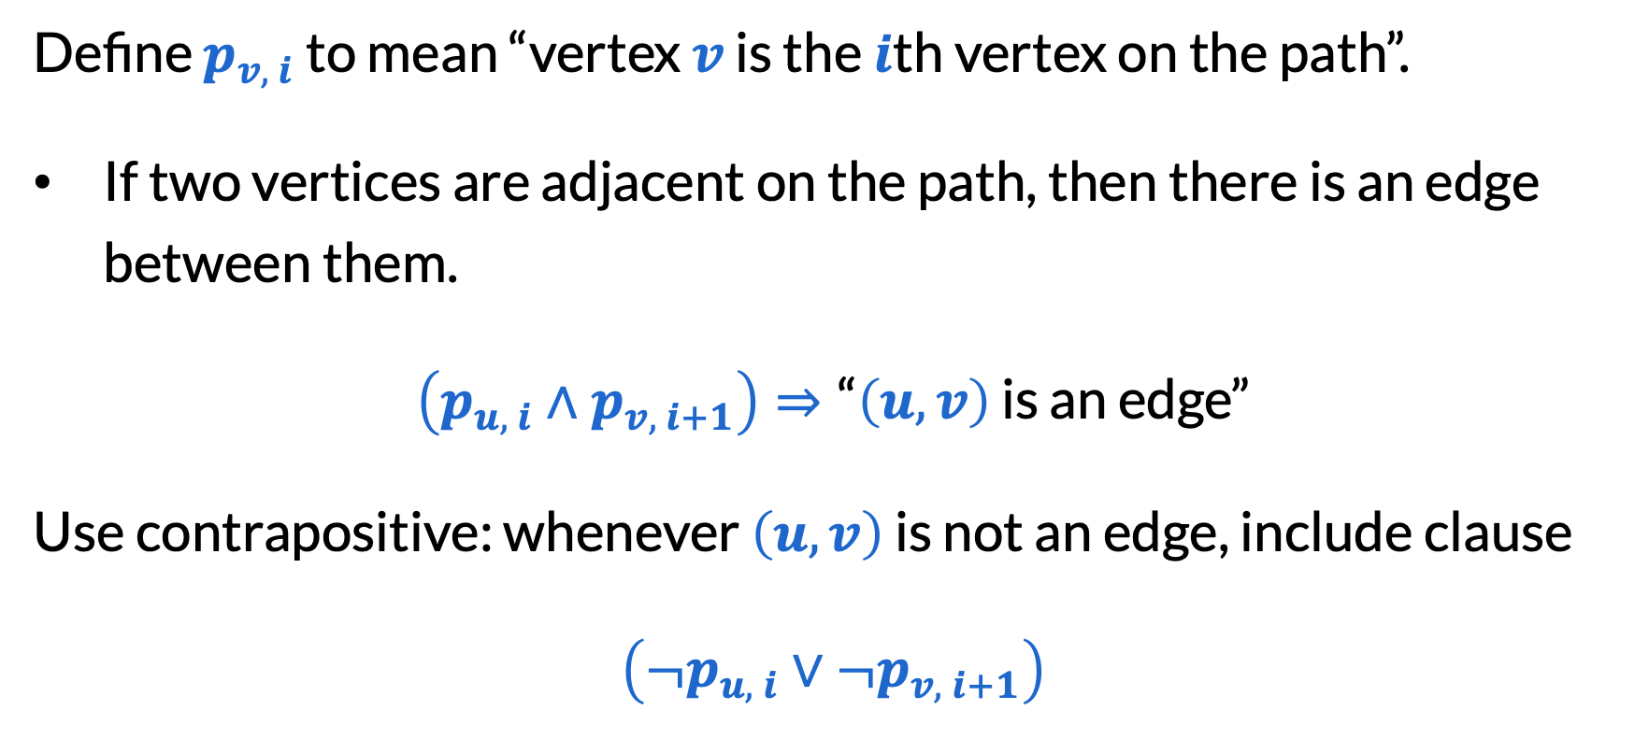
Hamiltonian path
Define $p_{v, i}$ to mean “vertex $v$ is the $i$th vertex on the path”.
If two vertices are adjacent on the path, then there is an edge between them.
$\left(p_{u, i}∧p_{v, i+1}\right)⇒\text{“}\left(u, v\right)$ is an edge”
Use contrapositive: whenever $\left(u, v\right)$ is not an edge, include clause
$\left({¬p}_{u, i}∨{¬p}_{v, i+1}\right)$

Slide 15
Defining helper variables

Slide 16
Witches puzzle
Alice: Bob is a witch. I am not a witch.
Bob: Carol is as honest as I am.
Carol: The number of witches is even. Alice and I are not both truthtellers. I am not a witch.
David: At least one of the witches is a truthteller.

Slide 17
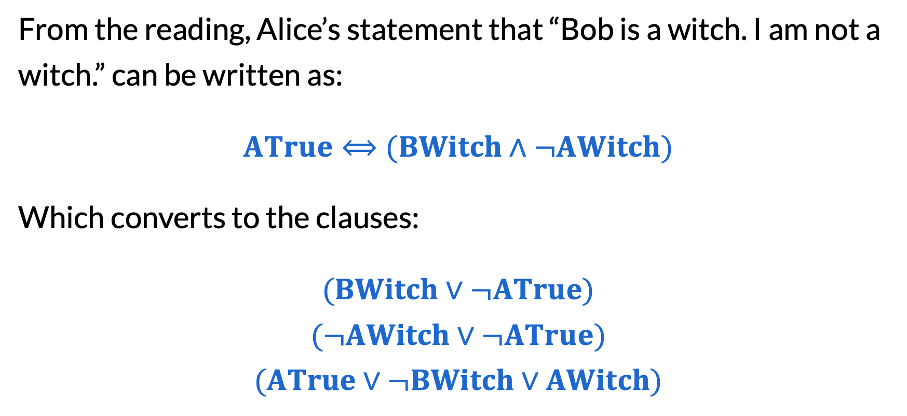
Witches puzzle
From the reading, Alice’s statement that “Bob is a witch. I am not a witch.” can be written as:
$ATrue⟺(BWitch∧¬AWitch)$
Which converts to the clauses:
$(BWitch∨¬ATrue)$
$$(¬AWitch∨¬ATrue)$$
$$(ATrue∨¬BWitch∨AWitch)$$

Slide 18

Witches puzzle
When Carol says, “The number of witches is even”, this converts to:
$EvenWitches=¬(AWitch⊕BWitch⊕CWitch⊕DWitch)$
How would this convert to CNF?

Slide 19
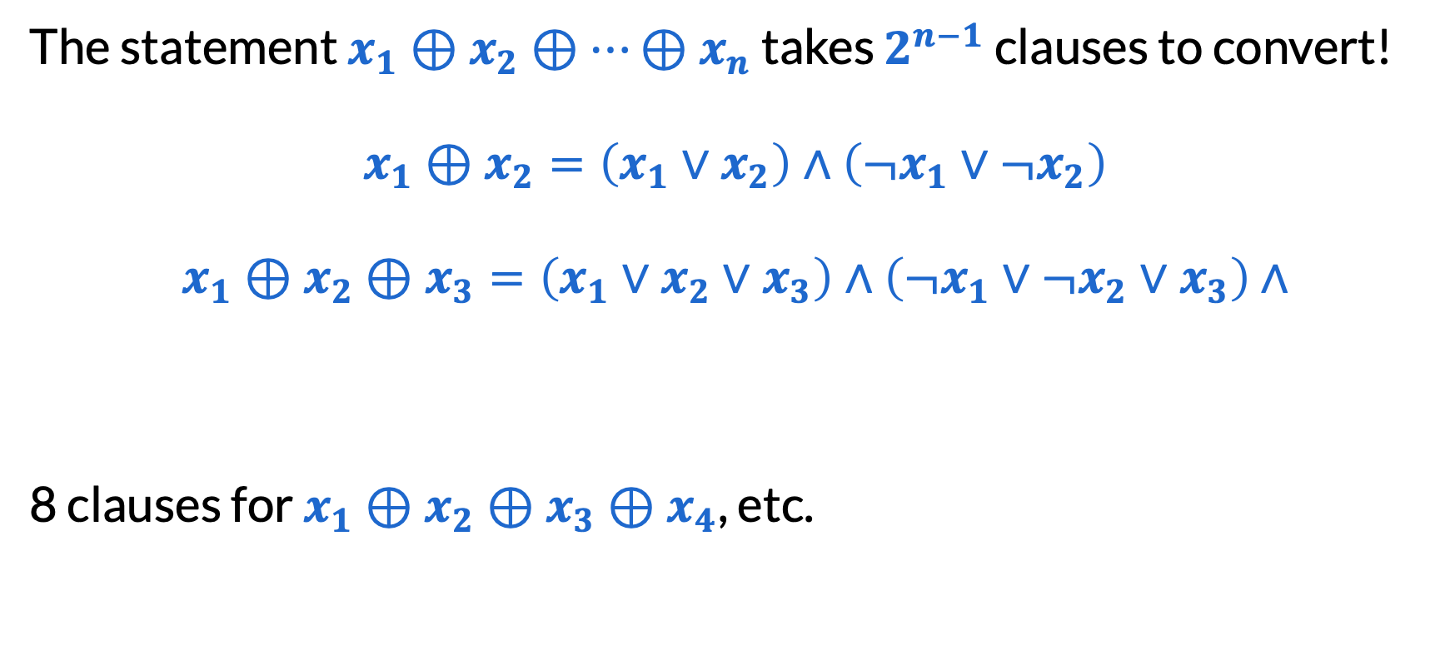
Long XORs
The statement $x_{1}⊕x_{2}⊕…⊕x_{n}$ takes $2^{n−1}$ clauses to convert!
$x_{1}⊕x_{2}=\left(x_{1}∨x_{2}\right)∧\left(¬x_{1}∨{¬x}_{2}\right)$
$x_{1}⊕x_{2}⊕x_{3}=\left(x_{1}∨x_{2}∨x_{3}\right)∧\left(¬x_{1}∨{¬x}_{2}∨x_{3}\right)$ $∧$
8 clauses for $x_{1}⊕x_{2}⊕x_{3}⊕x_{4}$, etc.
$$\left({¬x}_{1}∨x_{2}∨{¬x}_{3}\right)∧\left(x_{1}∨{¬x}_{2}∨{¬x}_{3}\right)$$

Slide 20

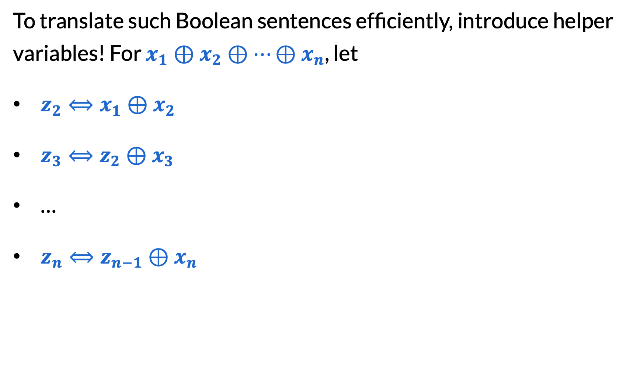
Tseitin transformations
To translate such Boolean sentences efficiently, introduce helper variables! For $x_{1}⊕x_{2}⊕…⊕x_{n}$, let
​$z_{2}⟺x_{1}⊕x_{2}$
​$z_{3}⟺z_{2}⊕x_{3}$
​…
​$z_{n}⟺z_{n−1}⊕x_{n}$
Each $a⟺$ $b⊕c$ takes 4 clauses to convert to CNF (today’s concept check).
Use $n−1$ new variables and represent this sentence in $O(n)$ clauses!

Slide 21
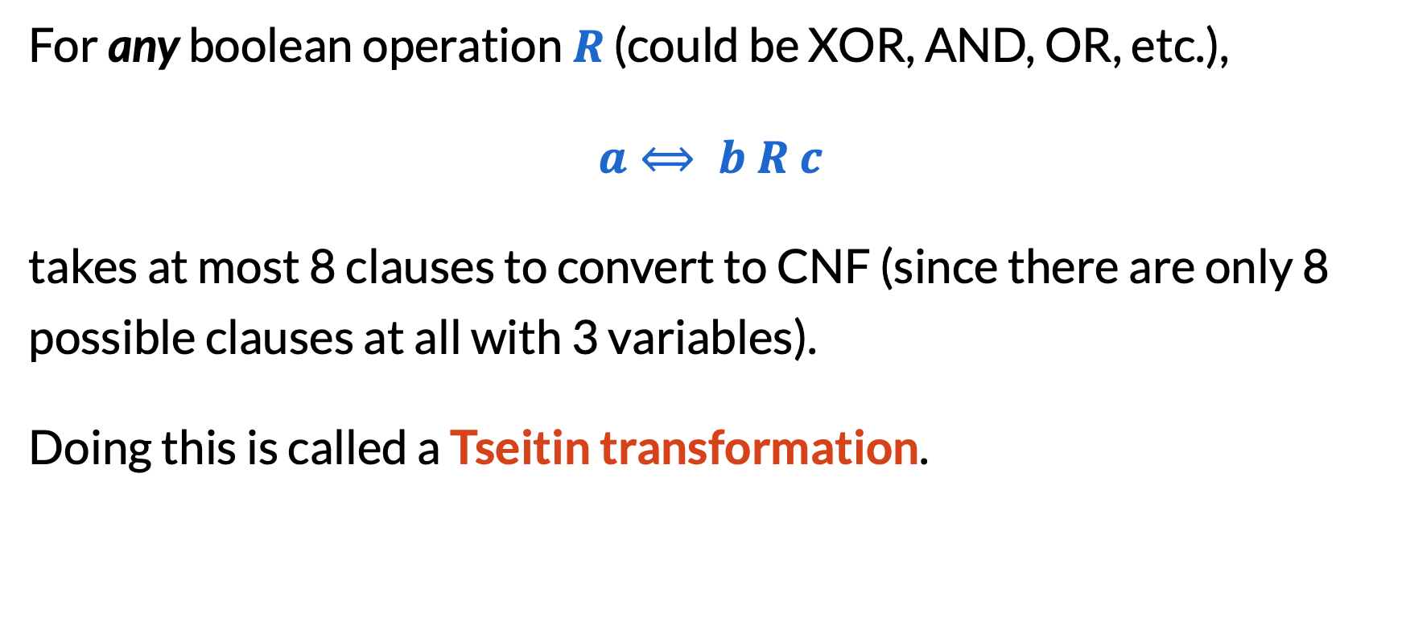
Tseitin transformations
For any boolean operation $R$ (could be XOR, AND, OR, etc.),
$a⟺ b R c$
takes at most 8 clauses to convert to CNF (since there are only 8 possible clauses at all with 3 variables).
Doing this is called a Tseitin transformation.

Slide 22
Program verification

Slide 23
What is program verification?
Input: A computer program written in some language and a formal specification
Goal: Does the program meet the spec for all inputs?

Slide 24
What is program verification?
division(int x, int y) {
int r = x;
int q = 0;
while (r >= y) {
r = r - y;
q++;
}
assert x == y * q + r;
assert r >= 0 && r < Math.abs(y);
code
spec

Slide 25
Program verification is too hard
hello(int n) {
String hello = “Hello world!”;
if (n is a counterexample to the
Collatz conjecture) {
hello = “Bye world”;
}
assert hello = “Hello world!”;
major open problem in number theory

Slide 26
Bounded model checking (BMC)
Two ideas to constrain the problem:
Assume all data has finite, fixed size (e.g. ints have 32 bits, or maybe even 4 bits)
Assume all loops terminate in a small number of iterations
Key assumption: Most software bugs can occur even when inputs are quite small!

Slide 27
Loop unrolling
This means: all future assertions get “or r >= y”
division(int x, int y) {
int r = x;
int q = 0;
if (r >= y) { r = r - y; q++; }
if (r >= y) { r = r - y; q++; }
assume r < y;
assert x == y * q + r;
assert r >= 0 && r < Math.abs(y);

Slide 28
Single static assignment
division(int x, int y) {
int r = x;
int q = 0;
if (r >= y) {
r = r - y;
q++;
}
division(int x, int y) {
int r1 = x;
int q1 = 0;
bool b1 = r1 >= y;
int r2 = r1 - y;
int q2 = q1 + 1;
int r3 = b1 ? r2 : r1;
int q3 = b1 ? q2 : q1;
x ? y : z means “if x, then y, else z”

Slide 29
What we have now
Our program now consists only of:
Basic functions like +, >, and _ ? _ : _
Assignment to variables
“Assume” statements
“Assert” statements
Kind of like OR, AND, XOR, etc?
Kind of like Tseitin transformations, except not just bools!
CNF constraints!

Slide 30
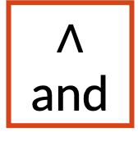
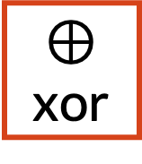

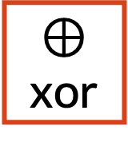
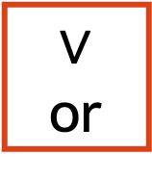
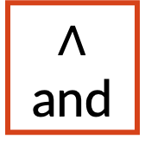
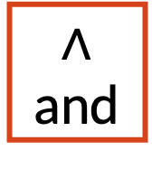
Circuits
a1
a0
b1
b0
In a class on digital design (CSE 369/EE 271), you would learn how to implement all these basic functions with circuits!
$∧$ and
$⊕$ xor
$∧$ and
$⊕$ xor
$∧$ and
$⊕$ xor
a1
a0
$∨$ or
+
b1
b0
c
s1
s0
c
s1
s0

Slide 31
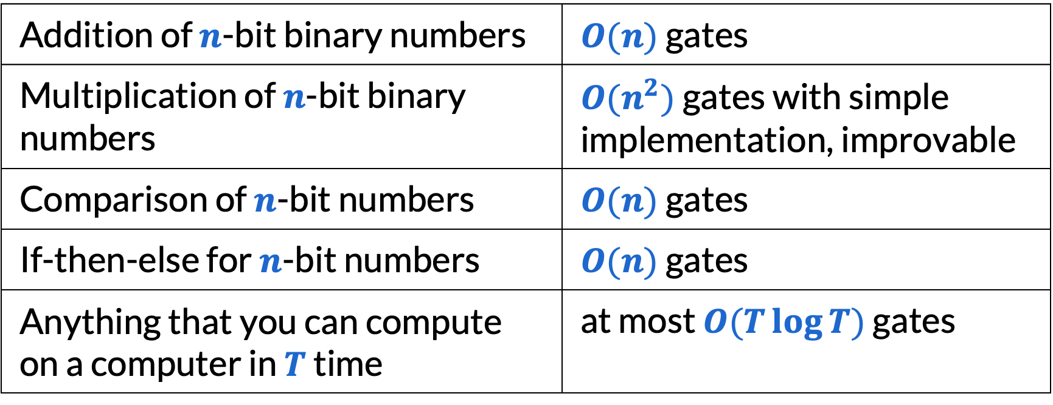
Some things you can do with circuits
Addition of $n$-bit binary numbers | $O(n)$ gates
Multiplication of $n$-bit binary numbers | $O(n^{2})$ gates with simple implementation, improvable
Comparison of $n$-bit numbers | $O(n)$ gates
If-then-else for $n$-bit numbers | $O(n)$ gates
Anything that you can compute on a computer in $T$ time | at most $O(T\log{T})$ gates
By Tseitin transformations: # new clauses ≈ # new variables = # gates!

Slide 32
Complete workflow for BMC
Unroll loops to a fixed depth
Convert to single static assignment form
Build circuits to represent your code and assertions
​Convert circuits to clauses via Tseitin transformation
Add a clause to say that at least one assertion is false
If a SAT solver says “satisfiable”, you have a counterexample!

Slide 33
Final reminders
HW6 (Greedy) resubmissions close tonight @ 11:59pm!
HW7 (Flows) due tonight @ 11:59pm!
I have OH now-12:30pm:
Meet at front of classroom, we’ll walk over together
CSE (Allen) 214 if you’re coming later
Nathan has online OH 12–1pm:
https://washington.zoom.us/my/nathanbrunelle

