Slide 1
Lecture 24: Intro to NP-completeness
Glenn Sun

Slide 2
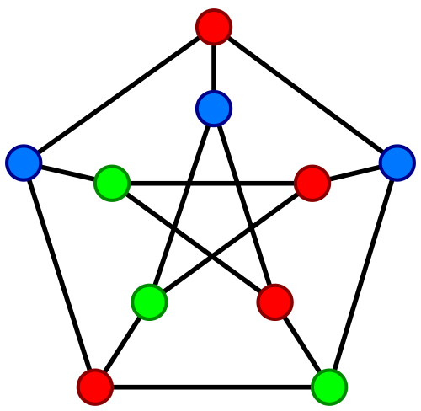
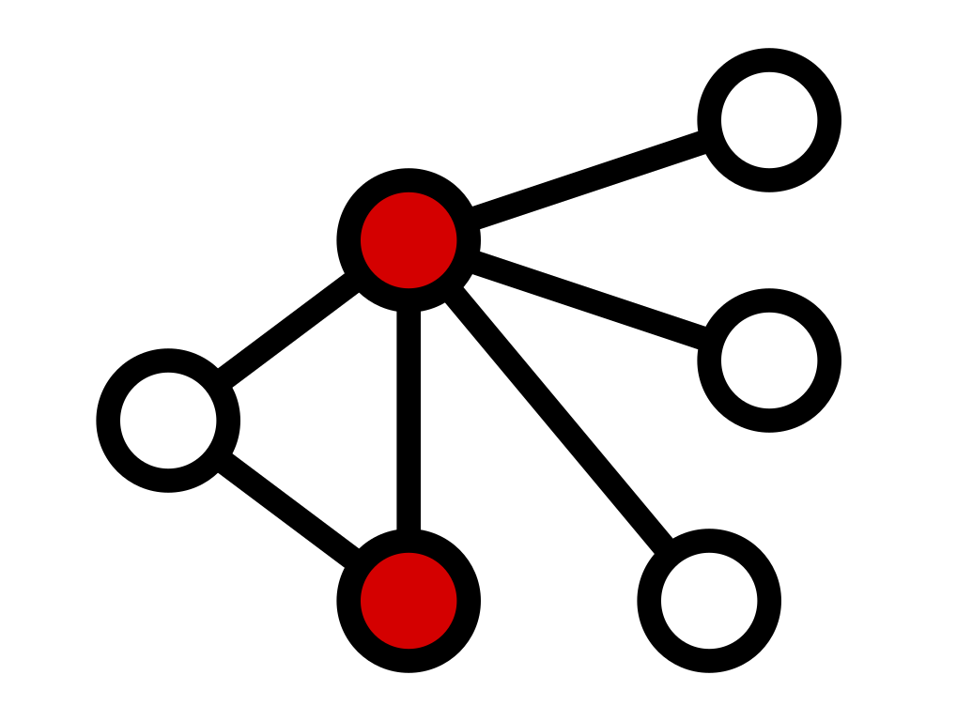
Some problems are hard to solve exactly
graph coloring
vertex cover
load balancing

Slide 3
What to do when a problem is hard?
Idea 1: Try a brute-force algorithm
Okay if you know the inputs are going to be very small
Idea 2: Try an approximation algorithm or a greedy idea
May still be quite far from optimal
Idea 3: Try to use a SAT solver

Slide 4
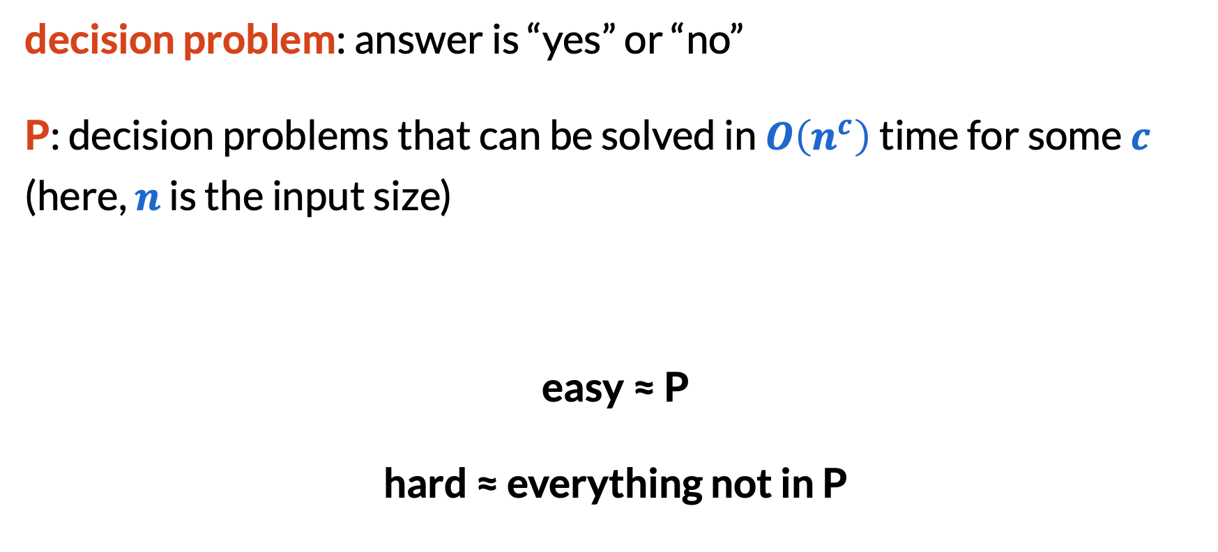
What do easy and hard mean?
decision problem: answer is “yes” or “no”
P: decision problems that can be solved in $O\left(n^{c}\right)$ time for some $c$ (here, $n$ is the input size)
easy ≈ P
hard ≈ everything not in P

Slide 5
A bit of practice
Do the following problems belong to P?
Q: Find the smallest number of coins needed to make change with quarters, dimes, nickels, and pennies.
A: No, not a decision problem!

Slide 6

A bit of practice
Do the following problems belong to P?
Q: Is there a spanning tree with weight $≤k$?
A: Yes, run Prim’s or Kruskal’s algorithms, then compare with$k$.

Slide 7
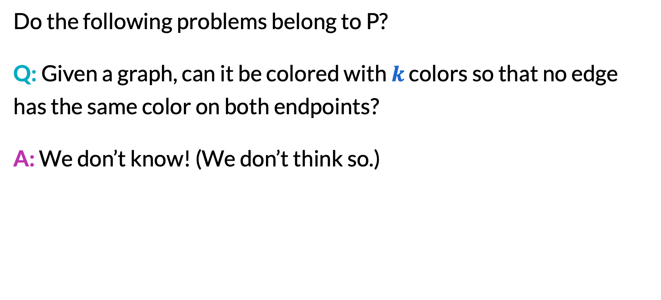
A bit of practice
Do the following problems belong to P?
Q: Given a graph, can it be colored with $k$ colors so that no edge has the same color on both endpoints?
A: We don’t know! (We don’t think so.)

Slide 8
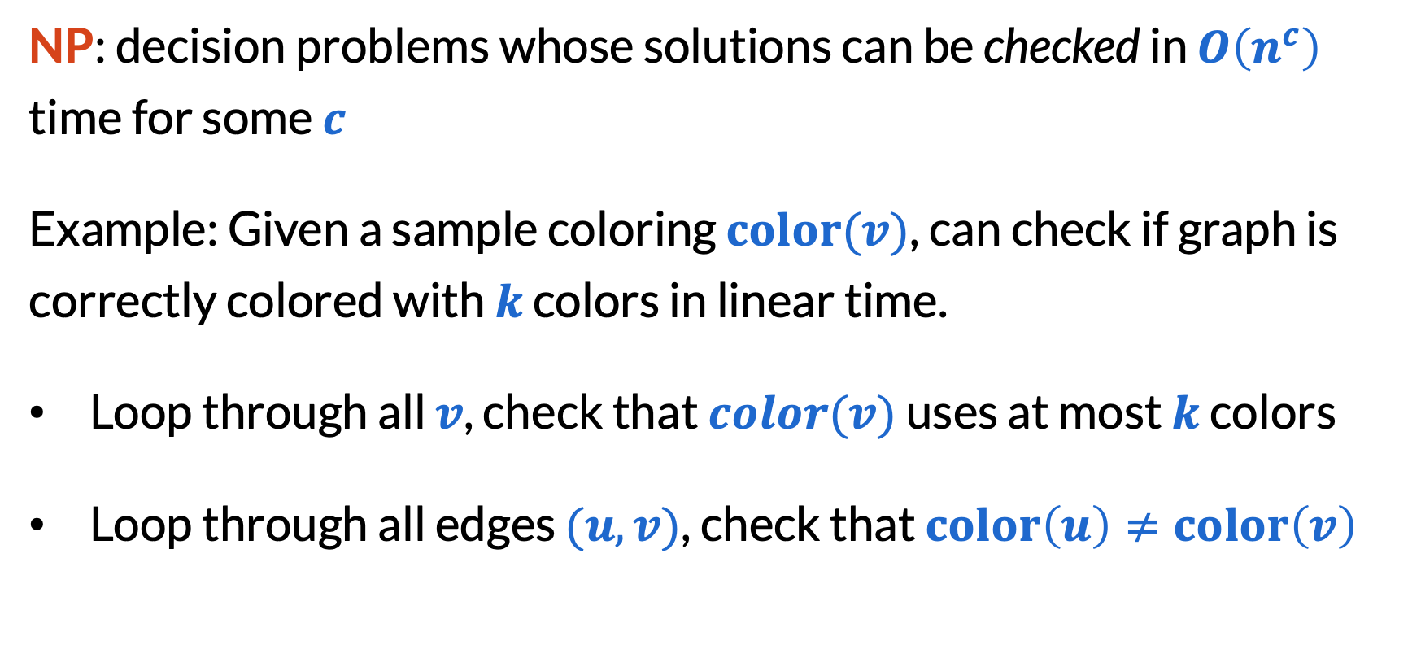
The class NP
NP: decision problems whose solutions can be checked in $O\left(n^{c}\right)$ time for some $c$
Example: Given a sample coloring $color(v)$, can check if graph is correctly colored with $k$ colors in linear time.
Loop through all $v$, check that $color(v)$ uses at most $k$ colors
Loop through all edges $(u, v)$, check that $color\left(u\right)≠color\left(v\right)$

Slide 9
P vs. NP
Most believe this
Most important open problem in CS:
Prove that either P = NP or P ≠ NP.
In other words, either:
Show how to solve every problem quickly, only knowing that it can be checked quickly, or
Give an example of a problem that can be checked quickly, but cannot be solved quickly.

Slide 10
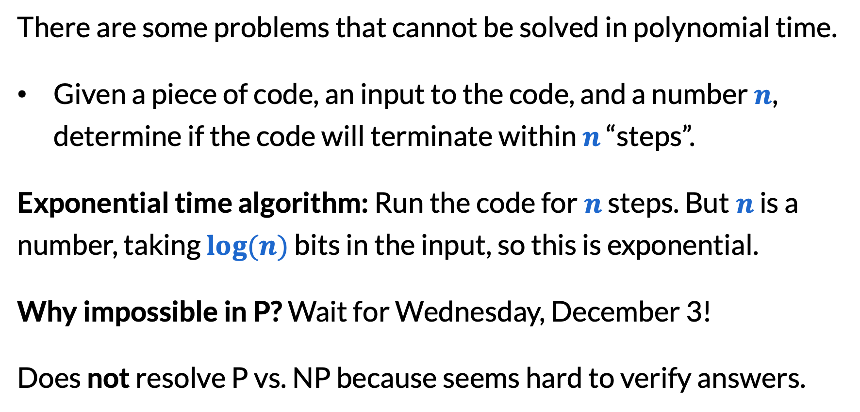
How to prove not in P?
There are some problems that cannot be solved in polynomial time.
Given a piece of code, an input to the code, and a number $n$, determine if the code will terminate within $n$ “steps”.
Exponential time algorithm: Run the code for$n$ steps. But$n$ is a number, taking $log⁡(n)$ bits in the input, so this is exponential.
Why impossible in P? Wait for Wednesday, December 3!
Does not resolve P vs. NP because seems hard to verify answers.

Slide 11
What people think the world looks like
Other problems (e.g. non-decision problems, harder problems, etc.)
EXPTIME
NP
P

Slide 12
Working with Boolean formulas

Slide 13
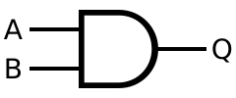
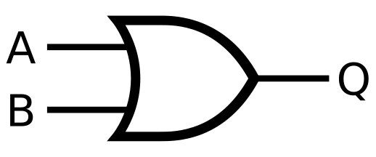

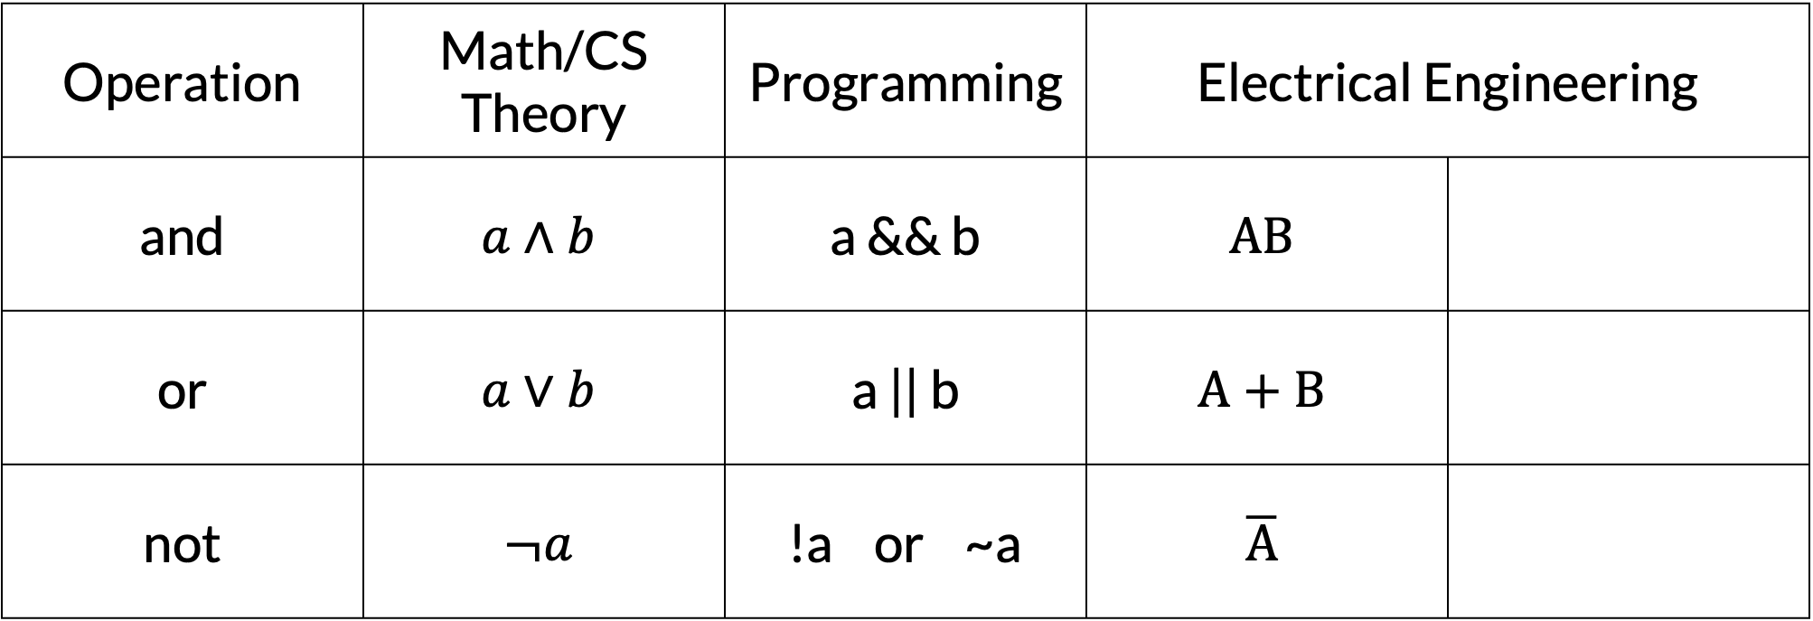
Different notations in different fields
Operation | Math/CS Theory | Programming | Electrical Engineering
and | $$a∧b$$ | a && b | $$AB$$
or | $$a∨b$$ | a || b | $$A+B$$
not | $$¬a$$ | !a or ~a | $$\overline{A}$$

Slide 14
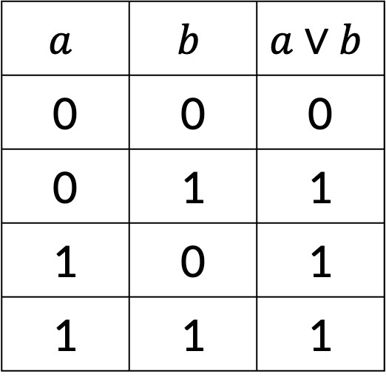
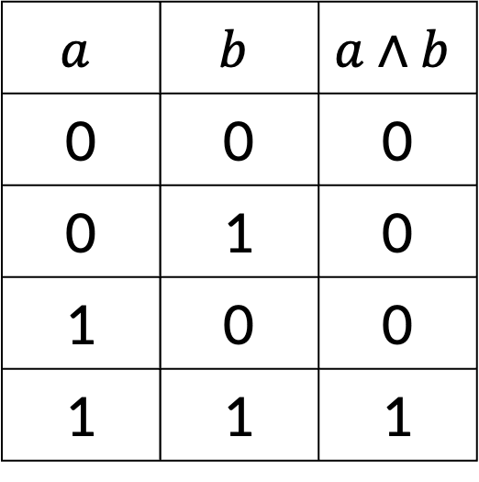
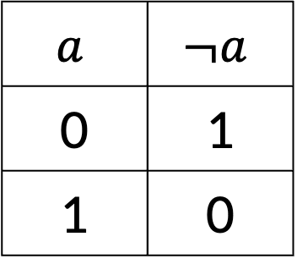
Truth tables
and
or
not
$$a$$ | $$b$$ | $$a∧b$$
0 | 0 | 0
0 | 1 | 0
1 | 0 | 0
1 | 1 | 1
$$a$$ | $$b$$ | $$a∨b$$
0 | 0 | 0
0 | 1 | 1
1 | 0 | 1
1 | 1 | 1
$$a$$ | $$¬a$$
0 | 1
1 | 0

Slide 15
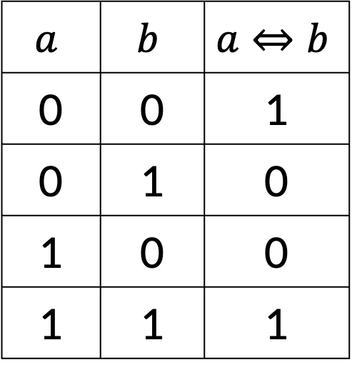
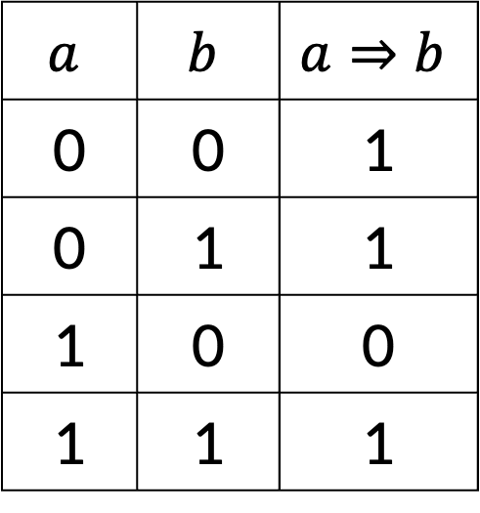
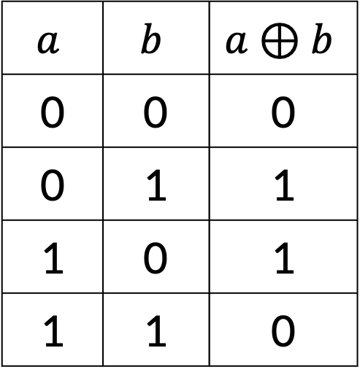
Truth tables
implies
if and only if
exclusive or (xor)
$$a$$ | $$b$$ | $$a⇒b$$
0 | 0 | 1
0 | 1 | 1
1 | 0 | 0
1 | 1 | 1
$$a$$ | $$b$$ | $$a⇔b$$
0 | 0 | 1
0 | 1 | 0
1 | 0 | 0
1 | 1 | 1
$$a$$ | $$b$$ | $$a⊕b$$
0 | 0 | 0
0 | 1 | 1
1 | 0 | 1
1 | 1 | 0

Slide 16
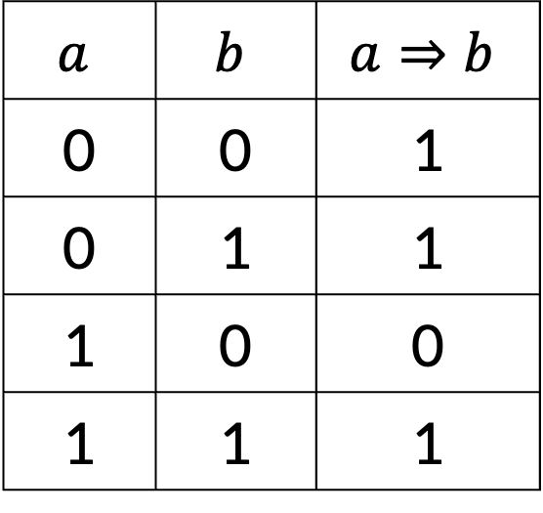

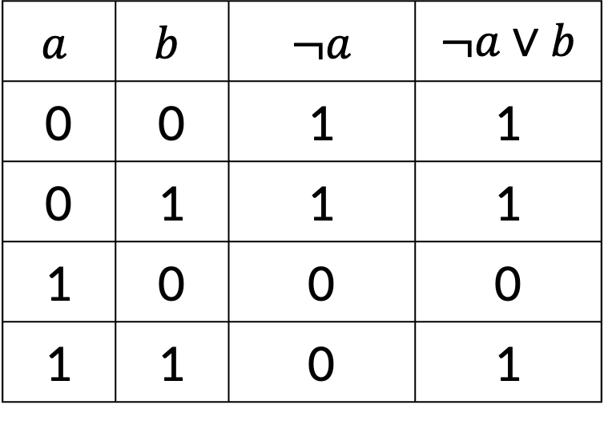
Practice with truth tables
“Do $a⇒b$ and $¬a∨b$ mean the same thing?”
$$a$$ | $$b$$ | $$a⇒b$$
0 | 0 | 1
0 | 1 | 1
1 | 0 | 0
1 | 1 | 1
$$a$$ | $$b$$ | $¬a$ | $¬a∨b$
0 | 0 | 1 | 1
0 | 1 | 1 | 1
1 | 0 | 0 | 0
1 | 1 | 0 | 1
Yes!

Slide 17
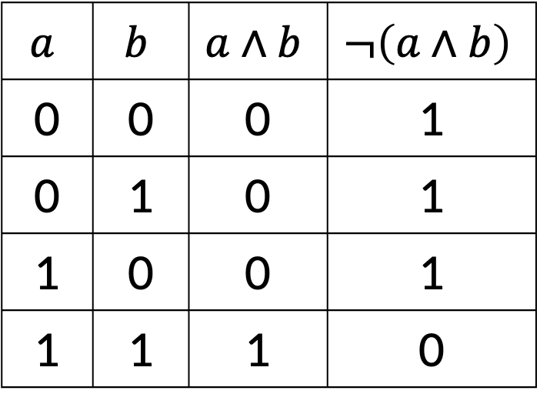

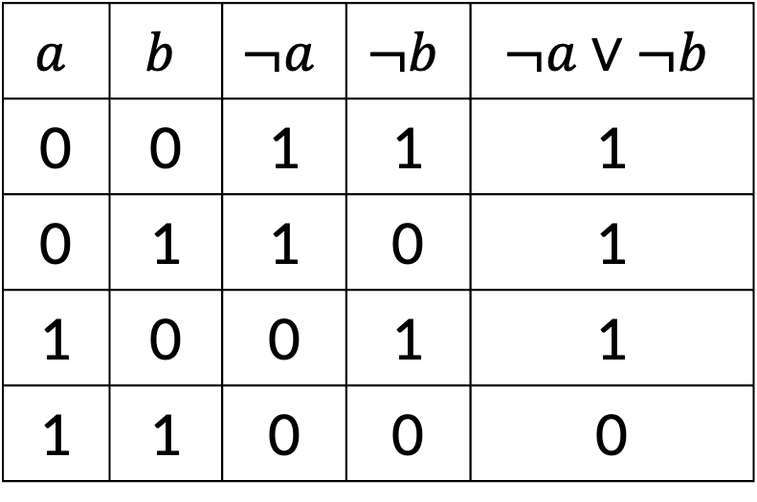
Rewriting expressions
Q: Rewrite $¬\left(a∧b\right)$ to an expression where $¬$ only appears on the “inside” (attached to variables, not larger expressions).
A: $¬a∨¬b$
$$a$$ | $$b$$ | $$a∧b$$ | $$¬\left(a∧b\right)$$
0 | 0 | 0 | 1
0 | 1 | 0 | 1
1 | 0 | 0 | 1
1 | 1 | 1 | 0
$$a$$ | $$b$$ | $$¬a$$ | $$¬b$$ | $$¬a∨¬b$$
0 | 0 | 1 | 1 | 1
0 | 1 | 1 | 0 | 1
1 | 0 | 0 | 1 | 1
1 | 1 | 0 | 0 | 0

Slide 18
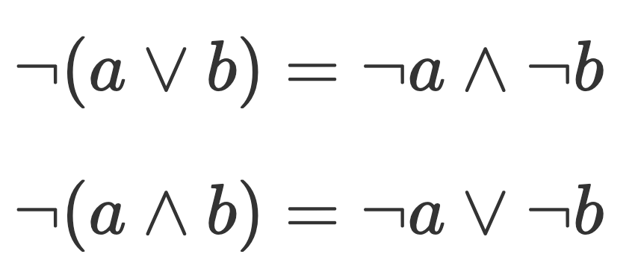
De Morgan’s laws

Slide 19
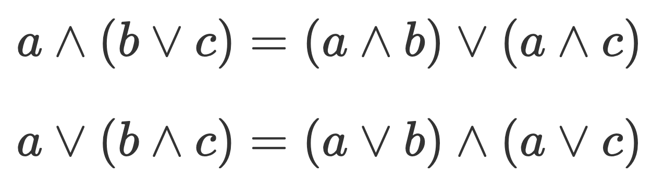

Distributivity laws
Just like $a × \left(b+c\right)=\left(a × b\right)+\left(a × c\right)$, similar things are true for boolean expressions:

Slide 20
All about SAT

Slide 21
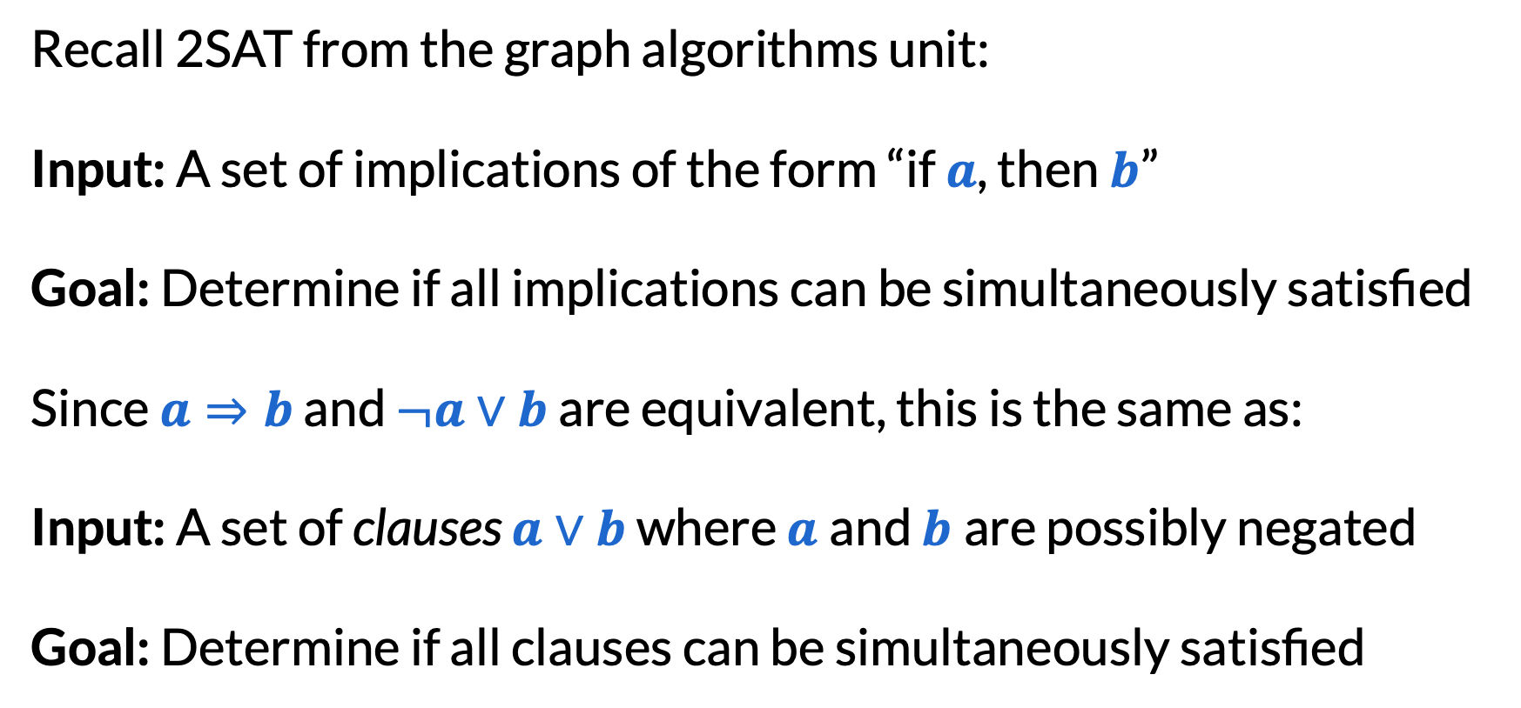
2SAT
Recall 2SAT from the graph algorithms unit:
Input: A set of implications of the form “if $a$, then $b$”
Goal: Determine if all implications can be simultaneously satisfied
Since $a⇒b$ and $¬a∨b$ are equivalent, this is the same as:
Input: A set of clauses $a∨b$ where $a$and $b$are possibly negated
Goal: Determine if all clauses can be simultaneously satisfied

Slide 22
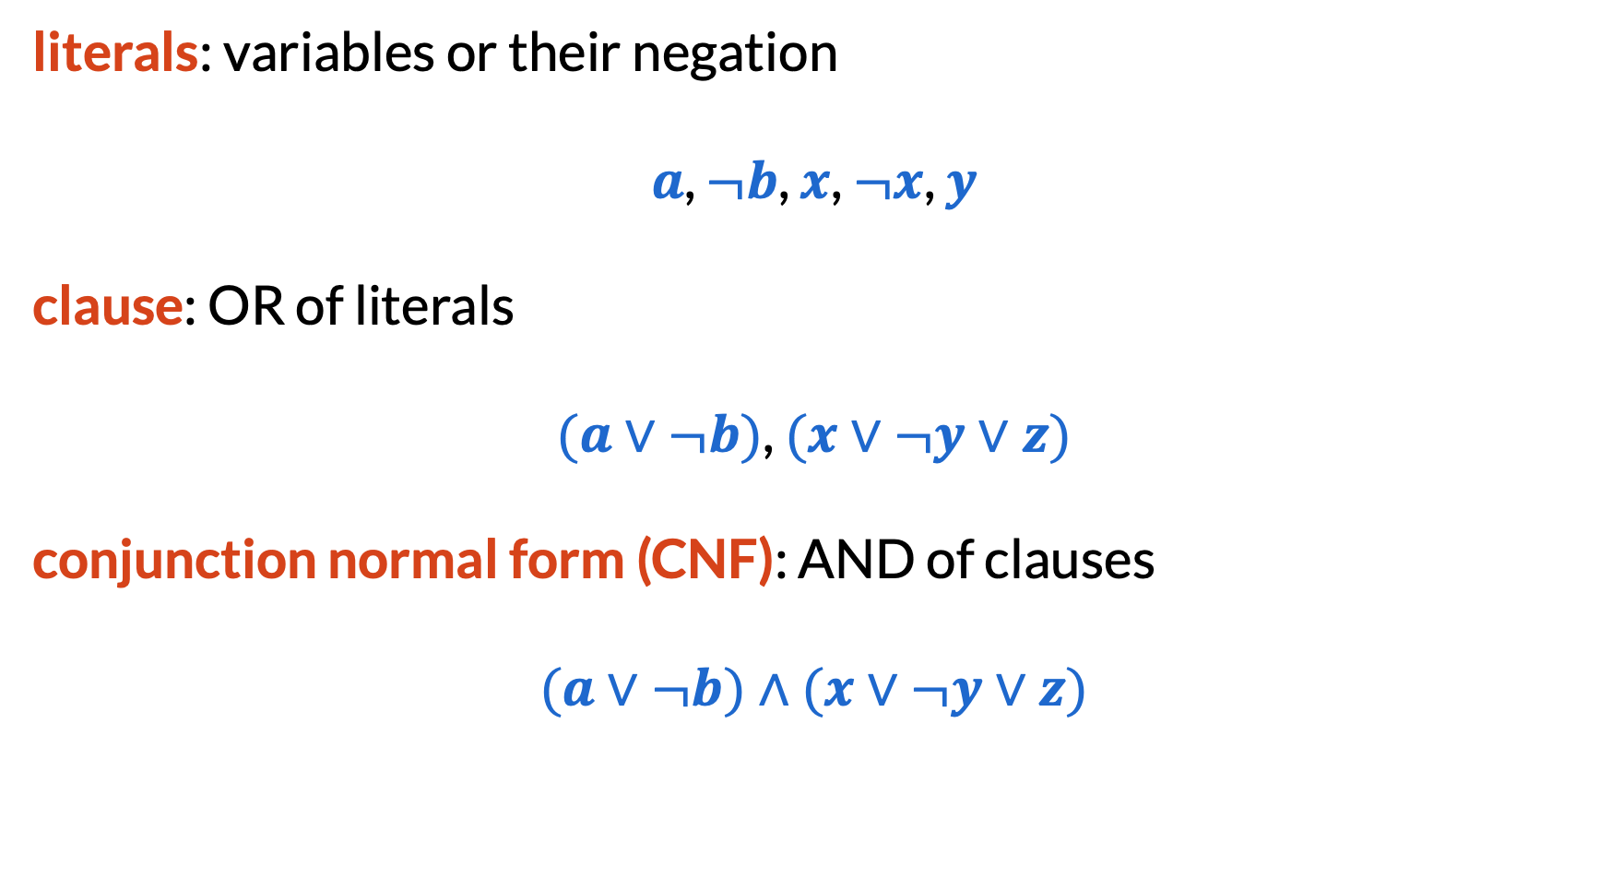
SAT (Satisfiability)
literals: variables or their negation
$a$, $¬b$, $x$, $¬x$, $y$
clause: OR of literals
$(a∨¬b)$, $(x∨¬y∨z)$
conjunction normal form (CNF): AND of clauses
$(a∨¬b)∧(x∨¬y∨z)$

Slide 23
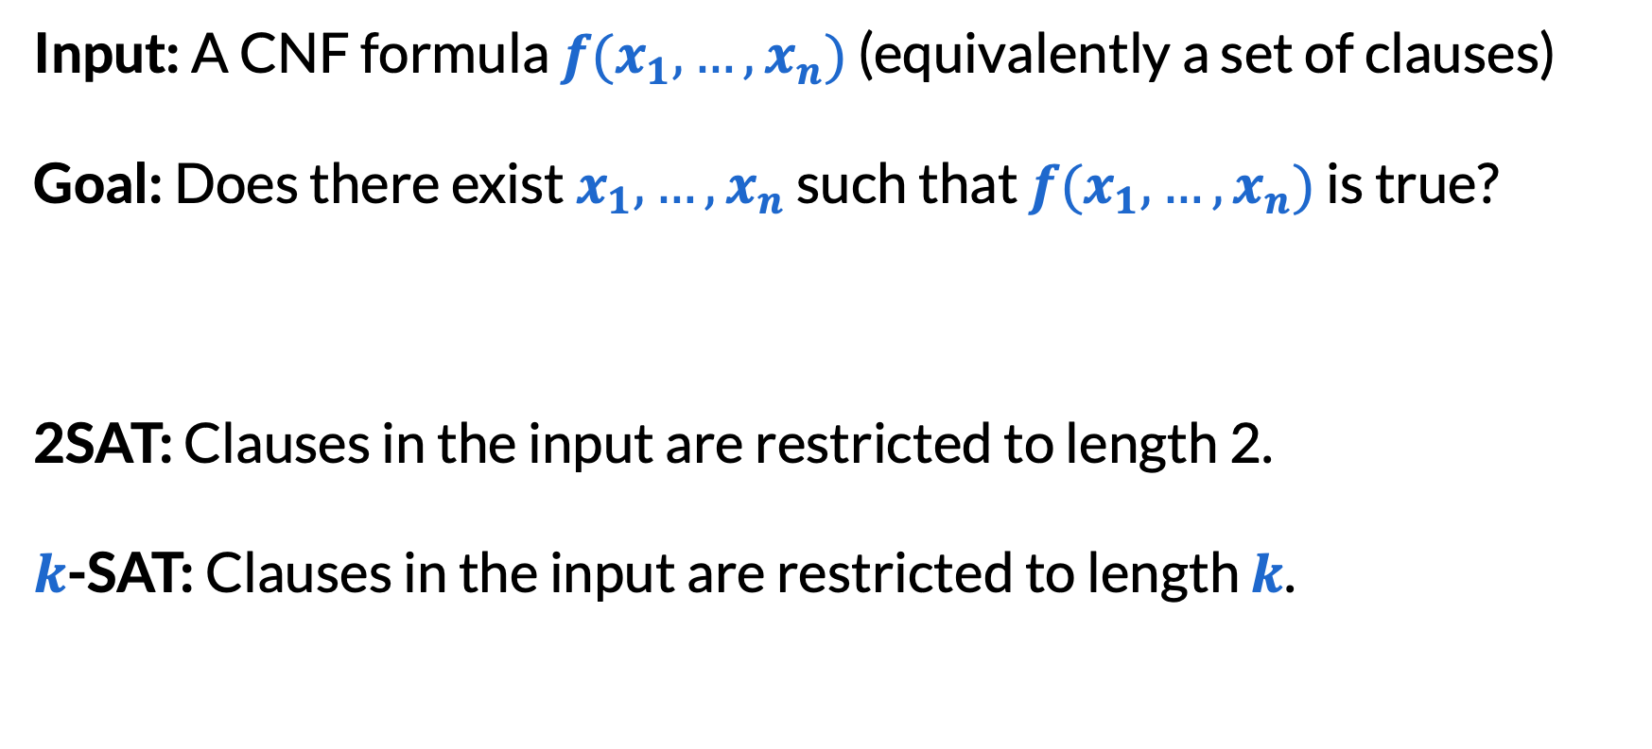
SAT (Satisfiability)
Input: A CNF formula $f(x_{1},…,x_{n})$ (equivalently a set of clauses)
Goal: Does there exist $x_{1},…,x_{n}$ such that $f(x_{1},…,x_{n})$ is true?
2SAT: Clauses in the input are restricted to length 2.
$k$-SAT: Clauses in the input are restricted to length $k$.

Slide 24
SAT example
Q: Is the following CNF satisfiable? Why or why not?
A: No, not satisfiable.
$\left(¬a∨b∨d\right)∧\left(¬b∨c∨d\right)∧\left(a∨¬c∨d\right)∧\left(a∨¬b∨¬d\right)$ $∧\left(b∨¬c∨¬d\right)∧\left(¬a∨c∨¬d\right)∧\left(a∨b∨c\right)∧(¬a∨¬b∨¬c)$

Slide 25
The importance of SAT
SAT was the first problem to be shown to be NP-hard.
This means that: every NP problem can be encoded as an instance of SAT with a small (polynomial overhead).
In other words, if you could find an algorithm to solve SAT, you automatically have an algorithm to solve all NP problems!
Similar to: Using graph algorithms to solve new problems, using Ford–Fulkerson to model new problems, etc.

Slide 26
The importance of SAT
General proof for all NP problems: Cook–Levin theorem, 1971
We won’t cover this, requires a mathematical definition of “what is an algorithm” and “what is a computer” (Turing machines).
Specific cases for some particular NP problems: next class!

Slide 27
NP-completeness
A problem that is both in NP and NP-hard is called NP-complete, such as SAT.
These are the hardest problems in NP.
NP-complete
What we believe (assuming P ≠ NP)
NP
P

Slide 28
Final reminders
HW5 (DP) resubmissions close tonight @ 11:59pm!
HW7 (Flows) due next Wednesday night
I have OH now-12:30pm:
Meet at front of classroom, we’ll walk over together
CSE (Allen) 214 if you’re coming later
Nathan has online OH 12–1pm:
https://washington.zoom.us/my/nathanbrunelle

