Slide 1
Lecture 22: Max Flow Applications
Nathan Brunelle

Slide 2
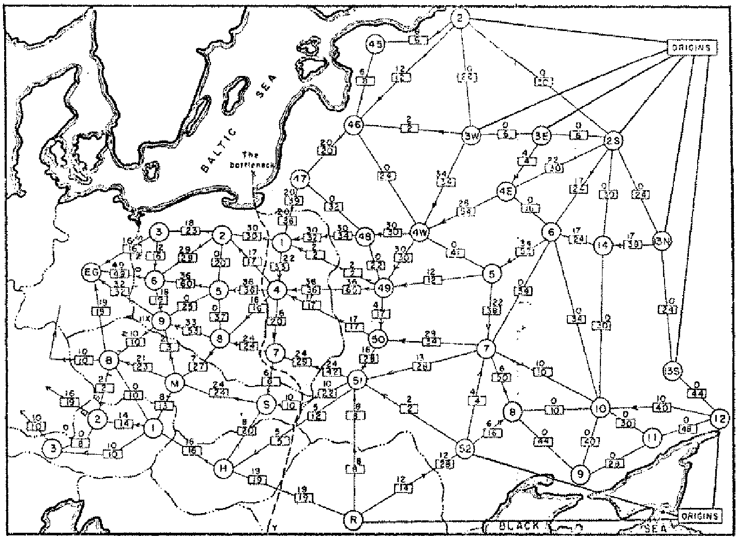
Origins of Max Flow and Min Cut Problems
Max Flow problem formulation:
[Tolstoy 1930] Rail transportation planning for the Soviet Union
Min Cut problem formulation:
  Cold War: US military planners want to find a way to cripple Soviet supply routes
  [Harris 1954] Secret RAND corp report for US Air Force
[Ford-Fulkerson 1955] Problems are equivalent
Soviet Rail Network 1955
Reference: On the history of the transportation and maximum flow problems.
Alexander Schrijver in Math Programming, 91: 3, 2002.
Notes:
Russian scientist A. N. Tolstoi investigated soviet rail network. Wanted to optimize amount of cargo that could be shipped from origins in Soviet Union (right) to destination satellite counties (Poland, Czechoslovakia, Austria, Eastern Germany) (left). American scientists Harris and Ross were also interested in Soviet rail system but from a different perspective. In a secret report (declassified at Schrijver's request in 1999), Harris and Ross calculated a "minimum interdiction" of 163,000 tons.
after aggregation, 44 vertices, 105 edges

Slide 3



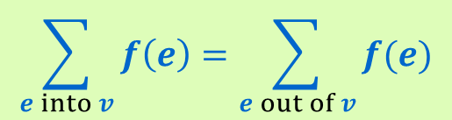
Flow Graph
Defn: An $s$-$t$ flow in a flow network is a function $f: E  ℝ$ that satisfies:
    For each $e∈E$: $0≤ f\left(e\right)≤ c(e)$ [capacity constraints]
    For each $v∈V−\{s,t\}$:
Defn: The value of flow $f$,
$$\sum_{e into v}{f\left(e\right)=\sum_{e out of v}{f(e)}}$$
[flow conservation]
a
6/9
d
$$v\left(f\right)=\sum_{e out of s}{f\left(e\right)}$$
10/10
4/4
15
15
6/10
s
3/5
b
8/8
e
8/10
t
Only show non-zero values of $f$
11/15
4
1/6
15
10/10
value = 24
c
11/30
f
Notes:
source = where material originates, sink = where material goes.
We use cut to mean s-t cut.

Slide 4

Maximum Flow Problem
Given: a flow network
Find: an $s$-$t$ flow of maximum value
a
6/9
d
10/10
4/4
15
15
6/10
s
3/5
b
8/8
e
8/10
t
11/15
4
1/6
15
value = 24
10/10
c
11/30
f
Notes:
source = where material originates, sink = where material goes.
We use cut to mean s-t cut.

Slide 5
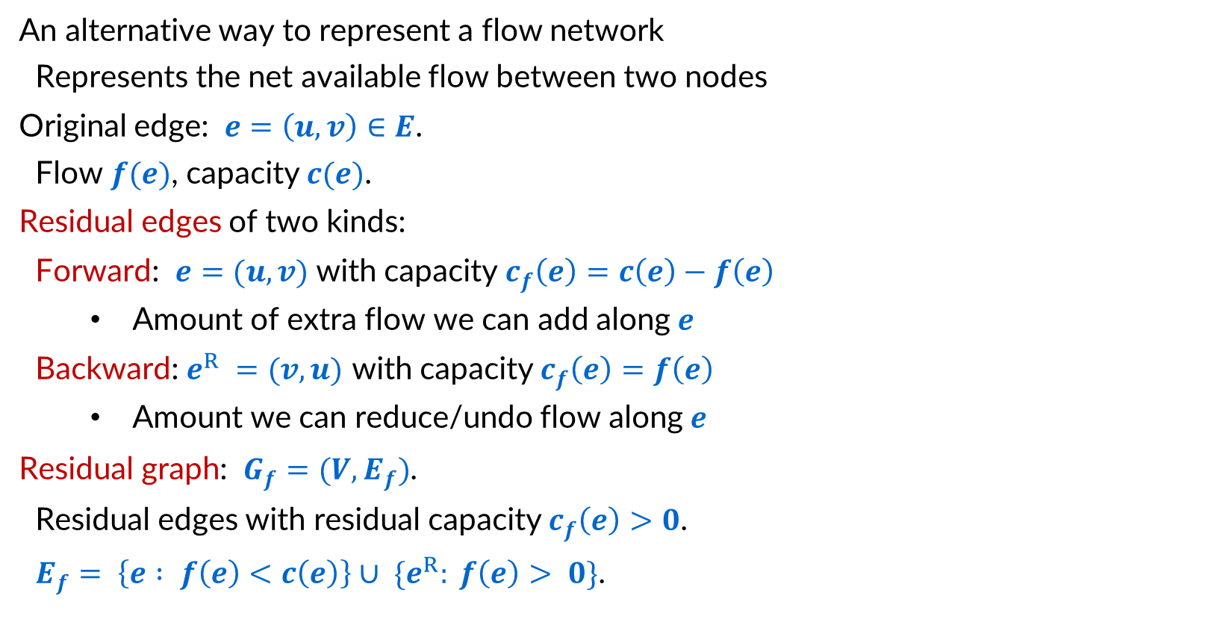
Residual Graphs
An alternative way to represent a flow network
  Represents the net available flow between two nodes
Original edge: $e=\left(u, v\right)∈E$.
  Flow $f(e)$, capacity $c(e)$.
Residual edges of two kinds:
  Forward: $e=(u, v)$ with capacity $c_{f}\left(e\right)=c\left(e\right)−f\left(e\right)$
    Amount of extra flow we can add along $e$
  Backward: $e^{R} =(v, u)$ with capacity $c_{f}\left(e\right)=f\left(e\right)$
    Amount we can reduce/undo flow along $e$
Residual graph: $G_{f}=(V, E_{f})$.
  Residual edges with residual capacity $c_{f}\left(e\right)>0$.
  $E_{f}= \left\{e : f\left(e\right)<c\left(e\right)\right\}∪ \{e^{R}: f\left(e\right)> 0\}$.
u
6/17
v
residual capacity
u
11
v
6
residual capacity

Slide 6
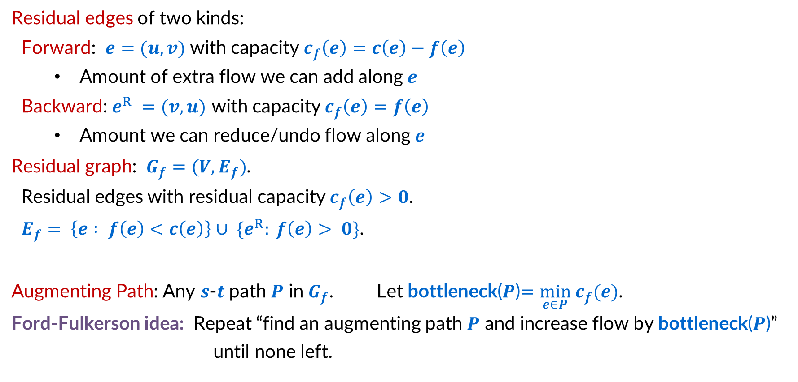
Residual Graphs and Augmenting Paths
residual capacity
Residual edges of two kinds:
  Forward: $e=(u, v)$ with capacity $c_{f}\left(e\right)=c\left(e\right)−f\left(e\right)$
    Amount of extra flow we can add along $e$
  Backward: $e^{R} =(v, u)$ with capacity $c_{f}\left(e\right)=f\left(e\right)$
    Amount we can reduce/undo flow along $e$
Residual graph: $G_{f}=(V, E_{f})$.
  Residual edges with residual capacity $c_{f}\left(e\right)>0$.
  $E_{f}= \left\{e : f\left(e\right)<c\left(e\right)\right\}∪ \{e^{R}: f\left(e\right)> 0\}$.
Augmenting Path: Any $s$-$t$ path $P$ in $G_{f}$. Let bottleneck($P$)$=\min_{e∈P} c_{f}(e)$.
Ford-Fulkerson idea: Repeat “find an augmenting path $P$ and increase flow by bottleneck($P$)” until none left.
u
11
v
6
residual capacity

Slide 7
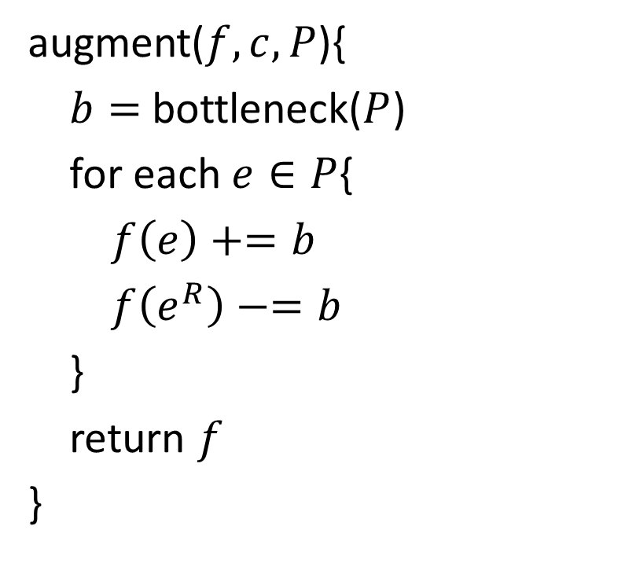
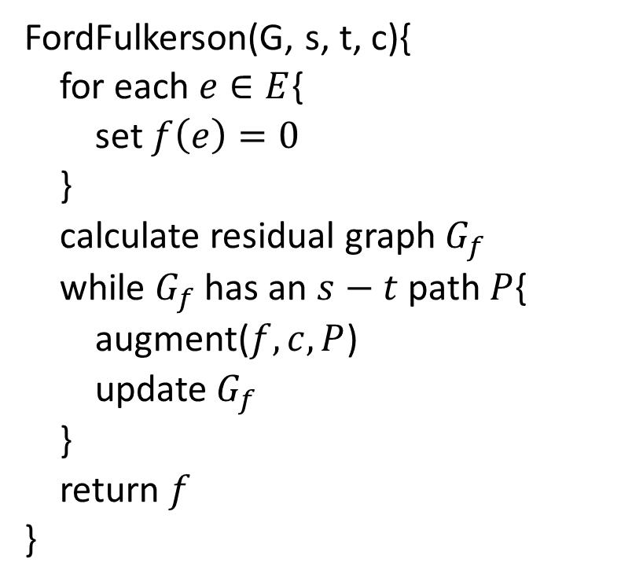
Fork Fulkerson Algorithm
FordFulkerson(G, s, t, c){
for each $e∈E${
set $f\left(e\right)=0$
}
calculate residual graph $G_{f}$
while $G_{f}$ has an $s−t$ path $P${
augment($f,c,P$)
update $G_{f}$
}
return $f$
}
augment($f,c,P$){
$b=$ bottleneck($P$)
for each $e∈P${
$f\left(e\right)+=b$
$f\left(e^{R}\right)−=b$
}
return $f$
}

Slide 8


Cuts
Defn: An $s$-$t$ cut is a partition $(A,B)$ of $V$ with $s∈A$ and $t∈B$.
  The capacity of cut $(A,B)$ is
  $$c\left(A,B\right)=\sum_{e out of A}{c(e)}$$
a
9
d
capacity 30
10
4
15
15
10
source
s
5
b
8
e
10
t
sink
$$A$$
4
6
15
15
10
c
30
f
Notes:
source = where material originates, sink = where material goes.
We use cut to mean s-t cut.

Slide 9


Cuts
Defn: An $s$-$t$ cut is a partition $(A,B)$ of $V$ with $s∈A$ and $t∈B$.
  The capacity of cut $(A,B)$ is
  $$c\left(A,B\right)=\sum_{e out of A}{c(e)}$$
a
9
d
capacity 48
10
4
15
15
10
source
s
5
b
8
e
10
t
sink
$$A$$
15
15
4
6
10
c
30
f
Notes:
source = where material originates, sink = where material goes.
We use cut to mean s-t cut.

Slide 10


Minimum Cut Problem
Minimum s-t cut problem:
Given: a flow network
Find: an $s$-$t$ cut of minimum capacity
a
9
d
capacity 28
10
4
15
15
10
source
s
5
b
8
e
10
t
sink
$$A$$
15
15
4
6
10
c
30
f
Notes:
source = where material originates, sink = where material goes.
We use cut to mean s-t cut.

Slide 11
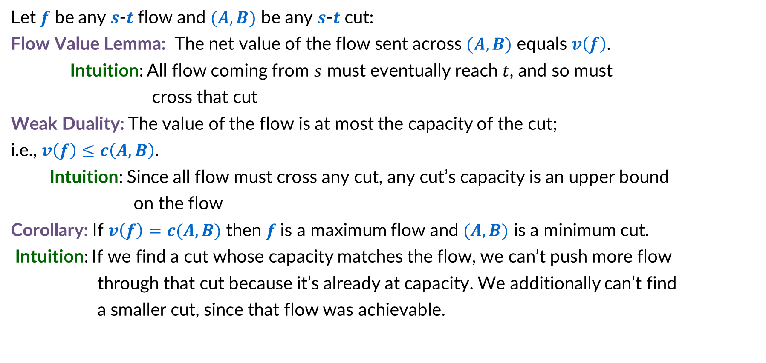
Flows and Cuts
Let $f$ be any $s$-$t$ flow and $(A,B)$ be any $s$-$t$ cut:
Flow Value Lemma: The net value of the flow sent across $(A,B)$ equals $v\left(f\right)$.
Intuition: All flow coming from $s$ must eventually reach $t$, and so must
cross that cut
Weak Duality: The value of the flow is at most the capacity of the cut; i.e., $v\left(f\right)≤c\left(A,B\right)$.
Intuition: Since all flow must cross any cut, any cut’s capacity is an upper bound
on the flow
Corollary: If $v\left(f\right)=c(A,B)$ then $f$ is a maximum flow and $(A,B)$ is a minimum cut.
Intuition: If we find a cut whose capacity matches the flow, we can’t push more flow
through that cut because it’s already at capacity. We additionally can’t find
a smaller cut, since that flow was achievable.

Slide 12
Flows and Cuts (Simplified)
The net flow crossing any cut equals the flow value.
    Why? Everything must cross the cut eventually
The capacity of any cut therefore is an upper bound on the max flow
    Why? No flow can exceed that capacity due to statement 1
If we found a flow whose value matches the capacity of some cut, then we know that the flow must be maximum, and the cut must be minimum
    Why? If there was a smaller cut or larger flow, we’ve broken statement 2
  What we need for correctness:
  When Ford-Fulkerson terminates, there exists a cut whose capacity matches the current flow value.

Slide 13


Certificate of Optimality
Let $f$ be any $s$-$t$ flow and $(A,B)$ be any $s$-$t$ cut.
If $v\left(f\right)=c(A,B)$ then $f$ is a max flow and $(A,B)$ is a min cut.
a
9/9
d
Value of flow = 28
10/10
4
1/15
15
9/10
Capacity of cut = 28
s
4/5
b
8/8
e
9/10
t
$$A$$
Both are optimal!
Each “certified” correctness of the other!
4
4/6
15
14/15
10/10
c
14/30
f
Notes:
source = where material originates, sink = where material goes.
We use cut to mean s-t cut.

Slide 14

Identifying the cut
To Show: If there is no augmenting path w.r.t. $f$, there is a cut $(A, B)$ s.t. $v(f)=c(A, B)$.
Selecting a cut: Let $f$ be a flow with no augmenting paths.
  Let $A$ be the set of vertices reachable from $s$ in residual graph $G_{f}$.
  By definition of $A$, $s∈A$.
  Since no augmenting path ($s$-$t$ path in $G_{f}$), $t∉A$.
Notice:
all edges out of the cut are saturated (flow=capacity)
all edges into the cut have no flow
a
9/9
d
a
9
d
14
1
10/10
4
1/15
15
9/10
10
4
1
15
9
$$A$$
s
4/5
b
8/8
e
9/10
t
s
1
b
8
e
9
t
4
1
4
4
4/6
15
1
4
2
15
14/15
10/10
10
14
14
c
14/30
f
c
16
f
Flow Graph
Residual Graph

Slide 15

Flow Value = Cut Capacity
To Show: If there is no augmenting path w.r.t. $f$, there is a cut $(A, B)$ s.t. $v(f)=c(A, B)$.
The cut: $A$ is the set of all nodes reachable from $s$ in the residual graph
$B$ is the set of all the other nodes in the graph
Showing Flow value = Cut Capacity:
For any edge outgoing from $A$ to $B$, that edge is saturated (flow = capacity)
Otherwise there would be an edge in the residual graph for the remaining capacity. Contradiction!
For any edge incoming from $B$ to $A$, that edge has no flow (flow = 0)
Otherwise there would be an edge in the residual graph to undo the flow. Contradiction!
So summing the flows of all $A$ to $B$edges is the same as summing the capacities!
a
9/9
d
a
9
d
14
1
10/10
4
1/15
15
9/10
$$A$$
10
4
1
15
9
s
4/5
b
8/8
e
9/10
t
s
1
b
8
e
9
t
4
4
1
14/15
4
4/6
15
1
4
2
15
10
10/10
14
14
c
14/30
f
c
16
f
Flow Graph
Residual Graph

Slide 16
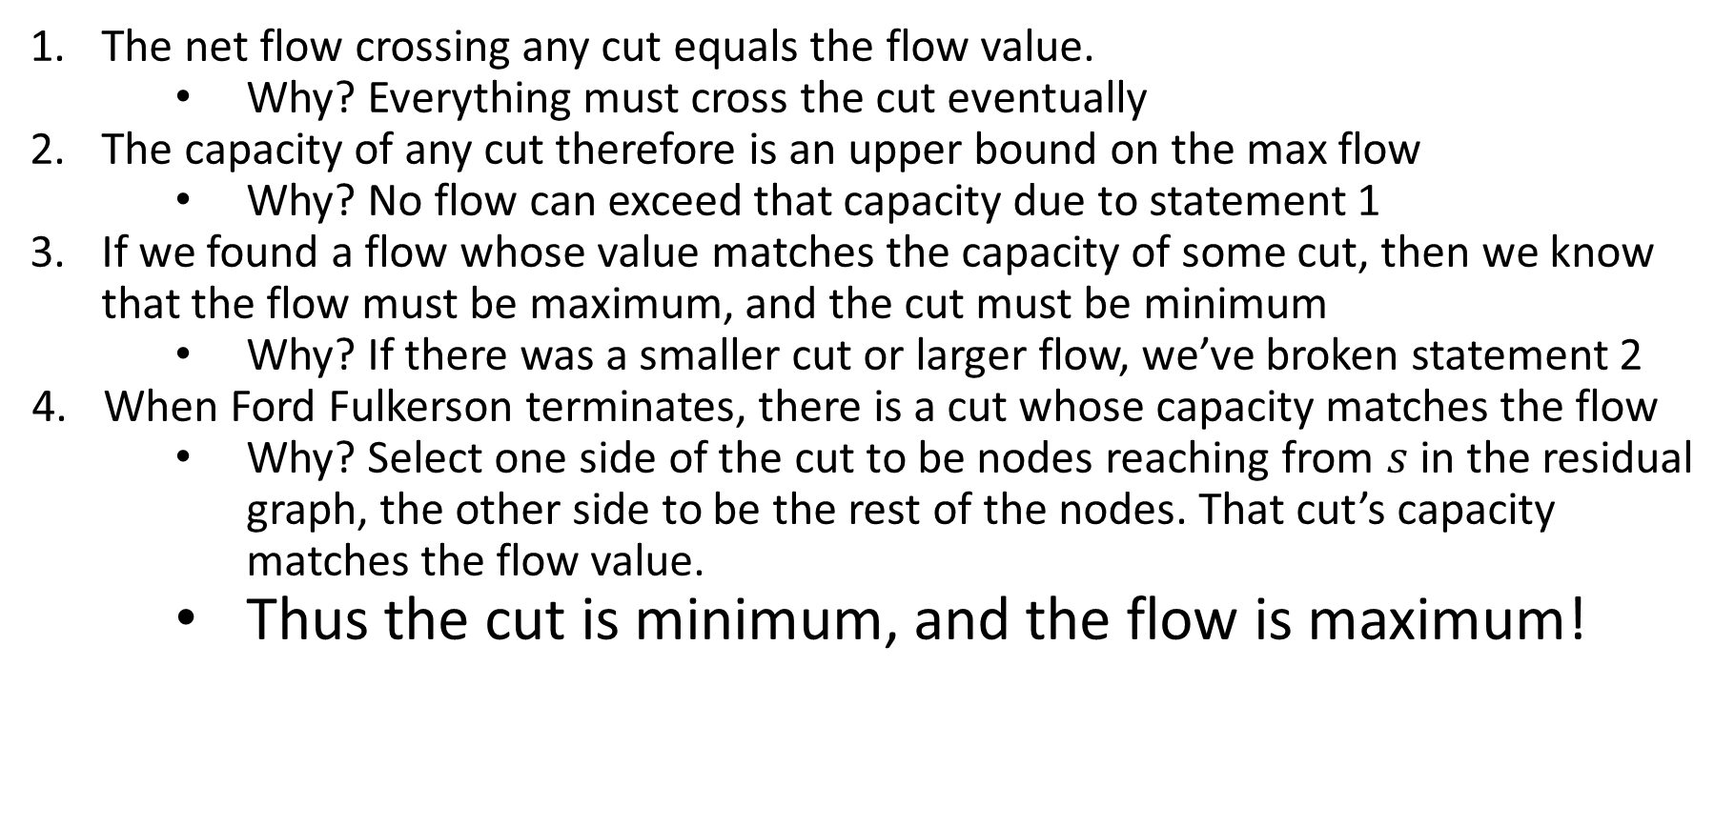
Flows and Cuts (Complete)
The net flow crossing any cut equals the flow value.
    Why? Everything must cross the cut eventually
The capacity of any cut therefore is an upper bound on the max flow
    Why? No flow can exceed that capacity due to statement 1
If we found a flow whose value matches the capacity of some cut, then we know that the flow must be maximum, and the cut must be minimum
    Why? If there was a smaller cut or larger flow, we’ve broken statement 2
When Ford Fulkerson terminates, there is a cut whose capacity matches the flow
    Why? Select one side of the cut to be nodes reaching from $s$ in the residual graph, the other side to be the rest of the nodes. That cut’s capacity matches the flow value.
    Thus the cut is minimum, and the flow is maximum!

Slide 17



Ford-Fulkerson Running Time
Worst case runtime $O\left(mnC\right)$ with integer capacities $≤C$.
  $O(m)$ time per iteration.
  At most $nC$ iterations.
  This is “pseudo-polynomial” running time.
May take exponential time, even with integer capacities:
$\text{c}=109$, say
1
1
1
a
c
a
c-1
a
c-1
c
c
c-1
s
1
t
s
1
t
s
1
t
etc.
c
c
c-1
c
c-1
c-1
b
b
b
1
$$G_{f}=G$$
1
1

Slide 18
Applications of Max Flow
Max flow is most useful when paired with reductions
Reduction idea:
  Create an algorithm for a new problem by transforming it into a different problem that can be solved by a preexisting algorithm
Reduction Definition - A pair of procedures:
  One that takes inputs for the new problem and transforms them into inputs for the old problem
  One that takes solutions from the old problem and converts those into solutions for the new problem
    Note: this second procedure only needs to apply to solutions to inputs that could possible come from the reduction (i.e. it does not have to work for every possible solution)
The way we’ll use max flow:
  Start with a non max flow problem
  Write a procedure to convert its input to a flow network
  Use Ford-Fulkerson to find the max flow through the network
  Use that max flow to find the solution to our non max flow problem.

Slide 19
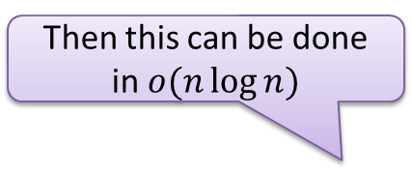
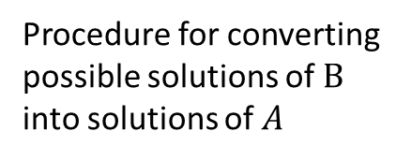





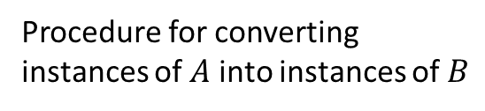



Reductions
Problem $A$
Problem $B$
$$A$$
$$B$$
Procedure for converting instances of $A$ into instances of $B$
Algorithm for solving $B$
Procedure for converting possible solutions of $B$ into solutions of $A$
Solution for $A$
Solution for chosen input of $B$
$$X$$
$$Y$$
Reduction

Slide 20
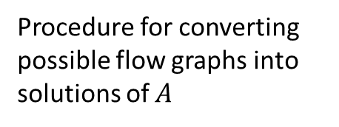
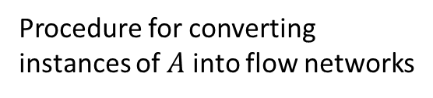
Max Flow Reductions
Problem $A$
Max Flow Problem
$$A$$
a
9
d
10
4
15
15
10
Procedure for converting instances of $A$ into flow networks
s
5
b
8
e
10
t
15
4
6
15
10
c
30
f
Ford-Fulkerson
Procedure for converting possible flow graphs into solutions of $A$
A maximal flow graph for that network
Solution for $A$
a
6/9
d
$$X$$
10/10
4/4
15
15
6/10
s
3/5
b
8/8
e
8/10
t
11/15
4
1/6
15
10/10
Reduction
c
11/30
f

Slide 21


Shift Scheduling
The manager at a bagel shop needs to staff all shifts during the day.
We have the following constraints:
  Shift $s_{i}$ must have at least $p_{i}$ people assigned to it
  Each employee $e_{i}$ has a list of shifts that they are able to work
  No employee is able to work more than $x$ shifts
Shifts:
6am, 2
9am, 2
12pm, 1
3pm, 1
Employees:
6am, 9am, 3pm
6am, 9am, 12pm
6am, 3pm
Solution:
Employee 1 assigned to 6am, 9am
Employee 2 assigned to 9am, 12pm
Employee 3 assigned to 6am, 3pm
$$x=2$$

Slide 22
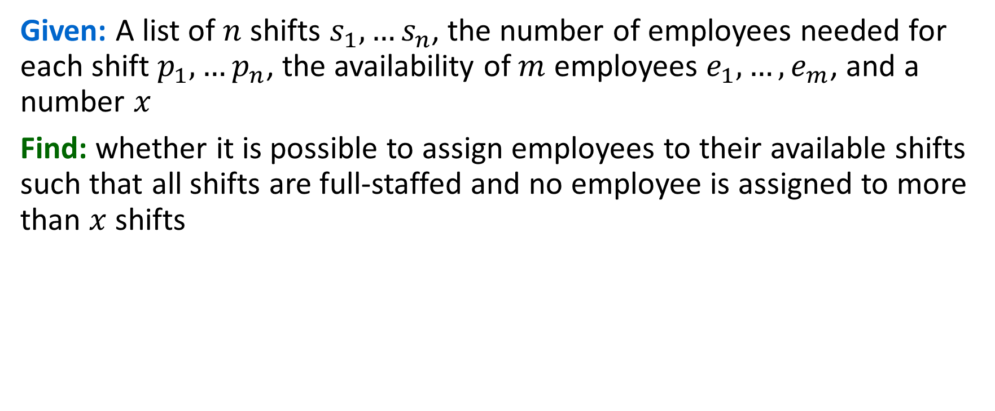
Shift Scheduling problem
Given: A list of $n$ shifts $s_{1},…s_{n}$, the number of employees needed for each shift $p_{1},…p_{n}$, the availability of $m$ employees $e_{1},…,e_{m}$, and a number $x$
Find: whether it is possible to assign employees to their available shifts such that all shifts are full-staffed and no employee is assigned to more than $x$ shifts
Shifts:
6am, 2
9am, 2
12pm, 1
3pm, 1
Employees:
6am, 9am, 3pm
6am, 9am, 12pm
6am, 3pm
Solution:
Employee 1 assigned to 6am, 9am
Employee 2 assigned to 9am, 12pm
Employee 3 assigned to 6am, 3pm
$$x=2$$

Slide 23










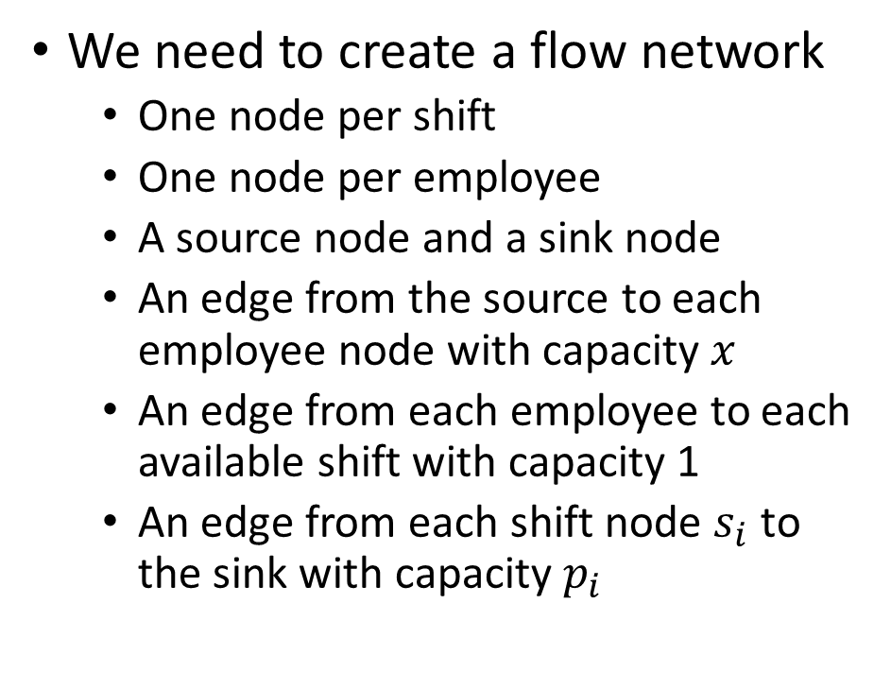

















Reducing to Max Flow
We need to create a flow network
  One node per shift
  One node per employee
  A source node and a sink node
  An edge from the source to each employee node with capacity $x$
  An edge from each employee to each available shift with capacity 1
  An edge from each shift node $s_{i}$ to the sink with capacity $p_{i}$
$$e_{1}$$
$$1$$
$$s_{1}$$
$$1$$
$$x$$
$$p_{1}$$
$$e_{2}$$
$$1$$
$$s_{2}$$
$$x$$
$$1$$
$$p_{2}$$
$$s$$
$$t$$
$$1$$
$$x$$
$$p_{3}$$
$$e_{3}$$
$$1$$
$$s_{3}$$
…
…
$$p_{n}$$
$$x$$
$$1$$
$$1$$
$$e_{m}$$
$$1$$
$$s_{n}$$

Slide 24





















Reducing to Max Flow
Shifts:
6am, 2
9am, 2
12pm, 1
3pm, 1
Employees:
6am, 9am, 3pm
6am, 9am, 12pm
6am, 3pm
$$x=2$$
We need to create a flow network
  One node per shift
  One node per employee
  A source node and a sink node
  An edge from the source to each employee node with capacity $x$
  An edge from each employee to each available shift with capacity 1
  An edge from each shift node $s_{i}$ to the sink with capacity $p_{i}$
$$e_{1}$$
$$1$$
$$6$$
$$1$$
$$1$$
$$2$$
$$2$$
$$e_{2}$$
$$9$$
$$2$$
$$1$$
$$2$$
$$s$$
$$1$$
$$t$$
$$2$$
$$1$$
$$1$$
$$e_{3}$$
$$12$$
$$1$$
$$1$$
$$3$$

Slide 25










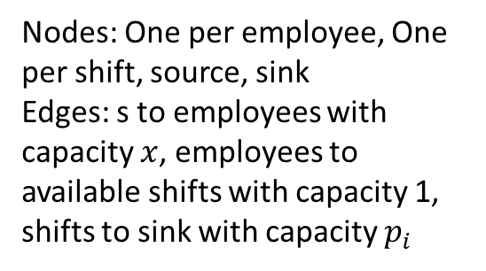

























Shift Scheduling Reduces to Max Flow
Max Flow Problem
Shift Scheduling
$$e_{1}$$
$$1$$
$$6$$
$$1$$
$$1$$
$$2$$
$$2$$
Shifts:
6am, 2
9am, 2
12pm, 1
3pm, 1
Employees:
6am, 9am, 3pm
6am, 9am, 12pm
6am, 3pm
$$2$$
$$e_{2}$$
$$1$$
$$9$$
$$2$$
$$s$$
$$1$$
$$t$$
Nodes: One per employee, One per shift, source, sink
Edges: s to employees with capacity $x$, employees to available shifts with capacity 1, shifts to sink with capacity $p_{i}$
$$1$$
$$2$$
$$1$$
$$e_{3}$$
$$12$$
$$1$$
$$1$$
$$3$$
$$x=2$$
Ford-Fulkerson
A maximal flow graph for that network
Schedule
If an employee-shift edge has flow, assign the employee to that shift
$$e_{1}$$
$$1/1$$
$$6$$
$$1$$
1/$1$
Solution:
Employee 1 assigned to 6am, 9am
Employee 2 assigned to 9am, 12pm
Employee 3 assigned to 6am, 3pm
$$2/2$$
$$2/2$$
$$2/2$$
$$e_{2}$$
$$1/1$$
$$9$$
$$2/2$$
$$s$$
$$1/1$$
$$t$$
$$2/2$$
$$1/1$$
$$1/1$$
Reduction
$$e_{3}$$
$$12$$
$$1/1$$
1/$1$
$$3$$

Slide 26
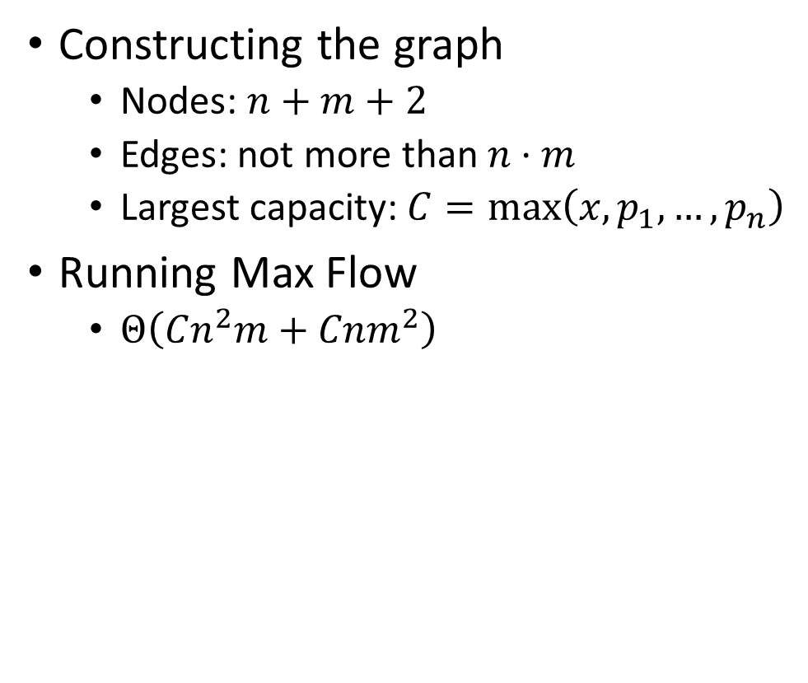
Running Time
Constructing the graph
  Nodes: $n+m+2$
  Edges: not more than $n⋅m$
  Largest capacity: $C=\max\left(x, p_{1},…,p_{n}\right)$
Running Max Flow
  $Θ\left(Cn^{2}m+Cnm^{2}\right)$
$$e_{1}$$
$$1$$
$$s_{1}$$
$$1$$
$$x$$
$$p_{1}$$
$$e_{2}$$
$$1$$
$$s_{2}$$
$$x$$
$$1$$
$$p_{2}$$
$$s$$
$$t$$
$$1$$
$$x$$
$$p_{3}$$
$$e_{3}$$
$$1$$
$$s_{3}$$
…
…
$$p_{n}$$
$$x$$
$$1$$
$$1$$
$$e_{m}$$
$$1$$
$$s_{n}$$

Slide 27
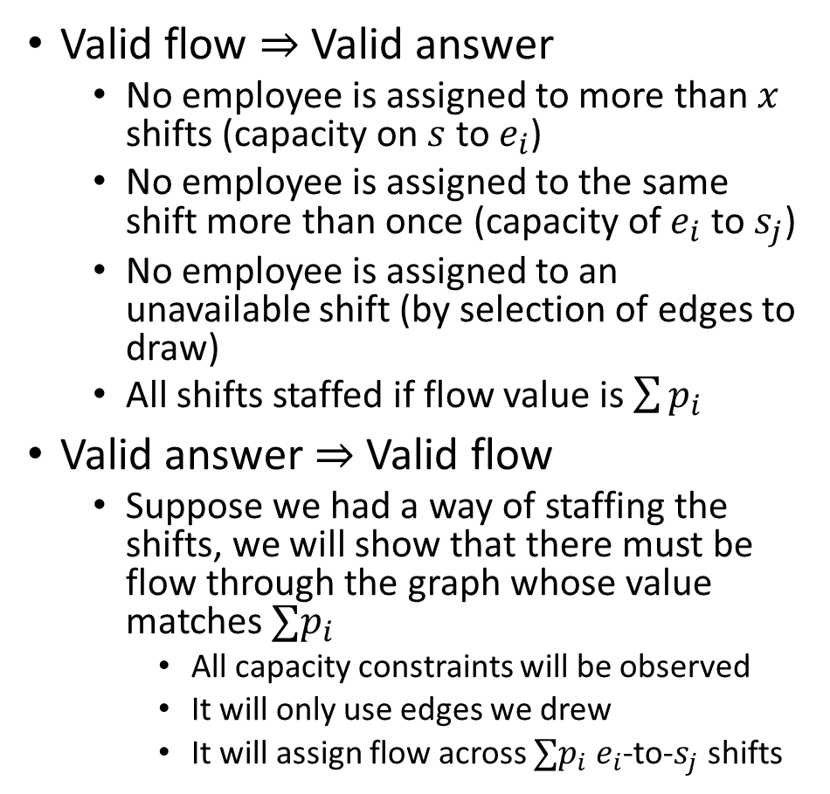
Correctness
Valid flow $⇒$ Valid answer
  No employee is assigned to more than $x$ shifts (capacity on $s$ to $e_{i}$)
  No employee is assigned to the same shift more than once (capacity of $e_{i}$ to $s_{j}$)
  No employee is assigned to an unavailable shift (by selection of edges to draw)
  All shifts staffed if flow value is $\sum{p_{i}}$
Valid answer $⇒$ Valid flow
  Suppose we had a way of staffing the shifts, we will show that there must be flow through the graph whose value matches $∑p_{i}$
    All capacity constraints will be observed
    It will only use edges we drew
    It will assign flow across $∑p_{i}$ $e_{i}$-to-$s_{j}$ shifts
$$e_{1}$$
$$1$$
$$s_{1}$$
$$1$$
$$x$$
$$p_{1}$$
$$e_{2}$$
$$1$$
$$s_{2}$$
$$x$$
$$1$$
$$p_{2}$$
$$s$$
$$t$$
$$1$$
$$x$$
$$p_{3}$$
$$e_{3}$$
$$1$$
$$s_{3}$$
…
…
$$p_{n}$$
$$x$$
$$1$$
$$1$$
$$e_{m}$$
$$1$$
$$s_{n}$$

Slide 28

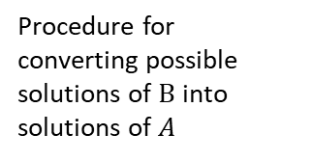



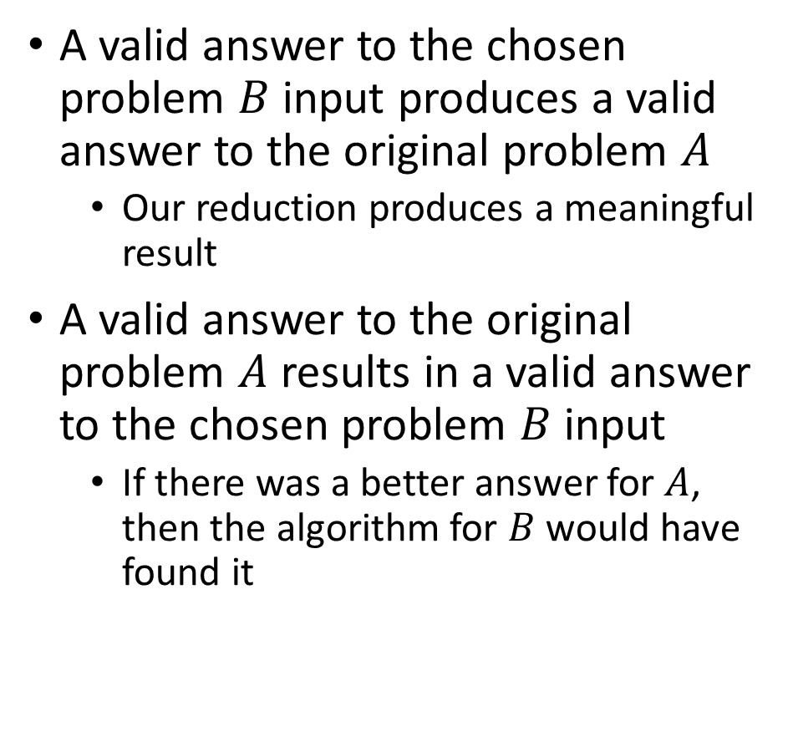

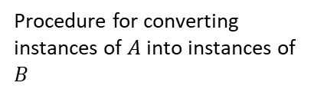




Reductions and Correctness
A valid answer to the chosen problem $B$ input produces a valid answer to the original problem $A$
  Our reduction produces a meaningful result
A valid answer to the original problem $A$ results in a valid answer to the chosen problem $B$ input
  If there was a better answer for $A$, then the algorithm for $B$ would have found it
Problem $A$
Problem $B$
$$A$$
$$B$$
Procedure for converting instances of $A$ into instances of $B$
Algorithm for
solving $B$
Procedure for converting possible solutions of $B$ into solutions of $A$
Solution for $A$
Solution for chosen
input of $B$
$$X$$
$$Y$$
Reduction

Slide 29

Edge-Disjoint Paths
Defn: Two paths in a graph are edge-disjoint iff they have no edge in common.
Edge disjoint path problem: Given: a directed graph $G=(V,E)$ and two vertices $s$ and $t$. Find: the maximum # of edge-disjoint simple $s$-$t$ paths in $G$.
a
d
s
b
e
t
c
f

Slide 30

Edge-Disjoint Paths – Example of size 2
Defn: Two paths in a graph are edge-disjoint iff they have no edge in common.
Edge disjoint path problem: Given: a directed graph $G=(V,E)$ and two vertices $s$ and $t$. Find: the maximum # of edge-disjoint simple $s$-$t$ paths in $G$.
a
d
s
b
e
t
c
f

Slide 31






Edge-Disjoint Paths
MaxFlow for edge-disjoint paths
  Assign capacity $1$ to every edge
  Add a source $s′$ and a sink $t′$
  Connect $s′$ to $s$ and $t′$ to $t$ with capacity $m$ (number of edges)
    At most every edge is its own path
  Compute max flow
  Use all edges with flow
Running Time:
Constructing the flow network: $O(n+m)$
Computing Max Flow: $O(nm^{2})$
Overall: $Θ\left(nm^{2}\right)$
a
1
d
1
1
1
1
1
$$s′$$
$$m$$
1
1
$$m$$
s
b
e
t
$$t′$$
1
1
1
1
1
c
1
f

Slide 32



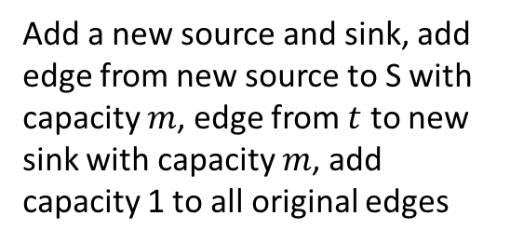



Edge Disjoint Paths Reduction to Max Flow
Max Flow Problem
Edge Disjoint Paths
a
d
1
1
1
1
1
a
d
1
1
$$s′$$
$$m$$
s
b
e
1
t
$$m$$
$$t′$$
1
1
1
1
1
Add a new source and sink, add edge from new source to S with capacity $m$, edge from $t$ to new sink with capacity $m$, add capacity 1 to all original edges
s
b
e
t
c
1
f
c
f
Ford-Fulkerson
A maximal flow graph for that network
a
d
If an employee-shift edge has flow, assign the employee to that shift
1/1
a
1
d
1
1/1
1
1
1/1
s
b
e
t
$$s′$$
s
1/1
b
e
t
$$t′$$
$$2/m$$
1/1
1/1
1/1
$$2/m$$
1
1/1
c
1/1
f
c
f
Reduction

Slide 33





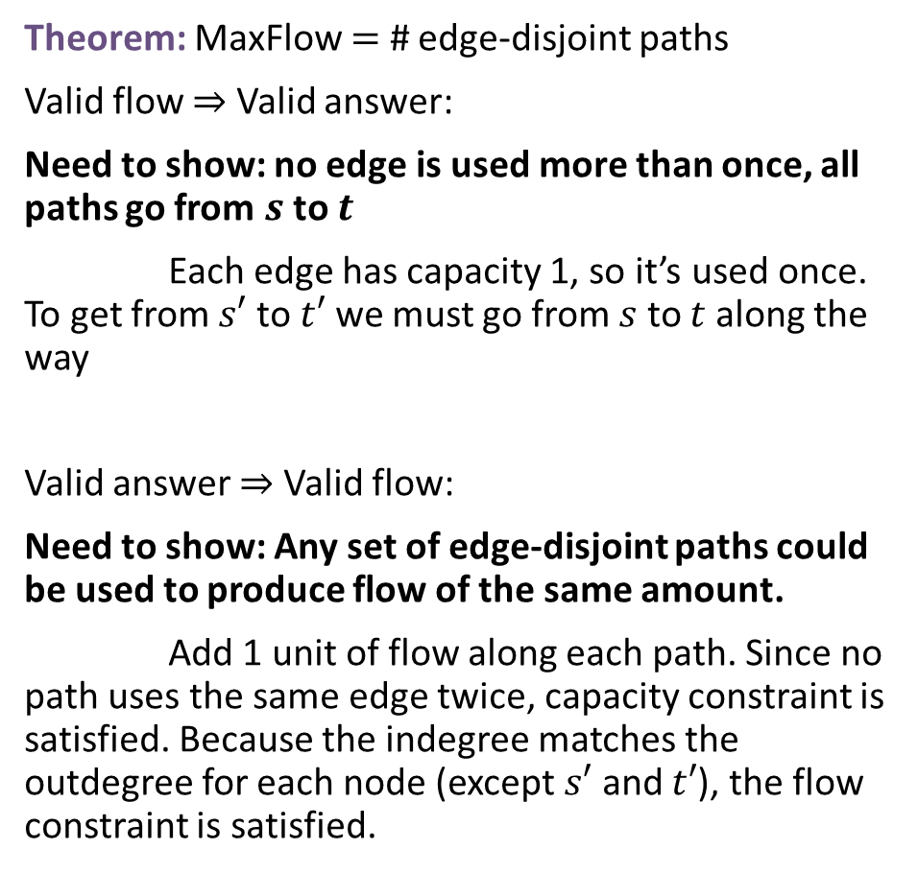
Edge-Disjoint Paths
Theorem: MaxFlow $=$ # edge-disjoint paths
Valid flow $⇒$ Valid answer:
Need to show: no edge is used more than once, all paths go from $s$ to $t$
Each edge has capacity 1, so it’s used once. To get from $s′$ to $t′$ we must go from $s$ to $t$ along the way
Valid answer $⇒$ Valid flow:
Need to show: Any set of edge-disjoint paths could be used to produce flow of the same amount.
Add 1 unit of flow along each path. Since no path uses the same edge twice, capacity constraint is satisfied. Because the indegree matches the outdegree for each node (except $s′$ and $t′$), the flow constraint is satisfied.
MaxFlow for edge-disjoint paths
  Assign capacity $1$ to every edge
  Add a source $s′$ and a sink $t′$
  Connect $s′$ to $s$ and $t′$ to $t$ with capacity $m$
  Compute max flow
  Use all edges with flow
a
1
d
1/1
1/1
1
1
1
$$s′$$
$$m$$
1/1
1/1
$$m$$
$$t′$$
s
b
e
t
1
1/1
1/1
1/1
1/1
c
1/1
f

Slide 34

Vertex-Disjoint Paths
Defn: Two paths in a graph are vertex-disjoint iff they have no vertices in common, except their end points.
Vertex disjoint path problem: Given: a directed graph $G=(V,E)$ and two vertices $s$ and $t$.
Find: the maximum # of vertex-disjoint simple $s$-$t$ paths in $G$.
a
d
s
b
e
t
c
f

Slide 35



Vertex-Disjoint Paths
Defn: Two paths in a graph are vertex-disjoint iff they have no vertices in common.
Vertex disjoint path problem: Given: a directed graph $G=(V,E)$ and two vertices $s$ and $t$.
Find: the maximum # of vertex-disjoint simple $s$-$t$ paths in $G$.
a
d
Observation: Every vertex-disjoint path is also edge-disjoint.
(Two paths which share an edge also share that edge’s endpoints)
Idea: Modify the graph so that all edge-disjoint paths are also vertex disjoint
s
b
e
t
c
f
$$a$$
$$a_{out}$$

Slide 36
Vertex Disjoint Paths Reduction to Edge-Disjoint Paths
Edge Disjoint Paths
Vertex Disjoint Paths
a
d
a
d
s
b
e
t
Split each node into a “in” and “out” node. Add an edge from in to out
s
b
e
t
c
f
c
f
Reduction to Max Flow
Maximal set of Edge-disjoint paths
Recombine the split nodes
a
d
a
d
s
b
e
t
s
b
e
t
Reduction
c
f
c
f

Slide 37
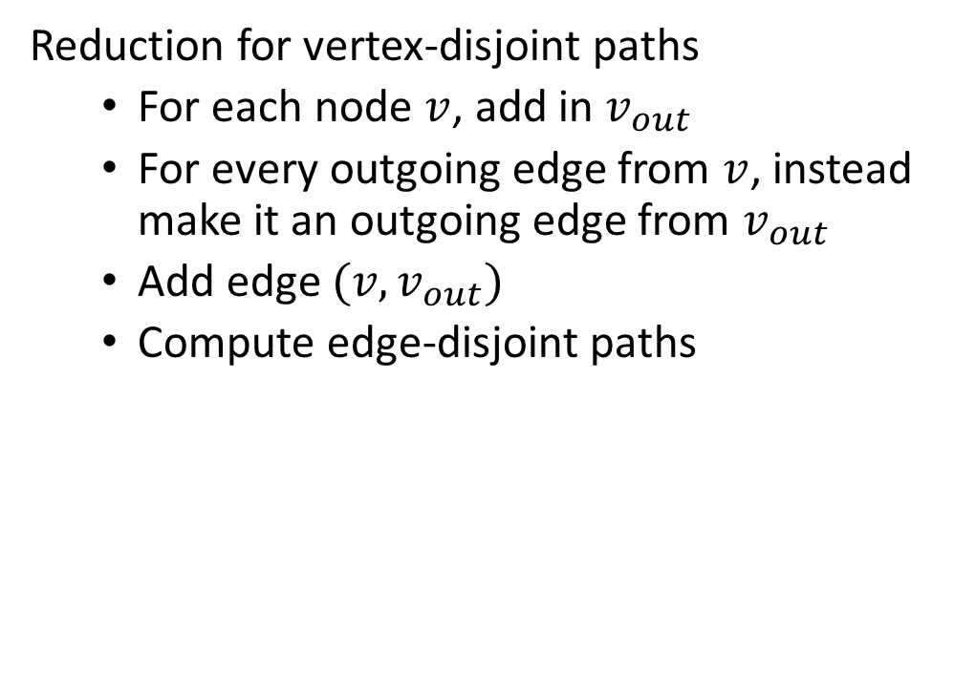

Vertex-Disjoint Paths Running time
Reduction for vertex-disjoint paths
  For each node $v$, add in $v_{out}$
  For every outgoing edge from $v$, instead make it an outgoing edge from $v_{out}$
  Add edge $(v, v_{out})$
  Compute edge-disjoint paths
Running Time:
Constructing the new graph: $O(n+m)$
Computing edge disjoint paths: $O\left(nm^{2}\right)$
Overall: $O\left(nm^{2}\right)$
a
d
b
e
t
c
f

Slide 38
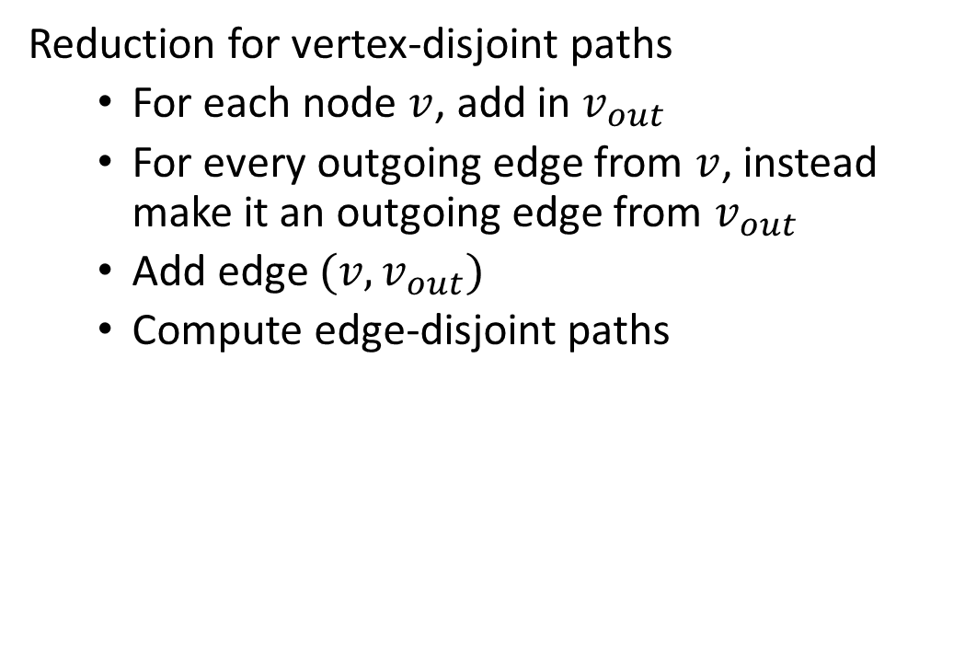
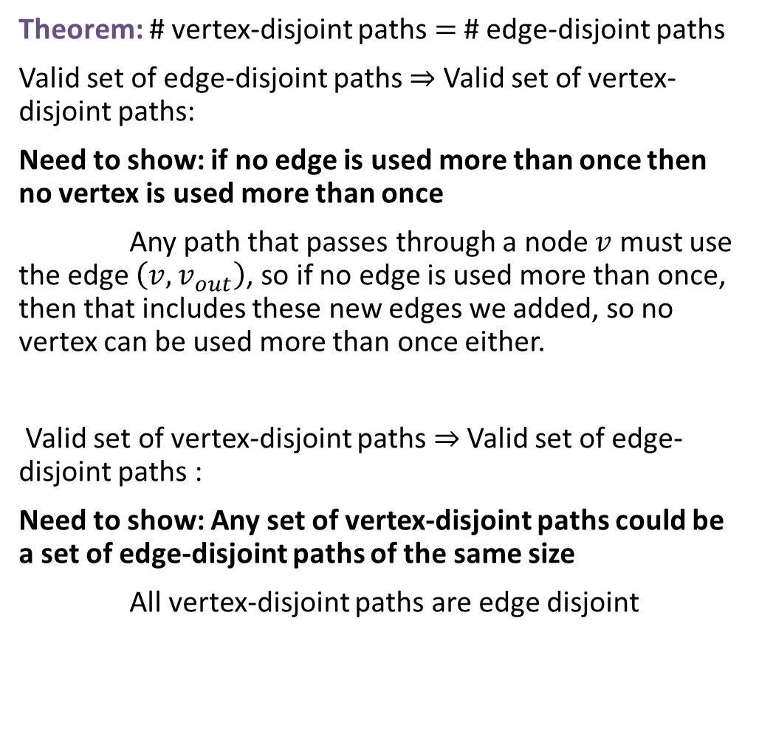
Vertex-Disjoint Paths
Theorem: # vertex-disjoint paths $=$ # edge-disjoint paths
Valid set of edge-disjoint paths $⇒$ Valid set of vertex-disjoint paths:
Need to show: if no edge is used more than once then no vertex is used more than once
Any path that passes through a node $v$ must use the edge $\left(v,v_{out}\right)$, so if no edge is used more than once, then that includes these new edges we added, so no vertex can be used more than once either.
Valid set of vertex-disjoint paths $⇒$ Valid set of edge-disjoint paths :
Need to show: Any set of vertex-disjoint paths could be a set of edge-disjoint paths of the same size
All vertex-disjoint paths are edge disjoint
Reduction for vertex-disjoint paths
  For each node $v$, add in $v_{out}$
  For every outgoing edge from $v$, instead make it an outgoing edge from $v_{out}$
  Add edge $(v, v_{out})$
  Compute edge-disjoint paths
a
d
s
b
e
t
c
f

Slide 39
Final reminders
HW6 due today @ 11:59pm.
HW7 released today, due Wednesday 11/26 @ 11:59pm
Quiz 2 on Friday 11/21 in class
We’ll release a practice quiz this evening
I have OH now-12:30pm:
Meet at front of classroom, we’ll walk over together
CSE (Allen) 434 if you’re coming later
Glenn has online OH 12–1pm

