Slide 1
Lecture 21: Max Flow
Nathan Brunelle

Slide 2
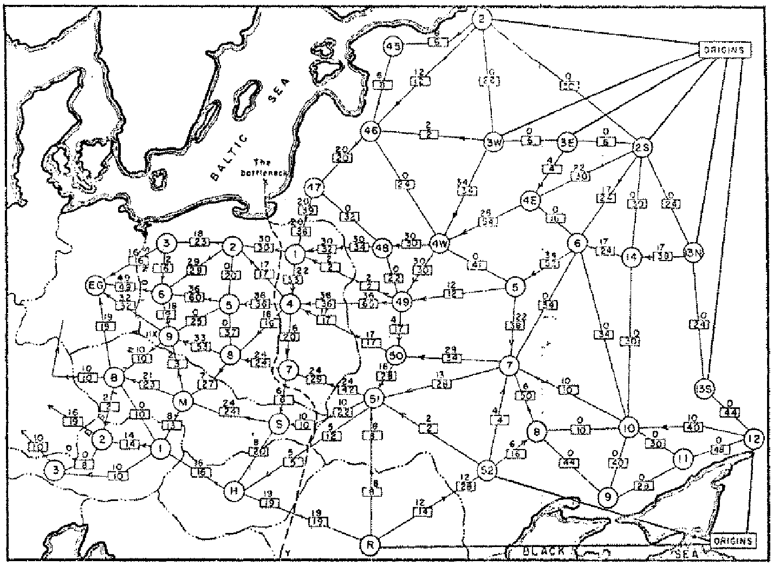
Origins of Max Flow and Min Cut Problems
Max Flow problem formulation:
[Tolstoy 1930] Rail transportation planning for the Soviet Union
Min Cut problem formulation:
  Cold War: US military planners want to find a way to cripple Soviet supply routes
  [Harris 1954] Secret RAND corp report for US Air Force
[Ford-Fulkerson 1955] Problems are equivalent
Soviet Rail Network 1955
Reference: On the history of the transportation and maximum flow problems.
Alexander Schrijver in Math Programming, 91: 3, 2002.
Notes:
Russian scientist A. N. Tolstoi investigated soviet rail network. Wanted to optimize amount of cargo that could be shipped from origins in Soviet Union (right) to destination satellite counties (Poland, Czechoslovakia, Austria, Eastern Germany) (left). American scientists Harris and Ross were also interested in Soviet rail system but from a different perspective. In a secret report (declassified at Schrijver's request in 1999), Harris and Ross calculated a "minimum interdiction" of 163,000 tons.
after aggregation, 44 vertices, 105 edges

Slide 3

Flow Network
Flow network:
  Abstraction for material flowing through the edges.
  $G=(V, E)$ directed graph, no parallel edges.
  Two distinguished nodes: $s$ = source, $t$= sink.
  $c(e)$ = capacity of edge$e≥0$.
a
9
d
10
4
15
15
10
source
s
5
b
8
e
10
t
sink
4
6
15
10
capacity
15
c
30
f
Notes:
source = where material originates, sink = where material goes.
We use cut to mean s-t cut.

Slide 4



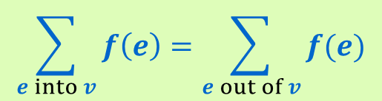
Flow Graph
Defn: An $s$-$t$ flow in a flow network is a function $f: E  ℝ$ that satisfies:
    For each $e∈E$: $0≤ f\left(e\right)≤ c(e)$ [capacity constraints]
    For each $v∈V−\{s,t\}$:
Defn: The value of flow $f$,
$$\sum_{e into v}{f\left(e\right)=\sum_{e out of v}{f(e)}}$$
[flow conservation]
a
9
d
$$v\left(f\right)=\sum_{e out of s}{f\left(e\right)}$$
4/10
4/4
15
15
10
s
5
b
4/8
e
4/10
t
Only show non-zero values of $f$
15
4
6
15
10
value = 4
c
30
f
Notes:
source = where material originates, sink = where material goes.
We use cut to mean s-t cut.

Slide 5
Another Flow Graph
Defn: An $s$-$t$ flow in a flow network is a function $f: E  ℝ$ that satisfies:
    For each $e∈E$: $0≤ f\left(e\right)≤ c(e)$ [capacity constraints]
    For each $v∈V−\{s,t\}$:
Defn: The value of flow $f$,
$$\sum_{e into v}{f\left(e\right)=\sum_{e out of v}{f(e)}}$$
[flow conservation]
a
6/9
d
$$v\left(f\right)=\sum_{e out of s}{f\left(e\right)}$$
10/10
4/4
15
15
6/10
s
3/5
b
8/8
e
8/10
t
Only show non-zero values of $f$
11/15
4
1/6
15
10/10
value = 24
c
11/30
f
Notes:
source = where material originates, sink = where material goes.
We use cut to mean s-t cut.

Slide 6

Maximum Flow Problem
Given: a flow network
Find: an $s$-$t$ flow of maximum value
a
6/9
d
10/10
4/4
15
15
6/10
s
3/5
b
8/8
e
8/10
t
11/15
4
1/6
15
value = 24
10/10
c
11/30
f
Notes:
source = where material originates, sink = where material goes.
We use cut to mean s-t cut.

Slide 7
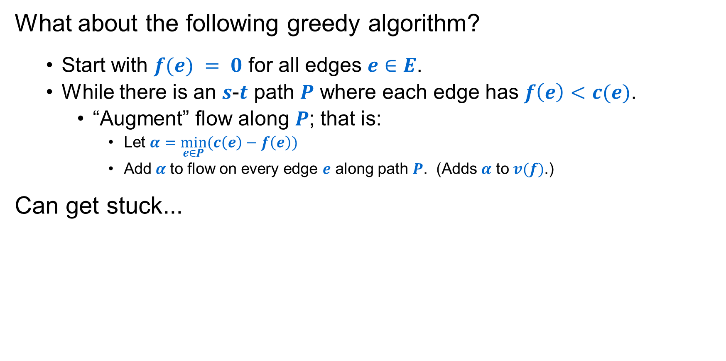
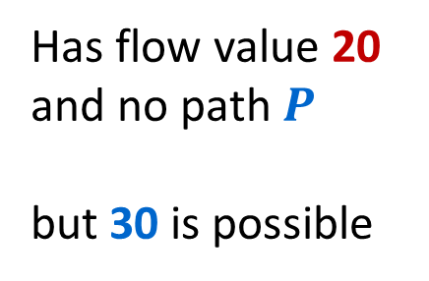
Attempt at a Greedy Solution
What about the following greedy algorithm?
  Start with $f(e) = 0$ for all edges $e∈E$.
  While there is an $s$-$t$ path $P$ where each edge has $f\left(e\right)<c(e)$.
    “Augment” flow along $P$; that is:
      Let $α=\min_{e∈P}(c\left(e\right)−f\left(e\right))$
      Add$α$ to flow on every edge $e$ along path $P$. (Adds $α$ to $v(f)$.)
Can get stuck...
u
u
Has flow value 20
and no path $P$
but 30 is possible
20/20
10
20/20
10/10
s
20/30
t
s
10/30
t
10
20/20
10/10
20/20
v
v

Slide 8

Another “Stuck” Example
On every $s$-$t$ path there is some edge with $f\left(e\right)=c(e)$:
a
6/9
d
Value of flow = 24
10/10
4/4
15
15
6/10
s
3/5
b
8/8
e
8/10
t
11/15
4
1/6
15
10/10
c
11/30
f
Next idea: Ford-Fulkerson Algorithm, which applies greedy ideas to a “residual graph” that lets us reverse prior flow decisions from the basic greedy approach to get optimal results!
Notes:
source = where material originates, sink = where material goes.
We use cut to mean s-t cut.

Slide 9
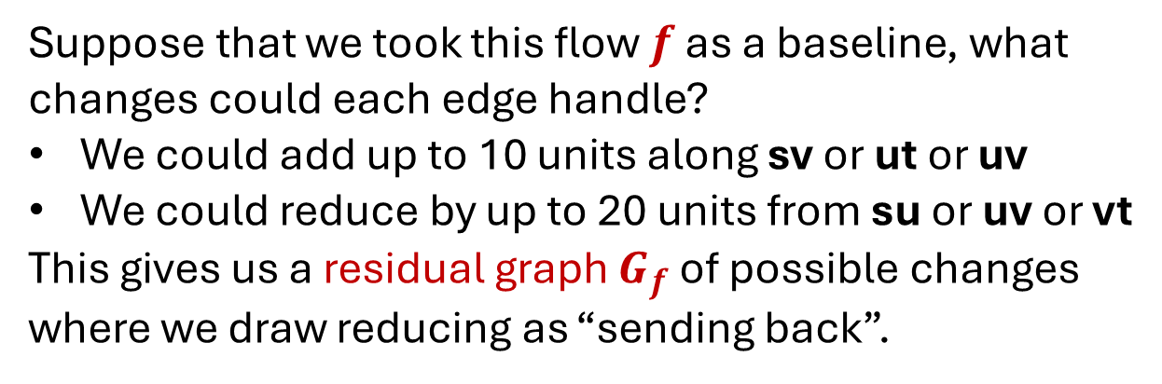
Greed Revisited: Residual Graph & Augmenting Paths
u
To get more flow from s to t we need to reduce the flow from u to v
To conserve flow in and out of u we need to increase the flow from u to t by that same amount.
20/20
10
s
20/30
t
10
20/20
v
Suppose that we took this flow $f$ as a baseline, what changes could each edge handle?
We could add up to 10 units along sv or ut or uv
We could reduce by up to 20 units from su or uv or vt
This gives us a residual graph $G_{f}$ of possible changes where we draw reducing as “sending back”.
u
20
10
s
20
10
t
10
20
v

Slide 10

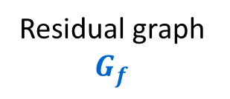
Greed Revisited: Residual Graph & Augmenting Paths
u
u
Augment flow along path
20/20
10
20/20
10/10
s
20/30
t
s
10/30
t
10
20/20
10/10
20/20
v
v
Residual graph $G_{f}$
u
Path in $G_{f}$
u
20
10
20
10
s
20
10
t
s
20
10
t
10
20
10
20
v
v

Slide 11

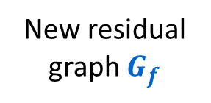
Greed Revisited: Residual Graph & Augmenting Paths
u
20/20
10/10
s
10/30
t
10/10
20/20
v
New residual graph $G_{f}$
u
20
10
s
10
20
t
No path can even leave $s$!
10
20
v

Slide 12
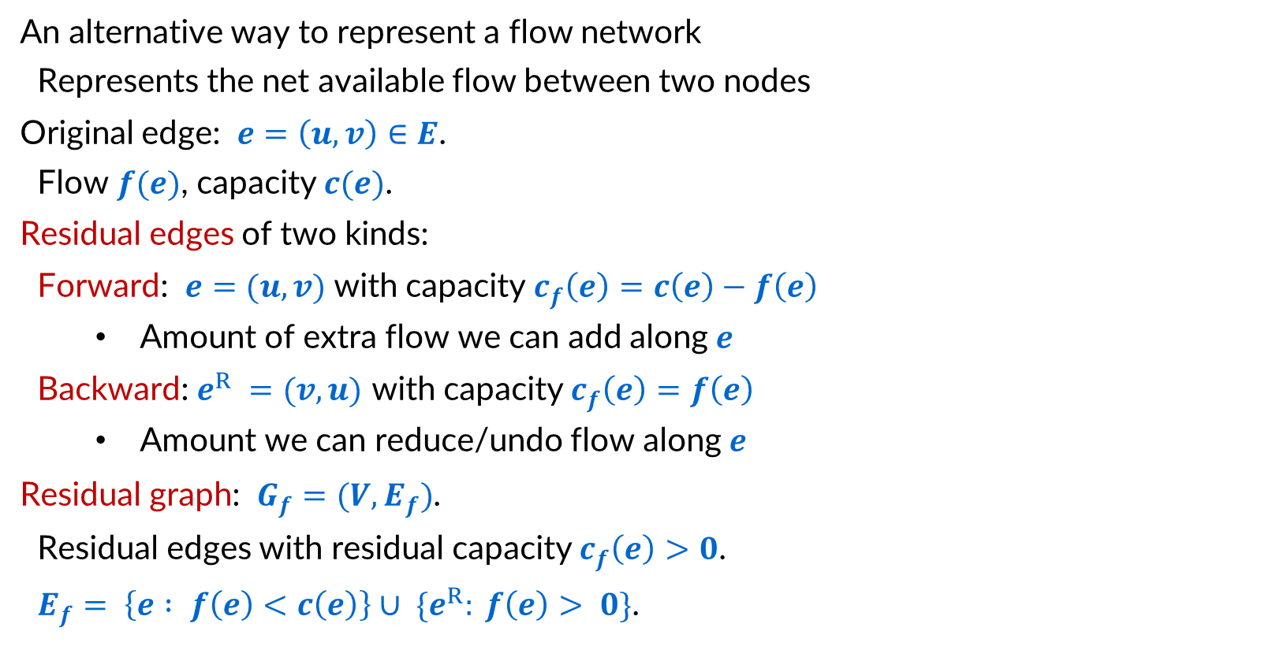
Residual Graphs
An alternative way to represent a flow network
  Represents the net available flow between two nodes
Original edge: $e=\left(u, v\right)∈E$.
  Flow $f(e)$, capacity $c(e)$.
Residual edges of two kinds:
  Forward: $e=(u, v)$ with capacity $c_{f}\left(e\right)=c\left(e\right)−f\left(e\right)$
    Amount of extra flow we can add along $e$
  Backward: $e^{R} =(v, u)$ with capacity $c_{f}\left(e\right)=f\left(e\right)$
    Amount we can reduce/undo flow along $e$
Residual graph: $G_{f}=(V, E_{f})$.
  Residual edges with residual capacity $c_{f}\left(e\right)>0$.
  $E_{f}= \left\{e : f\left(e\right)<c\left(e\right)\right\}∪ \{e^{R}: f\left(e\right)> 0\}$.
u
6/17
v
residual capacity
u
11
v
6
residual capacity

Slide 13
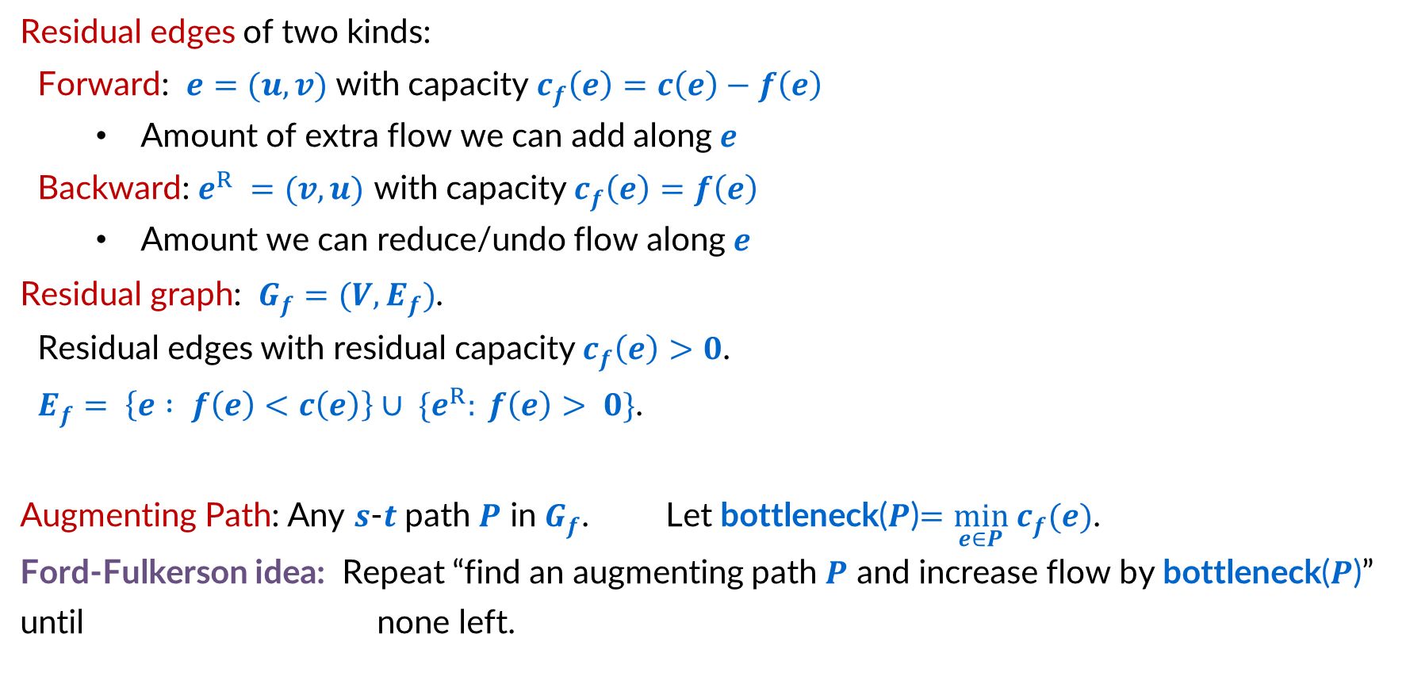
Residual Graphs and Augmenting Paths
residual capacity
Residual edges of two kinds:
  Forward: $e=(u, v)$ with capacity $c_{f}\left(e\right)=c\left(e\right)−f\left(e\right)$
    Amount of extra flow we can add along $e$
  Backward: $e^{R} =(v, u)$ with capacity $c_{f}\left(e\right)=f\left(e\right)$
    Amount we can reduce/undo flow along $e$
Residual graph: $G_{f}=(V, E_{f})$.
  Residual edges with residual capacity $c_{f}\left(e\right)>0$.
  $E_{f}= \left\{e : f\left(e\right)<c\left(e\right)\right\}∪ \{e^{R}: f\left(e\right)> 0\}$.
Augmenting Path: Any $s$-$t$ path $P$ in $G_{f}$. Let bottleneck($P$)$=\min_{e∈P} c_{f}(e)$.
Ford-Fulkerson idea: Repeat “find an augmenting path $P$ and increase flow by bottleneck($P$)” until none left.
u
11
v
6
residual capacity

Slide 14

Ford-Fulkerson Algorithm
a
4
b
capacity
$G$:
10
8
6
10
2
s
10
c
9
d
10
t

Slide 15

Ford-Fulkerson Algorithm
0 flows not shown
a
4
b
capacity
$G$:
10
8
6
10
Flow value = 0
2
s
10
c
9
d
10
t
a
4
b
residual capacity
$Gf$:
10
2
8
6
10
s
10
c
9
d
10
t

Slide 16
Ford-Fulkerson Algorithm
0 flows not shown
a
4
b
capacity
$G$:
8/
6
10
10
2
8/
Flow value = 0
8
+8=8
10
8/
s
c
9
d
10
t
a
4
b
residual capacity
$Gf$:
10
2
8
6
10
s
10
c
9
d
10
t

Slide 17
Ford-Fulkerson Algorithm
a
4
b
$G$:
8/10
8/8
6
10
Flow value = 8
2
s
10
c
9
d
8/10
t
a
4
b
$Gf$:
8
2
2
8
6
10
s
10
c
9
d
2
t
8

Slide 18
Ford-Fulkerson Algorithm
a
4
b
+2=10
$G$:
8/10
2/
8/8
6
10
Flow value = 8
2
+2=10
s
10
c
2/
d
8/10
t
9
+2=10
a
4
b
$Gf$:
8
2
2
8
6
10
s
10
c
9
d
2
t
8

Slide 19
Ford-Fulkerson Algorithm
a
4
b
$G$:
10/10
8/8
6
10
Flow value = 10
2/2
s
10
c
2/9
d
10/10
t
a
4
b
$Gf$:
10
2
8
6
10
s
10
c
7
d
10
t
2

Slide 20
Ford-Fulkerson Algorithm
a
4
b
$G$:
6/
6/
10/10
2/2
8/8
6
10
Flow value = 10
+6=16
6/
s
10
c
2/9
d
10/10
t
+6=8
a
4
b
$Gf$:
10
2
8
6
10
s
10
c
7
d
10
t
2

Slide 21
Ford-Fulkerson Algorithm
a
4
b
$G$:
10/10
8/8
6/6
6/10
Flow value = 16
2/2
s
6/10
c
8/9
d
10/10
t
a
4
b
$Gf$:
6
10
2
8
6
4
s
4
c
1
d
10
t
6
8

Slide 22
Ford-Fulkerson Algorithm
a
2/
b
4
$G$:
10/10
8/8
6/6
6/10
Flow value = 16
2/2
-2=0
+2=8
+2=18
s
6/10
c
8/9
d
10/10
t
+2=8
a
4
b
$Gf$:
6
10
2
8
6
4
s
4
c
1
d
10
t
6
8

Slide 23
Ford-Fulkerson Algorithm
a
2/4
b
$G$:
10/10
8/8
6/6
8/10
Flow value = 18
2
s
8/10
c
8/9
d
10/10
t
2
a
2
b
$Gf$:
8
10
2
8
6
2
s
2
c
1
d
10
t
8
8

Slide 24
Ford-Fulkerson Algorithm
+1=3
a
2/4
b
$G$:
10/10
8/8
6/6
8/10
Flow value = 18
2
-1=7
+1=9
+1=19
s
8/10
c
8/9
d
10/10
t
+1=9
+1=9
2
a
2
b
$Gf$:
8
10
2
8
6
2
s
2
c
1
d
10
t
8
8

Slide 25
Ford-Fulkerson Algorithm
a
3/4
b
$G$:
10/10
7/8
6/6
9/10
Flow value = 19
2
s
9/10
c
9/9
d
10/10
t
3
a
1
b
$Gf$:
9
1
10
2
7
6
1
s
1
c
9
d
10
t
9

Slide 26


Cuts
Defn: An $s$-$t$ cut is a partition $(A,B)$ of $V$ with $s∈A$ and $t∈B$.
  The capacity of cut $(A,B)$ is
  $$c\left(A,B\right)=\sum_{e out of A}{c(e)}$$
a
9
d
capacity 30
10
4
15
15
10
source
s
5
b
8
e
10
t
sink
$$A$$
4
6
15
15
10
c
30
f
Notes:
source = where material originates, sink = where material goes.
We use cut to mean s-t cut.

Slide 27


Cuts
Defn: An $s$-$t$ cut is a partition $(A,B)$ of $V$ with $s∈A$ and $t∈B$.
  The capacity of cut $(A,B)$ is
  $$c\left(A,B\right)=\sum_{e out of A}{c(e)}$$
a
9
d
capacity 48
10
4
15
15
10
source
s
5
b
8
e
10
t
sink
$$A$$
15
15
4
6
10
c
30
f
Notes:
source = where material originates, sink = where material goes.
We use cut to mean s-t cut.

Slide 28


Minimum Cut Problem
Minimum s-t cut problem:
Given: a flow network
Find: an $s$-$t$ cut of minimum capacity
a
9
d
capacity 28
10
4
15
15
10
source
s
5
b
8
e
10
t
sink
$$A$$
15
15
4
6
10
c
30
f
Notes:
source = where material originates, sink = where material goes.
We use cut to mean s-t cut.

Slide 29
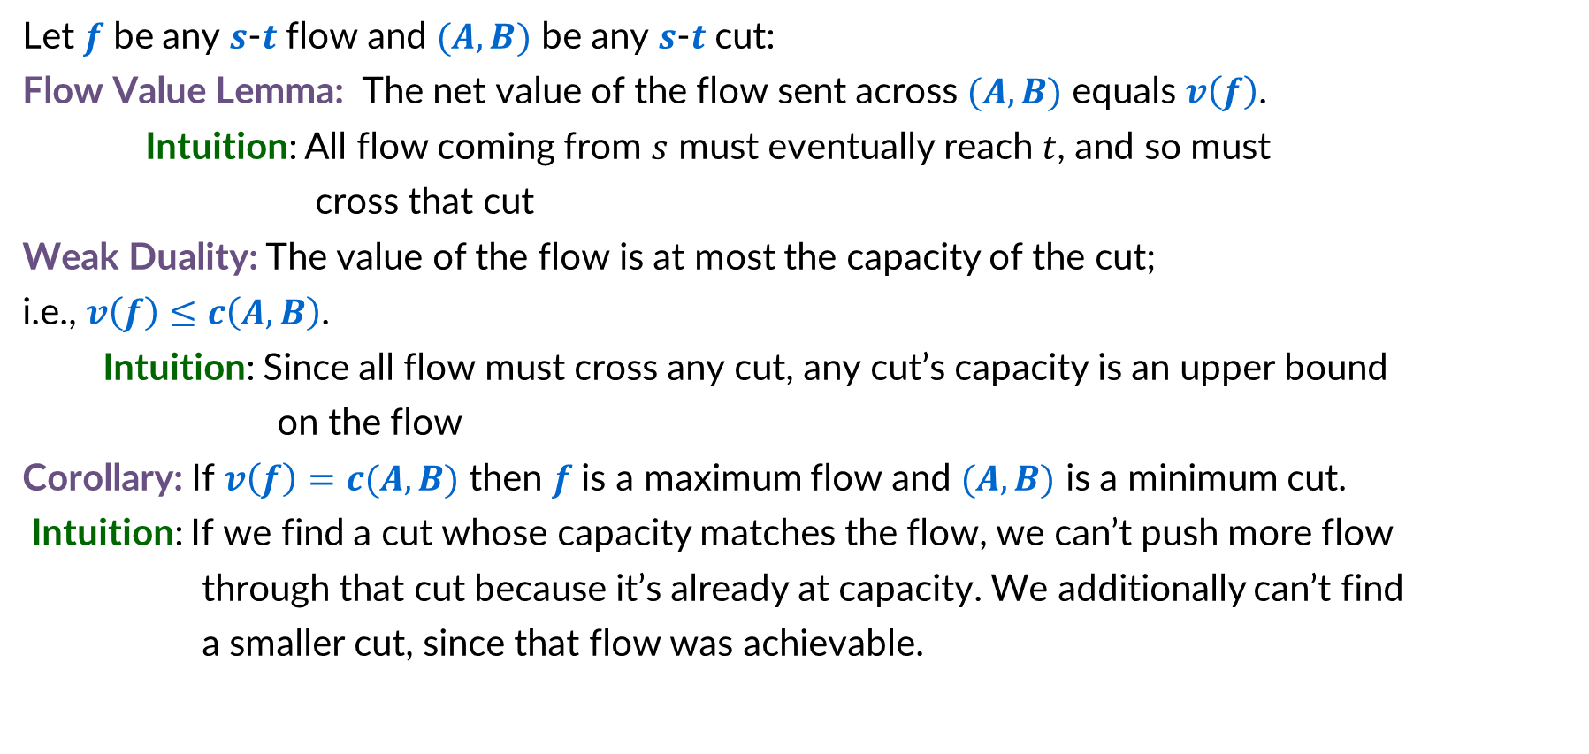
Flows and Cuts
Let $f$ be any $s$-$t$ flow and $(A,B)$ be any $s$-$t$ cut:
Flow Value Lemma: The net value of the flow sent across $(A,B)$ equals $v\left(f\right)$.
Intuition: All flow coming from $s$ must eventually reach $t$, and so must
cross that cut
Weak Duality: The value of the flow is at most the capacity of the cut; i.e., $v\left(f\right)≤c\left(A,B\right)$.
Intuition: Since all flow must cross any cut, any cut’s capacity is an upper bound
on the flow
Corollary: If $v\left(f\right)=c(A,B)$ then $f$ is a maximum flow and $(A,B)$ is a minimum cut.
Intuition: If we find a cut whose capacity matches the flow, we can’t push more flow
through that cut because it’s already at capacity. We additionally can’t find
a smaller cut, since that flow was achievable.

Slide 30
Flows and Cuts (Simplified)
The net flow crossing any cut equals the flow value.
Everything must cross the cut eventually
The capacity of any cut therefore is an upper bound on the max flow
No flow can exceed that capacity due to our previous observation
If we found a flow whose value matches the capacity of some cut, then we know that the flow must be maximum, and the cut must be minimum
If there was a smaller cut or larger flow, we’ve broken the previous point

Slide 31
Flows and Cuts (Simplified)
The net flow crossing any cut equals the flow value.
    Why? Everything must cross the cut eventually
The capacity of any cut therefore is an upper bound on the max flow
    Why? No flow can exceed that capacity due to statement 1
If we found a flow whose value matches the capacity of some cut, then we know that the flow must be maximum, and the cut must be minimum
    Why? If there was a smaller cut or larger flow, we’ve broken statement 2
  What we need for correctness:
  When Ford-Fulkerson terminates, there exists a cut whose capacity matches the current flow value.

Slide 32


Certificate of Optimality
Let $f$ be any $s$-$t$ flow and $(A,B)$ be any $s$-$t$ cut.
If $v\left(f\right)=c(A,B)$ then $f$ is a max flow and $(A,B)$ is a min cut.
a
9/9
d
Value of flow = 28
10/10
4
1/15
15
9/10
Capacity of cut = 28
s
4/5
b
8/8
e
9/10
t
$$A$$
Both are optimal!
Each “certified” correctness of the other!
4
4/6
15
14/15
10/10
c
14/30
f
Notes:
source = where material originates, sink = where material goes.
We use cut to mean s-t cut.

Slide 33

Identifying the cut
To Show: If there is no augmenting path w.r.t. $f$, there is a cut $(A, B)$ s.t. $v(f)=c(A, B)$.
Selecting a cut: Let $f$ be a flow with no augmenting paths.
  Let $A$ be the set of vertices reachable from $s$ in residual graph $G_{f}$.
  By definition of $A$, $s∈A$.
  Since no augmenting path ($s$-$t$ path in $G_{f}$), $t∉A$.
Notice:
all edges out of the cut are saturated (flow=capacity)
all edges into the cut have no flow
a
9/9
d
a
9
d
14
1
10/10
4
1/15
15
9/10
10
4
1
15
9
$$A$$
s
4/5
b
8/8
e
9/10
t
s
1
b
8
e
9
t
4
1
4
4
4/6
15
1
4
2
15
14/15
10/10
10
14
14
c
14/30
f
c
16
f
Flow Graph
Residual Graph

Slide 34

Flow Value = Cut Capacity
To Show: If there is no augmenting path w.r.t. $f$, there is a cut $(A, B)$ s.t. $v(f)=c(A, B)$.
The cut: $A$ is the set of all nodes reachable from $s$ in the residual graph
$B$ is the set of all the other nodes in the graph
Showing Flow value = Cut Capacity:
For any edge outgoing from $A$ to $B$, that edge is saturated (flow = capacity)
Otherwise there would be an edge in the residual graph for the remaining capacity. Contradiction!
For any edge incoming from $B$ to $A$, that edge has no flow (flow = 0)
Otherwise there would be an edge in the residual graph to undo the flow. Contradiction!
So summing the flows of all $A$ to $B$edges is the same as summing the capacities!
a
9/9
d
a
9
d
14
1
10/10
4
1/15
15
9/10
$$A$$
10
4
1
15
9
s
4/5
b
8/8
e
9/10
t
s
1
b
8
e
9
t
4
4
1
14/15
4
4/6
15
1
4
2
15
10
10/10
14
14
c
14/30
f
c
16
f
Flow Graph
Residual Graph

Slide 35
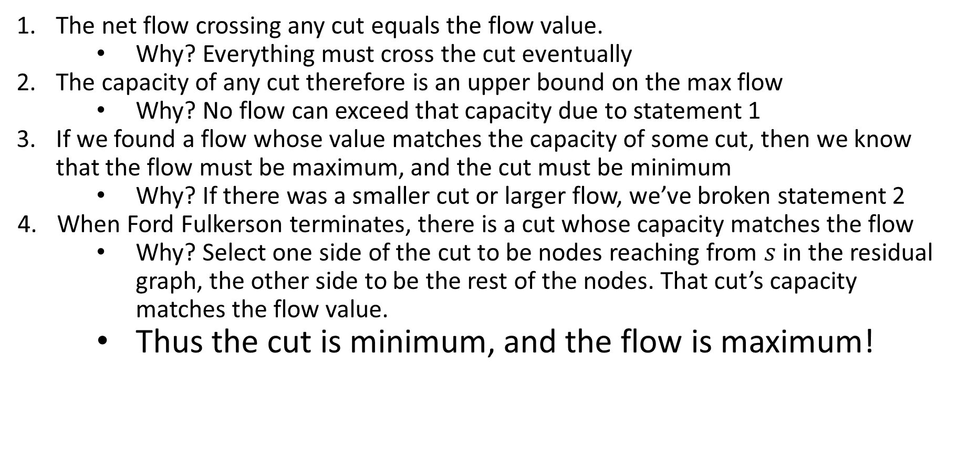
Flows and Cuts (Complete)
The net flow crossing any cut equals the flow value.
    Why? Everything must cross the cut eventually
The capacity of any cut therefore is an upper bound on the max flow
    Why? No flow can exceed that capacity due to statement 1
If we found a flow whose value matches the capacity of some cut, then we know that the flow must be maximum, and the cut must be minimum
    Why? If there was a smaller cut or larger flow, we’ve broken statement 2
When Ford Fulkerson terminates, there is a cut whose capacity matches the flow
    Why? Select one side of the cut to be nodes reaching from $s$ in the residual graph, the other side to be the rest of the nodes. That cut’s capacity matches the flow value.
    Thus the cut is minimum, and the flow is maximum!

Slide 36
Final reminders
HW6 released, due Friday @ 11:59pm.
Quiz 2 on Friday 11/21 in class
look for quiz prep materials on Friday
I have OH now-12:30pm:
Meet at front of classroom, we’ll walk over together
CSE (Allen) 434 if you’re coming later
Glenn has online OH 12–1pm

