Slide 1
Lecture 20: Non-optimal greedy
Glenn Sun

Slide 2
Some interesting greedy ideas

Slide 3
One example from before: A* search
Pick the next point with smallest
distance from source + estimated distance to end
A* search is optimal for shortest paths, if you only ever underestimate distance.
(via distance formula with coordinates, e.g.)
(computed like Dijkstra)

Slide 4
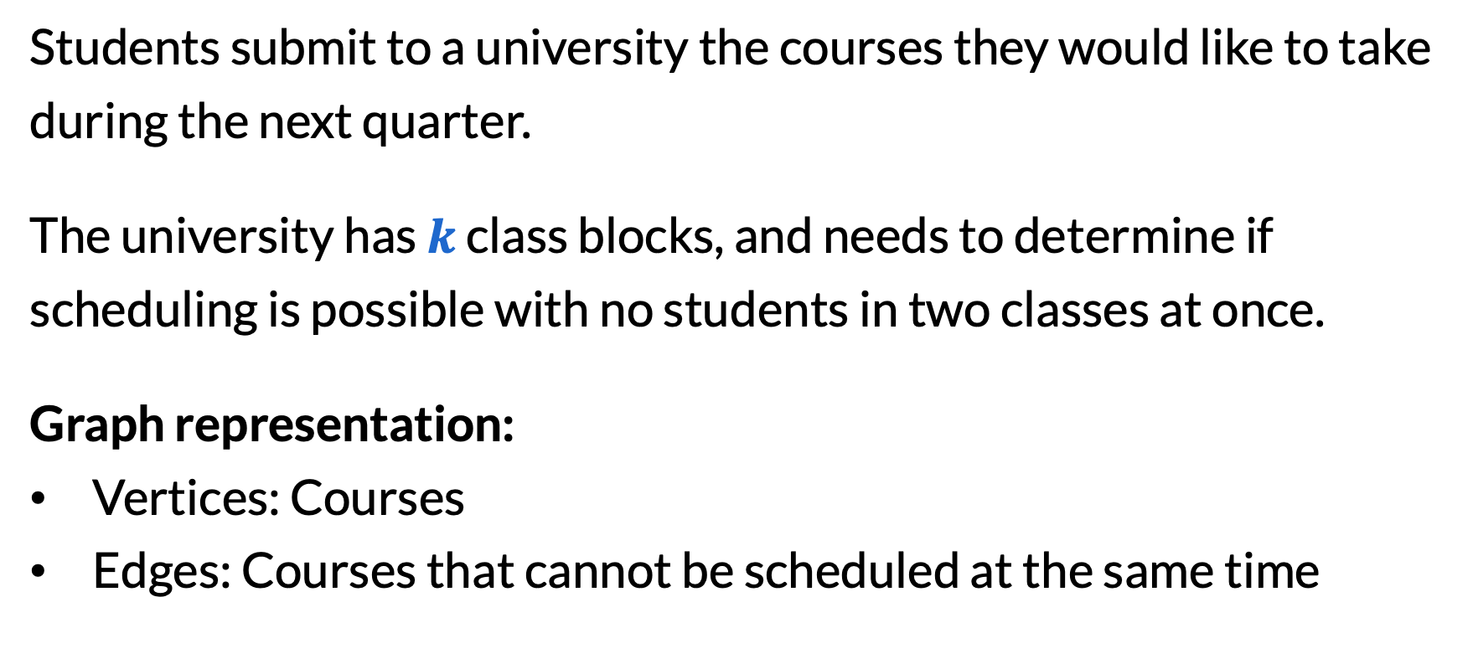
Second example: University timetabling
Students submit to a university the courses they would like to take during the next quarter.
The university has $k$ class blocks, and needs to determine if scheduling is possible with no students in two classes at once.
Graph representation:
Vertices: Courses
Edges: Courses that cannot be scheduled at the same time

Slide 5
Graph coloring
This is an instance of graph coloring. A valid graph coloring
Assigns a color (timeslot) to each vertex (course)
Such that no two adjacent vertices have the same color
Input: An undirected graph
Goal: What is the minimum number of colors needed?

Slide 6
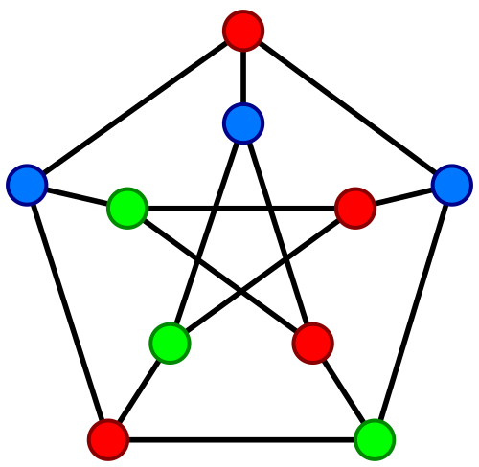
Graph coloring

Slide 7
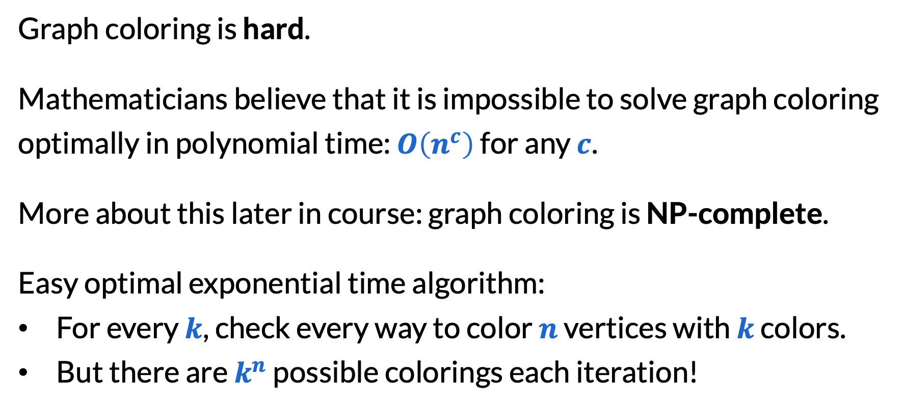
Why try a greedy algorithm?
Graph coloring is hard.
Mathematicians believe that it is impossible to solve graph coloring optimally in polynomial time: $O\left(n^{c}\right)$ for any $c$.
More about this later in course: graph coloring is NP-complete.
Easy optimal exponential time algorithm:
For every $k$, check every way to color $n$ vertices with $k$ colors.
But there are $k^{n}$ possible colorings each iteration!

Slide 8
Greedy approach to graph coloring
Think of colors as numbers 1, 2, 3, …
​while some vertex is not yet colored,
Color it with the smallest number that is not used by its neighbors.
1 2 3

Slide 9
Greedy approach to graph coloring
Think of colors as numbers 1, 2, 3, …
​while some vertex is not yet colored,
Color it with the smallest number that is not used by its neighbors.
1 2 3

Slide 10
Greedy approach to graph coloring
Think of colors as numbers 1, 2, 3, …
​while some vertex is not yet colored,
Color it with the smallest number that is not used by its neighbors.
1 2 3

Slide 11
Greedy approach to graph coloring
Think of colors as numbers 1, 2, 3, …
​while some vertex is not yet colored,
Color it with the smallest number that is not used by its neighbors.
1 2 3

Slide 12
Greedy approach to graph coloring
Think of colors as numbers 1, 2, 3, …
​while some vertex is not yet colored,
Color it with the smallest number that is not used by its neighbors.
1 2 3

Slide 13
Greedy approach to graph coloring
Think of colors as numbers 1, 2, 3, …
​while some vertex is not yet colored,
Color it with the smallest number that is not used by its neighbors.
1 2 3

Slide 14
Greedy approach to graph coloring
Think of colors as numbers 1, 2, 3, …
​while some vertex is not yet colored,
Color it with the smallest number that is not used by its neighbors.
1 2 3

Slide 15
Greedy approach to graph coloring
Think of colors as numbers 1, 2, 3, …
​while some vertex is not yet colored,
Color it with the smallest number that is not used by its neighbors.
1 2 3

Slide 16
Greedy approach to graph coloring
Think of colors as numbers 1, 2, 3, …
​while some vertex is not yet colored,
Color it with the smallest number that is not used by its neighbors.
1 2 3

Slide 17
Greedy approach to graph coloring
Think of colors as numbers 1, 2, 3, …
​while some vertex is not yet colored,
Color it with the smallest number that is not used by its neighbors.
1 2 3

Slide 18
Greedy approach to graph coloring
Think of colors as numbers 1, 2, 3, …
​while some vertex is not yet colored,
Color it with the smallest number that is not used by its neighbors.
1 2 3

Slide 19
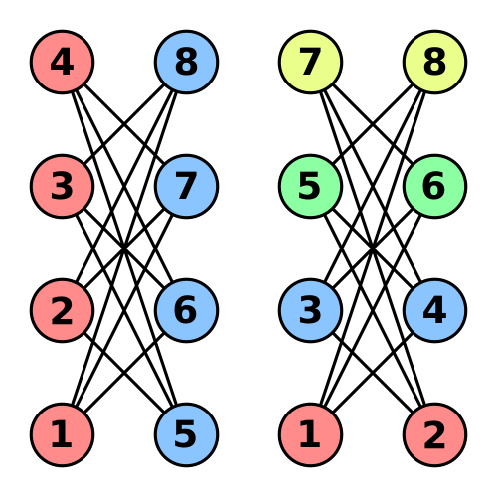


How bad can greedy be?
A family of counterexamples: crown graphs
Take two set of vertices $x_{1},…, x_{n}$ and $y_{1},…, y_{n}$
Connect every pair $\left(x_{i}, y_{j}\right)$ except when $i=j$
Greedy: $n/2$ colors
Optimal: $2$ colors
Gap: $n/4=Ω(n)$

Slide 20
How good is greedy?
The degree of a vertex is the number of neighbors it has.
Observation: The greedy algorithm uses at most 1 more color than the maximum degree of the graph!
Because we pick the smallest number different from all neighbors.

Slide 21
Approximation algorithms

Slide 22
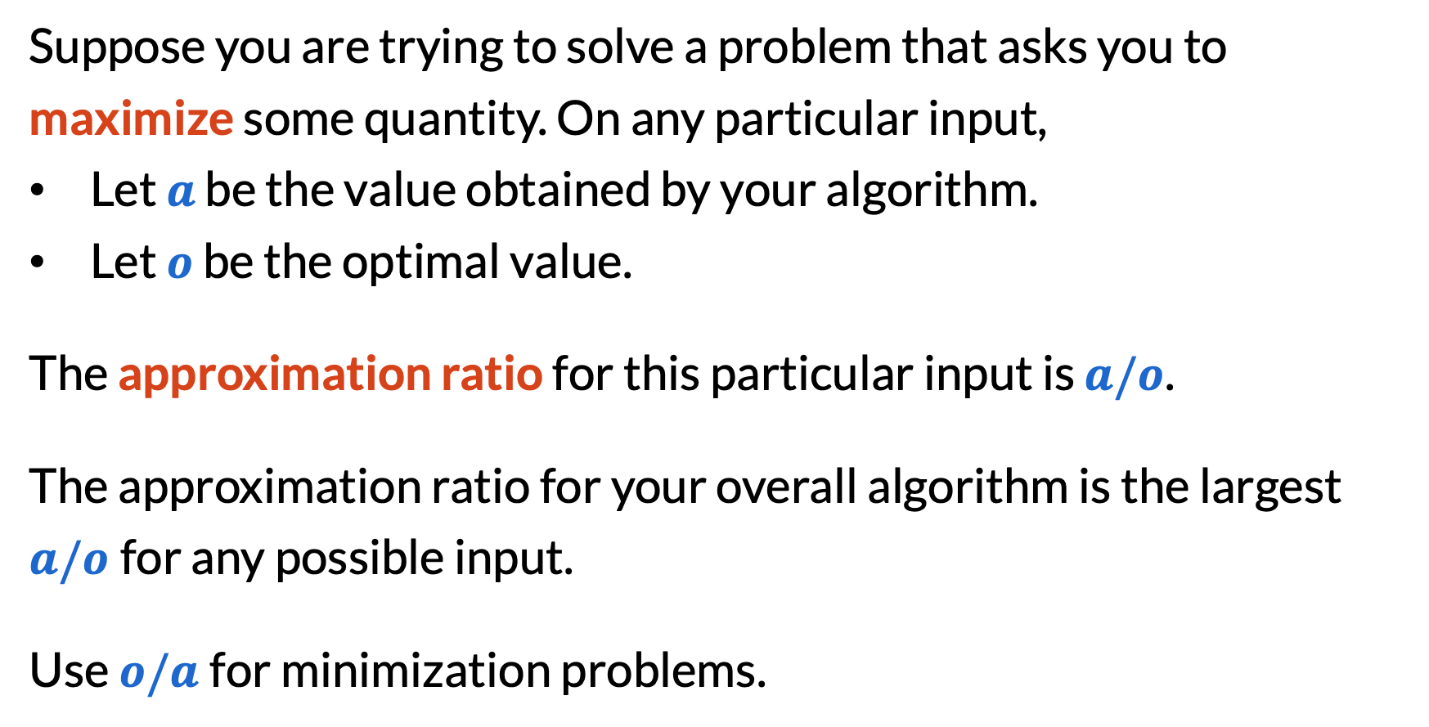
What is an approximation algorithm?
Suppose you are trying to solve a problem that asks you to maximize some quantity. On any particular input,
Let $a$ be the value obtained by your algorithm.
Let $o$ be the optimal value.
The approximation ratio for this particular input is $a/o$.
The approximation ratio for your overall algorithm is the largest $a/o$for any possible input.
Use $o/a$for minimization problems.

Slide 23
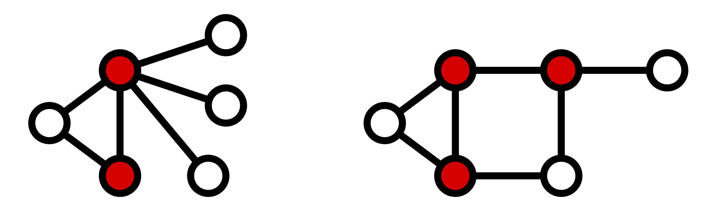
Vertex cover
Input: An undirected graph
Goal: Select a smallest set of vertices so that every edge is covered

Slide 24
A simple greedy approach
​while we don’t have a vertex cover (some edge is uncovered),
Pick any uncovered edge and select both of its endpoints.
Optimal
Greedy

Slide 25
Calculating the approximation ratio
Claim. The greedy algorithm achieves an approximation ratio of 2.
Because we picked uncovered edges, the chosen edges don’t touch each other.
Any vertex cover must cover all the chosen edges.
Because they don’t touch, every vertex can only cover one.
Thus, any vertex cover must use at least half of what we used!

Slide 26
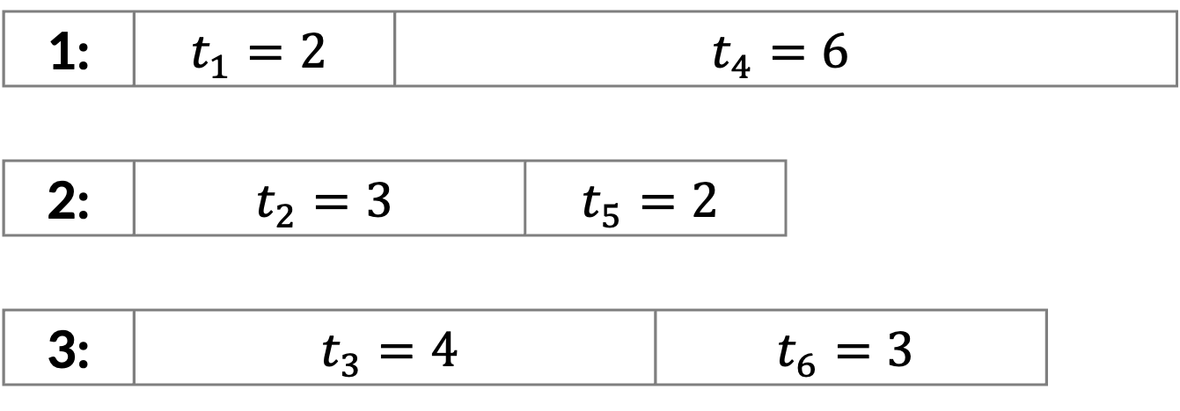

Load balancing
Input: There are $m$ computers and $n$ jobs, taking time $t_{1},…,t_{n}$.
The makespan is the time it takes to finish on all computers.
Goal: Distribute the jobs to minimize makespan.
1: | $$t_{1}=2$$ |  | $$t_{4}=6$$
2: | $$t_{2}=3$$ |  |  | $$t_{5}=2$$
3: | $$t_{3}=4$$ |  |  |  | $$t_{6}=3$$

Slide 27
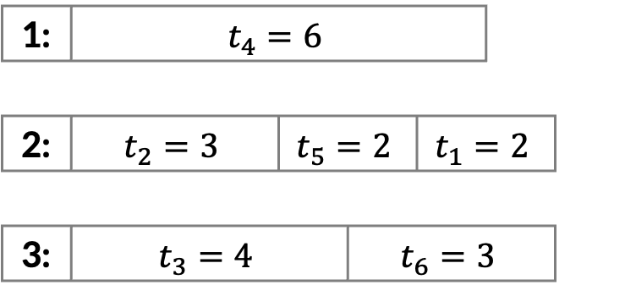
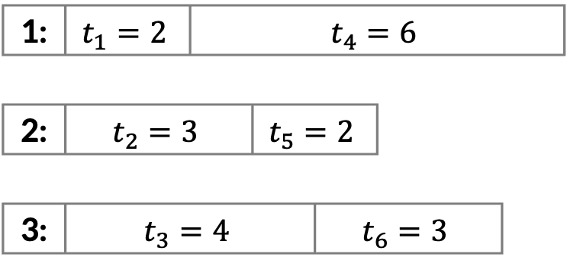
A greedy approach
​for each job in the order we received it,
Use the first available machine.
Greedy:
Optimal:
1: | $$t_{1}=2$$ |  | $$t_{4}=6$$
2: | $$t_{2}=3$$ |  |  | $$t_{5}=2$$
3: | $$t_{3}=4$$ |  |  |  | $$t_{6}=3$$
1: | $$t_{4}=6$$
2: | $$t_{2}=3$$ |  |  | $$t_{5}=2$$ |  | $$t_{1}=2$$
3: | $$t_{3}=4$$ |  |  |  | $$t_{6}=3$$

Slide 28
Calculating the approximation ratio
Take some time to
Come up with some more examples where greedy is suboptimal, and try to make them as bad as possible.
Think about how you might come up with an approximation ratio for this algorithm

Slide 29
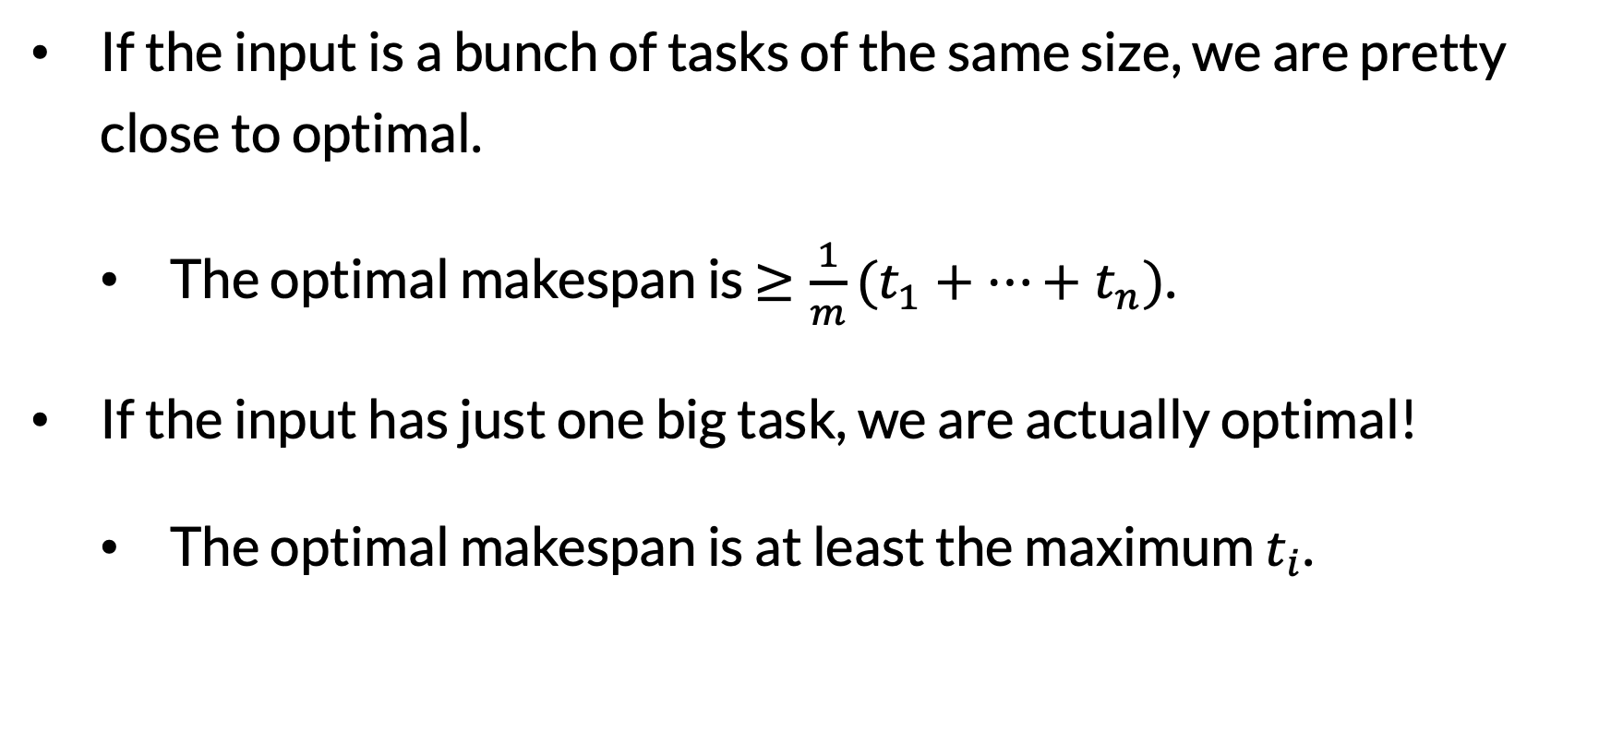
A few observations
If the input is a bunch of tasks of the same size, we are pretty close to optimal.
The optimal makespan is $≥\frac{1}{m}(t_{1}+…+t_{n})$.
If the input has just one big task, we are actually optimal!
The optimal makespan is at least the maximum $t_{i}$.

Slide 30
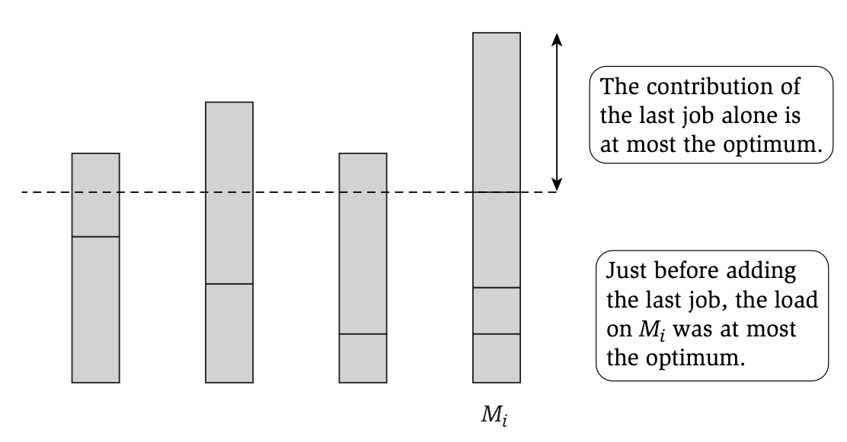
Calculating the approximation ratio
Claim. The greedy algorithm achieves an approximation ratio of 2.

Slide 31
Final reminders
HW4 (Graphs) resubmissions close tonight @ 11:59pm!
I have OH now-12:30pm:
Meet at front of classroom, we’ll walk over together
CSE (Allen) 214 if you’re coming later
Nathan has online OH 12–1pm:
https://washington.zoom.us/my/nathanbrunelle

