Slide 1
Lecture 19: Huffman codes
Glenn Sun

Slide 2
Homework this week
P11: Extending the algorithm from today’s lecture
P11X.1/2: Finding counterexamples
P12: Your own greedy algorithm

Slide 3
Wrapping up from Wednesday

Slide 4
Meeting scheduler
Input: List of time intervals (booking requests for a meeting room)
Output: Maximum number of meetings that can be booked
1 | 2 | 3 | 4 | 5 | 6 | 7 | 8 | 9 | 10 | 11 | 12 | 13 | 14 | 15

Slide 5
Our greedy solution
Algorithm: Pick the meeting that would end first.
1 | 2 | 3 | 4 | 5 | 6 | 7 | 8 | 9 | 10 | 11 | 12 | 13 | 14 | 15

Slide 6
Exchange argument for meeting scheduler
Suppose another schedule was different and look at the first time our schedules differed.
⭐ | ⭐ | ⭐ |  | ⭐ | ⭐ | ⭐ |  |  | ⭐ | ⭐ | ⭐
 |  |  |  |  |  |  |  |  |  |  |  | ⭐ | ⭐ | ⭐
1 | 2 | 3 | 4 | 5 | 6 | 7 | 8 | 9 | 10 | 11 | 12 | 13 | 14 | 15
 | us
⭐ | other
same until here, different here

Slide 7
Exchange argument for meeting scheduler
In the ⭐ solution, we could’ve picked our solution instead:
Compatible with previous picks because previous are same
Compatible with future picks because finishes earliest
⭐ | ⭐ | ⭐ |  | ⭐ | ⭐ | ⭐
 |  |  |  |  |  |  |  |  |  | ⭐
 |  |  |  |  |  |  |  |  |  |  |  | ⭐ | ⭐ | ⭐
1 | 2 | 3 | 4 | 5 | 6 | 7 | 8 | 9 | 10 | 11 | 12 | 13 | 14 | 15
 | us
⭐ | other

Slide 8
Exchange argument for meeting scheduler
In the ⭐ solution, we could’ve picked our solution instead:
Compatible with previous picks because previous are same
Compatible with future picks because finishes earliest
Because this process can transform any solution into ours while maintaining (or increasing) the number of meetings, our solution must be optimal!

Slide 9
Prefix codes

Slide 10
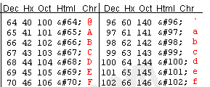
Encoding messages
Goal: Transmit a message over a digital signal using few bits.
Standard encoding used by computers is ASCII:
A = 65 = 0100 0001
8 bits/letter

Slide 11
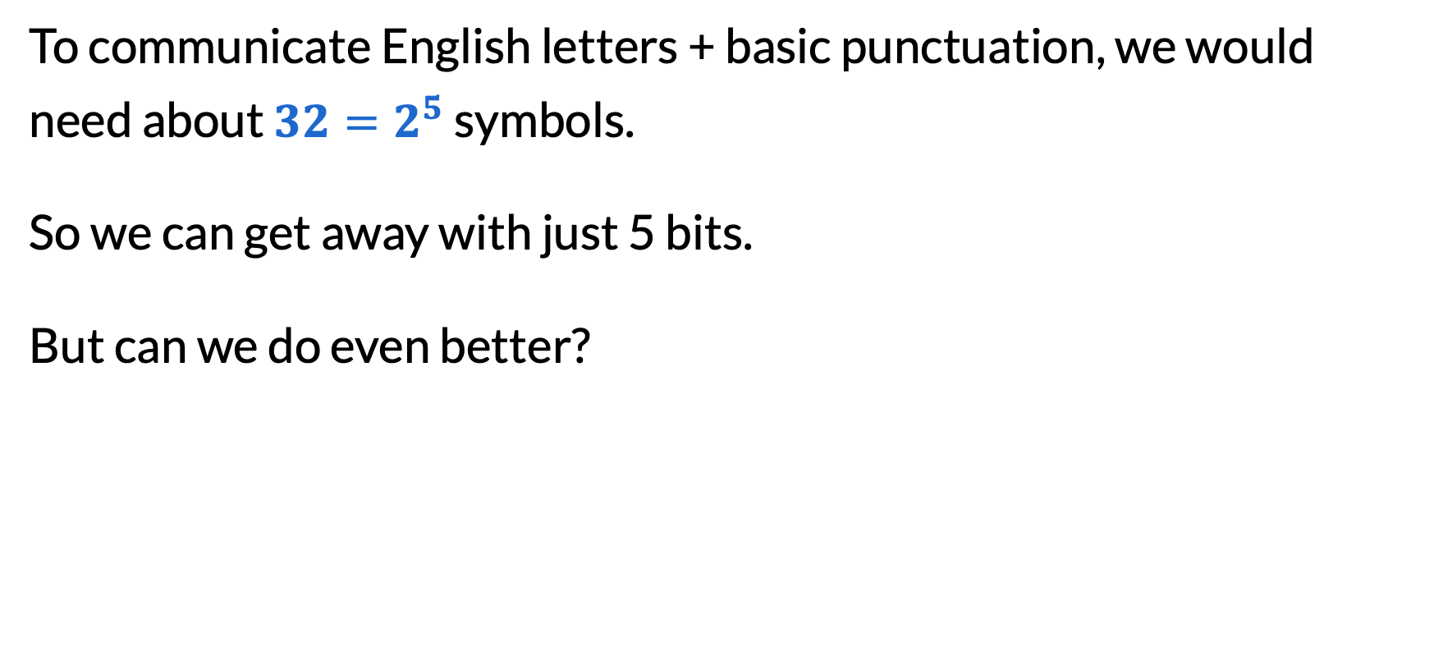
Better encodings
To communicate English letters + basic punctuation, we would need about $32=2^{5}$ symbols.
So we can get away with just 5 bits.
But can we do even better?

Slide 12
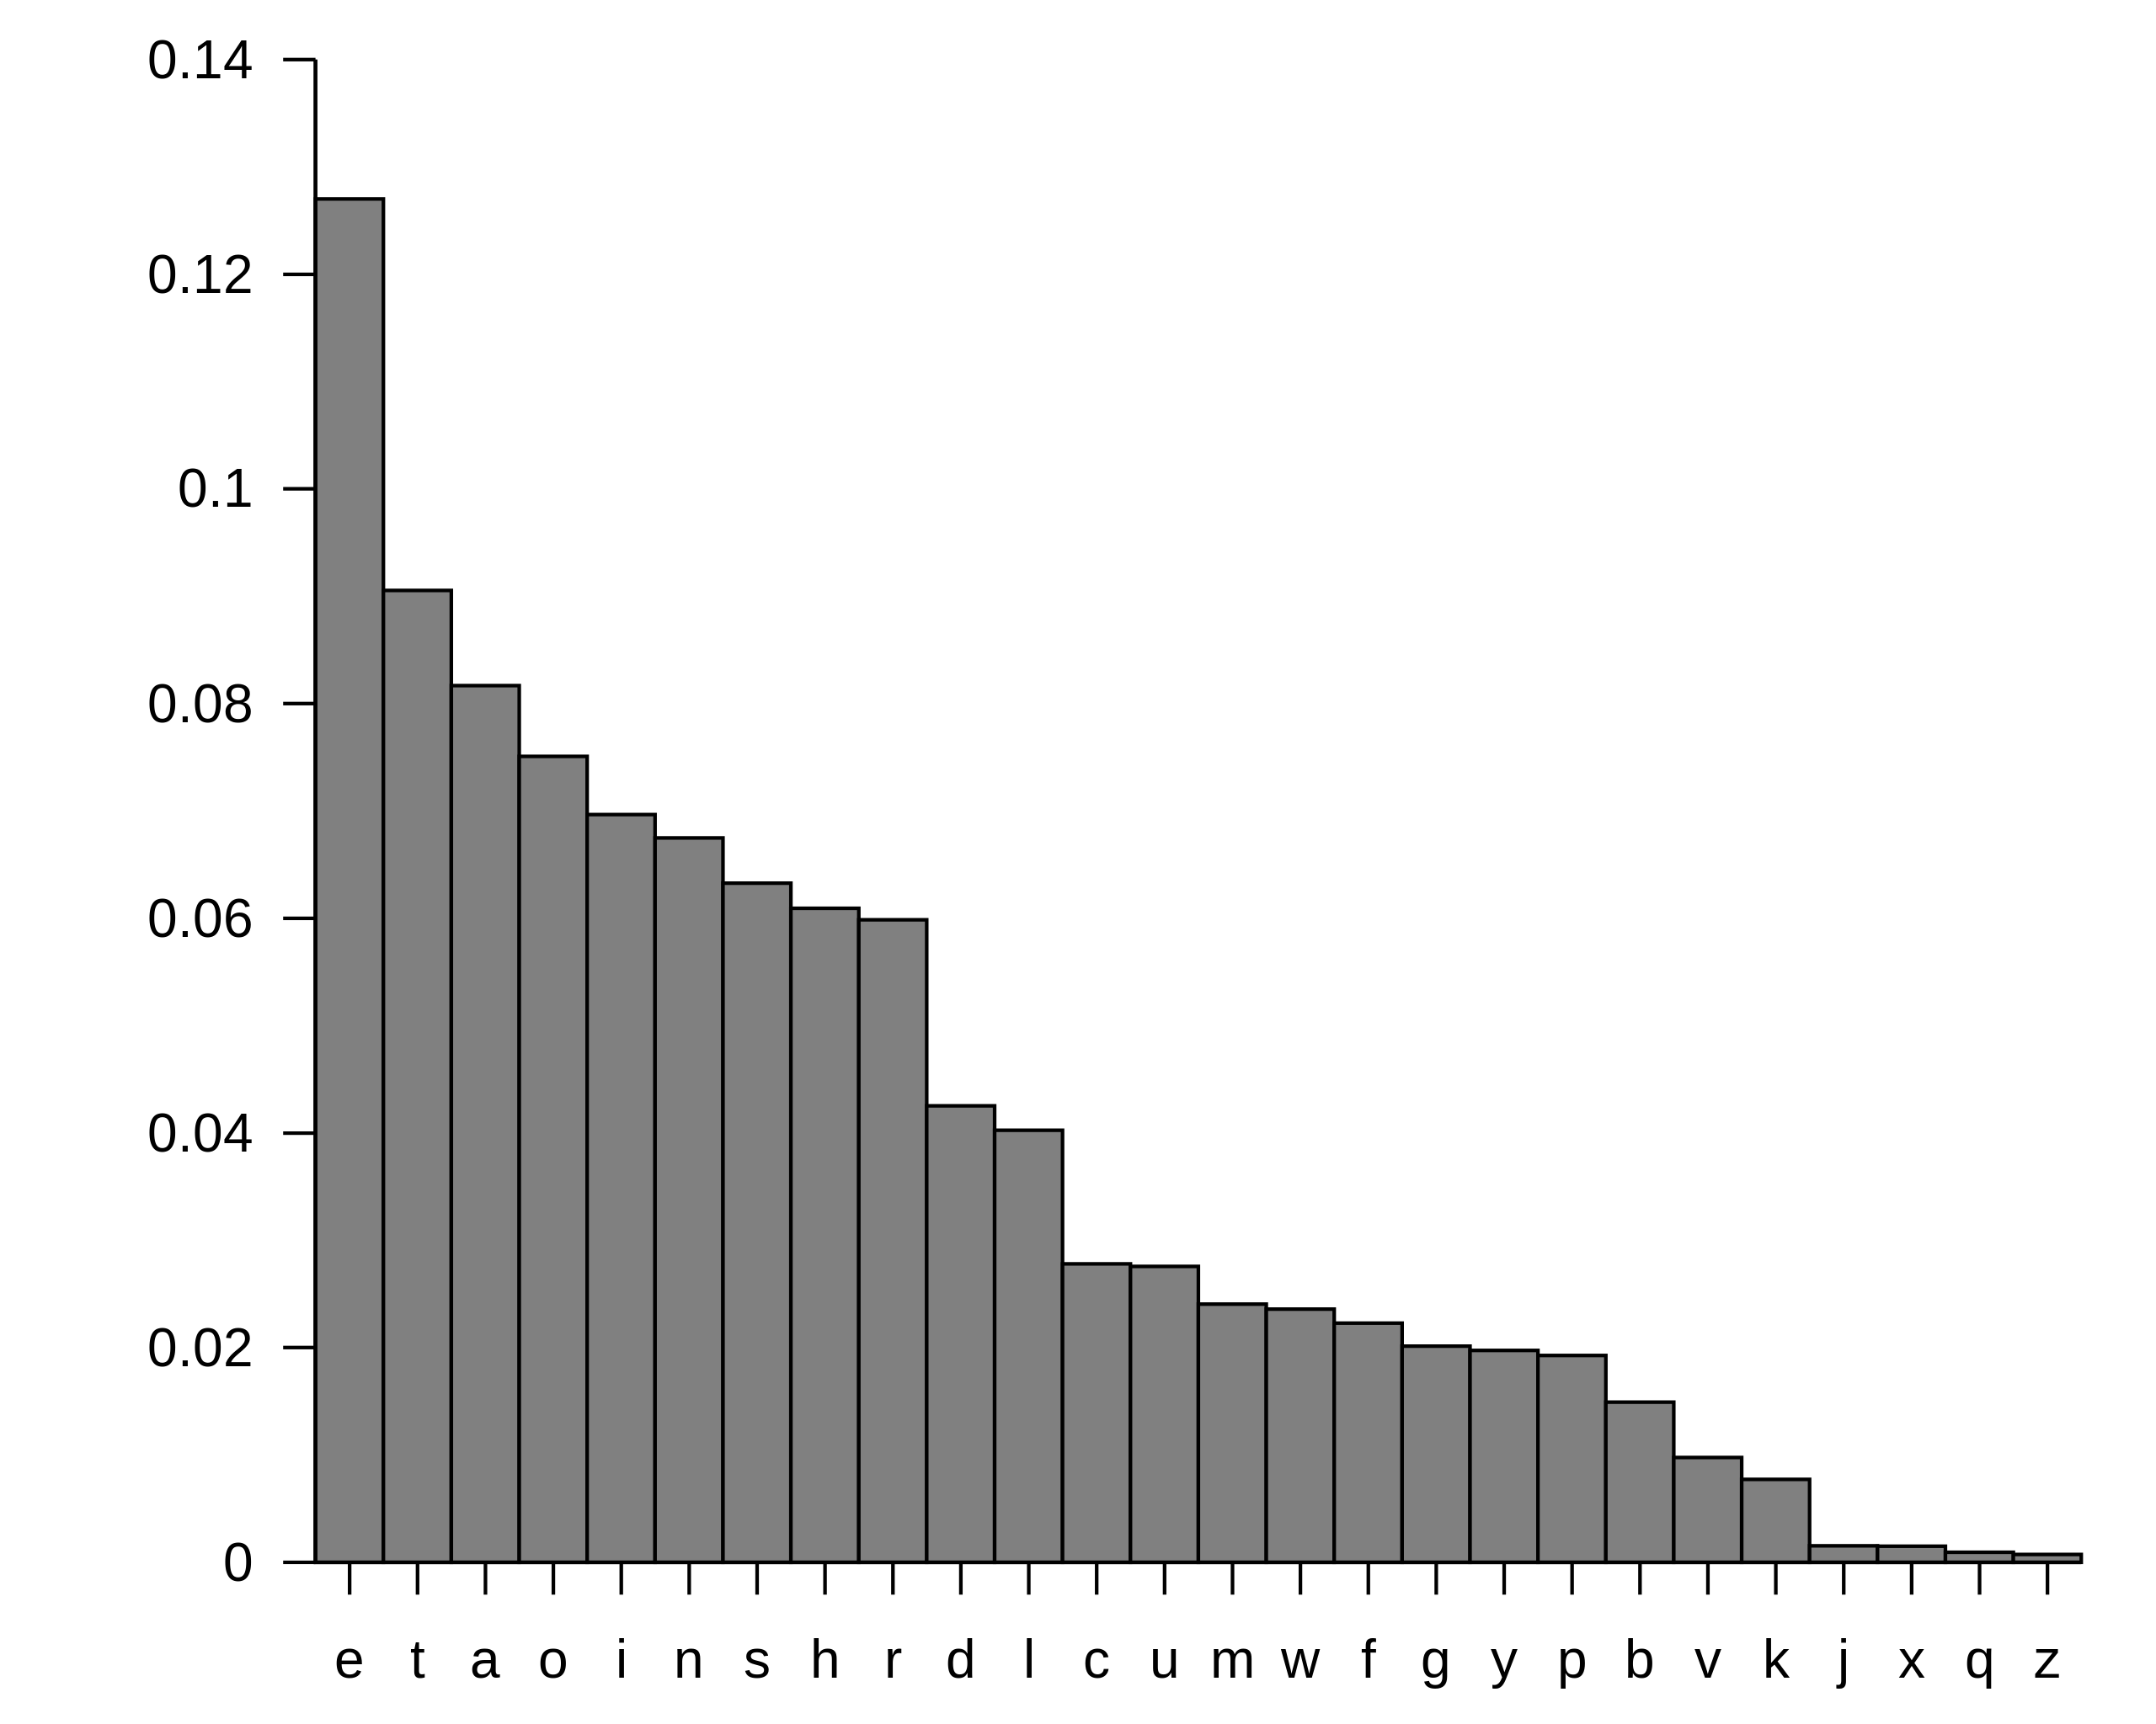
Distribution of English letters
OK to have longer codes for these
use shorter codes for these

Slide 13
Prefix codes
If we allow codes of different lengths, it may become impossible to uniquely decode a message!
Symbol | Codeword
A | 0
B | 1
C | 00
D | 01
E | 10
F | 11
How to decode “000”?
Could be AAA, AC, or CA!

Slide 14
Prefix codes
We will require prefix codes (also called prefix-free codes): no codeword should be a prefix of another codeword.
Symbol | Codeword
A | 00
B | 01
C | 100
D | 101
E | 110
F | 111
Now, “AC” is 00100.
Can only decode this as “AC”.

Slide 15
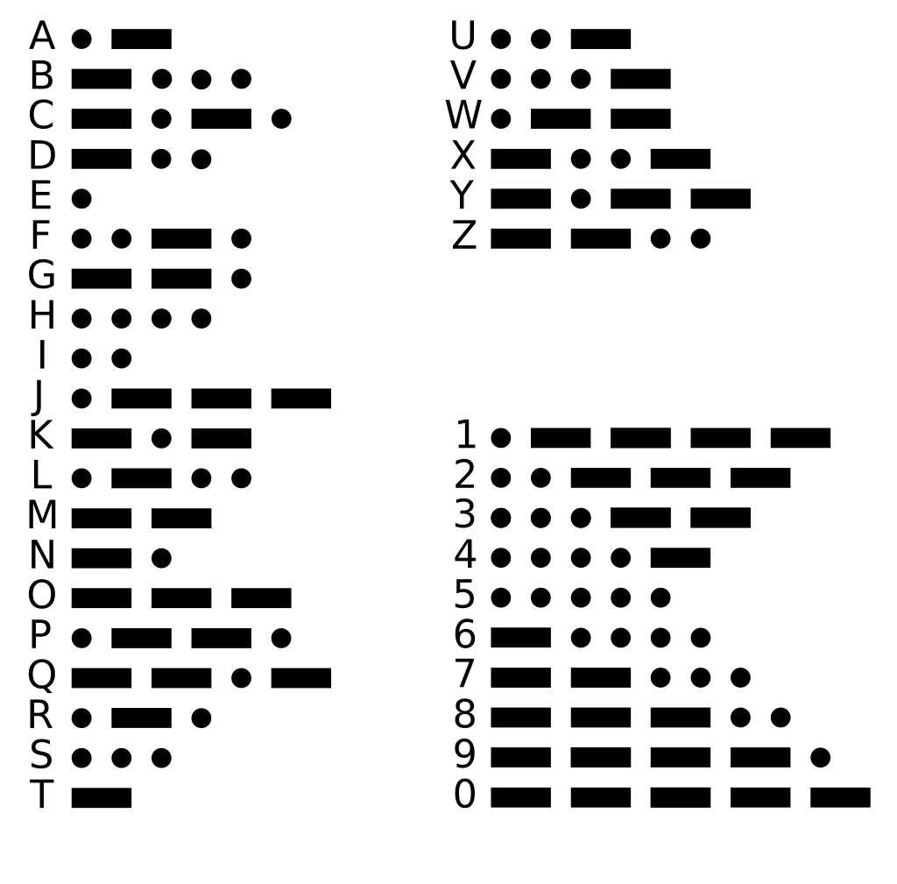
Side note: Morse code
Consider Morse code as being made up of “dits” and “dahs”.
Q: Is Morse code prefix free?
A: No! e.g. E is a prefix of A.
Morse code uses extra spacing between letters to allow decoding. Thus, in terms of “dits” and “dahs”, it is actually a ternary code!

Slide 16
Side note: Morse code
But if you consider it made up of “on” and “off”, it is a prefix code.
S
O
S
inter-character spaces

Slide 17
Decoding a prefix code
Given a table of codewords and an encoded message, how to decode it?
Algorithm: Take the first prefix that is a codeword!
Symbol | Codeword
A | 00
B | 01
C | 100
D | 101
E | 110
F | 111
Example: Decode “10100”.
“1” is not a codeword.
“10” is not a codeword”.
“101” is D, take this and remove “101” from string”

Slide 18
Decoding a prefix code
Algorithm: Take the first prefix that is a codeword!
Q: Is this a greedy algorithm?
A: Kind of? It is not an optimization problem, but makes “greedy-like” choices.
Why is it correct? The first codeword must be correct, because of the prefix-free property. (No other codeword can start with it.) Thus, we can repeat the argument to show that it’s all correct.

Slide 19

Calculating how good a code is
Take the average codeword length weighted by frequency:
$$f_{1}c_{1}+f_{2}c_{2}+…+f_{n}c_{n}$$
where $f_{1}+f_{2}+…+f_{n}=1$.
Symbol | Codeword | Frequency
A | 00 | 0.25
B | 01 | 0.25
C | 100 | 0.125
D | 101 | 0.125
E | 110 | 0.125
F | 111 | 0.125
Example:
0.25(2+2) + 0.125(3+3+3+3)
= 2.5

Slide 20
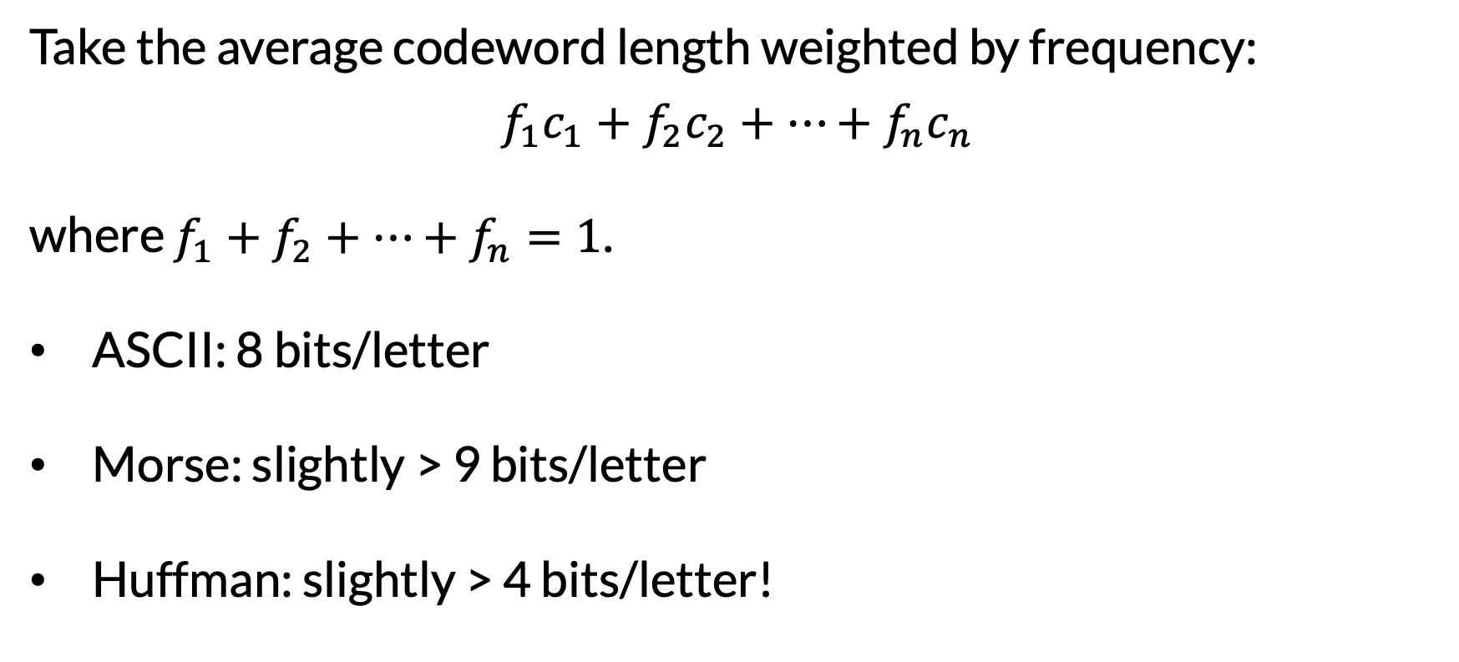
Calculating how good a code is
Take the average codeword length weighted by frequency:
$$f_{1}c_{1}+f_{2}c_{2}+…+f_{n}c_{n}$$
where $f_{1}+f_{2}+…+f_{n}=1$.
ASCII: 8 bits/letter
Morse: slightly > 9 bits/letter
Huffman: slightly > 4 bits/letter!

Slide 21
Viewing prefix codes as binary trees
0
1
Symbol | Codeword
A | 00
B | 01
C | 100
D | 101
E | 110
F | 111
0
1
0
1
A
B
0
1
0
1
C
D
E
F

Slide 22
But not necessarily full binary trees
0
1
Symbol | Codeword
A | 00
B | 01
C | 100
D | 101
0
1
0
A
B
0
1
(Full binary tree has 0 or 2 children per node.)
C
D

Slide 23
Swapping 0/1 doesn’t affect quality
1
0
Symbol | Codeword
A | 10
B | 11
C | 011
D | 010
0
1
1
A
B
1
0
C
D

Slide 24
Summary
Can view any prefix code as a binary tree
Can arbitrarily pick 0/1 labels for the edges of any binary tree to get a prefix code
“Prefix-free” is equivalent to all symbols being leaves

Slide 25
Huffman codes

Slide 26
Huffman’s idea
Input: List of frequencies (sum = 1, or alternatively sometimes counts of each symbol)
Goal: Find a prefix code with minimum average length.
Greedy algorithm:
Start with all symbols getting a node.
Choose the two least frequent symbols and combine them into a subtree, setting the frequency of the subtree to be the sum.

Slide 27
Example of Huffman’s idea
A
(3)
B
(1)
C
(2)
D
(2)
E
(5)
F
(2)
G
(1)

Slide 28
Example of Huffman’s idea
A
(3)
B
(1)
C
(2)
D
(2)
E
(5)
F
(2)
G
(1)

Slide 29
Example of Huffman’s idea
(2)
A
(3)
C
(2)
D
(2)
E
(5)
F
(2)
B
(1)
G
(1)

Slide 30
Example of Huffman’s idea
(2)
A
(3)
C
(2)
D
(2)
E
(5)
F
(2)
B
(1)
G
(1)

Slide 31
Example of Huffman’s idea
(4)
(2)
A
(3)
E
(5)
F
(2)
C
(2)
D
(2)
B
(1)
G
(1)

Slide 32
Example of Huffman’s idea
(4)
(2)
A
(3)
E
(5)
F
(2)
C
(2)
D
(2)
B
(1)
G
(1)

Slide 33
Example of Huffman’s idea
(4)
(4)
A
(3)
E
(5)
F
(2)
(2)
C
(2)
D
(2)
B
(1)
G
(1)

Slide 34
Example of Huffman’s idea
(4)
(4)
A
(3)
E
(5)
F
(2)
(2)
C
(2)
D
(2)
B
(1)
G
(1)
Two qualitatively different possible choices here! Choose either one, either will work!

Slide 35
Example of Huffman’s idea
(4)
(7)
E
(5)
F
(2)
(2)
A
(3)
(4)
B
(1)
G
(1)
C
(2)
D
(2)

Slide 36
Example of Huffman’s idea
(4)
(7)
E
(5)
F
(2)
(2)
A
(3)
(4)
B
(1)
G
(1)
C
(2)
D
(2)

Slide 37
Example of Huffman’s idea
(9)
(7)
E
(5)
(4)
A
(3)
(4)
F
(2)
(2)
C
(2)
D
(2)
B
(1)
G
(1)

Slide 38
Example of Huffman’s idea
(9)
(7)
E
(5)
(4)
A
(3)
(4)
F
(2)
(2)
C
(2)
D
(2)
B
(1)
G
(1)

Slide 39
(16)
(7)
(9)
A
(3)
(4)
E
(5)
(4)
C
(2)
D
(2)
F
(2)
(2)
B
(1)
G
(1)

Slide 40
0
1
Symbol | Codeword
A | 00
B | 1110
C | 010
D | 011
E | 10
F | 110
G | 1111
0
1
0
1
A
E
0
1
0
1
C
D
F
0
1
B
G

Slide 41
How did Huffman do?
Symbol | Codeword | Count | Frequency
A | 00 | 3 | 3/16
B | 1110 | 1 | 1/16
C | 010 | 2 | 2/16
D | 011 | 2 | 2/16
E | 10 | 5 | 5/16
F | 110 | 2 | 2/16
G | 1111 | 1 | 1/16
Average length:
2.625 bits/symbol

Slide 42
Recall basic exchange argument
To show that your solution is optimal,
Consider a different solution. Usually, it helps to consider the first time that it differs.
Show that you can change the other solution to be more like yours, while improving or maintaining the quality.
Conclude that yours is optimal!

Slide 43
Huffman exchange argument
Consider any prefix code that is different from yours.
Every prefix code corresponds to a binary tree.
Two ways the tree could be different:
It was not a full binary tree
It merged nodes in a different order than you.

Slide 44
Optimal solutions are full binary trees
Suppose a solution is not a full binary tree.
Q: How can you change it to a better solution?
1
0
0
1
1
A
B
1
0
C
D

Slide 45
Optimal solutions are full binary trees
Suppose a solution is not a full binary tree.
Q: How can you change it to a better solution?
A: Contract the nodes with one child!
1
0
0
1
1
A
B
1
0
C
D

Slide 46
Optimal solutions are full binary trees
Suppose a solution is not a full binary tree.
Q: How can you change it to a better solution?
A: Contract the nodes with one child!
Codewords can only become shorter when doing this.
1
0
0
1
1
0
A
B
C
D

Slide 47
Merging nodes in a different order
Claim: There is an optimal prefix code that puts the two least frequent symbols together.
Our exchange strategy:
Look at a prefix code that does not do this.
Swap in the least frequent symbols, improving the quality.

Slide 48
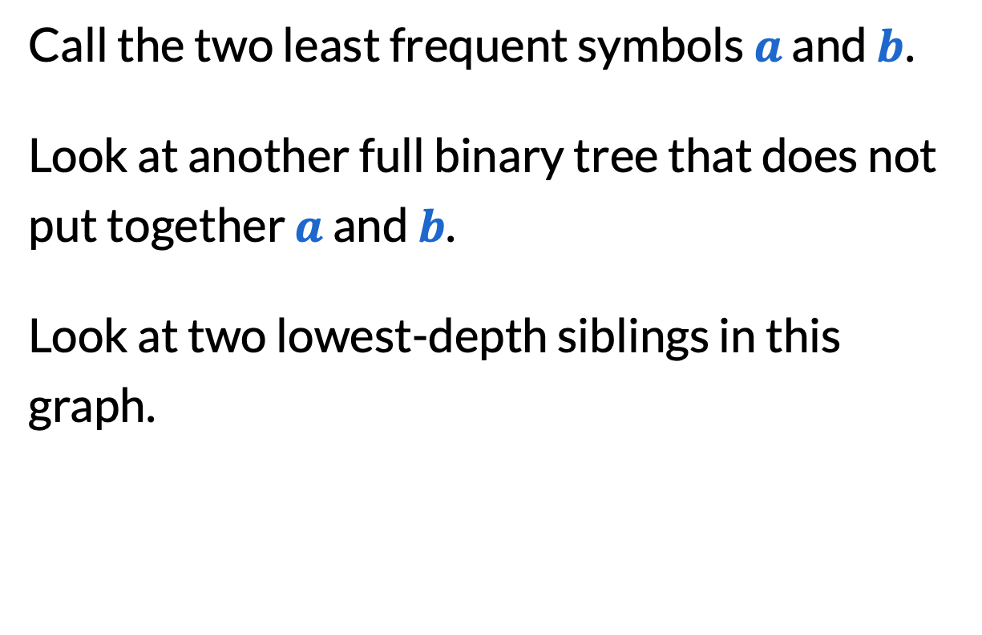
Merging nodes in a different order
Call the two least frequent symbols $a$ and $b$.
Look at another full binary tree that does not put together $a$ and $b$.
Look at two lowest-depth siblings in this graph.

Slide 49

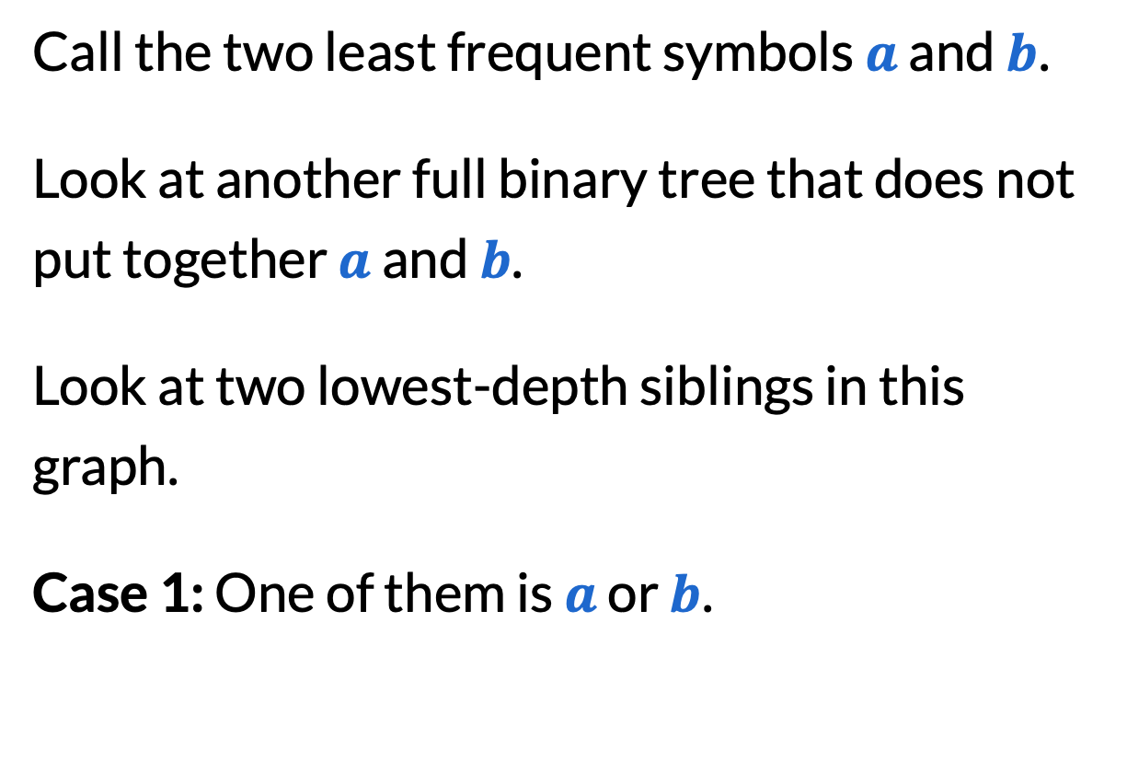


Merging nodes in a different order
Call the two least frequent symbols $a$ and $b$.
Look at another full binary tree that does not put together $a$ and $b$.
Look at two lowest-depth siblings in this graph.
Case 1: One of them is $a$ or $b$.
$$a$$
$$c$$
$$b$$

Slide 50

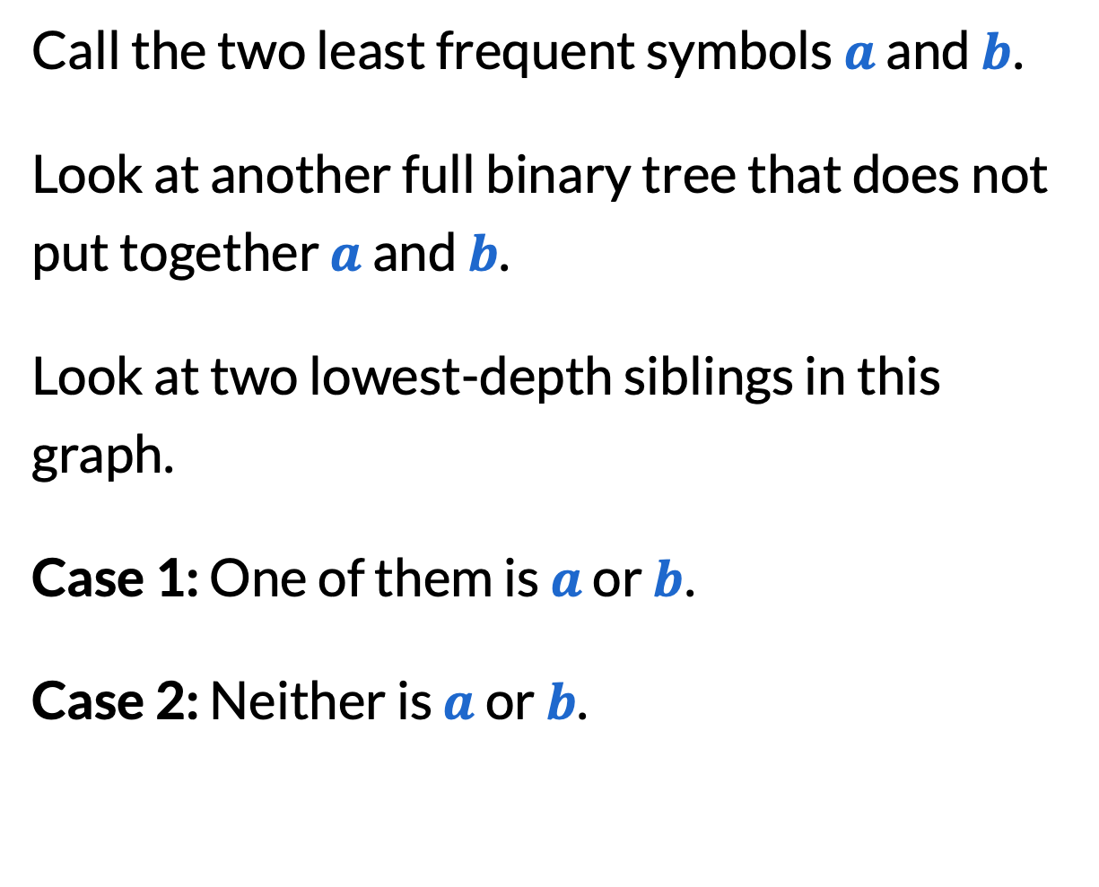


Merging nodes in a different order
Call the two least frequent symbols $a$ and $b$.
Look at another full binary tree that does not put together $a$ and $b$.
Look at two lowest-depth siblings in this graph.
Case 1: One of them is $a$ or $b$.
Case 2: Neither is $a$ or $b$.
$$a$$
$$c$$
$$d$$
$$b$$

Slide 51

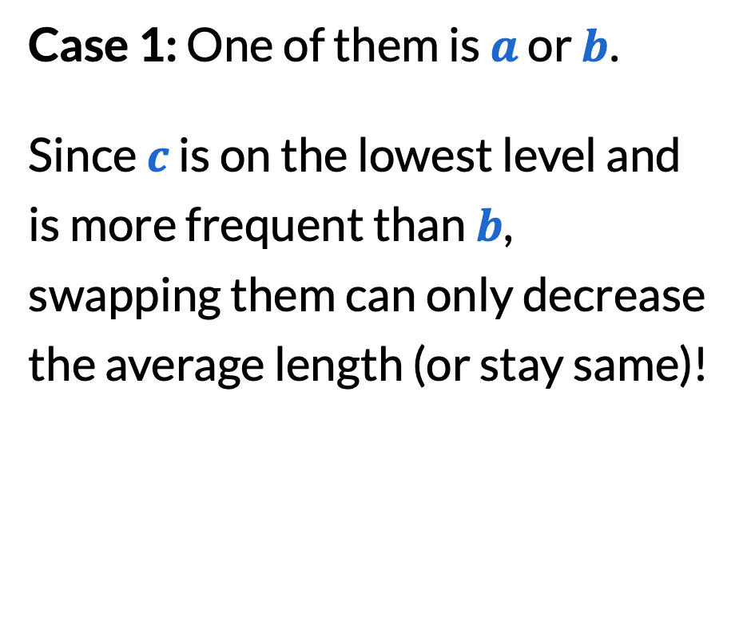


Merging nodes in a different order
Case 1: One of them is $a$ or $b$.
Since $c$ is on the lowest level and is more frequent than $b$, swapping them can only decrease the average length (or stay same)!
$$a$$
$$c$$
$$b$$

Slide 52
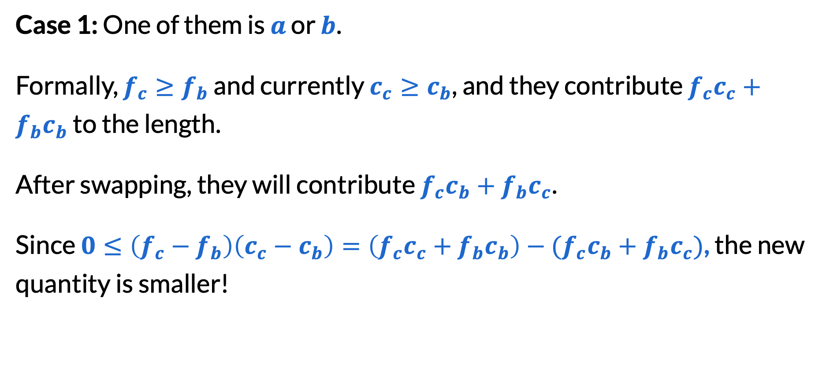
Merging nodes in a different order
Case 1: One of them is $a$ or $b$.
Formally, $f_{c}≥f_{b}$ and currently $c_{c}≥c_{b}$, and they contribute $f_{c}c_{c}+f_{b}c_{b}$ to the length.
After swapping, they will contribute $f_{c}c_{b}+f_{b}c_{c}$.
Since $0≤\left(f_{c}−f_{b}\right)\left(c_{c}−c_{b}\right)=\left(f_{c}c_{c}+f_{b}c_{b}\right)−{(f}_{c}c_{b}+f_{b}c_{c})$, the new quantity is smaller!

Slide 53

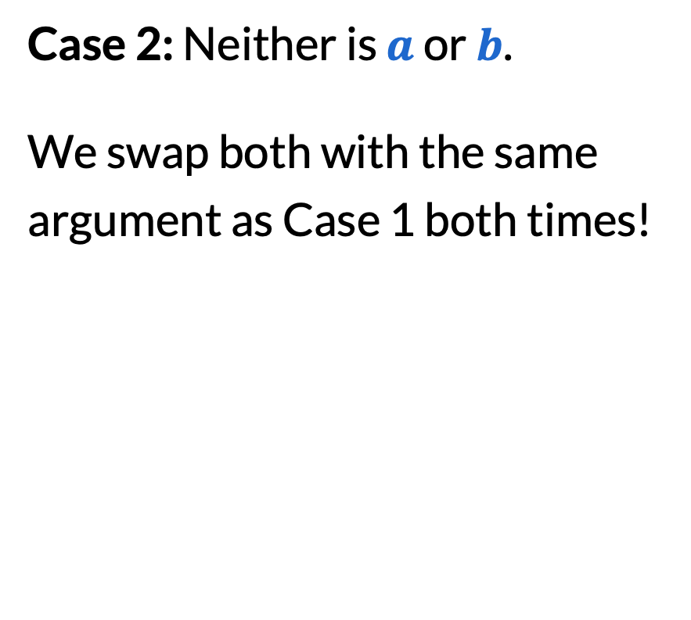



Merging nodes in a different order
Case 2: Neither is $a$ or $b$.
We swap both with the same argument as Case 1 both times!
$$a$$
$$c$$
$$d$$
$$b$$

Slide 54
Final reminders
I have OH now-12:30pm:
Meet at front of classroom, we’ll walk over together
CSE (Allen) 214 if you’re coming later
Nathan has online OH 12–1pm:
https://washington.zoom.us/my/nathanbrunelle

