Slide 1
Lecture 17: Dynamic Programming – Graphs
Nathan Brunelle

Slide 2

Single-source shortest paths (Dijkstra’s)
Given: an (un)directed graph $G=(V,E)$with each edge $e$ having a non-negative weight $w(e)$ and a vertex $s$
Find: (length of) shortest paths from $s$ to each vertex in $G$

Slide 3

Single-source shortest paths (Today)
Given: an (un)directed graph $G=(V,E)$with each edge $e$ having a non-negative weight $w(e)$ and a vertex $s$
Find: (length of) shortest paths from $s$ to each vertex in $G$

Slide 4
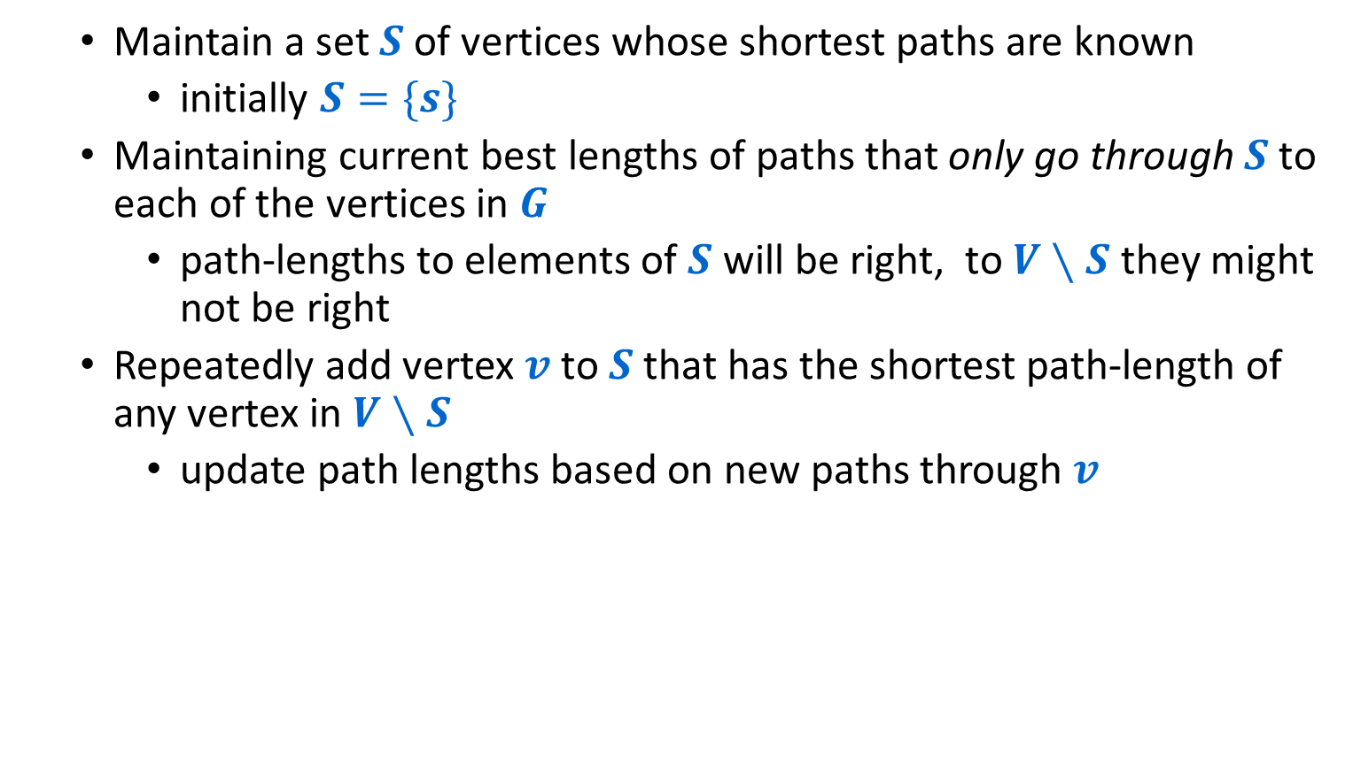
Dijkstra’s Algorithm
Maintain a set $S$ of vertices whose shortest paths are known
initially $S=\{s\}$
Maintaining current best lengths of paths that only go through $S$ to each of the vertices in $G$
path-lengths to elements of $S$ will be right, to $V∖S$ they might not be right
Repeatedly add vertex $v$ to $S$ that has the shortest path-length of any vertex in $V∖S$
update path lengths based on new paths through $v$

Slide 5
Directed Graph with Negative Weights
Dijkstra’s algorithm would not find the shortest path from 1 to 5
Shortest path is 1,3,5 which has cost 4
The path 1,2,4,5 has cost 7
Dijkstra’s will “lock in” that path before processing node 3
2
1
8
1
2
5
4
3
1
4
3
1
-4
6
6
5
7
2
9
5
10
9
-8
2
11
4
12
10
8
-9
7
9
13

Slide 6
Negative Cycles
There’s an issue when a graph has negative cost cycles
The shortest simple path to node 11 is
1,3,5,10,6,7,11 which has cost 13
The cycle 3,5,8,10,6,7,3 has cost -4
The (non-simple) path
1,3,5,8,10,6,7,3,5,10,6,7,11 has cost 9
Taking the cycle twice gives cost 5
No shortest path exists!
2
1
8
1
2
5
4
3
1
4
3
1
-4
6
6
5
7
2
9
5
10
9
-8
2
11
4
12
10
8
-9
7
9
13

Slide 7
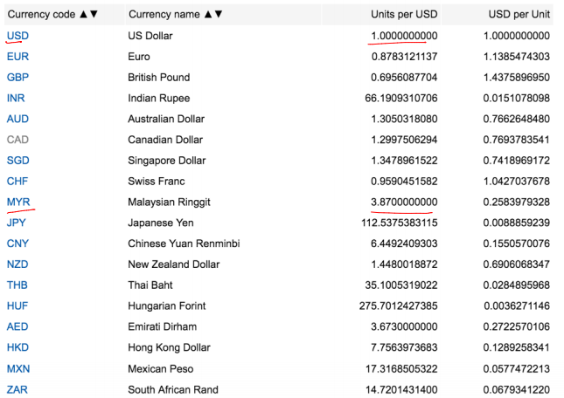
Motivating Example – Currency Exchanges
1 Dollar = 0.8783121137 Euro
1 Dollar = 3.87 Ringgit

Slide 8
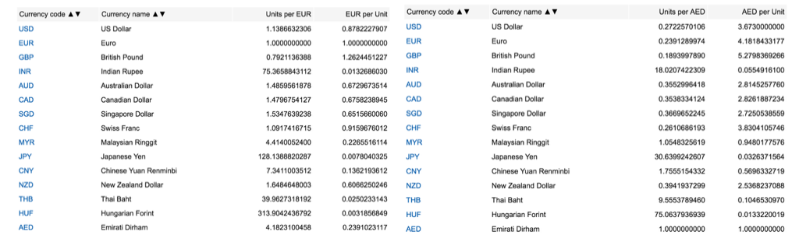
Dollars to Ringgit
1 Dollar = 0.8783121137 Euro
1 Euro= 4.1823100458 Dirham
1 Dirham= 1.0548325619 Ringgit
1 Dollar= 0.8783121137 * 4.1823100458 * 1.0548325619 Ringgit
= 3.87479406049 Ringgit
Directly: 1 Dollar = 3.87 Ringgit

Slide 9
How to get free money!
1 Dollar = 3.87479406049 Ringgit
1 Ringgit = 0.2583979328 Dollar
1 Dollar = 3.87479406049 * 0.2583979328 Dollar
= 1.00123877526 Dollar
Free Money!

Slide 10
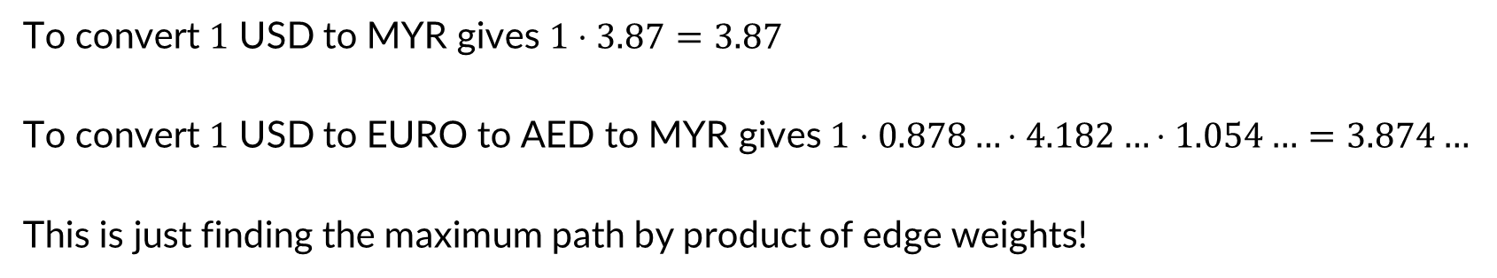
Currency Exchange as a Graph
3.8700000000
MYR
USD
0.2583979328
0.8783121137
AED
1.0548325619
EURO
4.1823100458
To convert $1$ USD to MYR gives $1⋅3.87=3.87$
To convert $1$ USD to EURO to AED to MYR gives $1⋅0.878…⋅4.182…⋅1.054…=3.874…$
This is just finding the maximum path by product of edge weights!

Slide 11
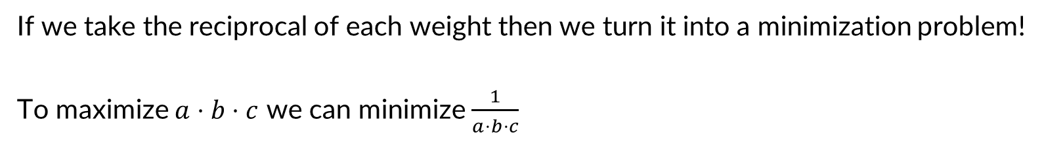
Converting to Shortest Path – max to min
1/3.8700000000
MYR
USD
1/0.2583979328
1/0.8783121137
AED
1/1.0548325619
EURO
1/4.1823100458
If we take the reciprocal of each weight then we turn it into a minimization problem!
To maximize $a⋅b⋅c$ we can minimize $\frac{1}{a⋅b⋅c}$

Slide 12
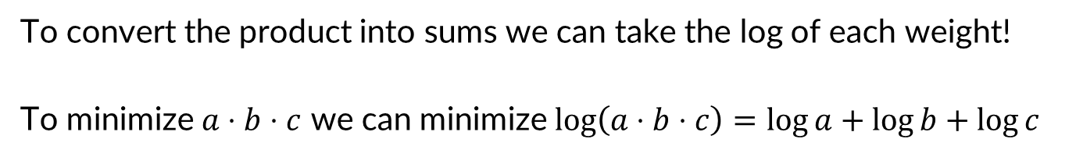
Converting to Shortest Path – product to sum
log(1/3.8700000000)
MYR
USD
log(1/0.2583979328)
log(1/0.8783121137)
log(1/1.0548325619)
EURO
AED
log(1/4.1823100458)
To convert the product into sums we can take the log of each weight!
To minimize $a⋅b⋅c$ we can minimize $\log\left(a⋅b⋅c\right)=\log{a}+\log{b}+\log{c}$

Slide 13
Best Exchange = Shortest path
-0.585
MYR
USD
0.57
0.06
-.02
EURO
AED
-0.63
To find the best way to convert USD to MYR, find the shortest path from USD to MYR!

Slide 14
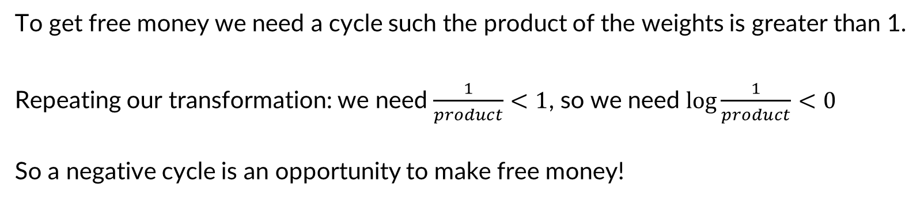
Free Money = Negative Cycles!
-0.585
MYR
USD
0.57
0.06
-.02
EURO
AED
-0.63
To get free money we need a cycle such the product of the weights is greater than 1.
Repeating our transformation: we need $\frac{1}{product}<1$, so we need $\log{\frac{1}{product}<0}$
So a negative cycle is an opportunity to make free money!
0.06-0.63-0.02+0.57=-0.02

Slide 15

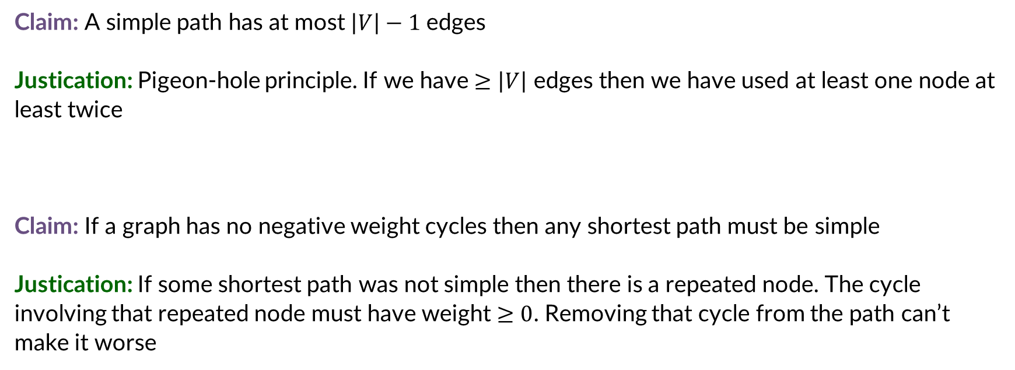


Observations
Claim: A simple path has at most $\left|V\right|−1$ edges
Justication: Pigeon-hole principle. If we have $≥\left|V\right|$ edges then we have used at least one node at least twice
Claim: If a graph has no negative weight cycles then any shortest path must be simple
Justication: If some shortest path was not simple then there is a repeated node. The cycle involving that repeated node must have weight $≥0$. Removing that cycle from the path can’t make it worse
$$s$$
$$t$$
Cost must be $≥0$

Slide 16
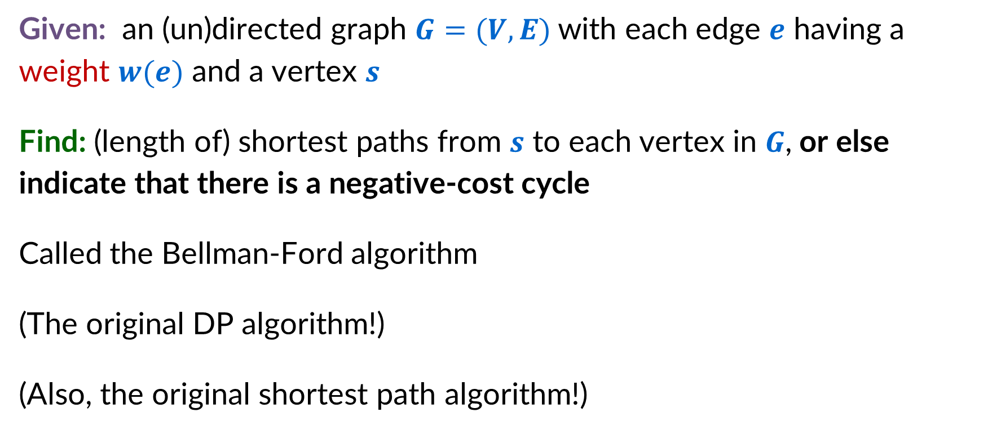
Single-source shortest paths, with negative edge weights
Given: an (un)directed graph $G=(V,E)$with each edge $e$ having a weight $w(e)$ and a vertex $s$
Find: (length of) shortest paths from $s$ to each vertex in $G$, or else indicate that there is a negative-cost cycle
Called the Bellman-Ford algorithm
(The original DP algorithm!)
(Also, the original shortest path algorithm!)

Slide 17
Bellman Ford – Step 1
Formulate the answer with a recursive structure
What are the options for the last choice?
For each such option, what does the subproblem look like? How do we use it?
Choose a memory structure.
Figure out the possible values of all parameters in the recursive calls.
How many subproblems (options for last choice) are there?
What are the parameters needed to identify each?
How many different values could there be per parameter?
Specify an order of evaluation.
Want to guarantee that the necessary subproblem solutions are in memory when you need them.
With this step: a “Bottom-up” (iterative) algorithm
Without this step: a “Top-down” (recursive) algorithm
See if there’s a way to save space
Is it possible to reuse some memory locations?

Slide 18

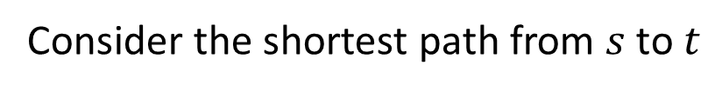



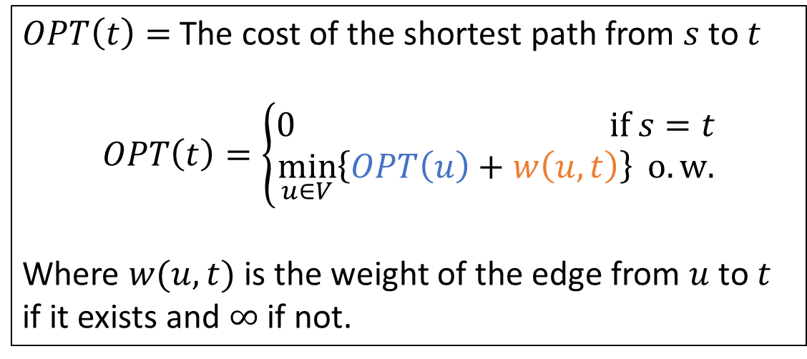
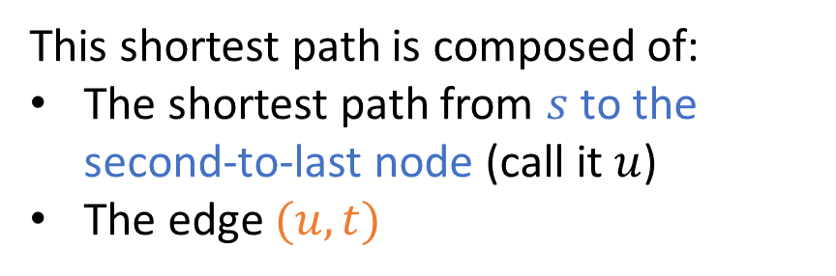

Identifying Recursive Structure – False Start
Consider the shortest path from $s$ to $t$
$OPT\left(t\right)=$ The cost of the shortest path from $s$ to $t$
$$OPT\left(t\right)=\left\{\begin{aligned}0 if s=t \\ \min_{u∈V}\left\{OPT\left(u\right)+w\left(u,t\right)\right\} o.w.\end{aligned}\right.$$
Where $w(u,t)$ is the weight of the edge from $u$ to $t$ if it exists and $∞$ if not.
$$s$$
$$t$$
This shortest path is composed of:
The shortest path from $s$ to the second-to-last node (call it $u$)
The edge $(u,t)$
$$s$$
$$u$$
$$t$$

Slide 19
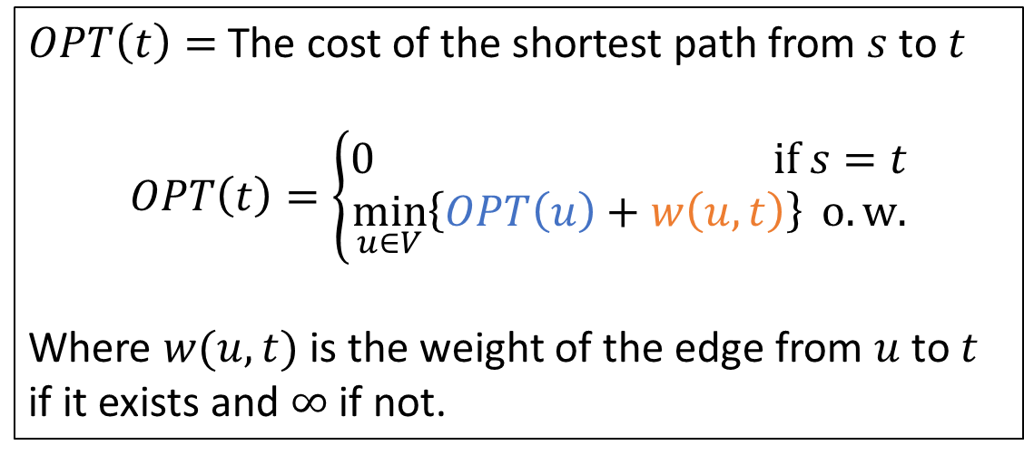
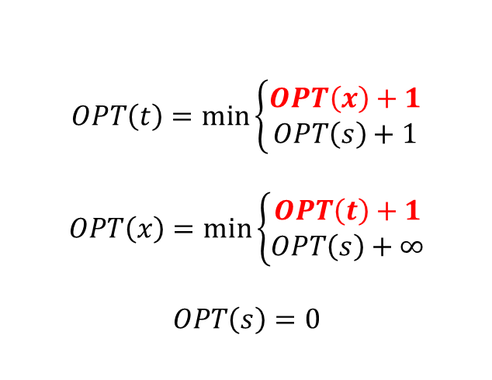



So…What’s wrong with this?
$OPT\left(t\right)=$ The cost of the shortest path from $s$ to $t$
$$OPT\left(t\right)=\left\{\begin{aligned}0 if s=t \\ \min_{u∈V}\left\{OPT\left(u\right)+w\left(u,t\right)\right\} o.w.\end{aligned}\right.$$
Where $w(u,t)$ is the weight of the edge from $u$ to $t$ if it exists and $∞$ if not.
$$x$$
1
1
1
$$s$$
$$t$$
$$OPT\left(t\right)=\min\left\{\begin{aligned}OPT\left(x\right)+1 \\ OPT\left(s\right)+1\end{aligned}\right.$$
$$OPT\left(x\right)=\min\left\{\begin{aligned}OPT\left(t\right)+1 \\ OPT\left(s\right)+∞\end{aligned}\right.$$
$$OPT\left(s\right)=0$$
We never reach a base case!

Slide 20




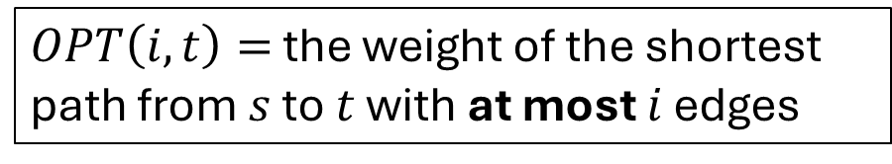







Identifying Recursive Structure – Correctly!
Suppose the shortest path from $s$ to $t$ has $i$ or fewer edges
$OPT\left(i,t\right)=$ the weight of the shortest path from $s$ to $t$ with at most $i$ edges
$$s$$
$$t$$
$≤i$ edges
This shortest path will be one of these:
Option 1: the shortest path from $s$ to some $u$ with $i−1$ or fewer edges, plus the edge $(u,t)$
$$\min_{u∈V}\left\{OPT\left(i−1,u\right)+w(u,t)\right\}$$
$$s$$
$$u$$
$$t$$
$i−1$ edges
Option 2: the same as shortest path from $s$ to $t$ with $i−1$ or fewer edges
$$s$$
$$OPT\left(i−1, t\right)$$
$$t$$
$≤i−1$ edges

Slide 21





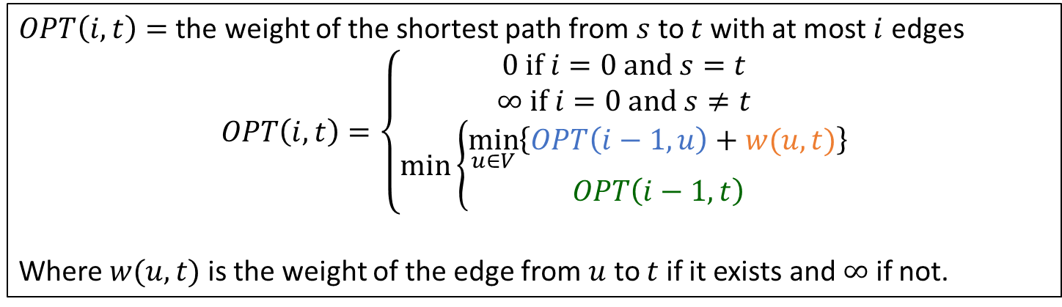






Final Recursive Structure
$OPT\left(i,t\right)=$ the weight of the shortest path from $s$ to $t$ with at most $i$ edges
$$OPT\left(i,t\right)=\left\{\begin{aligned}0 if i=0 and s=t \\ ∞ if i=0 and s≠t \\ \min\left\{\begin{aligned}\min_{u∈V}\left\{OPT\left(i−1,u\right)+w(u,t)\right\} \\ OPT\left(i−1, t\right)\end{aligned}\right.\end{aligned}\right.$$
Where $w(u,t)$ is the weight of the edge from $u$ to $t$ if it exists and $∞$ if not.
$$s$$
$$u$$
$$t$$
$$s$$
$$=min$$
$i−1$ edges
$$t$$
$≤i$ edges
$$s$$
$$t$$
$≤i−1$ edges

Slide 22








Bellman Ford – Step 2
$$s$$
$$u$$
$$t$$
Formulate the answer with a recursive structure
What are the options for the last choice?
For each such option, what does the subproblem look like? How do we use it?
Choose a memory structure.
Figure out the possible values of all parameters in the recursive calls.
How many subproblems (options for last choice) are there?
What are the parameters needed to identify each?
How many different values could there be per parameter?
Specify an order of evaluation.
Want to guarantee that the necessary subproblem solutions are in memory when you need them.
With this step: a “Bottom-up” (iterative) algorithm
Without this step: a “Top-down” (recursive) algorithm
See if there’s a way to save space
Is it possible to reuse some memory locations?
$$min$$
$i−1$ edges
$$s$$
$$t$$
$≤i−1$ edges

Slide 23













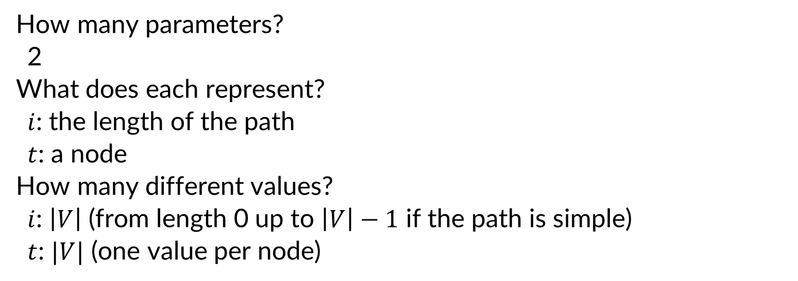


Identifying the Memory Structure
$$OPT\left(i,t\right)=\left\{\begin{aligned}0 if i=0 and s=t \\ ∞ if i=0 and s≠t \\ \min\left\{\begin{aligned}\min_{u∈V}\left\{OPT\left(i−1,u\right)+w(u,t)\right\} \\ OPT\left(i−1, t\right)\end{aligned}\right.\end{aligned}\right.$$
How many parameters?
2
What does each represent?
$i$: the length of the path
$t$: a node
How many different values?
$i$: $\left|V\right|$ (from length 0 up to $\left|V\right|−1$ if the path is simple)
$t$: $|V|$ (one value per node)
$$1$$
$$2$$
$$3$$
$$4$$
$$5$$
$$6$$
$$7$$
$$0$$
$$1$$
$$2$$
$$3$$
$$4$$
$$5$$
$$6$$

Slide 24
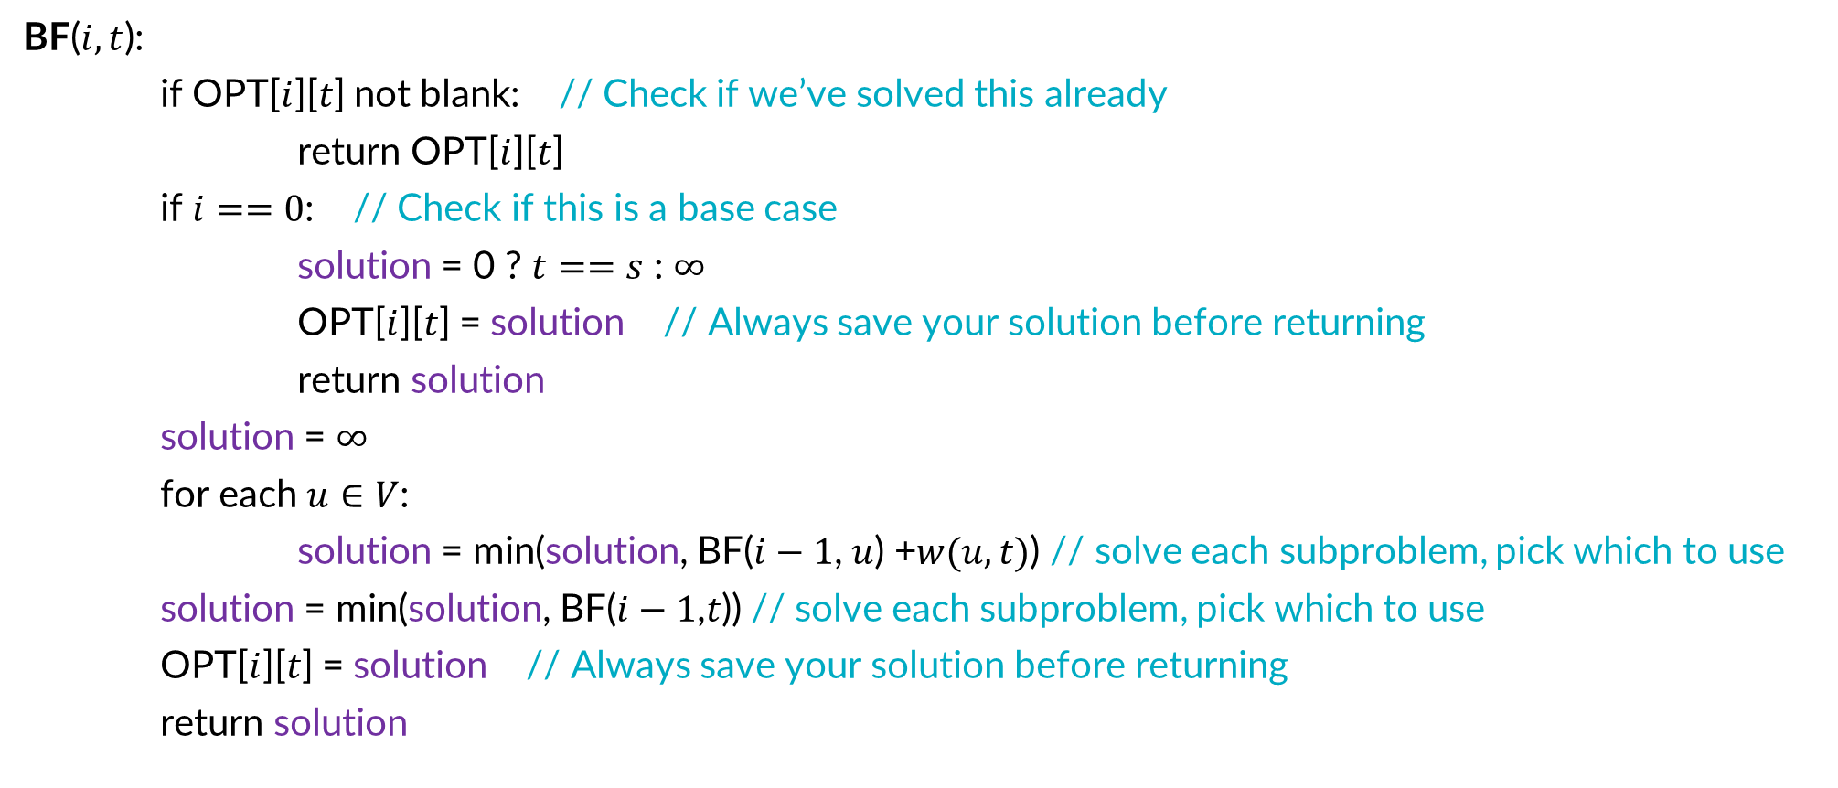
Top-Down Bellman-Ford
This algorithm correctly finds shortest paths when there are no negative-cost cycles
How can we check for negative cost cycles?
BF($i,t$):
if OPT[$i$][$t$] not blank: // Check if we’ve solved this already
return OPT[$i$][$t$]
if $i==0$: // Check if this is a base case
solution = 0 ? $t==s$ : $∞$
OPT[$i$][$t$] = solution // Always save your solution before returning
return solution
solution = $∞$
for each $u∈V$:
solution = min(solution, BF($i−1$, $u$) +$w(u,t)$) // solve each subproblem, pick which to use
solution = min(solution, BF($i−1$,$t$)) // solve each subproblem, pick which to use
OPT[$i$][$t$] = solution // Always save your solution before returning
return solution

Slide 25

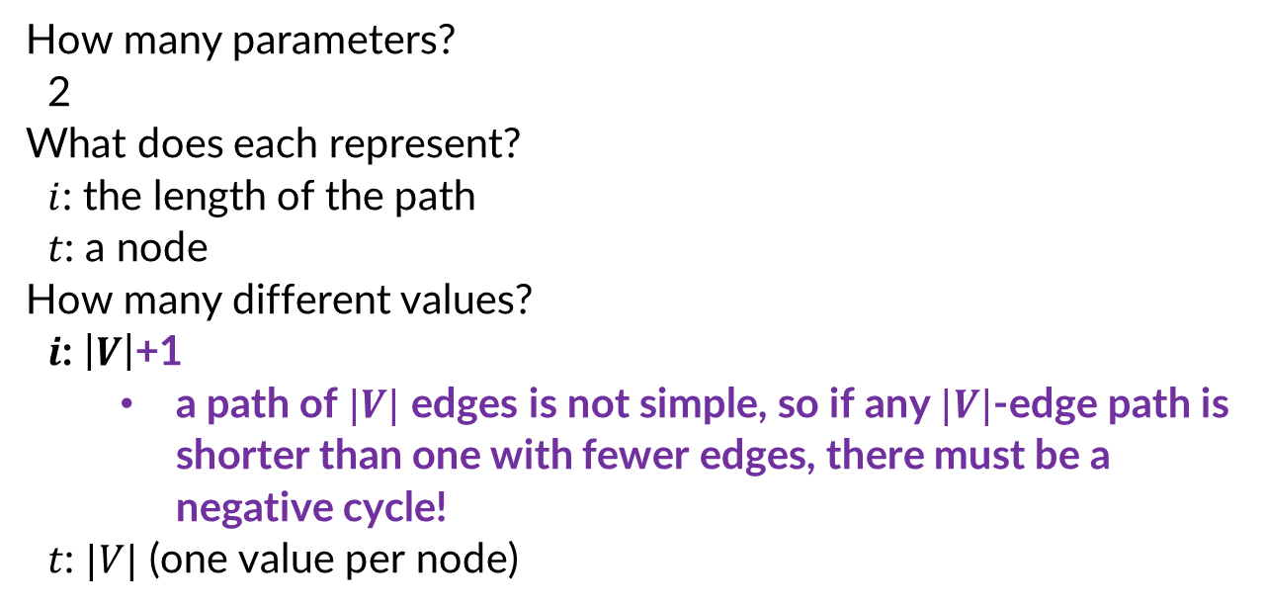
Checking for Negative Cycles
$$OPT\left(i,t\right)=\left\{\begin{aligned}0 if i=0 and s=t \\ ∞ if i=0 and s≠t \\ \min\left\{\begin{aligned}\min_{u∈V}\left\{OPT\left(i−1,u\right)+w(u,t)\right\} \\ OPT\left(i−1, t\right)\end{aligned}\right.\end{aligned}\right.$$
How many parameters?
2
What does each represent?
$i$: the length of the path
$t$: a node
How many different values?
$i$: $\left|V\right|$+1
a path of $|V|$ edges is not simple, so if any $|V|$-edge path is shorter than one with fewer edges, there must be a negative cycle!
$t$: $|V|$ (one value per node)
$$1$$
$$2$$
$$3$$
$$4$$
$$5$$
$$6$$
$$7$$
$$0$$
$$1$$
$$2$$
$$3$$
$$4$$
$$5$$
$$6$$
$$7$$

Slide 26
Bellman Ford – Step 3
$$s$$
Formulate the answer with a recursive structure
What are the options for the last choice?
For each such option, what does the subproblem look like? How do we use it?
Choose a memory structure.
Figure out the possible values of all parameters in the recursive calls.
How many subproblems (options for last choice) are there?
What are the parameters needed to identify each?
How many different values could there be per parameter?
Specify an order of evaluation.
Want to guarantee that the necessary subproblem solutions are in memory when you need them.
With this step: a “Bottom-up” (iterative) algorithm
Without this step: a “Top-down” (recursive) algorithm
See if there’s a way to save space
Is it possible to reuse some memory locations?
$$u$$
$$t$$
$$min$$
$i−1$ edges
$$s$$
$$t$$
$≤i−1$ edges

Slide 27



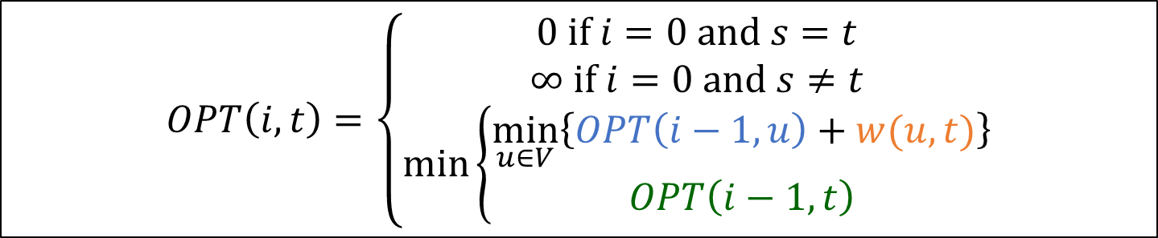













Order of Evaluations
$$OPT\left(i,t\right)=\left\{\begin{aligned}0 if i=0 and s=t \\ ∞ if i=0 and s≠t \\ \min\left\{\begin{aligned}\min_{u∈V}\left\{OPT\left(i−1,u\right)+w(u,t)\right\} \\ OPT\left(i−1, t\right)\end{aligned}\right.\end{aligned}\right.$$
$$1$$
$$2$$
$$3$$
$$4$$
$$5$$
$$6$$
$$7$$
$$0$$
Each cell depends on every value in the previous row
Solve in order of $i$
$$1$$
$$2$$
$$3$$
$$4$$
$$5$$
$$6$$
$$7$$

Slide 28
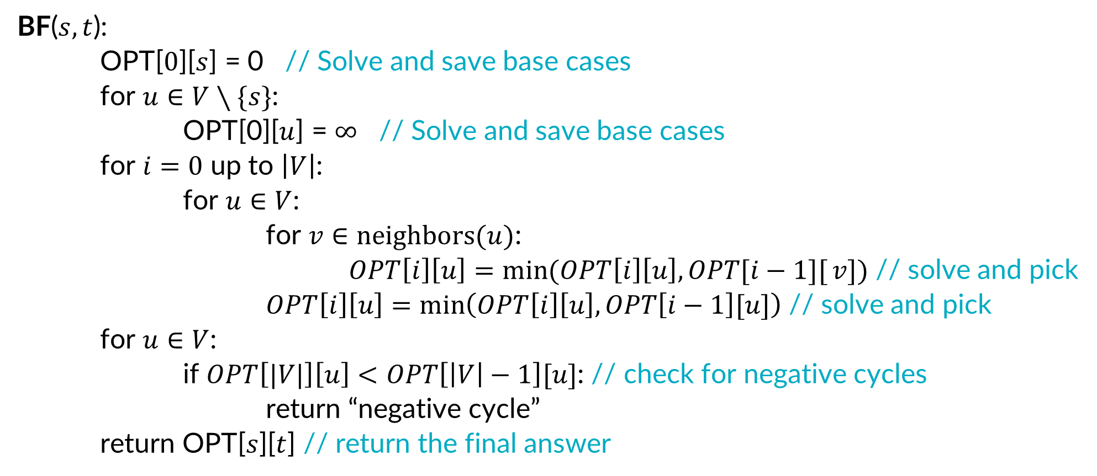
Bottom-Up Bellman-Ford
BF($s,t$):
OPT[$0$][$s$] = 0 // Solve and save base cases
for $u∈V∖\{s\}$:
OPT[0][$u$] = $∞$ // Solve and save base cases
for $i=0$ up to $\left|V\right|$:
for $u∈V$:
for $v∈neighbors(u)$:
$OPT\left[i\right]\left[u\right]=\min{(OPT\left[i\right]\left[u\right], OPT[i−1][}v])$ // solve and pick
$OPT\left[i\right]\left[u\right]=\min\left(OPT\left[i\right]\left[u\right],OPT\left[i−1\right][u]\right)$ // solve and pick
for $u∈V$:
if $OPT\left[|V|\right]\left[u\right]<OPT\left[\left|V\right|−1\right][u]$: // check for negative cycles
return “negative cycle”
return OPT[$s$][$t$] // return the final answer

Slide 29





Bottom-Up Bellman-Ford
BF($s,t$):
OPT[$0$][$s$] = 0 // Solve and save base cases
for $u∈V∖\{s\}$:
OPT[0][$u$] = $∞$ // Solve and save base cases
for $i=0$ up to $\left|V\right|$:
for $u∈V$:
for $v∈neighbors(u)$:
$OPT\left[i\right]\left[u\right]=\min{(OPT\left[i\right]\left[u\right], OPT[i−1][}v])$ // solve and pick
$OPT\left[i\right]\left[u\right]=\min\left(OPT\left[i\right]\left[u\right],OPT\left[i−1\right][u]\right)$ // solve and pick
for $u∈V$:
if $OPT\left[|V|\right]\left[u\right]<OPT\left[\left|V\right|−1\right][u]$: // check for negative cycles
return “negative cycle”
return OPT[$s$][$t$] // return the final answer
$$Θ(1)$$
$$Θ(|V|)$$
$$Θ(|V||E|)$$
$$Θ(|V|)$$
$$Θ(1)$$

Slide 30
Bellman Ford – Step 4
$$s$$
$$u$$
$$t$$
$i−1$ edges
Formulate the answer with a recursive structure
What are the options for the last choice?
For each such option, what does the subproblem look like? How do we use it?
Choose a memory structure.
Figure out the possible values of all parameters in the recursive calls.
How many subproblems (options for last choice) are there?
What are the parameters needed to identify each?
How many different values could there be per parameter?
Specify an order of evaluation.
Want to guarantee that the necessary subproblem solutions are in memory when you need them.
With this step: a “Bottom-up” (iterative) algorithm
Without this step: a “Top-down” (recursive) algorithm
See if there’s a way to save space
Is it possible to reuse some memory locations?
$$min$$
$$s$$
$$t$$
$≤i−1$ edges

Slide 31
Order of Evaluations
$$OPT\left(i,t\right)=\left\{\begin{aligned}0 if i=0 and s=t \\ ∞ if i=0 and s≠t \\ \min\left\{\begin{aligned}\min_{u∈V}\left\{OPT\left(i−1,u\right)+w(u,t)\right\} \\ OPT\left(i−1, t\right)\end{aligned}\right.\end{aligned}\right.$$
$$1$$
$$2$$
$$3$$
$$4$$
$$5$$
$$6$$
$$7$$
$$0$$
Each cell depends only on values in the previous row
We only need two rows!
$$1$$
$$2$$
$$3$$
$$4$$
$$5$$
$$6$$
$$7$$

Slide 32
Bellman Ford– Four Steps
$$s$$
$$u$$
$$t$$
$i−1$ edges
Formulate the answer with a recursive structure
What are the options for the last choice?
For each such option, what does the subproblem look like? How do we use it?
Choose a memory structure.
Figure out the possible values of all parameters in the recursive calls.
How many subproblems (options for last choice) are there?
What are the parameters needed to identify each?
How many different values could there be per parameter?
Specify an order of evaluation.
Want to guarantee that the necessary subproblem solutions are in memory when you need them.
With this step: a “Bottom-up” (iterative) algorithm
Without this step: a “Top-down” (recursive) algorithm
See if there’s a way to save space
Is it possible to reuse some memory locations?
$$min$$
$$s$$
$$t$$
$≤i−1$ edges

Slide 33

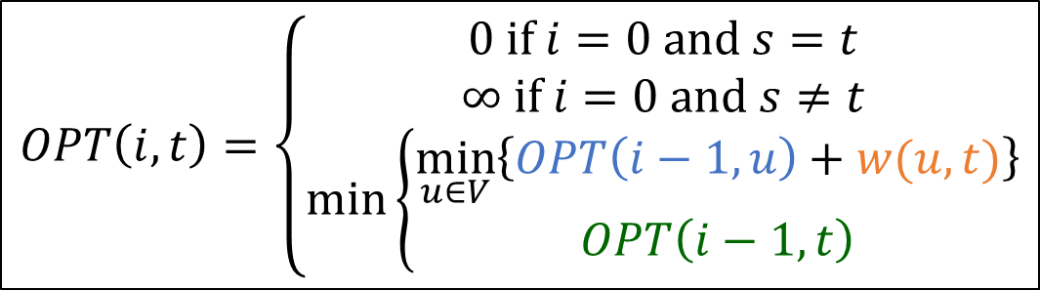






Example Execution
-7
5
4
1
4
2
1
3
1
2
3
7
$$1$$
$$2$$
$$3$$
$$4$$
$$5$$
$$6$$
$$7$$
8
-8
6
$$0$$
$$0$$
$$∞$$
$$∞$$
$$∞$$
$$∞$$
$$∞$$
$$∞$$
$$1$$
$$2$$
$$OPT\left(i,t\right)=\left\{\begin{aligned}0 if i=0 and s=t \\ ∞ if i=0 and s≠t \\ \min\left\{\begin{aligned}\min_{u∈V}\left\{OPT\left(i−1,u\right)+w(u,t)\right\} \\ OPT\left(i−1, t\right)\end{aligned}\right.\end{aligned}\right.$$
$$3$$
$$4$$
$$5$$
$$6$$
$$7$$

Slide 34







Example Execution
-7
5
4
1
4
2
1
3
1
2
3
7
$$1$$
$$2$$
$$3$$
$$4$$
$$5$$
$$6$$
$$7$$
8
-8
6
$$0$$
$$0$$
$$∞$$
$$∞$$
$$∞$$
$$∞$$
$$∞$$
$$∞$$
$$1$$
$$0$$
$$2$$
$$∞$$
$$∞$$
$$∞$$
$$8$$
$$∞$$
$$2$$
$$OPT\left(i,t\right)=\left\{\begin{aligned}0 if i=0 and s=t \\ ∞ if i=0 and s≠t \\ \min\left\{\begin{aligned}\min_{u∈V}\left\{OPT\left(i−1,u\right)+w(u,t)\right\} \\ OPT\left(i−1, t\right)\end{aligned}\right.\end{aligned}\right.$$
$$3$$
$$4$$
$$5$$
$$6$$
$$7$$

Slide 35









Example Execution
-7
5
4
1
4
2
1
3
1
2
3
7
$$1$$
$$2$$
$$3$$
$$4$$
$$5$$
$$6$$
$$7$$
8
-8
6
$$0$$
$$0$$
$$∞$$
$$∞$$
$$∞$$
$$∞$$
$$∞$$
$$∞$$
$$1$$
$$0$$
$$2$$
$$∞$$
$$∞$$
$$∞$$
$$8$$
$$∞$$
$$2$$
$$0$$
$$2$$
$$3$$
$$∞$$
$$∞$$
$$8$$
$$0$$
$$OPT\left(i,t\right)=\left\{\begin{aligned}0 if i=0 and s=t \\ ∞ if i=0 and s≠t \\ \min\left\{\begin{aligned}\min_{u∈V}\left\{OPT\left(i−1,u\right)+w(u,t)\right\} \\ OPT\left(i−1, t\right)\end{aligned}\right.\end{aligned}\right.$$
$$3$$
$$4$$
$$5$$
$$6$$
$$7$$

Slide 36









Example Execution
-7
5
4
1
4
2
1
3
1
2
3
7
$$1$$
$$2$$
$$3$$
$$4$$
$$5$$
$$6$$
$$7$$
8
-8
6
$$0$$
$$0$$
$$∞$$
$$∞$$
$$∞$$
$$∞$$
$$∞$$
$$∞$$
$$1$$
$$0$$
$$2$$
$$∞$$
$$∞$$
$$∞$$
$$8$$
$$∞$$
$$2$$
$$0$$
$$2$$
$$3$$
$$∞$$
$$∞$$
$$8$$
$$0$$
$$OPT\left(i,t\right)=\left\{\begin{aligned}0 if i=0 and s=t \\ ∞ if i=0 and s≠t \\ \min\left\{\begin{aligned}\min_{u∈V}\left\{OPT\left(i−1,u\right)+w(u,t)\right\} \\ OPT\left(i−1, t\right)\end{aligned}\right.\end{aligned}\right.$$
$$3$$
$$0$$
$$2$$
$$3$$
$$7$$
$$∞$$
$$8$$
$$0$$
$$4$$
$$5$$
$$6$$
$$7$$

Slide 37








Example Execution
-7
5
4
1
4
2
1
3
1
2
3
7
$$1$$
$$2$$
$$3$$
$$4$$
$$5$$
$$6$$
$$7$$
8
-8
6
$$0$$
$$0$$
$$∞$$
$$∞$$
$$∞$$
$$∞$$
$$∞$$
$$∞$$
$$1$$
$$0$$
$$2$$
$$∞$$
$$∞$$
$$∞$$
$$8$$
$$∞$$
$$2$$
$$0$$
$$2$$
$$3$$
$$∞$$
$$∞$$
$$8$$
$$0$$
$$OPT\left(i,t\right)=\left\{\begin{aligned}0 if i=0 and s=t \\ ∞ if i=0 and s≠t \\ \min\left\{\begin{aligned}\min_{u∈V}\left\{OPT\left(i−1,u\right)+w(u,t)\right\} \\ OPT\left(i−1, t\right)\end{aligned}\right.\end{aligned}\right.$$
$$3$$
$$0$$
$$2$$
$$3$$
$$7$$
$$∞$$
$$8$$
$$0$$
$$4$$
$$0$$
$$2$$
$$3$$
$$7$$
$$0$$
$$8$$
$$0$$
$$5$$
$$6$$
$$7$$

Slide 38








Example Execution
-7
5
4
1
4
2
1
3
1
2
3
7
$$1$$
$$2$$
$$3$$
$$4$$
$$5$$
$$6$$
$$7$$
8
-8
6
$$0$$
$$0$$
$$∞$$
$$∞$$
$$∞$$
$$∞$$
$$∞$$
$$∞$$
$$1$$
$$0$$
$$2$$
$$∞$$
$$∞$$
$$∞$$
$$8$$
$$∞$$
$$2$$
$$0$$
$$2$$
$$3$$
$$∞$$
$$∞$$
$$8$$
$$0$$
$$OPT\left(i,t\right)=\left\{\begin{aligned}0 if i=0 and s=t \\ ∞ if i=0 and s≠t \\ \min\left\{\begin{aligned}\min_{u∈V}\left\{OPT\left(i−1,u\right)+w(u,t)\right\} \\ OPT\left(i−1, t\right)\end{aligned}\right.\end{aligned}\right.$$
$$3$$
$$0$$
$$2$$
$$3$$
$$7$$
$$∞$$
$$8$$
$$0$$
$$4$$
$$0$$
$$2$$
$$3$$
$$7$$
$$0$$
$$8$$
$$0$$
$$5$$
$$0$$
$$1$$
$$3$$
$$7$$
$$0$$
$$8$$
$$0$$
$$6$$
$$7$$

Slide 39







Example Execution
-7
5
4
1
4
2
1
3
1
2
3
7
$$1$$
$$2$$
$$3$$
$$4$$
$$5$$
$$6$$
$$7$$
8
-8
6
$$0$$
$$0$$
$$∞$$
$$∞$$
$$∞$$
$$∞$$
$$∞$$
$$∞$$
$$1$$
$$0$$
$$2$$
$$∞$$
$$∞$$
$$∞$$
$$8$$
$$∞$$
$$2$$
$$0$$
$$2$$
$$3$$
$$∞$$
$$∞$$
$$8$$
$$0$$
$$OPT\left(i,t\right)=\left\{\begin{aligned}0 if i=0 and s=t \\ ∞ if i=0 and s≠t \\ \min\left\{\begin{aligned}\min_{u∈V}\left\{OPT\left(i−1,u\right)+w(u,t)\right\} \\ OPT\left(i−1, t\right)\end{aligned}\right.\end{aligned}\right.$$
$$3$$
$$0$$
$$2$$
$$3$$
$$7$$
$$∞$$
$$8$$
$$0$$
$$4$$
$$0$$
$$2$$
$$3$$
$$7$$
$$0$$
$$8$$
$$0$$
$$5$$
$$0$$
$$1$$
$$3$$
$$7$$
$$0$$
$$8$$
$$0$$
$$6$$
$$0$$
$$1$$
$$2$$
$$7$$
$$0$$
$$8$$
$$0$$
$$7$$

Slide 40








Example Execution
-7
5
4
1
4
2
1
3
1
2
3
7
$$1$$
$$2$$
$$3$$
$$4$$
$$5$$
$$6$$
$$7$$
8
-8
6
$$0$$
$$0$$
$$∞$$
$$∞$$
$$∞$$
$$∞$$
$$∞$$
$$∞$$
$$1$$
$$0$$
$$2$$
$$∞$$
$$∞$$
$$∞$$
$$8$$
$$∞$$
$$2$$
$$0$$
$$2$$
$$3$$
$$∞$$
$$∞$$
$$8$$
$$0$$
$$OPT\left(i,t\right)=\left\{\begin{aligned}0 if i=0 and s=t \\ ∞ if i=0 and s≠t \\ \min\left\{\begin{aligned}\min_{u∈V}\left\{OPT\left(i−1,u\right)+w(u,t)\right\} \\ OPT\left(i−1, t\right)\end{aligned}\right.\end{aligned}\right.$$
$$3$$
$$0$$
$$2$$
$$3$$
$$7$$
$$∞$$
$$8$$
$$0$$
$$4$$
$$0$$
$$2$$
$$3$$
$$7$$
$$0$$
$$8$$
$$0$$
$$5$$
$$0$$
$$1$$
$$3$$
$$7$$
$$0$$
$$8$$
$$0$$
$$6$$
$$0$$
$$1$$
$$2$$
$$7$$
$$0$$
$$8$$
$$0$$
$$7$$
$$0$$
$$1$$
$$2$$
$$3$$
$$0$$
$$8$$
$$0$$

Slide 41
Example Execution
-7
5
4
1
4
2
1
3
1
2
3
7
$$1$$
$$2$$
$$3$$
$$4$$
$$5$$
$$6$$
$$7$$
8
-8
6
$$0$$
$$0$$
$$∞$$
$$∞$$
$$∞$$
$$∞$$
$$∞$$
$$∞$$
$$1$$
$$0$$
$$2$$
$$∞$$
$$∞$$
$$∞$$
$$8$$
$$∞$$
$$2$$
$$0$$
$$2$$
$$3$$
$$∞$$
$$∞$$
$$8$$
$$0$$
$$OPT\left(i,t\right)=\left\{\begin{aligned}0 if i=0 and s=t \\ ∞ if i=0 and s≠t \\ \min\left\{\begin{aligned}\min_{u∈V}\left\{OPT\left(i−1,u\right)+w(u,t)\right\} \\ OPT\left(i−1, t\right)\end{aligned}\right.\end{aligned}\right.$$
$$3$$
$$0$$
$$2$$
$$3$$
$$7$$
$$∞$$
$$8$$
$$0$$
$$4$$
$$0$$
$$2$$
$$3$$
$$7$$
$$0$$
$$8$$
$$0$$
$$5$$
$$0$$
$$1$$
$$3$$
$$7$$
$$0$$
$$8$$
$$0$$
$$6$$
$$0$$
$$1$$
$$2$$
$$7$$
$$0$$
$$8$$
$$0$$
$$7$$
$$0$$
$$1$$
$$2$$
$$3$$
$$0$$
$$8$$
$$0$$
Negative Cycle Found!

Slide 42
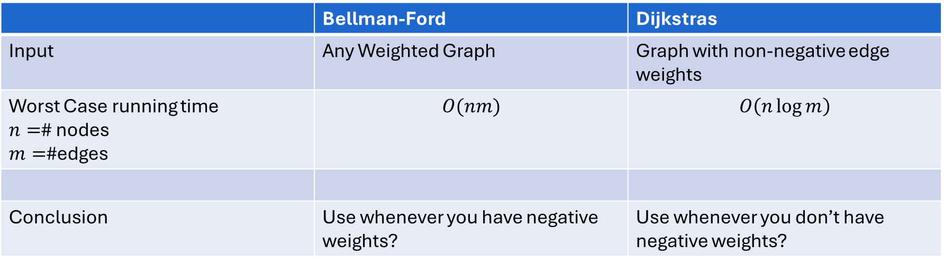
Bellman-Ford vs Dijkstras (1/2)
 | Bellman-Ford | Dijkstras
Input | Any Weighted Graph | Graph with non-negative edge weights
Worst Case running time $n=$# nodes $m=$#edges | $$O(nm)$$ | $$O\left(n\log{m}\right)$$
Conclusion | Use whenever you have negative weights? | Use whenever you don’t have negative weights?

Slide 43
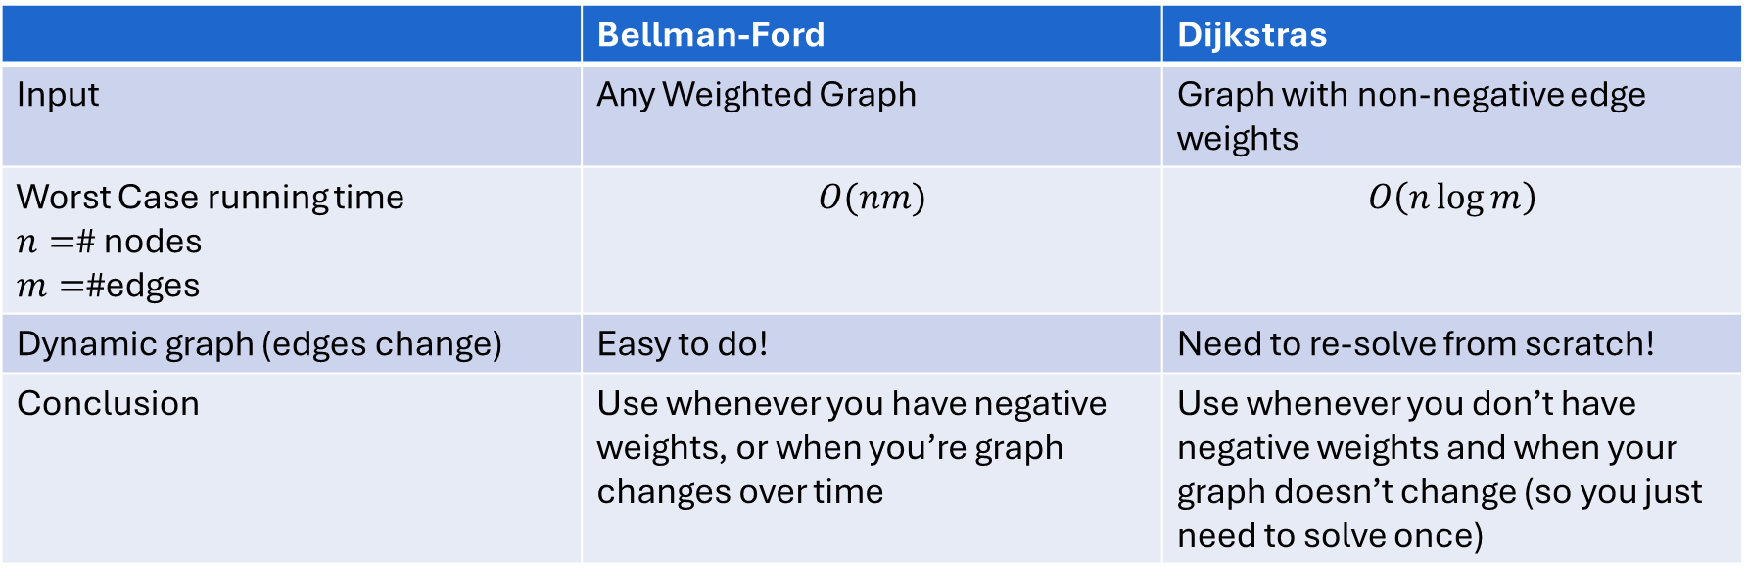
Bellman-Ford vs Dijkstras (2/2)
 | Bellman-Ford | Dijkstras
Input | Any Weighted Graph | Graph with non-negative edge weights
Worst Case running time $n=$# nodes $m=$#edges | $$O(nm)$$ | $$O\left(n\log{m}\right)$$
Dynamic graph (edges change) | Easy to do! | Need to re-solve from scratch!
Conclusion | Use whenever you have negative weights, or when you’re graph changes over time | Use whenever you don’t have negative weights and when your graph doesn’t change (so you just need to solve once)

Slide 44









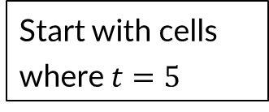

Changing an Edge
When 1 edge changes, we don’t necessarily need to update the whole table!
$$×$$
-2
-7
5
4
1
4
We only need to change cells where this edge is the one that changed (and any that depend on that edge)
2
1
3
Start with cells where $t=5$
1
2
3
7
$$1$$
$$2$$
$$3$$
$$4$$
$$5$$
$$6$$
$$7$$
8
-8
6
$$0$$
$$0$$
$$∞$$
$$∞$$
$$∞$$
$$∞$$
$$∞$$
$$∞$$
$$1$$
$$0$$
$$2$$
$$∞$$
$$∞$$
$$∞$$
$$8$$
$$∞$$
$$2$$
$$0$$
$$2$$
$$3$$
$$∞$$
$$∞$$
$$8$$
$$0$$
$$OPT\left(i,t\right)=\left\{\begin{aligned}0 if i=0 and s=t \\ ∞ if i=0 and s≠t \\ \min\left\{\begin{aligned}\min_{u∈V}\left\{OPT\left(i−1,u\right)+w(u,t)\right\} \\ OPT\left(i−1, t\right)\end{aligned}\right.\end{aligned}\right.$$
$$3$$
$$0$$
$$2$$
$$3$$
$$7$$
$$∞$$
$$8$$
$$0$$
$$4$$
$$0$$
$$2$$
$$3$$
$$7$$
$$0$$
$$8$$
$$0$$
$$5$$
$$0$$
$$1$$
$$3$$
$$7$$
$$0$$
$$8$$
$$0$$
$$6$$
$$0$$
$$1$$
$$2$$
$$7$$
$$0$$
$$8$$
$$0$$
$$7$$
$$0$$
$$1$$
$$2$$
$$3$$
$$0$$
$$8$$
$$0$$

Slide 45




Updating the Table
When 1 edge changes, we don’t necessarily need to update the whole table!
$$×$$
-2
-7
5
4
1
4
We only need to change cells where this edge is the one that changed (and any that depend on that edge)
2
1
3
Start with cells where $t=5$
1
2
3
7
$$1$$
$$2$$
$$3$$
$$4$$
$$5$$
$$6$$
$$7$$
8
-8
6
$$0$$
$$0$$
$$∞$$
$$∞$$
$$∞$$
$$∞$$
$$∞$$
$$∞$$
$$1$$
$$0$$
$$2$$
$$∞$$
$$∞$$
$$∞$$
$$8$$
$$∞$$
$$2$$
$$0$$
$$2$$
$$3$$
$$∞$$
$$∞$$
$$8$$
$$0$$
$$OPT\left(i,t\right)=\left\{\begin{aligned}0 if i=0 and s=t \\ ∞ if i=0 and s≠t \\ \min\left\{\begin{aligned}\min_{u∈V}\left\{OPT\left(i−1,u\right)+w(u,t)\right\} \\ OPT\left(i−1, t\right)\end{aligned}\right.\end{aligned}\right.$$
$$3$$
$$0$$
$$2$$
$$3$$
$$7$$
$$∞$$
$$8$$
$$0$$
$$4$$
$$0$$
$$2$$
$$3$$
$$7$$
$$5$$
$$8$$
$$0$$
$$5$$
$$0$$
$$6$$
$$3$$
$$7$$
$$0$$
$$8$$
$$0$$
$$6$$
$$0$$
$$1$$
$$7$$
$$7$$
$$0$$
$$8$$
$$0$$
$$7$$
$$0$$
$$1$$
$$2$$
$$7$$
$$0$$
$$8$$
$$0$$

Slide 46
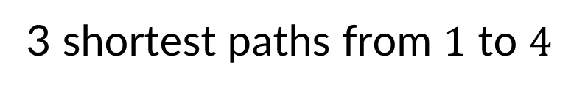

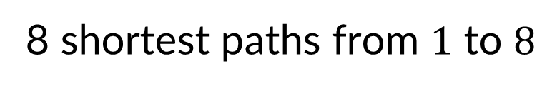
Counting Shortest Paths
If the shortest path from $s$ to $t$ has cost $c$, find the total number of $s$ to $t$ paths that have cost $c$
3 shortest paths from $1$ to $4$
8 shortest paths from $1$ to $8$
6
1
1
1
1
2
2
2
3
5
7
1
2
3
1
1
4
1
1
1
1
3
3
1
2
4
6
8
5
1
1
1
1

Slide 47



Counting Shortest Paths - Idea
If a shortest path from $s$ to $t$ uses edge $\left(u,t\right)$ then then we can add $(u,t)$ to every shortest path to $u$ to produce a shortest path to $t$.
$(7,8)$ is in a shortest path to $8$
$(6,8)$ is in a shortest path to $8$
The number of shortest paths to $8$ is at least
The number of shortest paths to $7$
plus the number of shortest paths to $6$
$(3,4)$ is in a shortest path to $4$
$(5,6)$ is in a shortest path to $4$
The number of shortest paths to $4$ is at least:
The number of shortest paths to $3$
plus the number of shortest paths to $5$
6
1
1
1
1
1
3
5
7
2
2
1
1
2
1
1
2
3
4
1
1
1
1
2
4
1
6
1
8
3
3
1
5

Slide 48
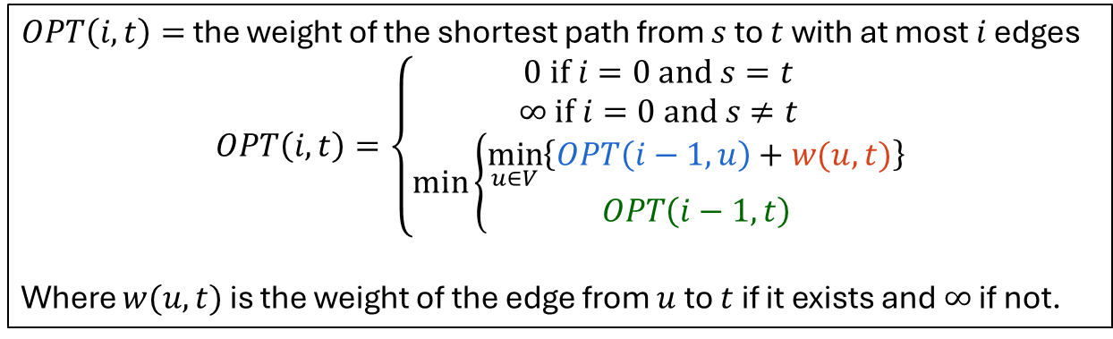
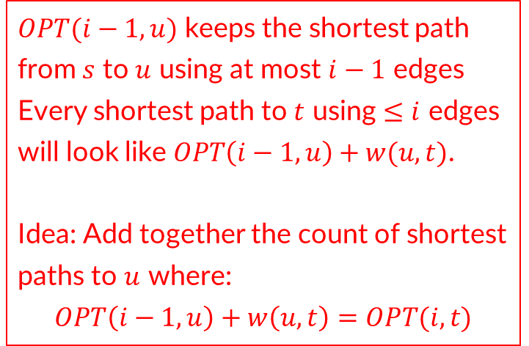
Recursive Structure – Bellman-Ford
$OPT(i−1,u)$ keeps the shortest path from $s$ to $u$ using at most $i−1$ edges
Every shortest path to $t$ using $≤i$ edges will look like $OPT\left(i−1,u\right)+w(u,t)$.
Idea: Add together the count of shortest paths to $u$ where:
$$OPT\left(i−1,u\right)+w\left(u,t\right)=OPT(i,t)$$
$OPT\left(i,t\right)=$ the weight of the shortest path from $s$ to $t$ with at most $i$ edges
$$OPT\left(i,t\right)=\left\{\begin{aligned}0 if i=0 and s=t \\ ∞ if i=0 and s≠t \\ \min\left\{\begin{aligned}\min_{u∈V}\left\{OPT\left(i−1,u\right)+w(u,t)\right\} \\ OPT\left(i−1, t\right)\end{aligned}\right.\end{aligned}\right.$$
Where $w(u,t)$ is the weight of the edge from $u$ to $t$ if it exists and $∞$ if not.
$$s$$
$$u$$
$$t$$
$$s$$
$$=min$$
$i−1$ edges
$$t$$
$≤i$ edges
$$s$$
$$t$$
$≤i−1$ edges

Slide 49
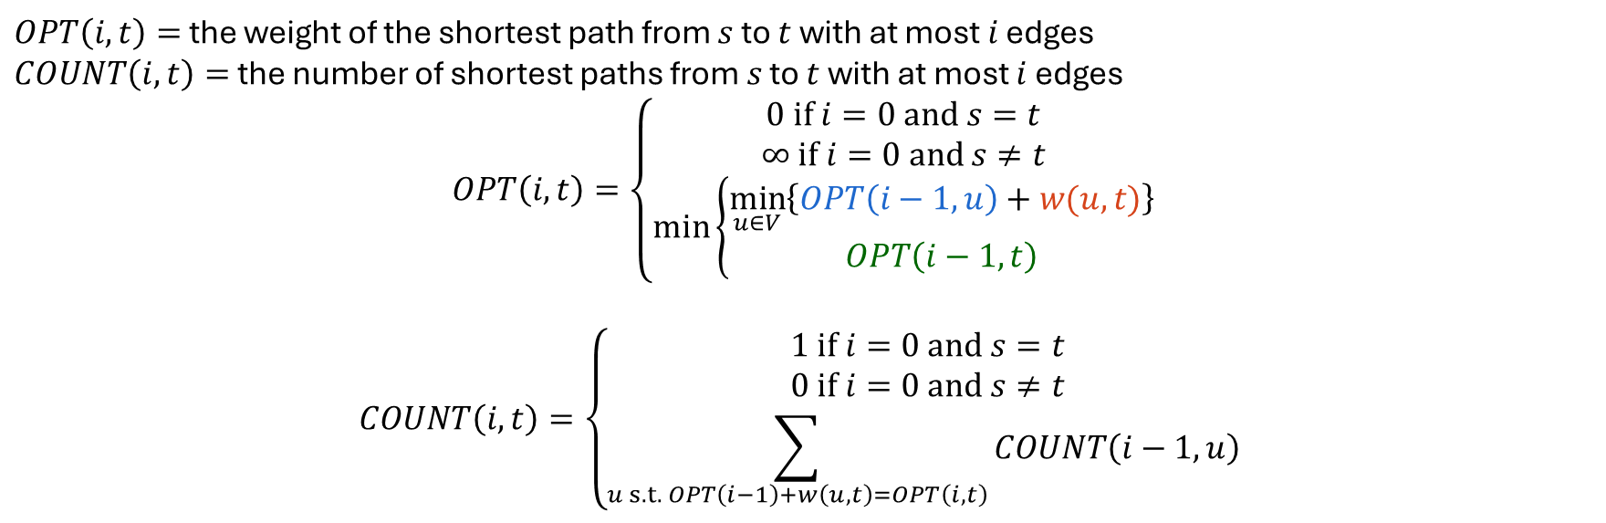

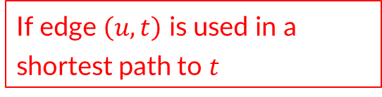
Recursive Structure – # Shortest Paths
$OPT\left(i,t\right)=$ the weight of the shortest path from $s$ to $t$ with at most $i$ edges
$COUNT\left(i,t\right)=$ the number of shortest paths from $s$ to $t$ with at most $i$ edges
$$OPT\left(i,t\right)=\left\{\begin{aligned}0 if i=0 and s=t \\ ∞ if i=0 and s≠t \\ \min\left\{\begin{aligned}\min_{u∈V}\left\{OPT\left(i−1,u\right)+w(u,t)\right\} \\ OPT\left(i−1, t\right)\end{aligned}\right.\end{aligned}\right.$$
$$COUNT\left(i,t\right)=\left\{\begin{aligned}1 if i=0 and s=t \\ 0 if i=0 and s≠t \\ \sum_{u s.t. OPT\left(i−1\right)+w\left(u,t\right)=OPT\left(i,t\right)}{COUNT\left(i−1,u\right)} \end{aligned}\right.$$
Then every shortest path to $u$ can be used in a shortest path to $t$
If edge $\left(u,t\right)$ is used in a shortest path to $t$

Slide 50
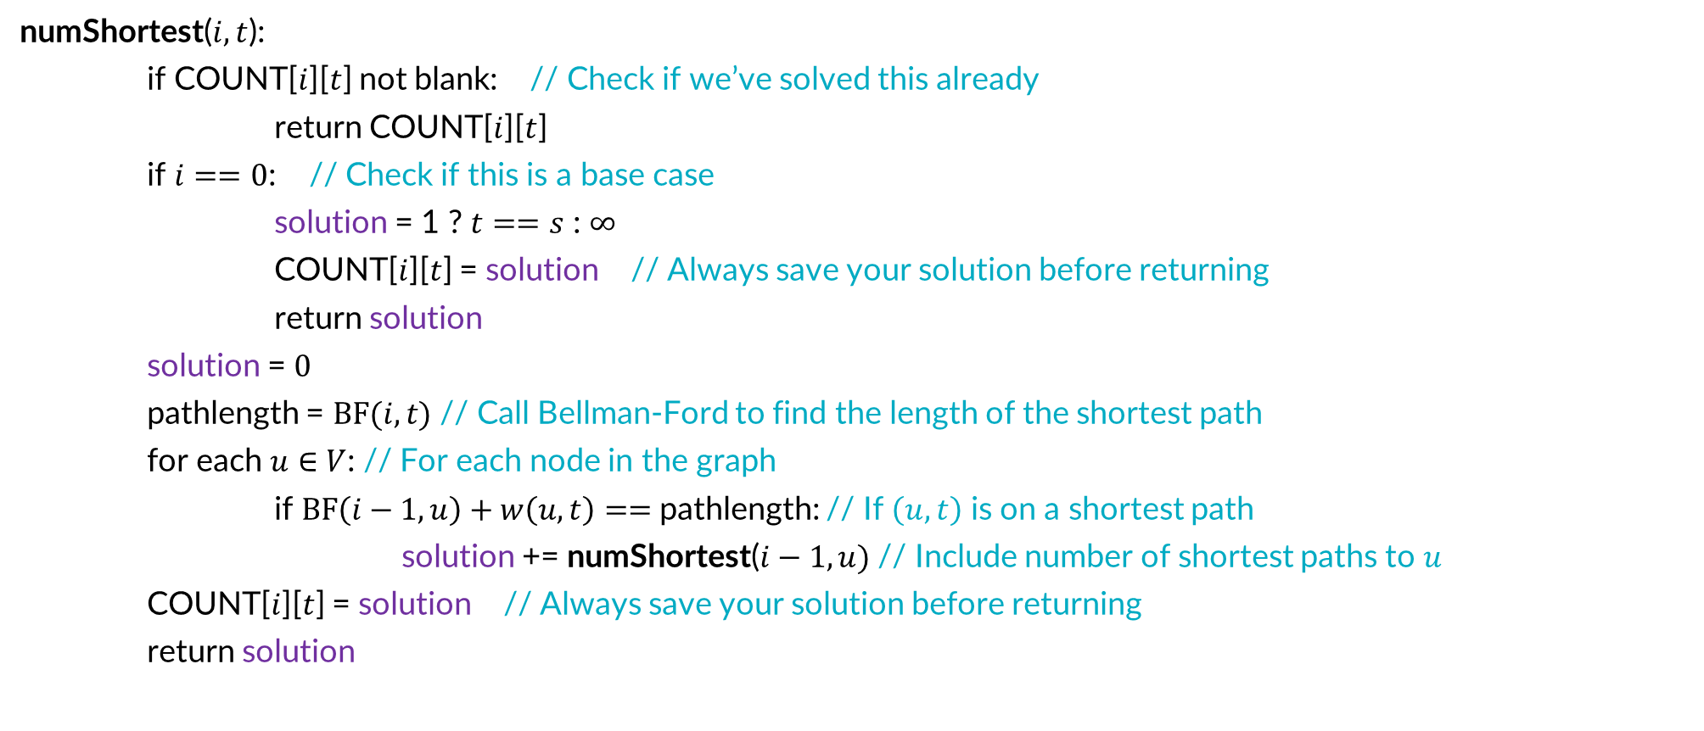
Top-Down # Shortest Paths
numShortest($i,t$):
if COUNT[$i$][$t$] not blank: // Check if we’ve solved this already
return COUNT[$i$][$t$]
if $i==0$: // Check if this is a base case
solution = 1 ? $t==s$ : $∞$
COUNT[$i$][$t$] = solution // Always save your solution before returning
return solution
solution = $0$
pathlength = $BF(i,t)$ // Call Bellman-Ford to find the length of the shortest path
for each $u∈V$: // For each node in the graph
if $BF\left(i−1,u\right)+w\left(u,t\right)==$pathlength: // If $\left(u,t\right)$ is on a shortest path
solution += numShortest($i−1,u)$ // Include number of shortest paths to $u$
COUNT[$i$][$t$] = solution // Always save your solution before returning
return solution

Slide 51
Final reminders
HW5 released, due Friday @ 11:59pm.
Quiz feedback released, regrades requests needed by tomorrow @ 11:59pm
I have OH now-12:30pm:
Meet at front of classroom, we’ll walk over together
CSE (Allen) 434 if you’re coming later
Glenn has online OH 12–1pm

