Slide 1
More Greedy;
Course wrap-up
CSE 417 Winter 24
Lecture 27

Slide 2
Change-Making
Suppose you need to “make change” with the fewest number of coins possible.
Greedy algorithm:
Is the greedy algorithm optimal if you have
1 cent coins, 10 cent coins, and 15 cent coins?
What about for U.S. coinage (1, 5, 10, 25, 50, 100)
Take the biggest coin less than the change remaining.

Slide 3
Change-Making
Suppose you need to “make change” with the fewest number of coins possible.
Is the greedy algorithm optimal if you have
1 cent coins, 10 cent coins, and 15 cent coins?
What about for U.S. coinage (1, 5, 10, 25, 50, 100)
Take the biggest coin less than the change remaining.

Slide 4
Change-Making
The greedy algorithm doesn’t always work!
  We forced you to observe that in a homework problem for those that did it.
But there are times where it does
  For “standard” US coinage, the greedy algorithm works
  And it also always works if your coins always exactly double in value.
  Another reason to be very careful with greedy algorithms!
  Also a good example of how you can sometimes avoid greedy if you can’t figure out a proof – maybe there’s a way to write a DP instead!

Slide 5
Interval Scheduling
You have a single processor, and a set of jobs with fixed start and end times.
Your goal is to maximize the number of jobs you can process.
I.e. choose the maximum number of non-overlapping intervals.

Slide 6
Interval Scheduling
You have a single processor, and a set of jobs with fixed start and end times.
Your goal is to maximize the number of jobs you can process.
I.e. choose the maximum number of non-overlapping intervals.
3 non-overlapping intervals

Slide 7
Interval Scheduling
You have a single processor, and a set of jobs with fixed start and end times.
Your goal is to maximize the number of jobs you can process.
I.e. choose the maximum number of non-overlapping intervals.
3 other non-overlapping intervals

Slide 8
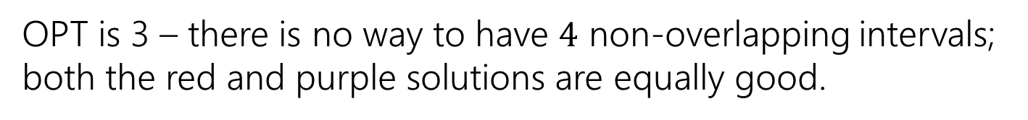
Interval Scheduling
You have a single processor, and a set of jobs with fixed start and end times.
Your goal is to maximize the number of jobs you can process.
I.e. choose the maximum number of non-overlapping intervals.
OPT is 3 – there is no way to have $4$ non-overlapping intervals; both the red and purple solutions are equally good.

Slide 9
Greedy Ideas
To specify a greedy algorithm, we need to:
Order the elements (intervals)
Choose a rule for deciding whether to add.
Rule: Add interval as long as it doesn’t overlap with those we’ve already selected.
What ordering should we use?
Think of at least two orderings you think might work.

Slide 10
Greedy Algorithm
Some possibilities
Earliest end time (add if no overlap with previous selected)
Latest end time
Earliest start time
Latest start time
Shortest interval
Fewest overlaps (with remaining intervals)

Slide 11
Greedy
That list slide is the real difficulty with greedy algorithms.
All of those look at least somewhat plausible at first glance.
With MSTs that was fine – those ideas all worked!
It’s not fine here.
They don’t all work.
As a first step – try to find counter-examples to narrow down

Slide 12
Greedy Algorithm
Earliest end time
Latest end time
Earliest start time
Latest start time
Shortest interval
Fewest overlaps (with remaining intervals)

Slide 13
Take Earliest Start Time – Counter Example

Slide 14
Take Earliest Start Time – Counter Example
Algorithm finds
Optimum
Taking the one with the earliest start time doesn’t give us the best answer.

Slide 15
Shortest Interval

Slide 16
Shortest Interval
Algorithm finds
Optimum
Taking the shortest interval first doesn’t give us the best answer

Slide 17
Greedy Algorithm
Earliest end time
Latest end time
Earliest start time
Latest start time
Shortest interval
Fewest overlaps (with remaining intervals)

Slide 18
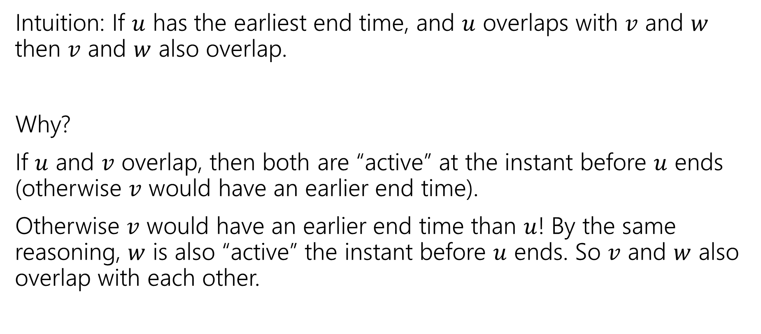
Earliest End Time
Intuition: If $u$ has the earliest end time, and $u$ overlaps with $v$ and $w$ then $v$ and $w$ also overlap.
Why?
If $u$ and $v$ overlap, then both are “active” at the instant before $u$ ends (otherwise $v$ would have an earlier end time).
Otherwise $v$ would have an earlier end time than $u$! By the same reasoning, $w$ is also “active” the instant before $u$ ends. So $v$ and $w$ also overlap with each other.

Slide 19
Earliest End Time
Can you prove it correct?
Do you want to use
Structural Result
Exchange Argument
Greedy Stays Ahead

Slide 20
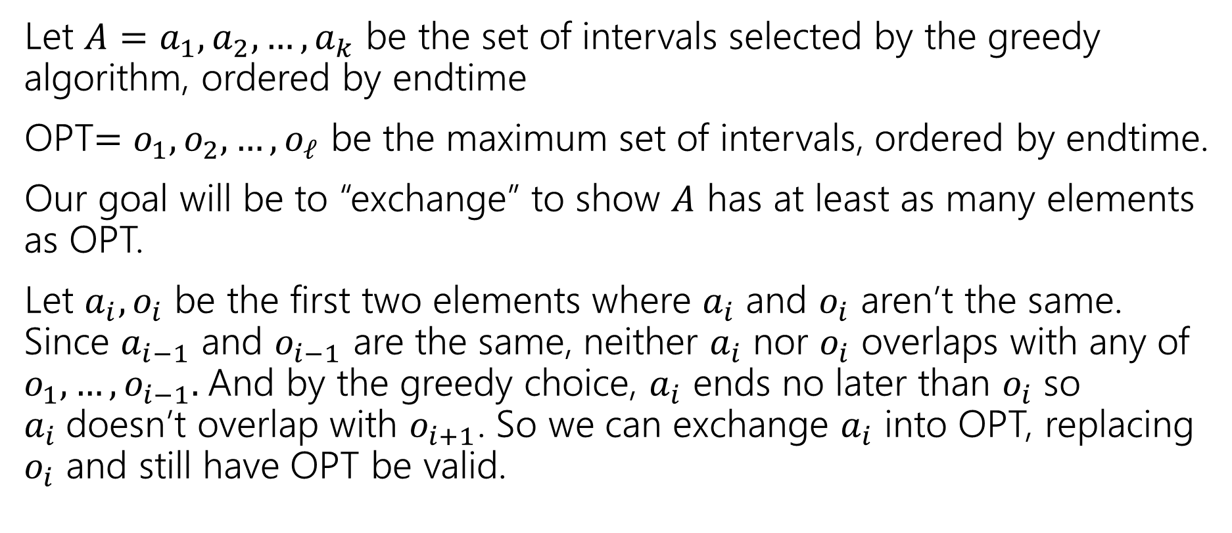
Exchange Argument
Let $A=a_{1},a_{2},…,a_{k}$ be the set of intervals selected by the greedy algorithm, ordered by endtime
OPT$=o_{1},o_{2},…,o_{ℓ}$ be the maximum set of intervals, ordered by endtime.
Our goal will be to “exchange” to show $A$ has at least as many elements as OPT.
Let $a_{i},o_{i}$ be the first two elements where $a_{i}$ and $o_{i}$ aren’t the same. Since $a_{i−1}$ and $o_{i−1}$ are the same, neither $a_{i}$ nor $o_{i}$ overlaps with any of $o_{1},…,o_{i−1}.$And by the greedy choice, $a_{i}$ ends no later than $o_{i}$ so $a_{i}$doesn’t overlap with $o_{i+1}$. So we can exchange $a_{i}$ into OPT, replacing $o_{i}$ and still have OPT be valid.

Slide 21
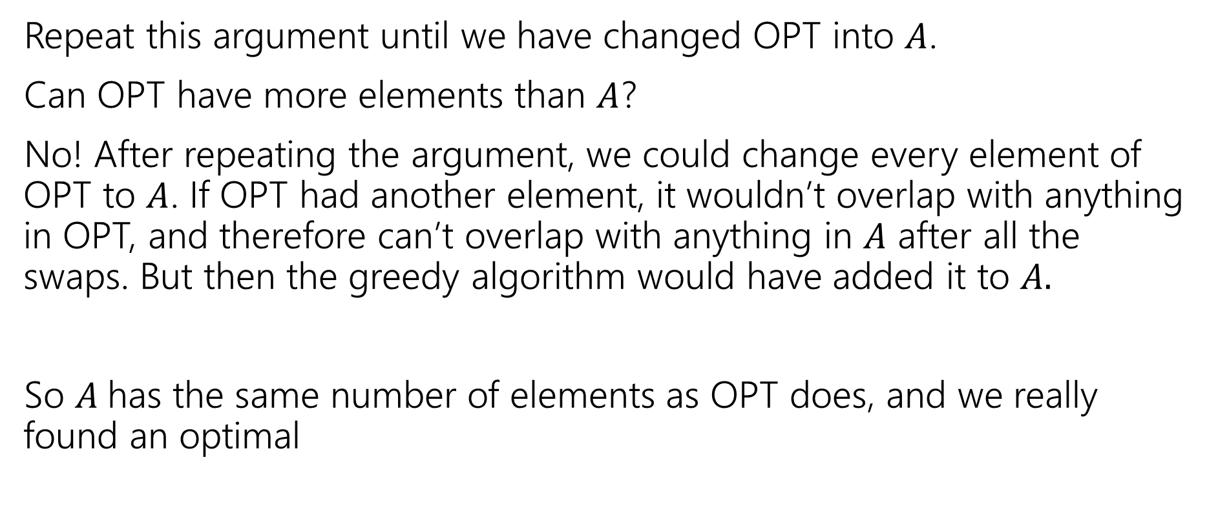
Exchange Argument
Repeat this argument until we have changed OPT into $A$.
Can OPT have more elements than $A$?
No! After repeating the argument, we could change every element of OPT to $A$. If OPT had another element, it wouldn’t overlap with anything in OPT, and therefore can’t overlap with anything in $A$ after all the swaps. But then the greedy algorithm would have added it to $A.$
So $A$has the same number of elements as OPT does, and we really found an optimal

Slide 22
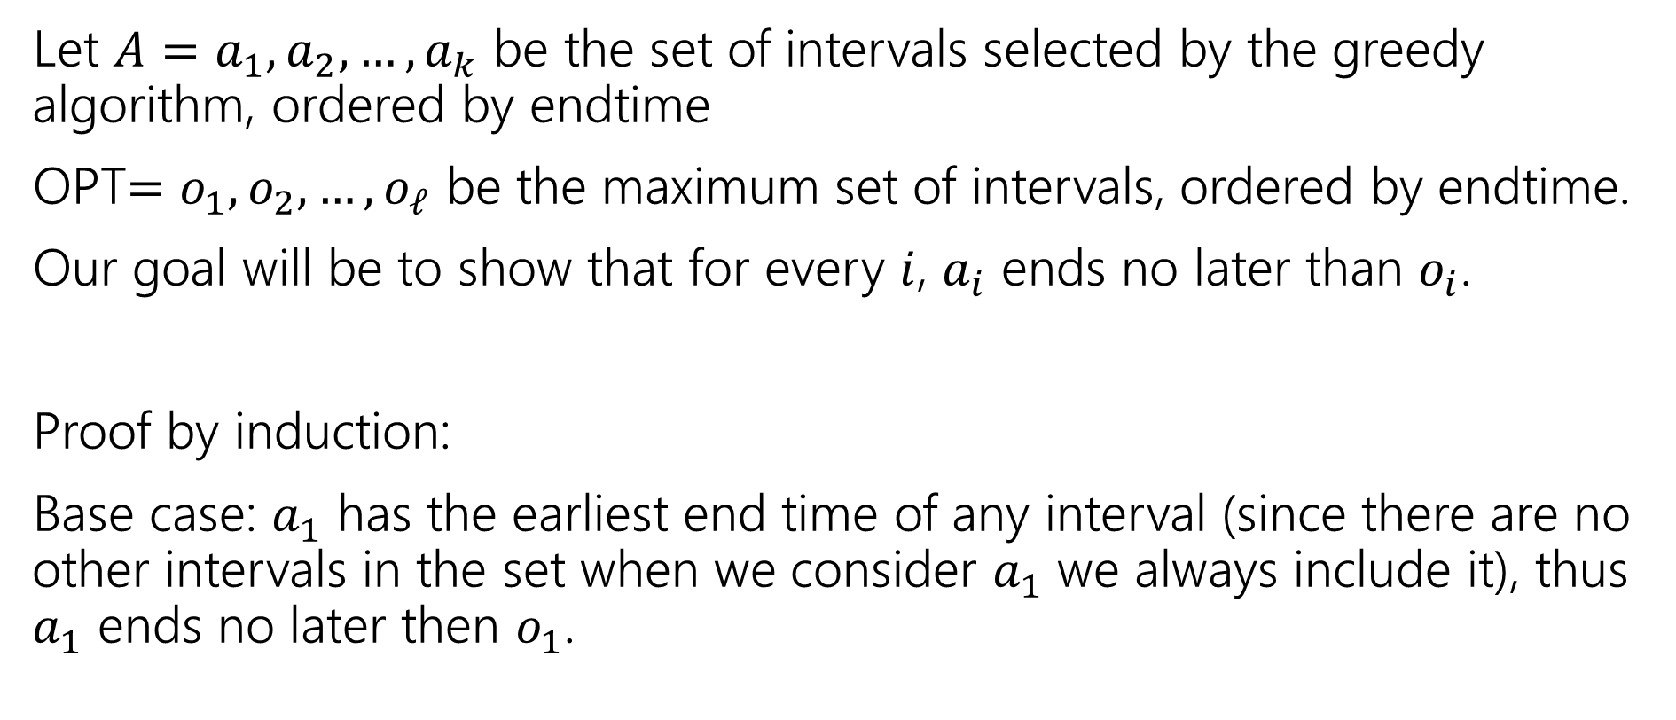
Greedy Stays Ahead
Let $A=a_{1},a_{2},…,a_{k}$ be the set of intervals selected by the greedy algorithm, ordered by endtime
OPT$=o_{1},o_{2},…,o_{ℓ}$ be the maximum set of intervals, ordered by endtime.
Our goal will be to show that for every $i$, $a_{i}$ ends no later than $o_{i}$.
Proof by induction:
Base case: $a_{1}$ has the earliest end time of any interval (since there are no other intervals in the set when we consider $a_{1}$ we always include it), thus $a_{1}$ ends no later then $o_{1}$.

Slide 23
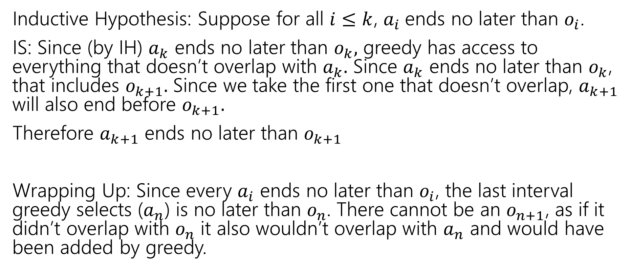
Greedy Stays Ahead
Inductive Hypothesis: Suppose for all $i≤k$, $a_{i}$ends no later than $o_{i}$.
IS: Since (by IH) $a_{k}$ ends no later than $o_{k},$ greedy has access to everything that doesn’t overlap with $a_{k}.$ Since $a_{k}$ ends no later than $o_{k}$, that includes $o_{k+1}.$ Since we take the first one that doesn’t overlap, $a_{k+1}$ will also end before $o_{k+1}.$
Therefore $a_{k+1}$ ends no later than $o_{k+1}$
Wrapping Up: Since every $a_{i}$ ends no later than $o_{i}$, the last interval greedy selects ($a_{n}$) is no later than $o_{n}$. There cannot be an $o_{n+1}$, as if it didn’t overlap with $o_{n}$ it also wouldn’t overlap with $a_{n}$ and would have been added by greedy.

Slide 24

Greedy Algorithm
Earliest end time
Latest end time
Earliest start time
Latest start time
Shortest interval
Fewest overlaps (with remaining intervals)

Slide 25
Other Greedy Algorithms
It turns out latest start time also works.
Latest start time is actually the same as earliest end time (imagine “reflecting” all the jobs along the time axis – the one with the earliest end time ends up having the last start time).
What about fewest overlaps?
Doesn’t work!

Slide 26
Fewest Overlaps counter-example
ALG
OPT
The top middle item will be selected first, eliminating the chance of getting the 4 intervals in OPT.

Slide 27
Greedy Algorithm
Earliest end time
Latest end time
Earliest start time
Latest start time
Shortest interval
Fewest overlaps (with remaining intervals)

Slide 28
Summary
Greedy algorithms
You’ll probably have 2 (or 3…or 6) ideas for greedy algorithms. Check some simple examples before you implement!
Greedy algorithms rarely work.
When they work AND you can prove they work, they’re great!
Proofs are often tricky
Structural results are the hardest to come up with, but the most versatile.
Greedy stays ahead usually use induction
Exchange start with the first difference between greedy and optimal.

Slide 29
Course Wrap; Which Technique

Slide 30
Which Technique?
When I see a new problem, how do I know which option to use?
Try modeling first – use the problems we’ve already solved
Preferences? Try stable matching.
Assignments? Try network flow.
Etc.

Slide 31
Which Technique?
Modeling Didn’t work?
What does this remind you of?
Then try:
recursive thinking (will lead to DP or D&C)
Ask how you would represent the problem visually (might lead to graphs)
Finally: remember your problem might be hard!

Slide 32
We’ve Covered A LOT
Stable Matchings
Proof fundamentals
Modifications of BFS/DFS
Divide & Conquer
Dynamic Programming
LPs
Network Flow (and assignment problems)
Reductions, P vs. NP
Coping with NP-completeness
Greedy algorithms

Slide 33
What Comes next?
CSE 417 is intended as a “last” undergraduate course for those of you about to graduate. But if you are hoping for more, consider:
CSE 422 (toolkit for modern algorithms)
  Mathematics and algorithms for larger data sets/ML, approximate solutions
CSE 521 (Graduate algorithms)
  More math background expected, more approximation algorithms, and a few other topics.
CSE 431 (Complexity theory)
  Proof-based (all your homework problems are proofs). More on NP, undecidability, other notions of “hard.”
Courses in Math & AMATH (especially for LPs and network flow)
  Math 461, 462 (combinatorics); Math 407, 408 (LPs, convex optimization); Math 409 (lots of overlap with this course)
  Math 514 (deep theory behind LPs, MSTs, etc.)

Slide 34
Tech Interview Advice

Slide 35
Resources
Cracking the Coding Interview (McDowell) or another book like it.
  Copies are at the library!
General Advice from Kasey Champion
Leetcode (we…borrowed…more than one homework problem from there).
General resume advice (and other resources). Some specific to Allen School.

Slide 36
Technical Questions
Your interviewer wants to see
  1. What you know
  2. Can you communicate technical ideas
  3. Can you problem-solve
  Getting the “right” solution helps with point 1. Not points 2 and 3.
  You also need to talk through what you see in the problem/how you solve it.
  The best way is to practice. Find a friend, a set of interview questions, and a whiteboard and practice.

Slide 37
Technical Questions
Show you can problem-solve.
It’s tempting to “skip” the problem-solving steps if you know the answer. It’s a good idea to still do all of them.
  You can go quicker, but give them something.
  Don’t feel obligated to use this exact method – others exist, but you should hit these points. Even if you know the best algorithm from the time you read the problem statement.

Slide 38
A sample Problem: https://leetcode.com/problems/house-robber/
You are a professional robber planning to rob houses along a street. Each house has a certain amount of money stashed, the only constraint stopping you from robbing each of them is that adjacent houses have security systems connected and it will automatically contact the police if two adjacent houses were broken into on the same night.
Given an integer array nums representing the amount of money of each house, return the maximum amount of money you can rob tonight without alerting the police.

Slide 39
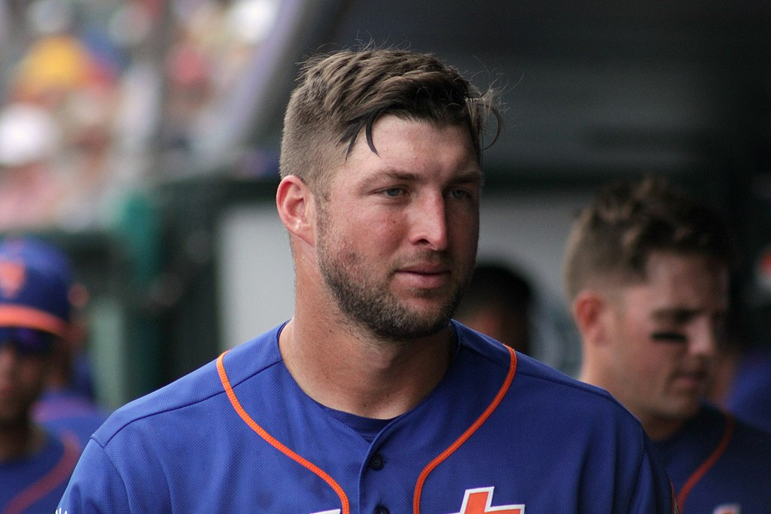
TEBOW IT
Talk
Example
Baseline (aka Brute Force)
Optimize
Walk-Through
Implement
Test
https://commons.wikimedia.org/wiki/File:Tim_Tebow_in_the_dugout.jpg
Tim Tebow:
Football player turned football analyst turned simultaneous-baseball-player-and-football-analyst turned football player turned football analyst again.
Acronym from Kasey Champion; similar process in Cracking the Coding Interview

Slide 40
Talk
Give you time to take deep breaths
Confirm you haven’t missed anything
Can sometimes get a simplifying assumption added.
Make sure you understand every technical term in the prompt (if any).
Ask questions to make sure you’ve got the idea.
Ask about simplifying assumptions.
Pick out any key pieces of the problem
You are a professional robber planning to rob houses along a street. Each house has a certain amount of money stashed, the only constraint stopping you from robbing each of them is that adjacent houses have security systems connected and it will automatically contact the police if two adjacent houses were broken into on the same night.
Given an integer array nums representing the amount of money of each house, return the maximum amount of money you can rob tonight without alerting the police.

Slide 41
Talk
If I enter houses 2 and 4 only, I don’t set off an alarm, right?
The houses are just in a line, I’m only worrying about “one side” of the street?
I’m planning just one night?
The amount of money is an integer? Can it be negative?
I don’t have to record which houses, just the final number?
You are a professional robber planning to rob houses along a street. Each house has a certain amount of money stashed, the only constraint stopping you from robbing each of them is that adjacent houses have security systems connected and it will automatically contact the police if two adjacent houses were broken into on the same night.
Given an integer array nums representing the amount of money of each house, return the maximum amount of money you can rob tonight without alerting the police.

Slide 42
Talk
Self-checks
Do I know the method signature (inputs and return type)?
Is there any information in the prompt that I feel is useless?
  There usually isn’t any, so maybe ask a question about that

Slide 43
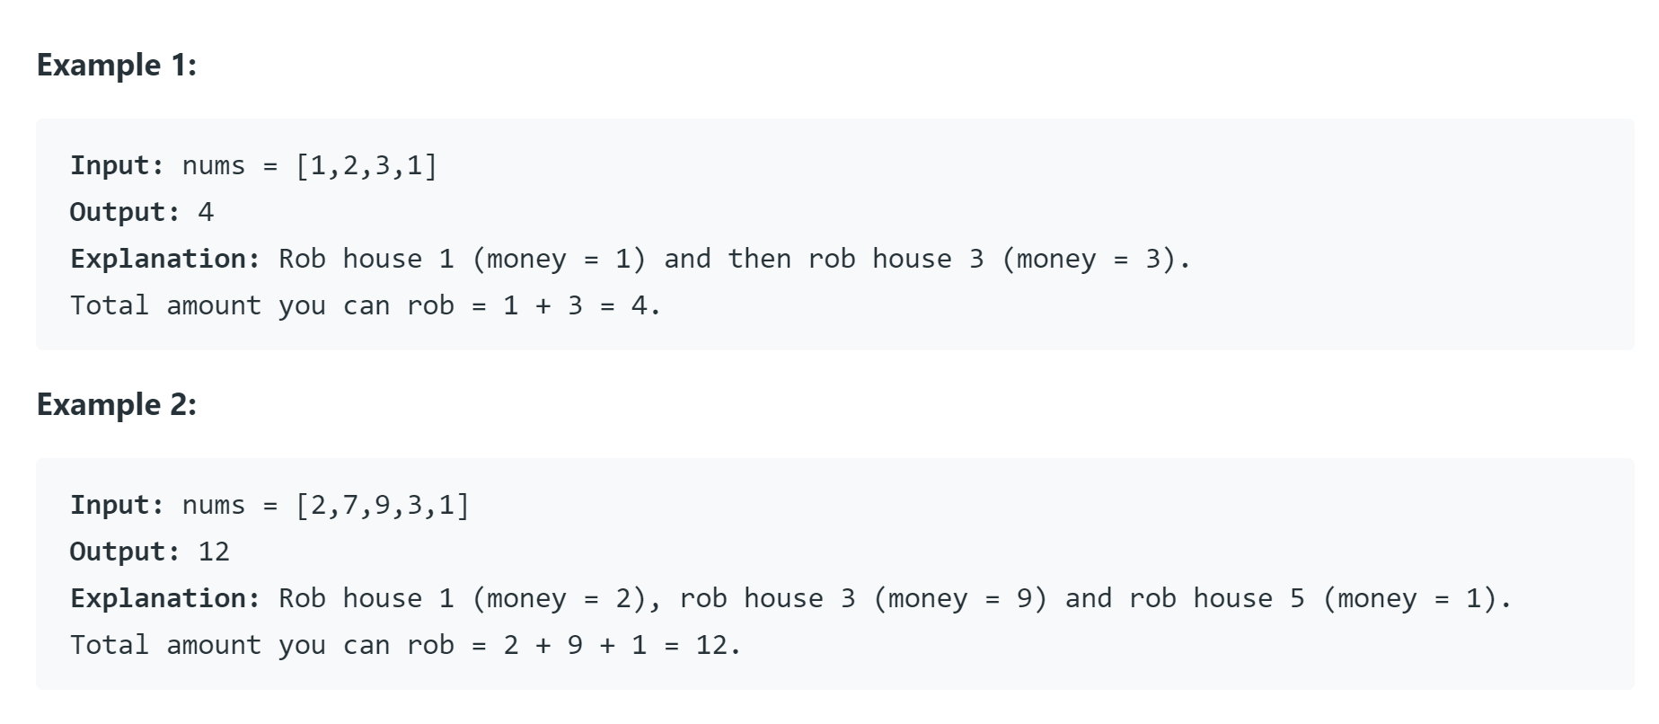
Example
You’ll need these later!
Make a sample input or two, find the answer and confirm it’s right with the interviewer

Slide 44
Baseline
Finally, designing the algorithm.
What we came here for.
First algorithm that comes to mind.
Doesn’t matter how slow.[1]
This is a good problem solving technique, sometimes you want to optimize the first thing you think of.
Sometimes you don’t, but it’s still useful for you as a human.
You’re going to be nervous. It’s a lot easier to think creatively with the baseline in your back pocket. You won’t end this interview having written no code.
[1] ok, it does matter how slow, but that’s not the point yet

Slide 45
Baseline
If you see what to do right away that’s fine! You can short-circuit this step. But if it doesn’t work come back here! I don’t like to spend more than a few minutes with no back-up plan.
Remember the examples you did! Those can help now. Were you doing a brute force on those to solve them?

Slide 46

Baseline
Well I guess we could check all $2^{n}$ sets of houses.
Will be really slow, but will work.
Let’s try to do better.

Slide 47
Optimize
Sometimes you’re going to speed up the baseline (say with better data structures).
Other times you’re starting from scracth
Now, let’s get a better algorithm.
What did you see in your examples?
What does this remind you of?
We’re finding the maximum something in an array, that might remind you of maximum subarray sum. Maybe DP?
Let’s start there…

Slide 48

Optimize
Let’s think recursively. Start with the last house.
We’re currently thinking about house $i$.
If we want to include $i,$then we want…
If we want to exclude $i$ then we want…

Slide 49
Optimize
Let’s think recursively. Start with the last house.
We’re currently thinking about house $i$.
If we want to include $i,$then we want…
If we want to exclude $i$ then we want…

Slide 50
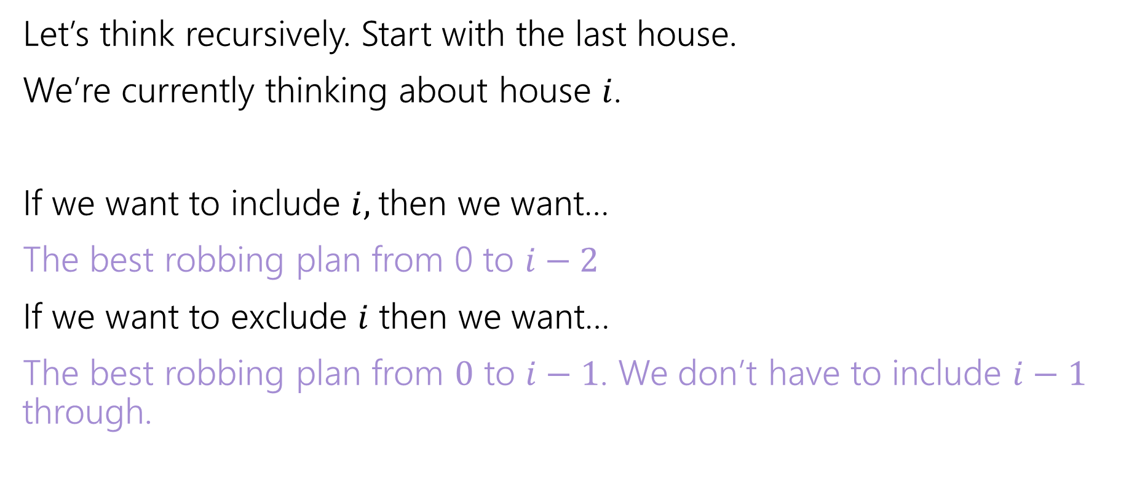
Optimize
Let’s think recursively. Start with the last house.
We’re currently thinking about house $i$.
If we want to include $i,$then we want…
The best robbing plan from 0 to $i−2$
If we want to exclude $i$ then we want…
The best robbing plan from $0$ to $i−1$. We don’t have to include $i−1$ through.
Let OPT be the value of the best robbing plan for the array from $0$ to $i$.

Slide 51
Optimize
You could also get an
OPT/Include split like we’ve often seen if you jump right there.

Slide 52
Walk-Through
Now we’ve got our idea…time for a very quick check
What happens on one of your small examples?
nums
0 | 1 | 2 | 3 | 4
2 | 7 | 9 | 3 | 1
OPT
0 | 1 | 2 | 3 | 4

Slide 53
Walk-Through
You might notice bugs or edge cases (like the base cases here!) if you go slowly
Now we’ve got our idea…time for a very quick check
What happens on one of your small examples?
nums
0 | 1 | 2 | 3 | 4
2 | 7 | 9 | 3 | 1
OPT
0 | 1 | 2 | 3 | 4
2 | 7 | 11 | 11 | 12

Slide 54
Implement
Tips: Use default data structures.
Your interviewer probably doesn’t remember all the tiny details of java default libraries either, so feel free to say “I’m going to assume the library has an X method” or “it works in this way” if you can’t remember whether it’s the Java or C++ version that works a certain way.
You might never have written code on a whiteboard (or typed without an IDE auto-completing things). You should practice those skills!!
Use comments and break-off easy methods/repeated code.
  If you’re running out of time, your interviewer might let you skip it.

Slide 55
Notes:
Method header: return type int, input int[]
Define int[] opt
Write for-loop, don’t worry about base cases yet.
Go back and handle base cases.
Wrap-up return.

Slide 56
int robbingNumber(int[] input){
int[] opt = new int[input.size]; //opt robbing number where we can access homes 0,…,i.
opt[0] = input[0];
opt[1] = Math.max(input[0], input[1]);
for(int i=0; i < input.size; i++){
opt[i] = Math.max( opt[i-1], opt[i-2]+input[i]);
}
return opt[input.size-1];

Slide 57
Test
If you haven’t already, do your big-O analysis
Then test your code!
  Use the examples you made early on
  Think about small cases (empty input, null input)
  Think about edge cases (repeated numbers)
  Double-check you’ve used all assumptions

Slide 58
Another Problem
Drive, a new rideshare company, focuses on getting their customers long-distances by having many individual drivers take them through separate parts of the journey. Drive has decided on a set of specific locations where pickups and drop-offs can happen, and they have the cost to ride between every pair of locations.
To incentivize you to try the system, Drive has given you a token for one free ride. Because the system is new, they haven’t mapped out how you’ll go long distances. It’s up to you to decide which locations to visit on the way from your starting point to the end point and which one you will use your coupon on.
Describe an algorithm that will let you get from your given start and end points while spending the minimum amount of money (with your token).

Slide 59
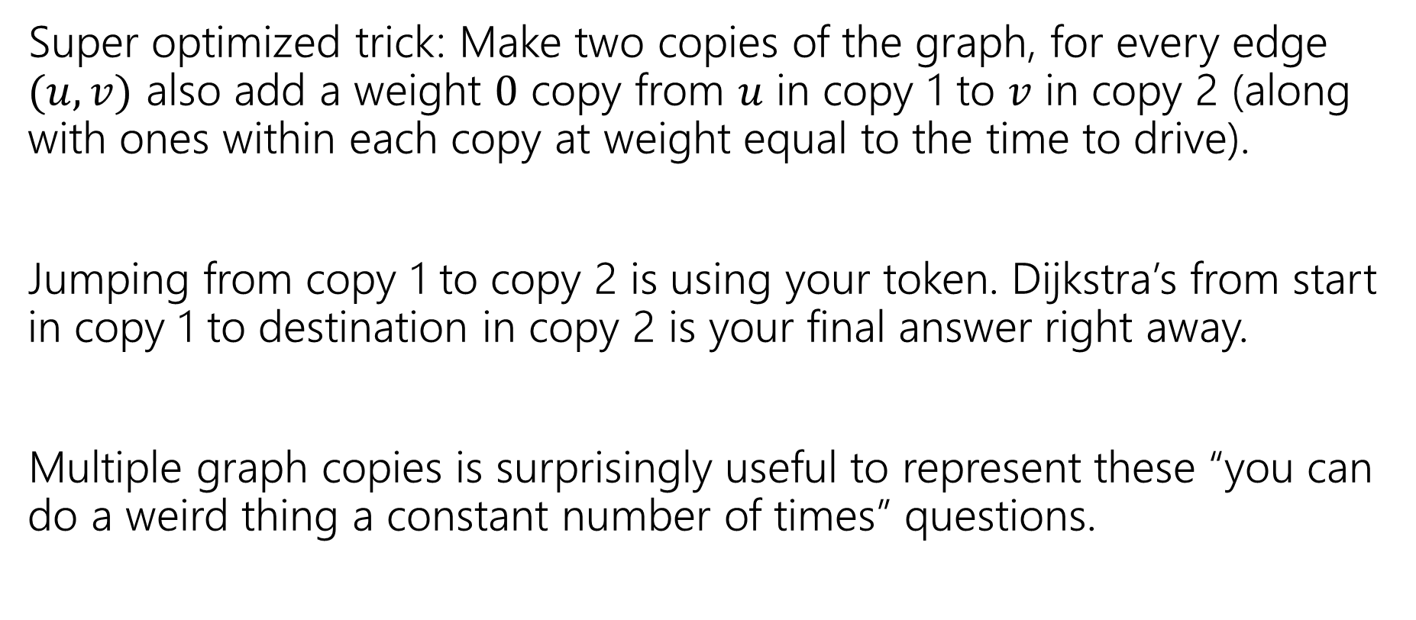
A Very Fun Trick
Super optimized trick: Make two copies of the graph, for every edge $(u,v)$ also add a weight $0$ copy from $u$ in copy 1 to $v$ in copy 2 (along with ones within each copy at weight equal to the time to drive).
Jumping from copy 1 to copy 2 is using your token. Dijkstra’s from start in copy 1 to destination in copy 2 is your final answer right away.
Multiple graph copies is surprisingly useful to represent these “you can do a weird thing a constant number of times” questions.

Slide 60
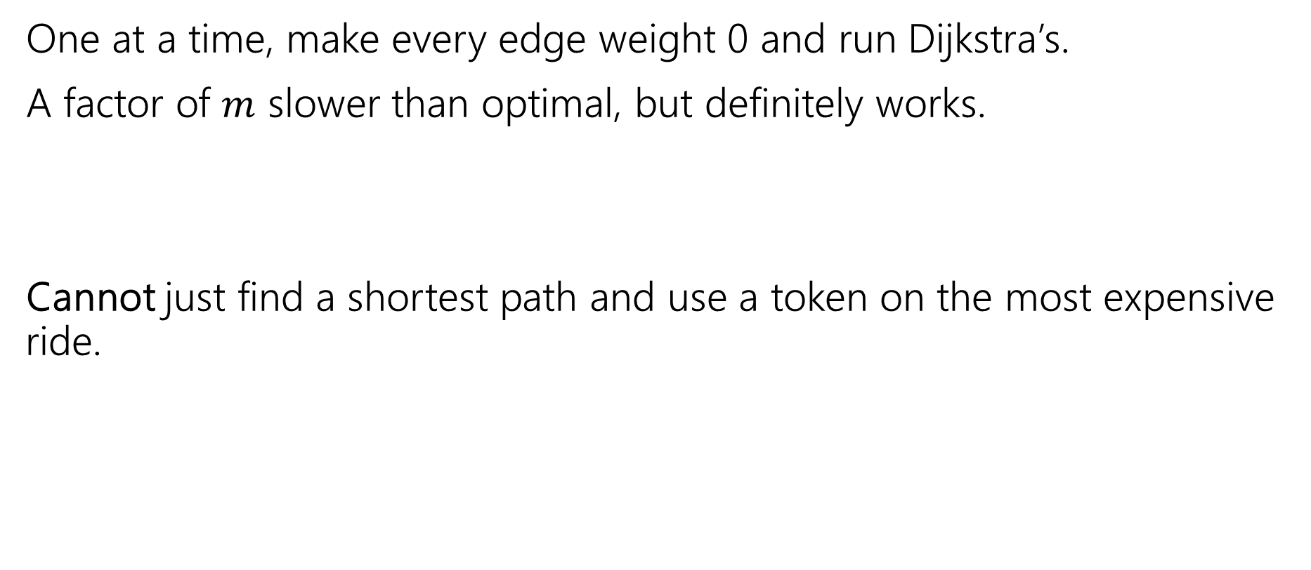
Other options
One at a time, make every edge weight 0 and run Dijkstra’s.
A factor of $m$ slower than optimal, but definitely works.
Cannot just find a shortest path and use a token on the most expensive ride.
3
3
3
s
t
10
1

Slide 61

One More For the Road
Given a list of integers, list all pairs $(A[i],A[j])$ such that $A\left[i\right]+A\left[j\right]=10$.

Slide 62
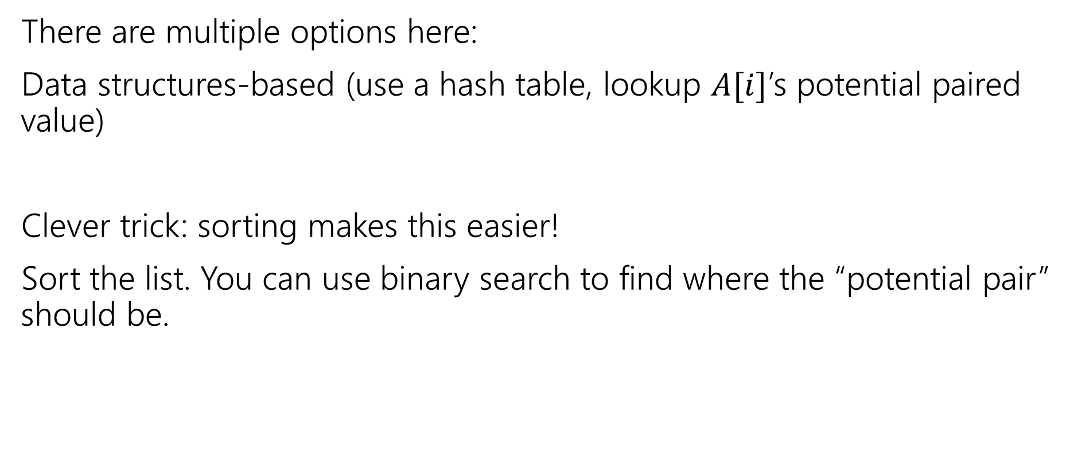
Optimized options
There are multiple options here:
Data structures-based (use a hash table, lookup $A[i]$’s potential paired value)
Clever trick: sorting makes this easier!
Sort the list. You can use binary search to find where the “potential pair” should be.

