Slide 1
Linear Programming
CSE 417 Winter 24
Lecture 16

Slide 2
Some Logistics
What should you do if you get feedback on a problem you don’t understand?
Option 1: Submit a regrade request.
That will go to the TA who graded that problem; they’ll be able to say the most exactly what they noticed.
Can submit even if you think the grade is probably right, but you don’t understand what was wrong with your submission. (but don’t submit for “hint on how to fix it”)
Option 2: Come talk to us at Office Hours.
The TA you talk to might not have graded that problem! So they might not be sure, but they’ll do their best (and they can talk to other staff members offline and get back to you).

Slide 3
DP on graphs

Slide 4
First Half of Today
Dynamic Programming on Graphs
We’re building up to “Bellman-Ford”
A very clever algorithms – we won’t ask you to be as clever.
But a standard library function, so it’s good to know.
And deriving them together is good for practicing DP skills.
Want to understand: why is DP on graphs with cycles harder than DP on trees?

Slide 5
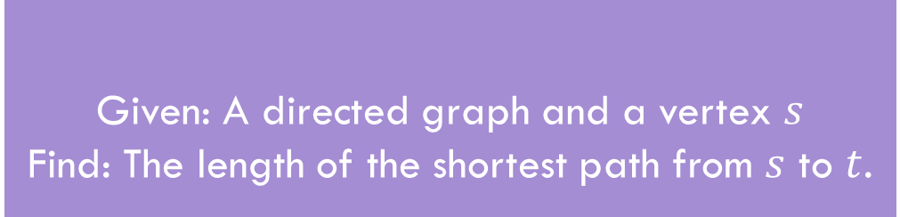
Shortest Paths
Given: A directed graph and a vertex $s$
Find: The length of the shortest path from $s$ to $t$.
Shortest Path Problem
The length of a path is the sum of the edge weights.
Baseline: Dijkstra’s Algorithm

Slide 6
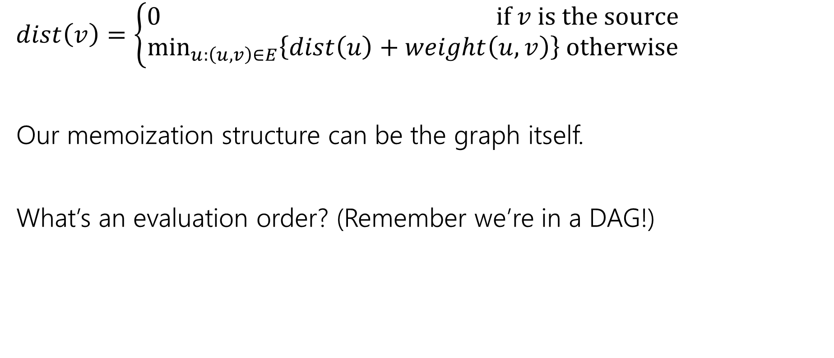
A recurrence
$dist\left(v\right)=\left\{\begin{aligned}0 if v is the source \\ \min_{u:\left(u,v\right)∈E}\left\{dist\left(u\right)+weight\left(u,v\right)\right\} otherwise\end{aligned}\right.$
Our memoization structure can be the graph itself.
What’s an evaluation order? (Remember we’re in a DAG!)

Slide 7
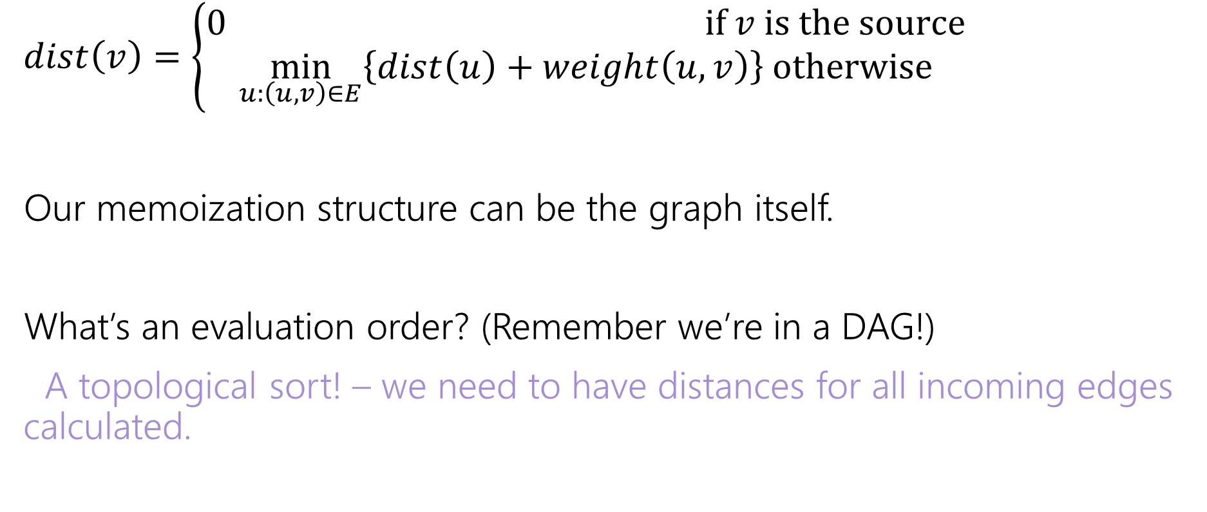
A recurrence
$dist\left(v\right)=\left\{\begin{aligned}0 if v is the source \\ \min_{u:\left(u,v\right)∈E}\left\{dist\left(u\right)+weight\left(u,v\right)\right\} otherwise\end{aligned}\right.$
Our memoization structure can be the graph itself.
What’s an evaluation order? (Remember we’re in a DAG!)
A topological sort! – we need to have distances for all incoming edges calculated.

Slide 8
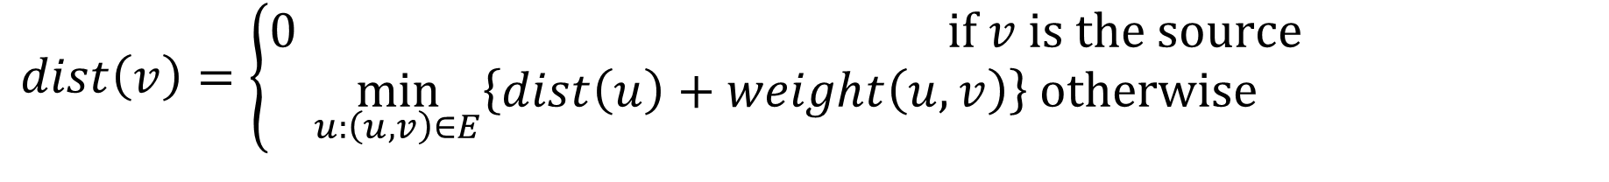
In a DAG
$dist\left(v\right)=\left\{\begin{aligned}0 if v is the source \\ \min_{u:\left(u,v\right)∈E}\left\{dist\left(u\right)+weight\left(u,v\right)\right\} otherwise\end{aligned}\right.$
6
3
5
3
2
1
8

Slide 9
What about cycles?
$dist\left(v\right)=\left\{\begin{aligned}0 if v is the source \\ \min_{u:\left(u,v\right)∈E}\left\{dist\left(u\right)+weight\left(u,v\right)\right\} otherwise\end{aligned}\right.$
6
3
5
3
2
1
8
4

Slide 10
Cycles
We need some way to “order” the paths.
I.e. we need to be sure we always have something to look up.
It doesn’t have to be the perfect distance necessarily…
As long as we’ll realize it and update later
And as long as we can fix it to the true distance eventually.

Slide 11
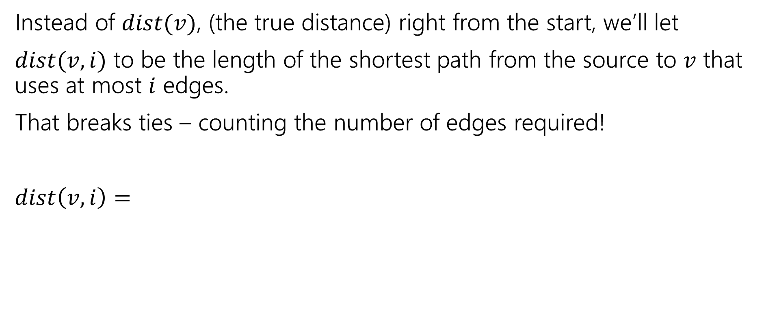
Ordering
Instead of $dist(v)$, (the true distance) right from the start, we’ll let
$dist(v,i)$ to be the length of the shortest path from the source to $v$ that uses at most $i$ edges.
That breaks ties – counting the number of edges required!
$dist\left(v,i\right)=$

Slide 12
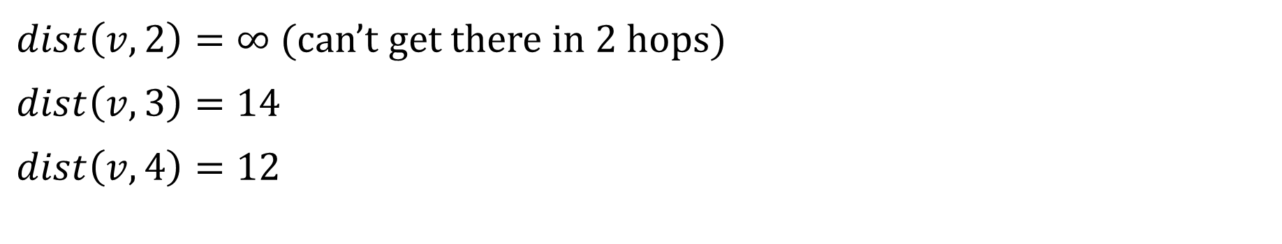
Distances
6
3
5
v
3
2
s
1
8
4
$dist\left(v,2\right)=∞$ (can’t get there in $2$ hops)
$dist\left(v,3\right)=14$
$dist\left(v,4\right)=12$

Slide 13
Ordering
Instead of $dist(v)$, (the true distance) right from the start, we’ll let
$dist(v,i)$ to be the length of the shortest path from the source to $v$ that uses at most $i$ edges.
That breaks ties – counting the number of edges required!
$dist\left(v,i\right)=$

Slide 14
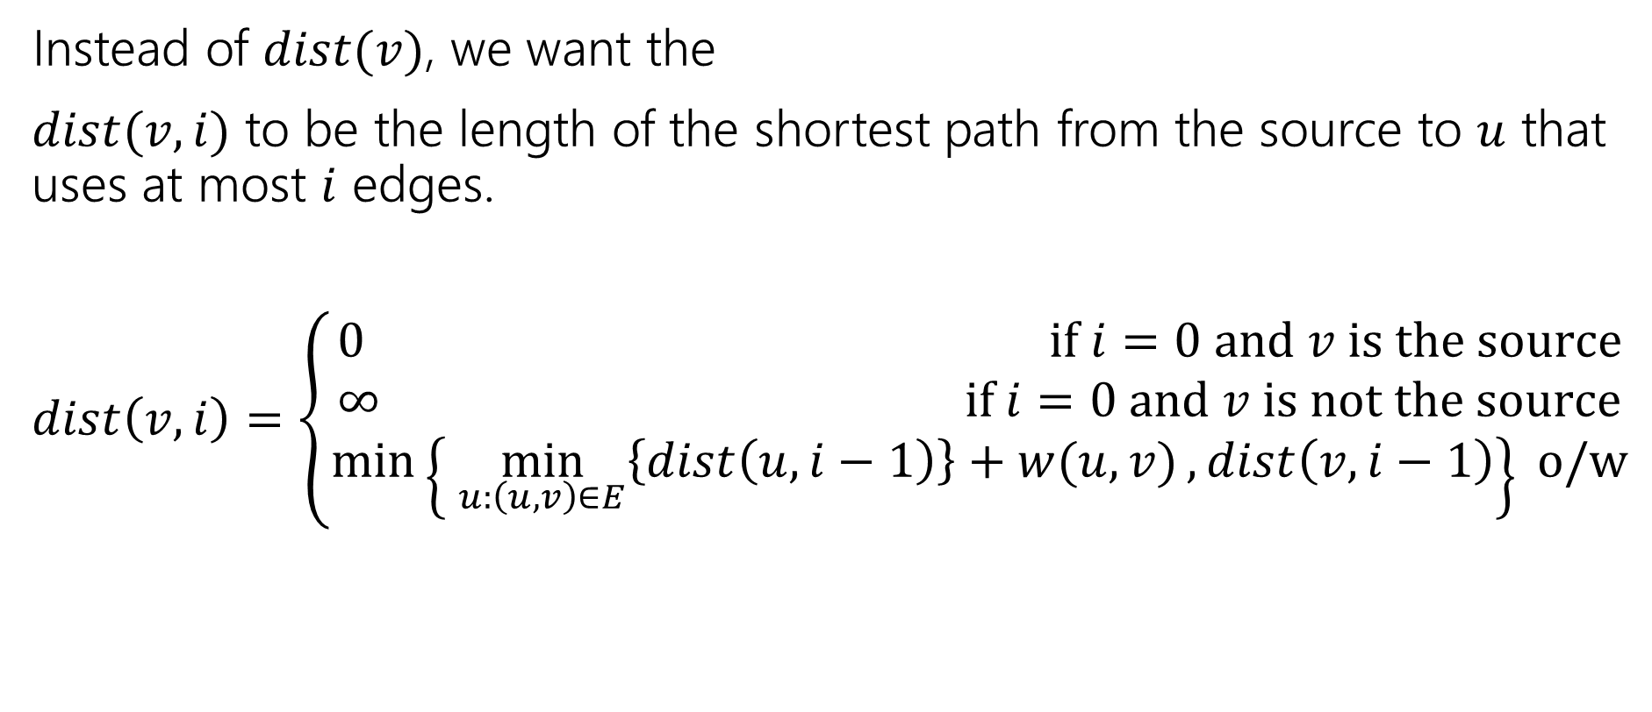
Ordering
Instead of $dist(v)$, we want the
$dist(v,i)$ to be the length of the shortest path from the source to $u$ that uses at most $i$ edges.
$dist\left(v,i\right)=\left\{\begin{aligned}0 if i=0 and v is the source \\ ∞ if i=0 and v is not the source \\ \min\left\{\min_{u:\left(u,v\right)∈E}\left\{dist\left(u,i−1\right)\right\}+w(u,v), dist\left(v,i−1\right)\right\} o/w\end{aligned}\right.$

Slide 15
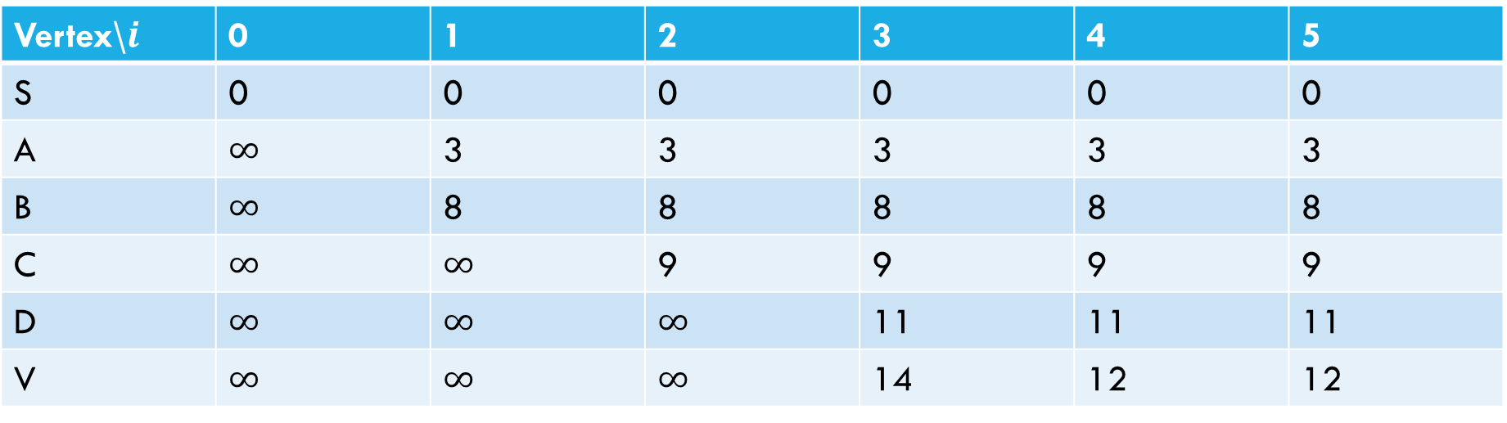
Sample calculation
6
a
5
3
c
v
3
2
s
1
8
b
d
4
Vertex\$i$ | 0 | 1 | 2 | 3 | 4 | 5
S | 0 | 0 | 0 | 0 | 0 | 0
A | $∞$ | 3 | 3 | 3 | 3 | 3
B | $∞$ | 8 | 8 | 8 | 8 | 8
C | $∞$ | $∞$ | 9 | 9 | 9 | 9
D | $∞$ | $∞$ | $∞$ | 11 | 11 | 11
V | $∞$ | $∞$ | $∞$ | 14 | 12 | 12

Slide 16
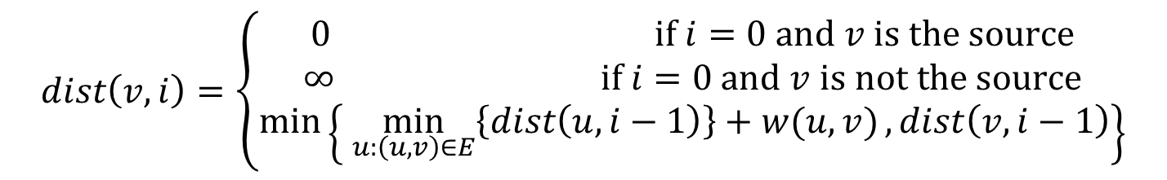
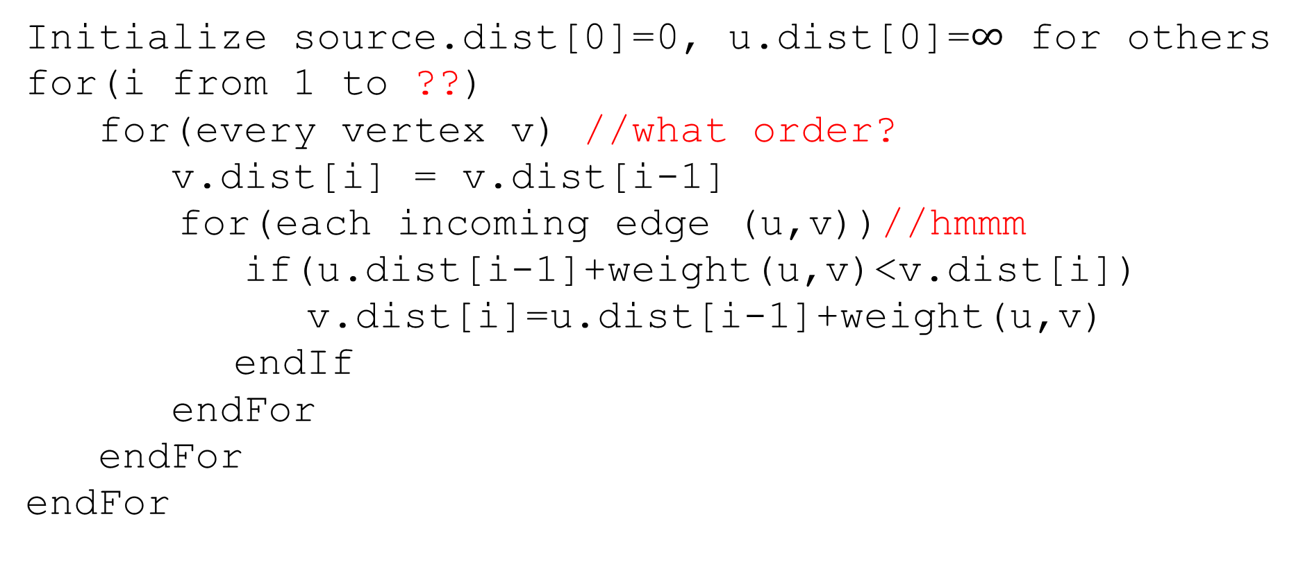
Pseudocode
Initialize source.dist[0]=0, u.dist[0]=$∞$ for others
for(i from 1 to ??)
for(every vertex v) //what order?
v.dist[i] = v.dist[i-1]
for(each incoming edge (u,v))//hmmm
if(u.dist[i-1]+weight(u,v)<v.dist[i])
v.dist[i]=u.dist[i-1]+weight(u,v)
endIf
endFor
endFor
endFor
$$dist\left(v,i\right)=\left\{\begin{aligned}0 if i=0 and v is the source \\ ∞ if i=0 and v is not the source \\ \min\left\{\min_{u:\left(u,v\right)∈E}\left\{dist\left(u,i−1\right)\right\}+w(u,v), dist\left(v,i−1\right)\right\}\end{aligned}\right.$$

Slide 17

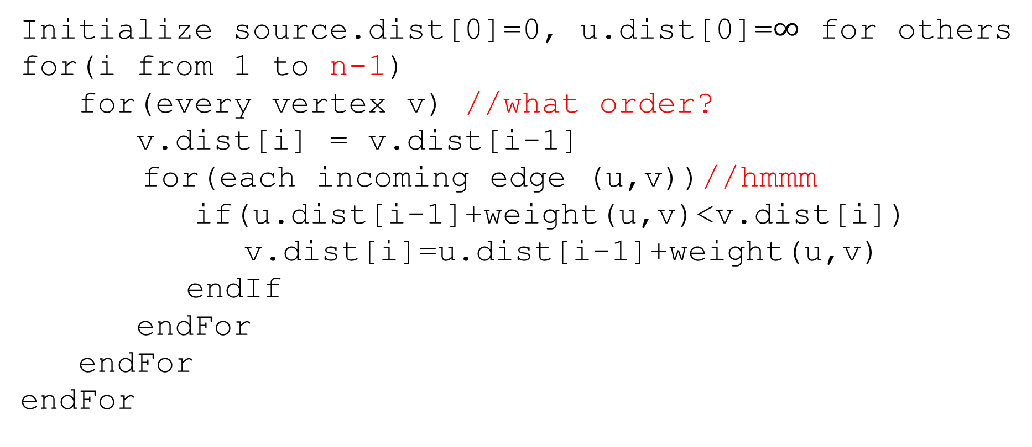
Pseudocode
Initialize source.dist[0]=0, u.dist[0]=$∞$ for others
for(i from 1 to n-1)
for(every vertex v) //what order?
v.dist[i] = v.dist[i-1]
for(each incoming edge (u,v))//hmmm
if(u.dist[i-1]+weight(u,v)<v.dist[i])
v.dist[i]=u.dist[i-1]+weight(u,v)
endIf
endFor
endFor
endFor
The shortest path will never need more than $n−1$ edges
(more than that and you’ve got a cycle)

Slide 18
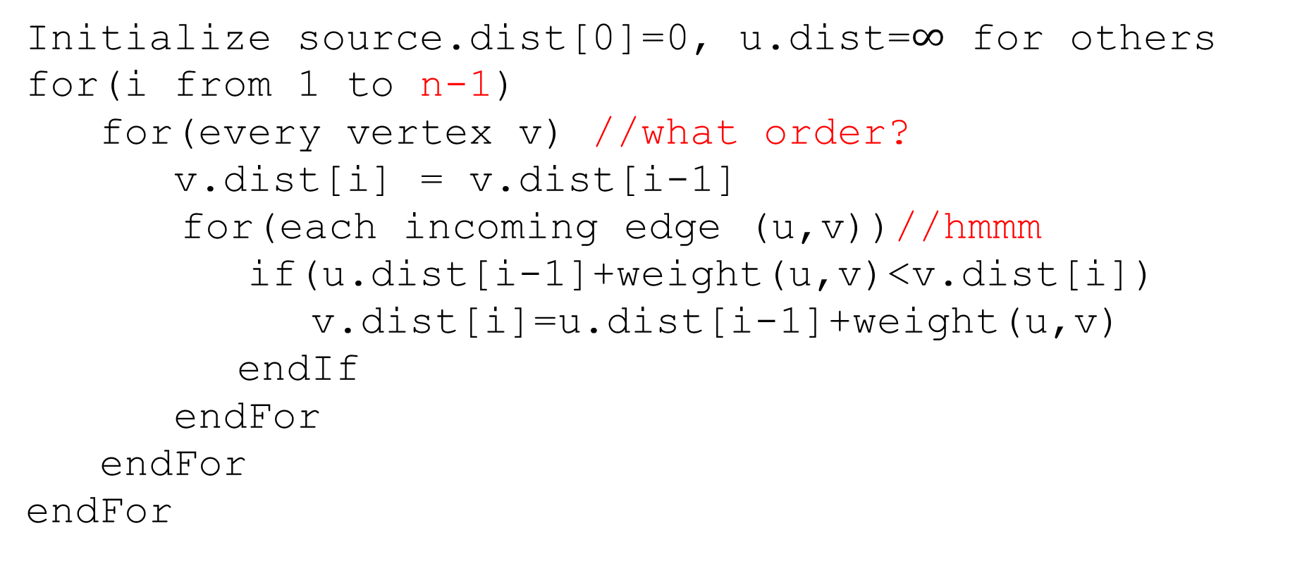
Pseudocode
Only ever need values from the last iteration
Order doesn’t matter!!
Initialize source.dist[0]=0, u.dist=$∞$ for others
for(i from 1 to n-1)
for(every vertex v) //what order?
v.dist[i] = v.dist[i-1]
for(each incoming edge (u,v))//hmmm
if(u.dist[i-1]+weight(u,v)<v.dist[i])
v.dist[i]=u.dist[i-1]+weight(u,v)
endIf
endFor
endFor
endFor

Slide 19
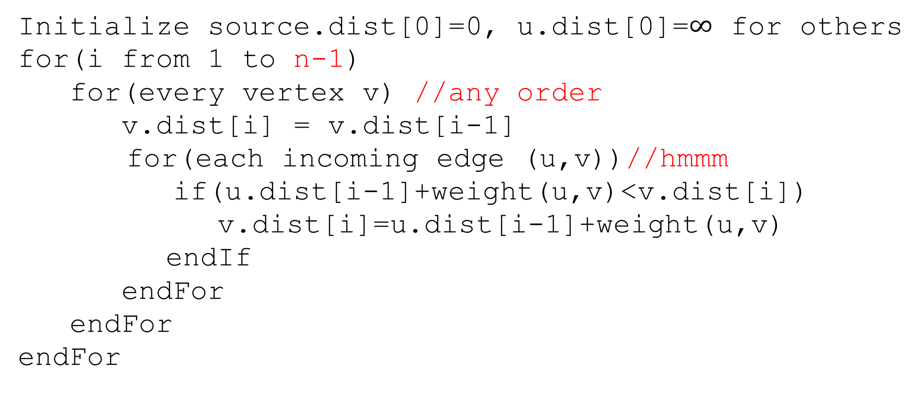
Pseudocode
Initialize source.dist[0]=0, u.dist[0]=$∞$ for others
for(i from 1 to n-1)
for(every vertex v) //any order
v.dist[i] = v.dist[i-1]
for(each incoming edge (u,v))//hmmm
if(u.dist[i-1]+weight(u,v)<v.dist[i])
v.dist[i]=u.dist[i-1]+weight(u,v)
endIf
endFor
endFor
endFor
Graphs don’t usually have easy access to their incoming edges (just the outgoing ones)

Slide 20
Pseudocode
Initialize source.dist[0]=0, u.dist[0]=$∞$ for others
for(i from 1 to n-1)
for(every vertex v) //any order
v.dist[i] = v.dist[i-1]
for(each incoming edge (u,v))//hmmm
if(u.dist[i-1]+weight(u,v)<v.dist[i])
v.dist[i]=u.dist[i-1]+weight(u,v)
endIf
endFor
endFor
endFor
But the order doesn’t matter – as long as we check every edge, the processing order is irrelevant.
So if we only have access to outgoing edges…

Slide 21
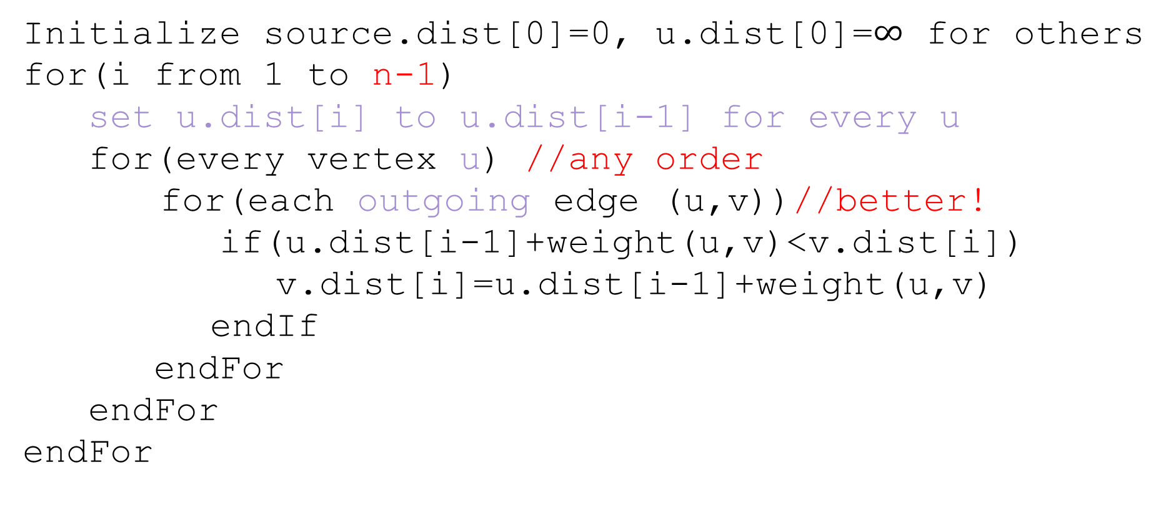
Pseudocode
Initialize source.dist[0]=0, u.dist[0]=$∞$ for others
for(i from 1 to n-1)
set u.dist[i] to u.dist[i-1] for every u
for(every vertex u) //any order
for(each outgoing edge (u,v))//better!
if(u.dist[i-1]+weight(u,v)<v.dist[i])
v.dist[i]=u.dist[i-1]+weight(u,v)
endIf
endFor
endFor
endFor

Slide 22
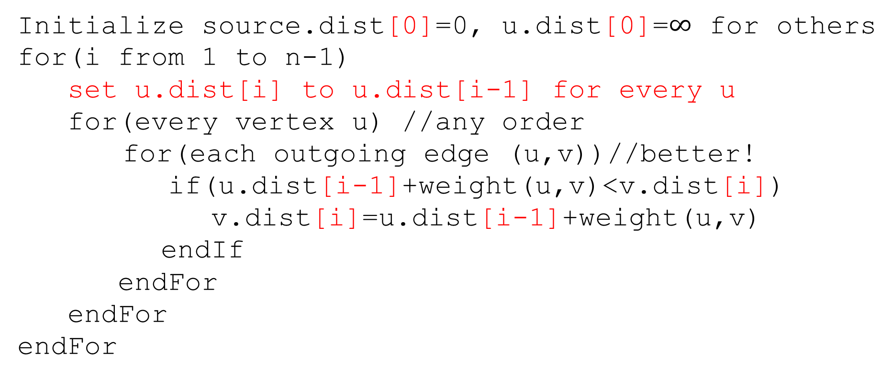
Pseudocode
Initialize source.dist[0]=0, u.dist[0]=$∞$ for others
for(i from 1 to n-1)
set u.dist[i] to u.dist[i-1] for every u
for(every vertex u) //any order
for(each outgoing edge (u,v))//better!
if(u.dist[i-1]+weight(u,v)<v.dist[i])
v.dist[i]=u.dist[i-1]+weight(u,v)
endIf
endFor
endFor
endFor
We don’t really need all the different values…
Just the most recent value.

Slide 23
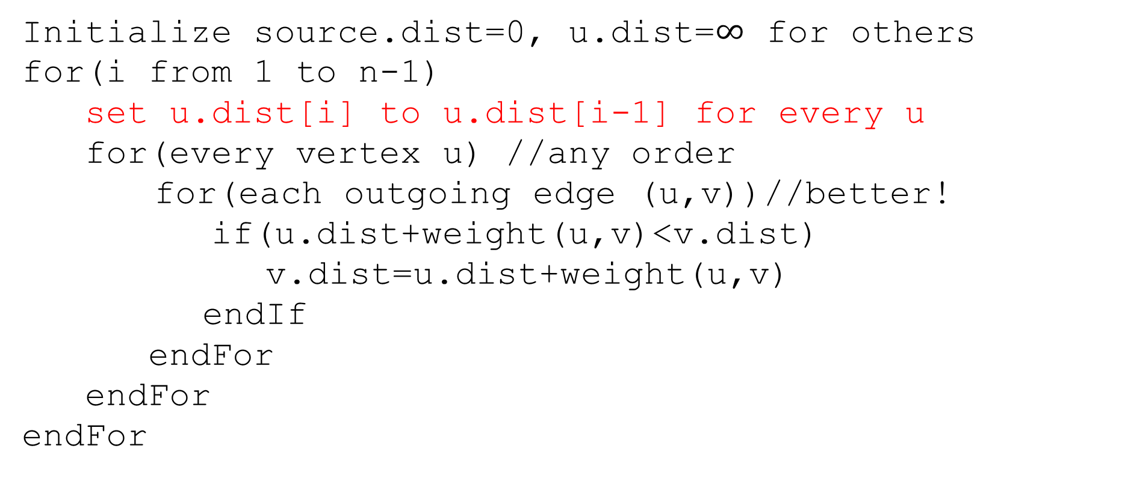
Pseudocode
Initialize source.dist=0, u.dist=$∞$ for others
for(i from 1 to n-1)
set u.dist[i] to u.dist[i-1] for every u
for(every vertex u) //any order
for(each outgoing edge (u,v))//better!
if(u.dist+weight(u,v)<v.dist)
v.dist=u.dist+weight(u,v)
endIf
endFor
endFor
endFor
We don’t really need all the different values…
Just the most recent value.

Slide 24
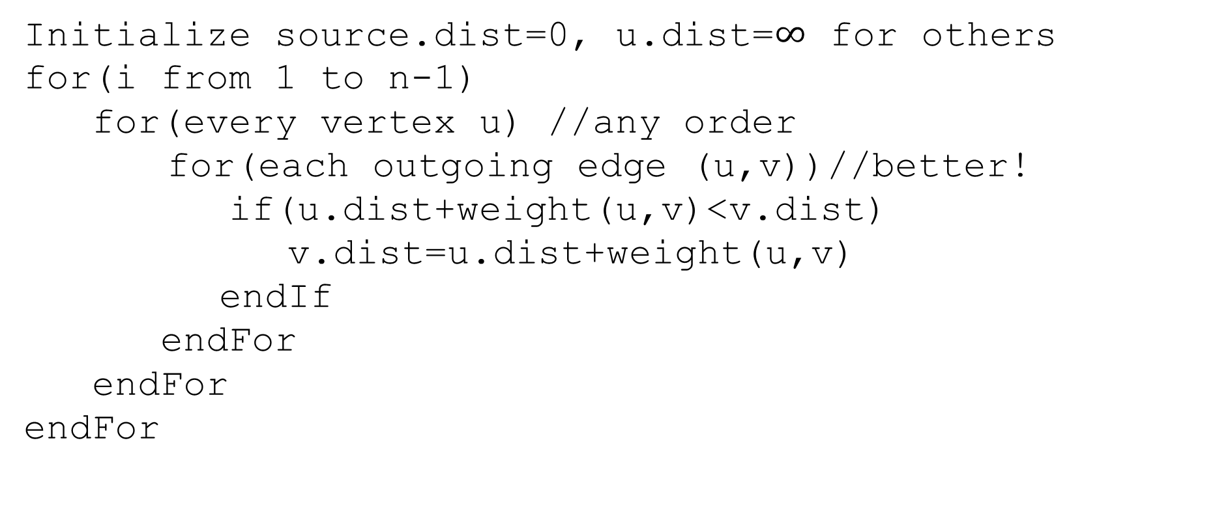
Pseudocode
Initialize source.dist=0, u.dist=$∞$ for others
for(i from 1 to n-1)
for(every vertex u) //any order
for(each outgoing edge (u,v))//better!
if(u.dist+weight(u,v)<v.dist)
v.dist=u.dist+weight(u,v)
endIf
endFor
endFor
endFor
We don’t really need all the different values…
Just the most recent value.

Slide 25
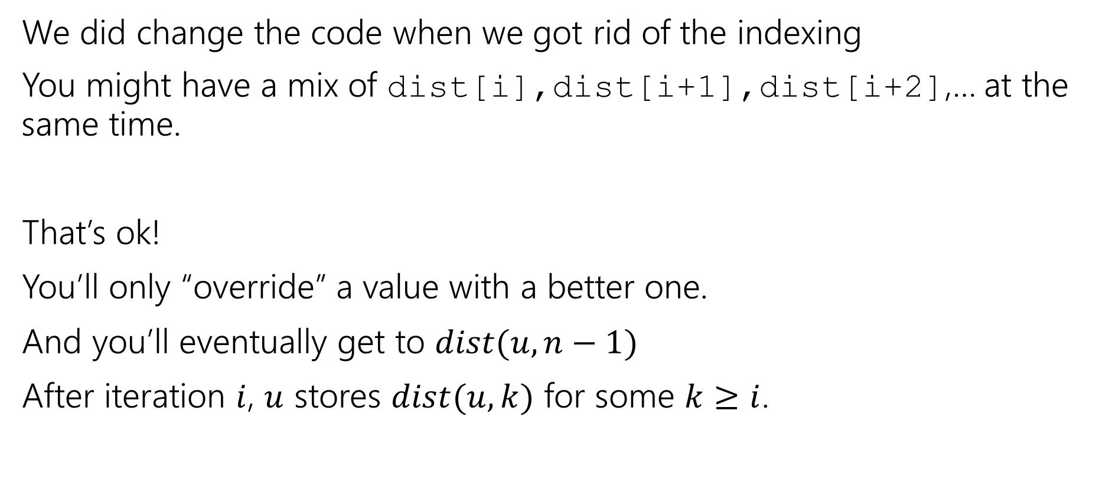
A Caution
We did change the code when we got rid of the indexing
You might have a mix of dist[i],dist[i+1],dist[i+2],… at the same time.
That’s ok!
You’ll only “override” a value with a better one.
And you’ll eventually get to $dist(u,n−1)$
After iteration $i$, $u$ stores $dist(u,k)$ for some $k≥i$.

Slide 26
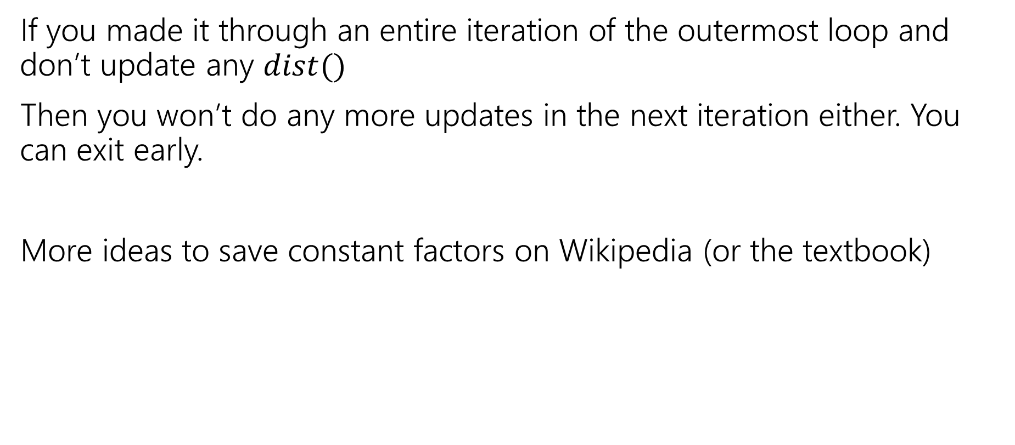
Exit early
If you made it through an entire iteration of the outermost loop and don’t update any $dist()$
Then you won’t do any more updates in the next iteration either. You can exit early.
More ideas to save constant factors on Wikipedia (or the textbook)
Notes:
Observe that if v’s distance doesn’t change then we don’t need to check (v,w) for any w. Some other clever ideas on Wikipedia.

Slide 27
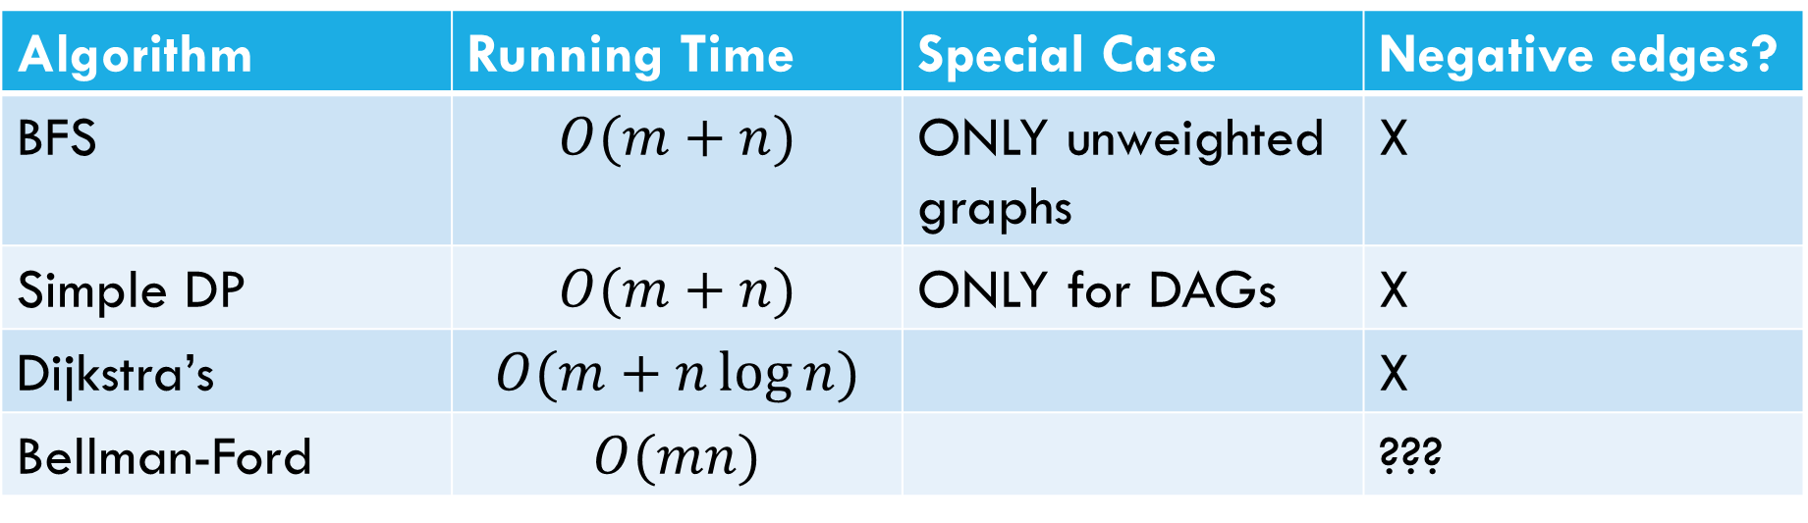
Laundry List of shortest pairs (so far)
Algorithm | Running Time | Special Case | Negative edges?
BFS | $$O(m+n)$$ | ONLY unweighted graphs | X
Simple DP | $$O(m+n)$$ | ONLY for DAGs | X
Dijkstra’s | $$O(m+n\log{n)}$$ |  | X
Bellman-Ford | $$O(mn)$$ |  | ???

Slide 28
Pseudocode
Initialize source.dist=0, u.dist=$∞$ for others
for(i from 1 to n-1)
for(every vertex u) //any order
for(each outgoing edge (u,v))//better!
if(u.dist+weight(u,v)<v.dist)
v.dist=u.dist+weight(u,v)
endIf
endFor
endFor
endFor
What happens if there’s a negative cycle?

Slide 29
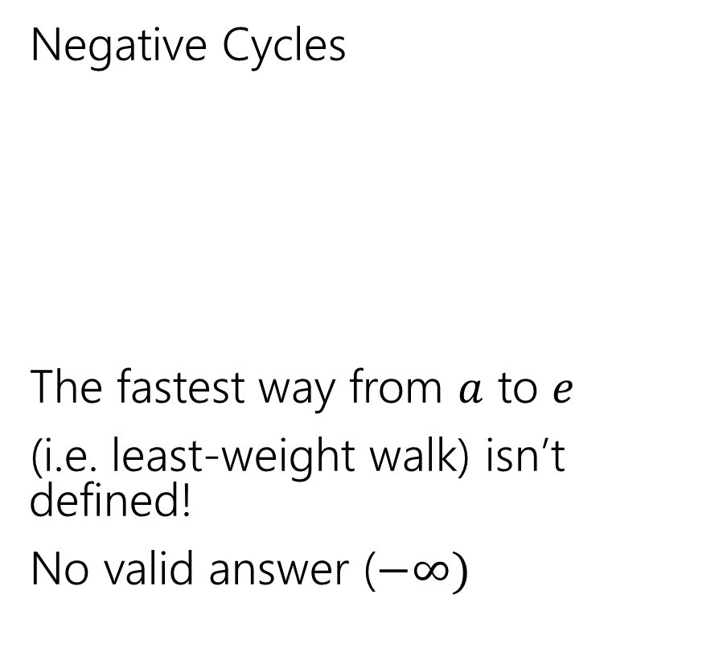
Negative Edges
Negative Cycles
The fastest way from $a$ to $e$
(i.e. least-weight walk) isn’t defined!
No valid answer ($−∞)$
Negative edges, but only non-negative cycles
Dijkstra’s might fail
But the shortest path IS defined.
There is an answer
a
6
5
c
e
a
6
5
c
e
3
2
3
2
1
b
d
1
-8
b
d
-3

Slide 30
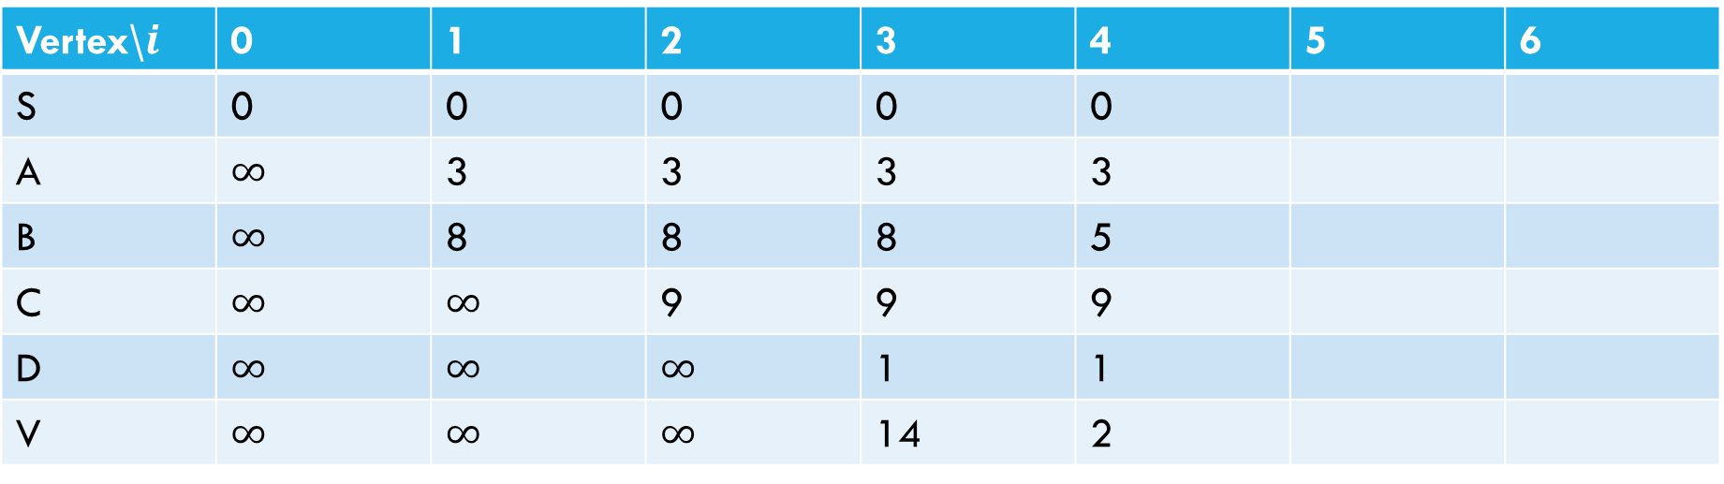
Negative Cycle
Pollev.com/Robbie
6
a
5
3
c
v
3
-8
s
1
8
b
d
4
Vertex\$i$ | 0 | 1 | 2 | 3 | 4 | 5 | 6
S | 0 | 0 | 0 | 0 | 0
A | $∞$ | 3 | 3 | 3 | 3
B | $∞$ | 8 | 8 | 8 | 5
C | $∞$ | $∞$ | 9 | 9 | 9
D | $∞$ | $∞$ | $∞$ | 1 | 1
V | $∞$ | $∞$ | $∞$ | 14 | 2

Slide 31
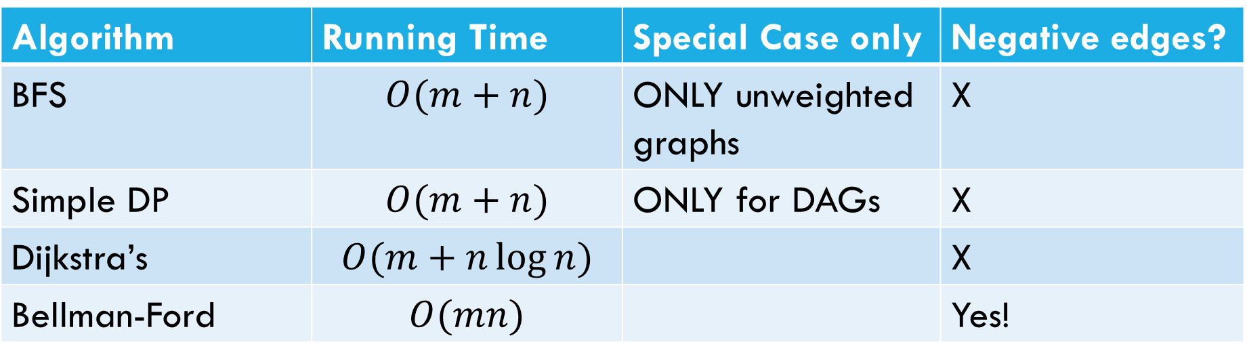
Laundry List of shortest pairs (so far)
Algorithm | Running Time | Special Case only | Negative edges?
BFS | $$O(m+n)$$ | ONLY unweighted graphs | X
Simple DP | $$O(m+n)$$ | ONLY for DAGs | X
Dijkstra’s | $$O(m+n\log{n)}$$ |  | X
Bellman-Ford | $$O(mn)$$ |  | Yes!

Slide 32
Why Bellman-Ford?
Bellman-Ford; a DP-inspired algorithm for shortest-paths.
Ended up with pseudocode very similar to Dijkstra’s…
…but slower.
Why? Handle negative edge weights.

Slide 33
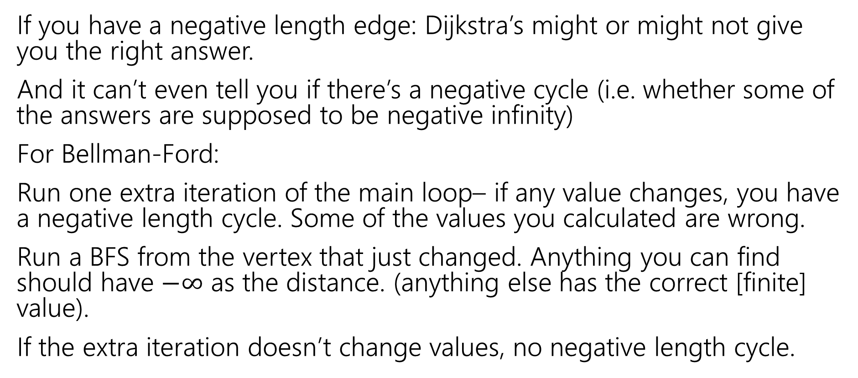
Negative Cycles
If you have a negative length edge: Dijkstra’s might or might not give you the right answer.
And it can’t even tell you if there’s a negative cycle (i.e. whether some of the answers are supposed to be negative infinity)
For Bellman-Ford:
Run one extra iteration of the main loop– if any value changes, you have a negative length cycle. Some of the values you calculated are wrong.
Run a BFS from the vertex that just changed. Anything you can find should have $−∞$ as the distance. (anything else has the correct [finite] value).
If the extra iteration doesn’t change values, no negative length cycle.

Slide 34
Laundry List of shortest pairs (so far)
Algorithm | Running Time | Special Case only | Negative edges?
BFS | $$O(m+n)$$ | ONLY unweighted graphs | X
Simple DP | $$O(m+n)$$ | ONLY for DAGs | X
Dijkstra’s | $$O(m+n\log{n)}$$ |  | X
Bellman-Ford | $$O(mn)$$ |  | Yes!

Slide 35
Linear Programming

Slide 36
Linear Programming
Used WIDELY in business and operations research.
Excel has a linear program solver.
A very expressive language for problem-solving
Can represent a wide-variety of problems, including some we’ve already seen.
Deep, beautiful theory…that we do not have time to cover.

Slide 37
Outline of LPs
What is a linear program?
A simple example LP
Computational Issues
An application – Vertex Cover on trees (again)
In a few weeks, we’ll return to LPs as a method of approximating NP-hard problems.

Slide 38
Example Problem
You’re laying down soil for a bunch of new gardens. You got a few big piles of soil delivered (more than enough to cover the gardens)
$1.5/unit
1.5
$2/unit
7
5
$4/unit
$4/unit
10
$1.5/unit
$3/unit
$8/unit
4
$2/unit
2.5
3
$4.5/unit

Slide 39
Example Problem
What variables should we use?
$1.5/unit
1.5
$2/unit
7
5
$4/unit
$4/unit
10
$1.5/unit
$3/unit
$8/unit
4
$2/unit
2.5
3
$4.5/unit

Slide 40

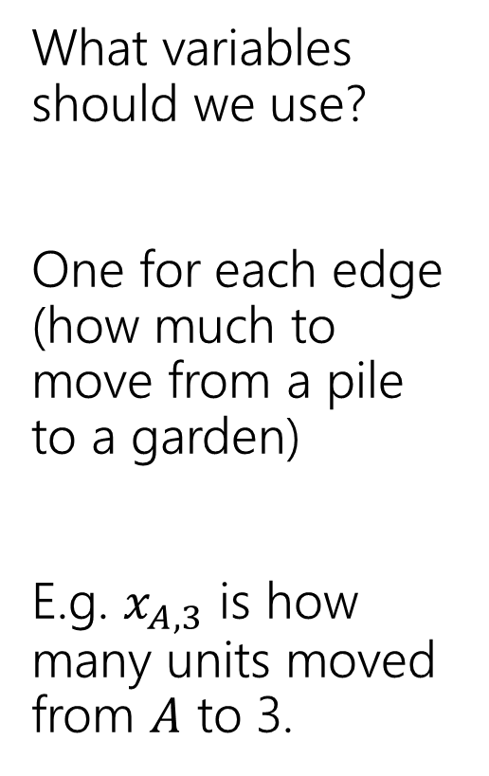
Example Problem
What variables should we use?
One for each edge (how much to move from a pile to a garden)
E.g. $x_{A,3}$ is how many units moved from $A$ to 3.
3
$$x_{A,3}$$
$1.5/unit
1.5
A
$2/unit
7
5
C
$4/unit
$4/unit
2
10
$1.5/unit
$3/unit
$8/unit
4
4
$2/unit
2.5
1
3
B
$4.5/unit

Slide 41
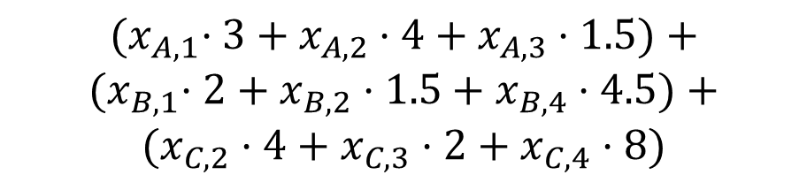
Example Problem
$${(x}_{A,1}⋅3+x_{A,2}⋅4+x_{A,3}⋅1.5)+$$
$${(x}_{B,1}⋅2+x_{B,2}⋅1.5+x_{B,4}⋅4.5)+$$
$$(x_{C,2}⋅4+x_{C,3}⋅2+x_{C,4}⋅8)$$
What’s the cost (in terms of the variables)?
Sum cost*var for all the variables
3
$$x_{A,3}$$
$1.5/unit
1.5
A
$2/unit
7
5
C
$4/unit
$4/unit
2
10
$1.5/unit
$3/unit
$8/unit
4
4
$2/unit
2.5
1
3
B
$4.5/unit

Slide 42
Example Problem
What constraints are there on the variables?
3
$$x_{A,3}$$
$1.5/unit
1.5
A
$2/unit
7
5
C
$4/unit
$4/unit
2
10
$1.5/unit
$3/unit
$8/unit
4
4
$2/unit
2.5
1
3
B
$4.5/unit

Slide 43
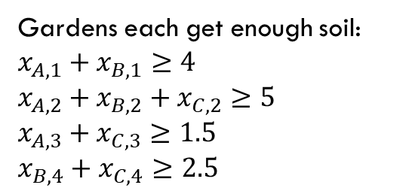
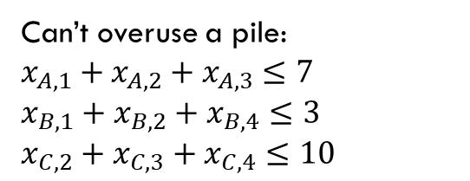
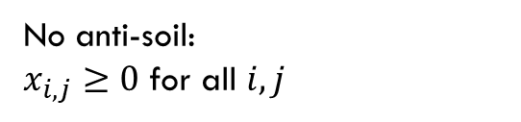
Example Problem
Gardens each get enough soil:
$x_{A,1}+x_{B,1}≥4$
$x_{A,2}+x_{B,2}+x_{C,2}≥5$
$x_{A,3}+x_{C,3}≥1.5$
$x_{B,4}+x_{C,4}≥2.5$
No anti-soil:
$x_{i,j}≥0$ for all $i,j$
What constraints are there on the variables?
Can’t overuse a pile:
$x_{A,1}+x_{A,2}+x_{A,3}≤7$
$x_{B,1}+x_{B,2}+x_{B,4}≤3$
$x_{C,2}+x_{C,3}+x_{C,4}≤10$
3
$$x_{A,3}$$
$1.5/unit
1.5
A
$2/unit
7
5
C
$4/unit
$4/unit
2
10
$1.5/unit
$3/unit
$8/unit
4
4
$2/unit
2.5
1
3
B
$4.5/unit

Slide 44

Full Definition
Minimize: ${(x}_{A,1}⋅3+x_{A,2}⋅4+x_{A,3}⋅1.5)+{(x}_{B,1}⋅2+x_{B,2}⋅1.5+x_{B,4}⋅4.5)+(x_{C,2}⋅4+x_{C,3}⋅2+x_{C,4}⋅8)$
Subject To:
$x_{A,1}+x_{B,1}≥4$
$x_{A,2}+x_{B,2}+x_{C,2}≥5$
$x_{A,3}+x_{C,3}≥1.5$
$x_{B,4}+x_{C,4}≥2.5$
$x_{A,1}+x_{A,2}+x_{A,3}≤7$
$x_{B,1}+x_{B,2}+x_{B,4}≤3$
$x_{C,2}+x_{C,3}+x_{C,4}≤10$
$x_{i,j}≥0$ for all $i,j$

Slide 45


A Linear Program
A linear program is defined by:
Real-valued variables
Subject to satisfying everything in a list of linear constraints
Maximizing or minimizing a linear objective function
A linear constraint is a statement of the form: $∑a_{i}x_{i}≤c_{i}$
where $a_{i}$ are constants, the $x_{i}$ are variables and $c_{i}$ is a constant.
A linear objective function is a function of the form: $∑b_{i}x_{i}$
where $b_{i}$ are constants and the $x_{i}$ are variables.

Slide 46

Linear constraints
Pollev.com/robbie
Can you write each of these requirements as linear constraint(s)?
Some of these are tricks…
$x_{i}$ times $x_{j}$ is at least $5$
${5x}_{i}$ is equal to $1$
$x_{i}≤5$ OR $x_{i}≥7$
$x_{i}$ is non-negative.
$x_{i}$ is an integer.

Slide 47
Linear constraints
Pollev.com/robbie
Can you write each of these requirements as linear constraint(s)?
Some of these are tricks…
$x_{i}$ times $x_{j}$ is at least $5$
${5x}_{i}$ is equal to $1$
$x_{i}≤5$ OR $x_{i}≥7$
$x_{i}$ is non-negative.
$x_{i}$ is an integer.

Slide 48
What are we looking for?
A solution (or “point”) is a setting of all the variables
A feasible point is a point that satisfies all the constraints.
An optimal point is a point that is feasible and has at least as good of an objective value as every other feasible point.

Slide 49
Example Problem
Gardens each get enough soil:
$x_{A,1}+x_{B,1}≥4$
$x_{A,2}+x_{B,2}+x_{C,2}≥5$
$x_{A,3}+x_{C,3}≥1.5$
$x_{B,4}+x_{C,4}≥2.5$
No anti-soil:
$x_{i,j}≥0$ for all $i,j$
Can’t overuse a pile:
$x_{A,1}+x_{A,2}+x_{A,3}≤7$
$x_{B,1}+x_{B,2}+x_{B,4}≤3$
$x_{C,2}+x_{C,3}+x_{C,4}≤10$
3
A
$1.5/unit
1.5
1.5
A feasible point.
Objective: 55
$2/unit
7
5
5
C
$4/unit
$4/unit
2
10
$1.5/unit
$3/unit
2.5
$8/unit
4
4
4
$2/unit
2.5
1
3
B
$4.5/unit

Slide 50
Example Problem
Gardens each get enough soil:
$x_{A,1}+x_{B,1}≥4$
$x_{A,2}+x_{B,2}+x_{C,2}≥5$
$x_{A,3}+x_{C,3}≥1.5$
$x_{B,4}+x_{C,4}≥2.5$
No anti-soil:
$x_{i,j}≥0$ for all $i,j$
Can’t overuse a pile:
$x_{A,1}+x_{A,2}+x_{A,3}≤7$
$x_{B,1}+x_{B,2}+x_{B,4}≤3$
$x_{C,2}+x_{C,3}+x_{C,4}≤10$
3
1.5
$1.5/unit
1.5
A
A feasible point.
Objective: 44.25
$2/unit
7
5
C
$4/unit
$4/unit
2
10
0.5
4.5
This is an optimal point. There are others!
$1.5/unit
$3/unit
$8/unit
4
4
4
$2/unit
2.5
2.5
1
3
B
$4.5/unit

Slide 51
Another Question
Change the problem
Instead of infinitely divisible dirt…
What if instead we’re moving whole unit things (the dirt is in bags we can’t open or we’re moving bikes or plants or anything else that can’t be split)
Well, the constraints will change (your “demand” and “supplies” will be integers)

Slide 52
Non-Integrality
Some linear programs have optimal solutions that have some (or all) variables as non-integers (even with only integers in the objective function and constraints) .
For dirt or water or anything arbitrarily divisible, no big deal!
For cell phones or bicycles…possibly a big deal! (also possibly not!)

Slide 53
What do you do if you need integers?
Integer Programs are linear programs where you can mark some variables as needing to be integers.
In practice – often still solvable (Excel also has a solver for these problems). But no longer guaranteed to be efficient.
And “just rounding” an LP answer often gets you really close.
In theory – lots of theory has been done for when the best answer will be an integer
But sometimes there’s just not a lot to be done…

Slide 54
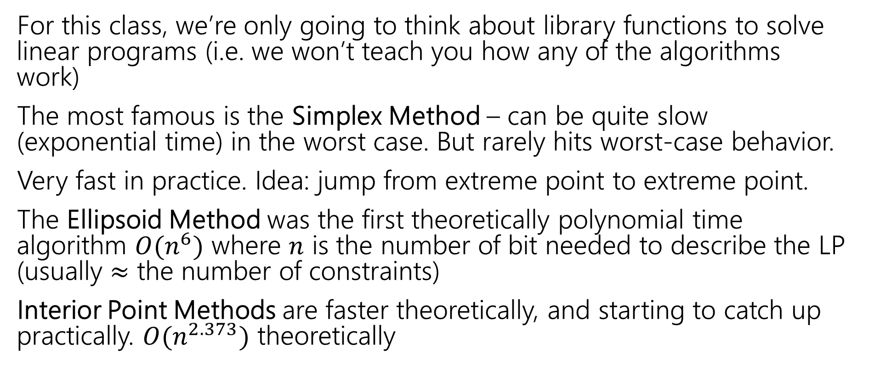
Solving LPs
For this class, we’re only going to think about library functions to solve linear programs (i.e. we won’t teach you how any of the algorithms work)
The most famous is the Simplex Method – can be quite slow (exponential time) in the worst case. But rarely hits worst-case behavior.
Very fast in practice. Idea: jump from extreme point to extreme point.
The Ellipsoid Method was the first theoretically polynomial time algorithm $O(n^{6})$ where $n$ is the number of bit needed to describe the LP (usually $≈$ the number of constraints)
Interior Point Methods are faster theoretically, and starting to catch up practically. $O(n^{2.373})$ theoretically

Slide 55
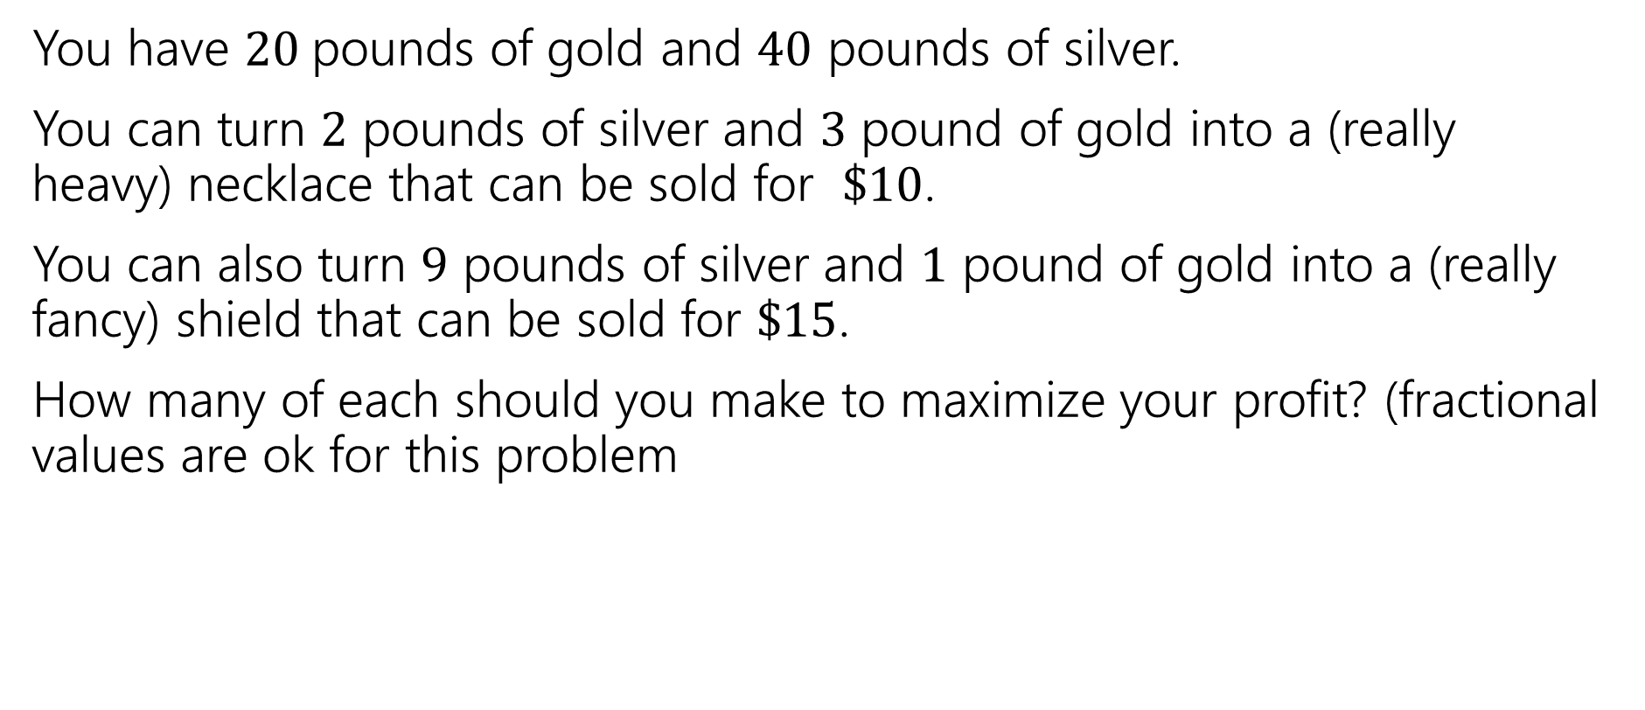
Extra Practice
You have $20$pounds of gold and $40$ pounds of silver.
You can turn $2$ pounds of silver and $3$ pound of gold into a (really heavy) necklace that can be sold for $\$10$.
You can also turn $9$ pounds of silver and $1$ pound of gold into a (really fancy) shield that can be sold for $\$15$.
How many of each should you make to maximize your profit? (fractional values are ok for this problem

Slide 56
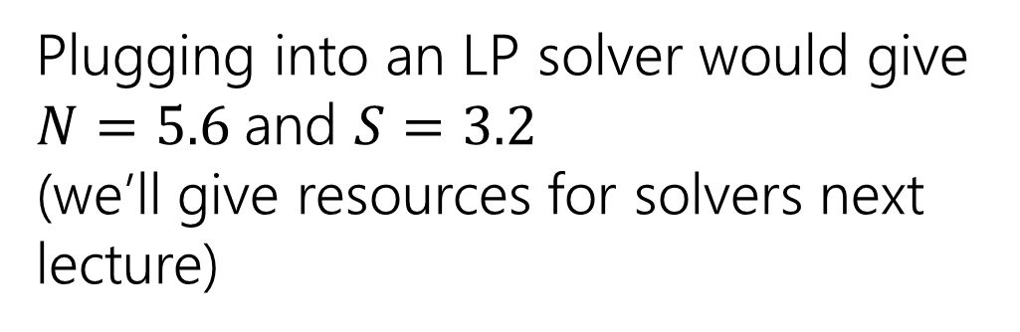
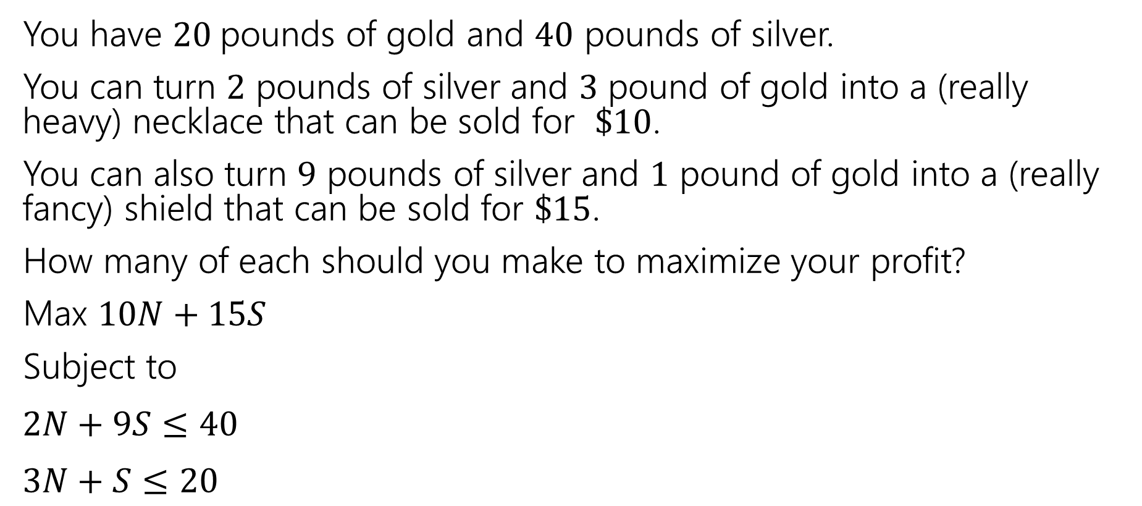
Extra Practice
You have $20$pounds of gold and $40$ pounds of silver.
You can turn $2$ pounds of silver and $3$ pound of gold into a (really heavy) necklace that can be sold for $\$10$.
You can also turn $9$ pounds of silver and $1$ pound of gold into a (really fancy) shield that can be sold for $\$15$.
How many of each should you make to maximize your profit?
Max $10N+15S$
Subject to
$2N+9S≤40$
$3N+S≤20$
Plugging into an LP solver would give $N=5.6$and $S=3.2$
(we’ll give resources for solvers next lecture)

