Slide 1
Dynamic Programming on Graphs
CSE 417 Winter 24
Lecture 15

Slide 2
New Resource on Assignments Page
For a few homeworks a “sample problem” with a “sample solution”
Not the actual problems on the homework, but a problem covering a similar topic (e.g., a divide and conquer question, a dynamic programming question, etc.).
Since we don’t have staff solutions (so you can resubmit!) we wanted to give you something to refer to for ‘style’/length/etc.
Lecture examples are also good! But it’s sometimes nice to see a full answer all in one spot.

Slide 3
Dynamic Programming
So far: DP on arrays and lists.
The end of yesterday’s slide deck has practice materials:
- Do LIS again, but from “left-to-right” instead of “right-to-left” (try doing the same problem again to see if you understood it).
- Another problem (subset sum)
Today: our last DP day---DP on trees and graphs
DP on trees is very common; we’ll practice it today. DP on graphs is less common; we’ll give you intuition why and tell you about a famous one.
Lots of slides we’re intentionally skipping

Slide 4
DP on Trees
Trees are recursive structures
A tree is a root node, with zero or more children
Each of which are roots of trees
Since DP is “smart recursion” (recursion where we save values)
Recursive functions/calculations are really common.

Slide 5
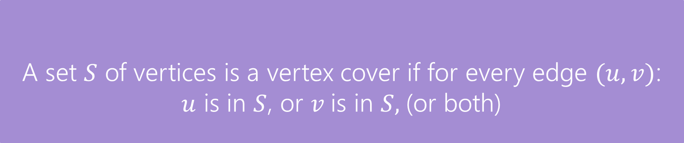
DP on Trees
Find the minimum vertex cover in a tree.
Give every vertex a weight, find the minimum weight vertex cover
Vertex Cover
A set $S$ of vertices is a vertex cover if for every edge $(u,v)$:
$u$ is in $S$, or $v$is in $S,$(or both)
The weight of a vertex cover is just the sum of the weights of the vertices in the set.
We want to find the minimum weight vertex cover.

Slide 6
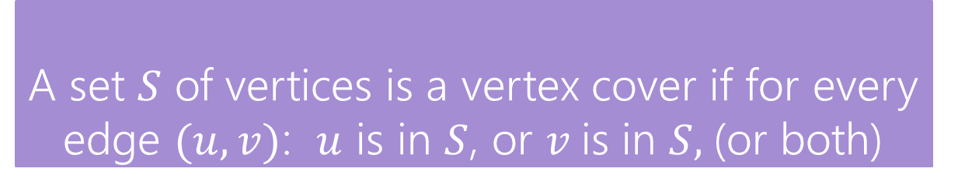
Vertex Cover
Vertex Cover
A set $S$ of vertices is a vertex cover if for every edge $(u,v)$: $u$ is in $S$, or $v$is in $S,$(or both)
Find the minimum vertex cover in a tree.
Give every vertex a weight, find the minimum weight vertex cover
1
10
8
5
3
20

Slide 7
Vertex Cover
Vertex Cover
A set $S$ of vertices is a vertex cover if for every edge $(u,v)$: $u$ is in $S$, or $v$is in $S,$(or both)
Find the minimum vertex cover in a tree.
Give every vertex a weight, find the minimum weight vertex cover
1
10
8
A valid vertex cover! (just take everything)
Definitely not the minimum though.
5
3
20

Slide 8
Vertex Cover
Vertex Cover
A set $S$ of vertices is a vertex cover if for every edge $(u,v)$: $u$ is in $S$, or $v$is in $S,$(or both)
Find the minimum vertex cover in a tree.
Give every vertex a weight, find the minimum weight vertex cover
1
10
8
A better vertex cover – weight 18
5
3
20

Slide 9
Vertex Cover
Vertex Cover
A set $S$ of vertices is a vertex cover if for every edge $(u,v)$: $u$ is in $S$, or $v$is in $S,$(or both)
Find the minimum vertex cover in a tree.
Give every vertex a weight, find the minimum weight vertex cover
1
10
8
The minimum vertex cover: weight 17
5
3
20

Slide 10
Vertex Cover
Vertex Cover
A set $S$ of vertices is a vertex cover if for every edge $(u,v)$: $u$ is in $S$, or $v$is in $S,$(or both)
Notice, the minimum weight vertex cover might have both endpoints of some edges
Even though only one of 1, 8 is required on the edge between them, they are both required for other edges.
1
10
8
5
3
20

Slide 11
Step 1: Formulate your problem recursively
Try top down and bottom up thinking.
Top down: For one particular “element” of the input, what do I need to decide? What are all the possibilities?
Bottom up: What is a smaller version of the problem?
What information do we need to solve the problem recursively?

Slide 12
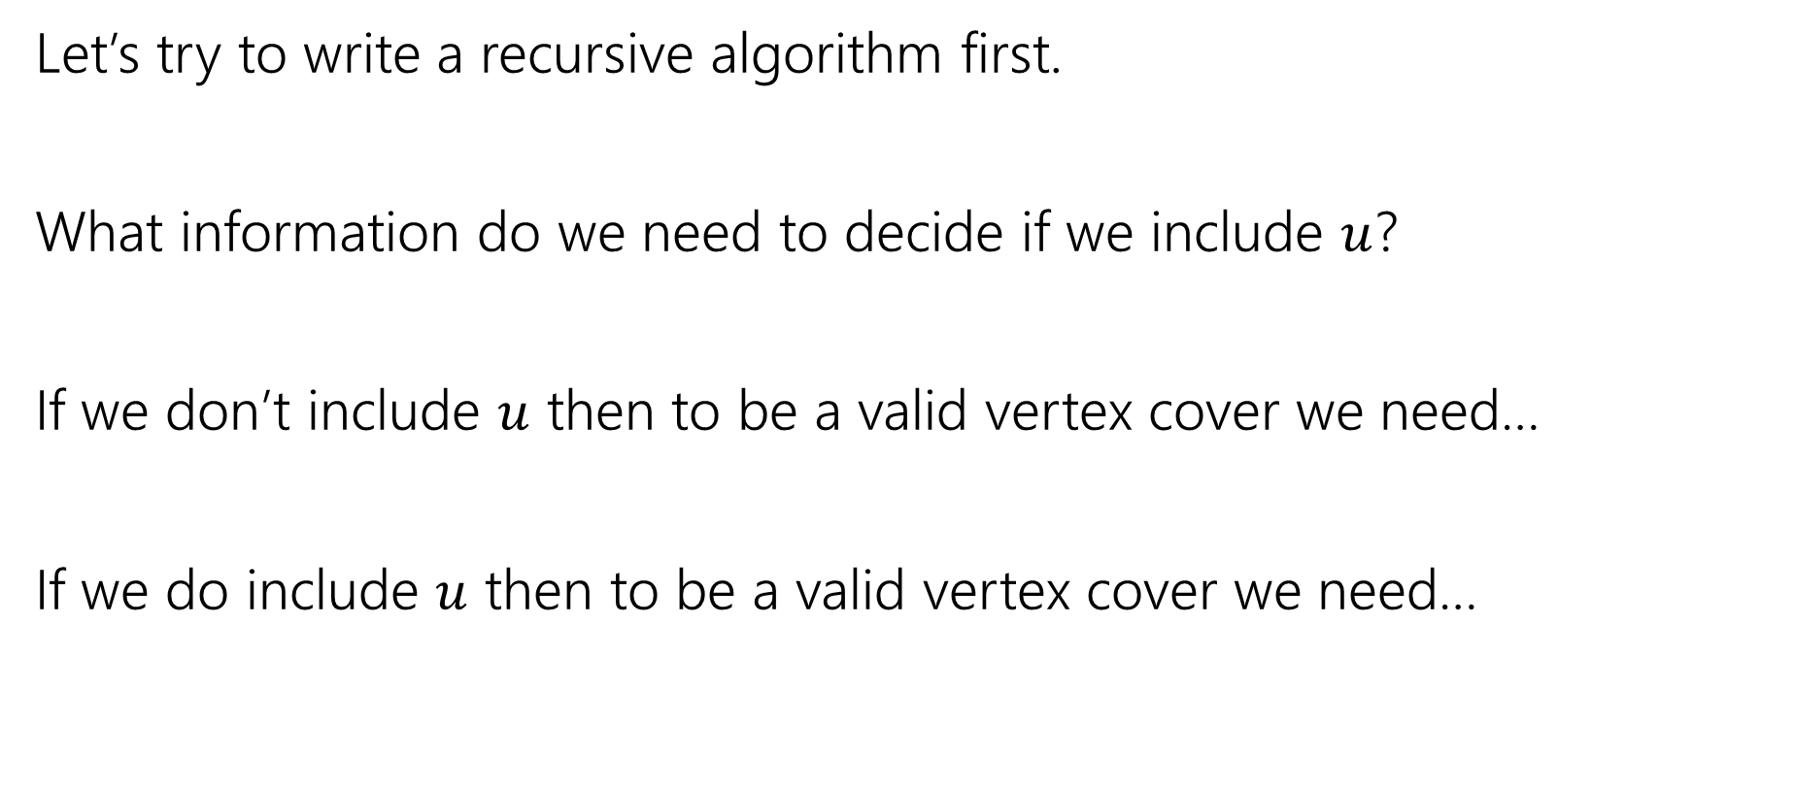
Vertex Cover – Recursively
Let’s try to write a recursive algorithm first.
What information do we need to decide if we include $u$?
If we don’t include $u$ then to be a valid vertex cover we need…
If we do include $u$ then to be a valid vertex cover we need…

Slide 13
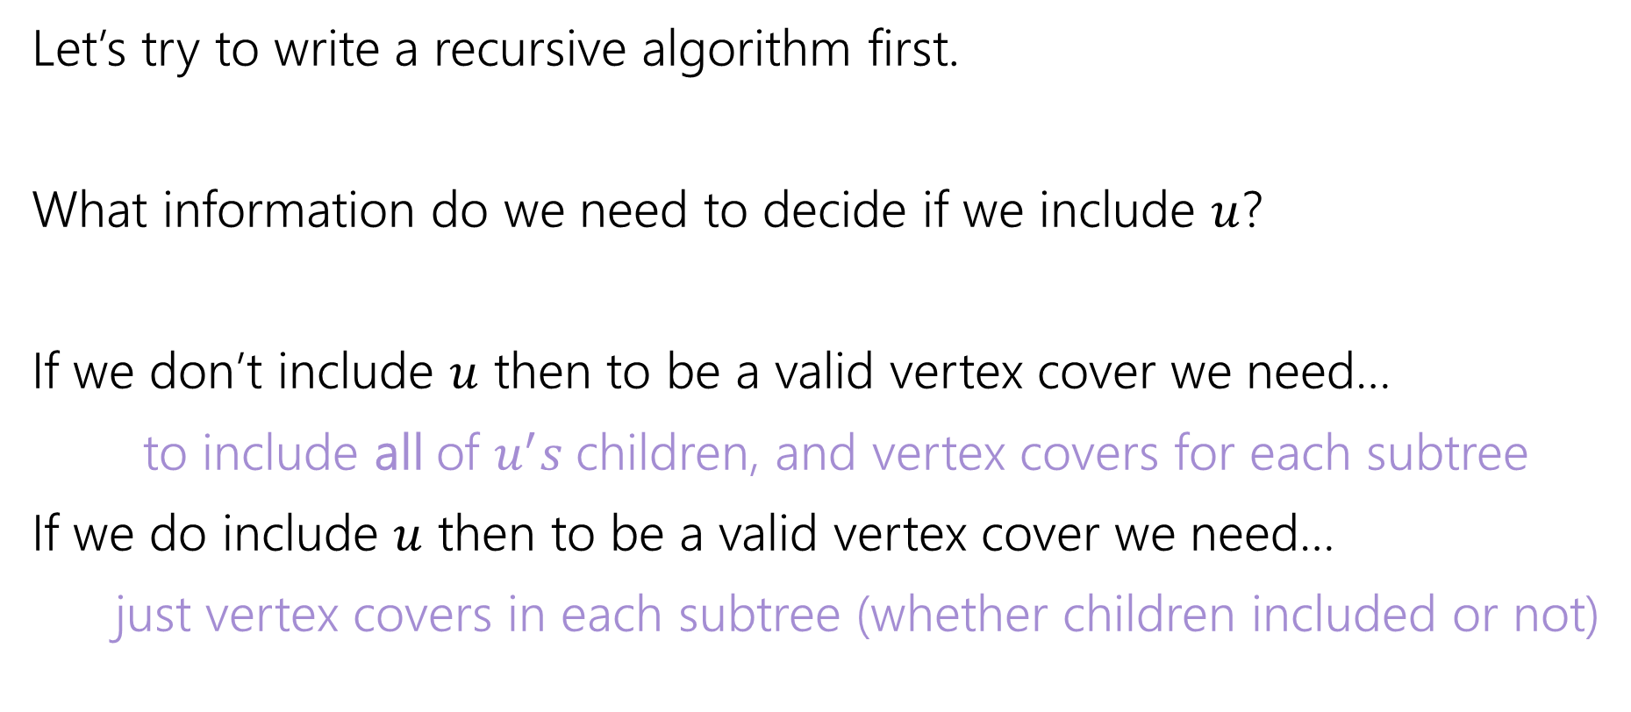
Vertex Cover – Recursively
Let’s try to write a recursive algorithm first.
What information do we need to decide if we include $u$?
If we don’t include $u$ then to be a valid vertex cover we need…
to include all of $u^{′}s$children, and vertex covers for each subtree
If we do include $u$ then to be a valid vertex cover we need…
just vertex covers in each subtree (whether children included or not)

Slide 14
Step 2: What do you need recursively
Write in English (not math. English.) what exactly the recursive call is giving you.
I know this sounds silly. Every time I am trying to solve a DP problem from scratch (or just remember how one worked) and can’t do it, it’s because I haven’t written it down in English.
If you realize “I need an extra parameter” update the English description with that extra parameter.

Slide 15
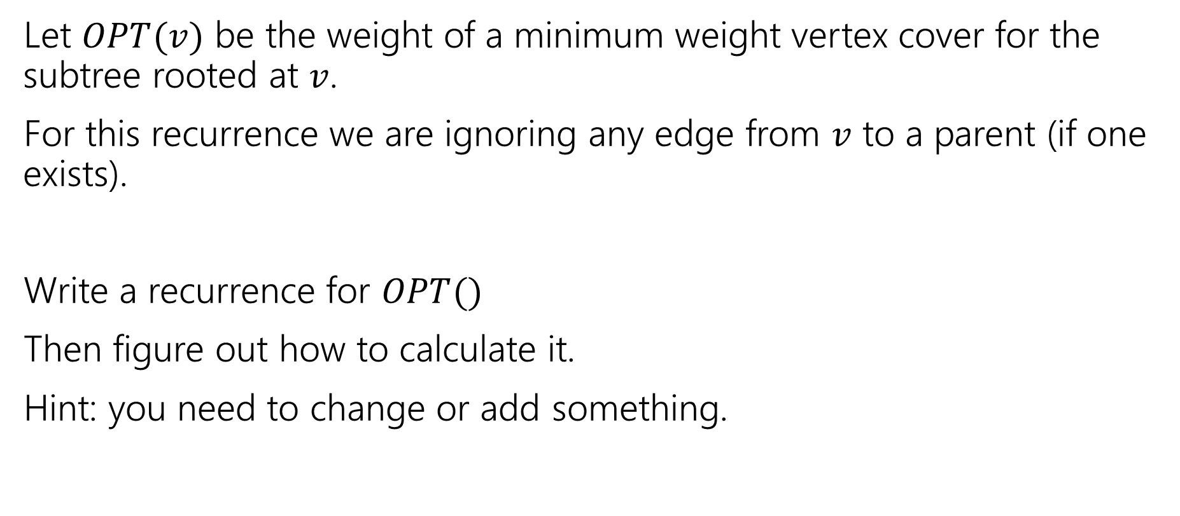
Recurrence
Let $OPT(v)$ be the weight of a minimum weight vertex cover for the subtree rooted at $v$.
For this recurrence we are ignoring any edge from $v$ to a parent (if one exists).
Write a recurrence for $OPT()$
Then figure out how to calculate it.
Hint: you need to change or add something.

Slide 16
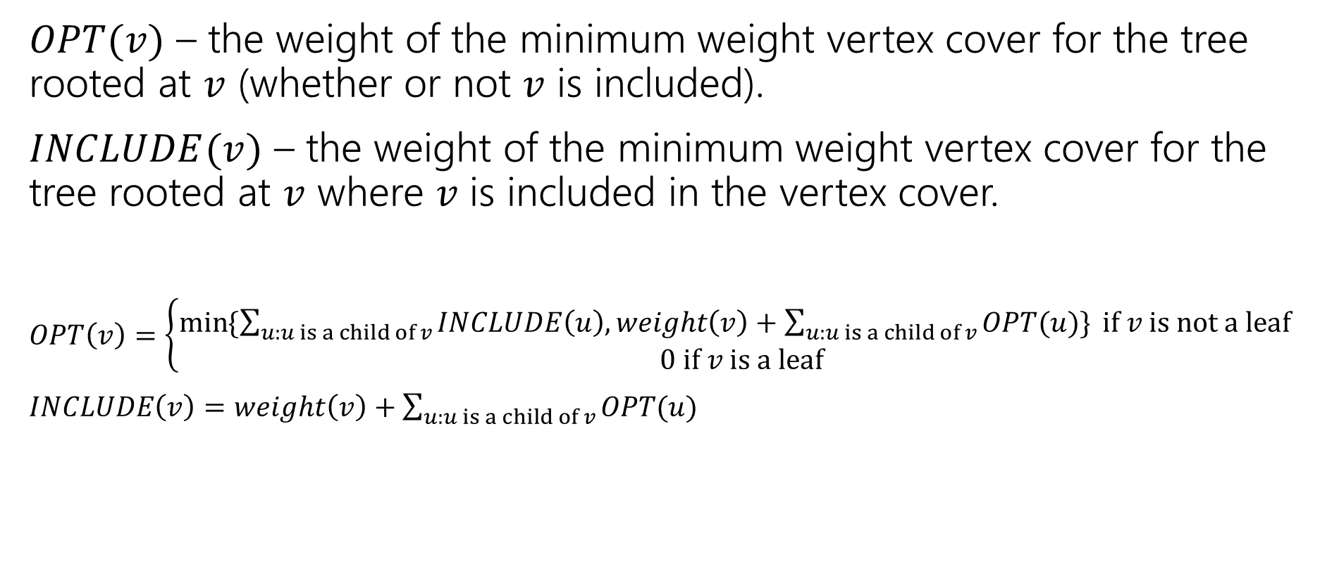
Recurrence
$OPT(v)$ – the weight of the minimum weight vertex cover for the tree rooted at $v$ (whether or not $v$ is included).
$INCLUDE(v)$ – the weight of the minimum weight vertex cover for the tree rooted at $v$ where $v$ is included in the vertex cover.
$OPT\left(v\right)=\left\{\begin{aligned}\min{⁡\{\sum_{u:u is a child of v}{INCLUDE\left(u\right), weight\left(v\right)+\sum_{u:u is a child of v}{OPT(u)\}} if v is not a leaf} } \\ 0 if v is a leaf\end{aligned}\right.$
$INCLUDE\left(v\right)=weight\left(v\right)+\sum_{u:u is a child of v}{OPT(u)}$

Slide 17
Vertex Cover Dynamic Program
What memoization structure should we use?
What code should we write?
What’s the running time?

Slide 18
Vertex Cover Dynamic Program
What memoization structure should we use?
the tree itself!
What code should we write?
What’s the running time?

Slide 19
Vertex Cover
What order do we do the calculation?
1
10
8
5
3
20

Slide 20
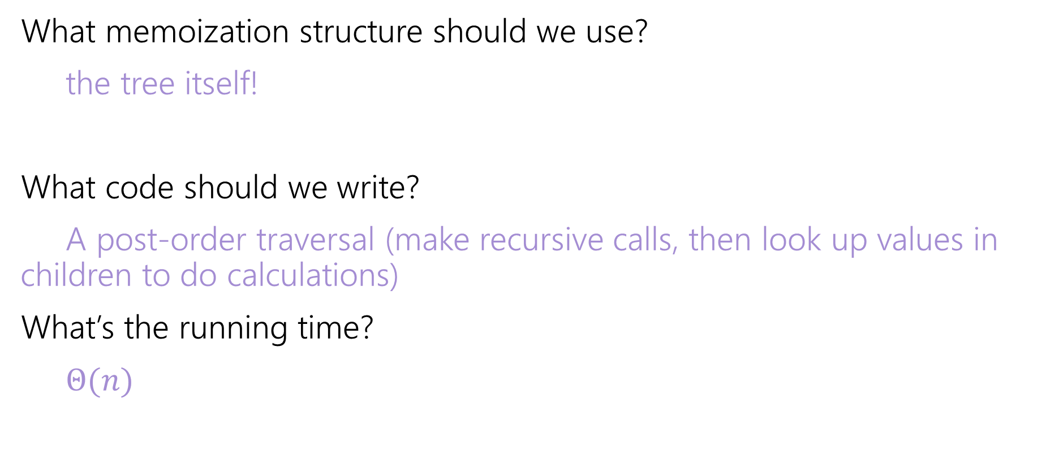
Vertex Cover Dynamic Program
What memoization structure should we use?
the tree itself!
What code should we write?
A post-order traversal (make recursive calls, then look up values in children to do calculations)
What’s the running time?
$Θ(n)$

Slide 21
DP on graphs

Slide 22
Rest of this slide deck
Dynamic Programming on Graphs
We’re building up to “Bellman-Ford” and “Floyd-Warshall”
Two very clever algorithms – we won’t ask you to be as clever.
But they’re standard library functions, so it’s good to know.
And deriving them together is good for practicing DP skills.
Want to understand: why is DP on graphs with cycles harder than DP on trees?

Slide 23
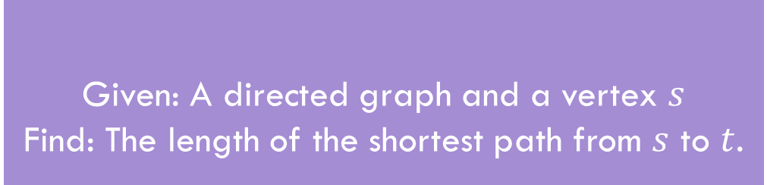
Shortest Paths
Given: A directed graph and a vertex $s$
Find: The length of the shortest path from $s$ to $t$.
Shortest Path Problem
The length of a path is the sum of the edge weights.
Baseline: Dijkstra’s Algorithm

Slide 24
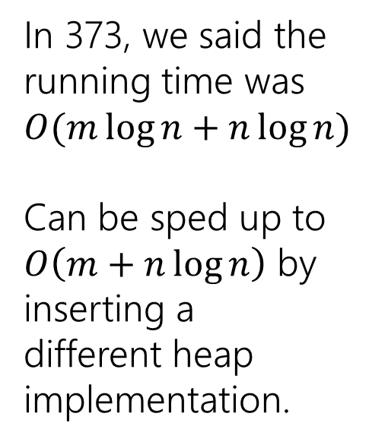
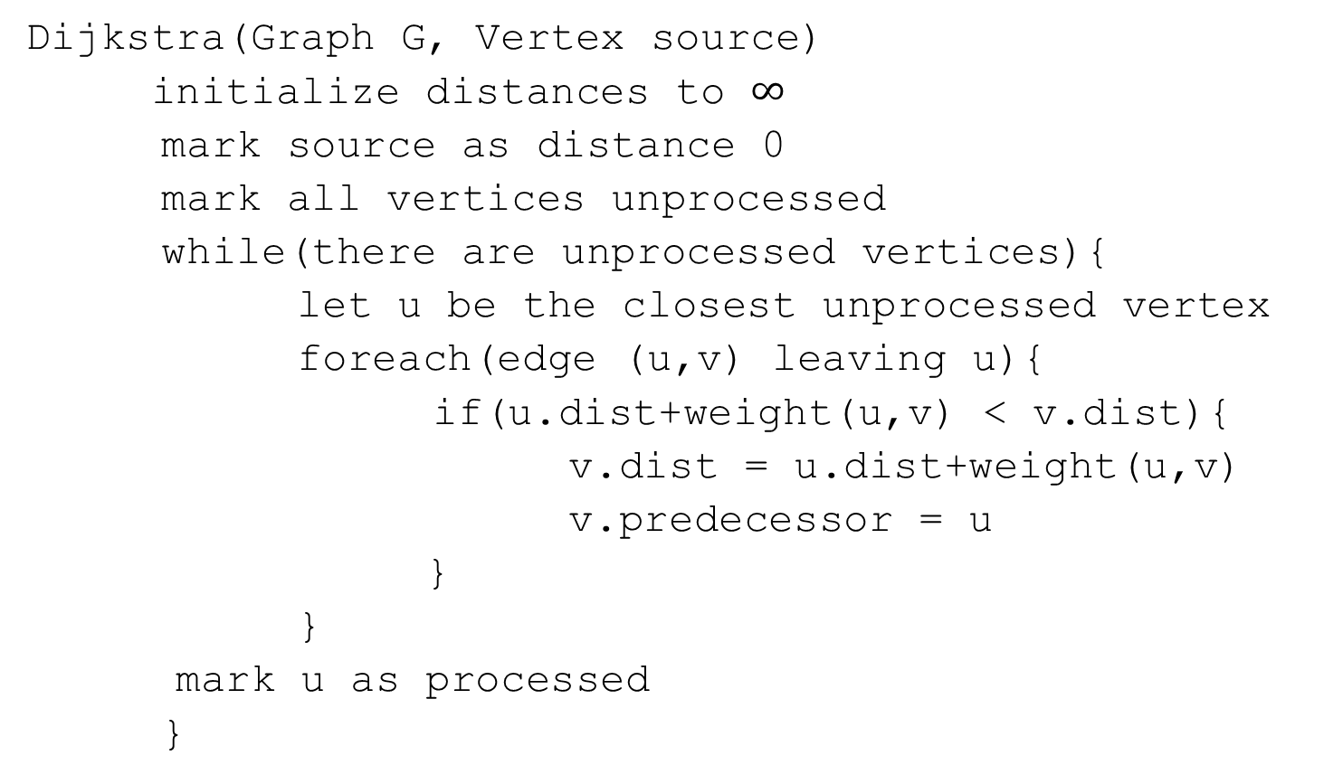
Dijkstra’s Algorithm
Dijkstra(Graph G, Vertex source)
initialize distances to $∞$
mark source as distance 0
mark all vertices unprocessed
while(there are unprocessed vertices){
let u be the closest unprocessed vertex
foreach(edge (u,v) leaving u){
if(u.dist+weight(u,v) < v.dist){
v.dist = u.dist+weight(u,v)
v.predecessor = u
}
}
mark u as processed
}
In 373, we said the running time was $O(m\log{n+n\log{n)}}$
Can be sped up to
$O\left(m+n\log{n}\right)$ by inserting a different heap implementation.

Slide 25

A recurrence
Suppose you have a directed acyclic graph $G$.
How could you find distances from $s$?
What’s one step in this problem?

Slide 26
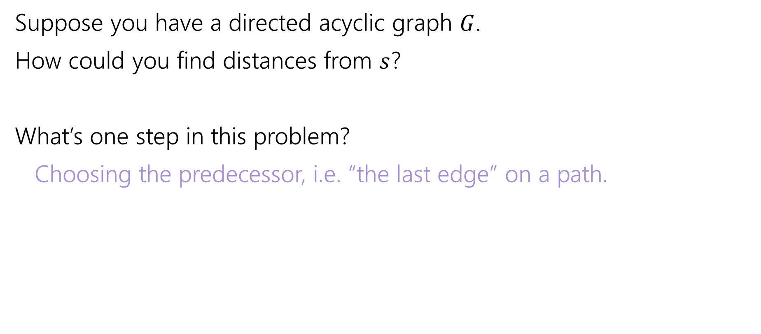
A recurrence
Suppose you have a directed acyclic graph $G$.
How could you find distances from $s$?
What’s one step in this problem?
Choosing the predecessor, i.e. “the last edge” on a path.

Slide 27
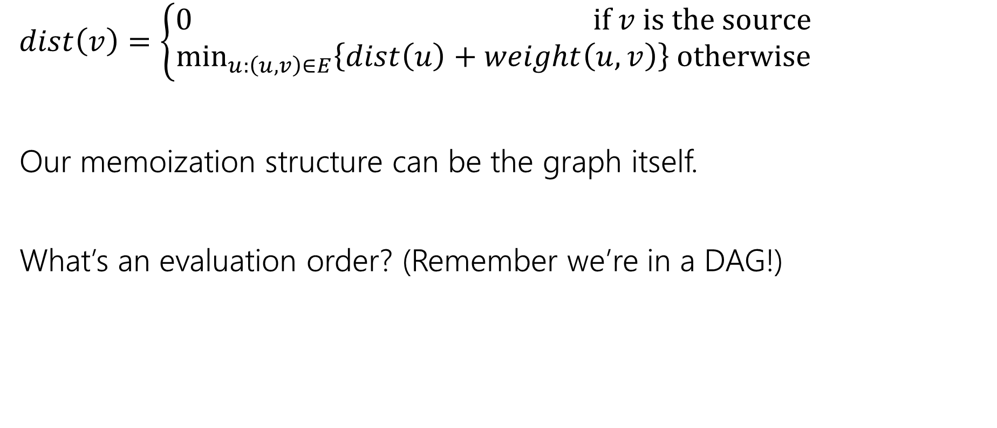
A recurrence
$dist\left(v\right)=\left\{\begin{aligned}0 if v is the source \\ \min_{u:\left(u,v\right)∈E}\left\{dist\left(u\right)+weight\left(u,v\right)\right\} otherwise\end{aligned}\right.$
Our memoization structure can be the graph itself.
What’s an evaluation order? (Remember we’re in a DAG!)

Slide 28
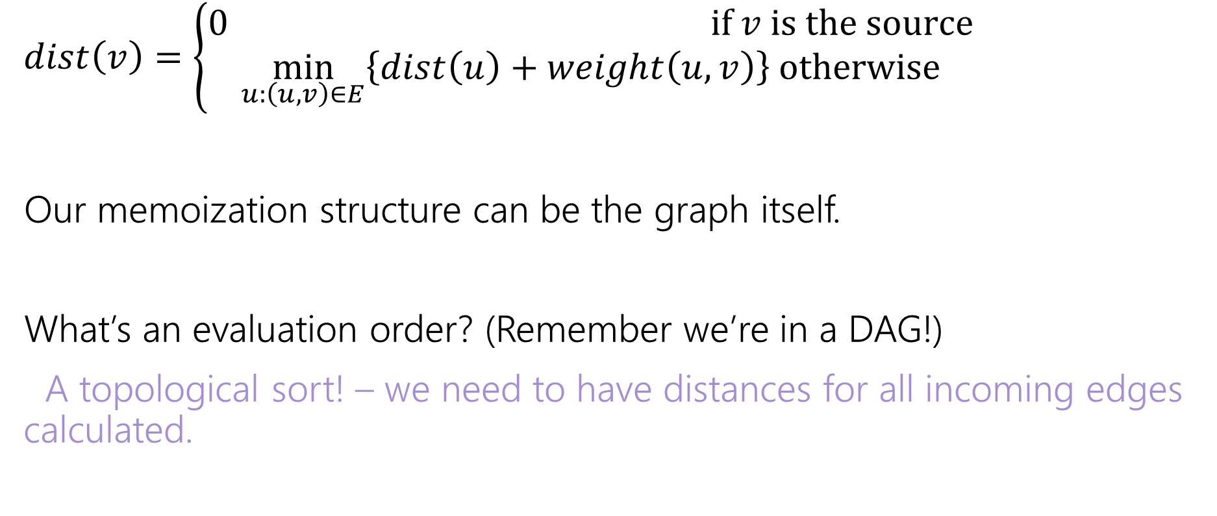
A recurrence
$dist\left(v\right)=\left\{\begin{aligned}0 if v is the source \\ \min_{u:\left(u,v\right)∈E}\left\{dist\left(u\right)+weight\left(u,v\right)\right\} otherwise\end{aligned}\right.$
Our memoization structure can be the graph itself.
What’s an evaluation order? (Remember we’re in a DAG!)
A topological sort! – we need to have distances for all incoming edges calculated.

Slide 29
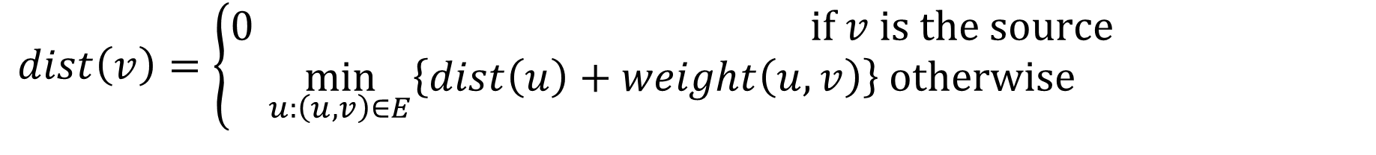
In a DAG
$dist\left(v\right)=\left\{\begin{aligned}0 if v is the source \\ \min_{u:\left(u,v\right)∈E}\left\{dist\left(u\right)+weight\left(u,v\right)\right\} otherwise\end{aligned}\right.$
6
3
5
3
2
1
8

Slide 30
What about cycles?
$dist\left(v\right)=\left\{\begin{aligned}0 if v is the source \\ \min_{u:\left(u,v\right)∈E}\left\{dist\left(u\right)+weight\left(u,v\right)\right\} otherwise\end{aligned}\right.$
6
3
5
3
2
1
8
4

Slide 31
Cycles
We need some way to “order” the paths.
I.e. we need to be sure we always have something to look up.
It doesn’t have to be the perfect distance necessarily…
As long as we’ll realize it and update later
And as long as we can fix it to the true distance eventually.

Slide 32
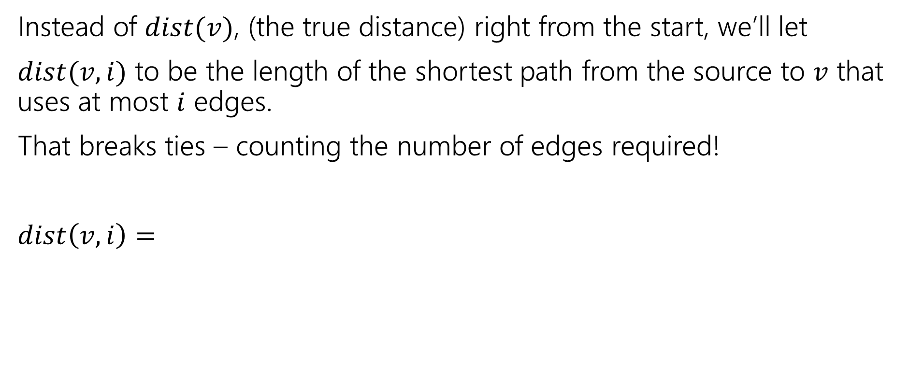
Ordering
Instead of $dist(v)$, (the true distance) right from the start, we’ll let
$dist(v,i)$ to be the length of the shortest path from the source to $v$ that uses at most $i$ edges.
That breaks ties – counting the number of edges required!
$dist\left(v,i\right)=$

Slide 33
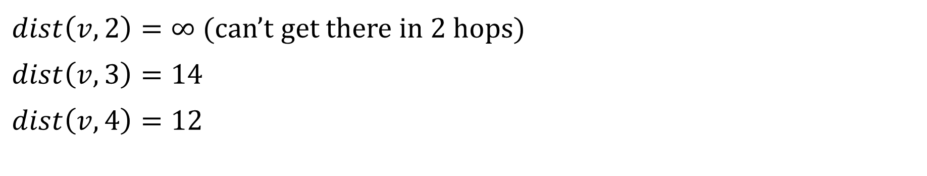
Distances
6
3
5
v
3
2
s
1
8
4
$dist\left(v,2\right)=∞$ (can’t get there in $2$ hops)
$dist\left(v,3\right)=14$
$dist\left(v,4\right)=12$

Slide 34
Ordering
Instead of $dist(v)$, (the true distance) right from the start, we’ll let
$dist(v,i)$ to be the length of the shortest path from the source to $v$ that uses at most $i$ edges.
That breaks ties – counting the number of edges required!
$dist\left(v,i\right)=$

Slide 35
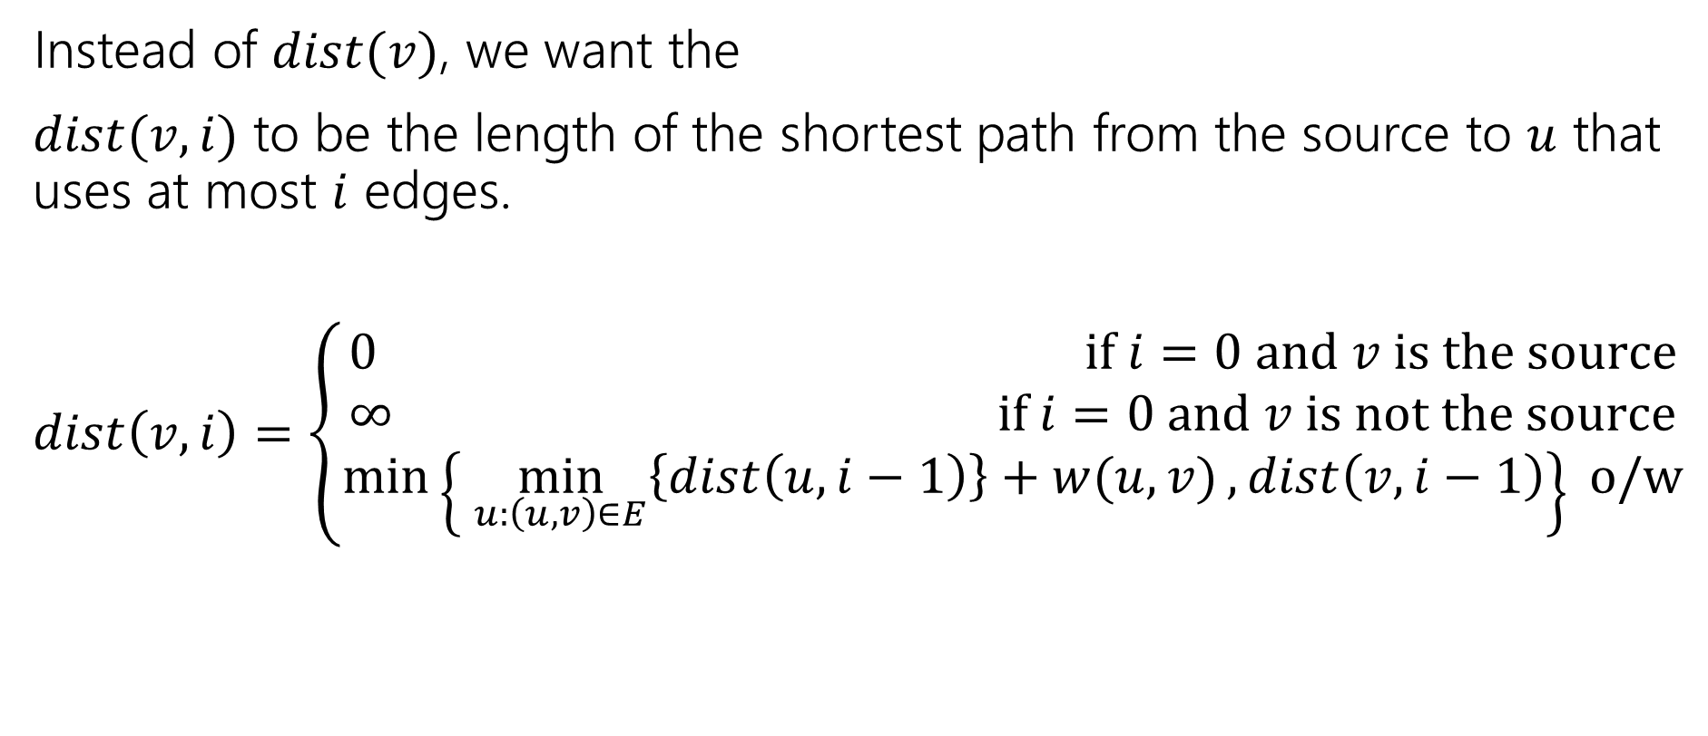
Ordering
Instead of $dist(v)$, we want the
$dist(v,i)$ to be the length of the shortest path from the source to $u$ that uses at most $i$ edges.
$dist\left(v,i\right)=\left\{\begin{aligned}0 if i=0 and v is the source \\ ∞ if i=0 and v is not the source \\ \min\left\{\min_{u:\left(u,v\right)∈E}\left\{dist\left(u,i−1\right)\right\}+w(u,v), dist\left(v,i−1\right)\right\} o/w\end{aligned}\right.$

Slide 36
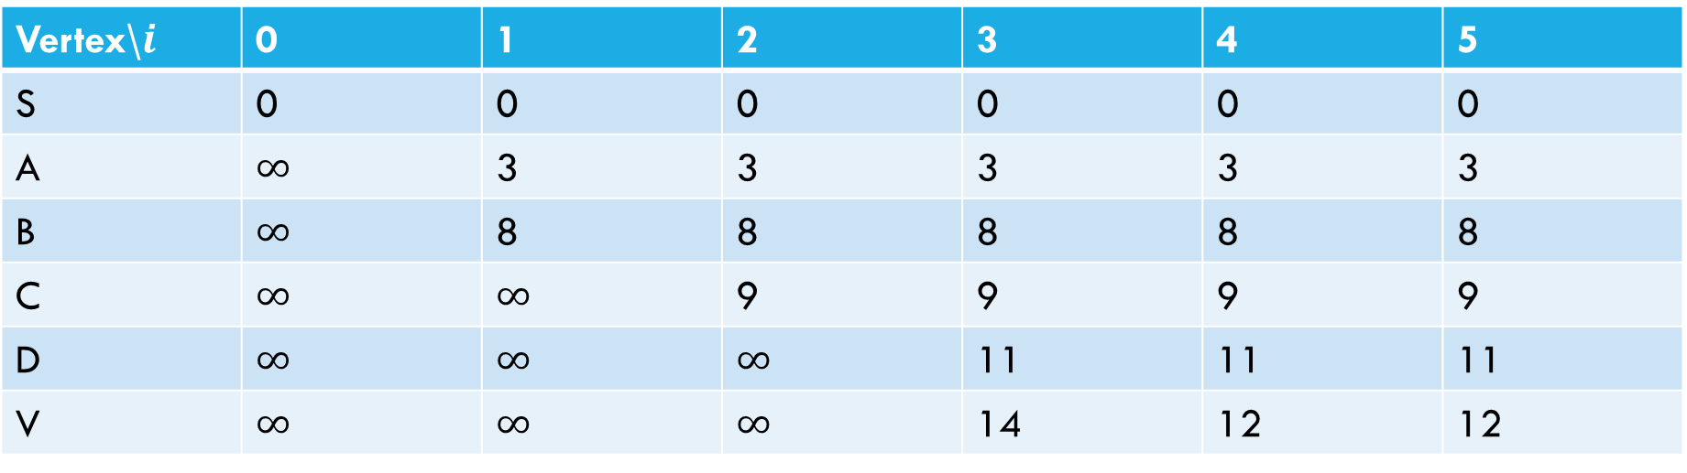
Sample calculation
6
a
5
3
c
v
3
2
s
1
8
b
d
4
Vertex\$i$ | 0 | 1 | 2 | 3 | 4 | 5
S | 0 | 0 | 0 | 0 | 0 | 0
A | $∞$ | 3 | 3 | 3 | 3 | 3
B | $∞$ | 8 | 8 | 8 | 8 | 8
C | $∞$ | $∞$ | 9 | 9 | 9 | 9
D | $∞$ | $∞$ | $∞$ | 11 | 11 | 11
V | $∞$ | $∞$ | $∞$ | 14 | 12 | 12

Slide 37
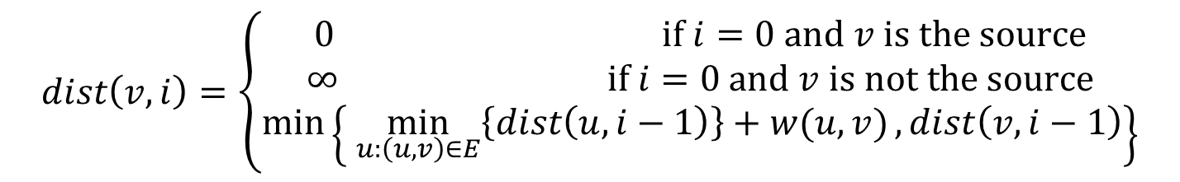
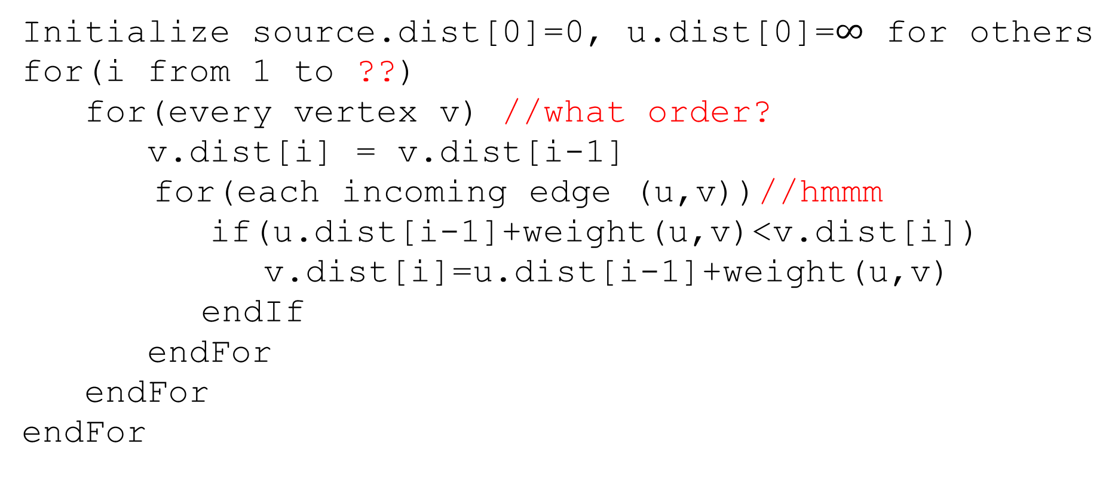
Pseudocode
Initialize source.dist[0]=0, u.dist[0]=$∞$ for others
for(i from 1 to ??)
for(every vertex v) //what order?
v.dist[i] = v.dist[i-1]
for(each incoming edge (u,v))//hmmm
if(u.dist[i-1]+weight(u,v)<v.dist[i])
v.dist[i]=u.dist[i-1]+weight(u,v)
endIf
endFor
endFor
endFor
$$dist\left(v,i\right)=\left\{\begin{aligned}0 if i=0 and v is the source \\ ∞ if i=0 and v is not the source \\ \min\left\{\min_{u:\left(u,v\right)∈E}\left\{dist\left(u,i−1\right)\right\}+w(u,v), dist\left(v,i−1\right)\right\}\end{aligned}\right.$$

Slide 38

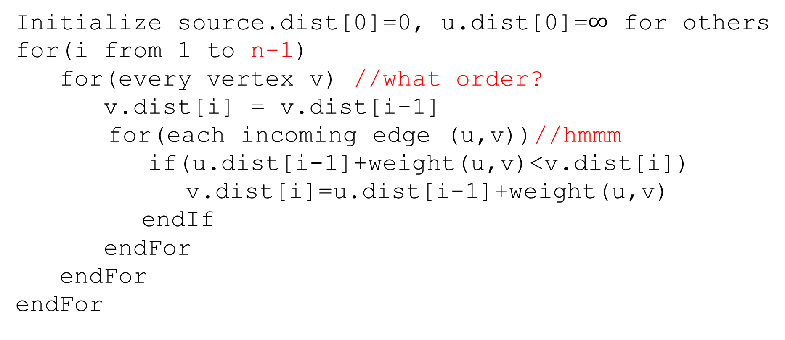
Pseudocode
Initialize source.dist[0]=0, u.dist[0]=$∞$ for others
for(i from 1 to n-1)
for(every vertex v) //what order?
v.dist[i] = v.dist[i-1]
for(each incoming edge (u,v))//hmmm
if(u.dist[i-1]+weight(u,v)<v.dist[i])
v.dist[i]=u.dist[i-1]+weight(u,v)
endIf
endFor
endFor
endFor
The shortest path will never need more than $n−1$ edges
(more than that and you’ve got a cycle)

Slide 39
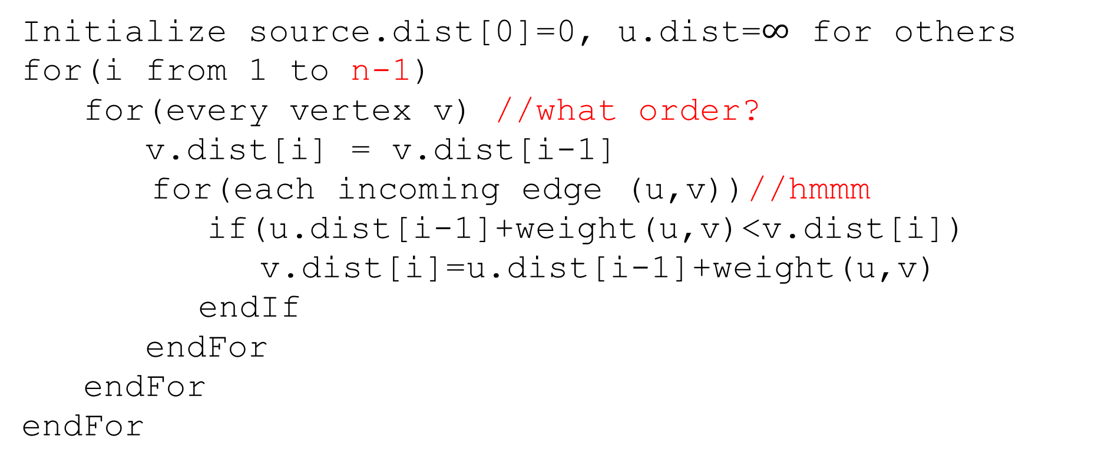
Pseudocode
Only ever need values from the last iteration
Order doesn’t matter!!
Initialize source.dist[0]=0, u.dist=$∞$ for others
for(i from 1 to n-1)
for(every vertex v) //what order?
v.dist[i] = v.dist[i-1]
for(each incoming edge (u,v))//hmmm
if(u.dist[i-1]+weight(u,v)<v.dist[i])
v.dist[i]=u.dist[i-1]+weight(u,v)
endIf
endFor
endFor
endFor

Slide 40
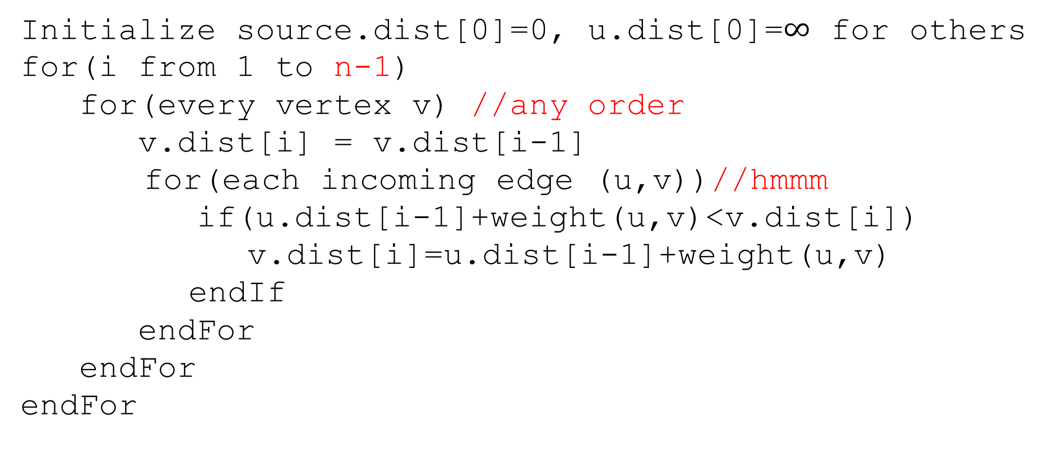
Pseudocode
Initialize source.dist[0]=0, u.dist[0]=$∞$ for others
for(i from 1 to n-1)
for(every vertex v) //any order
v.dist[i] = v.dist[i-1]
for(each incoming edge (u,v))//hmmm
if(u.dist[i-1]+weight(u,v)<v.dist[i])
v.dist[i]=u.dist[i-1]+weight(u,v)
endIf
endFor
endFor
endFor
Graphs don’t usually have easy access to their incoming edges (just the outgoing ones)

Slide 41
Pseudocode
Initialize source.dist[0]=0, u.dist[0]=$∞$ for others
for(i from 1 to n-1)
for(every vertex v) //any order
v.dist[i] = v.dist[i-1]
for(each incoming edge (u,v))//hmmm
if(u.dist[i-1]+weight(u,v)<v.dist[i])
v.dist[i]=u.dist[i-1]+weight(u,v)
endIf
endFor
endFor
endFor
But the order doesn’t matter – as long as we check every edge, the processing order is irrelevant.
So if we only have access to outgoing edges…

Slide 42
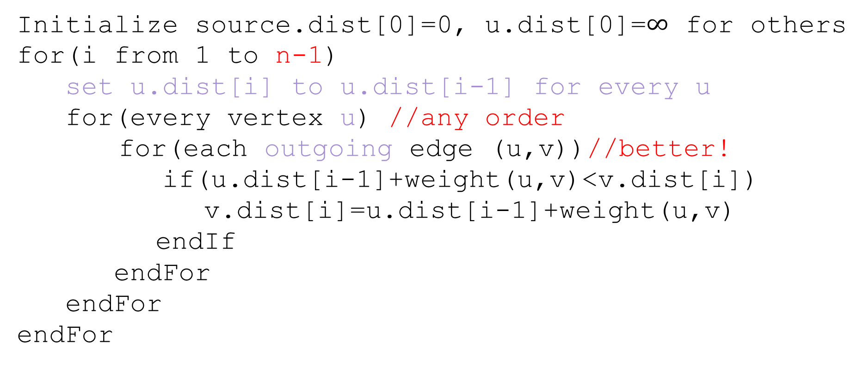
Pseudocode
Initialize source.dist[0]=0, u.dist[0]=$∞$ for others
for(i from 1 to n-1)
set u.dist[i] to u.dist[i-1] for every u
for(every vertex u) //any order
for(each outgoing edge (u,v))//better!
if(u.dist[i-1]+weight(u,v)<v.dist[i])
v.dist[i]=u.dist[i-1]+weight(u,v)
endIf
endFor
endFor
endFor

Slide 43
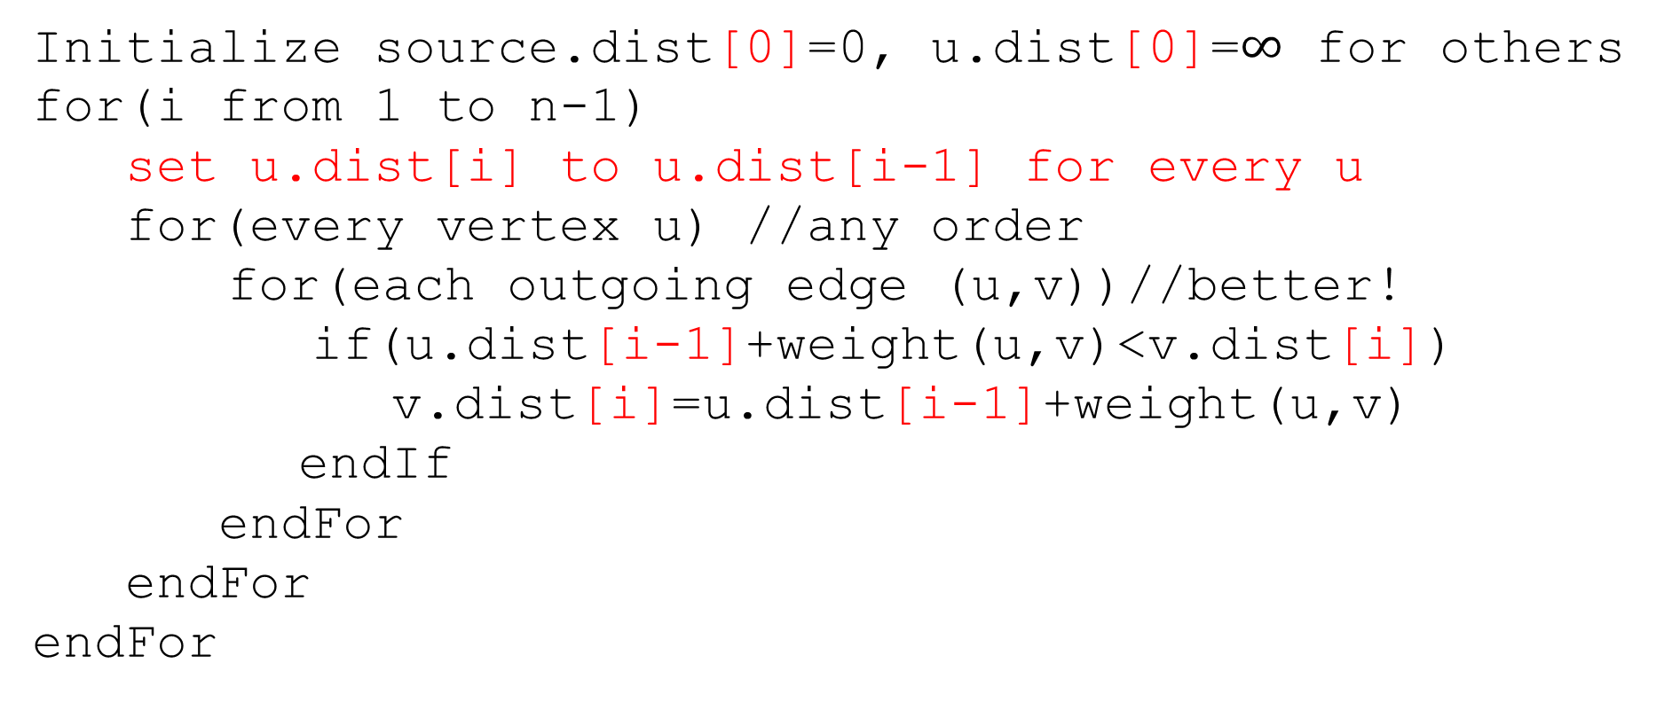
Pseudocode
Initialize source.dist[0]=0, u.dist[0]=$∞$ for others
for(i from 1 to n-1)
set u.dist[i] to u.dist[i-1] for every u
for(every vertex u) //any order
for(each outgoing edge (u,v))//better!
if(u.dist[i-1]+weight(u,v)<v.dist[i])
v.dist[i]=u.dist[i-1]+weight(u,v)
endIf
endFor
endFor
endFor
We don’t really need all the different values…
Just the most recent value.

Slide 44
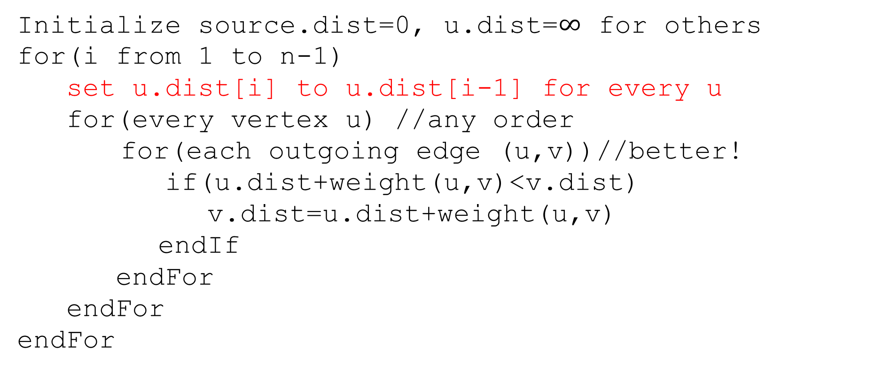
Pseudocode
Initialize source.dist=0, u.dist=$∞$ for others
for(i from 1 to n-1)
set u.dist[i] to u.dist[i-1] for every u
for(every vertex u) //any order
for(each outgoing edge (u,v))//better!
if(u.dist+weight(u,v)<v.dist)
v.dist=u.dist+weight(u,v)
endIf
endFor
endFor
endFor
We don’t really need all the different values…
Just the most recent value.

Slide 45
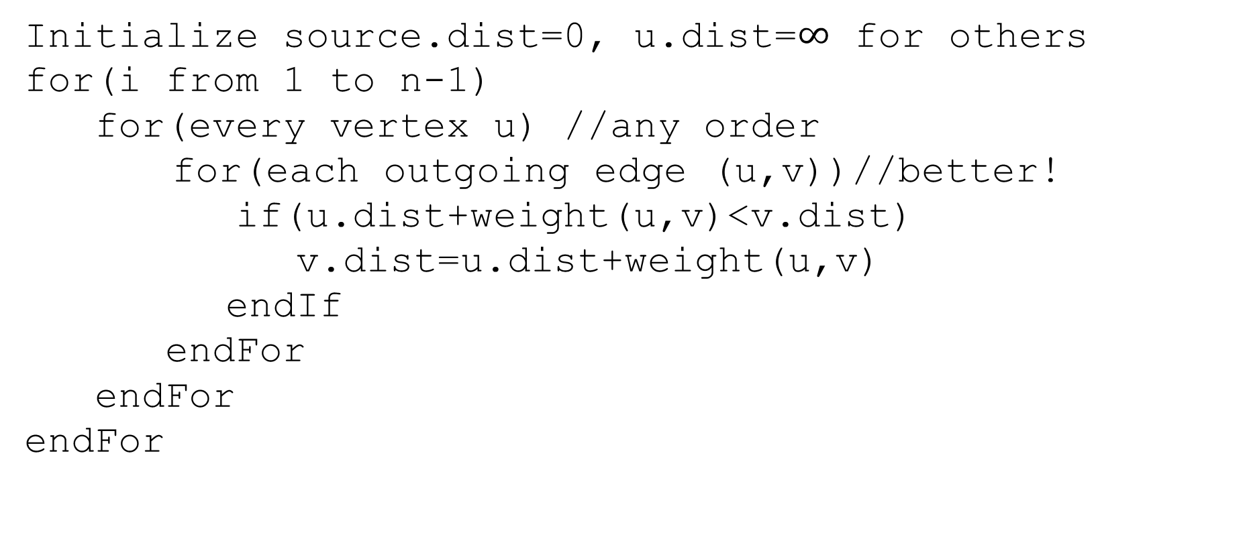
Pseudocode
Initialize source.dist=0, u.dist=$∞$ for others
for(i from 1 to n-1)
for(every vertex u) //any order
for(each outgoing edge (u,v))//better!
if(u.dist+weight(u,v)<v.dist)
v.dist=u.dist+weight(u,v)
endIf
endFor
endFor
endFor
We don’t really need all the different values…
Just the most recent value.

Slide 46
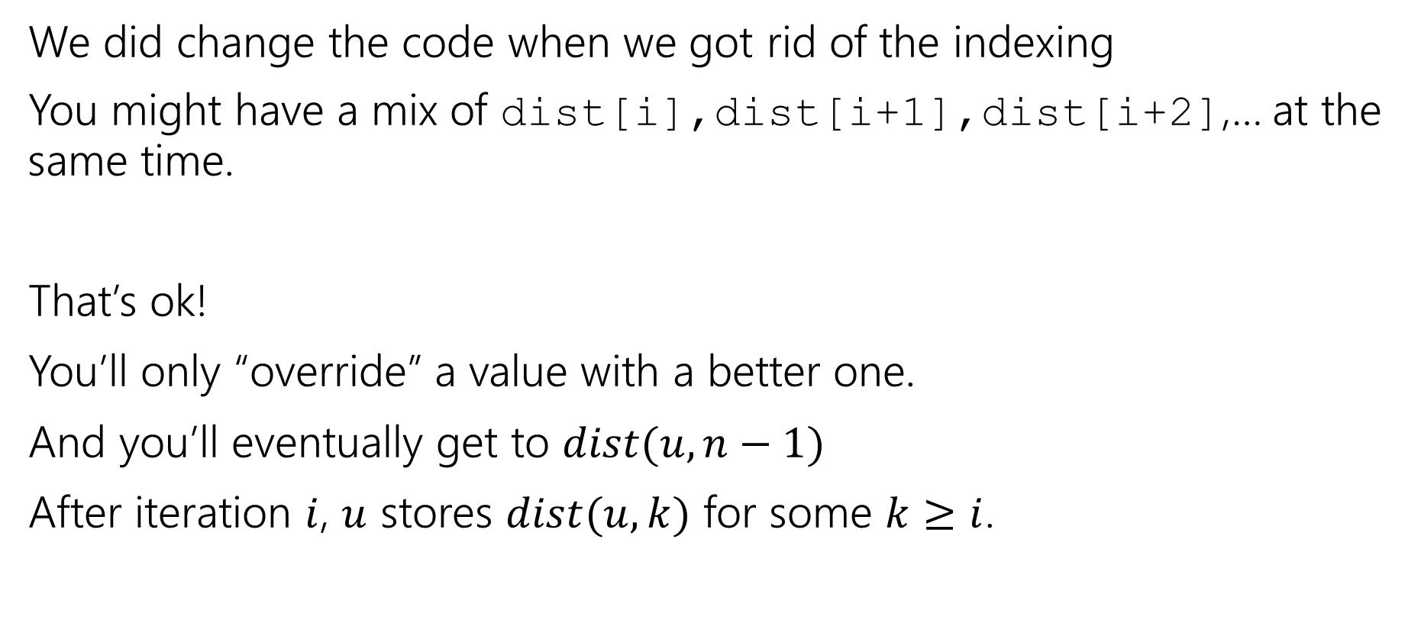
A Caution
We did change the code when we got rid of the indexing
You might have a mix of dist[i],dist[i+1],dist[i+2],… at the same time.
That’s ok!
You’ll only “override” a value with a better one.
And you’ll eventually get to $dist(u,n−1)$
After iteration $i$, $u$ stores $dist(u,k)$ for some $k≥i$.

Slide 47
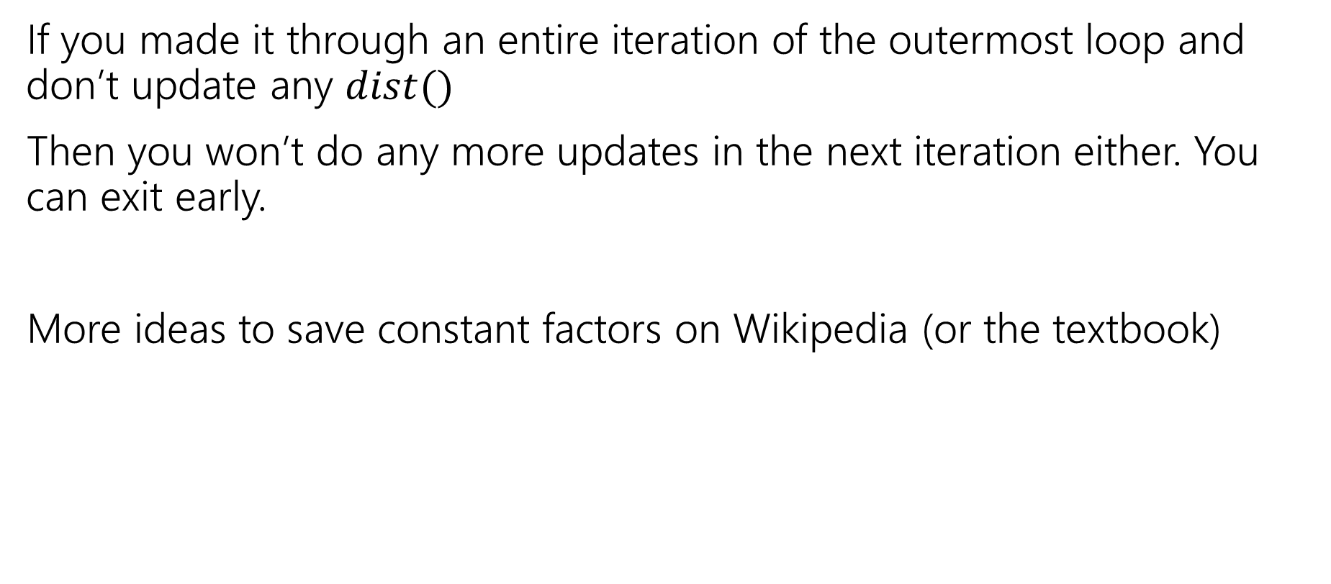
Exit early
If you made it through an entire iteration of the outermost loop and don’t update any $dist()$
Then you won’t do any more updates in the next iteration either. You can exit early.
More ideas to save constant factors on Wikipedia (or the textbook)
Notes:
Observe that if v’s distance doesn’t change then we don’t need to check (v,w) for any w. Some other clever ideas on Wikipedia.

Slide 48
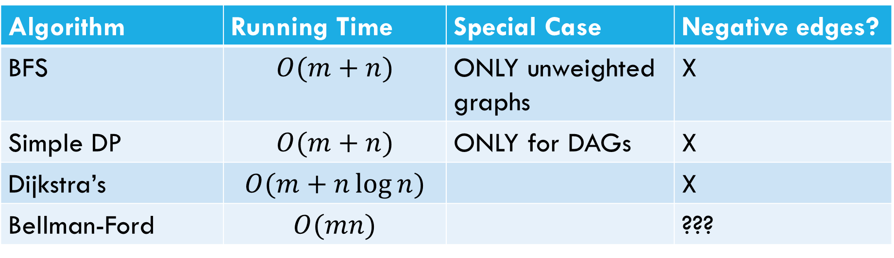
Laundry List of shortest pairs (so far)
Algorithm | Running Time | Special Case | Negative edges?
BFS | $$O(m+n)$$ | ONLY unweighted graphs | X
Simple DP | $$O(m+n)$$ | ONLY for DAGs | X
Dijkstra’s | $$O(m+n\log{n)}$$ |  | X
Bellman-Ford | $$O(mn)$$ |  | ???

Slide 49
Pseudocode
Initialize source.dist=0, u.dist=$∞$ for others
for(i from 1 to n-1)
for(every vertex u) //any order
for(each outgoing edge (u,v))//better!
if(u.dist+weight(u,v)<v.dist)
v.dist=u.dist+weight(u,v)
endIf
endFor
endFor
endFor
What happens if there’s a negative cycle?

Slide 50
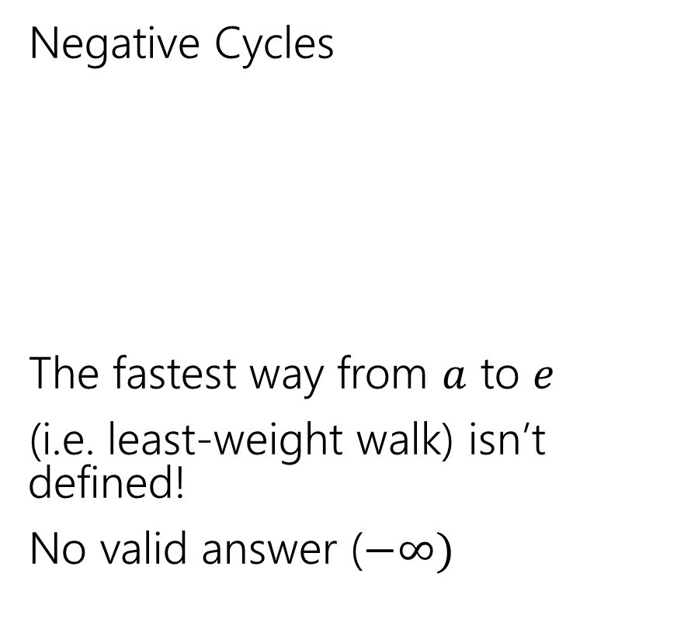
Negative Edges
Negative Cycles
The fastest way from $a$ to $e$
(i.e. least-weight walk) isn’t defined!
No valid answer ($−∞)$
Negative edges, but only non-negative cycles
Dijkstra’s might fail
But the shortest path IS defined.
There is an answer
a
6
5
c
e
a
6
5
c
e
3
2
3
2
1
b
d
1
-8
b
d
-3

Slide 51
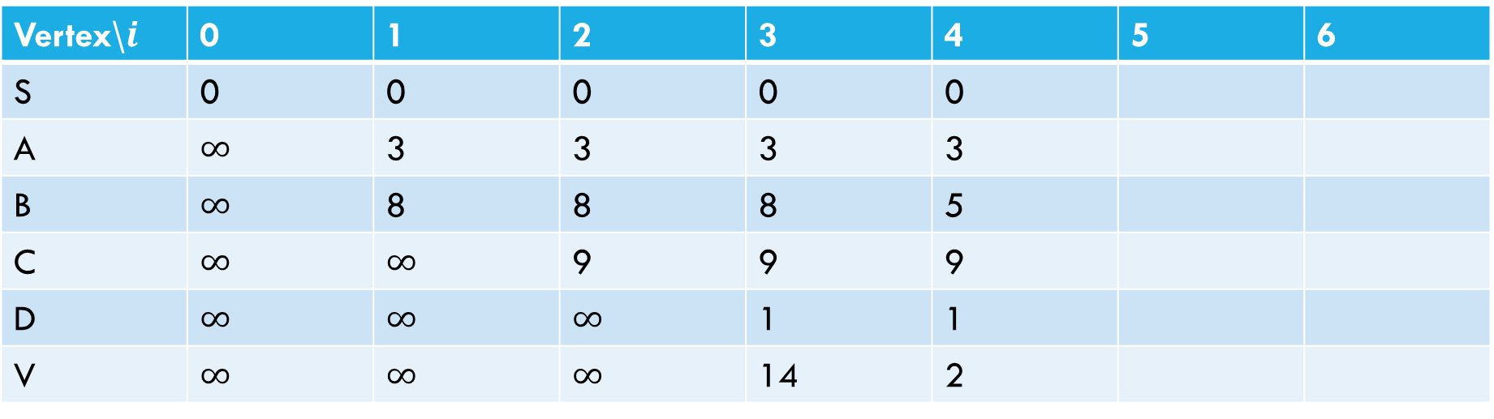
Negative Cycle
Pollev.com/Robbie
6
a
5
3
c
v
3
-8
s
1
8
b
d
4
Vertex\$i$ | 0 | 1 | 2 | 3 | 4 | 5 | 6
S | 0 | 0 | 0 | 0 | 0
A | $∞$ | 3 | 3 | 3 | 3
B | $∞$ | 8 | 8 | 8 | 5
C | $∞$ | $∞$ | 9 | 9 | 9
D | $∞$ | $∞$ | $∞$ | 1 | 1
V | $∞$ | $∞$ | $∞$ | 14 | 2

Slide 52
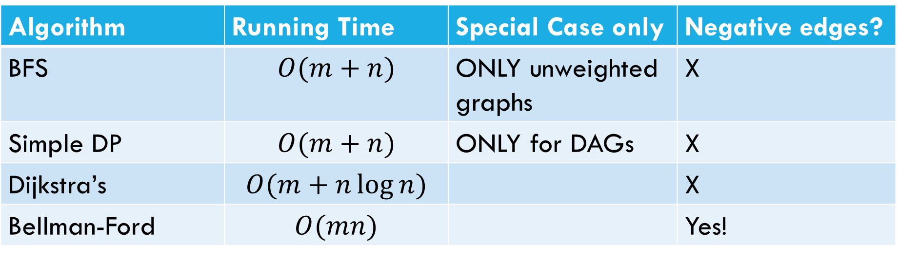
Laundry List of shortest pairs (so far)
Algorithm | Running Time | Special Case only | Negative edges?
BFS | $$O(m+n)$$ | ONLY unweighted graphs | X
Simple DP | $$O(m+n)$$ | ONLY for DAGs | X
Dijkstra’s | $$O(m+n\log{n)}$$ |  | X
Bellman-Ford | $$O(mn)$$ |  | Yes!

Slide 53
All Pairs Shortest Paths

Slide 54
All Pairs
For Dijkstra’s or Bellman-Ford we got the distances from the source to every vertex.
What if we want the distances from every vertex to every other vertex?

Slide 55
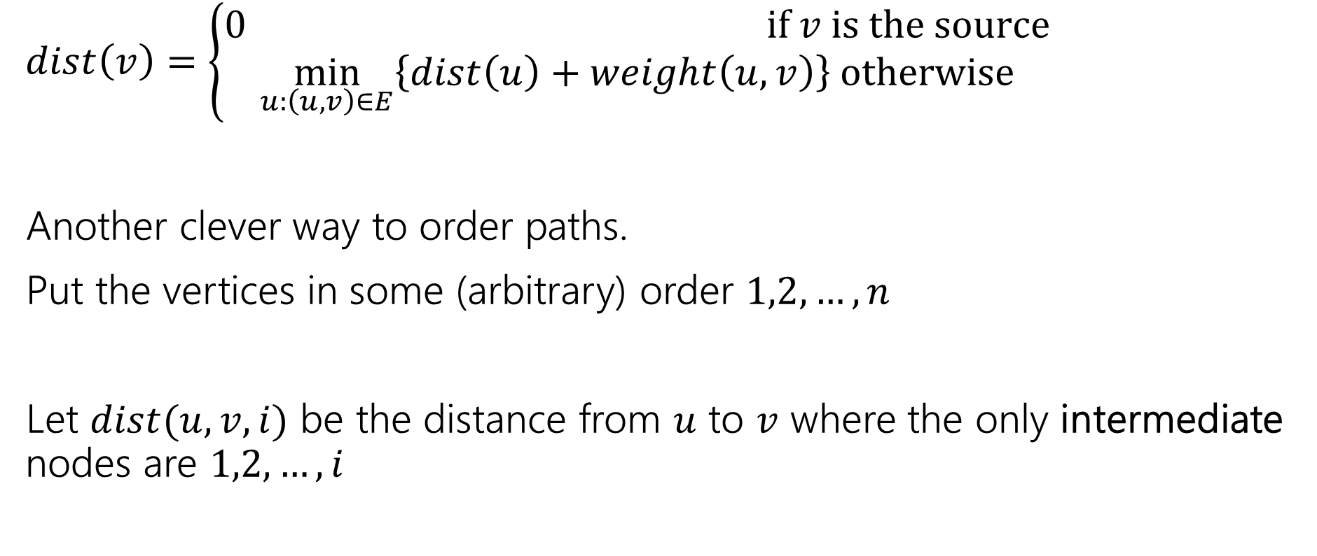
Another Recurrence
$dist\left(v\right)=\left\{\begin{aligned}0 if v is the source \\ \min_{u:\left(u,v\right)∈E}\left\{dist\left(u\right)+weight\left(u,v\right)\right\} otherwise\end{aligned}\right.$
Another clever way to order paths.
Put the vertices in some (arbitrary) order $1,2,…,n$
Let $dist(u,v,i)$ be the distance from $u$ to $v$ where the only intermediate nodes are $1,2,…,i$

Slide 56
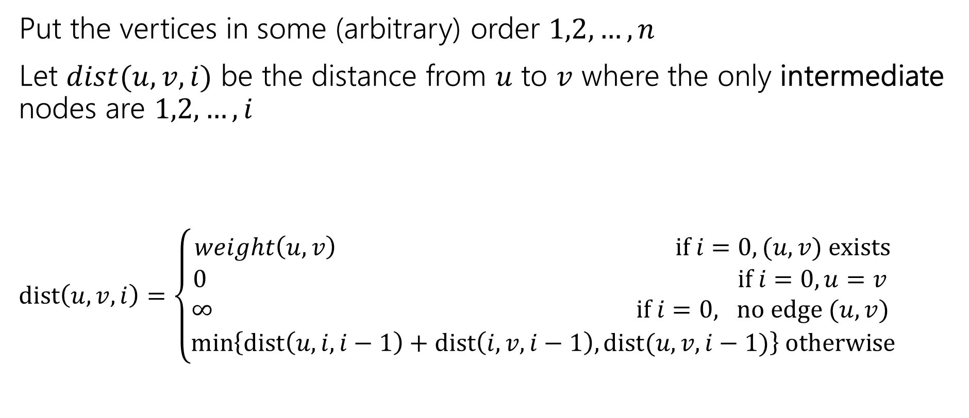
Another Recurrence
Put the vertices in some (arbitrary) order $1,2,…,n$
Let $dist(u,v,i)$ be the distance from $u$ to $v$ where the only intermediate nodes are $1,2,…,i$
$dist\left(u,v,i\right)=\left\{\begin{aligned}weight\left(u,v\right) if i=0, (u,v) exists \\ 0 if i=0, u=v \\ ∞ if i=0, no edge (u,v) \\ \min\left\{dist\left(u,i,i−1\right)+dist\left(i,v,i−1\right), dist(u,v,i−1)\right\} otherwise\end{aligned}\right.$

Slide 57

Pseudocode
dist[][] = new int[n-1][n-1]
for(int i=0; i<n; i++)
for(int j=0; j<n; j++)
dist[i][j] = edge(i,j) ? weight(i,j) : $∞$
for(int i=0; i<n; i++)
dist[i][i] = 0
for every vertex $r$
for every vertex $u$
for every vertex $v$
if(dist[u][r] + dist[r][v] < dist[u][v])
  dist[u][v]=dist[u][r] + dist[r][v]
“standard” form of the “Floyd-Warshall” algorithm. Similar to Bellman-Ford, you can get rid of the last entry of the recurrence (only need 2D array, not 3D array).

Slide 58

Running Time
$O\left(n^{3}\right)$
How does that compare to Dijkstra’s?

Slide 59
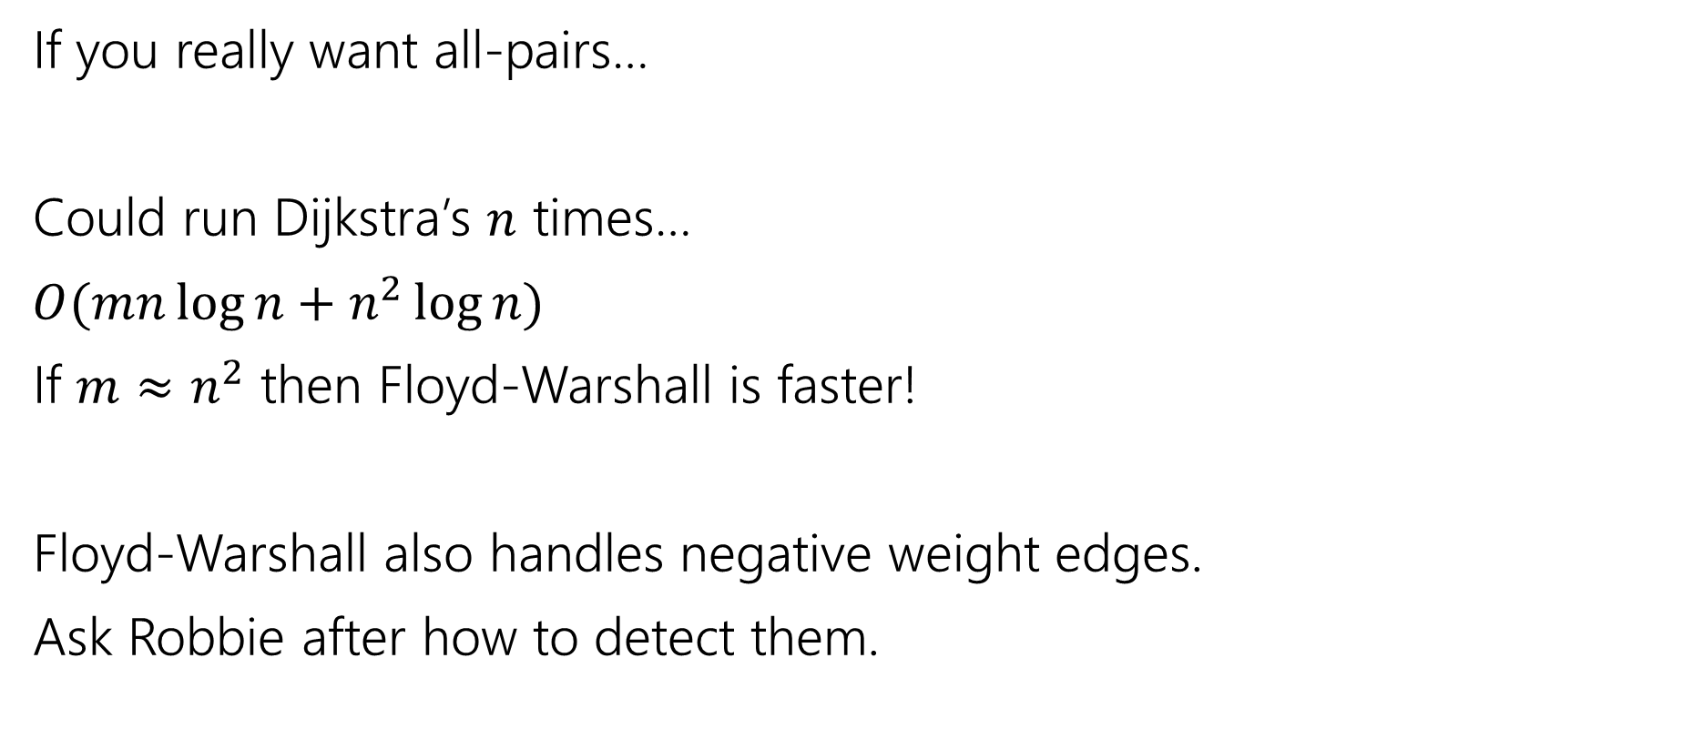
Running Time
If you really want all-pairs…
Could run Dijkstra’s $n$ times…
$O(mn\log{n}+n^{2}\log{n})$
If $m≈n^{2}$ then Floyd-Warshall is faster!
Floyd-Warshall also handles negative weight edges.
Ask Robbie after how to detect them.

Slide 60
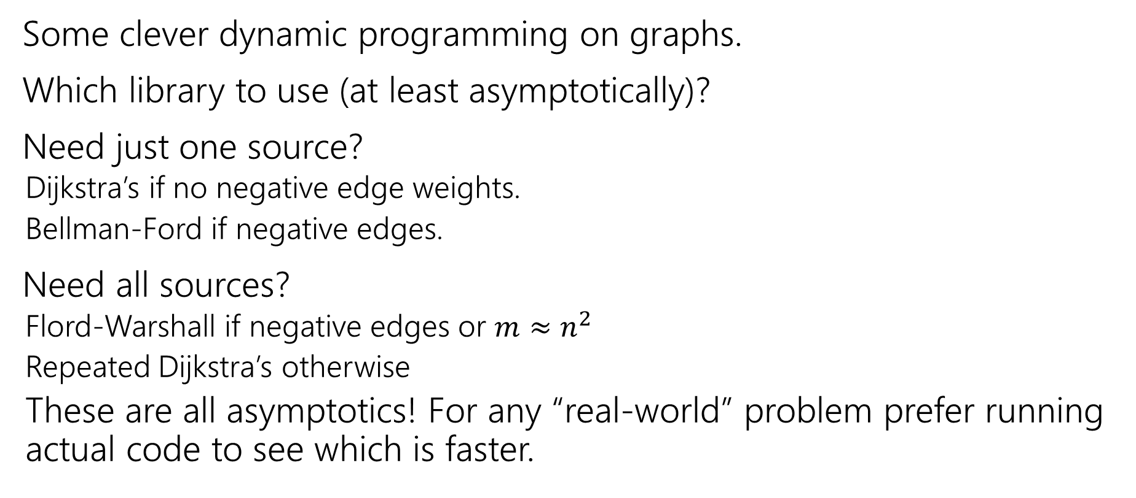
Takeaways
Some clever dynamic programming on graphs.
Which library to use (at least asymptotically)?
Need just one source?
  Dijkstra’s if no negative edge weights.
  Bellman-Ford if negative edges.
Need all sources?
  Flord-Warshall if negative edges or $m≈n^{2}$
  Repeated Dijkstra’s otherwise
  These are all asymptotics! For any “real-world” problem prefer running actual code to see which is faster.

