Slide 1
DP Practice!
CSE 417 24Wi
Lecture 14

Slide 2
What have we seen so far?
Key to dynamic programming is think recursively first, then memoize results you would recompute otherwise.
Strategies for recursive thinking:
1. State the problem you’re solving in English before going further. Write it down. Seriously. “OPT(i,j) is the sum of the maximum contiguous subarray between indicies i and j.”
2. When thinking recursively you might:
Realize you need multiple recurrences (I need to solve a slightly different problem)
Need to add an extra parameter to the recurrence
Think top-down or bottom-up

Slide 3
Longest Increasing Subsequence

Slide 4
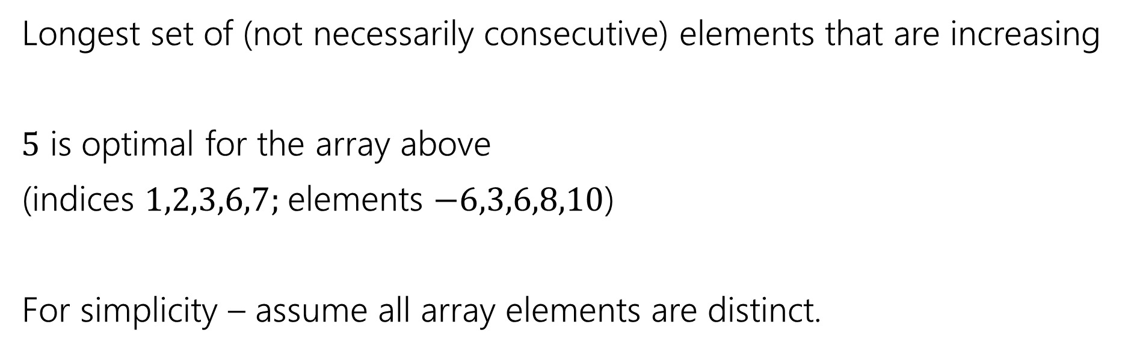
Longest Increasing Subsequence
0 | 1 | 2 | 3 | 4 | 5 | 6 | 7
5 | -6 | 3 | 6 | -5 | 2 | 8 | 10
Longest set of (not necessarily consecutive) elements that are increasing
$5$ is optimal for the array above
(indices $1,2,3,6,7;$elements $−6,3,6,8,10$)
For simplicity – assume all array elements are distinct.

Slide 5
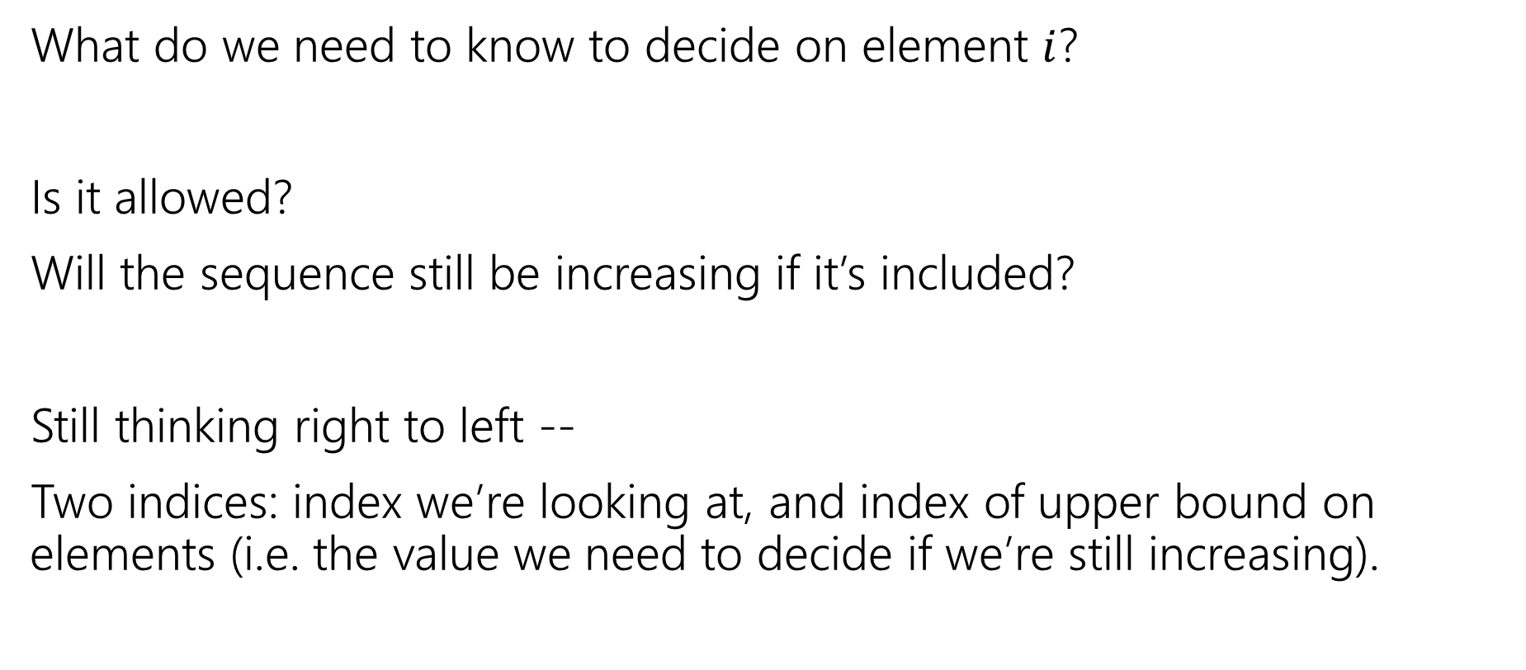
Longest Increasing Subsequence
What do we need to know to decide on element $i$?
Is it allowed?
Will the sequence still be increasing if it’s included?
Still thinking right to left --
Two indices: index we’re looking at, and index of upper bound on elements (i.e. the value we need to decide if we’re still increasing).

Slide 6

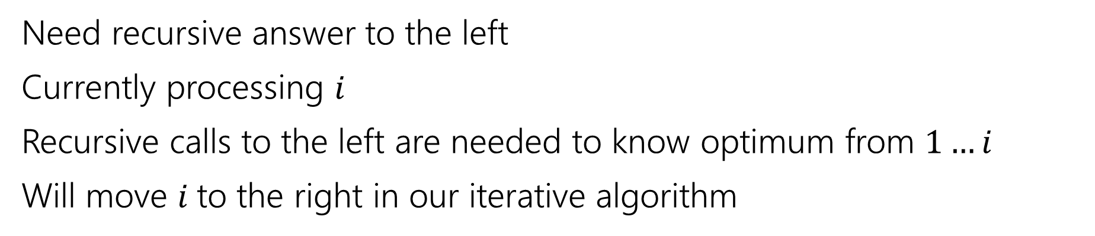
Recurrence
0 | 1 | 2 | 3 | 4 | 5 | 6 | 7
5 | -6 | 3 | 6 | -5 | 2 | 8 | 10
Recursive call is best value in this area
Current $i$
Will return to address these
Need recursive answer to the left
Currently processing $i$
Recursive calls to the left are needed to know optimum from $1…i$
Will move $i$to the right in our iterative algorithm

Slide 7
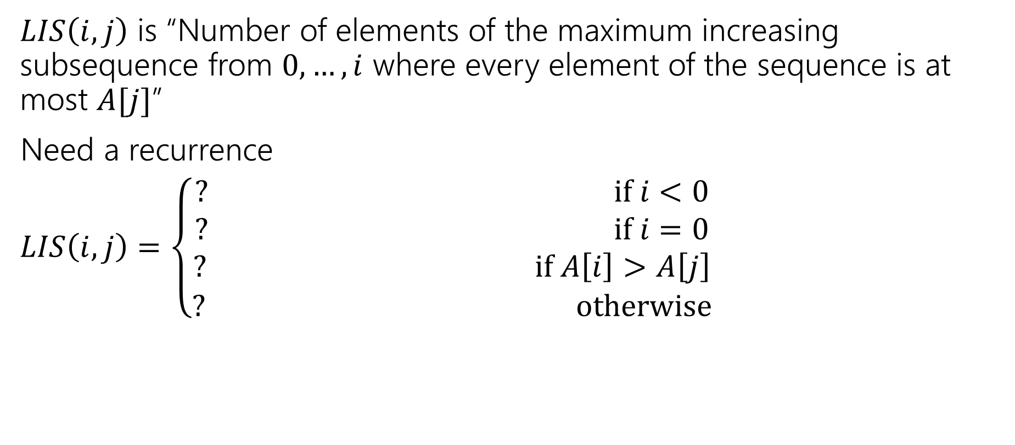
Longest Increasing Subsequence
$LIS\left(i,j\right)$ is “Number of elements of the maximum increasing subsequence from $0,…,i$ where every element of the sequence is at most $A[j]$”
Need a recurrence
$LIS\left(i,j\right)=\left\{\begin{aligned}? if i<0 \\ ? if i=0 \\ ? if A\left[i\right]>A\left[j\right] \\ ? otherwise\end{aligned}\right.$

Slide 8
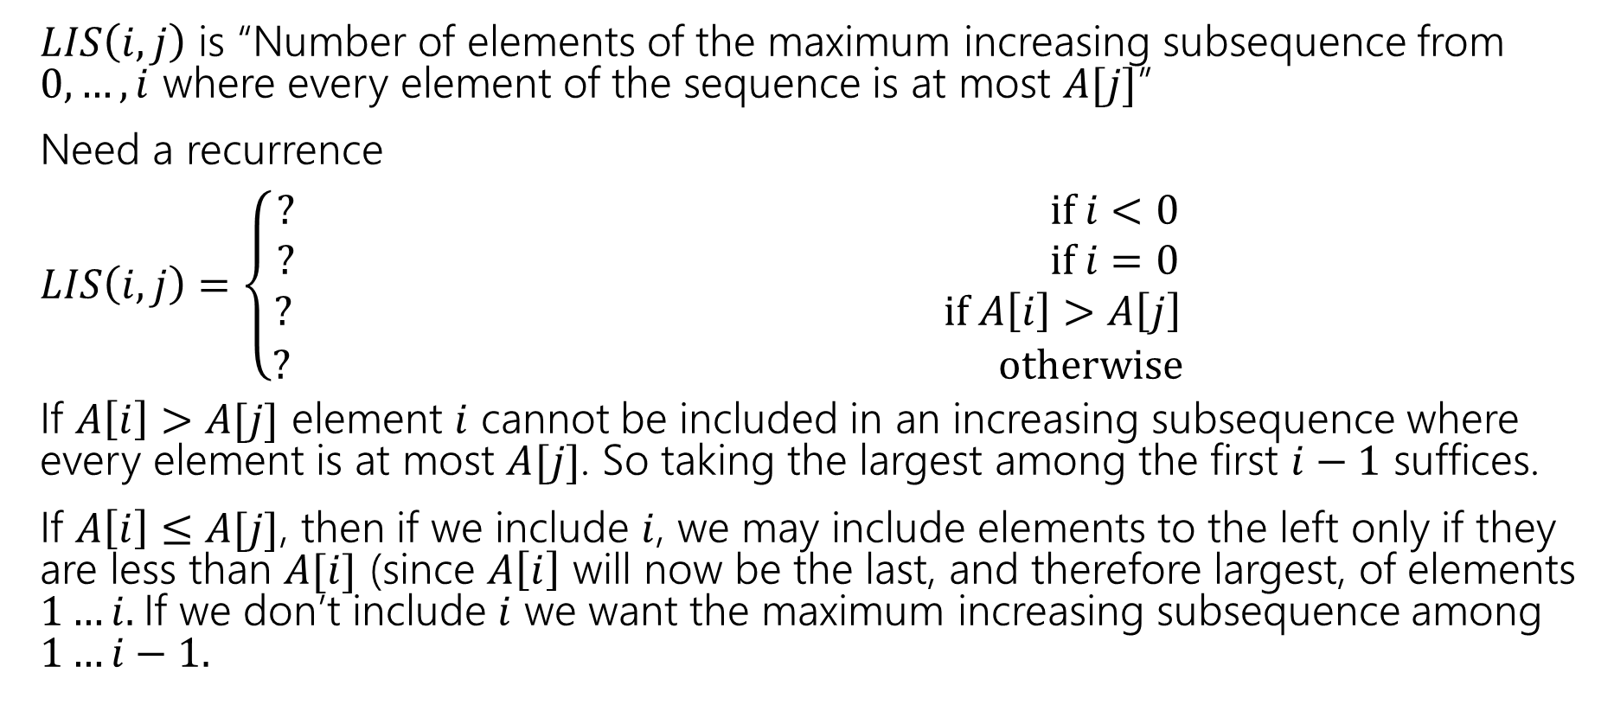
Longest Increasing Subsequence
$LIS\left(i,j\right)$ is “Number of elements of the maximum increasing subsequence from $0,…,i$ where every element of the sequence is at most $A[j]$”
Need a recurrence
$LIS\left(i,j\right)=\left\{\begin{aligned}? if i<0 \\ ? if i=0 \\ ? if A\left[i\right]>A\left[j\right] \\ ? otherwise\end{aligned}\right.$
If $A\left[i\right]>A[j]$ element $i$ cannot be included in an increasing subsequence where every element is at most $A[j]$. So taking the largest among the first $i−1$ suffices.
If $A\left[i\right]≤A[j]$, then if we include $i$, we may include elements to the left only if they are less than $A[i]$ (since $A\left[i\right]$ will now be the last, and therefore largest, of elements $1…i.$If we don’t include $i$ we want the maximum increasing subsequence among $1…i−1.$

Slide 9
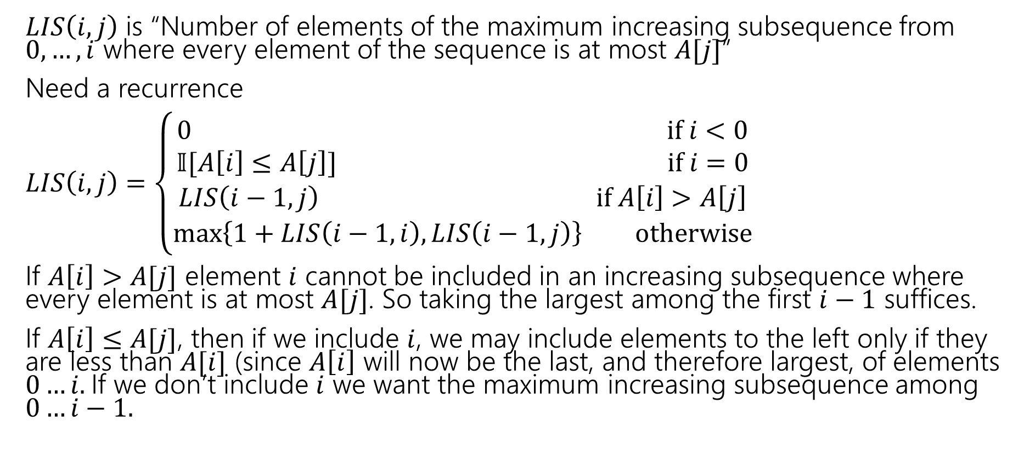
Longest Increasing Subsequence
$LIS\left(i,j\right)$ is “Number of elements of the maximum increasing subsequence from $0,…,i$ where every element of the sequence is at most $A[j]$”
Need a recurrence
$LIS\left(i,j\right)=\left\{\begin{aligned}0 if i<0 \\ 𝕀[A\left[i\right]≤A\left[j\right]] if i=0 \\ LIS\left(i−1,j\right) if A\left[i\right]>A\left[j\right] \\ \max\left\{1+LIS\left(i−1,i\right), LIS\left(i−1,j\right)\right\} otherwise\end{aligned}\right.$
If $A\left[i\right]>A[j]$ element $i$ cannot be included in an increasing subsequence where every element is at most $A[j]$. So taking the largest among the first $i−1$ suffices.
If $A\left[i\right]≤A[j]$, then if we include $i$, we may include elements to the left only if they are less than $A[i]$ (since $A\left[i\right]$ will now be the last, and therefore largest, of elements $0…i.$If we don’t include $i$ we want the maximum increasing subsequence among $0…i−1.$

Slide 10
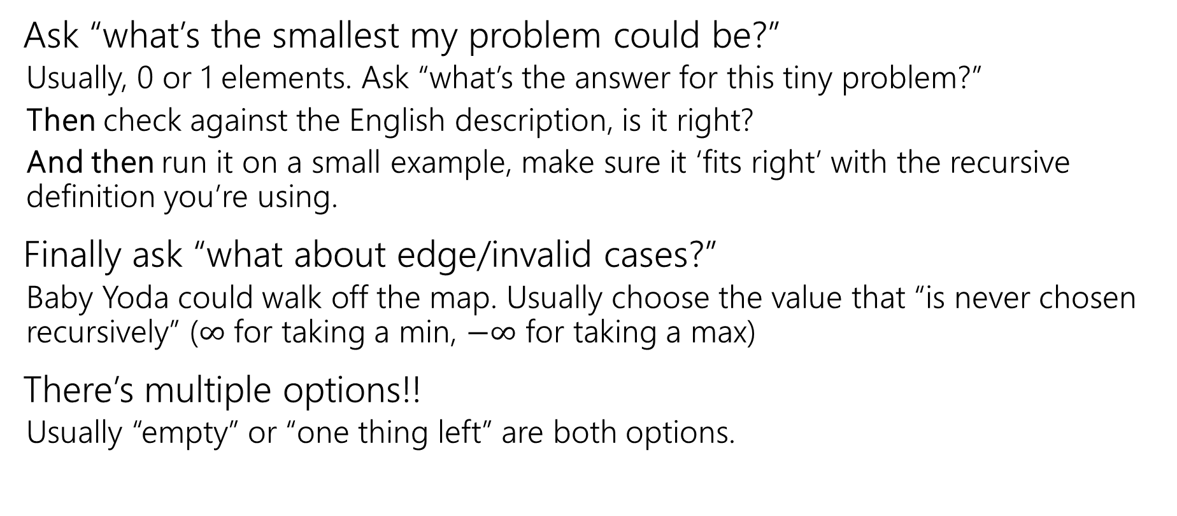
How do you choose your base cases?
Ask “what’s the smallest my problem could be?”
Usually, 0 or 1 elements. Ask “what’s the answer for this tiny problem?”
Then check against the English description, is it right?
And then run it on a small example, make sure it ‘fits right’ with the recursive definition you’re using.
Finally ask “what about edge/invalid cases?”
Baby Yoda could walk off the map. Usually choose the value that “is never chosen recursively” ($∞$ for taking a min, $−∞$ for taking a max)
There’s multiple options!!
Usually “empty” or “one thing left” are both options.

Slide 11
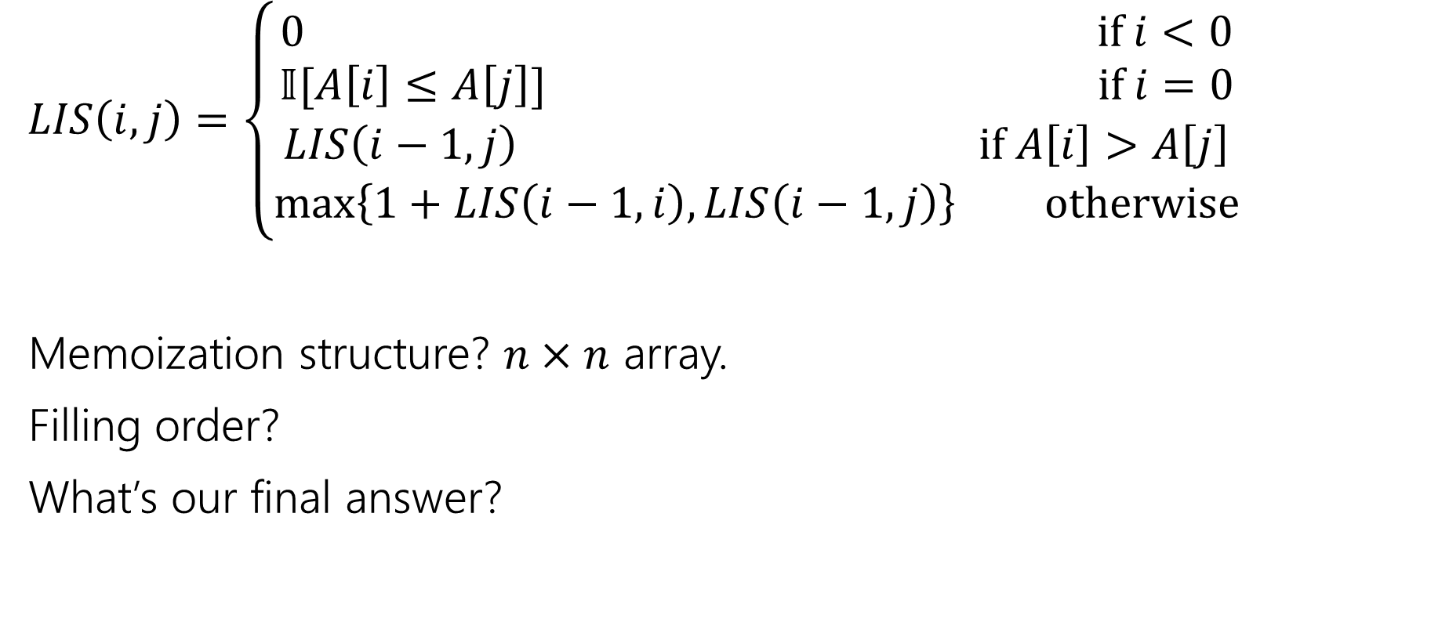
Longest Increasing Subsequence
$LIS\left(i,j\right)=\left\{\begin{aligned}0 if i<0 \\ 𝕀[A\left[i\right]≤A\left[j\right]] if i=0 \\ LIS\left(i−1,j\right) if A\left[i\right]>A\left[j\right] \\ \max\left\{1+LIS\left(i−1,i\right), LIS\left(i−1,j\right)\right\} otherwise\end{aligned}\right.$
Memoization structure? $n×n$ array.
Filling order?
What’s our final answer?

Slide 12


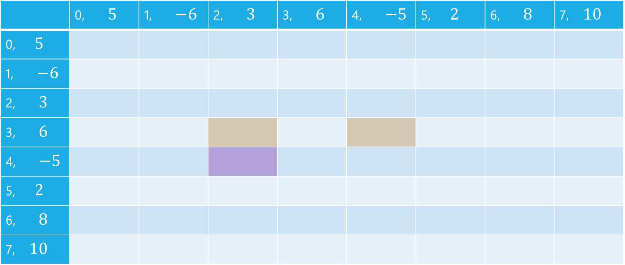


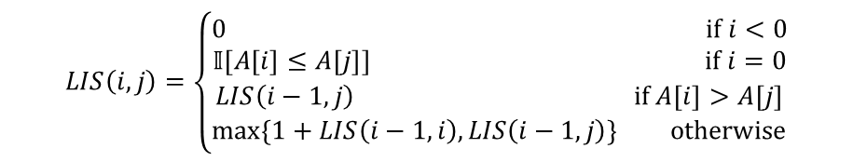
LIS
$$LIS\left(i,j\right)=\left\{\begin{aligned}0 if i<0 \\ 𝕀[A\left[i\right]≤A\left[j\right]] if i=0 \\ LIS\left(i−1,j\right) if A\left[i\right]>A\left[j\right] \\ \max\left\{1+LIS\left(i−1,i\right), LIS\left(i−1,j\right)\right\} otherwise\end{aligned}\right.$$
$$j$$
 | 0, $5$ | 1, $−6$ | 2, $3$ | 3, $6$ | 4, $−5$ | 5, $2$ | 6, $8$ | 7, $10$
0, $5$
1, $−6$
2, $3$
3, $6$
4, $−5$
5, $2$
6, $8$
7, $10$
$$i$$

Slide 13
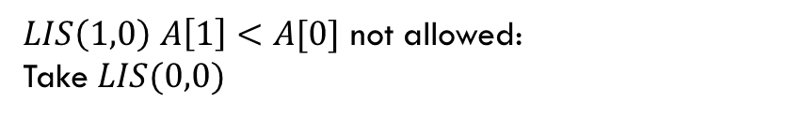
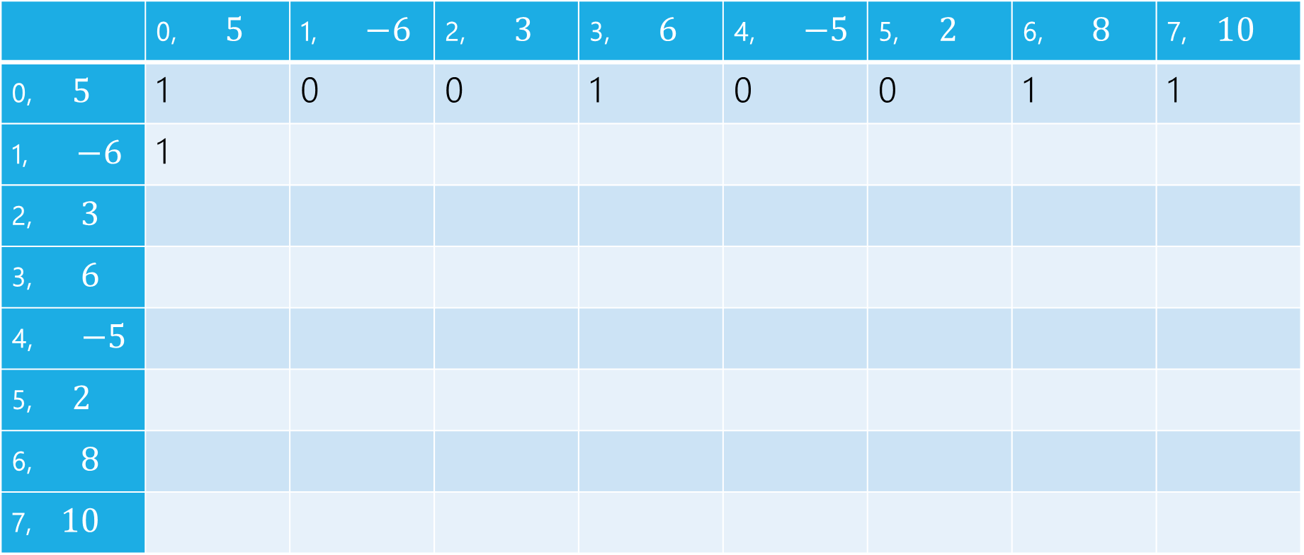
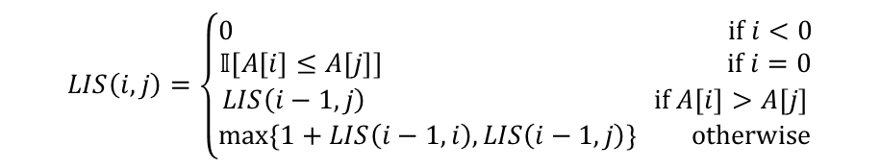
LIS
$LIS\left(1,0\right)$ $A\left[1\right]<A[0]$ not allowed:
Take $LIS(0,0)$
$$LIS\left(i,j\right)=\left\{\begin{aligned}0 if i<0 \\ 𝕀[A\left[i\right]≤A\left[j\right]] if i=0 \\ LIS\left(i−1,j\right) if A\left[i\right]>A\left[j\right] \\ \max\left\{1+LIS\left(i−1,i\right), LIS\left(i−1,j\right)\right\} otherwise\end{aligned}\right.$$
$$j$$
 | 0, $5$ | 1, $−6$ | 2, $3$ | 3, $6$ | 4, $−5$ | 5, $2$ | 6, $8$ | 7, $10$
0, $5$ | 1 | 0 | 0 | 1 | 0 | 0 | 1 | 1
1, $−6$ | 1
2, $3$
3, $6$
4, $−5$
5, $2$
6, $8$
7, $10$
$$i$$

Slide 14

LIS
$LIS\left(1,1\right)$ $A\left[1\right]≤A[1]$ can add, $1+LIS(0,1)$ or $LIS(0,1)$
$$LIS\left(i,j\right)=\left\{\begin{aligned}0 if i<0 \\ 𝕀[A\left[i\right]≤A\left[j\right]] if i=0 \\ LIS\left(i−1,j\right) if A\left[i\right]>A\left[j\right] \\ \max\left\{1+LIS\left(i−1,i\right), LIS\left(i−1,j\right)\right\} otherwise\end{aligned}\right.$$
$$j$$
 | 0, $5$ | 1, $−6$ | 2, $3$ | 3, $6$ | 4, $−5$ | 5, $2$ | 6, $8$ | 7, $10$
0, $5$ | 1 | 0 | 0 | 1 | 0 | 0 | 1 | 1
1, $−6$ | 1 | 1
2, $3$
3, $6$
4, $−5$
5, $2$
6, $8$
7, $10$
$$i$$

Slide 15

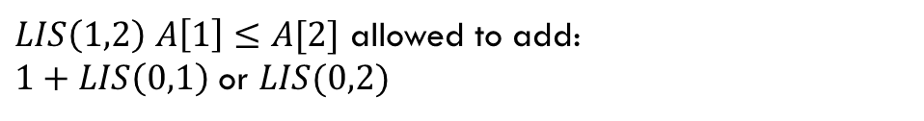
LIS
$LIS\left(1,2\right)$ $A\left[1\right]≤A[2]$ allowed to add:
$1+LIS\left(0,1\right)$ or $LIS(0,2)$
$$LIS\left(i,j\right)=\left\{\begin{aligned}0 if i<0 \\ 𝕀[A\left[i\right]≤A\left[j\right]] if i=0 \\ LIS\left(i−1,j\right) if A\left[i\right]>A\left[j\right] \\ \max\left\{1+LIS\left(i−1,i\right), LIS\left(i−1,j\right)\right\} otherwise\end{aligned}\right.$$
$$j$$
 | 0, $5$ | 1, $−6$ | 2, $3$ | 3, $6$ | 4, $−5$ | 5, $2$ | 6, $8$ | 7, $10$
0, $5$ | 1 | 0 | 0 | 1 | 0 | 0 | 1 | 1
1, $−6$ | 1 | 1 | 1
2, $3$
3, $6$
4, $−5$
5, $2$
6, $8$
7, $10$
$$i$$

Slide 16
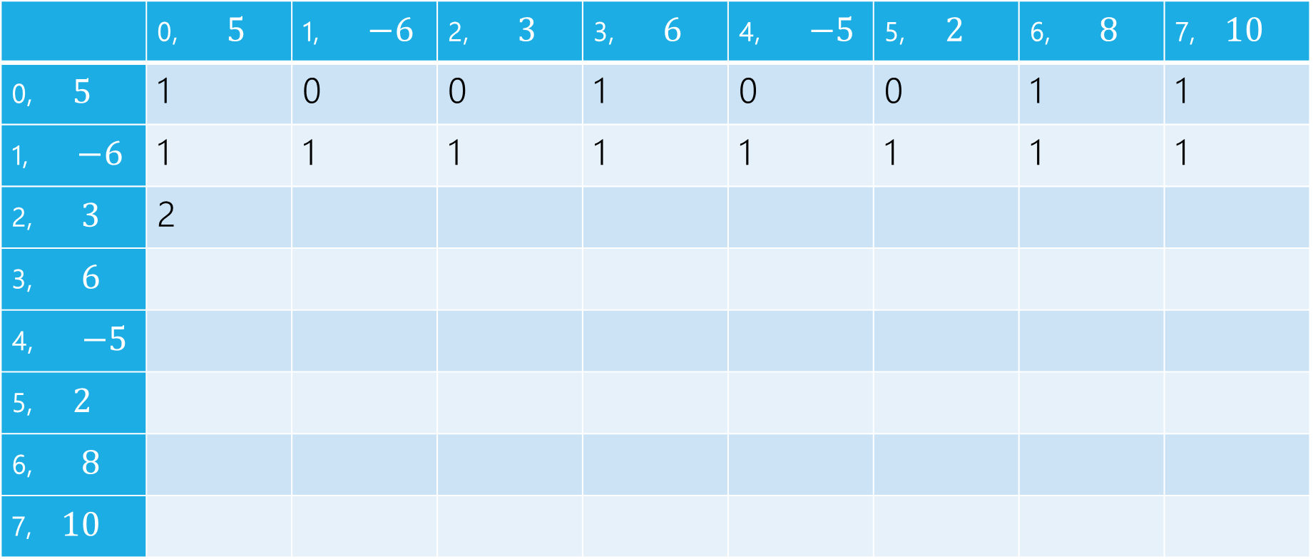
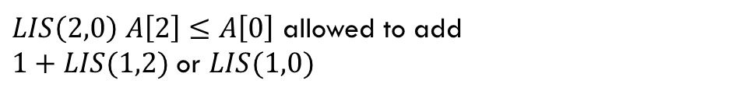
LIS
$LIS\left(2,0\right)$ $A\left[2\right]≤A\left[0\right]$ allowed to add
$1+LIS(1,2)$ or $LIS(1,0)$
$$LIS\left(i,j\right)=\left\{\begin{aligned}0 if i<0 \\ 𝕀[A\left[i\right]≤A\left[j\right]] if i=0 \\ LIS\left(i−1,j\right) if A\left[i\right]>A\left[j\right] \\ \max\left\{1+LIS\left(i−1,i\right), LIS\left(i−1,j\right)\right\} otherwise\end{aligned}\right.$$
$$j$$
 | 0, $5$ | 1, $−6$ | 2, $3$ | 3, $6$ | 4, $−5$ | 5, $2$ | 6, $8$ | 7, $10$
0, $5$ | 1 | 0 | 0 | 1 | 0 | 0 | 1 | 1
1, $−6$ | 1 | 1 | 1 | 1 | 1 | 1 | 1 | 1
2, $3$ | 2
3, $6$
4, $−5$
5, $2$
6, $8$
7, $10$
$$i$$

Slide 17
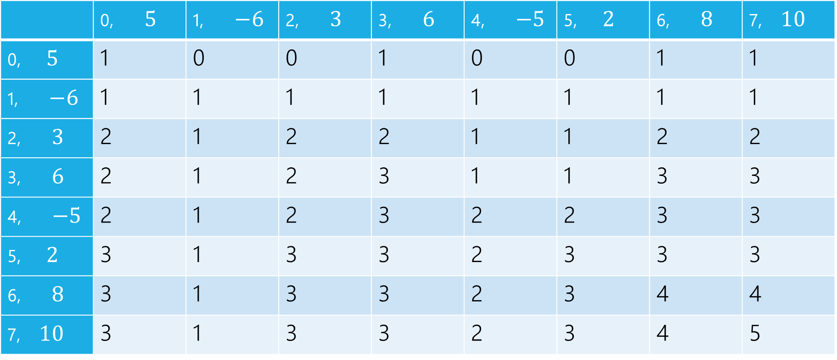
LIS
$$LIS\left(i,j\right)=\left\{\begin{aligned}0 if i<0 \\ 𝕀[A\left[i\right]≤A\left[j\right]] if i=0 \\ LIS\left(i−1,j\right) if A\left[i\right]>A\left[j\right] \\ \max\left\{1+LIS\left(i−1,i\right), LIS\left(i−1,j\right)\right\} otherwise\end{aligned}\right.$$
$$j$$
 | 0, $5$ | 1, $−6$ | 2, $3$ | 3, $6$ | 4, $−5$ | 5, $2$ | 6, $8$ | 7, $10$
0, $5$ | 1 | 0 | 0 | 1 | 0 | 0 | 1 | 1
1, $−6$ | 1 | 1 | 1 | 1 | 1 | 1 | 1 | 1
2, $3$ | 2 | 1 | 2 | 2 | 1 | 1 | 2 | 2
3, $6$ | 2 | 1 | 2 | 3 | 1 | 1 | 3 | 3
4, $−5$ | 2 | 1 | 2 | 3 | 2 | 2 | 3 | 3
5, $2$ | 3 | 1 | 3 | 3 | 2 | 3 | 3 | 3
6, $8$ | 3 | 1 | 3 | 3 | 2 | 3 | 4 | 4
7, $10$ | 3 | 1 | 3 | 3 | 2 | 3 | 4 | 5
$$i$$

Slide 18
pseudocode
//real code snippet that actually generated the table on the last slide
for(int j=0; j < n; j++){
vals[0][j] = (A[0] <= A[j]) ? 1 : 0;
}
for(int i = 1; i < 8; i++){
for(int j = 0; j < n; j++){
if(A[i] > A[j])
vals[i][j] = vals[i-1][j];
else{
vals[i][j] = Math.max(1+vals[i-1][i], vals[i-1][j]);
}
}
}

Slide 19
More Practice

Slide 20
Longest Increasing Subsequence
0 | 1 | 2 | 3 | 4 | 5 | 6 | 7
5 | -6 | 3 | 6 | -5 | 2 | 8 | 10
Longest set of (not necessarily consecutive) elements that are increasing
$5$ is optimal for the array above
(indices $1,2,3,6,7;$elements $−6,3,6,8,10$)
For simplicity – assume all array elements are distinct.
Try it again!
But mirrored

Slide 21

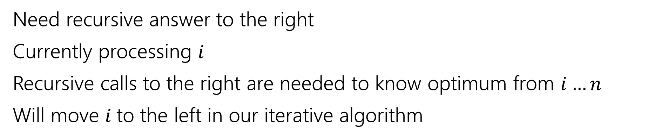
Recurrence
0 | 1 | 2 | 3 | 4 | 5 | 6 | 7
5 | -6 | 3 | 6 | -5 | 2 | 8 | 10
Parent recursive calls
Current $i$
Recursive call is best value in this area
Need recursive answer to the right
Currently processing $i$
Recursive calls to the right are needed to know optimum from $i…n$
Will move $i$to the left in our iterative algorithm

Slide 22
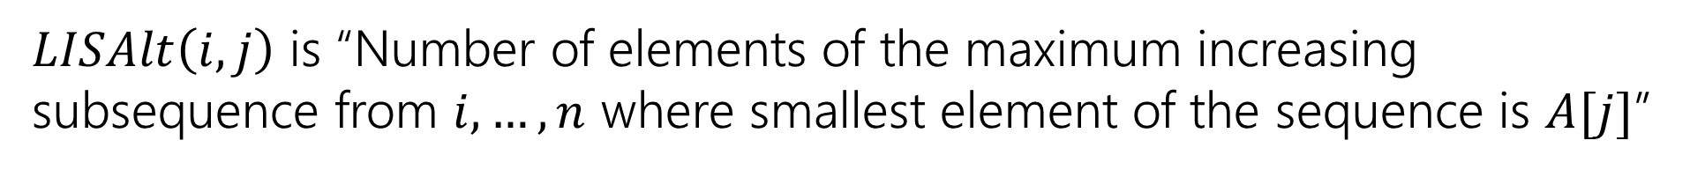
Recurrence
0 | 1 | 2 | 3 | 4 | 5 | 6 | 7
5 | -6 | 3 | 6 | -5 | 2 | 8 | 10
Parent recursive calls
Current $i$
Recursive call is best value in this area
pollev.com/robbie
Try to write a different recurrence for longest increasing subsequence.
$LISAlt\left(i,j\right)$ is “Number of elements of the maximum increasing subsequence from $i,…,n$ where smallest element of the sequence is $A[j]$”

Slide 23
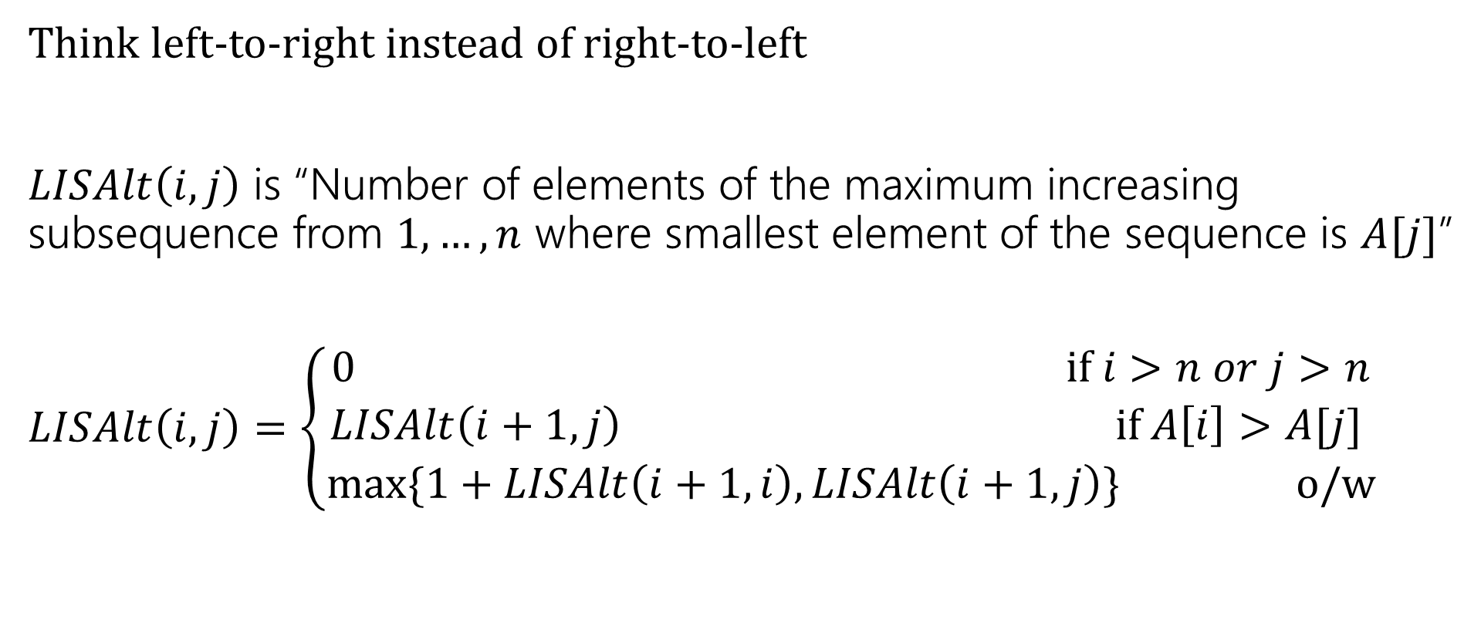
Longest Increasing Subsequence
Think left-to-right instead of right-to-left
$LISAlt\left(i,j\right)$ is “Number of elements of the maximum increasing subsequence from $1,…,n$ where smallest element of the sequence is $A[j]$”
$LISAlt\left(i,j\right)=\left\{\begin{aligned}0 if i>n or j>n \\ LISAlt\left(i+1,j\right) if A\left[i\right]>A[j] \\ \max{\{1+LISAlt\left(i+1,i\right), LISAlt\left(i+1,j\right)\}} o/w\end{aligned}\right.$

Slide 24
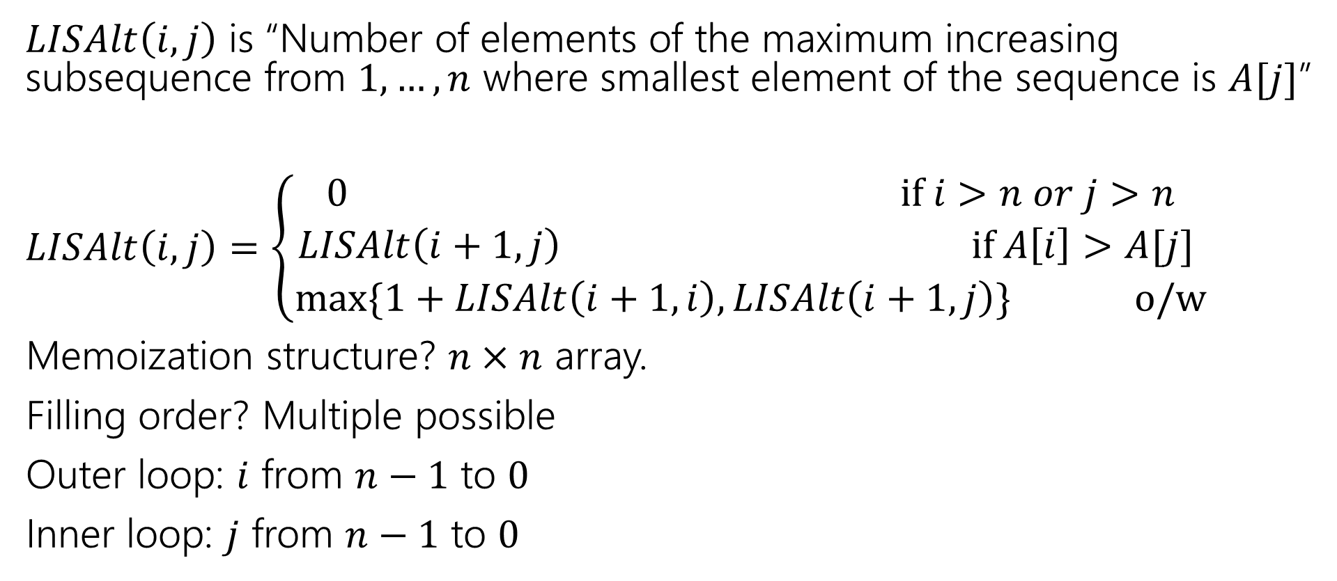
Longest Increasing Subsequence
$LISAlt\left(i,j\right)$ is “Number of elements of the maximum increasing subsequence from $1,…,n$ where smallest element of the sequence is $A[j]$”
$LISAlt\left(i,j\right)=\left\{\begin{aligned}0 if i>n or j>n \\ LISAlt\left(i+1,j\right) if A\left[i\right]>A[j] \\ \max{\{1+LISAlt\left(i+1,i\right), LISAlt\left(i+1,j\right)\}} o/w\end{aligned}\right.$
Memoization structure? $n×n$ array.
Filling order? Multiple possible
Outer loop: $i$ from $n−1$ to $0$
Inner loop: $j$ from $n−1$ to $0$

Slide 25
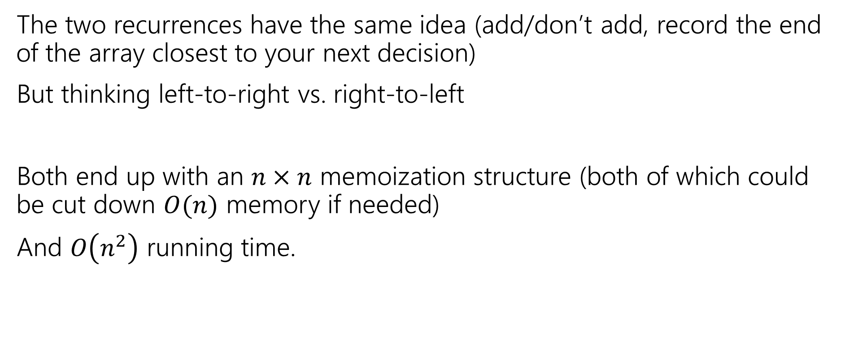
Summing Up
The two recurrences have the same idea (add/don’t add, record the end of the array closest to your next decision)
But thinking left-to-right vs. right-to-left
Both end up with an $n×n$ memoization structure (both of which could be cut down $O(n)$ memory if needed)
And $O\left(n^{2}\right)$ running time.

Slide 26
But Wait! There’s more
Another recurrence at the end of these slides for more practice.
Instead of thinking “do I include this element or not?” for each element,
Ask “what’s the next element” or equivalently “what’s the longest subsequence starting from me”
Get a different recurrence, but not a better running time.

Slide 27
Takeaways
When designing a dynamic program, we sometimes need to introduce a second variable, that doesn’t appear in the program
Or a second recurrence that mixes with the first if other decisions affect what’s optimal (beyond which problem you look at)
There might be more than one program available.

Slide 28
DP on Trees

Slide 29
DP on Trees
Trees are recursive structures
A tree is a root node, with zero or more children
Each of which are roots of trees
Since DP is “smart recursion” (recursion where we save values)
Recursive functions/calculations are really common.

Slide 30
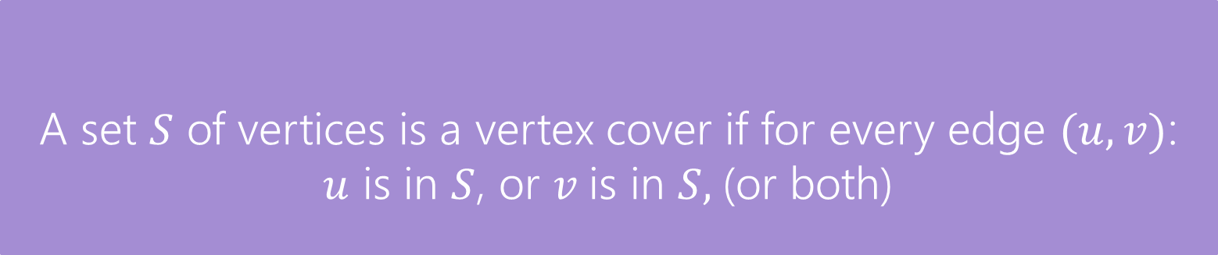
DP on Trees
Find the minimum vertex cover in a tree.
Give every vertex a weight, find the minimum weight vertex cover
Vertex Cover
A set $S$ of vertices is a vertex cover if for every edge $(u,v)$:
$u$ is in $S$, or $v$is in $S,$(or both)
The weight of a vertex cover is just the sum of the weights of the vertices in the set.
We want to find the minimum weight vertex cover.

Slide 31
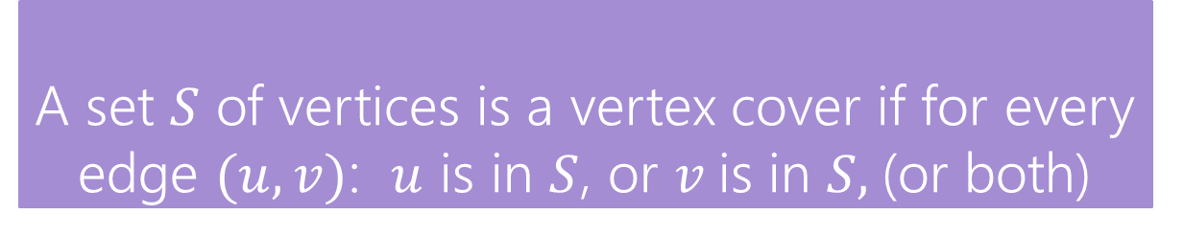
Vertex Cover
Vertex Cover
A set $S$ of vertices is a vertex cover if for every edge $(u,v)$: $u$ is in $S$, or $v$is in $S,$(or both)
Find the minimum vertex cover in a tree.
Give every vertex a weight, find the minimum weight vertex cover
1
10
8
5
3
20

Slide 32
Vertex Cover
Vertex Cover
A set $S$ of vertices is a vertex cover if for every edge $(u,v)$: $u$ is in $S$, or $v$is in $S,$(or both)
Find the minimum vertex cover in a tree.
Give every vertex a weight, find the minimum weight vertex cover
1
10
8
A valid vertex cover! (just take everything)
Definitely not the minimum though.
5
3
20

Slide 33
Vertex Cover
Vertex Cover
A set $S$ of vertices is a vertex cover if for every edge $(u,v)$: $u$ is in $S$, or $v$is in $S,$(or both)
Find the minimum vertex cover in a tree.
Give every vertex a weight, find the minimum weight vertex cover
1
10
8
A better vertex cover – weight 18
5
3
20

Slide 34
Vertex Cover
Vertex Cover
A set $S$ of vertices is a vertex cover if for every edge $(u,v)$: $u$ is in $S$, or $v$is in $S,$(or both)
Find the minimum vertex cover in a tree.
Give every vertex a weight, find the minimum weight vertex cover
1
10
8
The minimum vertex cover: weight 17
5
3
20

Slide 35
Vertex Cover
Vertex Cover
A set $S$ of vertices is a vertex cover if for every edge $(u,v)$: $u$ is in $S$, or $v$is in $S,$(or both)
Notice, the minimum weight vertex cover might have both endpoints of some edges
Even though only one of 1, 8 is required on the edge between them, they are both required for other edges.
1
10
8
5
3
20

Slide 36
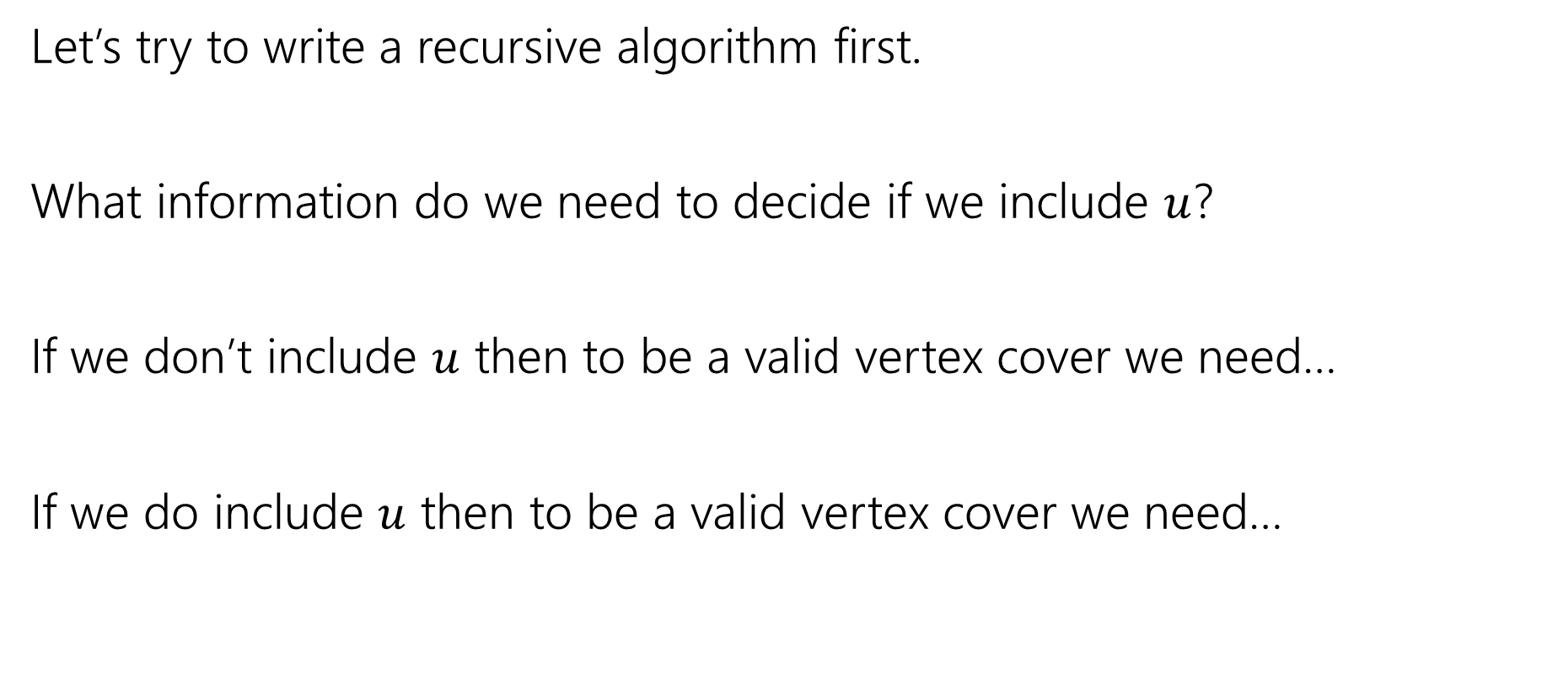
Vertex Cover – Recursively
Let’s try to write a recursive algorithm first.
What information do we need to decide if we include $u$?
If we don’t include $u$ then to be a valid vertex cover we need…
If we do include $u$ then to be a valid vertex cover we need…

Slide 37
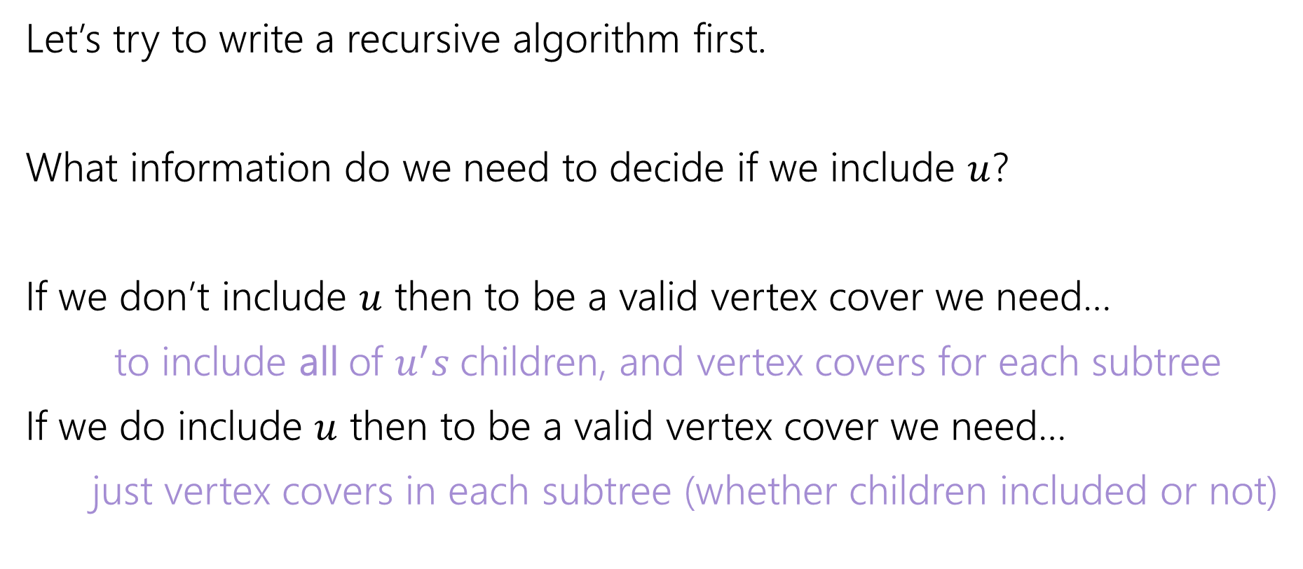
Vertex Cover – Recursively
Let’s try to write a recursive algorithm first.
What information do we need to decide if we include $u$?
If we don’t include $u$ then to be a valid vertex cover we need…
to include all of $u^{′}s$children, and vertex covers for each subtree
If we do include $u$ then to be a valid vertex cover we need…
just vertex covers in each subtree (whether children included or not)

Slide 38

Recurrence
Let $OPT(v)$ be the weight of a minimum weight vertex cover for the subtree rooted at $v$.
Write a recurrence for $OPT()$
Then figure out how to calculate it

Slide 39
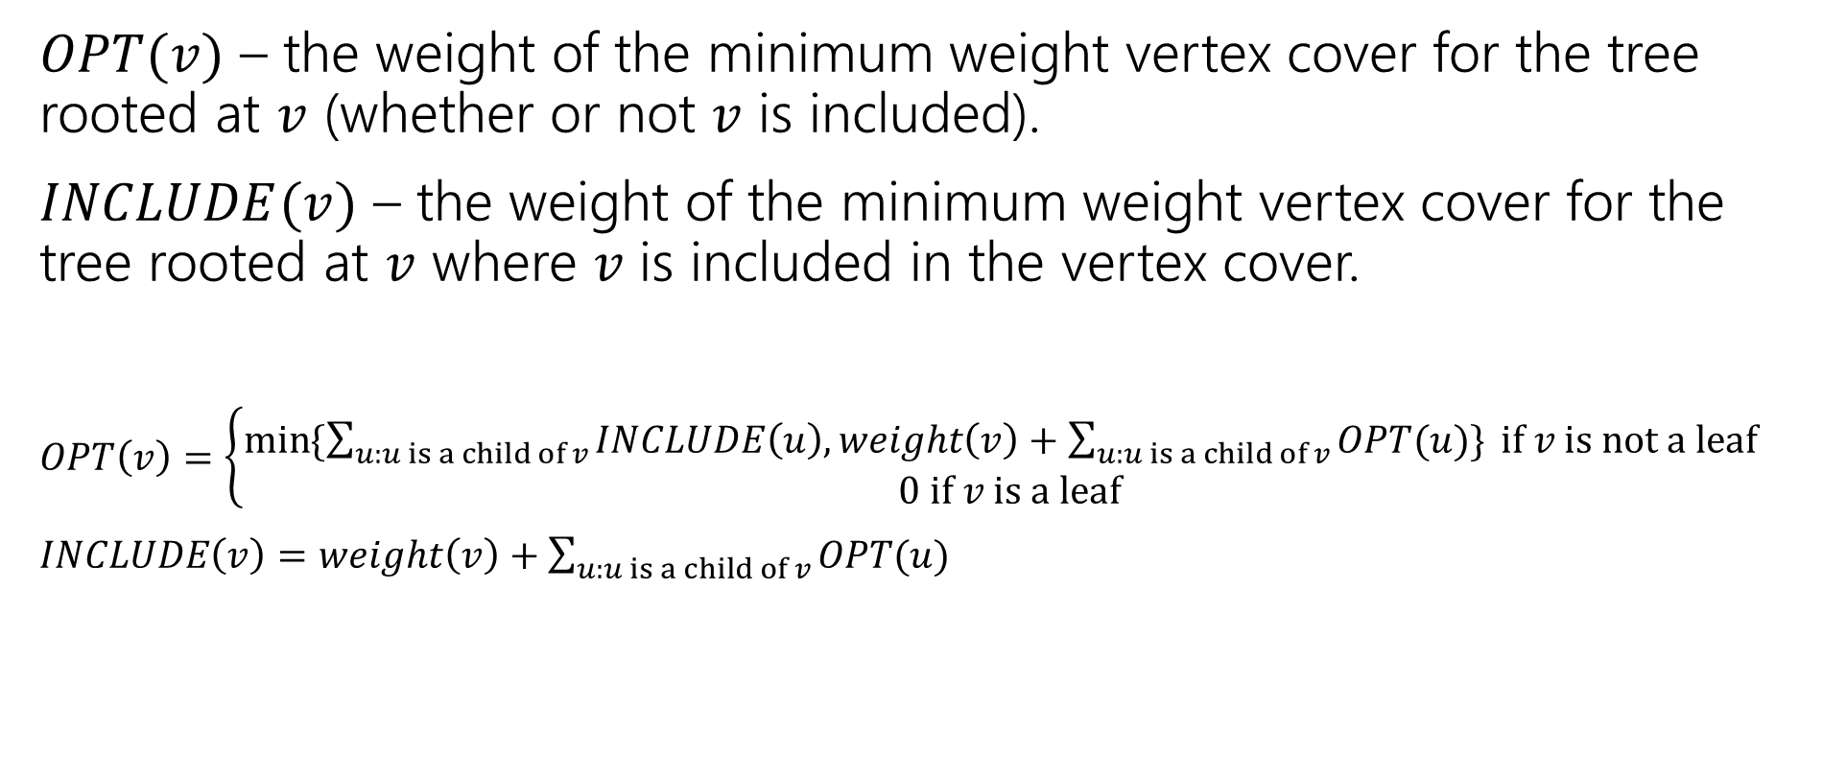
Recurrence
$OPT(v)$ – the weight of the minimum weight vertex cover for the tree rooted at $v$ (whether or not $v$ is included).
$INCLUDE(v)$ – the weight of the minimum weight vertex cover for the tree rooted at $v$ where $v$ is included in the vertex cover.
$OPT\left(v\right)=\left\{\begin{aligned}\min{⁡\{\sum_{u:u is a child of v}{INCLUDE\left(u\right), weight\left(v\right)+\sum_{u:u is a child of v}{OPT(u)\}} if v is not a leaf} } \\ 0 if v is a leaf\end{aligned}\right.$
$INCLUDE\left(v\right)=weight\left(v\right)+\sum_{u:u is a child of v}{OPT(u)}$

Slide 40
Vertex Cover Dynamic Program
What memoization structure should we use?
What code should we write?
What’s the running time?

Slide 41
Vertex Cover Dynamic Program
What memoization structure should we use?
the tree itself!
What code should we write?
What’s the running time?

Slide 42
Vertex Cover
What order do we do the calculation?
1
10
8
5
3
20

Slide 43
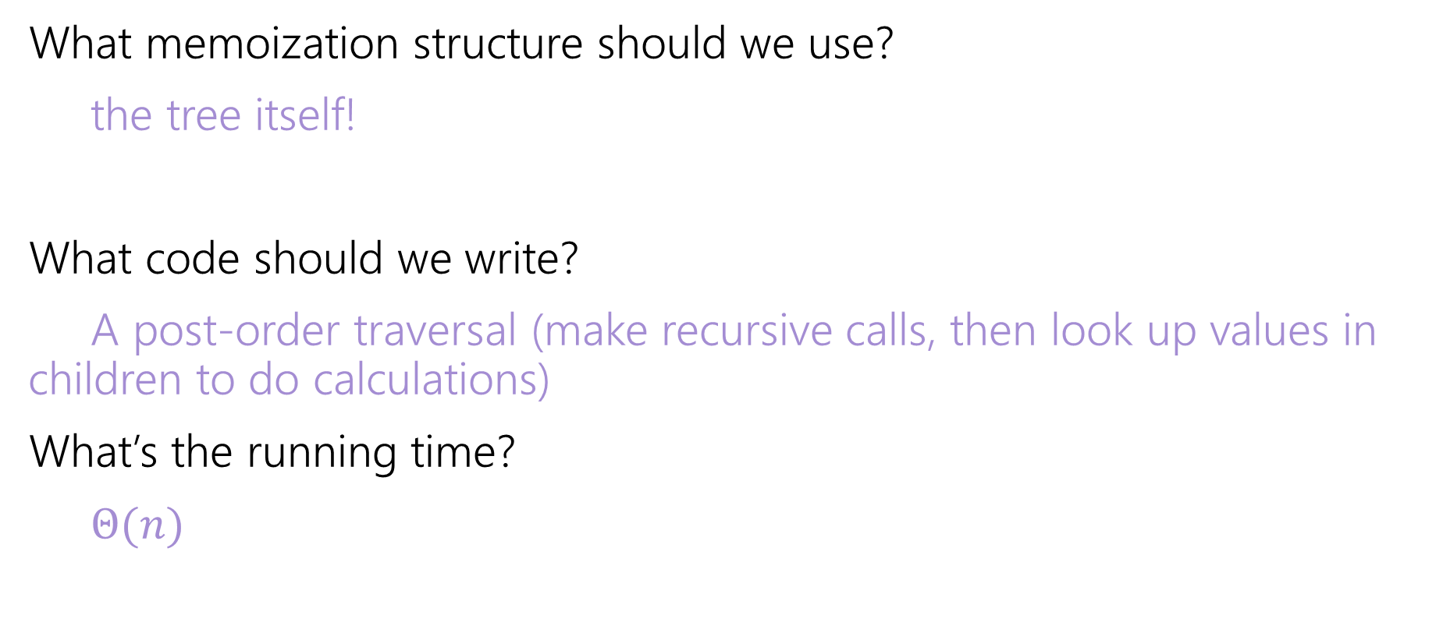
Vertex Cover Dynamic Program
What memoization structure should we use?
the tree itself!
What code should we write?
A post-order traversal (make recursive calls, then look up values in children to do calculations)
What’s the running time?
$Θ(n)$

Slide 44
Extra Practice

Slide 45
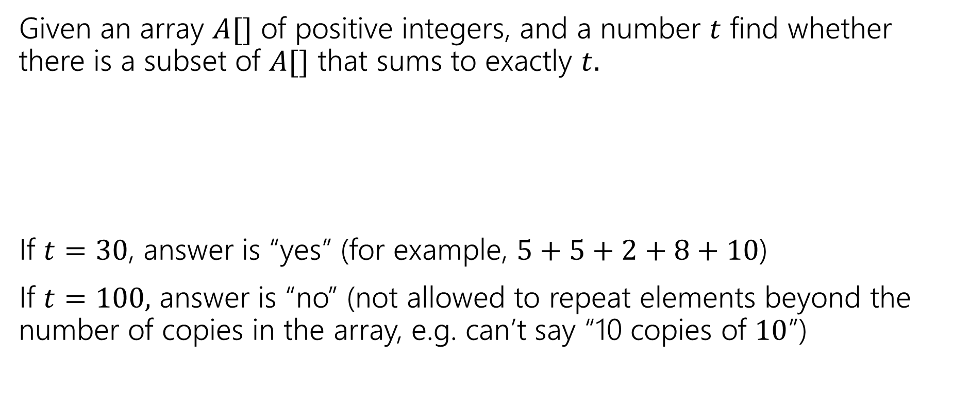
Subset Sum
Given an array $A[]$ of positive integers, and a number $t$ find whether there is a subset of $A[]$ that sums to exactly $t.$
If $t=30$, answer is “yes” (for example, $5+5+2+8+10$)
If $t=100,$ answer is “no” (not allowed to repeat elements beyond the number of copies in the array, e.g. can’t say “10 copies of $10$”)
0 | 1 | 2 | 3 | 4 | 5 | 6 | 7
5 | 6 | 3 | 6 | 5 | 2 | 8 | 10

Slide 46
Subset Sum
Write an English description of what you want to calculate
Write a recurrence
Give a sentence or two (in English) of why your recurrence should work.

Slide 47
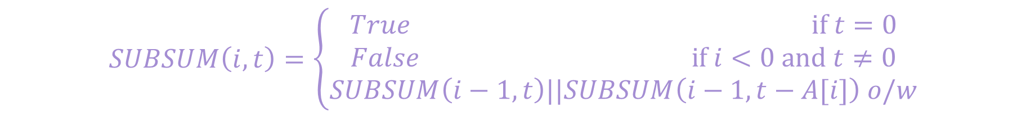
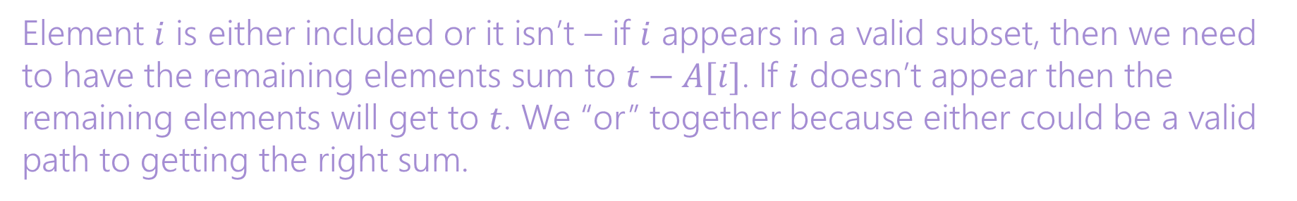
Subset Sum
Write an English description of what you want to calculate
Write a recurrence
Give a sentence or two (in English) of why your recurrence should work.
Let $SUBSUM(i,t)$ be true if and only if a subset of $A\left[0\right],…,A[i]$ can sum to $t$.
$$SUBSUM\left(i,t\right)=\left\{\begin{aligned}True if t=0 \\ False if i<0 and t≠0 \\ SUBSUM\left(i−1,t\right)||SUBSUM\left(i−1,t−A[i]\right) o/w\end{aligned}\right.$$
Element $i$ is either included or it isn’t – if $i$ appears in a valid subset, then we need to have the remaining elements sum to $t−A[i]$. If $i$ doesn’t appear then the remaining elements will get to $t$. We “or” together because either could be a valid path to getting the right sum.

Slide 48
Subset Sum
What memorization structure will you use?
Write the pseudocode to fill up the structure iteratively.
A 2D Boolean array SUBSUM($i,j$). Array will be $n×T$
SubSum(int[] A, int T)
Bool[][] SubSum = new Bool[n][T+1]
for(int j=0;j<T+1;j++){ SubSum[0][j]=False;}
SubSum[0][A[0]]=True;
for(int i=1; i<n;i++){
for(int j=0; j<T+1; j++){
if(SubSum[i-1][j]){
SubSum[i][j]=True;
SubSum[i][j+A[i]]=True;//need to catch Array index errors. Don’t do
//this in real code.
}
}
}
return SubSum[n][T-1];

Slide 49
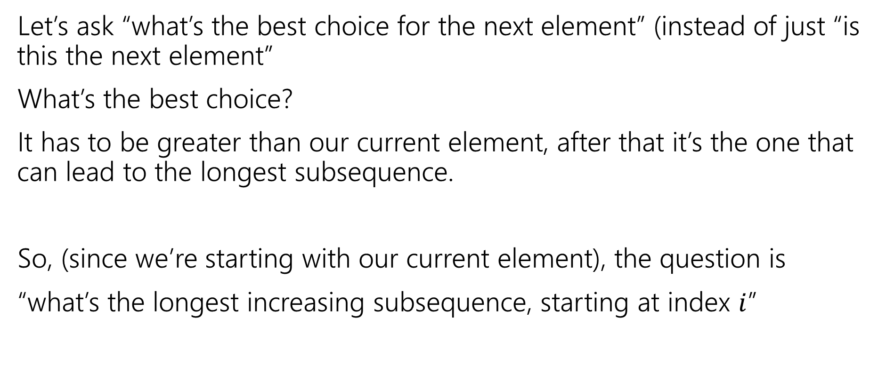
Longest Increasing Subsequence, Round 3
Let’s ask “what’s the best choice for the next element” (instead of just “is this the next element”
What’s the best choice?
It has to be greater than our current element, after that it’s the one that can lead to the longest subsequence.
So, (since we’re starting with our current element), the question is
“what’s the longest increasing subsequence, starting at index $i$”

Slide 50
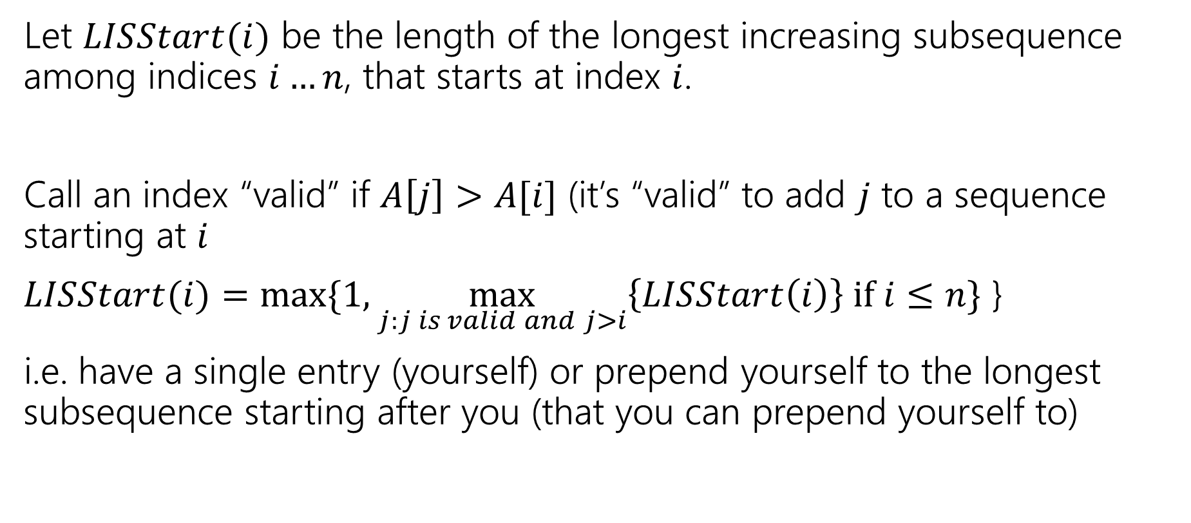
Longest Increasing Subsequence, Round 3
Let $LISStart(i)$ be the length of the longest increasing subsequence among indices $i…n$, that starts at index $i$.
Call an index “valid” if $A\left[j\right]>A[i]$ (it’s “valid” to add $j$ to a sequence starting at $i$
$LISStart(i)=max⁡\{1,\max_{j:j is valid and j>i}\left\{LISStart\left(i\right)\right\} if i≤n\}$ }
i.e. have a single entry (yourself) or prepend yourself to the longest subsequence starting after you (that you can prepend yourself to)

Slide 51
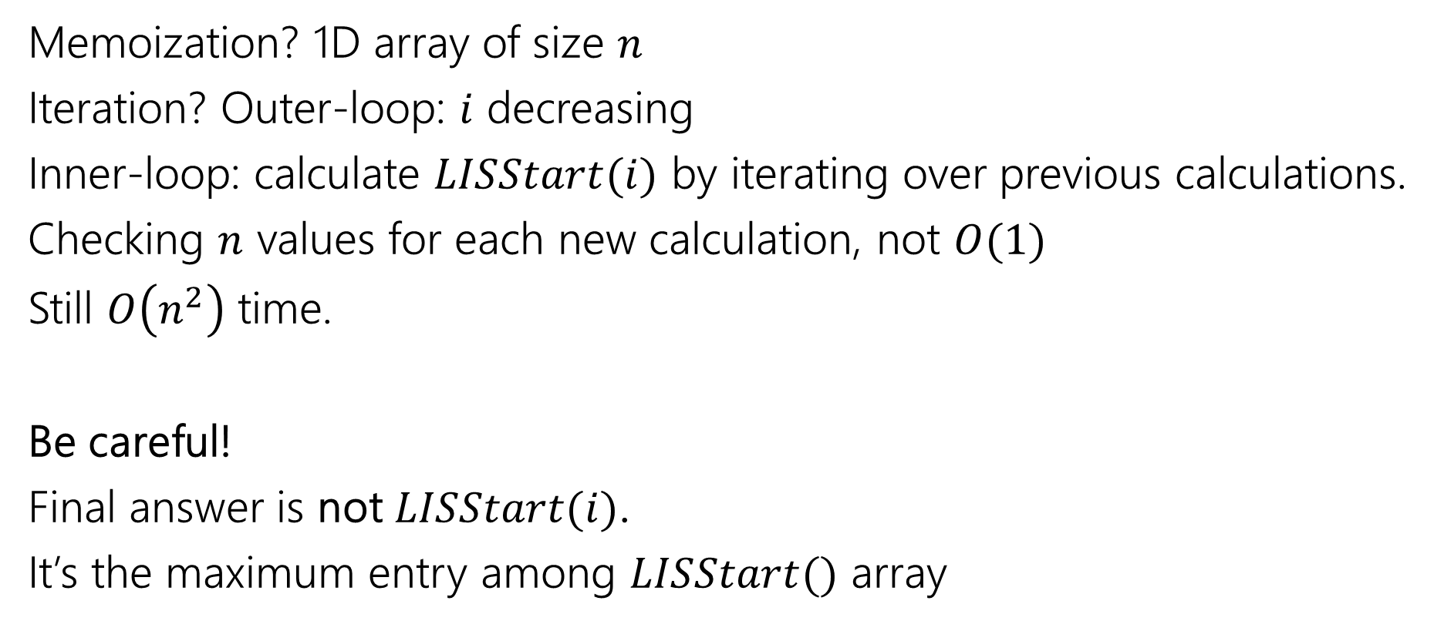
Longest Increasing Subsequence, Round 3
Memoization? 1D array of size $n$
Iteration? Outer-loop: $i$ decreasing
Inner-loop: calculate $LISStart(i)$ by iterating over previous calculations.
Checking $n$ values for each new calculation, not $O(1)$
Still $O\left(n^{2}\right)$ time.
Be careful!
Final answer is not $LISStart(i)$.
It’s the maximum entry among $LISStart()$ array

