Slide 1
Still Even More
Dynamic Programming
CSE 417 24Wi
Lecture 13

Slide 2
More Problems

Slide 3

Maximum Contiguous Subarray Sum
We saw an $O(n\log{n)}$divide and conquer algorithm.
Can we do better with DP?
Given: Array $A$[]
Output: $i,j$ such that $A\left[i\right]+A\left[i+1\right]+…+A[j]$ is maximized.

Slide 4
Dynamic Programming Process
1. Define the object you’re looking for
2. Write a recurrence to say how to find it
3. Design a memoization structure
4. Write an iterative algorithm

Slide 5
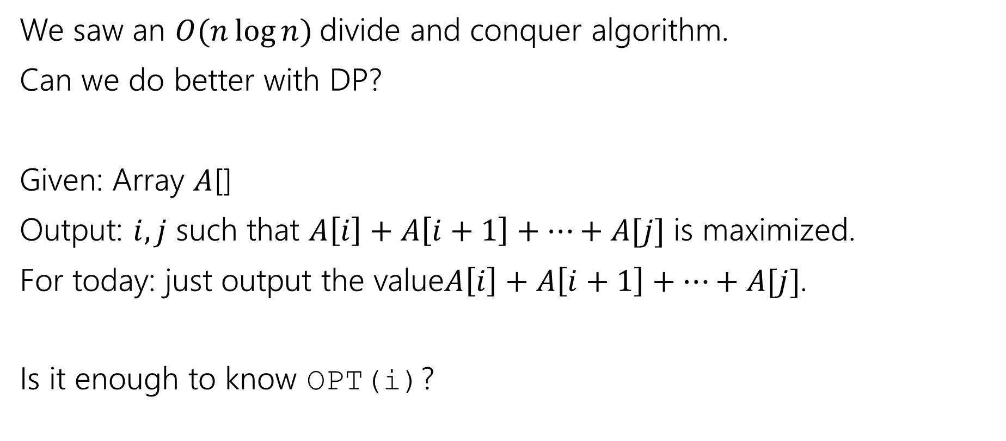
Maximum Contiguous Subarray Sum
We saw an $O(n\log{n)}$divide and conquer algorithm.
Can we do better with DP?
Given: Array $A$[]
Output: $i,j$ such that $A\left[i\right]+A\left[i+1\right]+…+A[j]$ is maximized.
For today: just output the value$A\left[i\right]+A\left[i+1\right]+…+A[j]$.
Is it enough to know OPT(i)?

Slide 6
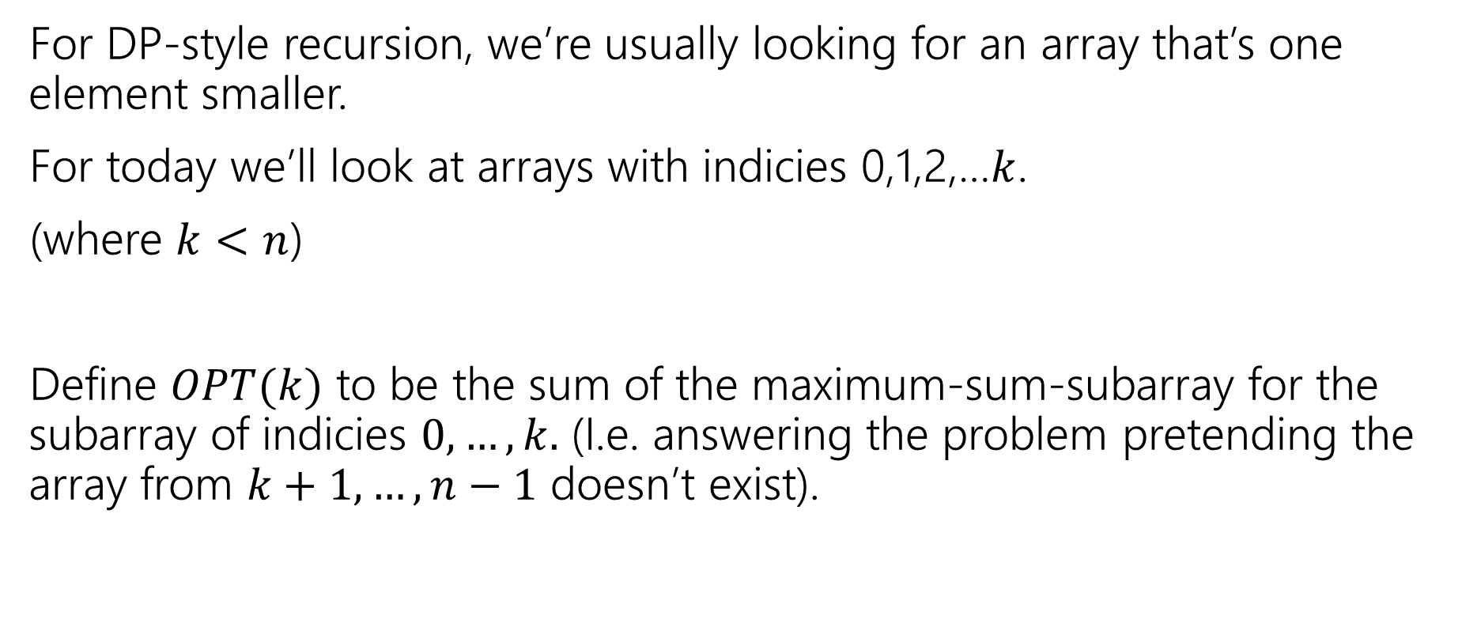
Approaching the problem recursively
For DP-style recursion, we’re usually looking for an array that’s one element smaller.
For today we’ll look at arrays with indicies 0,1,2,…$k$.
(where $k<n$)
Define $OPT(k)$ to be the sum of the maximum-sum-subarray for the subarray of indicies $0,…,k.$ (I.e. answering the problem pretending the array from $k+1,…,n−1$ doesn’t exist).

Slide 7
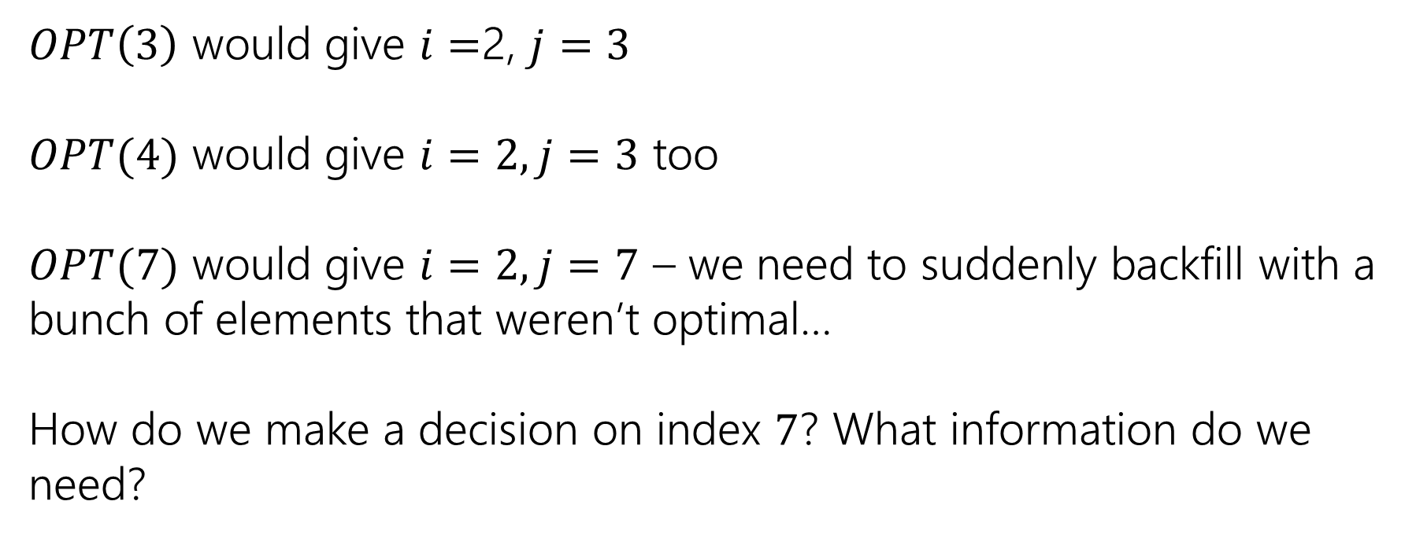
Trying to Recurse
0 | 1 | 2 | 3 | 4 | 5 | 6 | 7
5 | -6 | 3 | 4 | -5 | 2 | 2 | 4
$OPT\left(3\right)$ would give $i=$2, $j=3$
$OPT(4)$ would give $i=2, j=3$ too
$OPT(7)$ would give $i=2, j=7$ – we need to suddenly backfill with a bunch of elements that weren’t optimal…
How do we make a decision on index $7$? What information do we need?

Slide 8
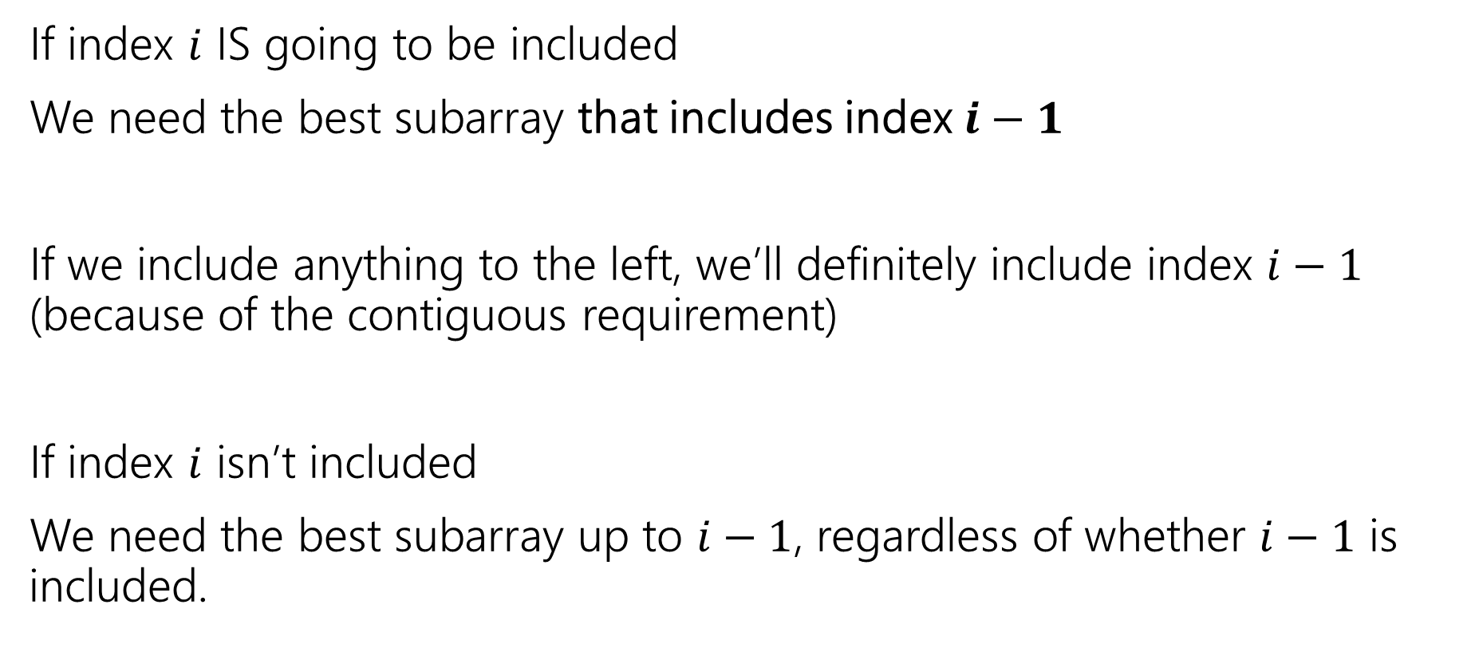
What do we need for recursion?
If index $i$ IS going to be included
We need the best subarray that includes index $i−1$
If we include anything to the left, we’ll definitely include index $i−1$ (because of the contiguous requirement)
If index $i$ isn’t included
We need the best subarray up to $i−1$, regardless of whether $i−1$ is included.

Slide 9
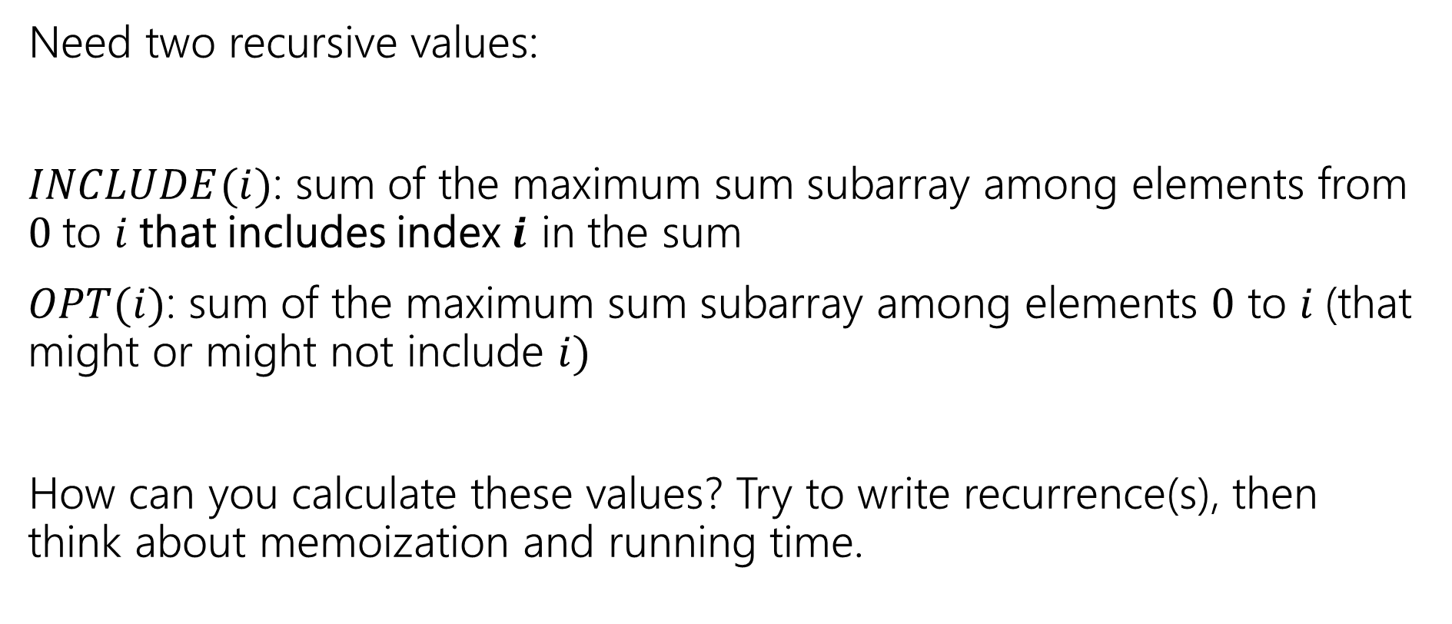
Two Values
Pollev.com/robbie
Need two recursive values:
$INCLUDE(i)$: sum of the maximum sum subarray among elements from $0$to $i$that includes index $i$ in the sum
$OPT(i)$: sum of the maximum sum subarray among elements $0$ to $i$(that might or might not include $i)$
How can you calculate these values? Try to write recurrence(s), then think about memoization and running time.

Slide 10
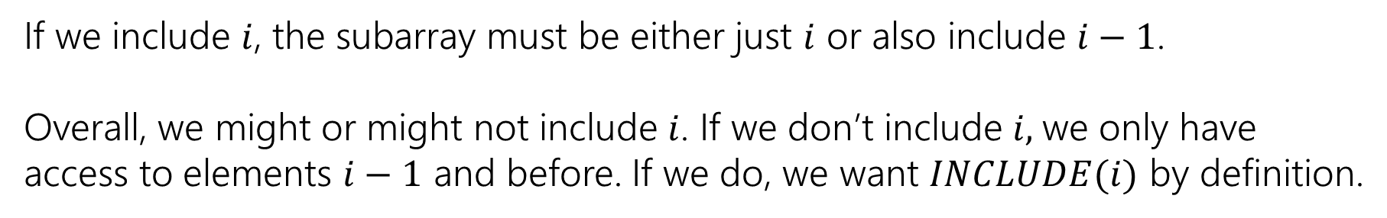

Recurrences
$INCLUDE\left(i\right)=\left\{\begin{aligned}\max\left\{A\left[i\right], A\left[i\right]+INLCUDE\left(i−1\right)\right\} if i≥0 \\ 0 otherwise\end{aligned}\right.$
$OPT\left(i\right)=\left\{\begin{aligned}\max\left\{INCLUDE\left(i\right),OPT\left(i−1\right)\right\} if i≥0 \\ 0 otherwise\end{aligned}\right.$
If we include $i$, the subarray must be either just $i$ or also include $i−1$.
Overall, we might or might not include $i$. If we don’t include $i,$we only have access to elements $i−1$ and before. If we do, we want $INCLUDE(i)$ by definition.

Slide 11



Example
$$A$$
0 | 1 | 2 | 3 | 4 | 5 | 6 | 7
5 | -6 | 3 | 4 | -5 | 2 | 2 | 4
$$OPT(i)$$
0 | 1 | 2 | 3 | 4 | 5 | 6 | 7
5
0 | 1 | 2 | 3 | 4 | 5 | 6 | 7
5
$$INCLUDE(i)$$

Slide 12
Example
$$A$$
0 | 1 | 2 | 3 | 4 | 5 | 6 | 7
5 | -6 | 3 | 4 | -5 | 2 | 2 | 4
$$OPT(i)$$
0 | 1 | 2 | 3 | 4 | 5 | 6 | 7
5 | 5
0 | 1 | 2 | 3 | 4 | 5 | 6 | 7
5 | -1
$$INCLUDE(i)$$

Slide 13
Example
$$A$$
0 | 1 | 2 | 3 | 4 | 5 | 6 | 7
5 | -6 | 3 | 4 | -5 | 2 | 2 | 4
$$OPT(i)$$
0 | 1 | 2 | 3 | 4 | 5 | 6 | 7
5 | 5 | 5 | 7 | 7 | 7 | 7 | 10
0 | 1 | 2 | 3 | 4 | 5 | 6 | 7
5 | -1 | 3 | 7 | 2 | 4 | 6 | 10
$$INCLUDE(i)$$

Slide 14
Pseudocode
int maxSubarraySum(int[] A)
int n=A.length
int[] OPT = new int[n]
int[] Inc = new int[n]
inc[0]=A[0]; OPT[0] = max{A[0],0}
for(int i=0;i<n;i++)
inc[i]=max{A[i], A[i]+inc[i-1]}
OPT[i]=max{inc[i], opt[i-1]}
endFor
return OPT[n-1]

Slide 15
Edit Distance

Slide 16
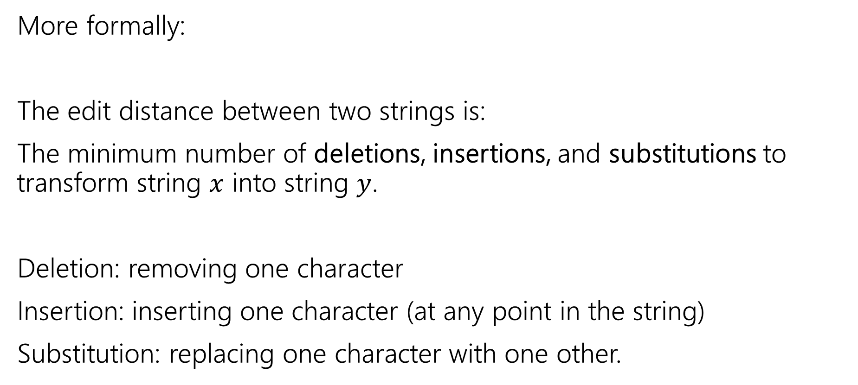
Edit Distance
More formally:
The edit distance between two strings is:
The minimum number of deletions, insertions, and substitutions to transform string $x$ into string $y$.
Deletion: removing one character
Insertion: inserting one character (at any point in the string)
Substitution: replacing one character with one other.

Slide 17
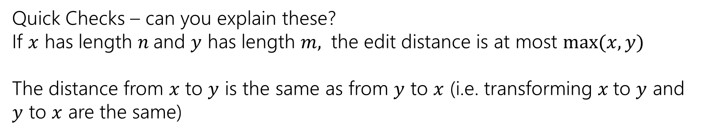
Example
What’s the distance between babyyodas and tastysoda?
B | A | B |  | Y | Y | O | D | A | S
sub |  | sub | ins |  | sub |  |  |  | del
T | A | S | T | Y | S | O | D | A
Distance: 5, one point for each colored box
Quick Checks – can you explain these?
If $x$ has length $n$and $y$ has length $m,$ the edit distance is at most $\max{(x,y)}$
The distance from $x$ to $y$ is the same as from $y$ to $x$ (i.e. transforming $x$to $y$ and $y$ to $x$ are the same)

Slide 18
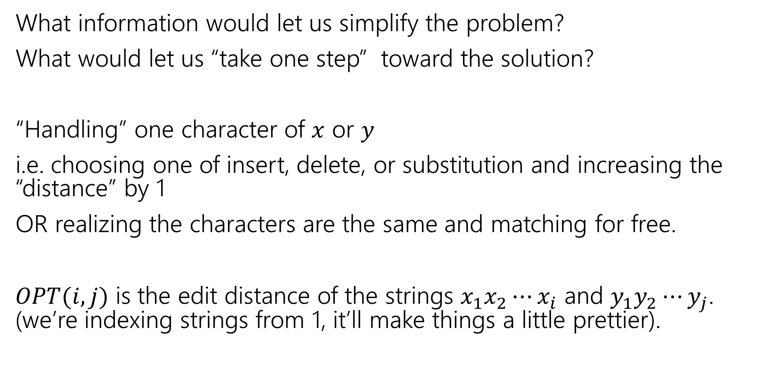
Finding a recurrence
What information would let us simplify the problem?
What would let us “take one step” toward the solution?
“Handling” one character of $x$ or $y$
i.e. choosing one of insert, delete, or substitution and increasing the “distance” by 1
OR realizing the characters are the same and matching for free.
$OPT(i,j)$ is the edit distance of the strings $x_{1}x_{2}⋯x_{i}$ and $y_{1}y_{2}⋯y_{j}$. (we’re indexing strings from 1, it’ll make things a little prettier).

Slide 19
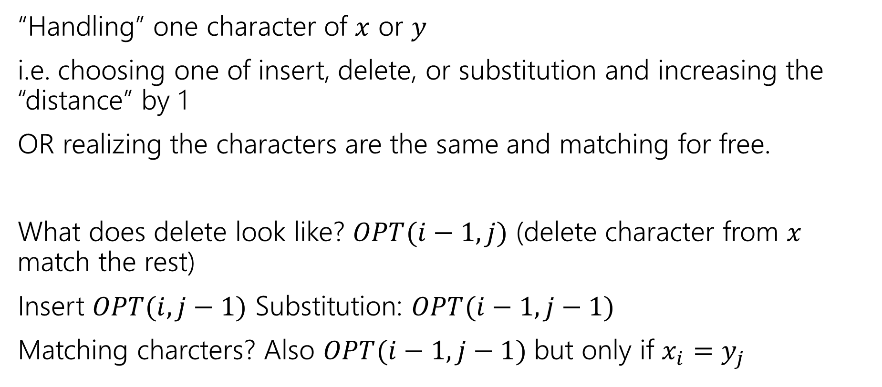
The recurrence
“Handling” one character of $x$ or $y$
i.e. choosing one of insert, delete, or substitution and increasing the “distance” by 1
OR realizing the characters are the same and matching for free.
What does delete look like? $OPT(i−1, j)$ (delete character from $x$ match the rest)
Insert $OPT(i,j−1)$ Substitution: $OPT(i−1,j−1)$
Matching charcters? Also $OPT(i−1,j−1)$ but only if $x_{i}=y_{j}$

Slide 20
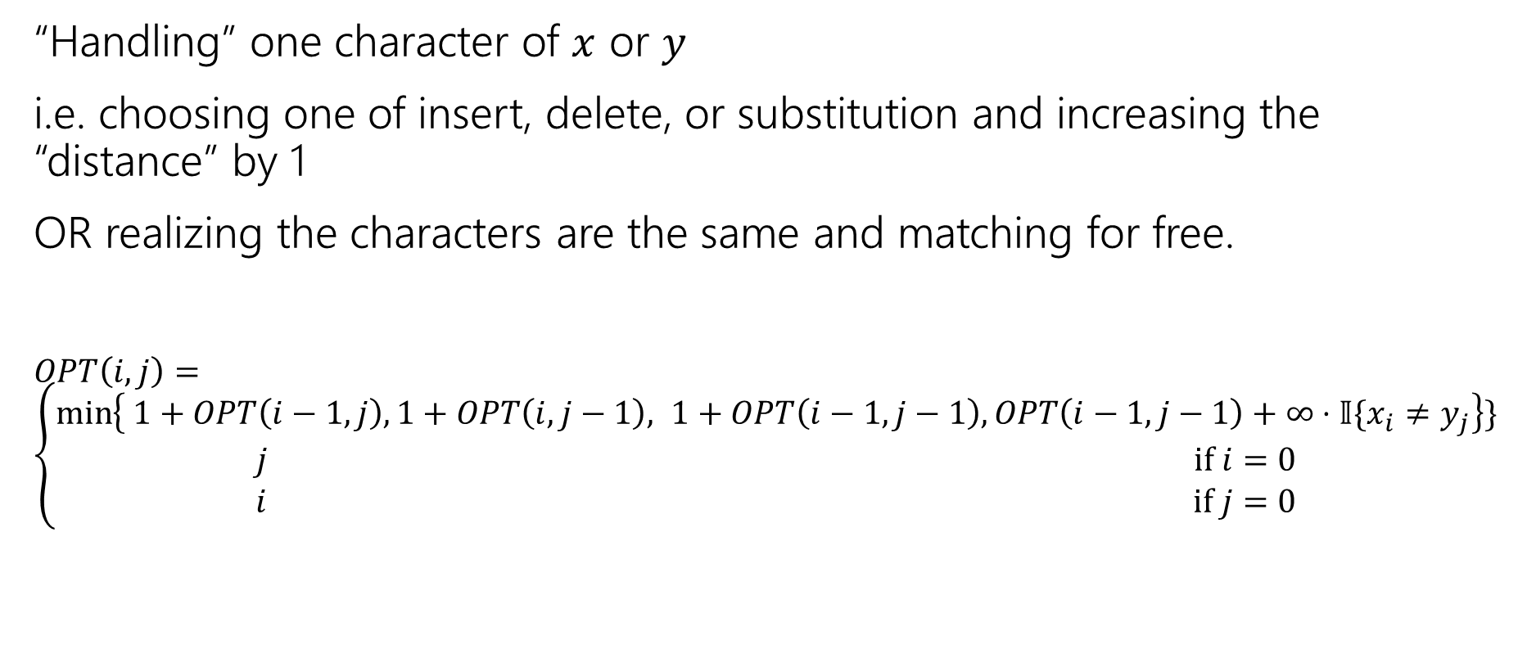
The recurrence (v1, we’ll improve soon)
“Handling” one character of $x$ or $y$
i.e. choosing one of insert, delete, or substitution and increasing the “distance” by 1
OR realizing the characters are the same and matching for free.
$OPT\left(i,j\right)=\left\{\begin{aligned}\min\left\{ 1+OPT\left(i−1,j\right), 1+OPT\left(i,j−1\right), 1+OPT\left(i−1,j−1\right), OPT\left(i−1,j−1\right)+∞⋅𝕀\{x_{i}≠y_{j}\right\}\} \\ j if i=0 \\ i if j=0\end{aligned}\right.$
Delete
Insert
Substitution
TODO: Just Match

Slide 21
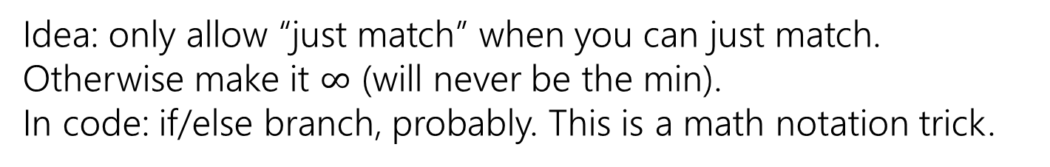
The recurrence (v1, we’ll improve soon)
“Handling” one character of $x$ or $y$
i.e. choosing one of insert, delete, or substitution and increasing the “distance” by 1
OR realizing the characters are the same and matching for free.
$OPT\left(i,j\right)=\left\{\begin{aligned}\min\left\{ 1+OPT\left(i−1,j\right), 1+OPT\left(i,j−1\right), 1+OPT\left(i−1,j−1\right), OPT\left(i−1,j−1\right)+∞⋅𝕀\{x_{i}≠y_{j}\right\}\} \\ j if i=0 \\ i if j=0\end{aligned}\right.$
Delete
Insert
Substitution
Just Match
Idea: only allow “just match” when you can just match. Otherwise make it $∞$ (will never be the min).
In code: if/else branch, probably. This is a math notation trick.
“Indicator” – math for “cast bool to int”

Slide 22
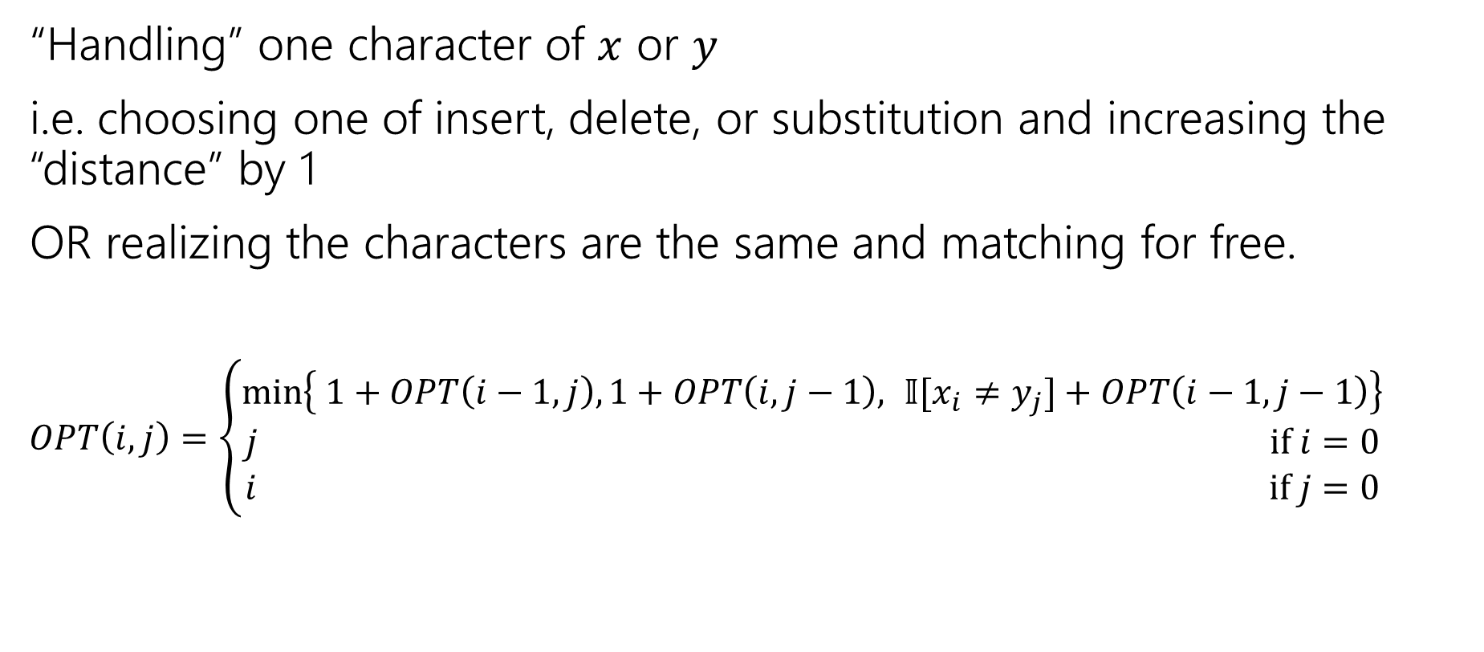
The recurrence
“Handling” one character of $x$ or $y$
i.e. choosing one of insert, delete, or substitution and increasing the “distance” by 1
OR realizing the characters are the same and matching for free.
$OPT\left(i,j\right)=\left\{\begin{aligned}\min\left\{ 1+OPT\left(i−1,j\right), 1+OPT\left(i,j−1\right), 𝕀[x_{i}≠y_{j}]+OPT\left(i−1,j−1\right)\right\} \\ j if i=0 \\ i if j=0\end{aligned}\right.$
Delete
Insert
Sub and matching
“Indicator” – math for “cast bool to int”
When we could match, we will never substitute; matching will always give us a better score! Still have to check delete, insert (those could be better).

Slide 23
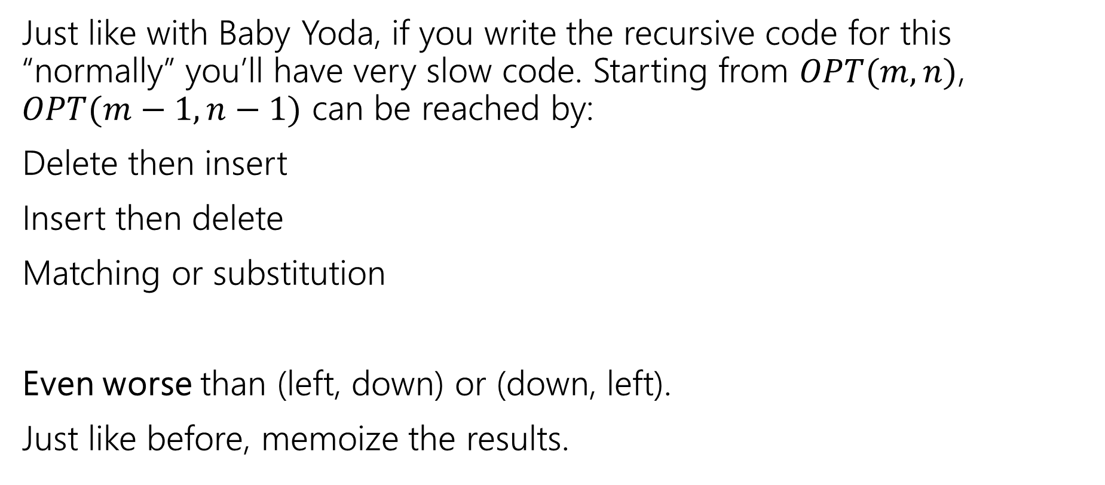
Recurrence to Code
Just like with Baby Yoda, if you write the recursive code for this “normally” you’ll have very slow code. Starting from $OPT(m,n)$, $OPT(m−1,n−1)$ can be reached by:
Delete then insert
Insert then delete
Matching or substitution
Even worse than (left, down) or (down, left).
Just like before, memoize the results.
Not a typo! It’s memoize, not memorize.
Notes:
Memoize as in “leave yourself a memo” DP was developed in the 50s and 60s (Wikipedia says term coined in 68 by Michie). To communicate with co-workers they didn’t use slack/discord or even email (which didn’t develop until the early 70s). They sent each other memos! So they made MEMO tables
thus “MEMOizing”

Slide 24
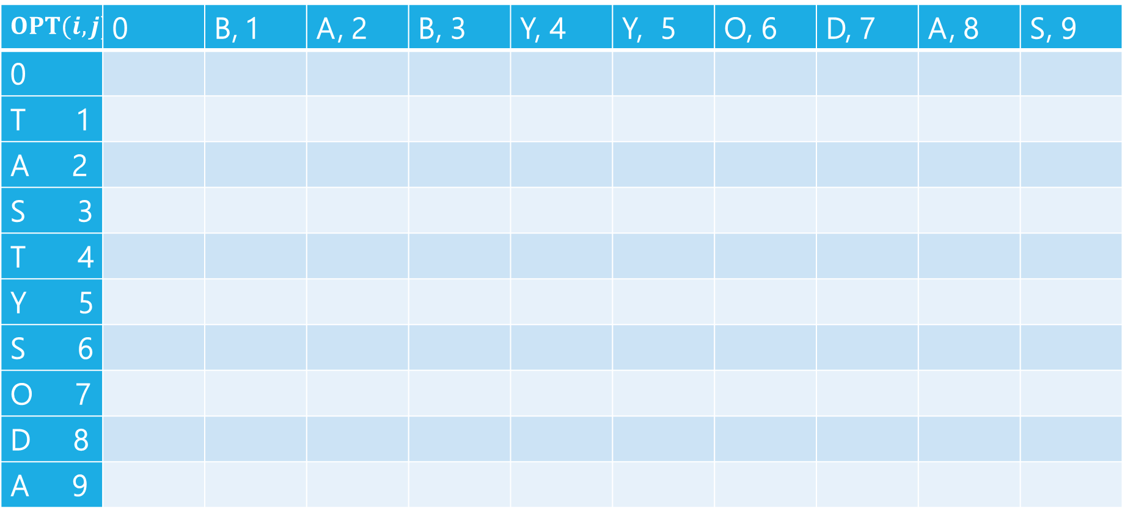
Edit Distance
$$OPT(i,j)$$ | 0 | B, 1 | A, 2 | B, 3 | Y, 4 | Y, 5 | O, 6 | D, 7 | A, 8 | S, 9
0
T 1
A 2
S 3
T 4
Y 5
S 6
O 7
D 8
A 9

Slide 25
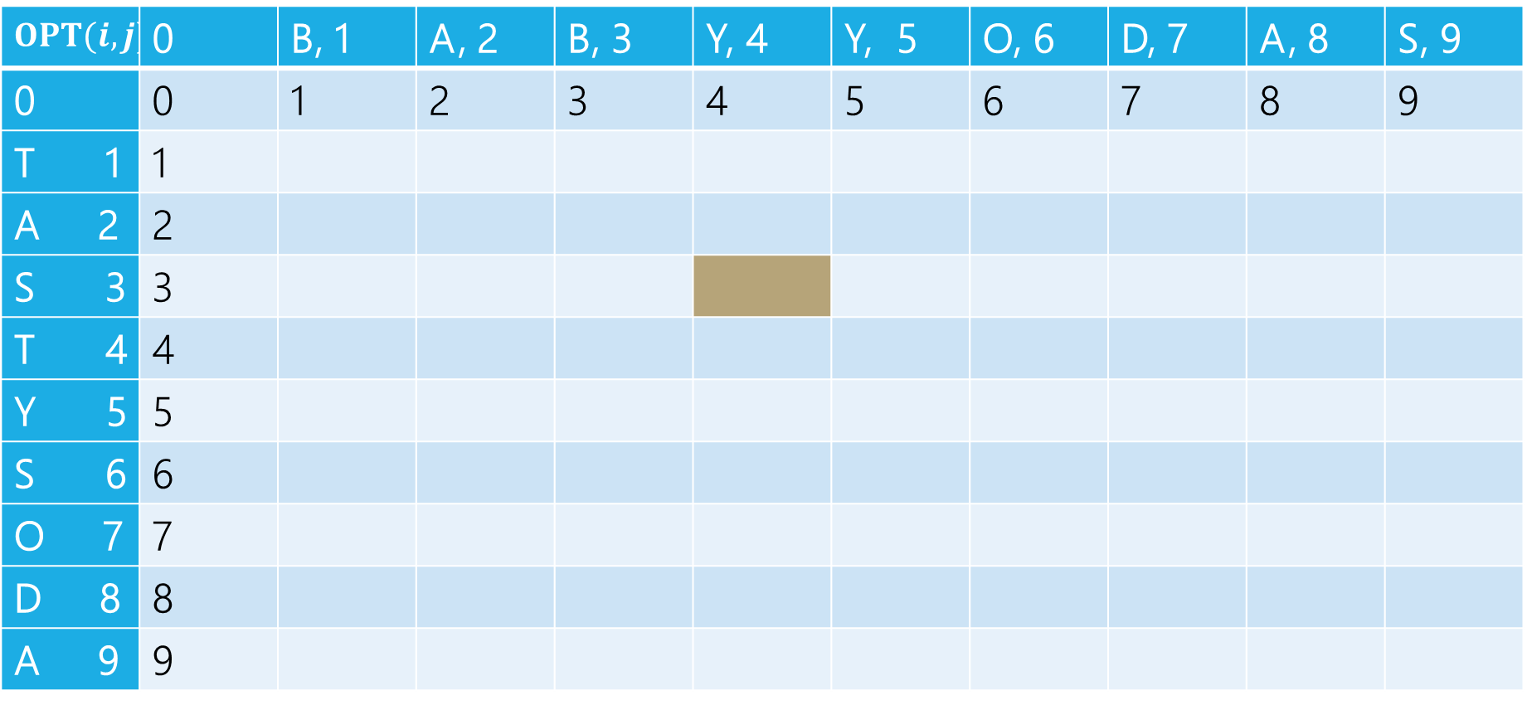
Edit Distance
B | A | B | Y
T | A | S
Current subproblem: edit dist between BABY and TAS
$$OPT(i,j)$$ | 0 | B, 1 | A, 2 | B, 3 | Y, 4 | Y, 5 | O, 6 | D, 7 | A, 8 | S, 9
0 | 0 | 1 | 2 | 3 | 4 | 5 | 6 | 7 | 8 | 9
T 1 | 1
A 2 | 2
S 3 | 3
T 4 | 4
Y 5 | 5
S 6 | 6
O 7 | 7
D 8 | 8
A 9 | 9

Slide 26
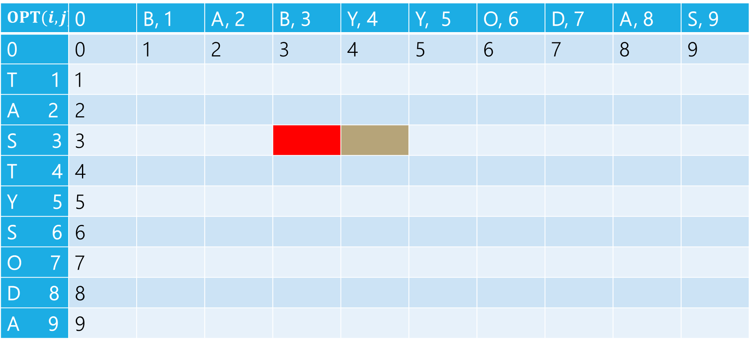
Edit Distance
B | A | B | Y
T | A | S
Delete: get rid of Y (cost 1)
BAB
TAS
$$OPT(i,j)$$ | 0 | B, 1 | A, 2 | B, 3 | Y, 4 | Y, 5 | O, 6 | D, 7 | A, 8 | S, 9
0 | 0 | 1 | 2 | 3 | 4 | 5 | 6 | 7 | 8 | 9
T 1 | 1
A 2 | 2
S 3 | 3
T 4 | 4
Y 5 | 5
S 6 | 6
O 7 | 7
D 8 | 8
A 9 | 9

Slide 27
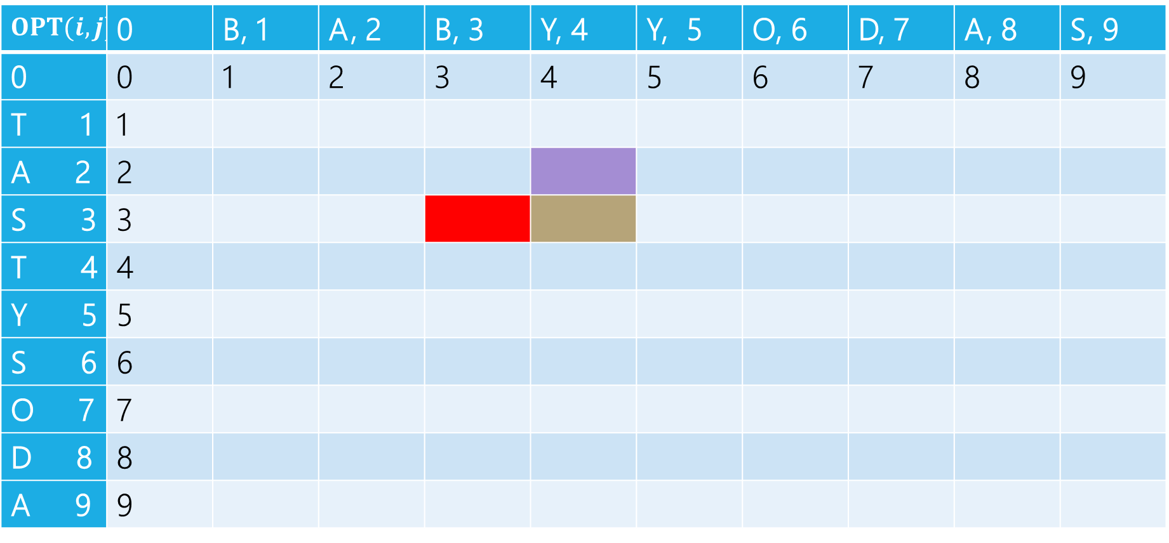
Edit Distance
B | A | B | Y
T | A | S
Insert: insert S (cost 1)
BABY
TA
$$OPT(i,j)$$ | 0 | B, 1 | A, 2 | B, 3 | Y, 4 | Y, 5 | O, 6 | D, 7 | A, 8 | S, 9
0 | 0 | 1 | 2 | 3 | 4 | 5 | 6 | 7 | 8 | 9
T 1 | 1
A 2 | 2
S 3 | 3
T 4 | 4
Y 5 | 5
S 6 | 6
O 7 | 7
D 8 | 8
A 9 | 9

Slide 28
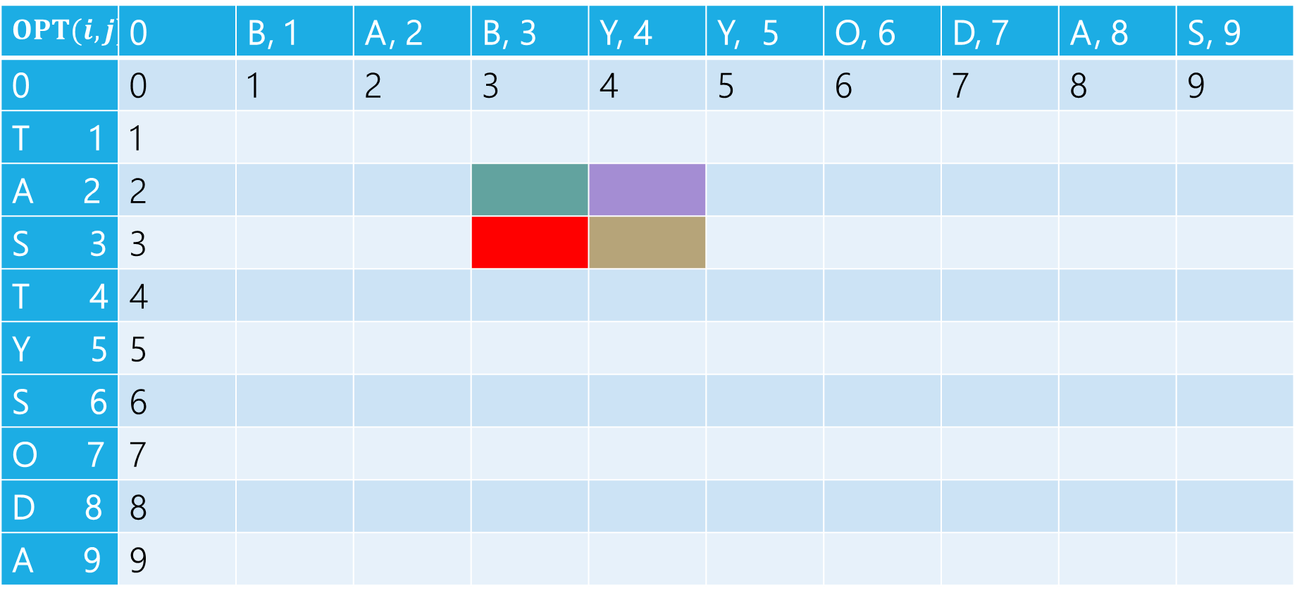
Edit Distance
B | A | B | Y
T | A | S
Sub: Transform Y to S (cost 1)
BAB
TA
$$OPT(i,j)$$ | 0 | B, 1 | A, 2 | B, 3 | Y, 4 | Y, 5 | O, 6 | D, 7 | A, 8 | S, 9
0 | 0 | 1 | 2 | 3 | 4 | 5 | 6 | 7 | 8 | 9
T 1 | 1
A 2 | 2
S 3 | 3
T 4 | 4
Y 5 | 5
S 6 | 6
O 7 | 7
D 8 | 8
A 9 | 9

Slide 29
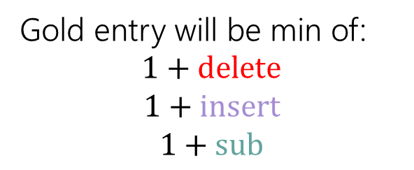
Edit Distance
Gold entry will be min of:
$$1+delete$$
$$1+insert$$
$$1+sub$$
B | A | B | Y
T | A | S
$$OPT(i,j)$$ | 0 | B, 1 | A, 2 | B, 3 | Y, 4 | Y, 5 | O, 6 | D, 7 | A, 8 | S, 9
0 | 0 | 1 | 2 | 3 | 4 | 5 | 6 | 7 | 8 | 9
T 1 | 1
A 2 | 2
S 3 | 3
T 4 | 4
Y 5 | 5
S 6 | 6
O 7 | 7
D 8 | 8
A 9 | 9

Slide 30
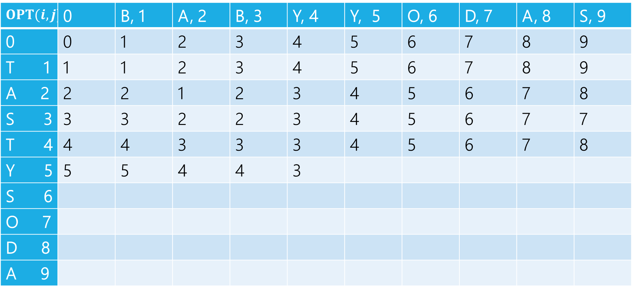

Edit Distance
$$1+2$$
$$1+3$$
$$1+2$$
Min: $3$
Gold entry will be min of:
$$1+delete$$
$$1+insert$$
$$1+sub$$
$$OPT(i,j)$$ | 0 | B, 1 | A, 2 | B, 3 | Y, 4 | Y, 5 | O, 6 | D, 7 | A, 8 | S, 9
0 | 0 | 1 | 2 | 3 | 4 | 5 | 6 | 7 | 8 | 9
T 1 | 1 | 1 | 2 | 3 | 4 | 5 | 6 | 7 | 8 | 9
A 2 | 2 | 2 | 1 | 2 | 3 | 4 | 5 | 6 | 7 | 8
S 3 | 3 | 3 | 2 | 2 | 3 | 4 | 5 | 6 | 7 | 7
T 4 | 4 | 4 | 3 | 3 | 3 | 4 | 5 | 6 | 7 | 8
Y 5 | 5 | 5 | 4 | 4 | 3
S 6
O 7
D 8
A 9

Slide 31
Edit Distance
Fill in the next two entries. Be careful with the sub/match distinction!
$$OPT(i,j)$$ | 0 | B, 1 | A, 2 | B, 3 | Y, 4 | Y, 5 | O, 6 | D, 7 | A, 8 | S, 9
0 | 0 | 1 | 2 | 3 | 4 | 5 | 6 | 7 | 8 | 9
T 1 | 1 | 1 | 2 | 3 | 4 | 5 | 6 | 7 | 8 | 9
A 2 | 2 | 2 | 1 | 2 | 3 | 4 | 5 | 6 | 7 | 8
S 3 | 3 | 3 | 2 | 2 | 3 | 4 | 5 | 6 | 7 | 7
T 4 | 4 | 4 | 3 | 3 | 3 | 4 | 5 | 6 | 7 | 8
Y 5 | 5 | 5 | 4 | 4 | 3
S 6
O 7
D 8
A 9

Slide 32
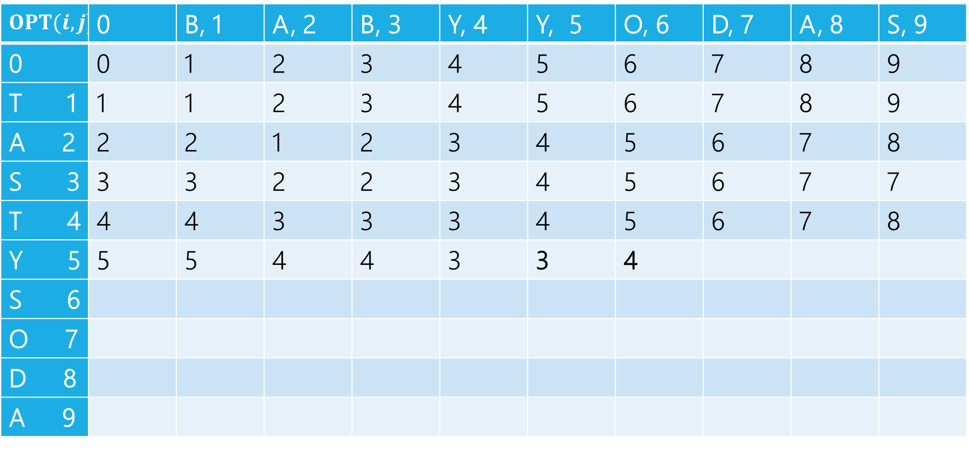
Edit Distance
Fill in the next two entries. Be careful with the sub/match distinction!
$$OPT(i,j)$$ | 0 | B, 1 | A, 2 | B, 3 | Y, 4 | Y, 5 | O, 6 | D, 7 | A, 8 | S, 9
0 | 0 | 1 | 2 | 3 | 4 | 5 | 6 | 7 | 8 | 9
T 1 | 1 | 1 | 2 | 3 | 4 | 5 | 6 | 7 | 8 | 9
A 2 | 2 | 2 | 1 | 2 | 3 | 4 | 5 | 6 | 7 | 8
S 3 | 3 | 3 | 2 | 2 | 3 | 4 | 5 | 6 | 7 | 7
T 4 | 4 | 4 | 3 | 3 | 3 | 4 | 5 | 6 | 7 | 8
Y 5 | 5 | 5 | 4 | 4 | 3 | 3 | 4
S 6
O 7
D 8
A 9
Y’s match, so sub is free!

Slide 33
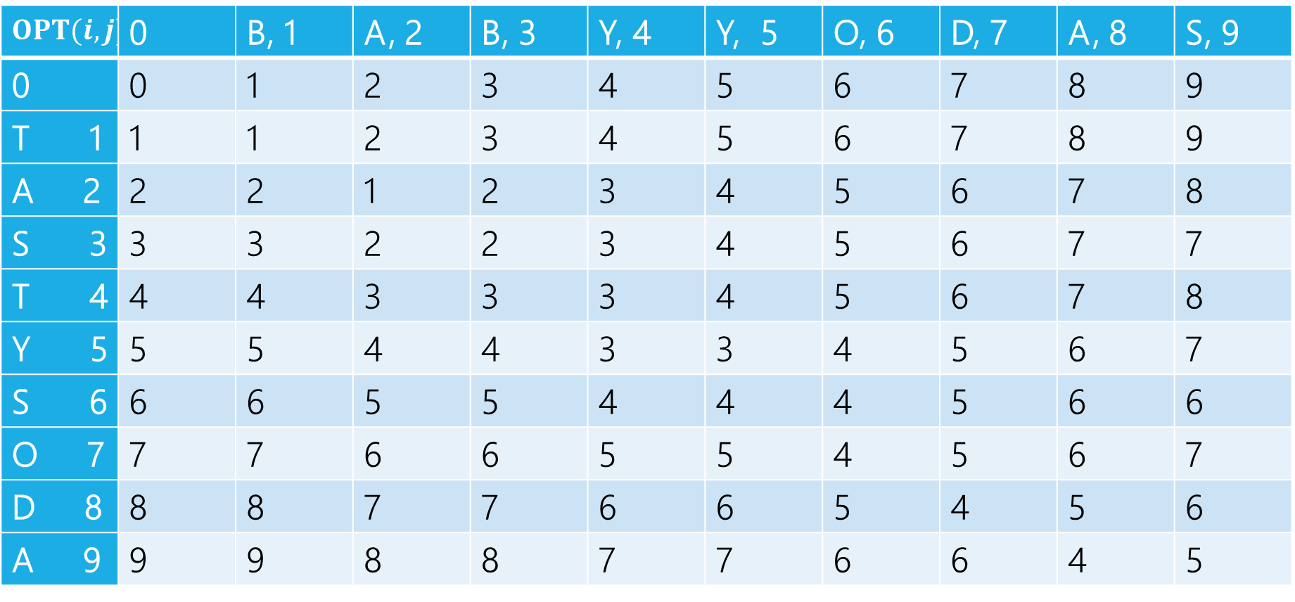
Edit Distance
$$OPT(i,j)$$ | 0 | B, 1 | A, 2 | B, 3 | Y, 4 | Y, 5 | O, 6 | D, 7 | A, 8 | S, 9
0 | 0 | 1 | 2 | 3 | 4 | 5 | 6 | 7 | 8 | 9
T 1 | 1 | 1 | 2 | 3 | 4 | 5 | 6 | 7 | 8 | 9
A 2 | 2 | 2 | 1 | 2 | 3 | 4 | 5 | 6 | 7 | 8
S 3 | 3 | 3 | 2 | 2 | 3 | 4 | 5 | 6 | 7 | 7
T 4 | 4 | 4 | 3 | 3 | 3 | 4 | 5 | 6 | 7 | 8
Y 5 | 5 | 5 | 4 | 4 | 3 | 3 | 4 | 5 | 6 | 7
S 6 | 6 | 6 | 5 | 5 | 4 | 4 | 4 | 5 | 6 | 6
O 7 | 7 | 7 | 6 | 6 | 5 | 5 | 4 | 5 | 6 | 7
D 8 | 8 | 8 | 7 | 7 | 6 | 6 | 5 | 4 | 5 | 6
A 9 | 9 | 9 | 8 | 8 | 7 | 7 | 6 | 6 | 4 | 5

Slide 34
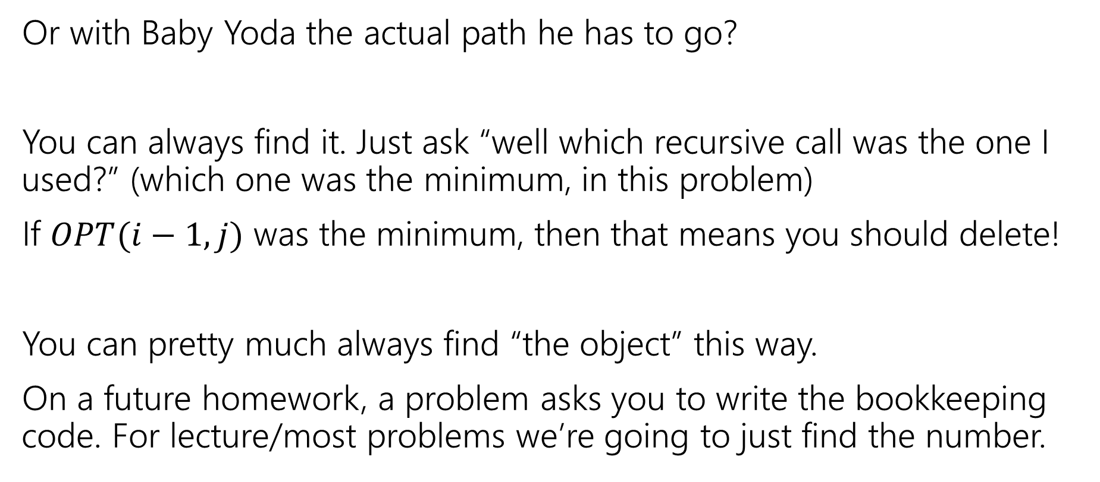
What if we want the list if inserts,delete,subs?
Or with Baby Yoda the actual path he has to go?
You can always find it. Just ask “well which recursive call was the one I used?” (which one was the minimum, in this problem)
If $OPT(i−1,j)$ was the minimum, then that means you should delete!
You can pretty much always find “the object” this way.
On a future homework, a problem asks you to write the bookkeeping code. For lecture/most problems we’re going to just find the number.

Slide 35
Edit Distance
$$OPT(i,j)$$ | 0 | B, 1 | A, 2 | B, 3 | Y, 4 | Y, 5 | O, 6 | D, 7 | A, 8 | S, 9
0 | 0 | 1 | 2 | 3 | 4 | 5 | 6 | 7 | 8 | 9
T 1 | 1 | 1 | 2 | 3 | 4 | 5 | 6 | 7 | 8 | 9
A 2 | 2 | 2 | 1 | 2 | 3 | 4 | 5 | 6 | 7 | 8
S 3 | 3 | 3 | 2 | 2 | 3 | 4 | 5 | 6 | 7 | 7
T 4 | 4 | 4 | 3 | 3 | 3 | 4 | 5 | 6 | 7 | 8
Y 5 | 5 | 5 | 4 | 4 | 3 | 3 | 4 | 5 | 6 | 7
S 6 | 6 | 6 | 5 | 5 | 4 | 4 | 4 | 5 | 6 | 6
O 7 | 7 | 7 | 6 | 6 | 5 | 5 | 4 | 5 | 6 | 7
D 8 | 8 | 8 | 7 | 7 | 6 | 6 | 5 | 4 | 5 | 6
A 9 | 9 | 9 | 8 | 8 | 7 | 7 | 6 | 6 | 4 | 5

Slide 36
Edit Distance
$$OPT(i,j)$$ | 0 | B, 1 | A, 2 | B, 3 | Y, 4 | Y, 5 | O, 6 | D, 7 | A, 8 | S, 9
0 | 0 | 1 | 2 | 3 | 4 | 5 | 6 | 7 | 8 | 9
T 1 | 1 | 1 | 2 | 3 | 4 | 5 | 6 | 7 | 8 | 9
A 2 | 2 | 2 | 1 | 2 | 3 | 4 | 5 | 6 | 7 | 8
S 3 | 3 | 3 | 2 | 2 | 3 | 4 | 5 | 6 | 7 | 7
T 4 | 4 | 4 | 3 | 3 | 3 | 4 | 5 | 6 | 7 | 8
Y 5 | 5 | 5 | 4 | 4 | 3 | 3 | 4 | 5 | 6 | 7
S 6 | 6 | 6 | 5 | 5 | 4 | 4 | 4 | 5 | 6 | 6
O 7 | 7 | 7 | 6 | 6 | 5 | 5 | 4 | 5 | 6 | 7
D 8 | 8 | 8 | 7 | 7 | 6 | 6 | 5 | 4 | 5 | 6
A 9 | 9 | 9 | 8 | 8 | 7 | 7 | 6 | 6 | 4 | 5

Slide 37
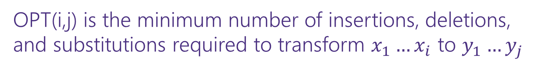
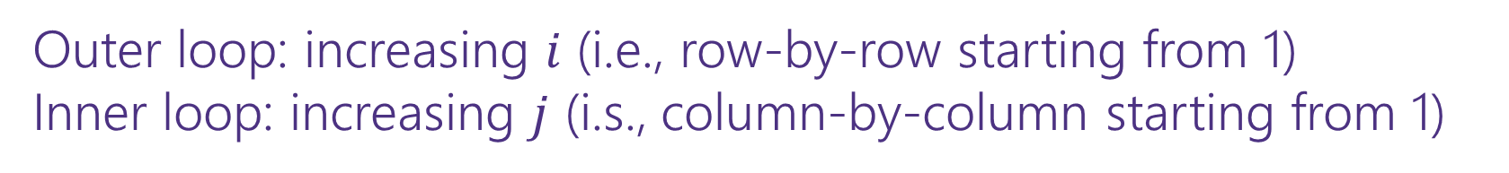
Dynamic Programming Process
1. Define the object you’re looking for
2. Write a recurrence to say how to find it
3. Design a memoization structure
4. Write an iterative algorithm
OPT(i,j) is the minimum number of insertions, deletions, and substitutions required to transform $x_{1}…x_{i}$ to $y_{1}…y_{j}$
✅
$m×n$ Array
Outer loop: increasing $i$ (i.e., row-by-row starting from 1)
Inner loop: increasing $j$ (i.s., column-by-column starting from 1)

Slide 38
Some General Advice

Slide 39
Recursive Thinking In General
As before, the hardest part is designing the recurrence.
It sometimes helps to think from multiple different angles.
Top-down: What’s the first step to take?
Baby Yoda will first go left or down. Use recursion to find out which of left or down is better.
The farthest right operation in the string transformation will be one of insert, delete, substitute, match for free. Use recursion to find out which is best.

Slide 40
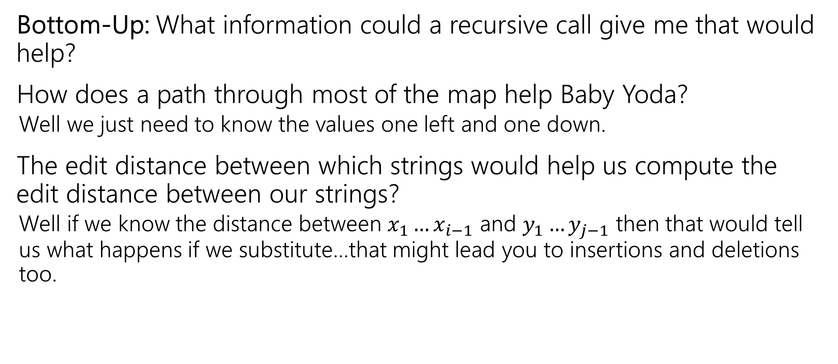
Recursive Thinking In General
Bottom-Up: What information could a recursive call give me that would help?
How does a path through most of the map help Baby Yoda?
  Well we just need to know the values one left and one down.
The edit distance between which strings would help us compute the edit distance between our strings?
  Well if we know the distance between $x_{1}…x_{i−1}$ and $y_{1}…y_{j−1}$ then that would tell us what happens if we substitute…that might lead you to insertions and deletions too.

Slide 41
Recursive Thinking In General
Some people refer to the “Optimal Substructure Property”
From the optimum (most eggs, fewest number of string operations) for a slightly smaller problem (Baby Yoda starting closer to the end, slightly smaller strings), we need to be able to build up the optimum for the full problem.

Slide 42
Longest Increasing Subsequence

Slide 43
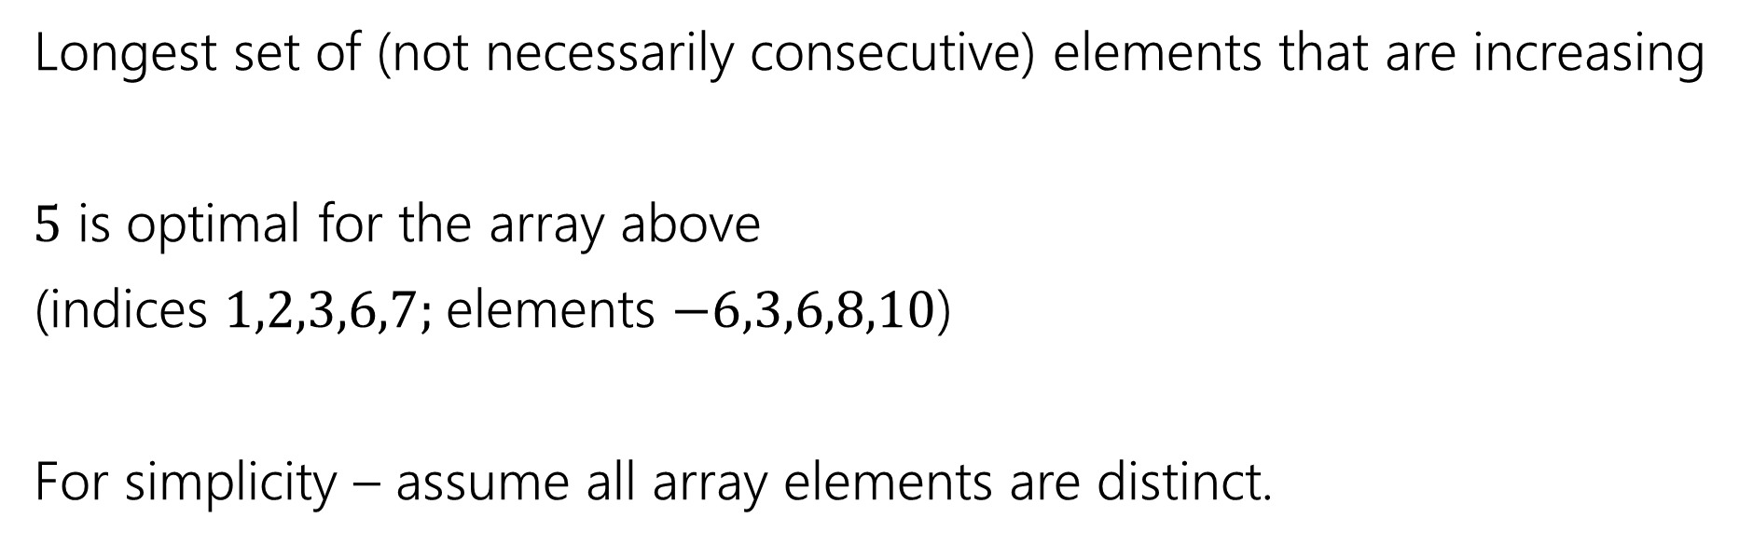
Longest Increasing Subsequence
0 | 1 | 2 | 3 | 4 | 5 | 6 | 7
5 | -6 | 3 | 6 | -5 | 2 | 8 | 10
Longest set of (not necessarily consecutive) elements that are increasing
$5$ is optimal for the array above
(indices $1,2,3,6,7;$elements $−6,3,6,8,10$)
For simplicity – assume all array elements are distinct.

Slide 44
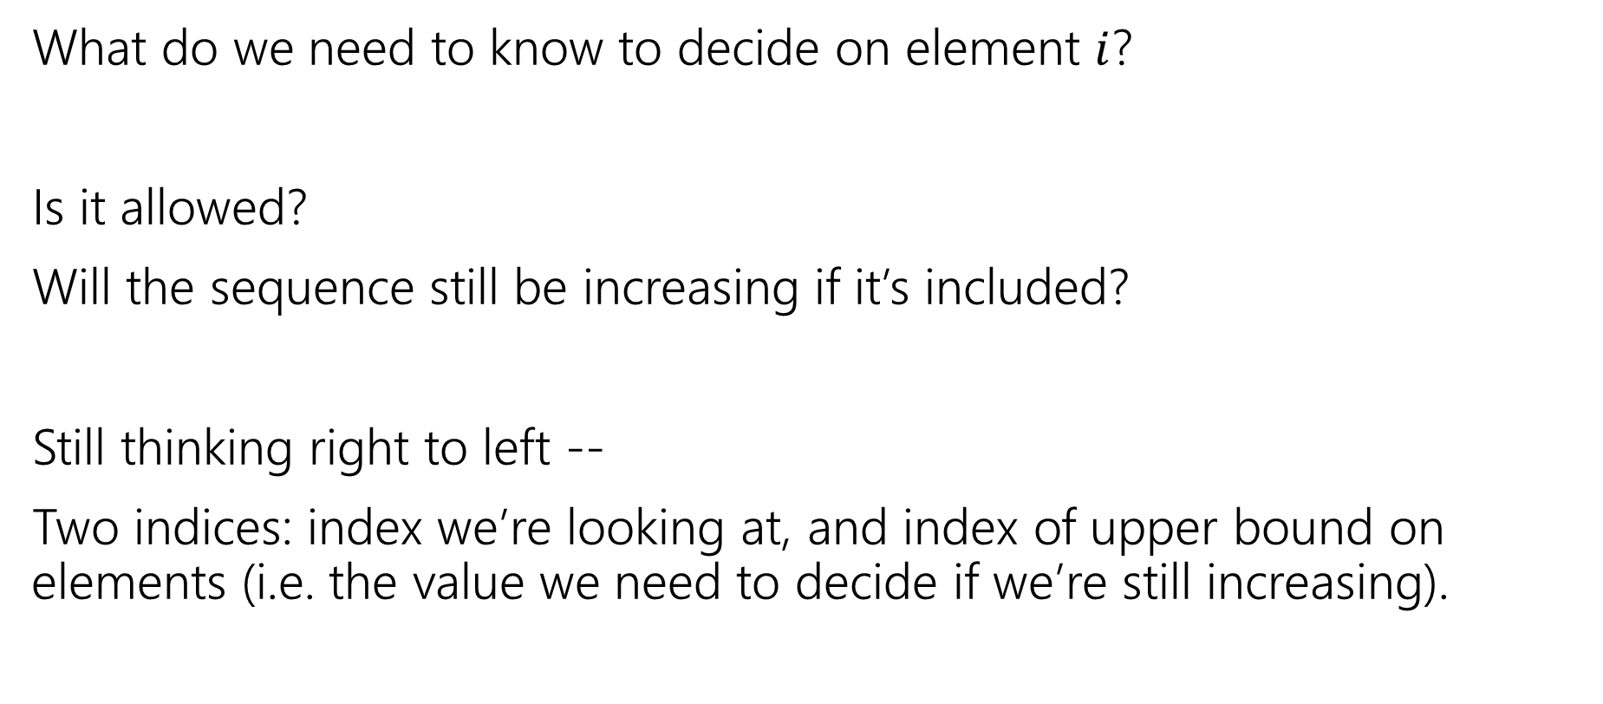
Longest Increasing Subsequence
What do we need to know to decide on element $i$?
Is it allowed?
Will the sequence still be increasing if it’s included?
Still thinking right to left --
Two indices: index we’re looking at, and index of upper bound on elements (i.e. the value we need to decide if we’re still increasing).

Slide 45

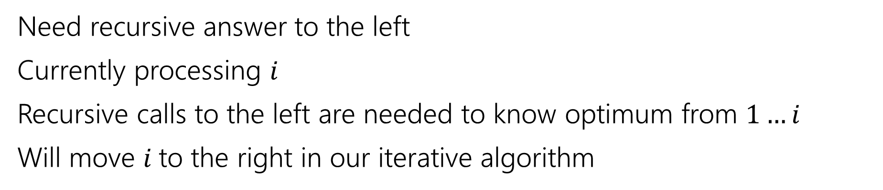
Recurrence
0 | 1 | 2 | 3 | 4 | 5 | 6 | 7
5 | -6 | 3 | 6 | -5 | 2 | 8 | 10
Recursive call is best value in this area
Current $i$
Not yet processed.
Need recursive answer to the left
Currently processing $i$
Recursive calls to the left are needed to know optimum from $1…i$
Will move $i$to the right in our iterative algorithm

Slide 46
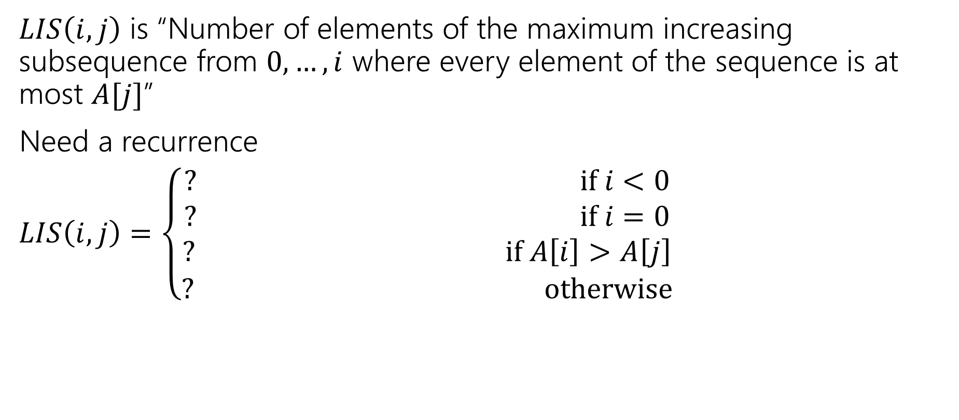
Longest Increasing Subsequence
$LIS\left(i,j\right)$ is “Number of elements of the maximum increasing subsequence from $0,…,i$ where every element of the sequence is at most $A[j]$”
Need a recurrence
$LIS\left(i,j\right)=\left\{\begin{aligned}? if i<0 \\ ? if i=0 \\ ? if A\left[i\right]>A\left[j\right] \\ ? otherwise\end{aligned}\right.$

Slide 47
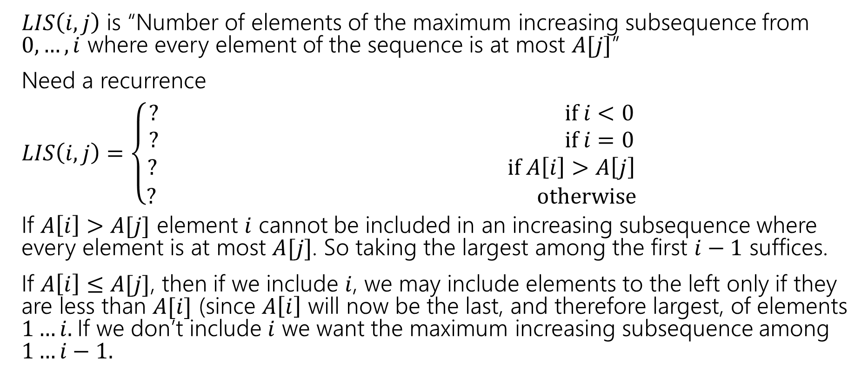
Longest Increasing Subsequence
$LIS\left(i,j\right)$ is “Number of elements of the maximum increasing subsequence from $0,…,i$ where every element of the sequence is at most $A[j]$”
Need a recurrence
$LIS\left(i,j\right)=\left\{\begin{aligned}? if i<0 \\ ? if i=0 \\ ? if A\left[i\right]>A\left[j\right] \\ ? otherwise\end{aligned}\right.$
If $A\left[i\right]>A[j]$ element $i$ cannot be included in an increasing subsequence where every element is at most $A[j]$. So taking the largest among the first $i−1$ suffices.
If $A\left[i\right]≤A[j]$, then if we include $i$, we may include elements to the left only if they are less than $A[i]$ (since $A\left[i\right]$ will now be the last, and therefore largest, of elements $1…i.$If we don’t include $i$ we want the maximum increasing subsequence among $1…i−1.$

Slide 48
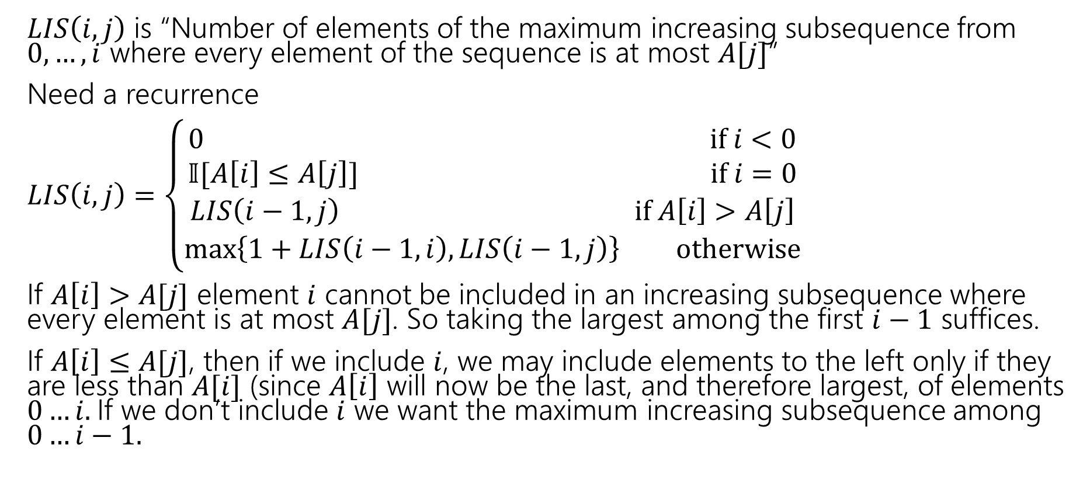
Longest Increasing Subsequence
$LIS\left(i,j\right)$ is “Number of elements of the maximum increasing subsequence from $0,…,i$ where every element of the sequence is at most $A[j]$”
Need a recurrence
$LIS\left(i,j\right)=\left\{\begin{aligned}0 if i<0 \\ 𝕀[A\left[i\right]≤A\left[j\right]] if i=0 \\ LIS\left(i−1,j\right) if A\left[i\right]>A\left[j\right] \\ \max\left\{1+LIS\left(i−1,i\right), LIS\left(i−1,j\right)\right\} otherwise\end{aligned}\right.$
If $A\left[i\right]>A[j]$ element $i$ cannot be included in an increasing subsequence where every element is at most $A[j]$. So taking the largest among the first $i−1$ suffices.
If $A\left[i\right]≤A[j]$, then if we include $i$, we may include elements to the left only if they are less than $A[i]$ (since $A\left[i\right]$ will now be the last, and therefore largest, of elements $0…i.$If we don’t include $i$ we want the maximum increasing subsequence among $0…i−1.$

Slide 49

Longest Increasing Subsequence
$LIS\left(i,j\right)=\left\{\begin{aligned}0 if i<0 \\ 𝕀[A\left[i\right]≤A\left[j\right]] if i=0 \\ LIS\left(i−1,j\right) if A\left[i\right]>A\left[j\right] \\ \max\left\{1+LIS\left(i−1,i\right), LIS\left(i−1,j\right)\right\} otherwise\end{aligned}\right.$
Memoization structure? $n×n$ array.
Filling order?

Slide 50


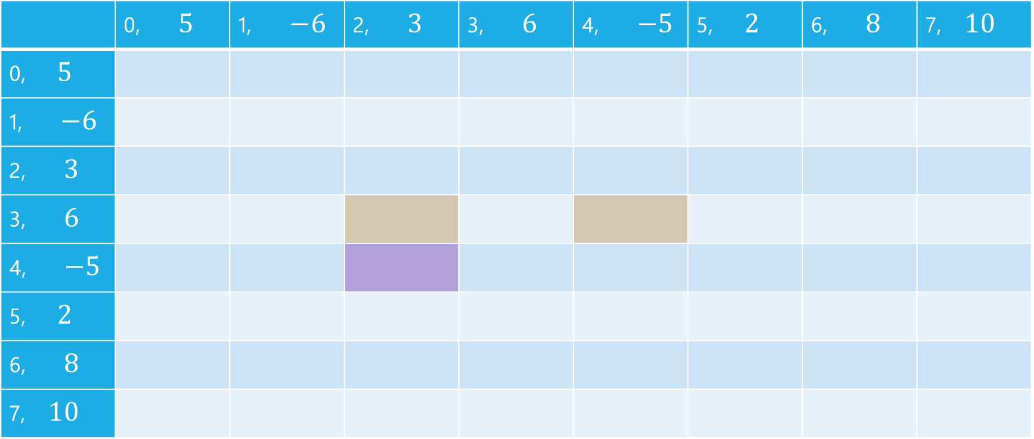


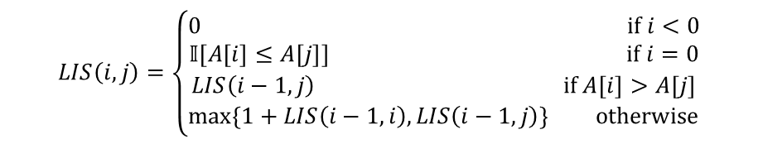
LIS
$$LIS\left(i,j\right)=\left\{\begin{aligned}0 if i<0 \\ 𝕀[A\left[i\right]≤A\left[j\right]] if i=0 \\ LIS\left(i−1,j\right) if A\left[i\right]>A\left[j\right] \\ \max\left\{1+LIS\left(i−1,i\right), LIS\left(i−1,j\right)\right\} otherwise\end{aligned}\right.$$
$$j$$
 | 0, $5$ | 1, $−6$ | 2, $3$ | 3, $6$ | 4, $−5$ | 5, $2$ | 6, $8$ | 7, $10$
0, $5$
1, $−6$
2, $3$
3, $6$
4, $−5$
5, $2$
6, $8$
7, $10$
$$i$$

Slide 51
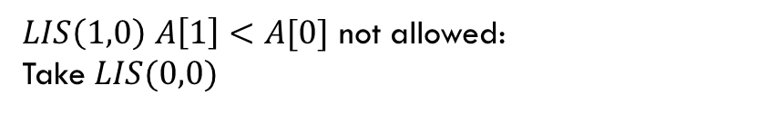
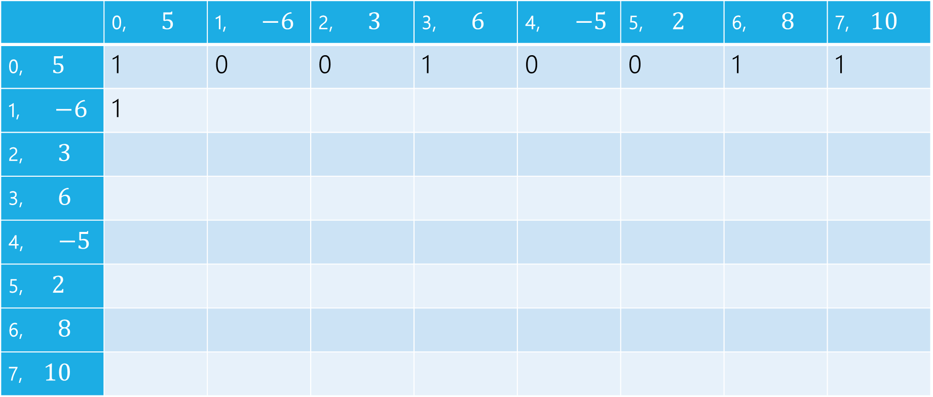
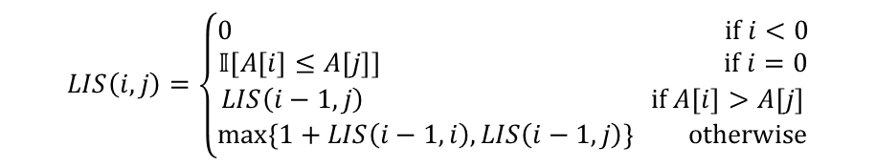
LIS
$LIS\left(1,0\right)$ $A\left[1\right]<A[0]$ not allowed:
Take $LIS(0,0)$
$$LIS\left(i,j\right)=\left\{\begin{aligned}0 if i<0 \\ 𝕀[A\left[i\right]≤A\left[j\right]] if i=0 \\ LIS\left(i−1,j\right) if A\left[i\right]>A\left[j\right] \\ \max\left\{1+LIS\left(i−1,i\right), LIS\left(i−1,j\right)\right\} otherwise\end{aligned}\right.$$
$$j$$
 | 0, $5$ | 1, $−6$ | 2, $3$ | 3, $6$ | 4, $−5$ | 5, $2$ | 6, $8$ | 7, $10$
0, $5$ | 1 | 0 | 0 | 1 | 0 | 0 | 1 | 1
1, $−6$ | 1
2, $3$
3, $6$
4, $−5$
5, $2$
6, $8$
7, $10$
$$i$$

Slide 52

LIS
$LIS\left(1,1\right)$ $A\left[1\right]≤A[1]$ can add, $1+LIS(0,1)$ or $LIS(0,1)$
$$LIS\left(i,j\right)=\left\{\begin{aligned}0 if i<0 \\ 𝕀[A\left[i\right]≤A\left[j\right]] if i=0 \\ LIS\left(i−1,j\right) if A\left[i\right]>A\left[j\right] \\ \max\left\{1+LIS\left(i−1,i\right), LIS\left(i−1,j\right)\right\} otherwise\end{aligned}\right.$$
$$j$$
 | 0, $5$ | 1, $−6$ | 2, $3$ | 3, $6$ | 4, $−5$ | 5, $2$ | 6, $8$ | 7, $10$
0, $5$ | 1 | 0 | 0 | 1 | 0 | 0 | 1 | 1
1, $−6$ | 1 | 1
2, $3$
3, $6$
4, $−5$
5, $2$
6, $8$
7, $10$
$$i$$

Slide 53

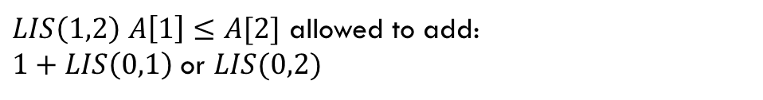
LIS
$LIS\left(1,2\right)$ $A\left[1\right]≤A[2]$ allowed to add:
$1+LIS\left(0,1\right)$ or $LIS(0,2)$
$$LIS\left(i,j\right)=\left\{\begin{aligned}0 if i<0 \\ 𝕀[A\left[i\right]≤A\left[j\right]] if i=0 \\ LIS\left(i−1,j\right) if A\left[i\right]>A\left[j\right] \\ \max\left\{1+LIS\left(i−1,i\right), LIS\left(i−1,j\right)\right\} otherwise\end{aligned}\right.$$
$$j$$
 | 0, $5$ | 1, $−6$ | 2, $3$ | 3, $6$ | 4, $−5$ | 5, $2$ | 6, $8$ | 7, $10$
0, $5$ | 1 | 0 | 0 | 1 | 0 | 0 | 1 | 1
1, $−6$ | 1 | 1 | 1
2, $3$
3, $6$
4, $−5$
5, $2$
6, $8$
7, $10$
$$i$$

Slide 54
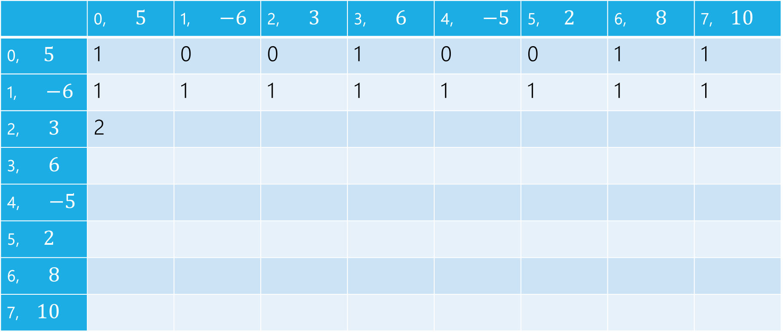
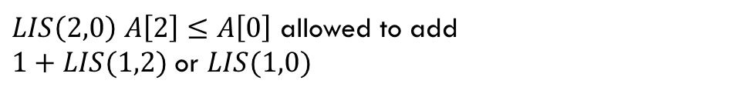
LIS
$LIS\left(2,0\right)$ $A\left[2\right]≤A\left[0\right]$ allowed to add
$1+LIS(1,2)$ or $LIS(1,0)$
$$LIS\left(i,j\right)=\left\{\begin{aligned}0 if i<0 \\ 𝕀[A\left[i\right]≤A\left[j\right]] if i=0 \\ LIS\left(i−1,j\right) if A\left[i\right]>A\left[j\right] \\ \max\left\{1+LIS\left(i−1,i\right), LIS\left(i−1,j\right)\right\} otherwise\end{aligned}\right.$$
$$j$$
 | 0, $5$ | 1, $−6$ | 2, $3$ | 3, $6$ | 4, $−5$ | 5, $2$ | 6, $8$ | 7, $10$
0, $5$ | 1 | 0 | 0 | 1 | 0 | 0 | 1 | 1
1, $−6$ | 1 | 1 | 1 | 1 | 1 | 1 | 1 | 1
2, $3$ | 2
3, $6$
4, $−5$
5, $2$
6, $8$
7, $10$
$$i$$

Slide 55
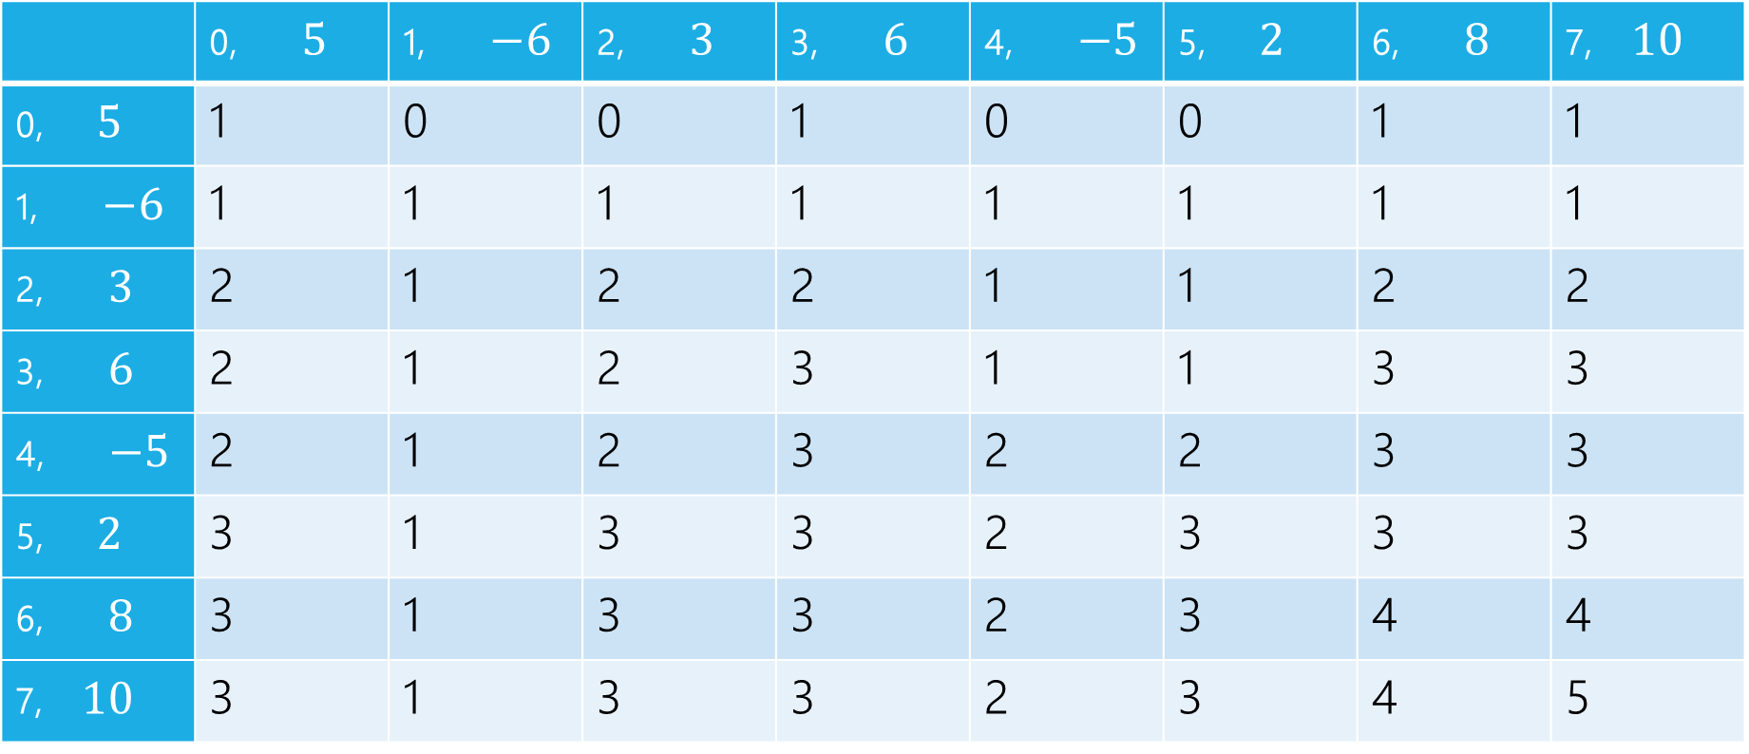
LIS
$$LIS\left(i,j\right)=\left\{\begin{aligned}0 if i<0 \\ 𝕀[A\left[i\right]≤A\left[j\right]] if i=0 \\ LIS\left(i−1,j\right) if A\left[i\right]>A\left[j\right] \\ \max\left\{1+LIS\left(i−1,i\right), LIS\left(i−1,j\right)\right\} otherwise\end{aligned}\right.$$
$$j$$
 | 0, $5$ | 1, $−6$ | 2, $3$ | 3, $6$ | 4, $−5$ | 5, $2$ | 6, $8$ | 7, $10$
0, $5$ | 1 | 0 | 0 | 1 | 0 | 0 | 1 | 1
1, $−6$ | 1 | 1 | 1 | 1 | 1 | 1 | 1 | 1
2, $3$ | 2 | 1 | 2 | 2 | 1 | 1 | 2 | 2
3, $6$ | 2 | 1 | 2 | 3 | 1 | 1 | 3 | 3
4, $−5$ | 2 | 1 | 2 | 3 | 2 | 2 | 3 | 3
5, $2$ | 3 | 1 | 3 | 3 | 2 | 3 | 3 | 3
6, $8$ | 3 | 1 | 3 | 3 | 2 | 3 | 4 | 4
7, $10$ | 3 | 1 | 3 | 3 | 2 | 3 | 4 | 5
$$i$$

Slide 56
pseudocode
//real code snippet that actually generated the table on the last slide
for(int j=0; j < n; j++){
vals[0][j] = (A[0] <= A[j]) ? 1 : 0;
}
for(int i = 1; i < 8; i++){
for(int j = 0; j < n; j++){
if(A[i] > A[j])
vals[i][j] = vals[i-1][j];
else{
vals[i][j] = Math.max(1+vals[i-1][i], vals[i-1][j]);
}
}
}

