Slide 1
Even More
Dynamic Programming
CSE 417 24Wi
Lecture 12

Slide 2
Modifying Problems

Slide 3
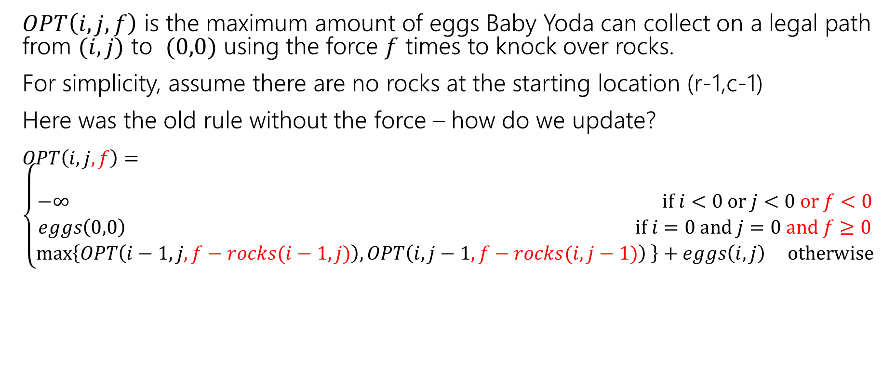
Updating the Problem
$OPT\left(i,j,f\right)$ is the maximum amount of eggs Baby Yoda can collect on a legal path from $(i,j)$ to $(0,0)$ using the force $f$ times to knock over rocks.
For simplicity, assume there are no rocks at the starting location (r-1,c-1)
Here was the old rule without the force – how do we update?
$OPT\left(i,j,f\right)=\left\{\begin{aligned} \\ −∞ if i<0 or j<0 or f<0 \\ eggs\left(0,0\right) if i=0 and j=0 and f≥0 \\ \max\left\{OPT\left(i−1,j,f−rocks(i−1,j)\right), OPT\left(i,j−1,f−rocks(i,j−1)\right) \right\}+eggs\left(i,j\right) otherwise\end{aligned}\right.$
Casting Boolean as an integer
(subtract 1 if you would need to knock over rocks)

Slide 4
Updating the Problem
$OPT\left(i,j,f\right)$ is the maximum amount of eggs Baby Yoda can collect on a legal path from $(i,j)$ to $(0,0)$ using the force $f$ times to knock over rocks.
For simplicity, assume there are no rocks at the starting location (r-1,c-1)
Here was the old rule without the force – how do we update?
$OPT\left(i,j,f\right)=\left\{\begin{aligned} \\ −∞ if i<0 or j<0 or f<0 \\ eggs\left(0,0\right) if i=0 and j=0 and f≥0 \\ \max\left\{OPT\left(i−1,j,f−rocks(i−1,j)\right), OPT\left(i,j−1,f−rocks(i,j−1)\right) \right\}+eggs\left(i,j\right) otherwise\end{aligned}\right.$
rocks(i,j) doesn’t guarantee $−∞$ anymore. Only if you were out of force uses before trying to jump onto that location.

Slide 5
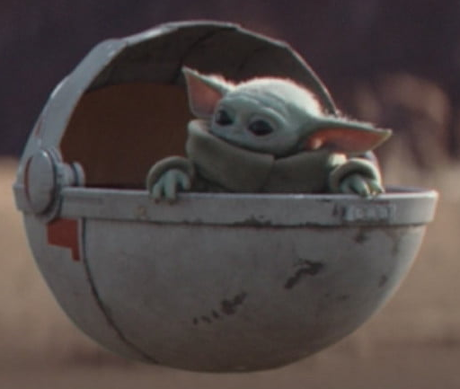
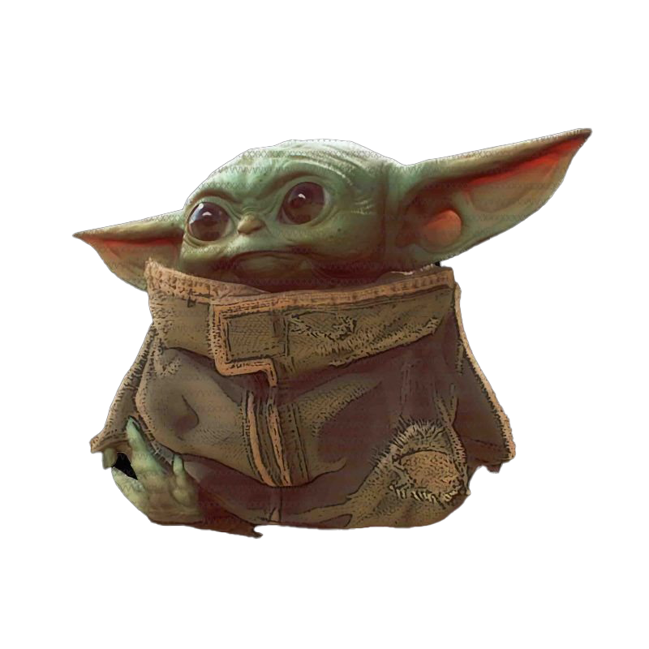
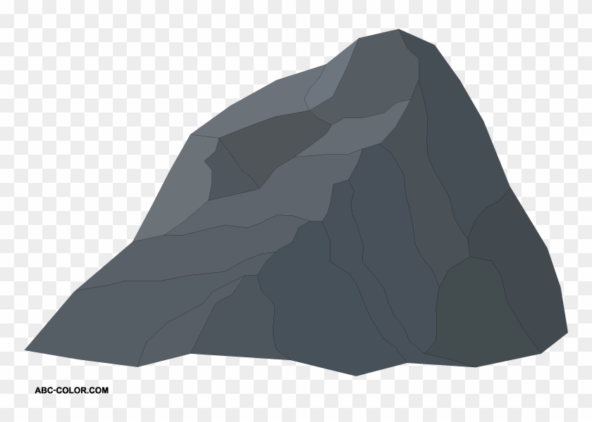
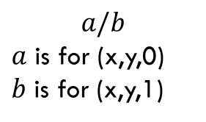
Baby Yoda Searching
(c-1,r-1)
r-1
What can we fill in?
Y-coordinate
$$a/b$$
$a$ is for (x,y,0)
$b$ is for (x,y,1)
0
X-coordinate
0
c-1
Notes:
https://1.bp.blogspot.com/-XxfNI65zLnU/Xc98O96LVnI/AAAAAAAAGFY/Xsmd7IMlIrEltYONCdGKk1hqPw1BgL3ggCLcBGAsYHQ/s1600/Mandalorian.jpg
http://www.pngmart.com/image/161116/png/161115
https://www.pikpng.com/pngvi/hiTxbbR_clip-art-rock-rock-clipart-transparent-background-png-download/

Slide 6








Baby Yoda Searching
(c-1,r-1)
r-1
What can we fill in?
Y-coordinate
$$a/b$$
$a$ is for (x,y,0)
$b$ is for (x,y,1)
0
$$0/?$$
$$1/?$$
$$2/?$$
$$2/?$$
$$2/?$$
$$2/?$$
$$2/?$$
$$2/?$$
X-coordinate
0
c-1
Notes:
https://1.bp.blogspot.com/-XxfNI65zLnU/Xc98O96LVnI/AAAAAAAAGFY/Xsmd7IMlIrEltYONCdGKk1hqPw1BgL3ggCLcBGAsYHQ/s1600/Mandalorian.jpg
http://www.pngmart.com/image/161116/png/161115
https://www.pikpng.com/pngvi/hiTxbbR_clip-art-rock-rock-clipart-transparent-background-png-download/

Slide 7


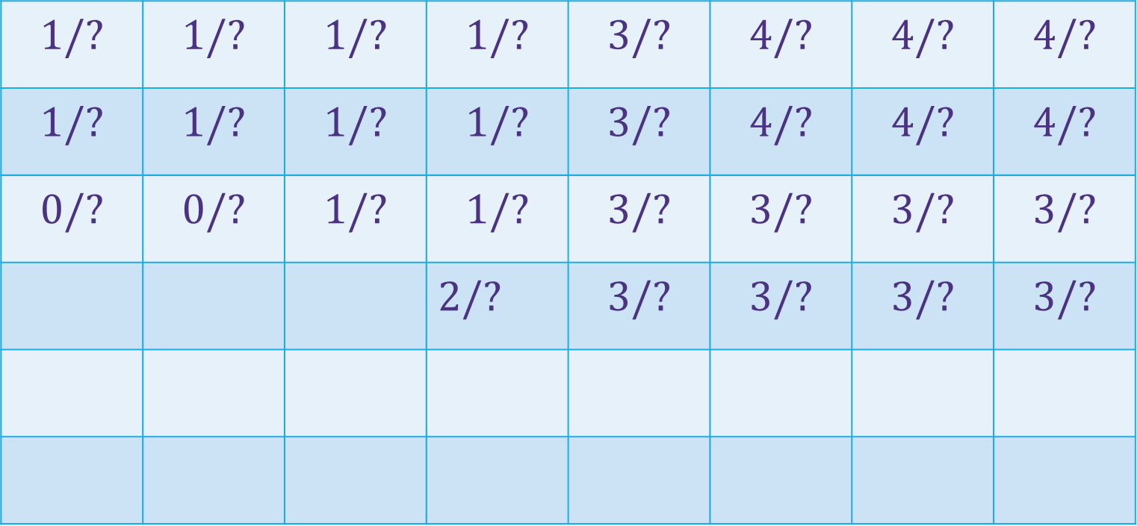





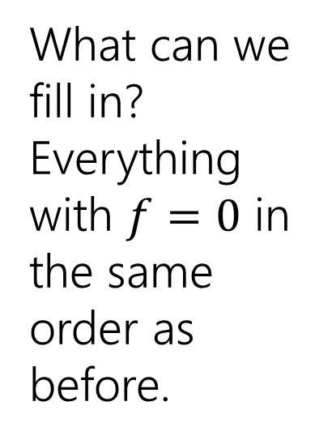







Baby Yoda Searching
(c-1,r-1)
$$1/?$$ | $$1/?$$ | $$1/?$$ | $$1/?$$ | $$3/?$$ | $$4/?$$ | $$4/?$$ | $$4/?$$
$$1/?$$ | $$1/?$$ | $$1/?$$ | $$1/?$$ | $$3/?$$ | $$4/?$$ | $$4/?$$ | $$4/?$$
$$0/?$$ | $$0/?$$ | $$1/?$$ | $$1/?$$ | $$3/?$$ | $$3/?$$ | $$3/?$$ | $$3/?$$
 |  |  | $2/?$ | $$3/?$$ | $$3/?$$ | $$3/?$$ | $$3/?$$
r-1
What can we fill in?
Everything with $f=0$ in the same order as before.
Y-coordinate
$$0/?$$
$$1/?$$
$$−∞/?$$
$$0/?$$
$$1/?$$
$$2/?$$
$$2/?$$
$$2/?$$
$$2/?$$
$$2/?$$
$$2/?$$
0
$$0/?$$
$$1/?$$
$$2/?$$
$$2/?$$
$$2/?$$
$$2/?$$
$$2/?$$
$$2/?$$
Entries are slightly different – we’re handling rocks differently.
X-coordinate
0
c-1
Notes:
https://1.bp.blogspot.com/-XxfNI65zLnU/Xc98O96LVnI/AAAAAAAAGFY/Xsmd7IMlIrEltYONCdGKk1hqPw1BgL3ggCLcBGAsYHQ/s1600/Mandalorian.jpg
http://www.pngmart.com/image/161116/png/161115
https://www.pikpng.com/pngvi/hiTxbbR_clip-art-rock-rock-clipart-transparent-background-png-download/

Slide 8
Baby Yoda Searching
(c-1,r-1)
$$1/?$$ | $$1/?$$ | $$1/?$$ | $$1/?$$ | $$3/?$$ | $$4/?$$ | $$4/?$$ | $$4/?$$
$$1/?$$ | $$1/?$$ | $$1/?$$ | $$1/?$$ | $$3/?$$ | $$4/?$$ | $$4/?$$ | $$4/?$$
$$0/?$$ | $$0/?$$ | $$1/?$$ | $$1/?$$ | $$3/?$$ | $$3/?$$ | $$3/?$$ | $$3/?$$
 |  |  | $2/?$ | $$3/?$$ | $$3/?$$ | $$3/?$$ | $$3/?$$
r-1
What can we fill in?
Again from left to right, bottom to top, now filling in
Y-coordinate
$$0/?$$
$$1/?$$
$$−∞/?$$
$$0/?$$
$$1/?$$
$$2/?$$
$$2/?$$
$$2/?$$
$$2/?$$
$$2/?$$
$$2/?$$
0
$$0/?$$
$$1/?$$
$$2/?$$
$$2/?$$
$$2/?$$
$$2/?$$
$$2/?$$
$$2/?$$
X-coordinate
0
c-1
Notes:
https://1.bp.blogspot.com/-XxfNI65zLnU/Xc98O96LVnI/AAAAAAAAGFY/Xsmd7IMlIrEltYONCdGKk1hqPw1BgL3ggCLcBGAsYHQ/s1600/Mandalorian.jpg
http://www.pngmart.com/image/161116/png/161115
https://www.pikpng.com/pngvi/hiTxbbR_clip-art-rock-rock-clipart-transparent-background-png-download/

Slide 9



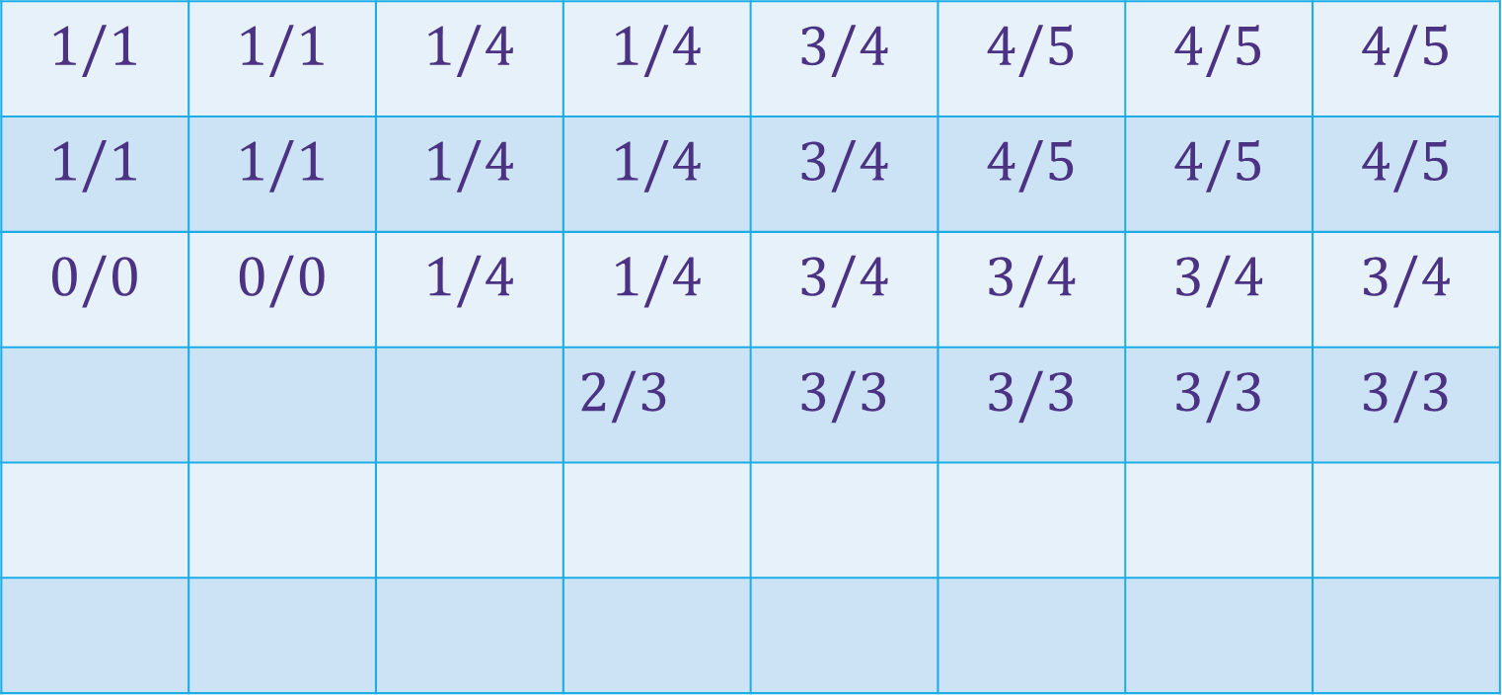
















Baby Yoda Searching
(c-1,r-1)
$$1/1$$ | $$1/1$$ | $$1/4$$ | $$1/4$$ | $$3/4$$ | $$4/5$$ | $$4/5$$ | $$4/5$$
$$1/1$$ | $$1/1$$ | $$1/4$$ | $$1/4$$ | $$3/4$$ | $$4/5$$ | $$4/5$$ | $$4/5$$
$$0/0$$ | $$0/0$$ | $$1/4$$ | $$1/4$$ | $$3/4$$ | $$3/4$$ | $$3/4$$ | $$3/4$$
 |  |  | $2/3$ | $$3/3$$ | $$3/3$$ | $$3/3$$ | $$3/3$$
r-1
What can we fill in?
Again from left to right, bottom to top, now filling in
Y-coordinate
$$0/0$$
$$1/1$$
$$−∞/3$$
$$0/0$$
$$1/1$$
$$2/2$$
$$2/2$$
$$2/2$$
$$2/2$$
$$2/2$$
$$2/2$$
0
$$0/0$$
$$1/1$$
$$2/2$$
$$2/2$$
$$2/2$$
$$2/2$$
$$2/2$$
$$2/2$$
X-coordinate
0
c-1
Notes:
https://1.bp.blogspot.com/-XxfNI65zLnU/Xc98O96LVnI/AAAAAAAAGFY/Xsmd7IMlIrEltYONCdGKk1hqPw1BgL3ggCLcBGAsYHQ/s1600/Mandalorian.jpg
http://www.pngmart.com/image/161116/png/161115
https://www.pikpng.com/pngvi/hiTxbbR_clip-art-rock-rock-clipart-transparent-background-png-download/

Slide 10
Dynamic Programming Process
1. Define the object you’re looking for
2. Write a recurrence to say how to find it
3. Design a memoization structure
4. Write an iterative algorithm

Slide 11
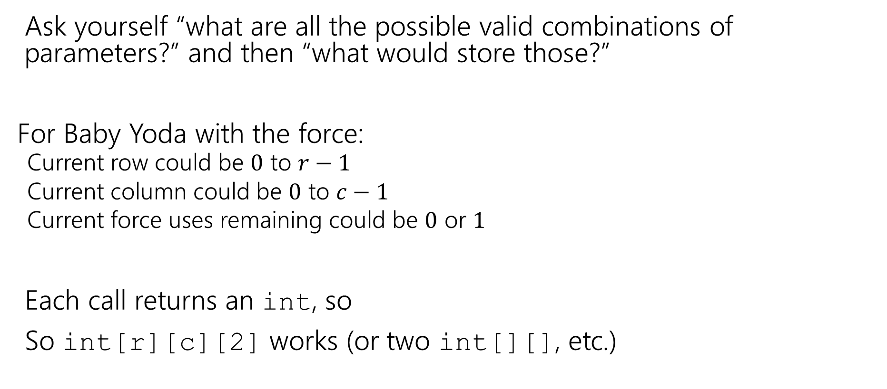
How we decide on the memo structure?
Ask yourself “what are all the possible valid combinations of parameters?” and then “what would store those?”
For Baby Yoda with the force:
  Current row could be $0$ to $r−1$
  Current column could be $0$ to $c−1$
  Current force uses remaining could be $0$ or $1$
Each call returns an int, so
So int[r][c][2] works (or two int[][], etc.)

Slide 12
But how does it work?
The key to DP is having a recursive call for every (plausible) choice you could make.
We could go left or down (we could use the force here or save it for later).
The magic of recursion checks all the possibilities (if it’s better to “save” using the force for later, you check the option that ‘goes around’ by making a different decision earlier).
It’s not your job to figure out a rule (“we should go to the left when there aren’t rocks in the way and the number of eggs in the row is at least 3 or there is a set of rock directly below you…”) recursion builds up the best options automatically by trying all options.

Slide 13
Bells,Whistles, and optimiziation

Slide 14
Baby Yoda Searching
(c-1,r-1)
$$1/1$$ | $$1/1$$ | $$1/4$$ | $$1/4$$ | $$3/4$$ | $$4/5$$ | $$4/5$$ | $$4/5$$
$$1/1$$ | $$1/1$$ | $$1/4$$ | $$1/4$$ | $$3/4$$ | $$4/5$$ | $$4/5$$ | $$4/5$$
$$0/0$$ | $$0/0$$ | $$1/4$$ | $$1/4$$ | $$3/4$$ | $$3/4$$ | $$3/4$$ | $$3/4$$
 |  |  | $2/3$ | $$3/3$$ | $$3/3$$ | $$3/3$$ | $$3/3$$
r-1
So should Baby Yoda go left or down?
Y-coordinate
$$0/0$$
$$1/1$$
$$−∞/3$$
$$0/0$$
$$1/1$$
$$2/2$$
$$2/2$$
$$2/2$$
$$2/2$$
$$2/2$$
$$2/2$$
0
$$0/0$$
$$1/1$$
$$2/2$$
$$2/2$$
$$2/2$$
$$2/2$$
$$2/2$$
$$2/2$$
X-coordinate
0
c-1
Notes:
https://1.bp.blogspot.com/-XxfNI65zLnU/Xc98O96LVnI/AAAAAAAAGFY/Xsmd7IMlIrEltYONCdGKk1hqPw1BgL3ggCLcBGAsYHQ/s1600/Mandalorian.jpg
http://www.pngmart.com/image/161116/png/161115
https://www.pikpng.com/pngvi/hiTxbbR_clip-art-rock-rock-clipart-transparent-background-png-download/

Slide 15
Which Way to Go
When you’re taking the max in the recursive case, you can also record which option gave you the max.
That’s the way to go.
We’ll ask you to do that once…but for the most part we’ll just have you find the number.

Slide 16
Optimizing
Do we need all that memory?
Let’s go back to the simple version (no using the Force)

Slide 17
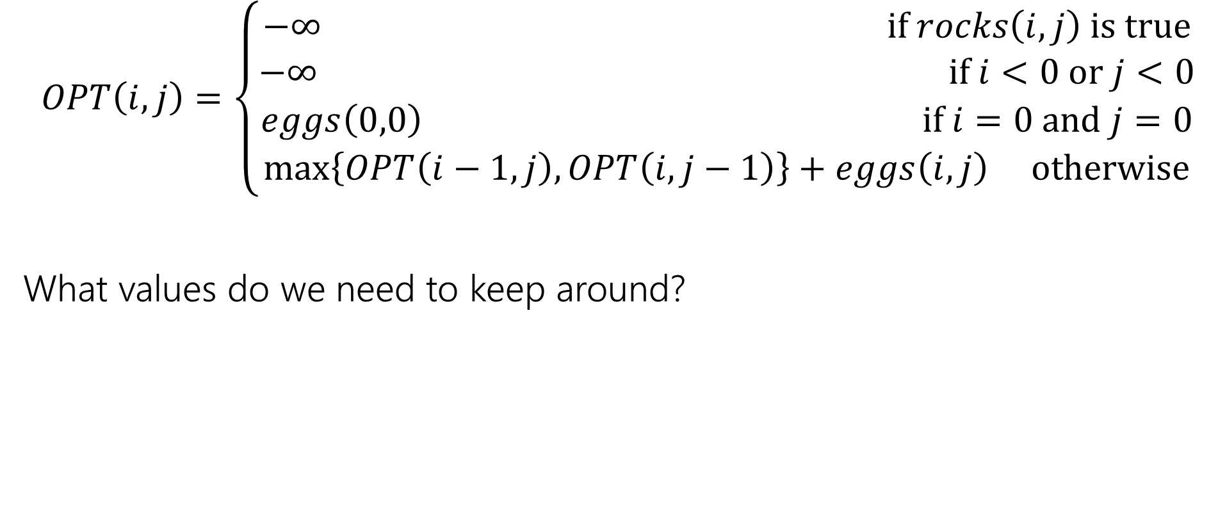
Recurrence Form
$$OPT\left(i,j\right)=\left\{\begin{aligned}−∞ if rocks\left(i,j\right) is true \\ −∞ if i<0 or j<0 \\ eggs\left(0,0\right) if i=0 and j=0 \\ \max\left\{OPT\left(i−1,j\right), OPT\left(i,j−1\right)\right\}+eggs\left(i,j\right) otherwise\end{aligned}\right.$$
What values do we need to keep around?
Notes:
Recurrence formulation of DP

Slide 18



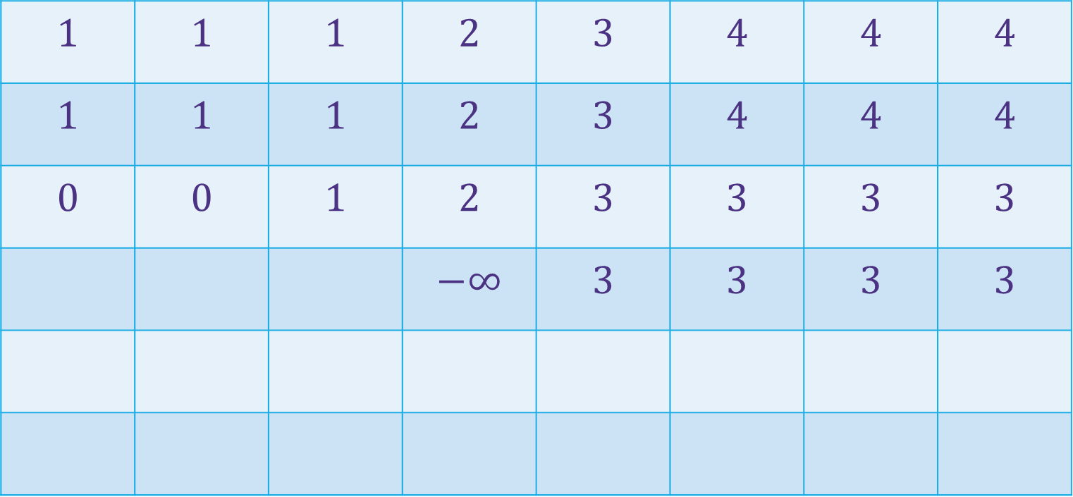







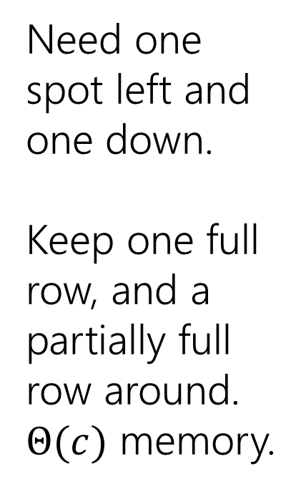









Baby Yoda Searching
(c-1,r-1)
$$1$$ | $$1$$ | $$1$$ | $$2$$ | $$3$$ | $$4$$ | $$4$$ | $$4$$
$$1$$ | $$1$$ | $$1$$ | $$2$$ | $$3$$ | $$4$$ | $$4$$ | $$4$$
$$0$$ | $$0$$ | $$1$$ | $$2$$ | $$3$$ | $$3$$ | $$3$$ | $$3$$
 |  |  | $$−∞$$ | $$3$$ | $$3$$ | $$3$$ | $$3$$
r-1
Need one spot left and one down.
Keep one full row, and a partially full row around.
$Θ(c)$ memory.
Y-coordinate
$$0$$
$$−∞$$
$$−∞$$
$$0$$
$$1$$
$$−∞$$
$$2$$
$$2$$
$$2$$
$$2$$
$$2$$
0
$$0$$
$$1$$
$$2$$
$$2$$
$$2$$
$$2$$
$$2$$
$$2$$
X-coordinate
0
c-1
Notes:
https://1.bp.blogspot.com/-XxfNI65zLnU/Xc98O96LVnI/AAAAAAAAGFY/Xsmd7IMlIrEltYONCdGKk1hqPw1BgL3ggCLcBGAsYHQ/s1600/Mandalorian.jpg
http://www.pngmart.com/image/161116/png/161115
https://www.pikpng.com/pngvi/hiTxbbR_clip-art-rock-rock-clipart-transparent-background-png-download/

Slide 19
More Problems

Slide 20

Maximum Contiguous Subarray Sum
We saw an $O(n\log{n)}$divide and conquer algorithm.
Can we do better with DP?
Given: Array $A$[]
Output: $i,j$ such that $A\left[i\right]+A\left[i+1\right]+…+A[j]$ is maximized.

Slide 21
Dynamic Programming Process
1. Define the object you’re looking for
2. Write a recurrence to say how to find it
3. Design a memoization structure
4. Write an iterative algorithm

Slide 22
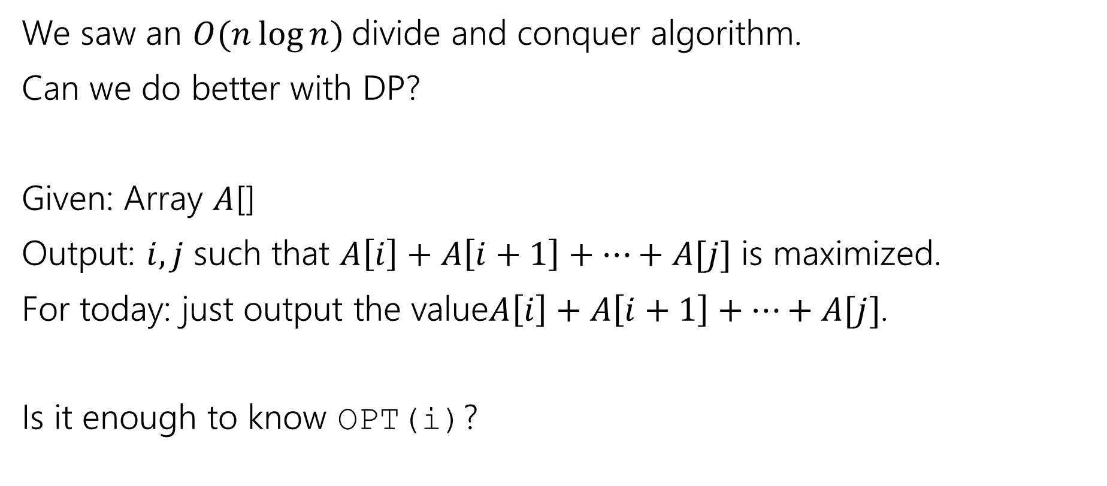
Maximum Contiguous Subarray Sum
We saw an $O(n\log{n)}$divide and conquer algorithm.
Can we do better with DP?
Given: Array $A$[]
Output: $i,j$ such that $A\left[i\right]+A\left[i+1\right]+…+A[j]$ is maximized.
For today: just output the value$A\left[i\right]+A\left[i+1\right]+…+A[j]$.
Is it enough to know OPT(i)?

Slide 23
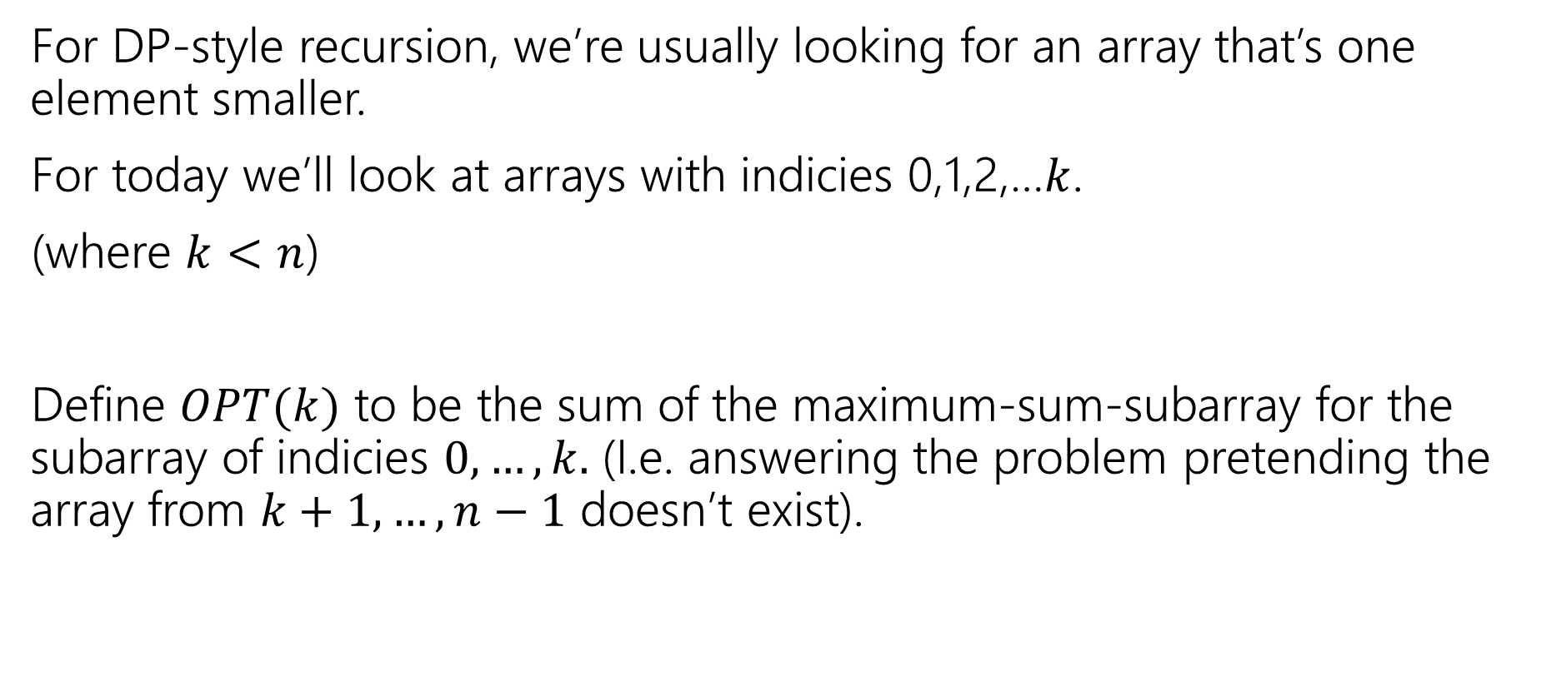
Approaching the problem recursively
For DP-style recursion, we’re usually looking for an array that’s one element smaller.
For today we’ll look at arrays with indicies 0,1,2,…$k$.
(where $k<n$)
Define $OPT(k)$ to be the sum of the maximum-sum-subarray for the subarray of indicies $0,…,k.$ (I.e. answering the problem pretending the array from $k+1,…,n−1$ doesn’t exist).

Slide 24
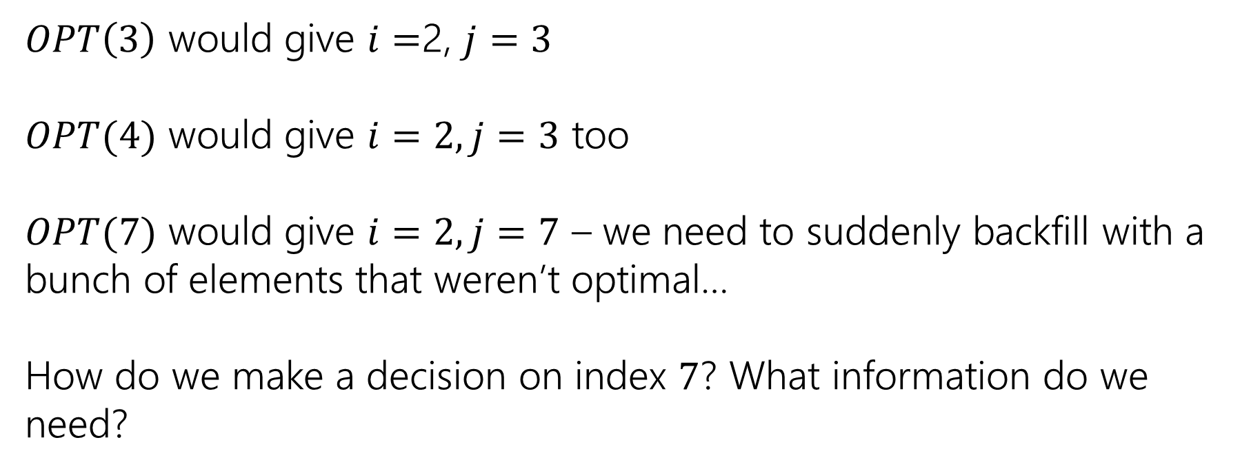
Trying to Recurse
0 | 1 | 2 | 3 | 4 | 5 | 6 | 7
5 | -6 | 3 | 4 | -5 | 2 | 2 | 4
$OPT\left(3\right)$ would give $i=$2, $j=3$
$OPT(4)$ would give $i=2, j=3$ too
$OPT(7)$ would give $i=2, j=7$ – we need to suddenly backfill with a bunch of elements that weren’t optimal…
How do we make a decision on index $7$? What information do we need?

Slide 25
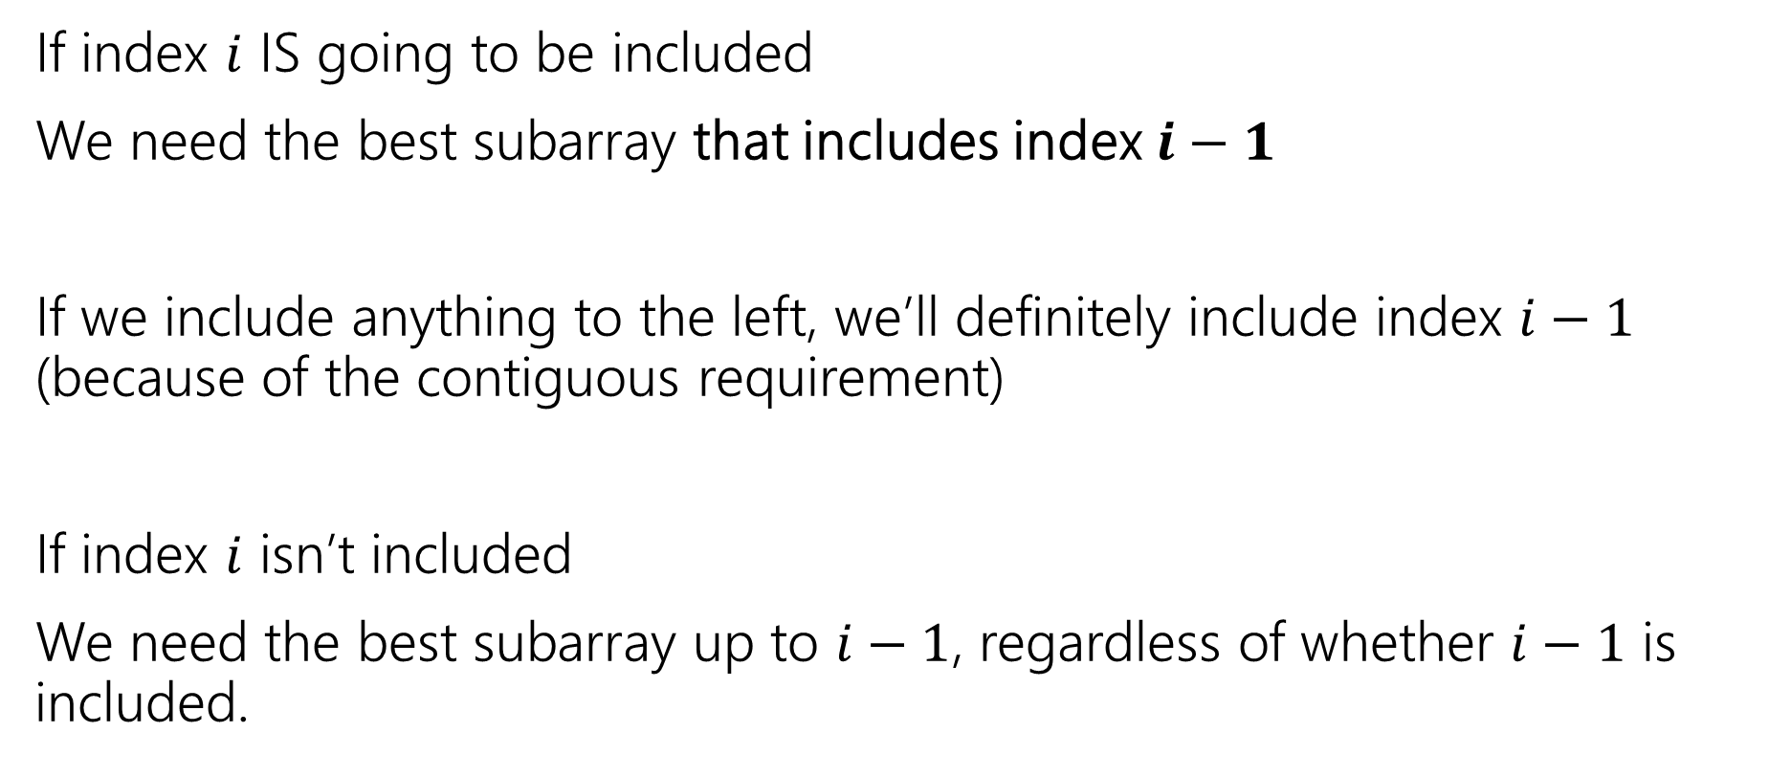
What do we need for recursion?
If index $i$ IS going to be included
We need the best subarray that includes index $i−1$
If we include anything to the left, we’ll definitely include index $i−1$ (because of the contiguous requirement)
If index $i$ isn’t included
We need the best subarray up to $i−1$, regardless of whether $i−1$ is included.

Slide 26
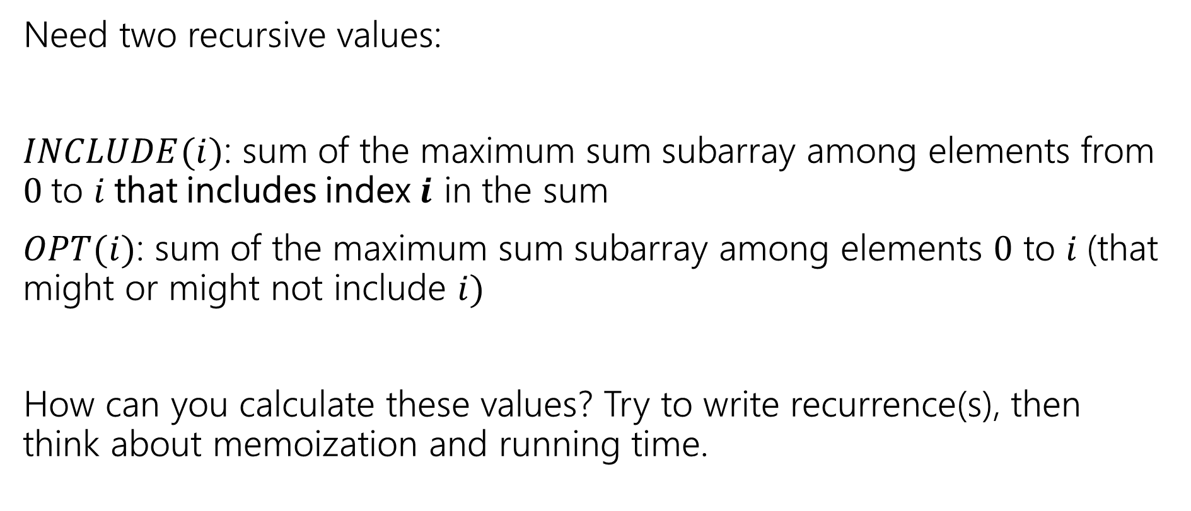
Two Values
Pollev.com/robbie
Need two recursive values:
$INCLUDE(i)$: sum of the maximum sum subarray among elements from $0$to $i$that includes index $i$ in the sum
$OPT(i)$: sum of the maximum sum subarray among elements $0$ to $i$(that might or might not include $i)$
How can you calculate these values? Try to write recurrence(s), then think about memoization and running time.

Slide 27
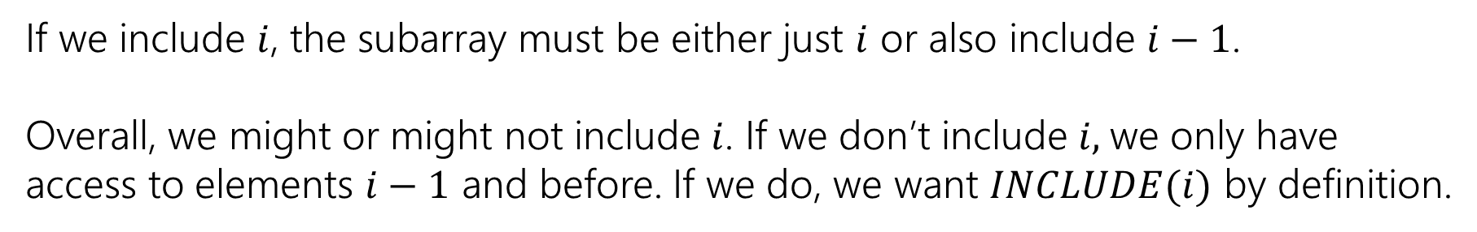

Recurrences
$INCLUDE\left(i\right)=\left\{\begin{aligned}\max\left\{A\left[i\right], A\left[i\right]+INLCUDE\left(i−1\right)\right\} if i≥0 \\ 0 otherwise\end{aligned}\right.$
$OPT\left(i\right)=\left\{\begin{aligned}\max\left\{INCLUDE\left(i\right),OPT\left(i−1\right)\right\} if i≥0 \\ 0 otherwise\end{aligned}\right.$
If we include $i$, the subarray must be either just $i$ or also include $i−1$.
Overall, we might or might not include $i$. If we don’t include $i,$we only have access to elements $i−1$ and before. If we do, we want $INCLUDE(i)$ by definition.

Slide 28



Example
$$A$$
0 | 1 | 2 | 3 | 4 | 5 | 6 | 7
5 | -6 | 3 | 4 | -5 | 2 | 2 | 4
$$OPT(i)$$
0 | 1 | 2 | 3 | 4 | 5 | 6 | 7
5
0 | 1 | 2 | 3 | 4 | 5 | 6 | 7
5
$$INCLUDE(i)$$

Slide 29
Example
$$A$$
0 | 1 | 2 | 3 | 4 | 5 | 6 | 7
5 | -6 | 3 | 4 | -5 | 2 | 2 | 4
$$OPT(i)$$
0 | 1 | 2 | 3 | 4 | 5 | 6 | 7
5 | 5
0 | 1 | 2 | 3 | 4 | 5 | 6 | 7
5 | -1
$$INCLUDE(i)$$

Slide 30
Example
$$A$$
0 | 1 | 2 | 3 | 4 | 5 | 6 | 7
5 | -6 | 3 | 4 | -5 | 2 | 2 | 4
$$OPT(i)$$
0 | 1 | 2 | 3 | 4 | 5 | 6 | 7
5 | 5 | 5 | 7 | 7 | 7 | 7 | 10
0 | 1 | 2 | 3 | 4 | 5 | 6 | 7
5 | -1 | 3 | 7 | 2 | 4 | 6 | 10
$$INCLUDE(i)$$

Slide 31
Pseudocode
int maxSubarraySum(int[] A)
int n=A.length
int[] OPT = new int[n]
int[] Inc = new int[n]
inc[0]=A[0]; OPT[0] = max{A[0],0}
for(int i=0;i<n;i++)
inc[i]=max{A[i], A[i]+inc[i-1]}
OPT[i]=max{inc[i], opt[i-1]}
endFor
return OPT[n-1]

Slide 32
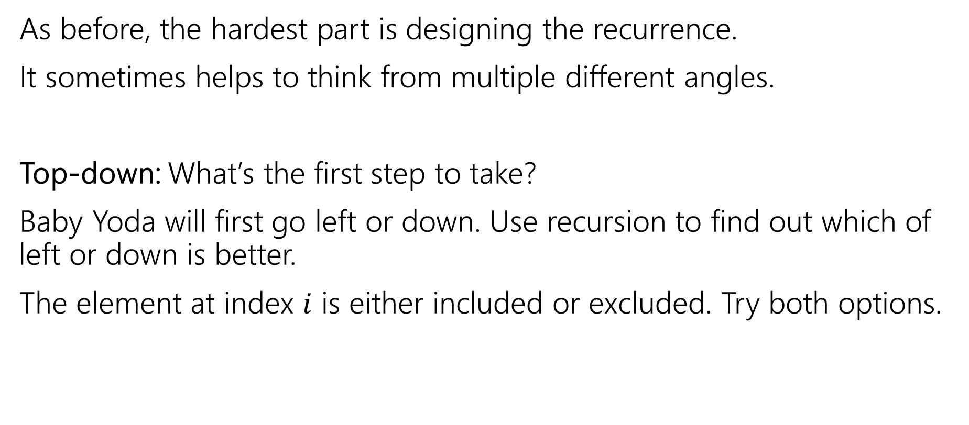
Recursive Thinking In General
As before, the hardest part is designing the recurrence.
It sometimes helps to think from multiple different angles.
Top-down: What’s the first step to take?
Baby Yoda will first go left or down. Use recursion to find out which of left or down is better.
The element at index $i$ is either included or excluded. Try both options.

Slide 33
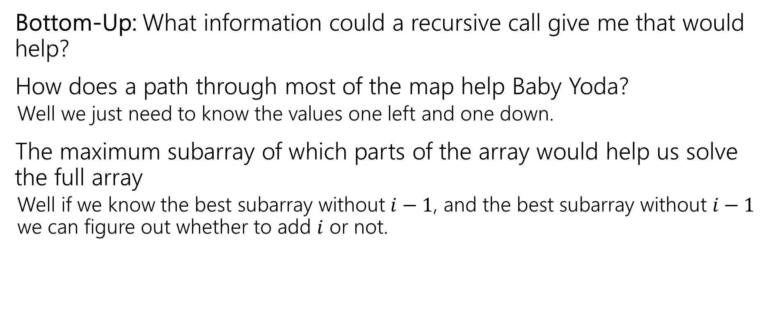
Recursive Thinking In General
Bottom-Up: What information could a recursive call give me that would help?
How does a path through most of the map help Baby Yoda?
  Well we just need to know the values one left and one down.
The maximum subarray of which parts of the array would help us solve the full array
  Well if we know the best subarray without $i−1$, and the best subarray without $i−1$ we can figure out whether to add $i$ or not.

Slide 34
Recursive Thinking In General
Some people refer to the “Optimal Substructure Property”
From the optimum (most eggs, largest sum) for a slightly smaller problem (Baby Yoda starting closer to the end, slightly smaller array), we need to be able to build up the optimum for the full problem.

Slide 35
Edit Distance

Slide 36
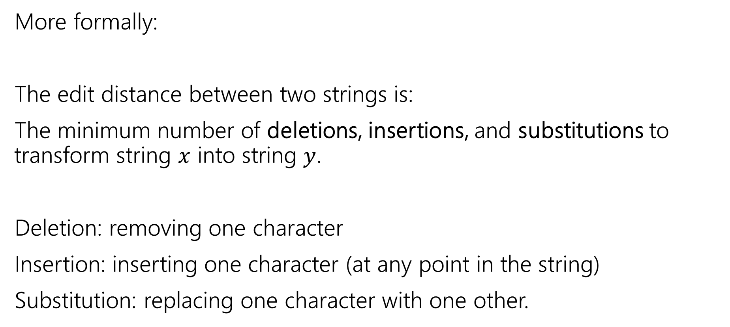
Edit Distance
More formally:
The edit distance between two strings is:
The minimum number of deletions, insertions, and substitutions to transform string $x$ into string $y$.
Deletion: removing one character
Insertion: inserting one character (at any point in the string)
Substitution: replacing one character with one other.

Slide 37
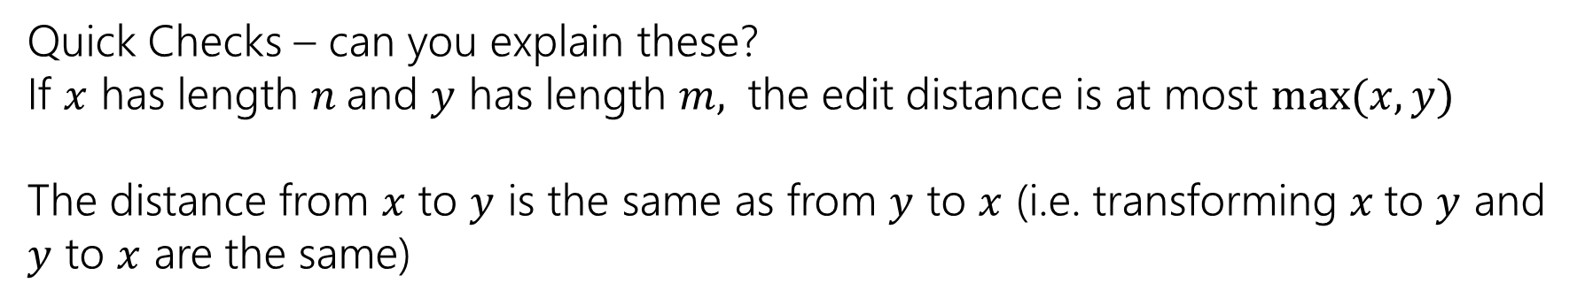
Example
What’s the distance between babyyodas and tastysoda?
B | A | B |  | Y | Y | O | D | A | S
sub |  | sub | ins |  | sub |  |  |  | del
T | A | S | T | Y | S | O | D | A
Distance: 5, one point for each colored box
Quick Checks – can you explain these?
If $x$ has length $n$and $y$ has length $m,$ the edit distance is at most $\max{(x,y)}$
The distance from $x$ to $y$ is the same as from $y$ to $x$ (i.e. transforming $x$to $y$ and $y$ to $x$ are the same)

Slide 38
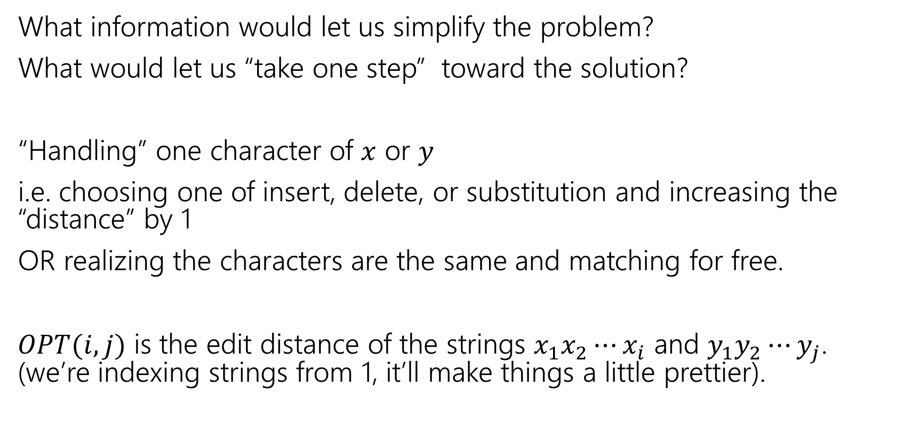
Finding a recurrence
What information would let us simplify the problem?
What would let us “take one step” toward the solution?
“Handling” one character of $x$ or $y$
i.e. choosing one of insert, delete, or substitution and increasing the “distance” by 1
OR realizing the characters are the same and matching for free.
$OPT(i,j)$ is the edit distance of the strings $x_{1}x_{2}⋯x_{i}$ and $y_{1}y_{2}⋯y_{j}$. (we’re indexing strings from 1, it’ll make things a little prettier).

Slide 39
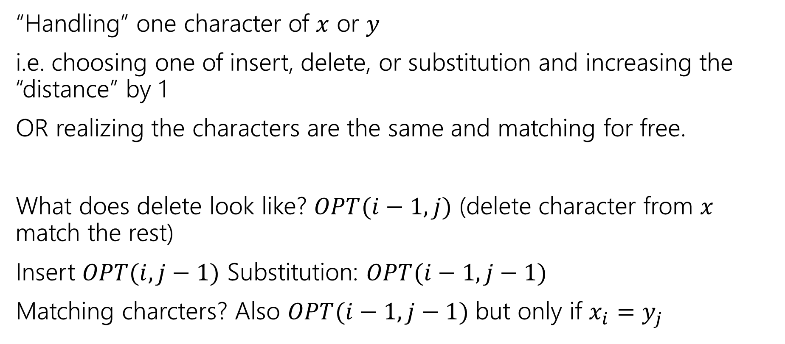
The recurrence
“Handling” one character of $x$ or $y$
i.e. choosing one of insert, delete, or substitution and increasing the “distance” by 1
OR realizing the characters are the same and matching for free.
What does delete look like? $OPT(i−1, j)$ (delete character from $x$ match the rest)
Insert $OPT(i,j−1)$ Substitution: $OPT(i−1,j−1)$
Matching charcters? Also $OPT(i−1,j−1)$ but only if $x_{i}=y_{j}$

Slide 40
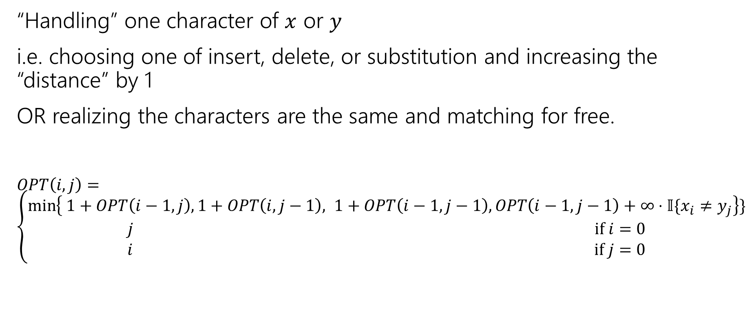
The recurrence (v1, we’ll improve soon)
“Handling” one character of $x$ or $y$
i.e. choosing one of insert, delete, or substitution and increasing the “distance” by 1
OR realizing the characters are the same and matching for free.
$OPT\left(i,j\right)=\left\{\begin{aligned}\min\left\{ 1+OPT\left(i−1,j\right), 1+OPT\left(i,j−1\right), 1+OPT\left(i−1,j−1\right), OPT\left(i−1,j−1\right)+∞⋅𝕀\{x_{i}≠y_{j}\right\}\} \\ j if i=0 \\ i if j=0\end{aligned}\right.$
Delete
Insert
Substitution
TODO: Just Match

Slide 41
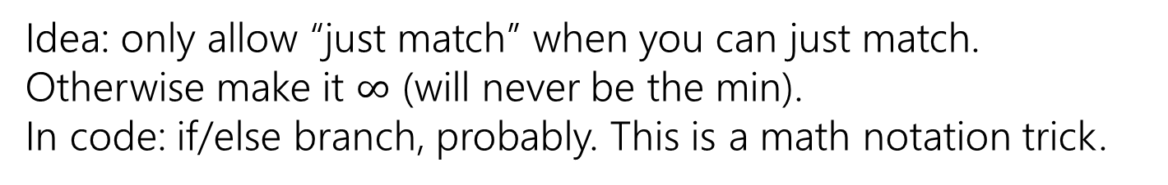
The recurrence (v1, we’ll improve soon)
“Handling” one character of $x$ or $y$
i.e. choosing one of insert, delete, or substitution and increasing the “distance” by 1
OR realizing the characters are the same and matching for free.
$OPT\left(i,j\right)=\left\{\begin{aligned}\min\left\{ 1+OPT\left(i−1,j\right), 1+OPT\left(i,j−1\right), 1+OPT\left(i−1,j−1\right), OPT\left(i−1,j−1\right)+∞⋅𝕀\{x_{i}≠y_{j}\right\}\} \\ j if i=0 \\ i if j=0\end{aligned}\right.$
Delete
Insert
Substitution
Just Match
Idea: only allow “just match” when you can just match. Otherwise make it $∞$ (will never be the min).
In code: if/else branch, probably. This is a math notation trick.
“Indicator” – math for “cast bool to int”

Slide 42
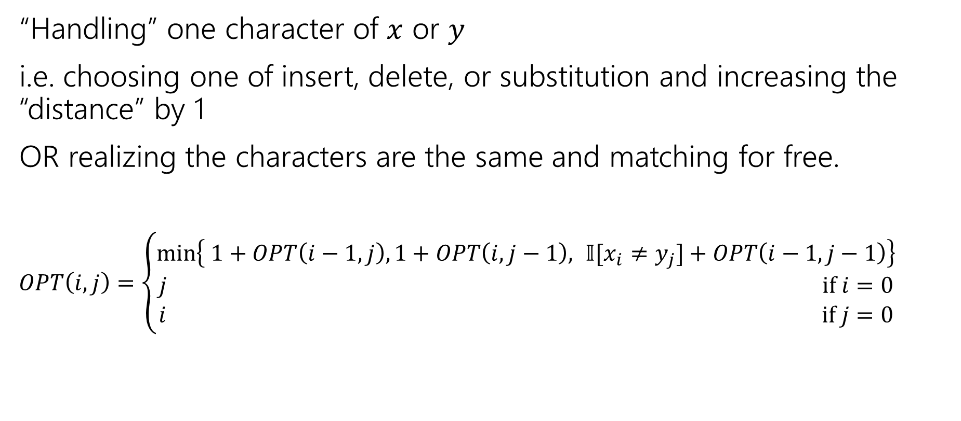
The recurrence
“Handling” one character of $x$ or $y$
i.e. choosing one of insert, delete, or substitution and increasing the “distance” by 1
OR realizing the characters are the same and matching for free.
$OPT\left(i,j\right)=\left\{\begin{aligned}\min\left\{ 1+OPT\left(i−1,j\right), 1+OPT\left(i,j−1\right), 𝕀[x_{i}≠y_{j}]+OPT\left(i−1,j−1\right)\right\} \\ j if i=0 \\ i if j=0\end{aligned}\right.$
Delete
Insert
Sub and matching
“Indicator” – math for “cast bool to int”
When we could match, we will never substitute; matching will always give us a better score! Still have to check delete, insert (those could be better).

Slide 43
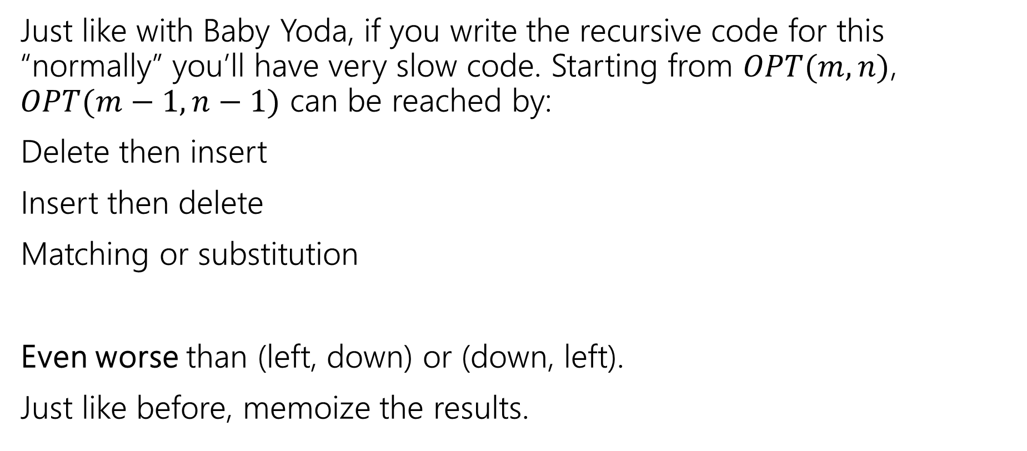
Recurrence to Code
Just like with Baby Yoda, if you write the recursive code for this “normally” you’ll have very slow code. Starting from $OPT(m,n)$, $OPT(m−1,n−1)$ can be reached by:
Delete then insert
Insert then delete
Matching or substitution
Even worse than (left, down) or (down, left).
Just like before, memoize the results.
Not a typo! It’s memoize, not memorize.
Notes:
Memoize as in “leave yourself a memo” DP was developed in the 50s and 60s (Wikipedia says term coined in 68 by Michie). To communicate with co-workers they didn’t use slack/discord or even email (which didn’t develop until the early 70s). They sent each other memos! So they made MEMO tables
thus “MEMOizing”

Slide 44
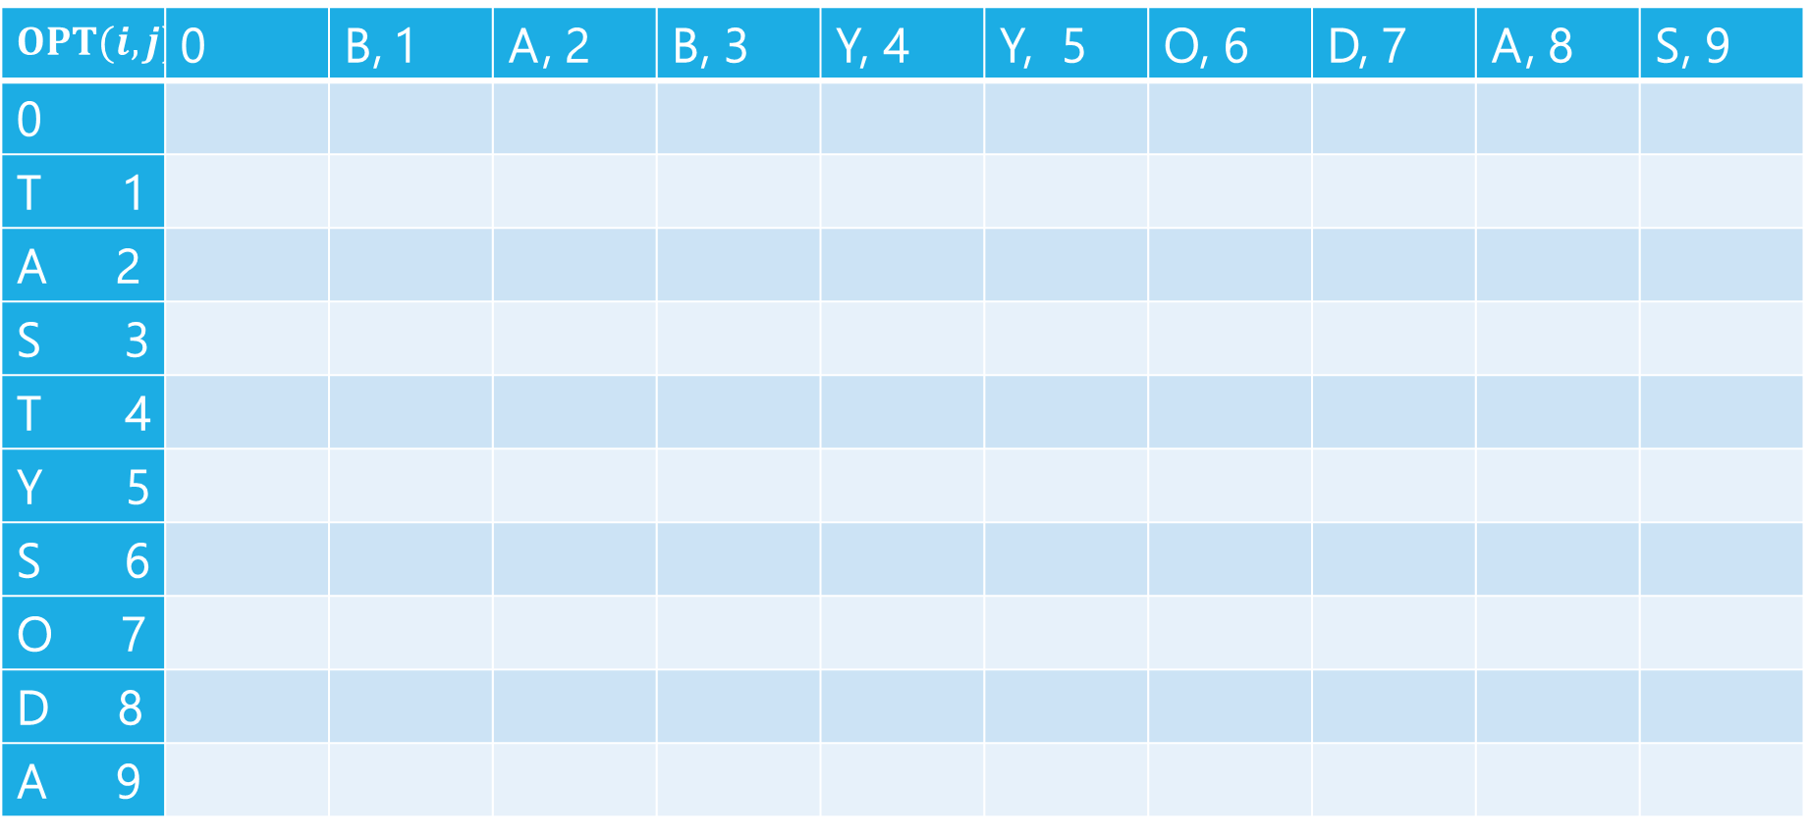
Edit Distance
$$OPT(i,j)$$ | 0 | B, 1 | A, 2 | B, 3 | Y, 4 | Y, 5 | O, 6 | D, 7 | A, 8 | S, 9
0
T 1
A 2
S 3
T 4
Y 5
S 6
O 7
D 8
A 9

Slide 45
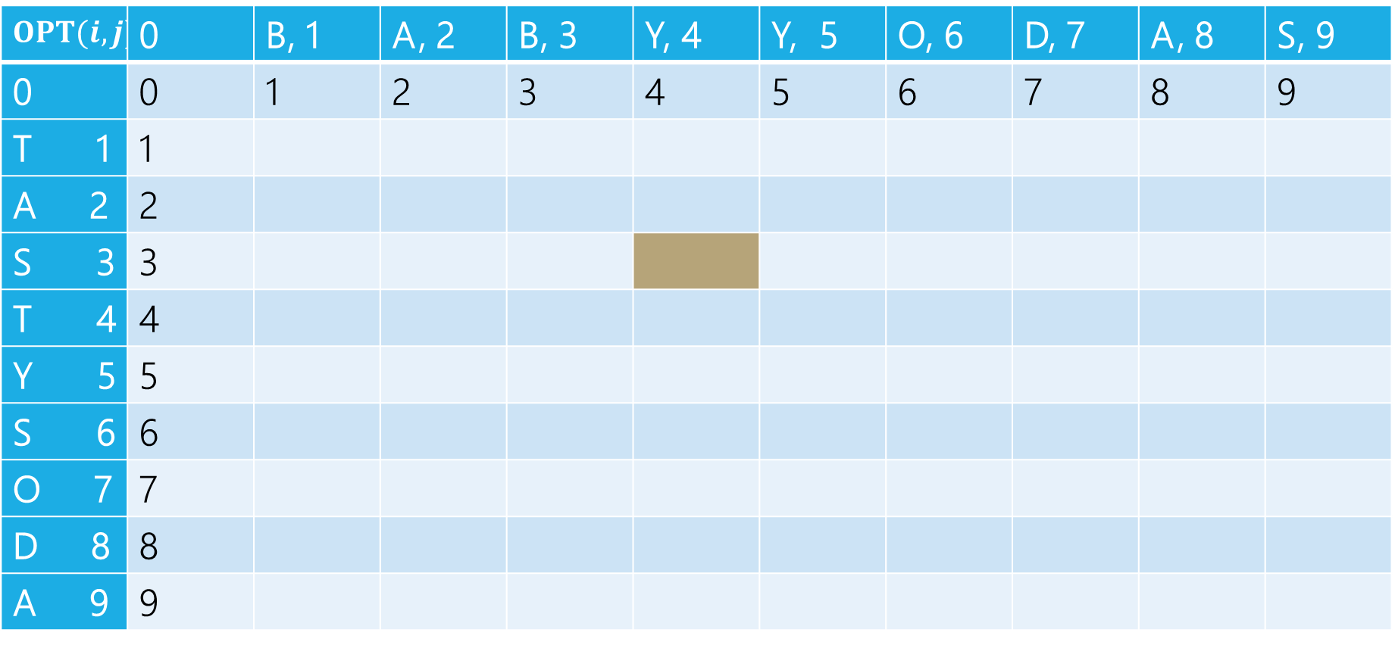
Edit Distance
B | A | B | Y
T | A | S
Current subproblem: edit dist between BABY and TAS
$$OPT(i,j)$$ | 0 | B, 1 | A, 2 | B, 3 | Y, 4 | Y, 5 | O, 6 | D, 7 | A, 8 | S, 9
0 | 0 | 1 | 2 | 3 | 4 | 5 | 6 | 7 | 8 | 9
T 1 | 1
A 2 | 2
S 3 | 3
T 4 | 4
Y 5 | 5
S 6 | 6
O 7 | 7
D 8 | 8
A 9 | 9

Slide 46
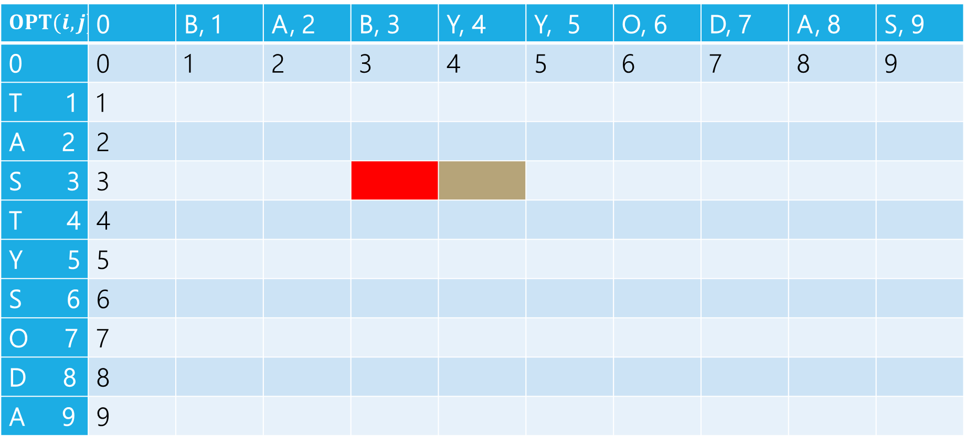
Edit Distance
B | A | B | Y
T | A | S
Delete: get rid of Y (cost 1)
BAB
TAS
$$OPT(i,j)$$ | 0 | B, 1 | A, 2 | B, 3 | Y, 4 | Y, 5 | O, 6 | D, 7 | A, 8 | S, 9
0 | 0 | 1 | 2 | 3 | 4 | 5 | 6 | 7 | 8 | 9
T 1 | 1
A 2 | 2
S 3 | 3
T 4 | 4
Y 5 | 5
S 6 | 6
O 7 | 7
D 8 | 8
A 9 | 9

Slide 47
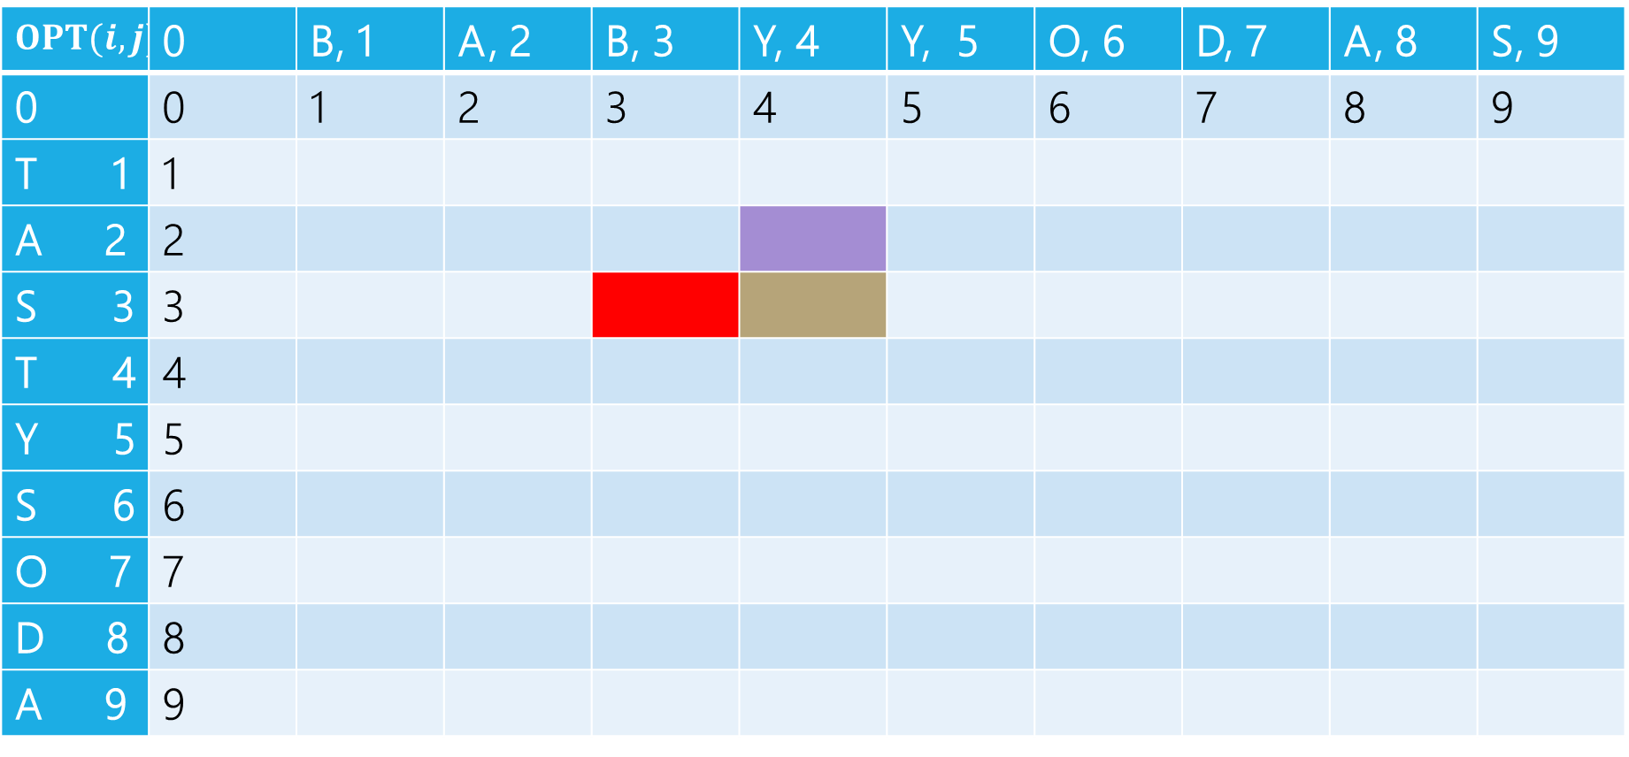
Edit Distance
B | A | B | Y
T | A | S
Insert: insert S (cost 1)
BABY
TA
$$OPT(i,j)$$ | 0 | B, 1 | A, 2 | B, 3 | Y, 4 | Y, 5 | O, 6 | D, 7 | A, 8 | S, 9
0 | 0 | 1 | 2 | 3 | 4 | 5 | 6 | 7 | 8 | 9
T 1 | 1
A 2 | 2
S 3 | 3
T 4 | 4
Y 5 | 5
S 6 | 6
O 7 | 7
D 8 | 8
A 9 | 9

Slide 48
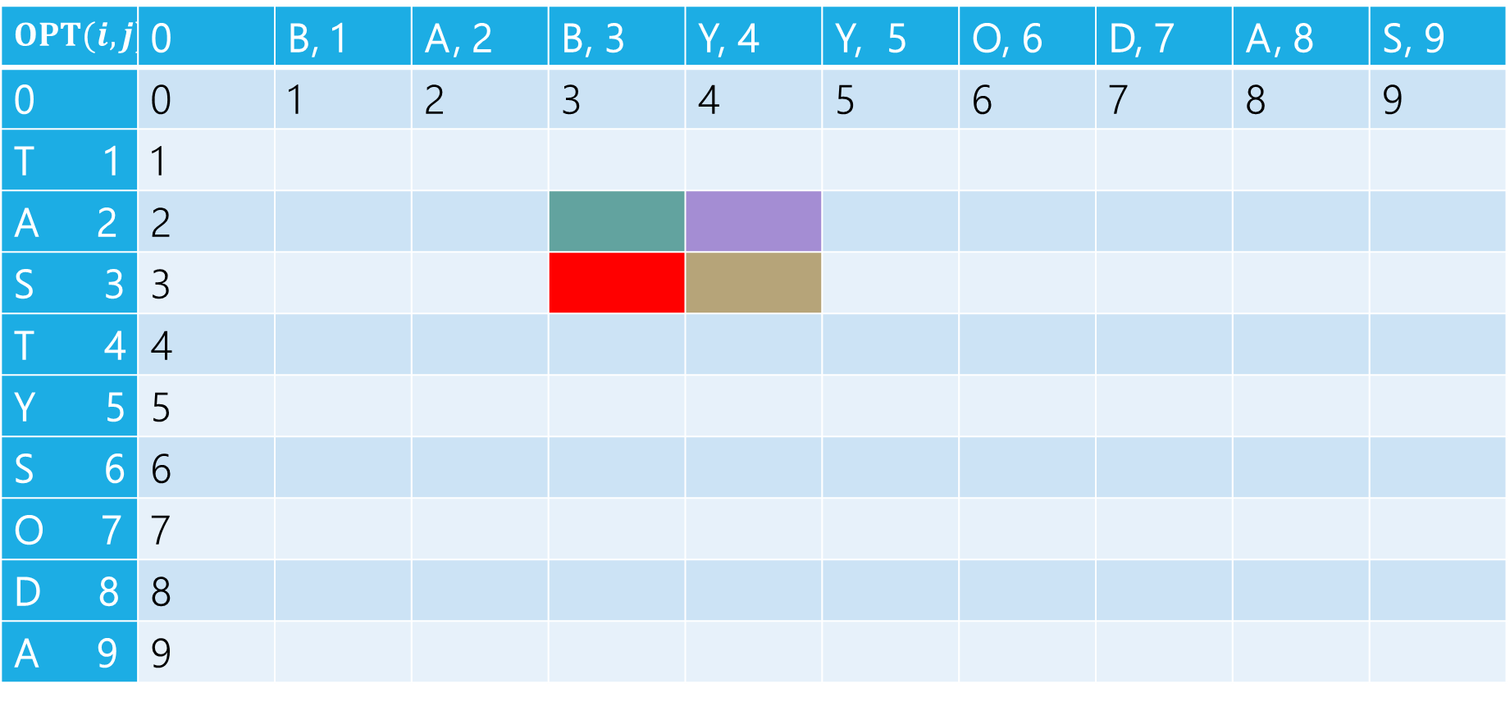
Edit Distance
B | A | B | Y
T | A | S
Sub: Transform Y to S (cost 1)
BAB
TA
$$OPT(i,j)$$ | 0 | B, 1 | A, 2 | B, 3 | Y, 4 | Y, 5 | O, 6 | D, 7 | A, 8 | S, 9
0 | 0 | 1 | 2 | 3 | 4 | 5 | 6 | 7 | 8 | 9
T 1 | 1
A 2 | 2
S 3 | 3
T 4 | 4
Y 5 | 5
S 6 | 6
O 7 | 7
D 8 | 8
A 9 | 9

Slide 49
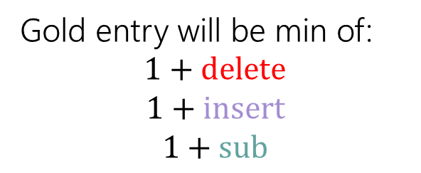
Edit Distance
Gold entry will be min of:
$$1+delete$$
$$1+insert$$
$$1+sub$$
B | A | B | Y
T | A | S
$$OPT(i,j)$$ | 0 | B, 1 | A, 2 | B, 3 | Y, 4 | Y, 5 | O, 6 | D, 7 | A, 8 | S, 9
0 | 0 | 1 | 2 | 3 | 4 | 5 | 6 | 7 | 8 | 9
T 1 | 1
A 2 | 2
S 3 | 3
T 4 | 4
Y 5 | 5
S 6 | 6
O 7 | 7
D 8 | 8
A 9 | 9

Slide 50
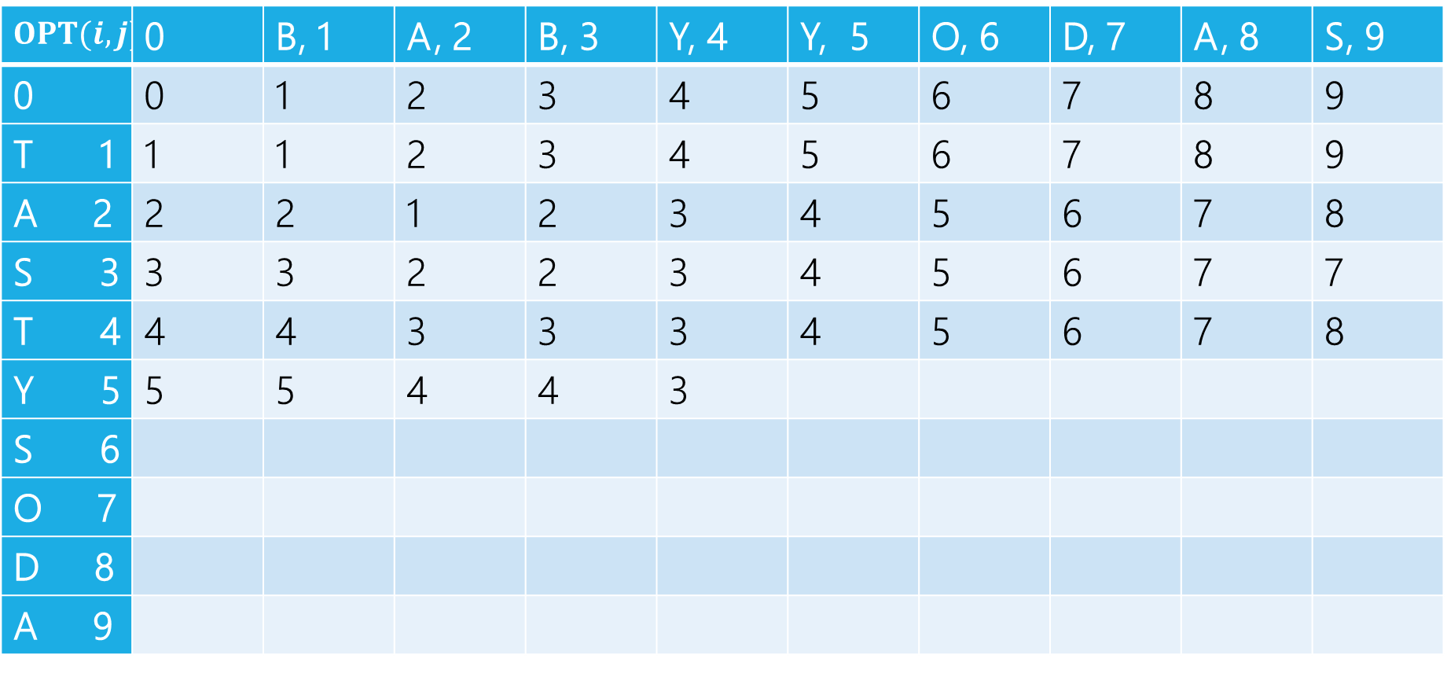

Edit Distance
$$1+2$$
$$1+3$$
$$1+2$$
Min: $3$
Gold entry will be min of:
$$1+delete$$
$$1+insert$$
$$1+sub$$
$$OPT(i,j)$$ | 0 | B, 1 | A, 2 | B, 3 | Y, 4 | Y, 5 | O, 6 | D, 7 | A, 8 | S, 9
0 | 0 | 1 | 2 | 3 | 4 | 5 | 6 | 7 | 8 | 9
T 1 | 1 | 1 | 2 | 3 | 4 | 5 | 6 | 7 | 8 | 9
A 2 | 2 | 2 | 1 | 2 | 3 | 4 | 5 | 6 | 7 | 8
S 3 | 3 | 3 | 2 | 2 | 3 | 4 | 5 | 6 | 7 | 7
T 4 | 4 | 4 | 3 | 3 | 3 | 4 | 5 | 6 | 7 | 8
Y 5 | 5 | 5 | 4 | 4 | 3
S 6
O 7
D 8
A 9

Slide 51
Edit Distance
Fill in the next two entries. Be careful with the sub/match distinction!
$$OPT(i,j)$$ | 0 | B, 1 | A, 2 | B, 3 | Y, 4 | Y, 5 | O, 6 | D, 7 | A, 8 | S, 9
0 | 0 | 1 | 2 | 3 | 4 | 5 | 6 | 7 | 8 | 9
T 1 | 1 | 1 | 2 | 3 | 4 | 5 | 6 | 7 | 8 | 9
A 2 | 2 | 2 | 1 | 2 | 3 | 4 | 5 | 6 | 7 | 8
S 3 | 3 | 3 | 2 | 2 | 3 | 4 | 5 | 6 | 7 | 7
T 4 | 4 | 4 | 3 | 3 | 3 | 4 | 5 | 6 | 7 | 8
Y 5 | 5 | 5 | 4 | 4 | 3
S 6
O 7
D 8
A 9

Slide 52
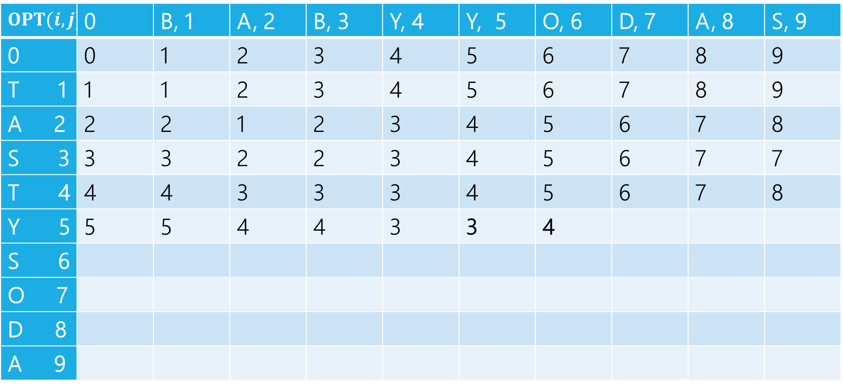
Edit Distance
Fill in the next two entries. Be careful with the sub/match distinction!
$$OPT(i,j)$$ | 0 | B, 1 | A, 2 | B, 3 | Y, 4 | Y, 5 | O, 6 | D, 7 | A, 8 | S, 9
0 | 0 | 1 | 2 | 3 | 4 | 5 | 6 | 7 | 8 | 9
T 1 | 1 | 1 | 2 | 3 | 4 | 5 | 6 | 7 | 8 | 9
A 2 | 2 | 2 | 1 | 2 | 3 | 4 | 5 | 6 | 7 | 8
S 3 | 3 | 3 | 2 | 2 | 3 | 4 | 5 | 6 | 7 | 7
T 4 | 4 | 4 | 3 | 3 | 3 | 4 | 5 | 6 | 7 | 8
Y 5 | 5 | 5 | 4 | 4 | 3 | 3 | 4
S 6
O 7
D 8
A 9
Y’s match, so sub is free!

Slide 53
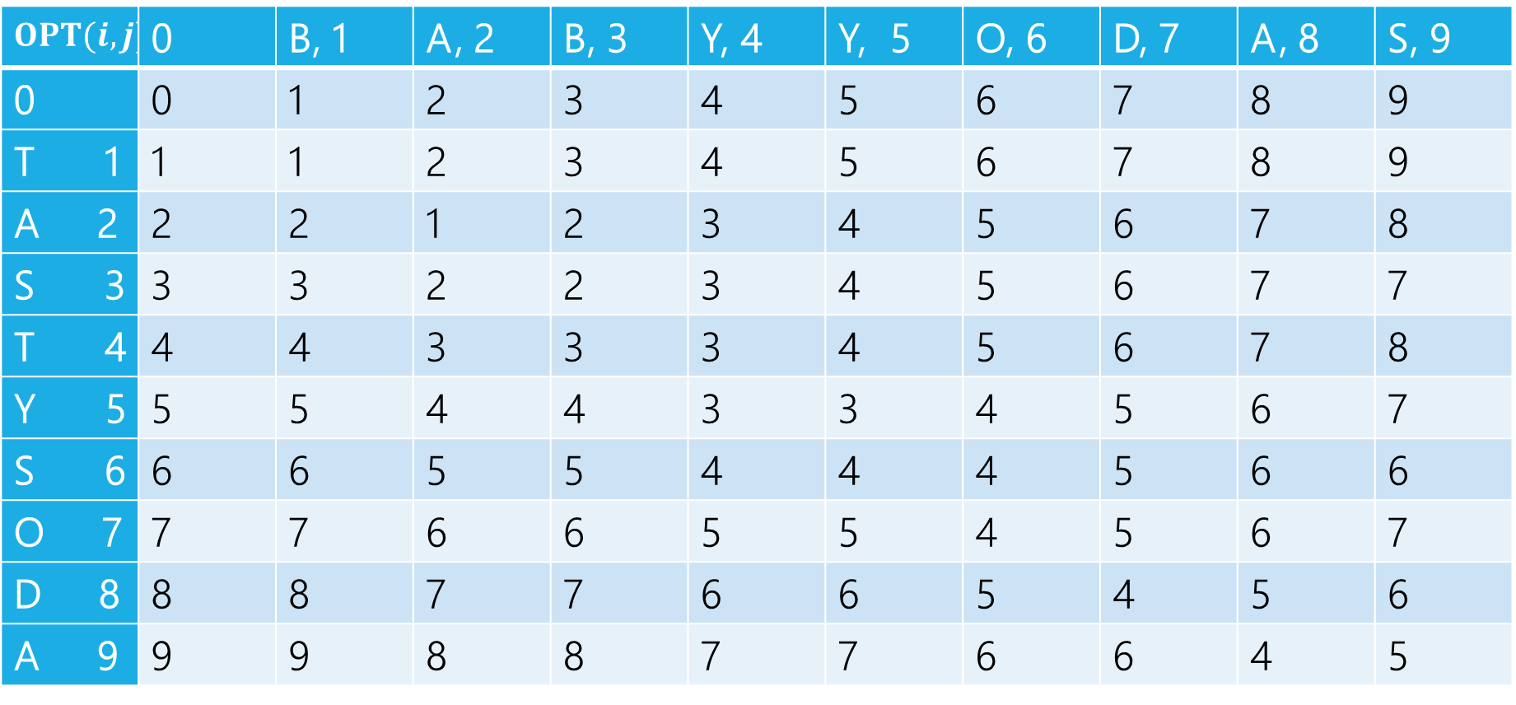
Edit Distance
$$OPT(i,j)$$ | 0 | B, 1 | A, 2 | B, 3 | Y, 4 | Y, 5 | O, 6 | D, 7 | A, 8 | S, 9
0 | 0 | 1 | 2 | 3 | 4 | 5 | 6 | 7 | 8 | 9
T 1 | 1 | 1 | 2 | 3 | 4 | 5 | 6 | 7 | 8 | 9
A 2 | 2 | 2 | 1 | 2 | 3 | 4 | 5 | 6 | 7 | 8
S 3 | 3 | 3 | 2 | 2 | 3 | 4 | 5 | 6 | 7 | 7
T 4 | 4 | 4 | 3 | 3 | 3 | 4 | 5 | 6 | 7 | 8
Y 5 | 5 | 5 | 4 | 4 | 3 | 3 | 4 | 5 | 6 | 7
S 6 | 6 | 6 | 5 | 5 | 4 | 4 | 4 | 5 | 6 | 6
O 7 | 7 | 7 | 6 | 6 | 5 | 5 | 4 | 5 | 6 | 7
D 8 | 8 | 8 | 7 | 7 | 6 | 6 | 5 | 4 | 5 | 6
A 9 | 9 | 9 | 8 | 8 | 7 | 7 | 6 | 6 | 4 | 5

Slide 54
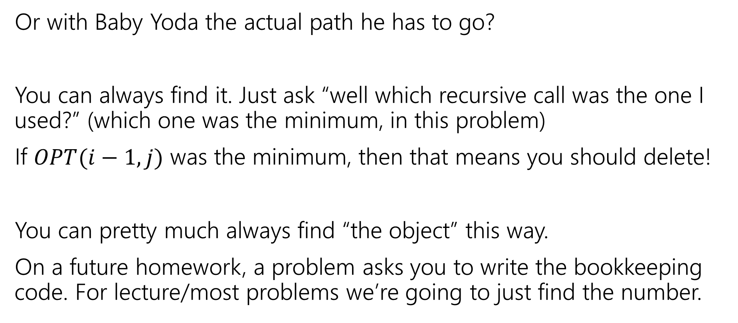
What if we want the list if inserts,delete,subs?
Or with Baby Yoda the actual path he has to go?
You can always find it. Just ask “well which recursive call was the one I used?” (which one was the minimum, in this problem)
If $OPT(i−1,j)$ was the minimum, then that means you should delete!
You can pretty much always find “the object” this way.
On a future homework, a problem asks you to write the bookkeeping code. For lecture/most problems we’re going to just find the number.

Slide 55
Edit Distance
$$OPT(i,j)$$ | 0 | B, 1 | A, 2 | B, 3 | Y, 4 | Y, 5 | O, 6 | D, 7 | A, 8 | S, 9
0 | 0 | 1 | 2 | 3 | 4 | 5 | 6 | 7 | 8 | 9
T 1 | 1 | 1 | 2 | 3 | 4 | 5 | 6 | 7 | 8 | 9
A 2 | 2 | 2 | 1 | 2 | 3 | 4 | 5 | 6 | 7 | 8
S 3 | 3 | 3 | 2 | 2 | 3 | 4 | 5 | 6 | 7 | 7
T 4 | 4 | 4 | 3 | 3 | 3 | 4 | 5 | 6 | 7 | 8
Y 5 | 5 | 5 | 4 | 4 | 3 | 3 | 4 | 5 | 6 | 7
S 6 | 6 | 6 | 5 | 5 | 4 | 4 | 4 | 5 | 6 | 6
O 7 | 7 | 7 | 6 | 6 | 5 | 5 | 4 | 5 | 6 | 7
D 8 | 8 | 8 | 7 | 7 | 6 | 6 | 5 | 4 | 5 | 6
A 9 | 9 | 9 | 8 | 8 | 7 | 7 | 6 | 6 | 4 | 5

Slide 56
Edit Distance
$$OPT(i,j)$$ | 0 | B, 1 | A, 2 | B, 3 | Y, 4 | Y, 5 | O, 6 | D, 7 | A, 8 | S, 9
0 | 0 | 1 | 2 | 3 | 4 | 5 | 6 | 7 | 8 | 9
T 1 | 1 | 1 | 2 | 3 | 4 | 5 | 6 | 7 | 8 | 9
A 2 | 2 | 2 | 1 | 2 | 3 | 4 | 5 | 6 | 7 | 8
S 3 | 3 | 3 | 2 | 2 | 3 | 4 | 5 | 6 | 7 | 7
T 4 | 4 | 4 | 3 | 3 | 3 | 4 | 5 | 6 | 7 | 8
Y 5 | 5 | 5 | 4 | 4 | 3 | 3 | 4 | 5 | 6 | 7
S 6 | 6 | 6 | 5 | 5 | 4 | 4 | 4 | 5 | 6 | 6
O 7 | 7 | 7 | 6 | 6 | 5 | 5 | 4 | 5 | 6 | 7
D 8 | 8 | 8 | 7 | 7 | 6 | 6 | 5 | 4 | 5 | 6
A 9 | 9 | 9 | 8 | 8 | 7 | 7 | 6 | 6 | 4 | 5

Slide 57
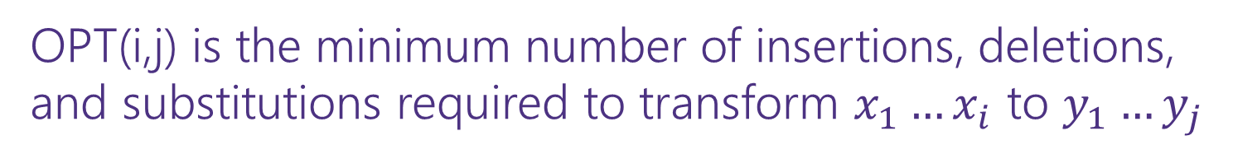

Dynamic Programming Process
1. Define the object you’re looking for
2. Write a recurrence to say how to find it
3. Design a memoization structure
4. Write an iterative algorithm
OPT(i,j) is the minimum number of insertions, deletions, and substitutions required to transform $x_{1}…x_{i}$ to $y_{1}…y_{j}$
✅
$m×n$ Array
Outer loop: increasing $i$ (i.e., row-by-row starting from 1)
Inner loop: increasing $j$ (i.s., column-by-column starting from 1)

Slide 58
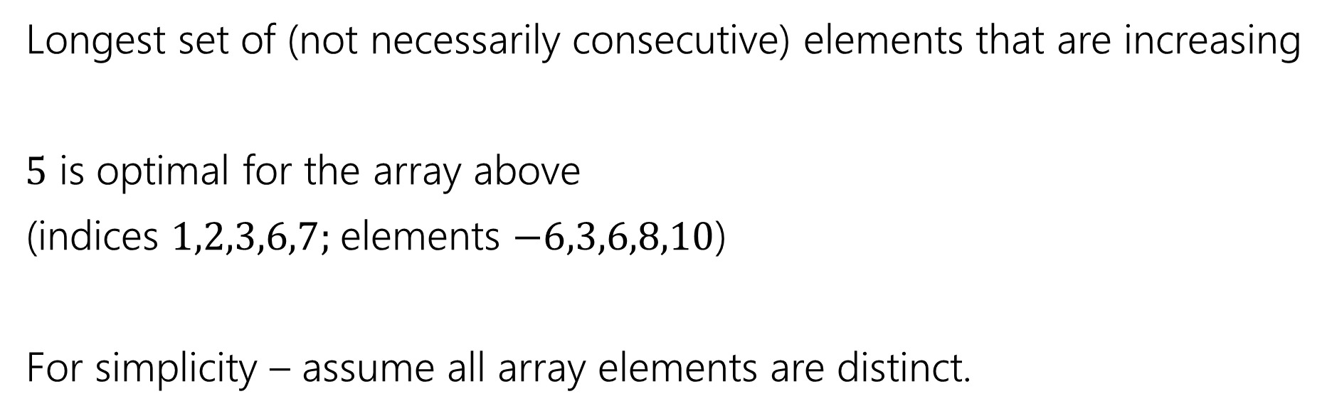
Longest Increasing Subsequence
0 | 1 | 2 | 3 | 4 | 5 | 6 | 7
5 | -6 | 3 | 6 | -5 | 2 | 8 | 10
Longest set of (not necessarily consecutive) elements that are increasing
$5$ is optimal for the array above
(indices $1,2,3,6,7;$elements $−6,3,6,8,10$)
For simplicity – assume all array elements are distinct.

