Slide 1
More Dynamic Programming
CSE 417 Fall 22
Lecture 12

Slide 2
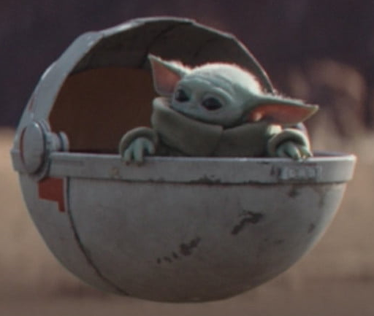
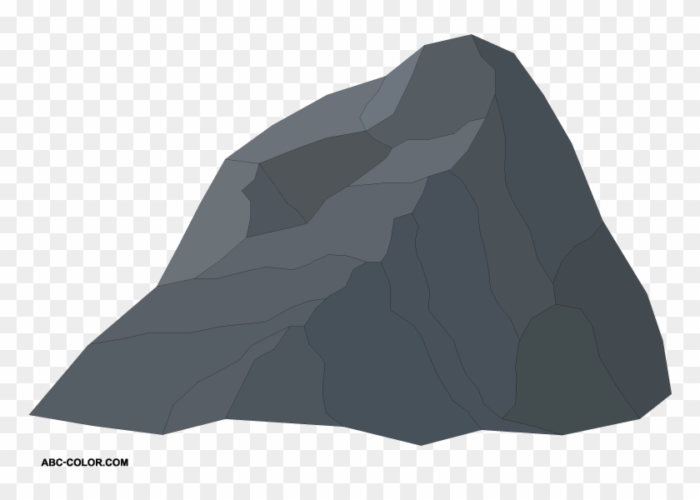
Baby Yoda Searching
Baby Yoda has to get from the upper-right corner to the lower left.
His cradle will only let him go left and down.
He can’t get past the rocks (too high) – he has to go around them (but still only going left and down)
As usual…he’s hungry.
He wants to eat as many frog eggs as possible on the way.

Slide 3
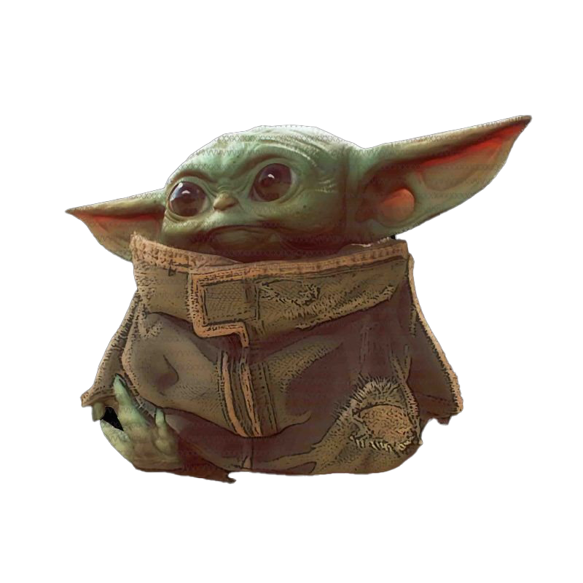
Baby Yoda Searching
(c-1,r-1)
r-1
Y-coordinate
(0,2)
(0,1)
(1,1)
0
(0,0)
X-coordinate
0
c-1
Notes:
https://1.bp.blogspot.com/-XxfNI65zLnU/Xc98O96LVnI/AAAAAAAAGFY/Xsmd7IMlIrEltYONCdGKk1hqPw1BgL3ggCLcBGAsYHQ/s1600/Mandalorian.jpg
http://www.pngmart.com/image/161116/png/161115
https://www.pikpng.com/pngvi/hiTxbbR_clip-art-rock-rock-clipart-transparent-background-png-download/

Slide 4
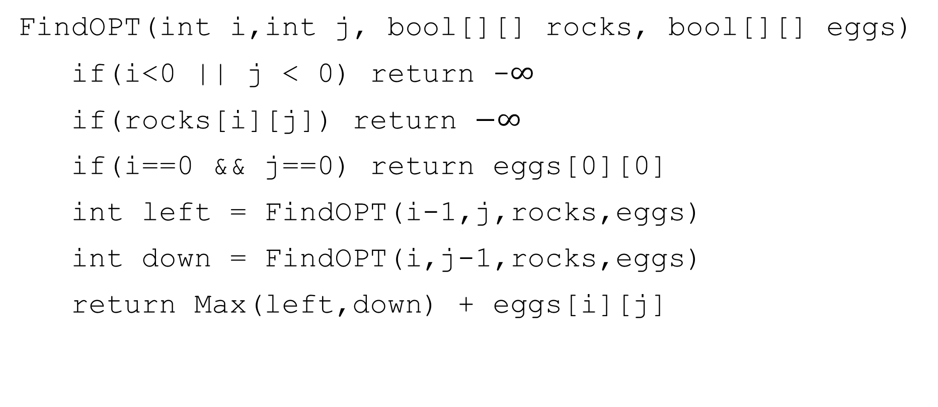
A Recursive Function
FindOPT(int i,int j, bool[][] rocks, bool[][] eggs)
if(i<0 || j < 0) return -$∞$
if(rocks[i][j]) return $−∞$
if(i==0 && j==0) return eggs[0][0]
int left = FindOPT(i-1,j,rocks,eggs)
int down = FindOPT(i,j-1,rocks,eggs)
return Max(left,down) + eggs[i][j]

Slide 5
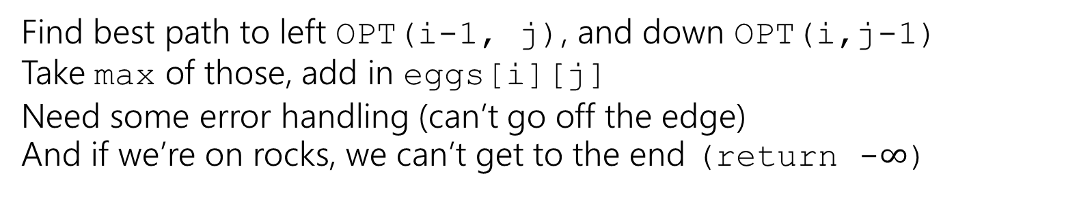
Recursive Baby Yoda
Let OPT(i,j) be the maximum number of eggs we can get on a legal path from (i,j) to (0,0)(including the egg in (i,j) if there is one)
Base Case?
Recursive case?
At (0,0), nowhere to go, return eggs[0][0]
Find best path to left OPT(i-1, j), and down OPT(i,j-1)
Take max of those, add in eggs[i][j]
Need some error handling (can’t go off the edge)
And if we’re on rocks, we can’t get to the end (return -$∞$)

Slide 6
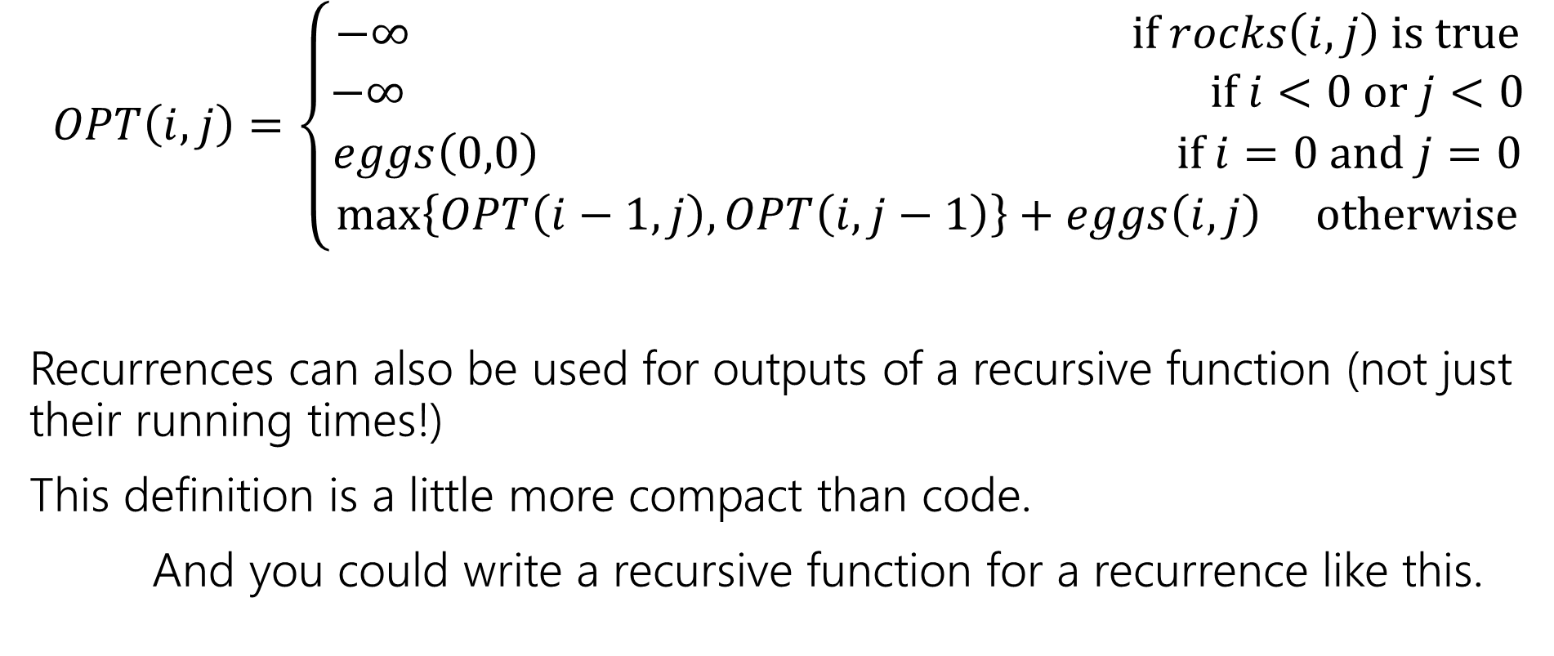
Recurrence Form
$$OPT\left(i,j\right)=\left\{\begin{aligned}−∞ if rocks\left(i,j\right) is true \\ −∞ if i<0 or j<0 \\ eggs\left(0,0\right) if i=0 and j=0 \\ \max\left\{OPT\left(i−1,j\right), OPT\left(i,j−1\right)\right\}+eggs\left(i,j\right) otherwise\end{aligned}\right.$$
Recurrences can also be used for outputs of a recursive function (not just their running times!)
This definition is a little more compact than code.
And you could write a recursive function for a recurrence like this.

Slide 7

Analyzing the recursive function
So…how does the code work? What’s its running time?
$T\left(c,r\right)=\left\{\begin{aligned}T\left(c−1,r\right)+T\left(c,r−1\right)+Θ\left(n\right) if r≥0 and c≥0 \\ Θ\left(1\right) otherwise\end{aligned}\right.$
Master Theorem says…

Slide 8
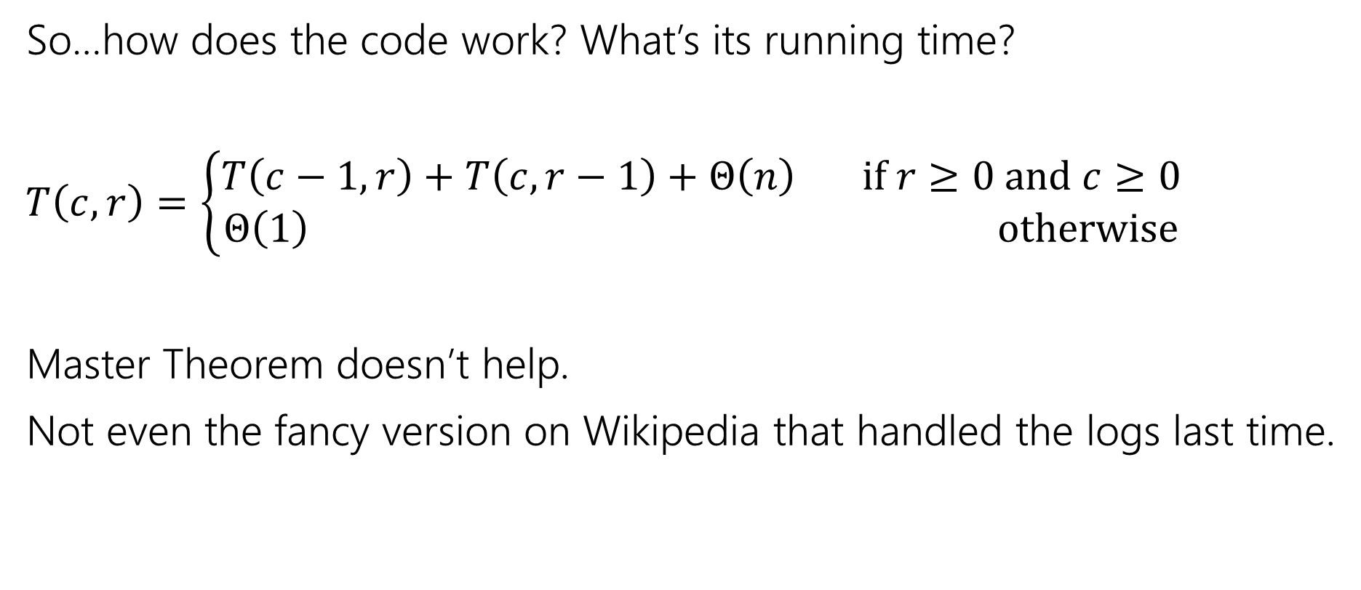
Analyzing the recursive function
So…how does the code work? What’s its running time?
$T\left(c,r\right)=\left\{\begin{aligned}T\left(c−1,r\right)+T\left(c,r−1\right)+Θ\left(n\right) if r≥0 and c≥0 \\ Θ\left(1\right) otherwise\end{aligned}\right.$
Master Theorem doesn’t help.
Not even the fancy version on Wikipedia that handled the logs last time.

Slide 9

Tree Method, Maybe…
OPT
(r,c)
OPT
(r-1,c)
OPT
(r,c-1)
OPT
(r-2,c)
OPT
(r-1,c-1)
OPT
(r-1,c-1)
OPT
(r,c-2)
…
…
…
…
When do we hit the base case?
Sometime between $min⁡(r,c)$ and $r+c$ levels.

Slide 10
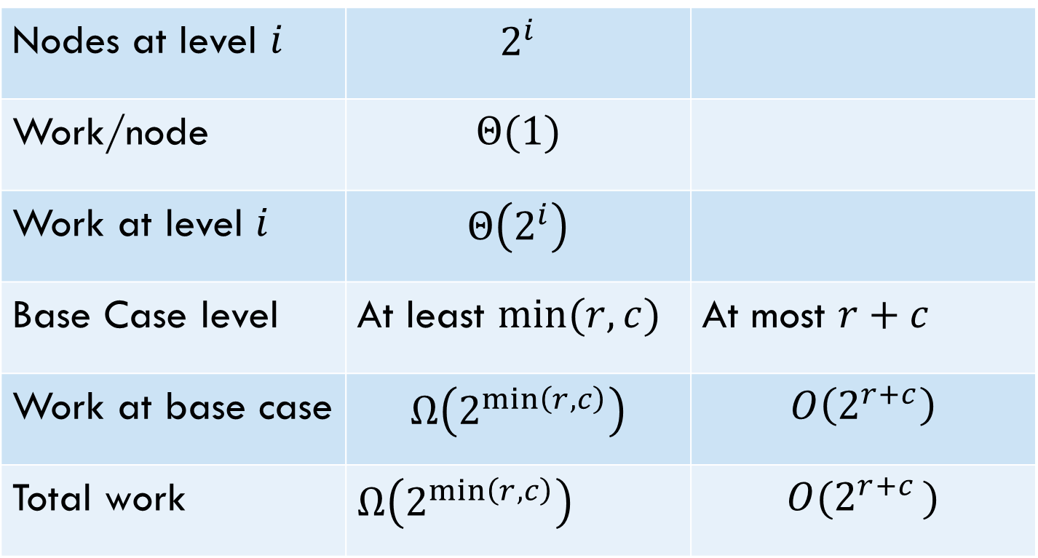
Tree Method
Nodes at level $i$ | $$2^{i}$$
Work/node | $$Θ(1)$$
Work at level $i$ | $$Θ\left(2^{i}\right)$$
Base Case level | At least $min⁡(r,c)$ | At most $r+c$
Work at base case | $$Ω\left(2^{\min\left(r,c\right)}\right)$$ | $$O\left(2^{r+c}\right)$$
Total work | $Ω\left(2^{\min\left(r,c\right)}\right)$ | $$O(2^{r+c })$$
Overall work is sum over all levels – each level has twice the work as the last, so the last level is about half the total work.
Tight big-O depends on relationship between $r$ and $c$…but regardless – it’s slow.

Slide 11
Speedup
That’s way too slow…but it doesn’t have to be.
OPT
(r,c)
OPT
(r-1,c)
OPT
(r,c-1)
OPT
(r-2,c)
OPT
(r-1,c-1)
OPT
(r-1,c-1)
OPT
(r,c-2)
…
…
…
…

Slide 12
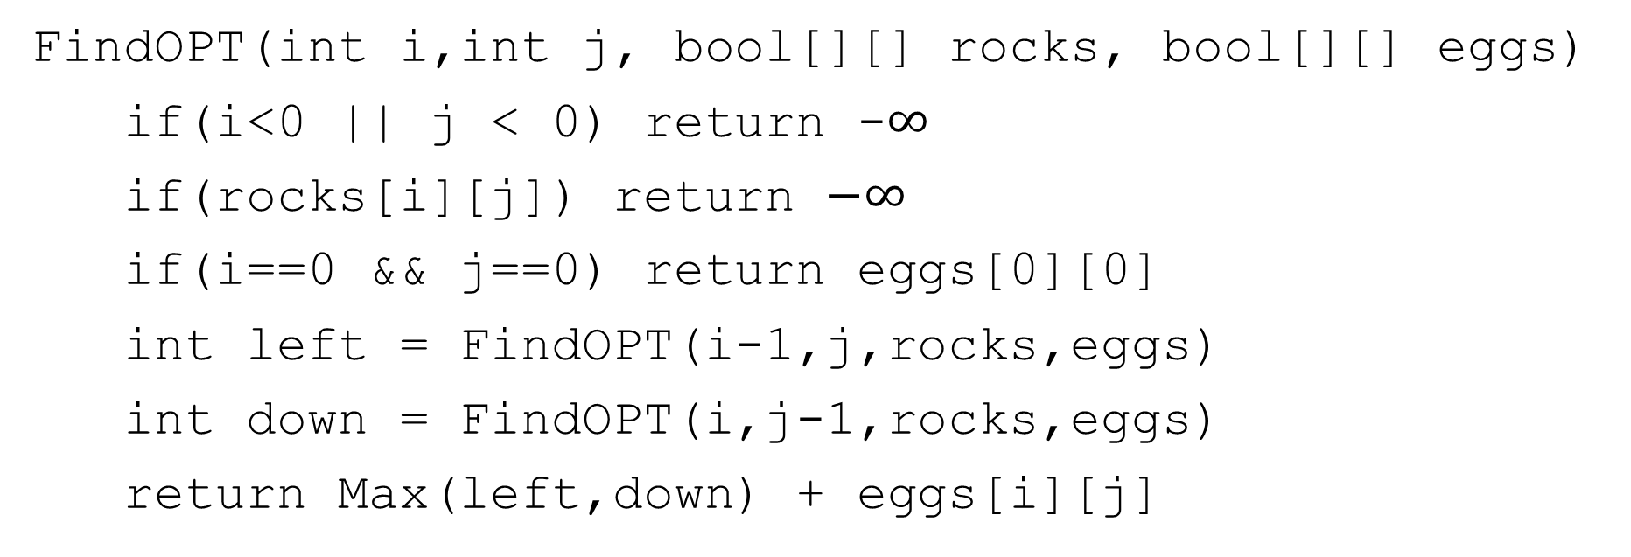
Activity
Fill out the question at pollev.com/robbie
Figure out how to take advantage of the repeated calculation.
What do you think the running time will be of your new algorithm?
FindOPT(int i,int j, bool[][] rocks, bool[][] eggs)
if(i<0 || j < 0) return -$∞$
if(rocks[i][j]) return $−∞$
if(i==0 && j==0) return eggs[0][0]
int left = FindOPT(i-1,j,rocks,eggs)
int down = FindOPT(i,j-1,rocks,eggs)
return Max(left,down) + eggs[i][j]

Slide 13
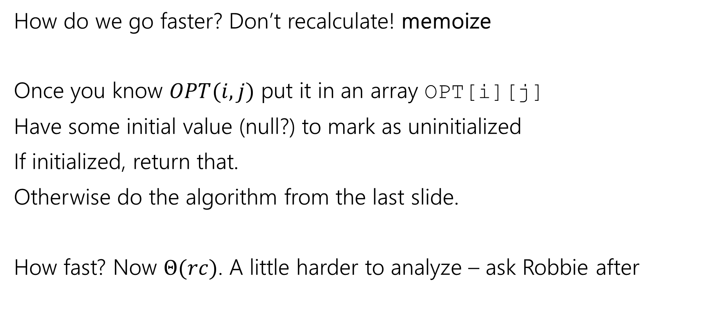
Speedup
How do we go faster? Don’t recalculate! memoize
Once you know $OPT(i,j)$ put it in an array OPT[i][j]
Have some initial value (null?) to mark as uninitialized
If initialized, return that.
Otherwise do the algorithm from the last slide.
How fast? Now $Θ(rc)$. A little harder to analyze – ask Robbie after

Slide 14
Baby Yoda Searching
(c-1,r-1)
r-1
Y-coordinate
(0,2)
(0,1)
(1,1)
0
(0,0)
X-coordinate
0
c-1
Notes:
https://1.bp.blogspot.com/-XxfNI65zLnU/Xc98O96LVnI/AAAAAAAAGFY/Xsmd7IMlIrEltYONCdGKk1hqPw1BgL3ggCLcBGAsYHQ/s1600/Mandalorian.jpg
http://www.pngmart.com/image/161116/png/161115
https://www.pikpng.com/pngvi/hiTxbbR_clip-art-rock-rock-clipart-transparent-background-png-download/

Slide 15
Going Bottom-up
So how does that recursion work?
What’s the first entry of the table that we fill?
OPT[0][0]
Why not just start filling in there?

Slide 16








Baby Yoda Searching
(c-1,r-1)
r-1
What else can we fill in?
Y-coordinate
(0,2)
(0,1)
(1,1)
0
$$0$$
$$1$$
$$2$$
$$2$$
$$2$$
$$2$$
$$2$$
$$2$$
(0,0)
X-coordinate
0
c-1
Notes:
https://1.bp.blogspot.com/-XxfNI65zLnU/Xc98O96LVnI/AAAAAAAAGFY/Xsmd7IMlIrEltYONCdGKk1hqPw1BgL3ggCLcBGAsYHQ/s1600/Mandalorian.jpg
http://www.pngmart.com/image/161116/png/161115
https://www.pikpng.com/pngvi/hiTxbbR_clip-art-rock-rock-clipart-transparent-background-png-download/

Slide 17











Baby Yoda Searching
(c-1,r-1)
r-1
What else can we fill in?
Y-coordinate
(0,2)
$$0$$
$$1$$
$$−∞$$
$$2$$
$$2$$
$$2$$
$$2$$
$$2$$
(0,1)
(1,1)
0
$$0$$
$$1$$
$$2$$
$$2$$
$$2$$
$$2$$
$$2$$
$$2$$
X-coordinate
0
c-1
Notes:
https://1.bp.blogspot.com/-XxfNI65zLnU/Xc98O96LVnI/AAAAAAAAGFY/Xsmd7IMlIrEltYONCdGKk1hqPw1BgL3ggCLcBGAsYHQ/s1600/Mandalorian.jpg
http://www.pngmart.com/image/161116/png/161115
https://www.pikpng.com/pngvi/hiTxbbR_clip-art-rock-rock-clipart-transparent-background-png-download/

Slide 18





Baby Yoda Searching
(c-1,r-1)
r-1
What else can we fill in?
Y-coordinate
$$0$$
$$−∞$$
$$0$$
$$1$$
$$−∞$$
$$2$$
$$2$$
$$2$$
$$2$$
$$2$$
0
$$0$$
$$1$$
$$2$$
$$2$$
$$2$$
$$2$$
$$2$$
$$2$$
X-coordinate
0
c-1
Notes:
https://1.bp.blogspot.com/-XxfNI65zLnU/Xc98O96LVnI/AAAAAAAAGFY/Xsmd7IMlIrEltYONCdGKk1hqPw1BgL3ggCLcBGAsYHQ/s1600/Mandalorian.jpg
http://www.pngmart.com/image/161116/png/161115
https://www.pikpng.com/pngvi/hiTxbbR_clip-art-rock-rock-clipart-transparent-background-png-download/

Slide 19
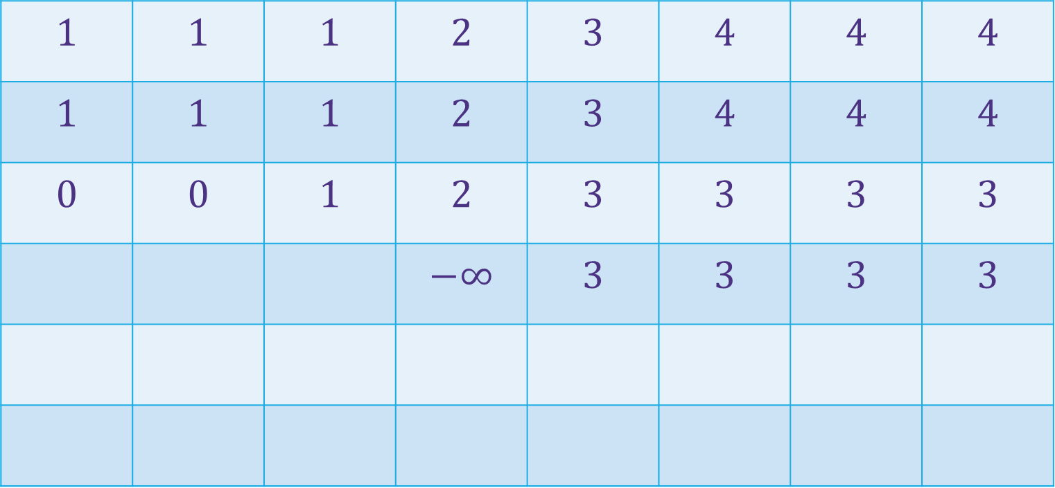

Baby Yoda Searching
(c-1,r-1)
$$1$$ | $$1$$ | $$1$$ | $$2$$ | $$3$$ | $$4$$ | $$4$$ | $$4$$
$$1$$ | $$1$$ | $$1$$ | $$2$$ | $$3$$ | $$4$$ | $$4$$ | $$4$$
$$0$$ | $$0$$ | $$1$$ | $$2$$ | $$3$$ | $$3$$ | $$3$$ | $$3$$
 |  |  | $$−∞$$ | $$3$$ | $$3$$ | $$3$$ | $$3$$
r-1
Where’s the final answer?
In the top right. Where Baby Yoda starts.
Y-coordinate
$$0$$
$$−∞$$
$$−∞$$
$$0$$
$$1$$
$$−∞$$
$$2$$
$$2$$
$$2$$
$$2$$
$$2$$
0
$$0$$
$$1$$
$$2$$
$$2$$
$$2$$
$$2$$
$$2$$
$$2$$
X-coordinate
0
c-1
Notes:
https://1.bp.blogspot.com/-XxfNI65zLnU/Xc98O96LVnI/AAAAAAAAGFY/Xsmd7IMlIrEltYONCdGKk1hqPw1BgL3ggCLcBGAsYHQ/s1600/Mandalorian.jpg
http://www.pngmart.com/image/161116/png/161115
https://www.pikpng.com/pngvi/hiTxbbR_clip-art-rock-rock-clipart-transparent-background-png-download/

Slide 20
What order?
Fill in a row at a time (left to right)
Going up to the next row once a level is done.
In actual code, probably easier to handle edges first
Avoid the index-out-of-bound exceptions.

Slide 21

Pseudocode
int eggsSoFar=0;
Boolean rocksInWay=false
for(int x=0; x<c; x++)
if(rocks[x][0]) rocksInWay = true
eggsSoFar+=eggs[x][0]
OPT[x][0]= rocksInWay ? $−∞$: eggsSoFar
eggsSoFar=0
rocksInWay=false
for(int y=0; y<r; y++)
if(rocks[0][y]) rocksInWay = true
eggsSoFar+=eggs[0][y]
OPT[0][y]= rocksInWay ? $−∞$ : eggsSoFar
for(int y=0;y<r;y++)
for(int x=0;x<c;x++)
if(rocks[x][y])
OPT[x][y]=-$∞$
else
OPT[x][y]=max(OPT[x-1][y], OPT[x][y-1])+eggs[x][y]

Slide 22
Why Switch To Iterative?
It does the same thing…
It’s easier to analyze (no need to imagine a recursion tree)
Saves constant factors (recursive version puts a lot on the call stack)
Will let you optimize memory (next week)
Recursive version is often a little more intuitive, though…

Slide 23
Modifying Problems

Slide 24
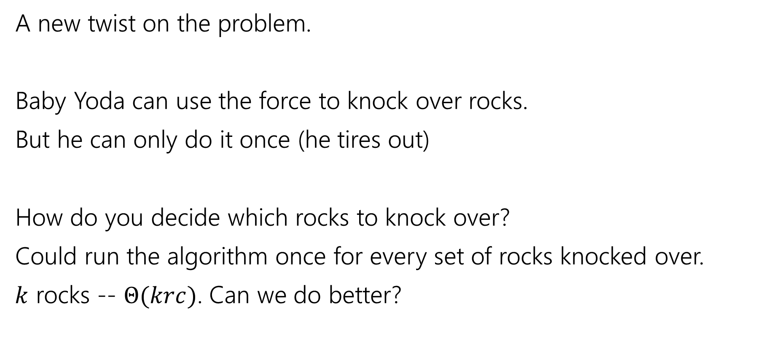
Updating the Problem
A new twist on the problem.
Baby Yoda can use the force to knock over rocks.
But he can only do it once (he tires out)
How do you decide which rocks to knock over?
Could run the algorithm once for every set of rocks knocked over.
$k$ rocks -- $Θ(krc)$. Can we do better?

Slide 25
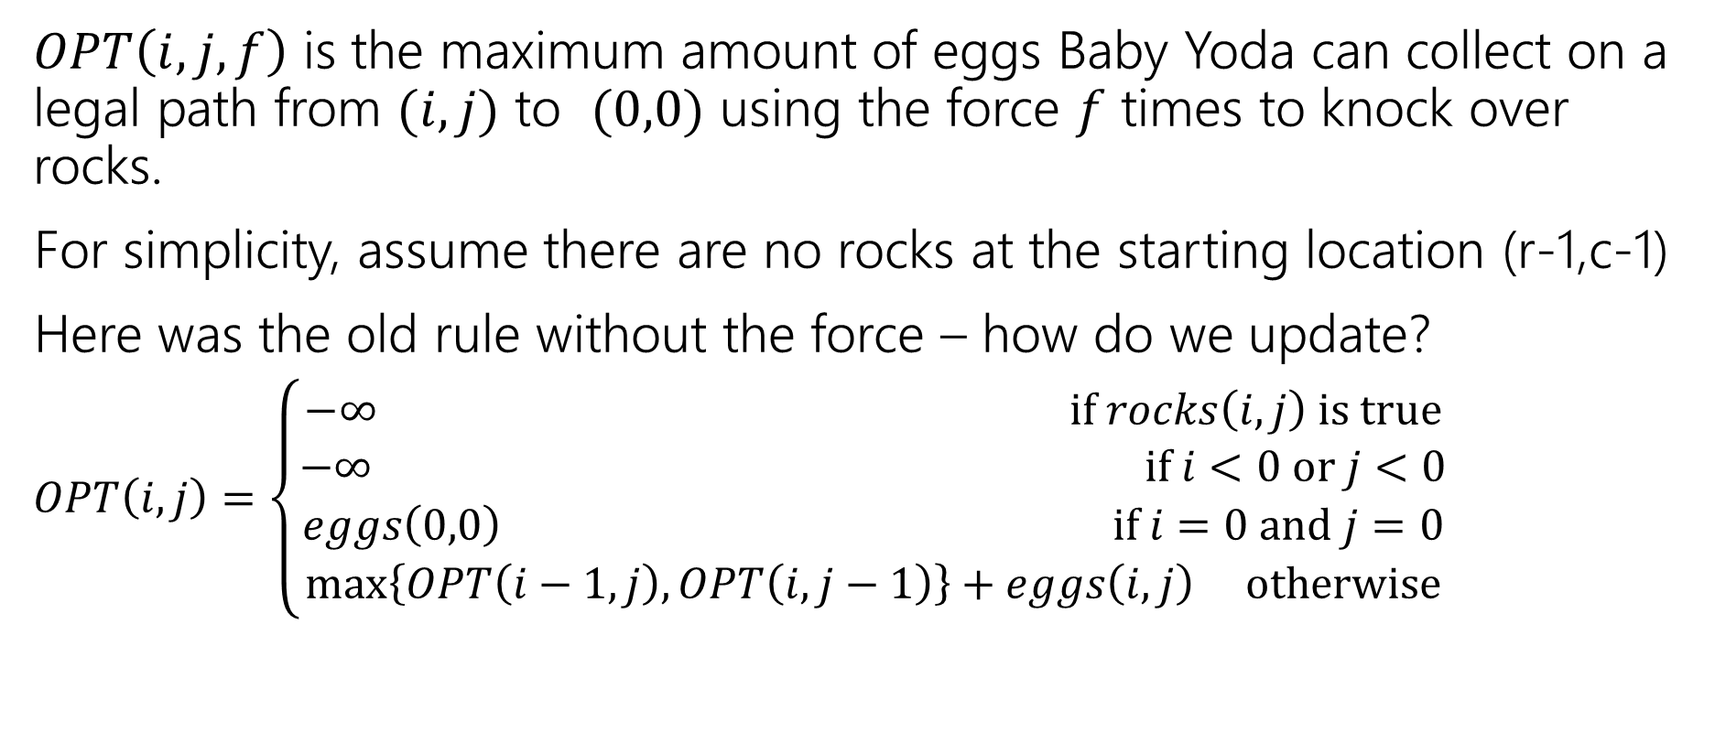
Updating the Problem
$OPT\left(i,j,f\right)$ is the maximum amount of eggs Baby Yoda can collect on a legal path from $(i,j)$ to $(0,0)$ using the force $f$ times to knock over rocks.
For simplicity, assume there are no rocks at the starting location (r-1,c-1)
Here was the old rule without the force – how do we update?
$OPT\left(i,j\right)=\left\{\begin{aligned}−∞ if rocks\left(i,j\right) is true \\ −∞ if i<0 or j<0 \\ eggs\left(0,0\right) if i=0 and j=0 \\ \max\left\{OPT\left(i−1,j\right), OPT\left(i,j−1\right)\right\}+eggs\left(i,j\right) otherwise\end{aligned}\right.$

Slide 26
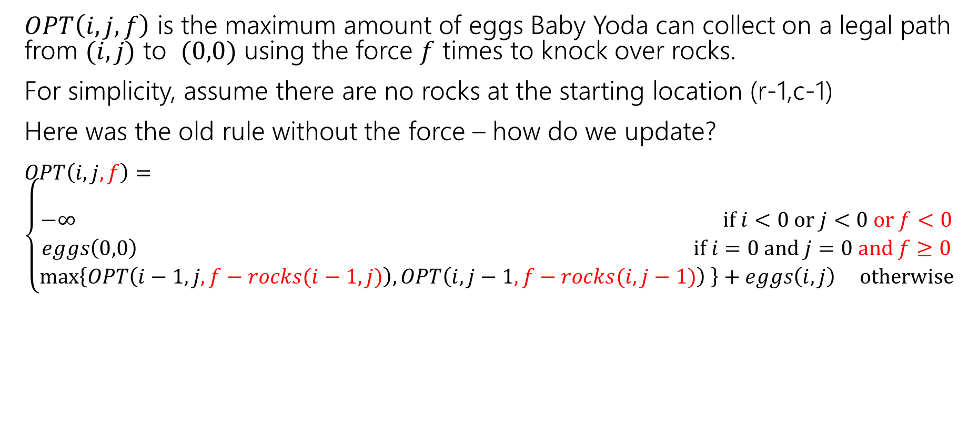
Updating the Problem
$OPT\left(i,j,f\right)$ is the maximum amount of eggs Baby Yoda can collect on a legal path from $(i,j)$ to $(0,0)$ using the force $f$ times to knock over rocks.
For simplicity, assume there are no rocks at the starting location (r-1,c-1)
Here was the old rule without the force – how do we update?
$OPT\left(i,j,f\right)=\left\{\begin{aligned} \\ −∞ if i<0 or j<0 or f<0 \\ eggs\left(0,0\right) if i=0 and j=0 and f≥0 \\ \max\left\{OPT\left(i−1,j,f−rocks(i−1,j)\right), OPT\left(i,j−1,f−rocks(i,j−1)\right) \right\}+eggs\left(i,j\right) otherwise\end{aligned}\right.$
Casting Boolean as an integer
(subtract 1 if you would need to knock over rocks)

Slide 27
Updating the Problem
$OPT\left(i,j,f\right)$ is the maximum amount of eggs Baby Yoda can collect on a legal path from $(i,j)$ to $(0,0)$ using the force $f$ times to knock over rocks.
For simplicity, assume there are no rocks at the starting location (r-1,c-1)
Here was the old rule without the force – how do we update?
$OPT\left(i,j,f\right)=\left\{\begin{aligned} \\ −∞ if i<0 or j<0 or f<0 \\ eggs\left(0,0\right) if i=0 and j=0 and f≥0 \\ \max\left\{OPT\left(i−1,j,f−rocks(i−1,j)\right), OPT\left(i,j−1,f−rocks(i,j−1)\right) \right\}+eggs\left(i,j\right) otherwise\end{aligned}\right.$
rocks(i,j) doesn’t guarantee $−∞$ anymore. Only if you were out of force uses before trying to jump onto that location.

Slide 28
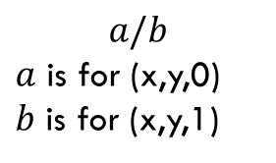
Baby Yoda Searching
(c-1,r-1)
r-1
What can we fill in?
Y-coordinate
$$a/b$$
$a$ is for (x,y,0) $b$ is for (x,y,1)
0
X-coordinate
0
c-1
Notes:
https://1.bp.blogspot.com/-XxfNI65zLnU/Xc98O96LVnI/AAAAAAAAGFY/Xsmd7IMlIrEltYONCdGKk1hqPw1BgL3ggCLcBGAsYHQ/s1600/Mandalorian.jpg
http://www.pngmart.com/image/161116/png/161115
https://www.pikpng.com/pngvi/hiTxbbR_clip-art-rock-rock-clipart-transparent-background-png-download/

Slide 29








Baby Yoda Searching
(c-1,r-1)
r-1
What can we fill in?
Y-coordinate
$$a/b$$
$a$ is for (x,y,0) $b$ is for (x,y,1)
0
$$0/?$$
$$1/?$$
$$2/?$$
$$2/?$$
$$2/?$$
$$2/?$$
$$2/?$$
$$2/?$$
X-coordinate
0
c-1
Notes:
https://1.bp.blogspot.com/-XxfNI65zLnU/Xc98O96LVnI/AAAAAAAAGFY/Xsmd7IMlIrEltYONCdGKk1hqPw1BgL3ggCLcBGAsYHQ/s1600/Mandalorian.jpg
http://www.pngmart.com/image/161116/png/161115
https://www.pikpng.com/pngvi/hiTxbbR_clip-art-rock-rock-clipart-transparent-background-png-download/

Slide 30


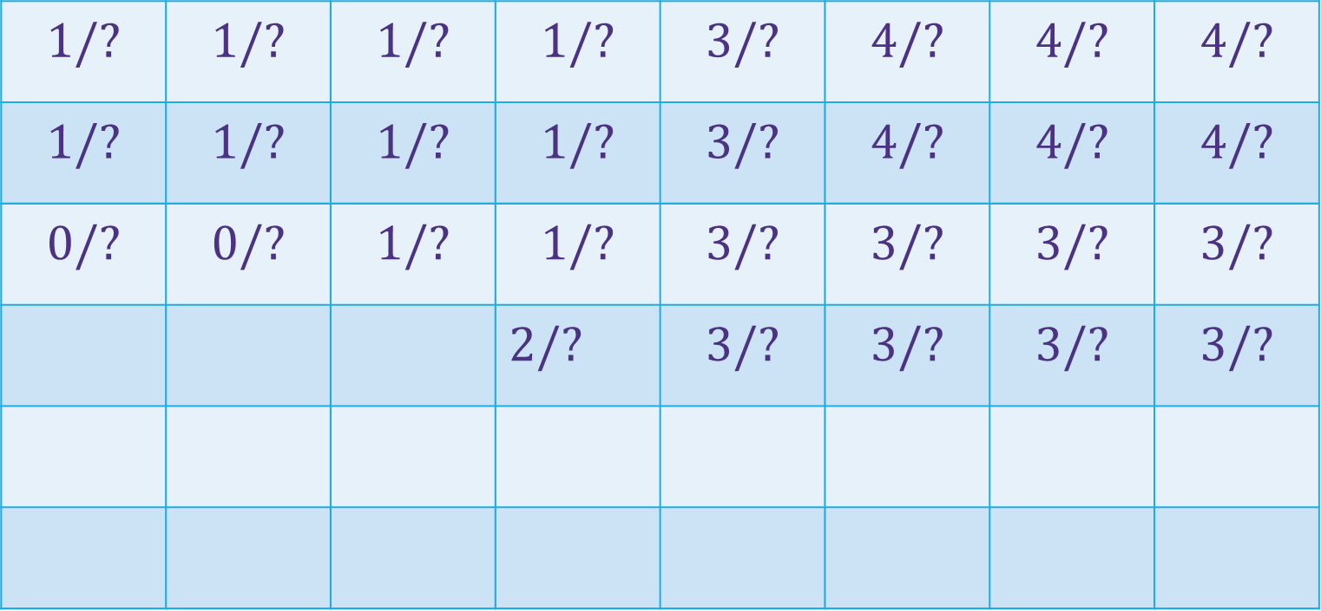





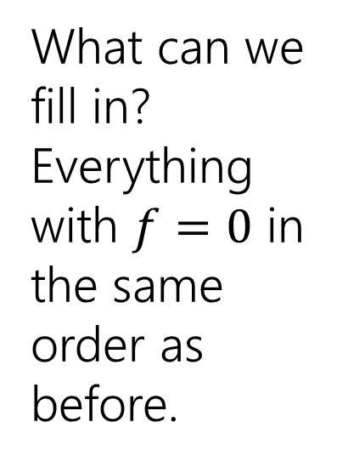







Baby Yoda Searching
(c-1,r-1)
$$1/?$$ | $$1/?$$ | $$1/?$$ | $$1/?$$ | $$3/?$$ | $$4/?$$ | $$4/?$$ | $$4/?$$
$$1/?$$ | $$1/?$$ | $$1/?$$ | $$1/?$$ | $$3/?$$ | $$4/?$$ | $$4/?$$ | $$4/?$$
$$0/?$$ | $$0/?$$ | $$1/?$$ | $$1/?$$ | $$3/?$$ | $$3/?$$ | $$3/?$$ | $$3/?$$
 |  |  | $2/?$ | $$3/?$$ | $$3/?$$ | $$3/?$$ | $$3/?$$
r-1
What can we fill in?
Everything with $f=0$ in the same order as before.
Y-coordinate
$$0/?$$
$$1/?$$
$$−∞/?$$
$$0/?$$
$$1/?$$
$$2/?$$
$$2/?$$
$$2/?$$
$$2/?$$
$$2/?$$
$$2/?$$
0
$$0/?$$
$$1/?$$
$$2/?$$
$$2/?$$
$$2/?$$
$$2/?$$
$$2/?$$
$$2/?$$
Entries are slightly different – we’re handling rocks differently.
X-coordinate
0
c-1
Notes:
https://1.bp.blogspot.com/-XxfNI65zLnU/Xc98O96LVnI/AAAAAAAAGFY/Xsmd7IMlIrEltYONCdGKk1hqPw1BgL3ggCLcBGAsYHQ/s1600/Mandalorian.jpg
http://www.pngmart.com/image/161116/png/161115
https://www.pikpng.com/pngvi/hiTxbbR_clip-art-rock-rock-clipart-transparent-background-png-download/

Slide 31
Baby Yoda Searching
(c-1,r-1)
$$1/?$$ | $$1/?$$ | $$1/?$$ | $$1/?$$ | $$3/?$$ | $$4/?$$ | $$4/?$$ | $$4/?$$
$$1/?$$ | $$1/?$$ | $$1/?$$ | $$1/?$$ | $$3/?$$ | $$4/?$$ | $$4/?$$ | $$4/?$$
$$0/?$$ | $$0/?$$ | $$1/?$$ | $$1/?$$ | $$3/?$$ | $$3/?$$ | $$3/?$$ | $$3/?$$
 |  |  | $2/?$ | $$3/?$$ | $$3/?$$ | $$3/?$$ | $$3/?$$
r-1
What can we fill in?
Again from left to right, bottom to top, now filling in
Y-coordinate
$$0/?$$
$$1/?$$
$$−∞/?$$
$$0/?$$
$$1/?$$
$$2/?$$
$$2/?$$
$$2/?$$
$$2/?$$
$$2/?$$
$$2/?$$
0
$$0/?$$
$$1/?$$
$$2/?$$
$$2/?$$
$$2/?$$
$$2/?$$
$$2/?$$
$$2/?$$
X-coordinate
0
c-1
Notes:
https://1.bp.blogspot.com/-XxfNI65zLnU/Xc98O96LVnI/AAAAAAAAGFY/Xsmd7IMlIrEltYONCdGKk1hqPw1BgL3ggCLcBGAsYHQ/s1600/Mandalorian.jpg
http://www.pngmart.com/image/161116/png/161115
https://www.pikpng.com/pngvi/hiTxbbR_clip-art-rock-rock-clipart-transparent-background-png-download/

Slide 32



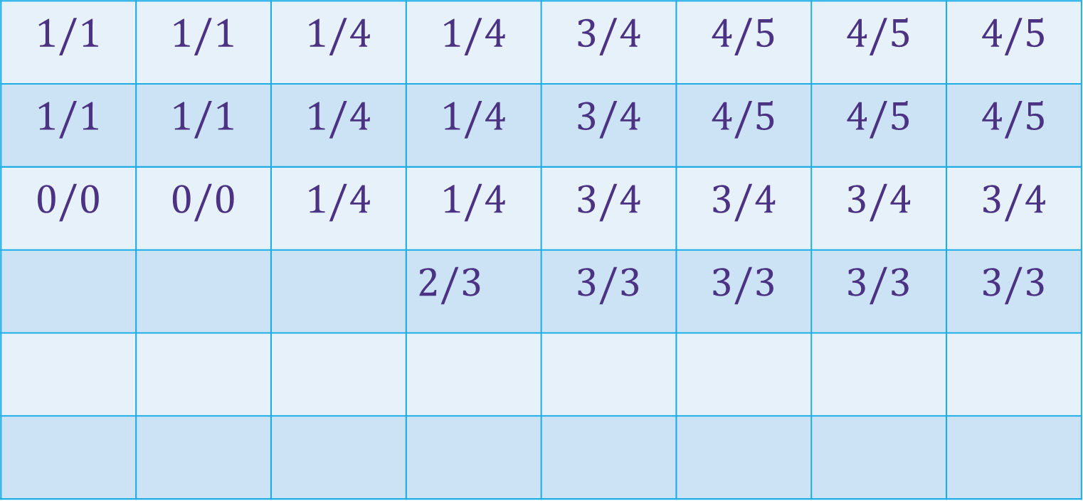
















Baby Yoda Searching
(c-1,r-1)
$$1/1$$ | $$1/1$$ | $$1/4$$ | $$1/4$$ | $$3/4$$ | $$4/5$$ | $$4/5$$ | $$4/5$$
$$1/1$$ | $$1/1$$ | $$1/4$$ | $$1/4$$ | $$3/4$$ | $$4/5$$ | $$4/5$$ | $$4/5$$
$$0/0$$ | $$0/0$$ | $$1/4$$ | $$1/4$$ | $$3/4$$ | $$3/4$$ | $$3/4$$ | $$3/4$$
 |  |  | $2/3$ | $$3/3$$ | $$3/3$$ | $$3/3$$ | $$3/3$$
r-1
What can we fill in?
Again from left to right, bottom to top, now filling in
Y-coordinate
$$0/0$$
$$1/1$$
$$−∞/3$$
$$0/0$$
$$1/1$$
$$2/2$$
$$2/2$$
$$2/2$$
$$2/2$$
$$2/2$$
$$2/2$$
0
$$0/0$$
$$1/1$$
$$2/2$$
$$2/2$$
$$2/2$$
$$2/2$$
$$2/2$$
$$2/2$$
X-coordinate
0
c-1
Notes:
https://1.bp.blogspot.com/-XxfNI65zLnU/Xc98O96LVnI/AAAAAAAAGFY/Xsmd7IMlIrEltYONCdGKk1hqPw1BgL3ggCLcBGAsYHQ/s1600/Mandalorian.jpg
http://www.pngmart.com/image/161116/png/161115
https://www.pikpng.com/pngvi/hiTxbbR_clip-art-rock-rock-clipart-transparent-background-png-download/

Slide 33
Dynamic Programming Process
1. Define the object you’re looking for
2. Write a recurrence to say how to find it
3. Design a memoization structure
4. Write an iterative algorithm

Slide 34
Bells,Whistles, and optimiziation

Slide 35
Baby Yoda Searching
(c-1,r-1)
$$1/1$$ | $$1/1$$ | $$1/4$$ | $$1/4$$ | $$3/4$$ | $$4/5$$ | $$4/5$$ | $$4/5$$
$$1/1$$ | $$1/1$$ | $$1/4$$ | $$1/4$$ | $$3/4$$ | $$4/5$$ | $$4/5$$ | $$4/5$$
$$0/0$$ | $$0/0$$ | $$1/4$$ | $$1/4$$ | $$3/4$$ | $$3/4$$ | $$3/4$$ | $$3/4$$
 |  |  | $2/3$ | $$3/3$$ | $$3/3$$ | $$3/3$$ | $$3/3$$
r-1
So should Baby Yoda go left or down?
Y-coordinate
$$0/0$$
$$1/1$$
$$−∞/3$$
$$0/0$$
$$1/1$$
$$2/2$$
$$2/2$$
$$2/2$$
$$2/2$$
$$2/2$$
$$2/2$$
0
$$0/0$$
$$1/1$$
$$2/2$$
$$2/2$$
$$2/2$$
$$2/2$$
$$2/2$$
$$2/2$$
X-coordinate
0
c-1
Notes:
https://1.bp.blogspot.com/-XxfNI65zLnU/Xc98O96LVnI/AAAAAAAAGFY/Xsmd7IMlIrEltYONCdGKk1hqPw1BgL3ggCLcBGAsYHQ/s1600/Mandalorian.jpg
http://www.pngmart.com/image/161116/png/161115
https://www.pikpng.com/pngvi/hiTxbbR_clip-art-rock-rock-clipart-transparent-background-png-download/

Slide 36
Which Way to Go
When you’re taking the max in the recursive case, you can also record which option gave you the max.
That’s the way to go.
We’ll ask you to do that once…but for the most part we’ll just have you find the number.

Slide 37
Optimizing
Do we need all that memory?
Let’s go back to the simple version (no using the Force)

Slide 38
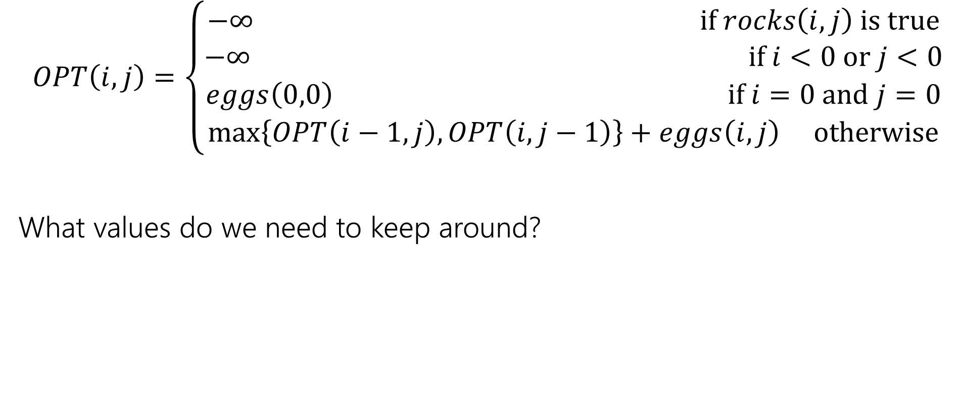
Recurrence Form
$$OPT\left(i,j\right)=\left\{\begin{aligned}−∞ if rocks\left(i,j\right) is true \\ −∞ if i<0 or j<0 \\ eggs\left(0,0\right) if i=0 and j=0 \\ \max\left\{OPT\left(i−1,j\right), OPT\left(i,j−1\right)\right\}+eggs\left(i,j\right) otherwise\end{aligned}\right.$$
What values do we need to keep around?

Slide 39
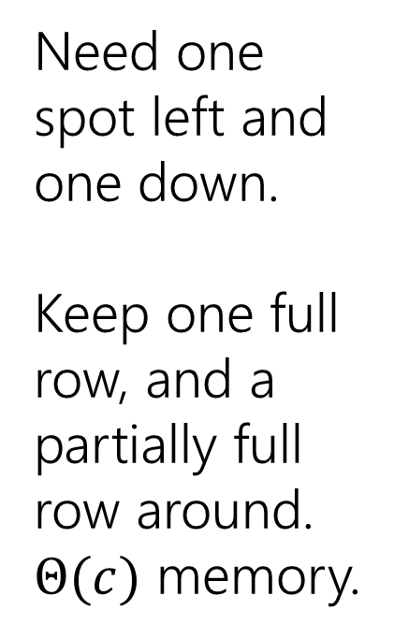
Baby Yoda Searching
(c-1,r-1)
$$1$$ | $$1$$ | $$1$$ | $$2$$ | $$3$$ | $$4$$ | $$4$$ | $$4$$
$$1$$ | $$1$$ | $$1$$ | $$2$$ | $$3$$ | $$4$$ | $$4$$ | $$4$$
$$0$$ | $$0$$ | $$1$$ | $$2$$ | $$3$$ | $$3$$ | $$3$$ | $$3$$
 |  |  | $$−∞$$ | $$3$$ | $$3$$ | $$3$$ | $$3$$
r-1
Need one spot left and one down.
Keep one full row, and a partially full row around.
$Θ(c)$ memory.
Y-coordinate
$$0$$
$$−∞$$
$$−∞$$
$$0$$
$$1$$
$$−∞$$
$$2$$
$$2$$
$$2$$
$$2$$
$$2$$
0
$$0$$
$$1$$
$$2$$
$$2$$
$$2$$
$$2$$
$$2$$
$$2$$
X-coordinate
0
c-1
Notes:
https://1.bp.blogspot.com/-XxfNI65zLnU/Xc98O96LVnI/AAAAAAAAGFY/Xsmd7IMlIrEltYONCdGKk1hqPw1BgL3ggCLcBGAsYHQ/s1600/Mandalorian.jpg
http://www.pngmart.com/image/161116/png/161115
https://www.pikpng.com/pngvi/hiTxbbR_clip-art-rock-rock-clipart-transparent-background-png-download/

