Slide 1
D&C wrap; Dynamic Programming
CSE 417 Winter 24
Lecture 10

Slide 2
Classic Divide & Conquer

Slide 3
Activity
Write a recurrence to describe the running time of this code. What’s the big-O?
DivConqExponentiation(int a, int b, int n)
if(n==0) return 1
if(n==1) return a%b
int k = divConqExponentiation(a,b,n/2) /*int div*/
if(n%2==1) return (k*k*a)%b
return (k*k)%b
Go to pollev.com/robbie so I know how long to explain

Slide 4
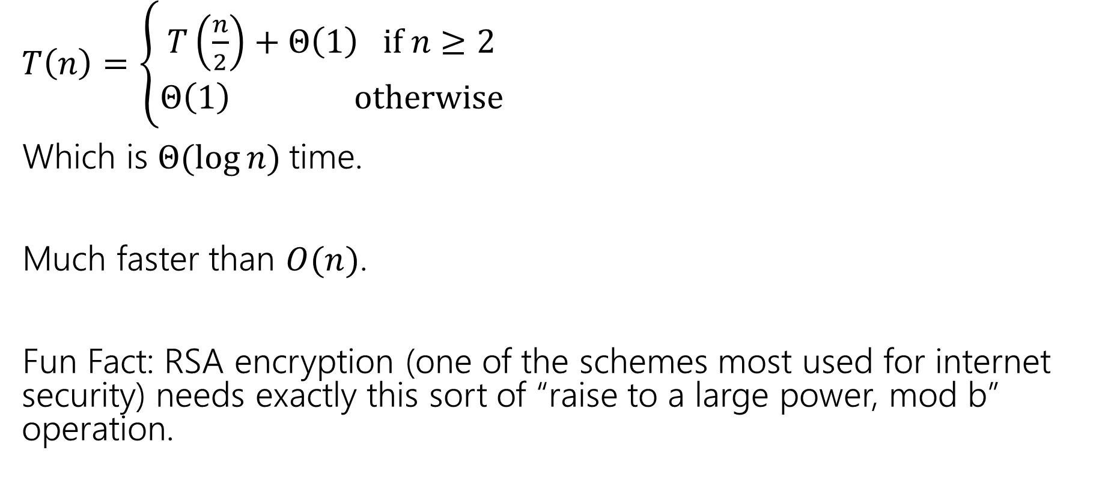
Running Time?
$T\left(n\right)=\left\{\begin{aligned}T\left(\frac{n}{2}\right)+Θ\left(1\right) if n≥2 \\ Θ\left(1\right) otherwise\end{aligned}\right.$
Which is $Θ(\log{n)}$time.
Much faster than $O(n)$.
Fun Fact: RSA encryption (one of the schemes most used for internet security) needs exactly this sort of “raise to a large power, mod b” operation.

Slide 5
Classic Applications
There are a few really famous divide & conquer algorithms where the way to recurse is very clever.
The point of the next few examples is not to teach you really useful tricks (they often don’t generalize to new problems).
It’s partially to show you that sometimes being really clever gives you a really big improvement
And partially because these are “standard” in algorithms classes, so you should at least have heard of these algorithms.

Slide 6
Multiplying Faster
Our end goal is to multiply really big numbers.
Really big.
Like around 1000 bits per number.
Why? Another step in the RSA encryption scheme!
Also a favorite problem of theoreticians.

Slide 7
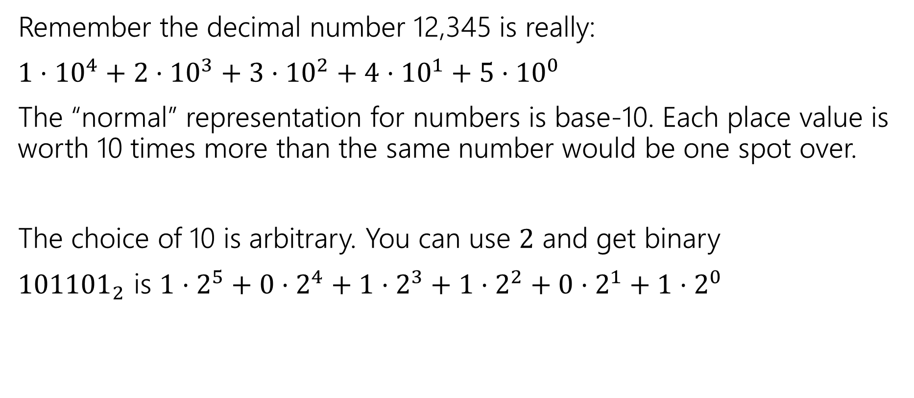
Place Values
Remember the decimal number 12,345 is really:
$1⋅{10}^{4}+2⋅{10}^{3}+3⋅{10}^{2}+4⋅{10}^{1}+5⋅{10}^{0}$
The “normal” representation for numbers is base-10. Each place value is worth 10 times more than the same number would be one spot over.
The choice of 10 is arbitrary. You can use $2$ and get binary
${101101}_{2}$ is $1⋅2^{5}+0⋅2^{4}+1⋅2^{3}+1⋅2^{2}+0⋅2^{1}+1⋅2^{0}$

Slide 8
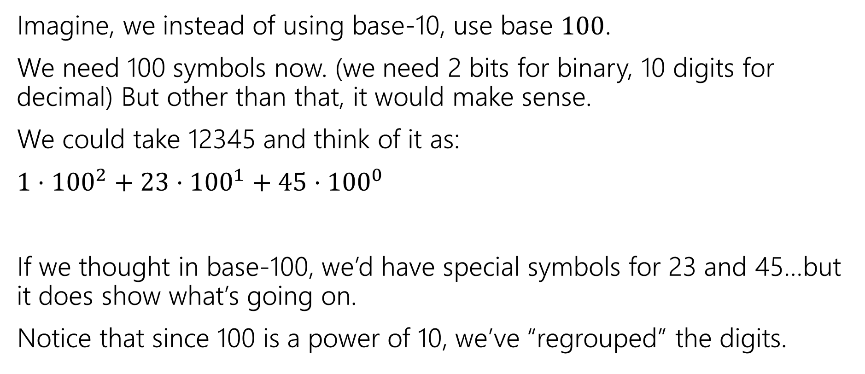
Place Values
Imagine, we instead of using base-10, use base $100$.
We need 100 symbols now. (we need 2 bits for binary, 10 digits for decimal) But other than that, it would make sense.
We could take 12345 and think of it as:
$1⋅{100}^{2}+23⋅{100}^{1}+45⋅{100}^{0}$
If we thought in base-100, we’d have special symbols for 23 and 45…but it does show what’s going on.
Notice that since 100 is a power of 10, we’ve “regrouped” the digits.

Slide 9
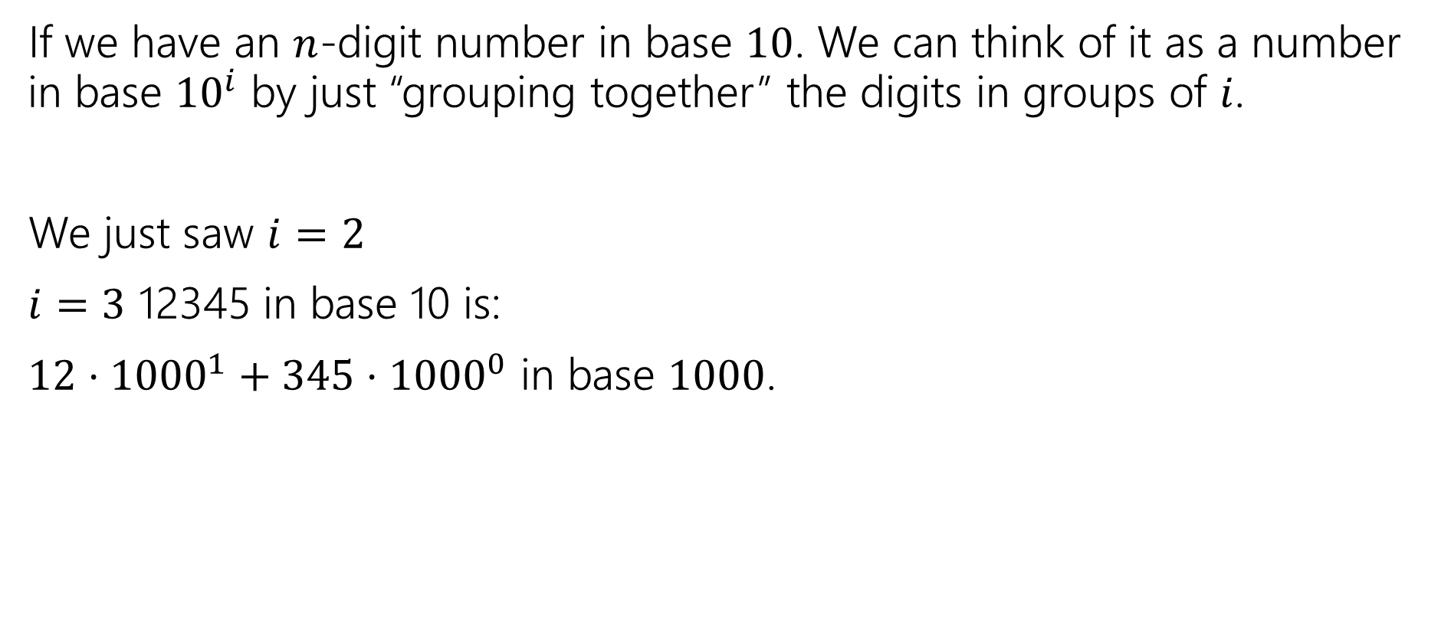
Place Values
If we have an $n$-digit number in base $10$. We can think of it as a number in base ${10}^{i}$ by just “grouping together” the digits in groups of $i$.
We just saw $i=2$
$i=3$ 12345 in base 10 is:
$12⋅{1000}^{1}+345⋅{1000}^{0}$ in base $1000$.

Slide 10
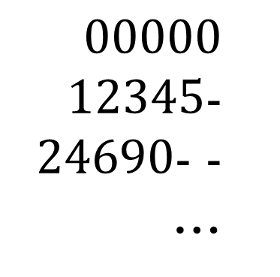
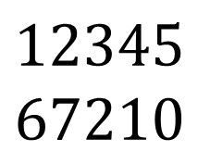
Why does it matter?
Imagine I asked you to multiply
$$12345$$
$$67210$$
Take the ones place, multiply digit-by-digit.
Take the 10’s place, multiply digit-by-digit, and shift answer by 10.
Take the 100’s place, multiply digit-by-digit, and shift the answer by 100.
$00000$
$12345$-
$24690$- -
…

Slide 11
Why does it matter?
Now imagine they’re in base 1000
$$12345$$
$$67210$$
Take the ones place, multiply digit-by-digit.
Take the 1000’s place, multiply digit-by-digit, and shift answer by 1000.

Slide 12
Alright…so…
We can multiply in a different way, why should you care?
It’s going to let us divide-and-conquer multiplication.

Slide 13
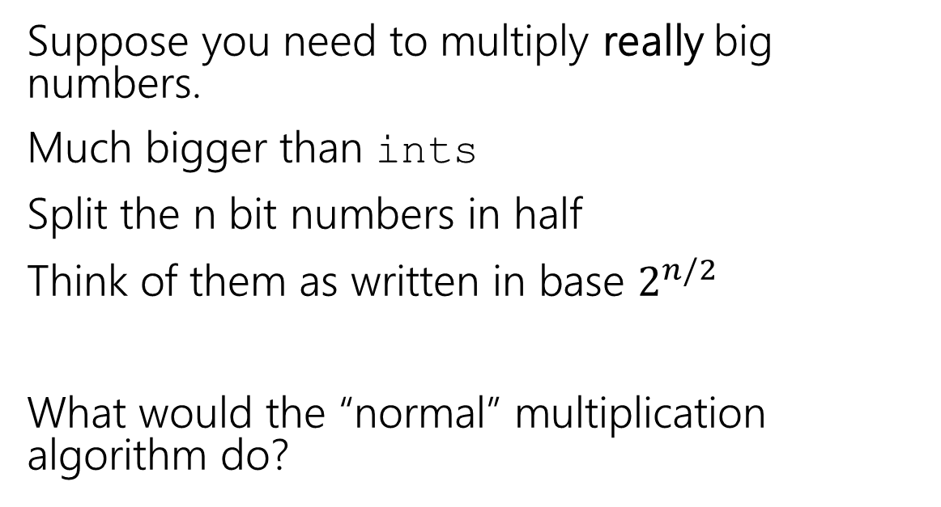
Classic Application
Suppose you need to multiply really big numbers.
Much bigger than ints
Split the n bit numbers in half
Think of them as written in base $2^{n/2}$
What would the “normal” multiplication algorithm do?
x_1
x_0
y_1
y_0
x_1y_0
x_0y_0
4 multiplications, i.e. 4 recursive calls.
x_1y_1
x_0y_1

Slide 14
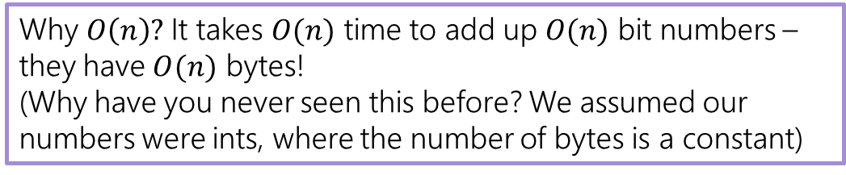
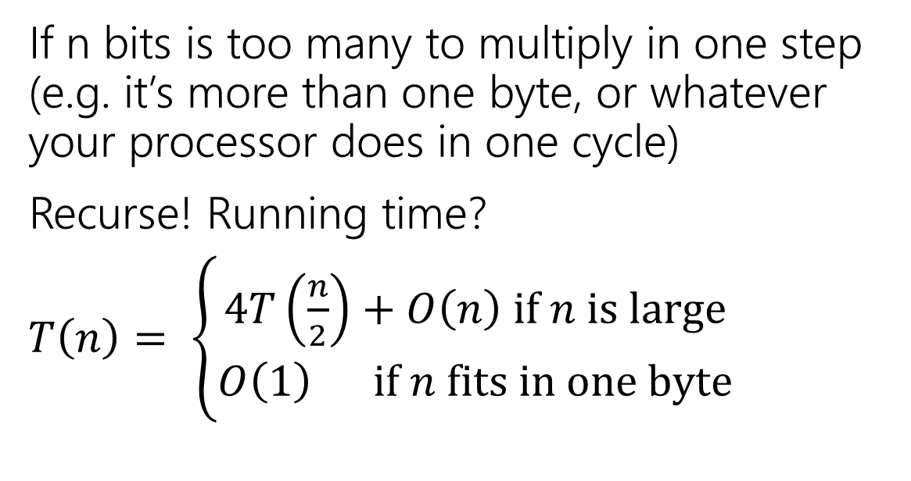
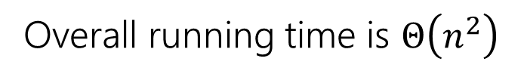
Classic Application
If n bits is too many to multiply in one step (e.g. it’s more than one byte, or whatever your processor does in one cycle)
Recurse! Running time?
$T\left(n\right)= \left\{\begin{aligned}4T\left(\frac{n}{2}\right)+O\left(n\right) if n is large \\ O\left(1\right) if n fits in one byte\end{aligned}\right.$
x_1
x_0
y_1
y_0
x_1y_0
x_0y_0
x_1y_1
x_0y_1
Why $O\left(n\right)?$ It takes $O(n)$ time to add up $O(n)$ bit numbers – they have $O(n)$ bytes!
(Why have you never seen this before? We assumed our numbers were ints, where the number of bytes is a constant)
Overall running time is $Θ\left(n^{2}\right)$

Slide 15
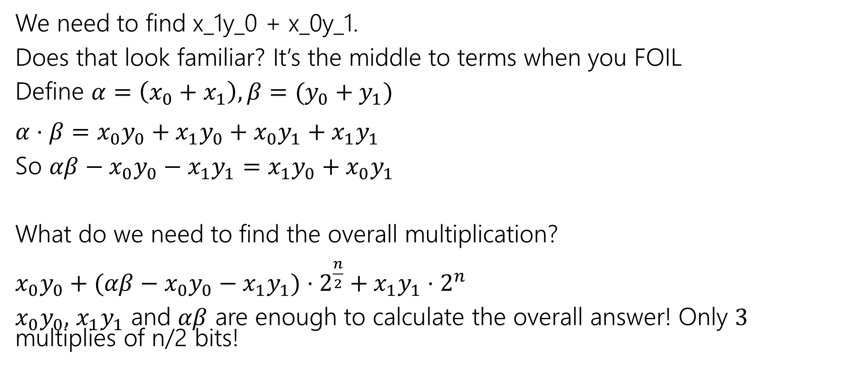
Clever Trick
We need to find x_1y_0 + x_0y_1.
Does that look familiar? It’s the middle to terms when you FOIL
Define $α=\left(x_{0}+x_{1}\right), β=(y_{0}+y_{1})$
$α⋅β=x_{0}y_{0}+x_{1}y_{0}+x_{0}y_{1}+x_{1}y_{1}$
So $αβ−x_{0}y_{0}−x_{1}y_{1}=$ $x_{1}y_{0}+x_{0}y_{1}$
What do we need to find the overall multiplication?
$x_{0}y_{0}+(αβ−x_{0}y_{0}−x_{1}y_{1})⋅2^{\frac{n}{2}}+x_{1}y_{1}⋅2^{n}$
$x_{0}y_{0},$ $x_{1}y_{1}$ and $αβ$ are enough to calculate the overall answer! Only $3$ multiplies of n/2 bits!

Slide 16

Running Time
$T\left(n\right)= \left\{\begin{aligned}3T\left(\frac{n}{2}\right)+O\left(n\right) if n is large \\ O\left(1\right) if n fits in one byte\end{aligned}\right.$
$\log_{2}\left(3\right)>1$,
So running time is $O\left(n^{\log_{2}\left(3\right)}\right)$
Or about $O\left(n^{1.585}\right)$

Slide 17
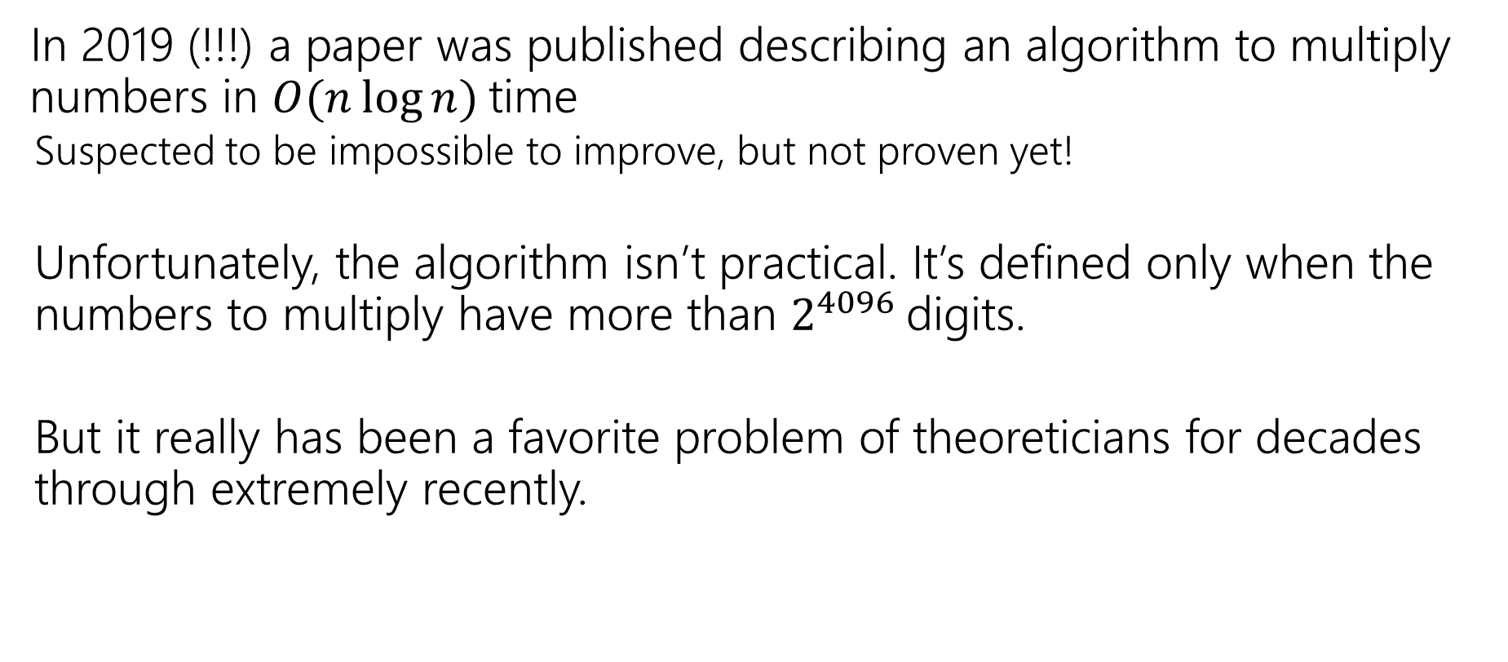
You can go faster!
In 2019 (!!!) a paper was published describing an algorithm to multiply numbers in $O(n\log{n)}$time
  Suspected to be impossible to improve, but not proven yet!
  Unfortunately, the algorithm isn’t practical. It’s defined only when the numbers to multiply have more than $2^{4096 }$digits.
  But it really has been a favorite problem of theoreticians for decades through extremely recently.

Slide 18
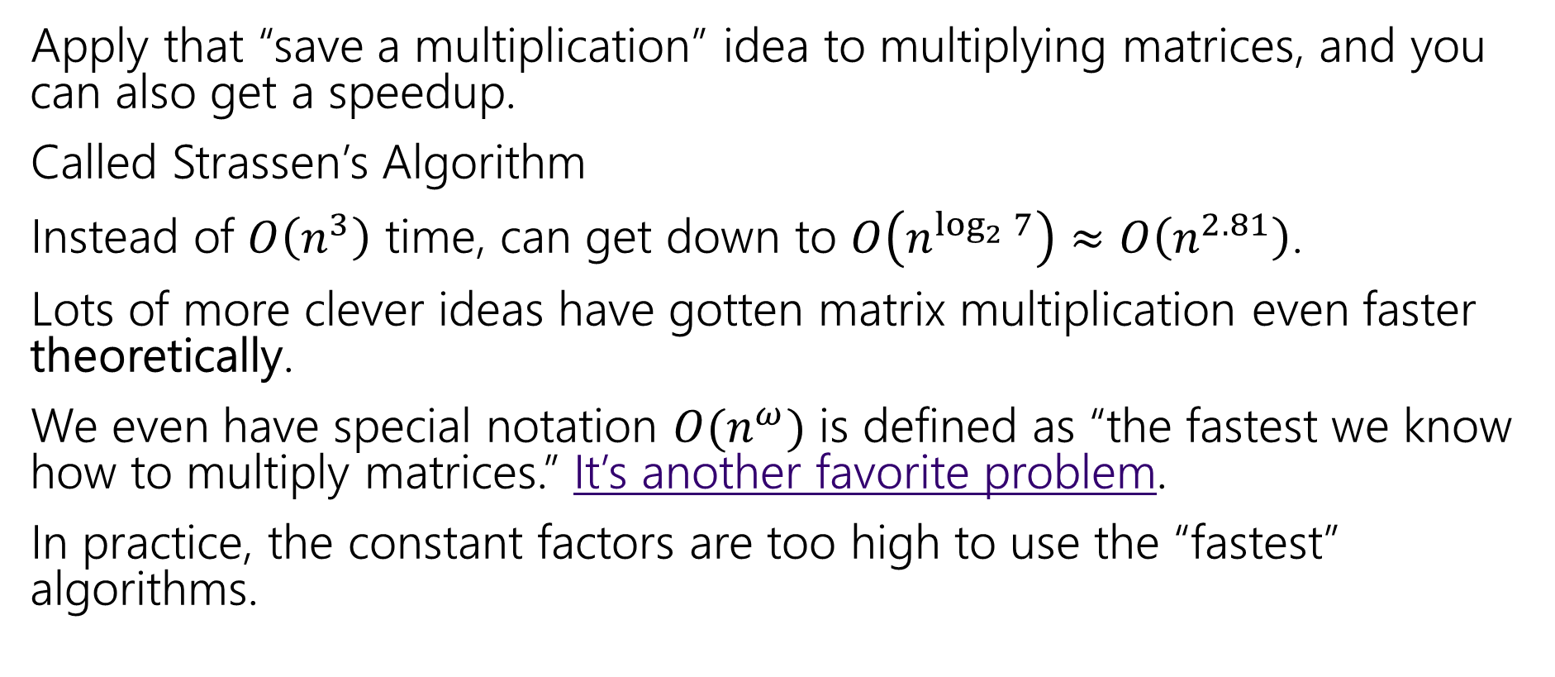
Strassen’s Algorithm
Apply that “save a multiplication” idea to multiplying matrices, and you can also get a speedup.
Called Strassen’s Algorithm
Instead of $O\left(n^{3}\right)$ time, can get down to $O\left(n^{\log_{2}{7}}\right)≈O\left(n^{2.81}\right)$.
Lots of more clever ideas have gotten matrix multiplication even faster theoretically.
We even have special notation $O(n^{ω})$ is defined as “the fastest we know how to multiply matrices.” It’s another favorite problem.
In practice, the constant factors are too high to use the “fastest” algorithms.

Slide 19
Dynamic Programming

Slide 20
Dynamic Programming
The most robust algorithm design paradigm we’ll study this quarter.
Small changes in the problem usually lead to small changes in the algorithm.
Also the one you’re most likely to be asked about in a tech interview.

Slide 21
Classic DP
This problem is going to look silly (and it is)
But it is going to make it much easier to do the hard DP problems next week.

Slide 22
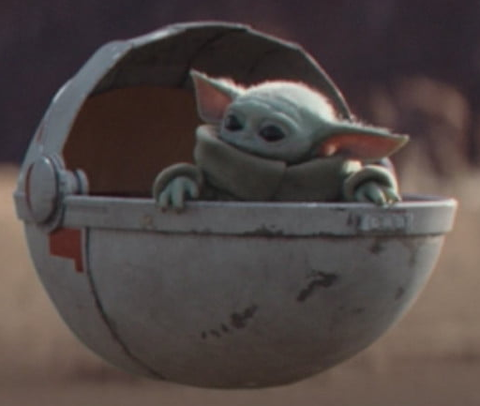
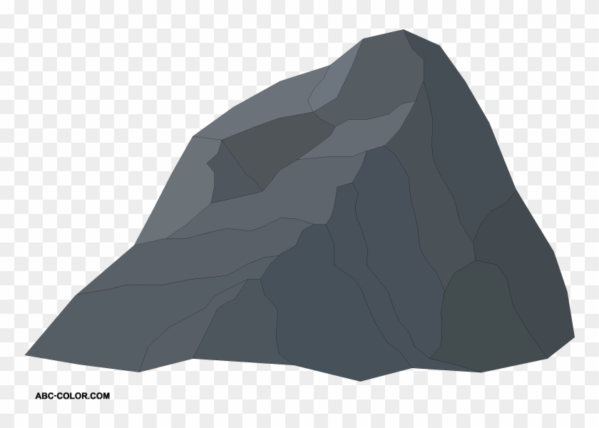
Baby Yoda Searching
Baby Yoda has to get from the upper-right corner to the lower left.
His cradle will only let him go left and down.
He can’t get past the rocks (too high) – he has to go around them (but still only going left and down)
As usual…he’s hungry.
He wants to eat as many frog eggs as possible on the way.

Slide 23
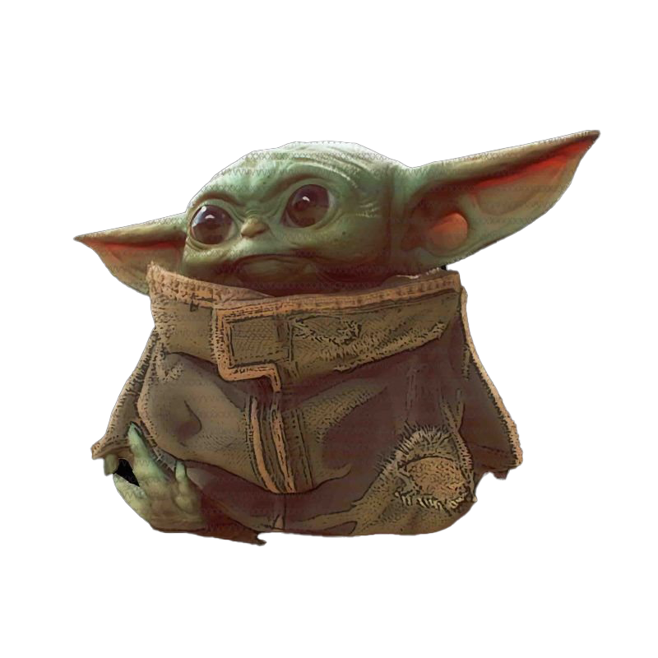
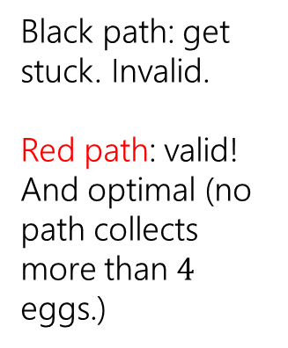
Baby Yoda Searching
Black path: get stuck. Invalid.
Red path: valid! And optimal (no path collects more than $4$ eggs.)
Notes:
https://1.bp.blogspot.com/-XxfNI65zLnU/Xc98O96LVnI/AAAAAAAAGFY/Xsmd7IMlIrEltYONCdGKk1hqPw1BgL3ggCLcBGAsYHQ/s1600/Mandalorian.jpg
http://www.pngmart.com/image/161116/png/161115
https://www.pikpng.com/pngvi/hiTxbbR_clip-art-rock-rock-clipart-transparent-background-png-download/

Slide 24
Baby Yoda Searching
Can we represent the problem with a graph?
Yeah, but it doesn’t work great (want most eggs, Dijkstra’s can only do least eggs)
Notes:
https://1.bp.blogspot.com/-XxfNI65zLnU/Xc98O96LVnI/AAAAAAAAGFY/Xsmd7IMlIrEltYONCdGKk1hqPw1BgL3ggCLcBGAsYHQ/s1600/Mandalorian.jpg
http://www.pngmart.com/image/161116/png/161115
https://www.pikpng.com/pngvi/hiTxbbR_clip-art-rock-rock-clipart-transparent-background-png-download/

Slide 25
Baby Yoda Searching
Best left-side path might start at a place inaccessible to end of best right-side path.
Could make a subproblem for each start and ending spot?
Can we divide and conquer?
Notes:
https://1.bp.blogspot.com/-XxfNI65zLnU/Xc98O96LVnI/AAAAAAAAGFY/Xsmd7IMlIrEltYONCdGKk1hqPw1BgL3ggCLcBGAsYHQ/s1600/Mandalorian.jpg
http://www.pngmart.com/image/161116/png/161115
https://www.pikpng.com/pngvi/hiTxbbR_clip-art-rock-rock-clipart-transparent-background-png-download/

Slide 26
Baby Yoda Searching
Notes:
https://1.bp.blogspot.com/-XxfNI65zLnU/Xc98O96LVnI/AAAAAAAAGFY/Xsmd7IMlIrEltYONCdGKk1hqPw1BgL3ggCLcBGAsYHQ/s1600/Mandalorian.jpg
http://www.pngmart.com/image/161116/png/161115
https://www.pikpng.com/pngvi/hiTxbbR_clip-art-rock-rock-clipart-transparent-background-png-download/

Slide 27
Baby Yoda Searching
So what should we do?
Let’s try to use recursion.
What should our recursive calls be finding?
What recursive calls do we need?

Slide 28
Let OPT(i,j) be the maximum number of eggs we can get on a legal path from (i,j) to (0,0)(including the egg in (i,j) if there is one)
What recursive calls do we need?
Don’t try to divide & conquer, think closer to home…
We have to decide whether to go down or left…

Slide 29
Baby Yoda Searching
(c-1,r-1)
r-1
Y-coordinate
(0,2)
(0,1)
(1,1)
0
(0,0)
X-coordinate
0
c-1
Notes:
https://1.bp.blogspot.com/-XxfNI65zLnU/Xc98O96LVnI/AAAAAAAAGFY/Xsmd7IMlIrEltYONCdGKk1hqPw1BgL3ggCLcBGAsYHQ/s1600/Mandalorian.jpg
http://www.pngmart.com/image/161116/png/161115
https://www.pikpng.com/pngvi/hiTxbbR_clip-art-rock-rock-clipart-transparent-background-png-download/

Slide 30
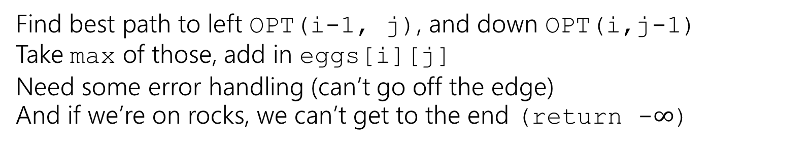
Recursive Baby Yoda
Let OPT(i,j) be the maximum number of eggs we can get on a legal path from (i,j) to (0,0)(including the egg in (i,j) if there is one)
Base Case?
Recursive case?
At (0,0), nowhere to go, return eggs[0][0]
Find best path to left OPT(i-1, j), and down OPT(i,j-1)
Take max of those, add in eggs[i][j]
Need some error handling (can’t go off the edge)
And if we’re on rocks, we can’t get to the end (return -$∞$)

Slide 31
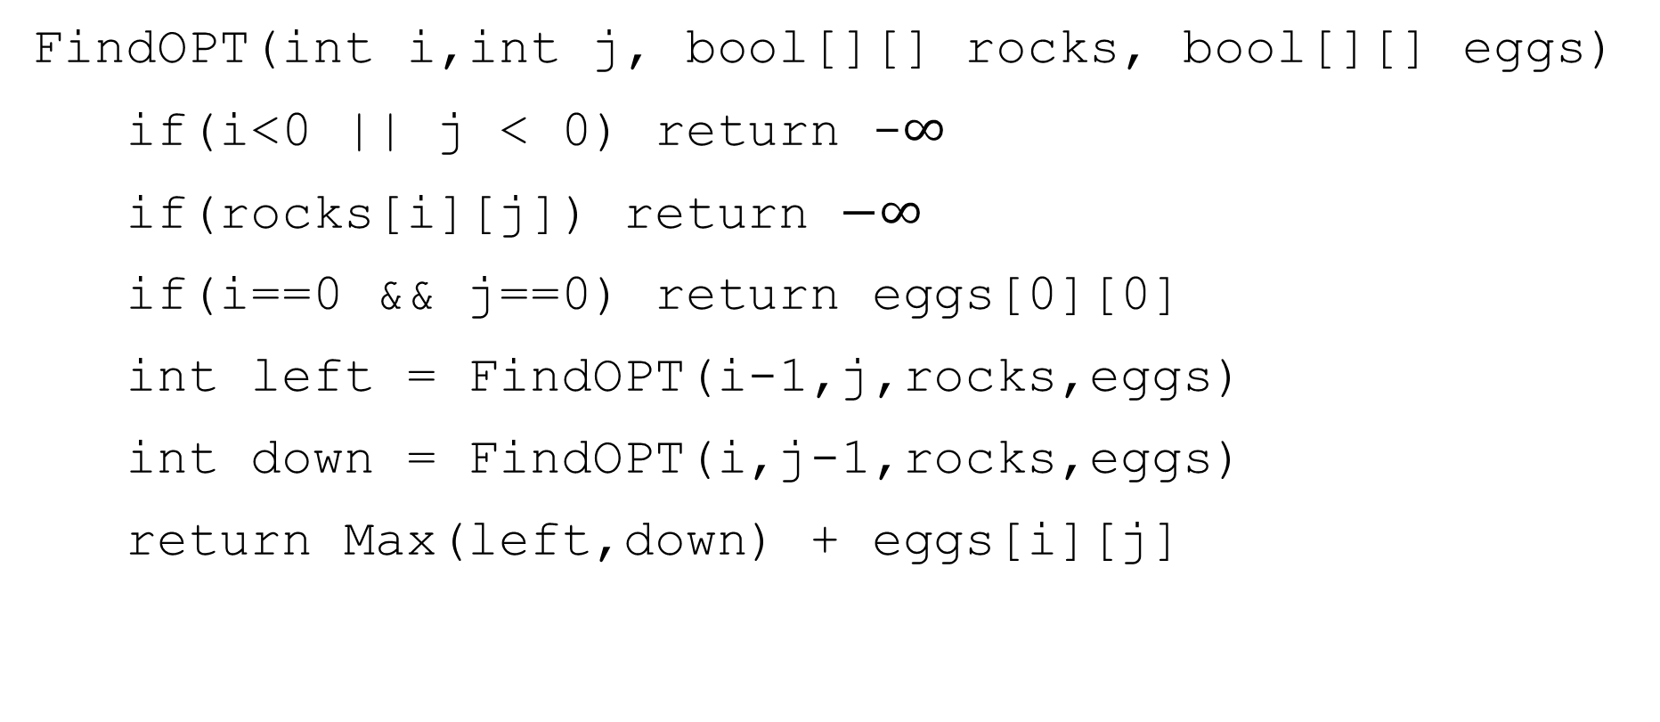
A Recursive Function
FindOPT(int i,int j, bool[][] rocks, bool[][] eggs)
if(i<0 || j < 0) return -$∞$
if(rocks[i][j]) return $−∞$
if(i==0 && j==0) return eggs[0][0]
int left = FindOPT(i-1,j,rocks,eggs)
int down = FindOPT(i,j-1,rocks,eggs)
return Max(left,down) + eggs[i][j]

Slide 32
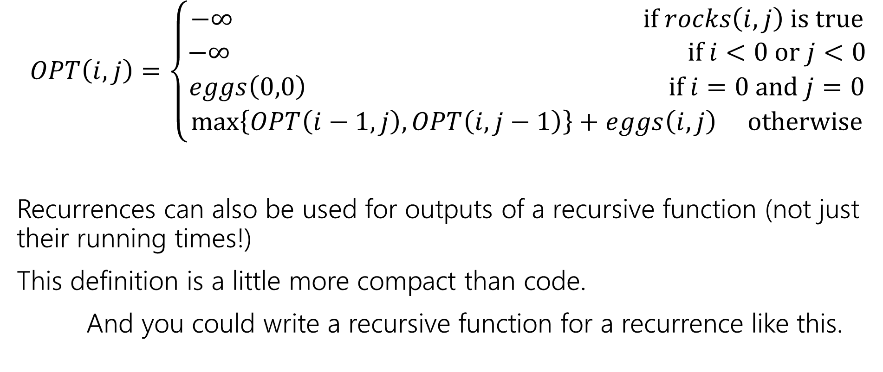
Recurrence Form
$$OPT\left(i,j\right)=\left\{\begin{aligned}−∞ if rocks\left(i,j\right) is true \\ −∞ if i<0 or j<0 \\ eggs\left(0,0\right) if i=0 and j=0 \\ \max\left\{OPT\left(i−1,j\right), OPT\left(i,j−1\right)\right\}+eggs\left(i,j\right) otherwise\end{aligned}\right.$$
Recurrences can also be used for outputs of a recursive function (not just their running times!)
This definition is a little more compact than code.
And you could write a recursive function for a recurrence like this.

Slide 33

Analyzing the recursive function
So…how does the code work? What’s its running time?
$T\left(c,r\right)=\left\{\begin{aligned}T\left(c−1,r\right)+T\left(c,r−1\right)+Θ\left(n\right) if r≥0 and c≥0 \\ Θ\left(1\right) otherwise\end{aligned}\right.$
Master Theorem says…

Slide 34
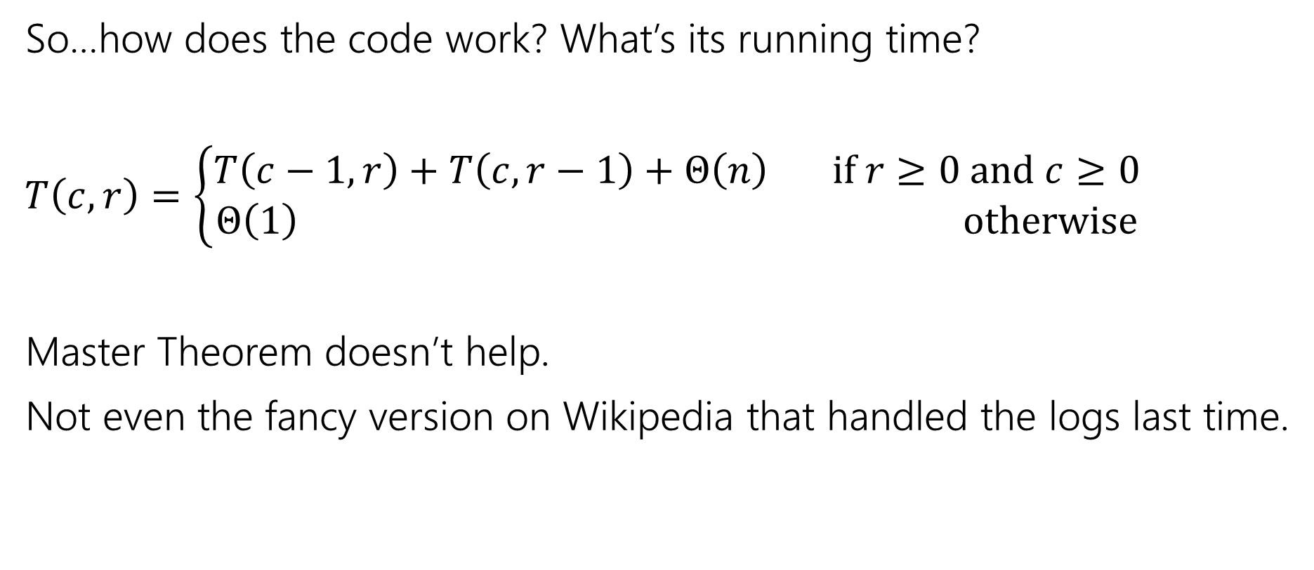
Analyzing the recursive function
So…how does the code work? What’s its running time?
$T\left(c,r\right)=\left\{\begin{aligned}T\left(c−1,r\right)+T\left(c,r−1\right)+Θ\left(n\right) if r≥0 and c≥0 \\ Θ\left(1\right) otherwise\end{aligned}\right.$
Master Theorem doesn’t help.
Not even the fancy version on Wikipedia that handled the logs last time.

Slide 35

Tree Method, Maybe…
OPT
(r,c)
OPT
(r-1,c)
OPT
(r,c-1)
OPT
(r-2,c)
OPT
(r-1,c-1)
OPT
(r-1,c-1)
OPT
(r,c-2)
…
…
…
…
When do we hit the base case?
Sometime between $min⁡(r,c)$ and $r+c$ levels.

Slide 36
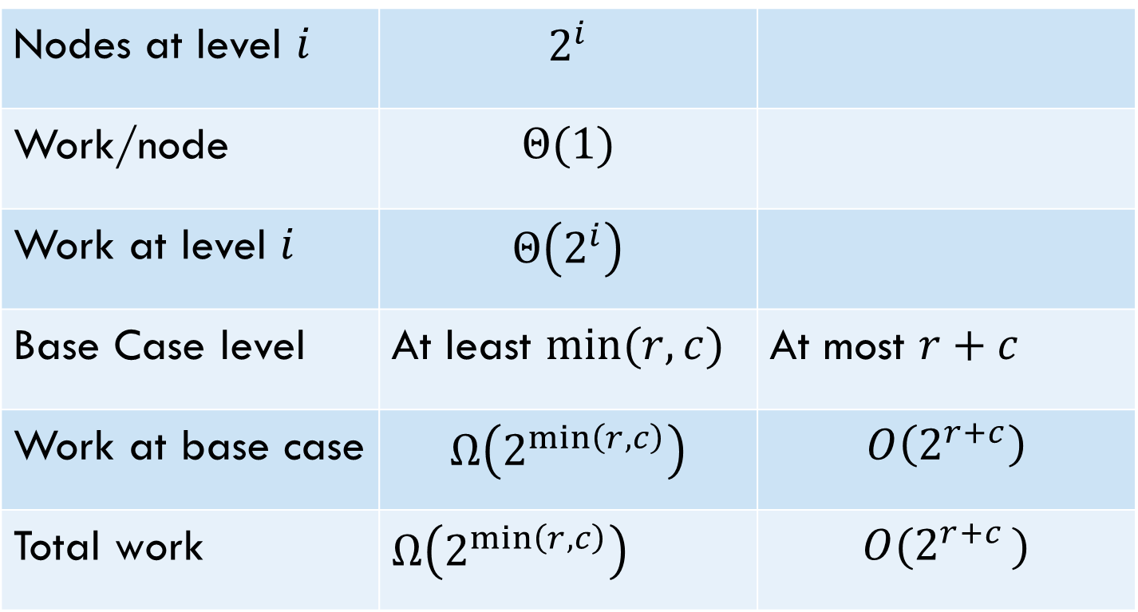
Tree Method
Nodes at level $i$ | $$2^{i}$$
Work/node | $$Θ(1)$$
Work at level $i$ | $$Θ\left(2^{i}\right)$$
Base Case level | At least $min⁡(r,c)$ | At most $r+c$
Work at base case | $$Ω\left(2^{\min\left(r,c\right)}\right)$$ | $$O\left(2^{r+c}\right)$$
Total work | $Ω\left(2^{\min\left(r,c\right)}\right)$ | $$O(2^{r+c })$$
Overall work is sum over all levels – each level has twice the work as the last, so the last level is about half the total work.
Tight big-O depends on relationship between $r$ and $c$…but regardless – it’s slow.

Slide 37
Speedup
That’s way too slow…but it doesn’t have to be.
OPT
(r,c)
OPT
(r-1,c)
OPT
(r,c-1)
OPT
(r-2,c)
OPT
(r-1,c-1)
OPT
(r-1,c-1)
OPT
(r,c-2)
…
…
…
…

Slide 38
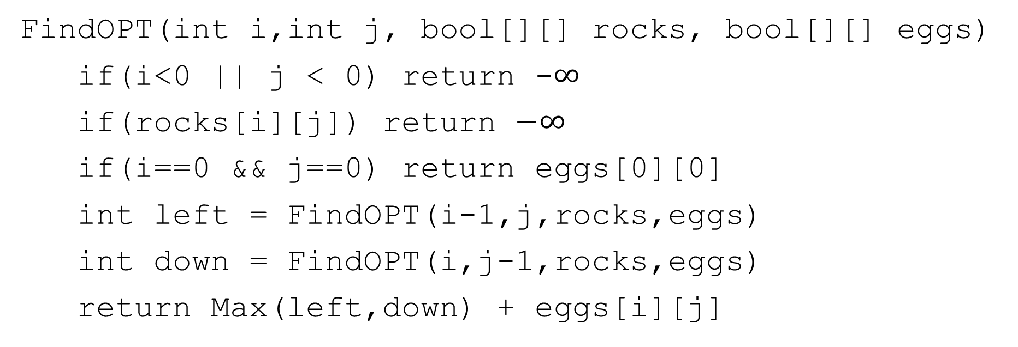
Activity
Fill out the question at pollev.com/robbie
Figure out how to take advantage of the repeated calculation.
What do you think the running time will be of your new algorithm?
FindOPT(int i,int j, bool[][] rocks, bool[][] eggs)
if(i<0 || j < 0) return -$∞$
if(rocks[i][j]) return $−∞$
if(i==0 && j==0) return eggs[0][0]
int left = FindOPT(i-1,j,rocks,eggs)
int down = FindOPT(i,j-1,rocks,eggs)
return Max(left,down) + eggs[i][j]

Slide 39
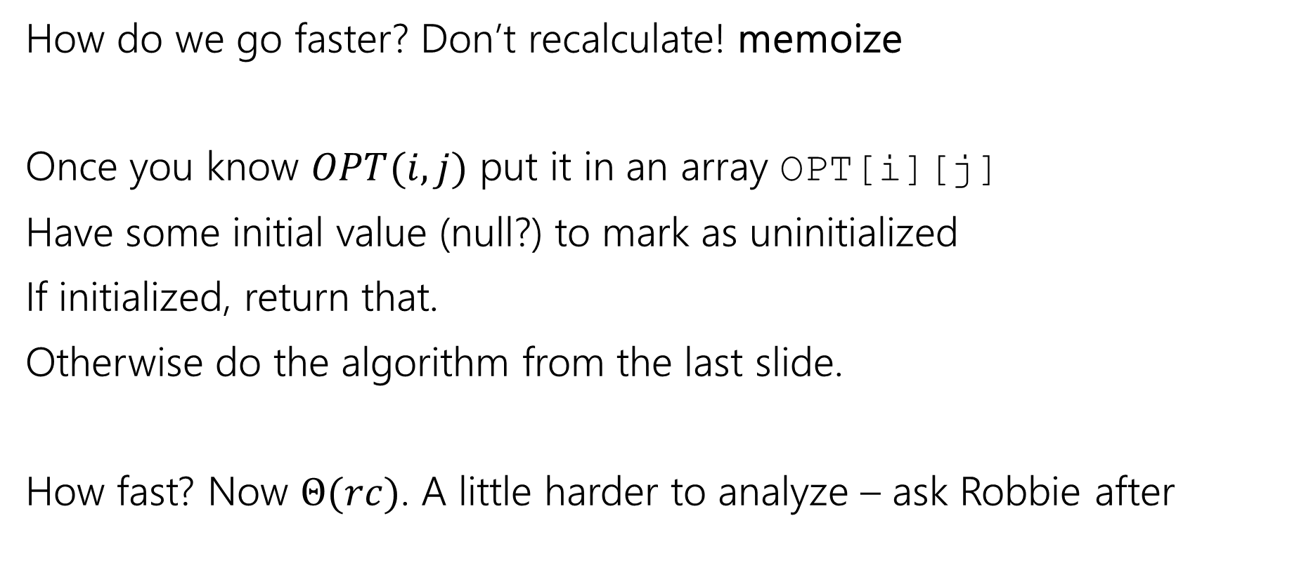
Speedup
How do we go faster? Don’t recalculate! memoize
Once you know $OPT(i,j)$ put it in an array OPT[i][j]
Have some initial value (null?) to mark as uninitialized
If initialized, return that.
Otherwise do the algorithm from the last slide.
How fast? Now $Θ(rc)$. A little harder to analyze – ask Robbie after

Slide 40
Baby Yoda Searching
(c-1,r-1)
r-1
Y-coordinate
(0,2)
(0,1)
(1,1)
0
(0,0)
X-coordinate
0
c-1
Notes:
https://1.bp.blogspot.com/-XxfNI65zLnU/Xc98O96LVnI/AAAAAAAAGFY/Xsmd7IMlIrEltYONCdGKk1hqPw1BgL3ggCLcBGAsYHQ/s1600/Mandalorian.jpg
http://www.pngmart.com/image/161116/png/161115
https://www.pikpng.com/pngvi/hiTxbbR_clip-art-rock-rock-clipart-transparent-background-png-download/

Slide 41
Going Bottom-up
So how does that recursion work?
What’s the first entry of the table that we fill?
OPT[0][0]
Why not just start filling in there?

Slide 42








Baby Yoda Searching
(c-1,r-1)
r-1
What else can we fill in?
Y-coordinate
(0,2)
(0,1)
(1,1)
0
$$0$$
$$1$$
$$2$$
$$2$$
$$2$$
$$2$$
$$2$$
$$2$$
(0,0)
X-coordinate
0
c-1
Notes:
https://1.bp.blogspot.com/-XxfNI65zLnU/Xc98O96LVnI/AAAAAAAAGFY/Xsmd7IMlIrEltYONCdGKk1hqPw1BgL3ggCLcBGAsYHQ/s1600/Mandalorian.jpg
http://www.pngmart.com/image/161116/png/161115
https://www.pikpng.com/pngvi/hiTxbbR_clip-art-rock-rock-clipart-transparent-background-png-download/

Slide 43











Baby Yoda Searching
(c-1,r-1)
r-1
What else can we fill in?
Y-coordinate
(0,2)
$$0$$
$$1$$
$$−∞$$
$$2$$
$$2$$
$$2$$
$$2$$
$$2$$
(0,1)
(1,1)
0
$$0$$
$$1$$
$$2$$
$$2$$
$$2$$
$$2$$
$$2$$
$$2$$
X-coordinate
0
c-1
Notes:
https://1.bp.blogspot.com/-XxfNI65zLnU/Xc98O96LVnI/AAAAAAAAGFY/Xsmd7IMlIrEltYONCdGKk1hqPw1BgL3ggCLcBGAsYHQ/s1600/Mandalorian.jpg
http://www.pngmart.com/image/161116/png/161115
https://www.pikpng.com/pngvi/hiTxbbR_clip-art-rock-rock-clipart-transparent-background-png-download/

Slide 44







Baby Yoda Searching
(c-1,r-1)
r-1
What else can we fill in?
Y-coordinate
$$0$$
$$−∞$$
$$0$$
$$1$$
$$−∞$$
$$2$$
$$2$$
$$2$$
$$2$$
$$2$$
0
$$0$$
$$1$$
$$2$$
$$2$$
$$2$$
$$2$$
$$2$$
$$2$$
X-coordinate
0
c-1
Notes:
https://1.bp.blogspot.com/-XxfNI65zLnU/Xc98O96LVnI/AAAAAAAAGFY/Xsmd7IMlIrEltYONCdGKk1hqPw1BgL3ggCLcBGAsYHQ/s1600/Mandalorian.jpg
http://www.pngmart.com/image/161116/png/161115
https://www.pikpng.com/pngvi/hiTxbbR_clip-art-rock-rock-clipart-transparent-background-png-download/

Slide 45
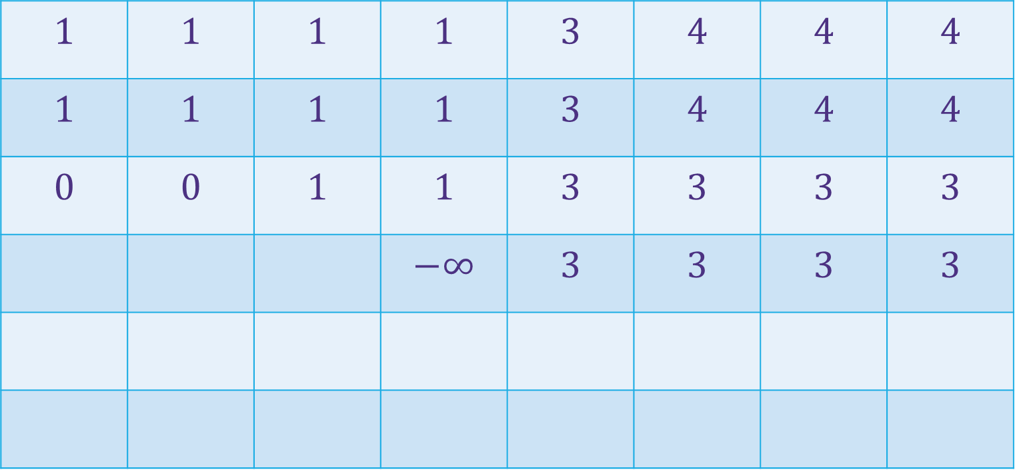

Baby Yoda Searching
(c-1,r-1)
$$1$$ | $$1$$ | $$1$$ | $$1$$ | $$3$$ | $$4$$ | $$4$$ | $$4$$
$$1$$ | $$1$$ | $$1$$ | $$1$$ | $$3$$ | $$4$$ | $$4$$ | $$4$$
$$0$$ | $$0$$ | $$1$$ | $$1$$ | $$3$$ | $$3$$ | $$3$$ | $$3$$
 |  |  | $$−∞$$ | $$3$$ | $$3$$ | $$3$$ | $$3$$
r-1
Where’s the final answer?
In the top right. Where Baby Yoda starts.
Y-coordinate
$$0$$
$$−∞$$
$$−∞$$
$$0$$
$$1$$
$$−∞$$
$$2$$
$$2$$
$$2$$
$$2$$
$$2$$
0
$$0$$
$$1$$
$$2$$
$$2$$
$$2$$
$$2$$
$$2$$
$$2$$
X-coordinate
0
c-1
Notes:
https://1.bp.blogspot.com/-XxfNI65zLnU/Xc98O96LVnI/AAAAAAAAGFY/Xsmd7IMlIrEltYONCdGKk1hqPw1BgL3ggCLcBGAsYHQ/s1600/Mandalorian.jpg
http://www.pngmart.com/image/161116/png/161115
https://www.pikpng.com/pngvi/hiTxbbR_clip-art-rock-rock-clipart-transparent-background-png-download/

Slide 46
What order?
Fill in a row at a time (left to right)
Going up to the next row once a level is done.
In actual code, probably easier to handle edges first
Avoid the index-out-of-bound exceptions.

Slide 47

Pseudocode
int eggsSoFar=0;
Boolean rocksInWay=false
for(int x=0; x<c; x++)
if(rocks[x][0]) rocksInWay = true
eggsSoFar+=eggs[x][0]
OPT[x][0]= rocksInWay ? $−∞$: eggsSoFar
eggsSoFar=0
rocksInWay=false
for(int y=0; y<r; y++)
if(rocks[0][y]) rocksInWay = true
eggsSoFar+=eggs[0][y]
OPT[0][y]= rocksInWay ? $−∞$ : eggsSoFar
for(int y=0;y<r;y++)
for(int x=0;x<c;x++)
if(rocks[x][y])
OPT[x][y]=-$∞$
else
OPT[x][y]=max(OPT[x-1][y], OPT[x][y-1])+eggs[x][y]

Slide 48
Why Switch To Iterative?
It does the same thing…
It’s easier to analyze (no need to imagine a recursion tree)
Saves constant factors (recursive version puts a lot on the call stack)
Will let you optimize memory (next week)
Recursive version is often a little more intuitive, though…

