Slide 1
Divide & Conquer
CSE 417 24Wi
Lecture 8

Slide 2
Divide & Conquer
Algorithm Design Paradigm
1. Divide instance into subparts.
2. Solve the parts recursively.
3. Conquer by combining the answers

Slide 3
Merge Sort
https://www.youtube.com/watch?v=XaqR3G_NVoo
Divide
0 | 1 | 2 | 3 | 4 | 5 | 6 | 7 | 8 | 9
8 | 2 | 91 | 22 | 57 | 1 | 10 | 6 | 7 | 4
0 | 1 | 2 | 3 | 4
8 | 2 | 91 | 22 | 57
5 | 6 | 7 | 8 | 9
1 | 10 | 6 | 7 | 4
Sort the pieces through the magic of recursion
magic
Combine
0 | 1 | 2 | 3 | 4
2 | 8 | 22 | 57 | 91
5 | 6 | 7 | 8 | 9
1 | 4 | 6 | 7 | 10
0 | 1 | 2 | 3 | 4 | 5 | 6 | 7 | 8 | 9
1 | 2 | 4 | 6 | 7 | 8 | 10 | 22 | 57 | 91

Slide 4

Merge Sort
0 | 1 | 2 | 3 | 4
8 | 2 | 57 | 91 | 22
0 | 1
8 | 2
0 | 1 | 2
57 | 91 | 22
mergeSort(input) {
if (input.length == 1)
return
else
smallerHalf = mergeSort(new [0, ..., mid])
largerHalf = mergeSort(new [mid + 1, ...])
return merge(smallerHalf, largerHalf)
}
0
8
0
2
0
57
0 | 1
91 | 22
0
91
0
22
1 if n<= 1
2T(n/2) + n otherwise
0 | 1
22 | 91
Worst case runtime?
Best case runtime?
Average runtime?
Stable?
In-place?
T(n) =
= $O(n\log{n})$
Same
0 | 1
2 | 8
0 | 1 | 2
22 | 57 | 91
Same
Yes
0 | 1 | 2 | 3 | 4
2 | 8 | 22 | 57 | 91
No

Slide 5
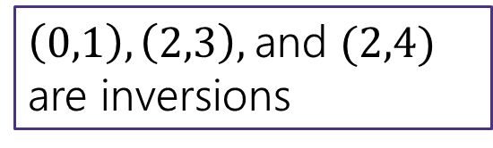
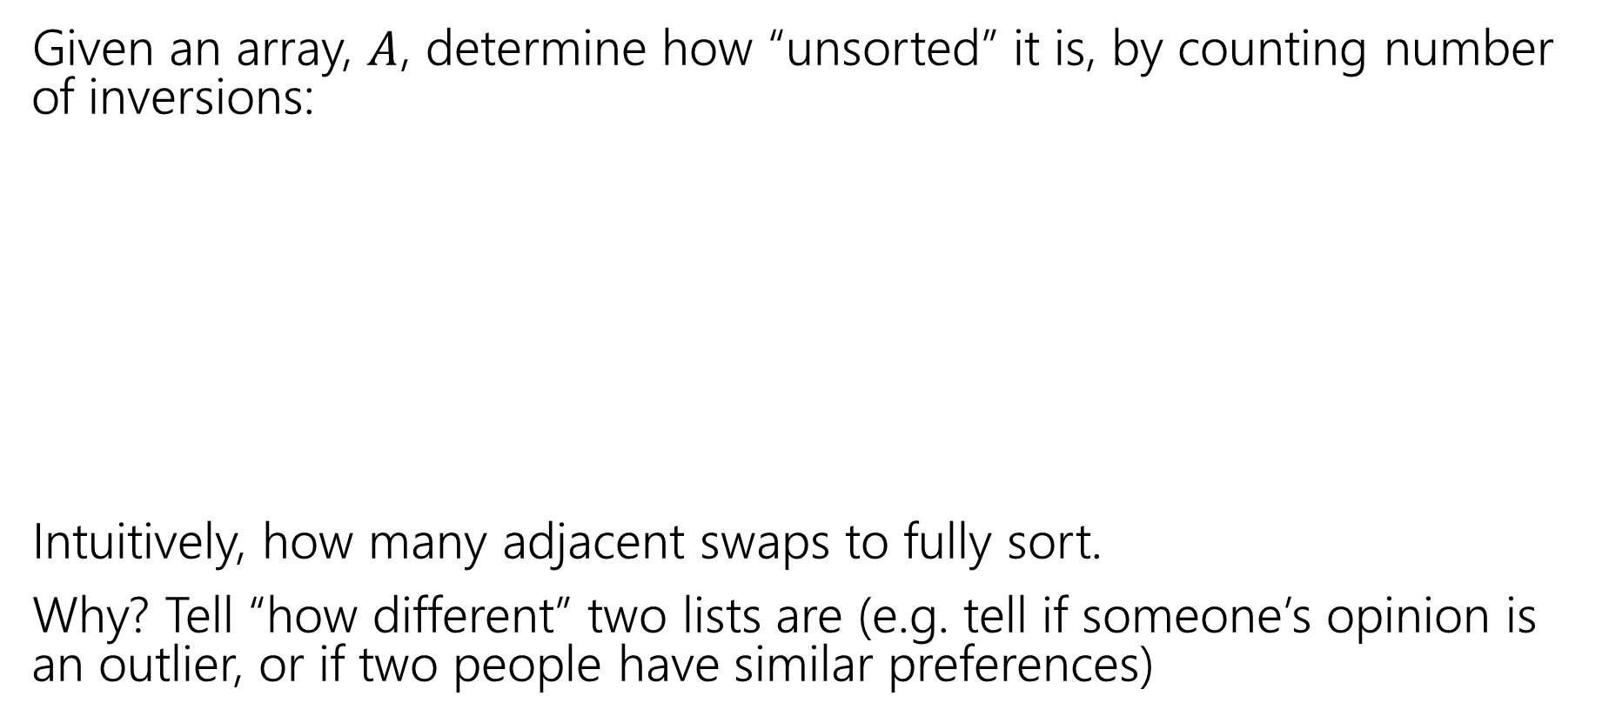

Counting Inversions
Given an array, $A$, determine how “unsorted” it is, by counting number of inversions:
Intuitively, how many adjacent swaps to fully sort.
Why? Tell “how different” two lists are (e.g. tell if someone’s opinion is an outlier, or if two people have similar preferences)
Inversion: pair $i,j$ such that $i<j$ but $A\left[i\right]>A[j]$
0 | 1 | 2 | 3 | 4
8 | 2 | 91 | 22 | 57
$\left(0,1\right), \left(2,3\right),$and $(2,4)$ are inversions

Slide 6

Counting Inversions
Given an array, $A$, determine how “unsorted” it is:
Find the number of pairs $i,j$ such that $i<j$ but $A\left[i\right]>A[j]$
0 | 1 | 2 | 3 | 4
8 | 2 | 91 | 22 | 57
Visualization: overlaps correspond to inversions (needed swaps)
0 | 1 | 2 | 3 | 4
2 | 8 | 22 | 57 | 91

Slide 7

Counting Inversions
What’s the first idea that comes to mind (don’t try to divide and conquer yet).
Check every pair $i,j$
$Θ(n^{2})$ time.
Goal: do better than $Θ(n^{2})$

Slide 8
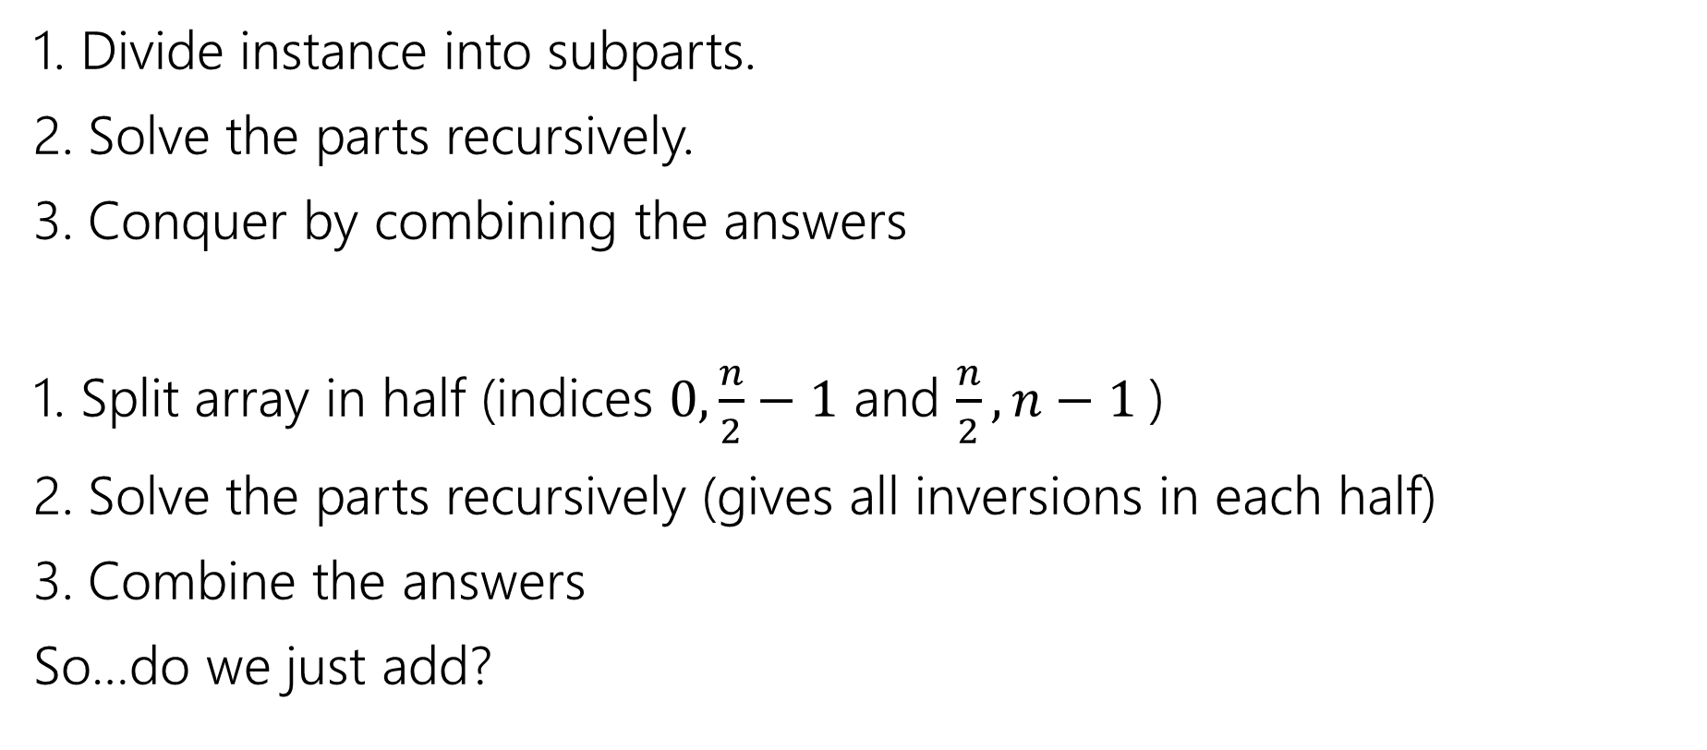
Divide & Conquer Inversions
1. Divide instance into subparts.
2. Solve the parts recursively.
3. Conquer by combining the answers
1. Split array in half (indices $0,\frac{n}{2}−1$ and $\frac{n}{2},n−1$)
2. Solve the parts recursively (gives all inversions in each half)
3. Combine the answers
So…do we just add?

Slide 9
Conquer
Can’t just add!
0 | 1 | 2 | 3 | 4
8 | 2 | 91 | 22 | 57
0 | 1 | 2
8 | 2 | 91
3 | 4
22 | 57

Slide 10
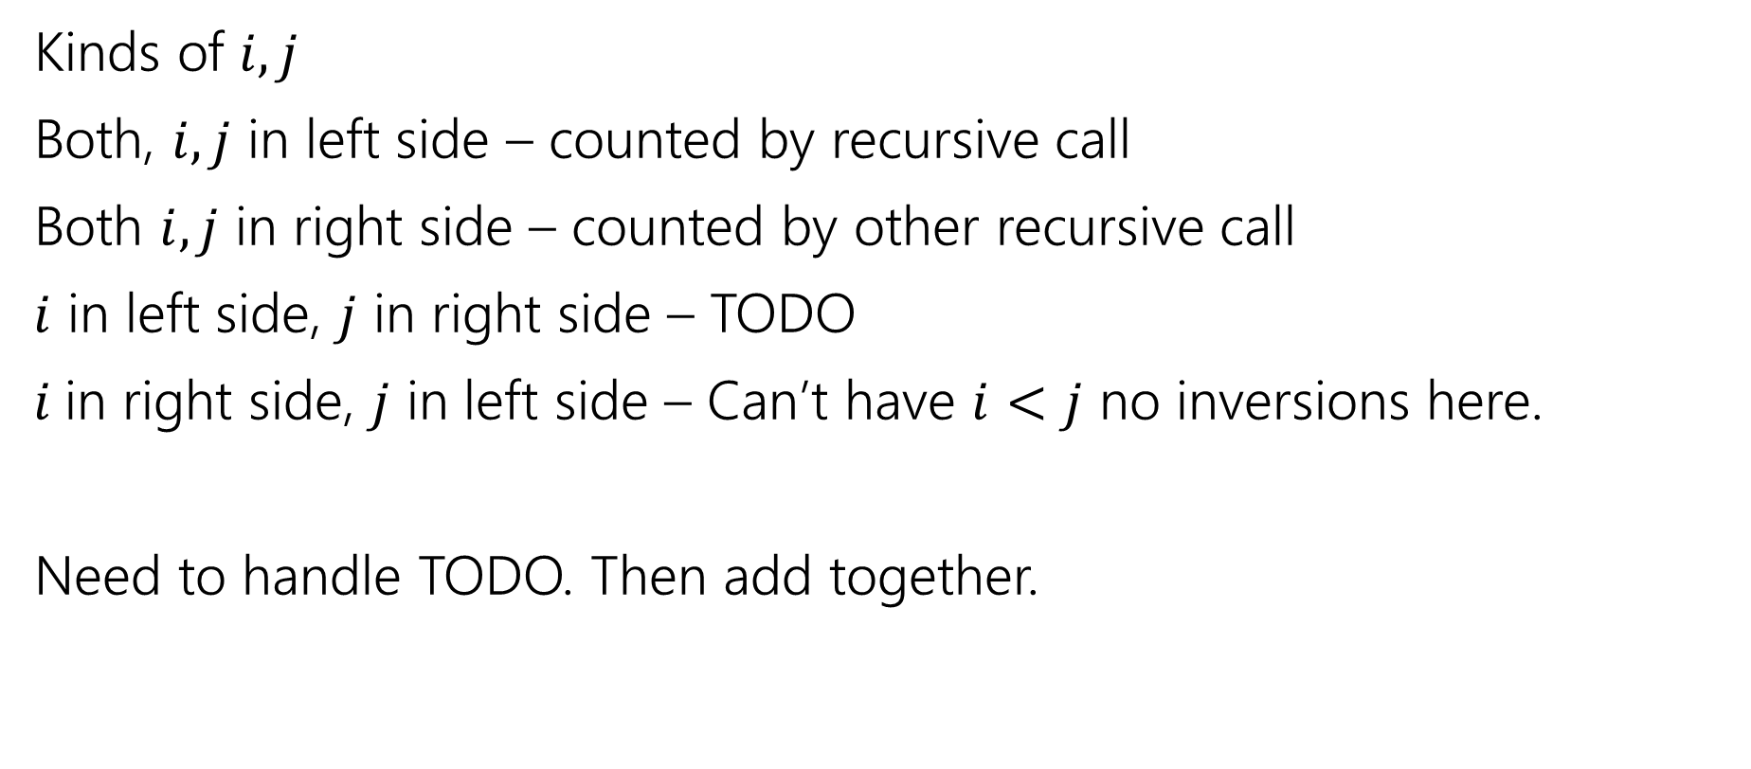
Conquer
Kinds of $i, j$
Both, $i,j$ in left side – counted by recursive call
Both $i,j$ in right side – counted by other recursive call
$i$ in left side, $j$ in right side – TODO
$i$in right side, $j$ in left side – Can’t have $i<j$ no inversions here.
Need to handle TODO. Then add together.

Slide 11

Inversions across the middle
Fix some $i$ on the left side. How many $j$ on the right side form inversions?
So how do we find all the “crossing inversions”
$\frac{n}{2}$ elements, each checking $\frac{n}{2}$ others, so that’s time…$Θ(n^{2})$ to merge
0 | 1 | 2 | 3 | 4
8 | 2 | 91 | 22 | 57

Slide 12

Running Time
$T\left(n\right)=\left\{\begin{aligned}2T\left(\frac{n}{2}\right)+Θ\left(n^{2}\right) if n≥2 \\ Θ\left(1\right) othwerwise\end{aligned}\right.$
Master Theorem says:

Slide 13

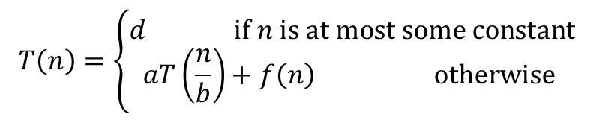
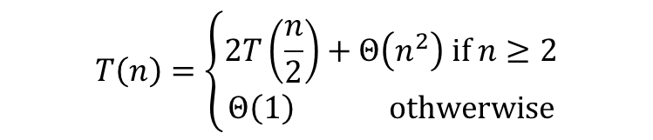

Master Theorem
Given a recurrence of the following form, where $a,b,c,$ and $d$ are constants:
$$T\left(n\right)=\left\{\begin{aligned}2T\left(\frac{n}{2}\right)+Θ\left(n^{2}\right) if n≥2 \\ Θ\left(1\right) othwerwise\end{aligned}\right.$$
$$T\left(n\right)=\left\{\begin{aligned}d if n is at most some constant \\ aT\left(\frac{n}{b}\right)+f\left(n\right) otherwise \end{aligned}\right.$$
Where $f\left(n\right)$ is $Θ\left(n^{c}\right)$
If
$$\log_{b}{a}<c$$
then
$$T\left(n\right)∈Θ\left(n^{c}\right)$$
If
$$\log_{b}{a}=c$$
then
$$T\left(n\right)∈Θ\left(n^{c}\log{n}\right)$$
If
$$\log_{b}{a}>c$$
then
$$T\left(n\right)∈Θ\left(n^{\log_{b}{a}}\right)$$

Slide 14

Running Time
$T\left(n\right)=\left\{\begin{aligned}2T\left(\frac{n}{2}\right)+O\left(n^{2}\right) if n≥2 \\ O\left(1\right) othwerwise\end{aligned}\right.$
Master Theorem says:
$\log_{2}\left(2\right)=1<2$
So $O(n^{2})$
Not actually better than brute force.

Slide 15
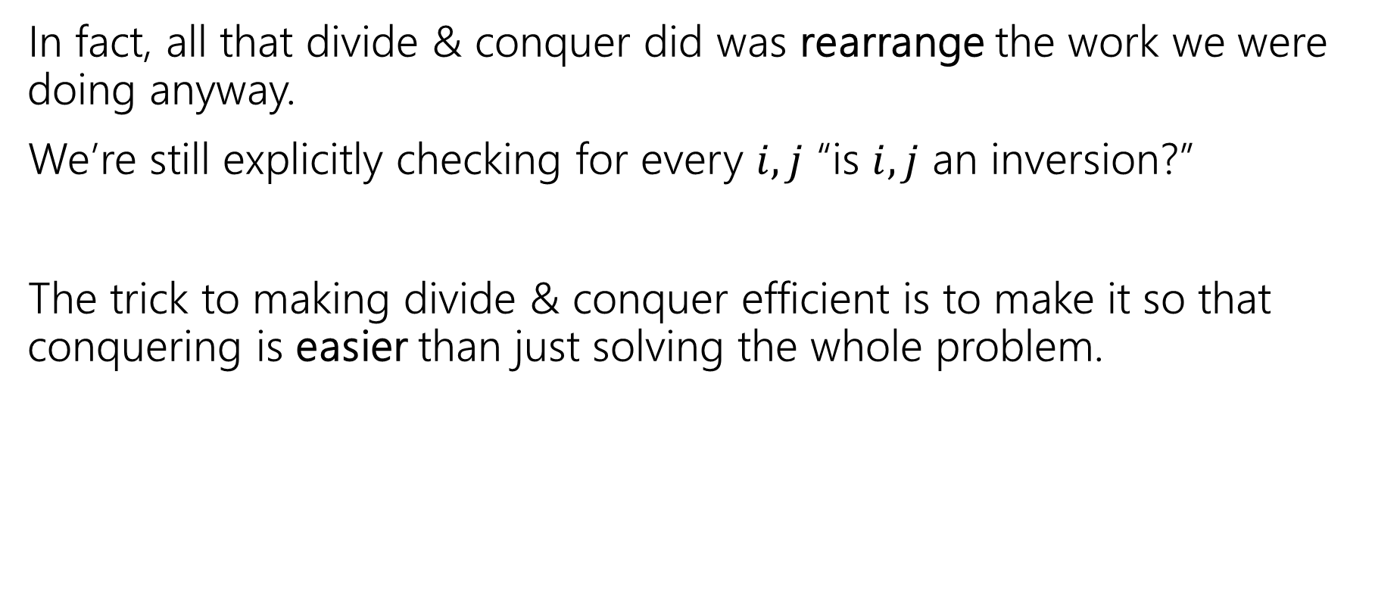
Divide & Conquer Smarter
In fact, all that divide & conquer did was rearrange the work we were doing anyway.
We’re still explicitly checking for every $i,j$ “is $i,j$ an inversion?”
The trick to making divide & conquer efficient is to make it so that conquering is easier than just solving the whole problem.

Slide 16

Counting Across the Middle
Fix some $i$ on the left side. How many $j$ on the right side form inversions?
What would we do if the right hand side were sorted?

Slide 17
Counting the inversions
0 | 1 | 2 | 3 | 4
8 | 2 | 91 | 22 | 57
5 | 6 | 7 | 8 | 9
1 | 4 | 6 | 7 | 10
Inversions involving index $0$: $(0,5)…(0,8)$
Inversions involving index $1$: $(1,5)$
Inversions involving index $4$: [none]

Slide 18
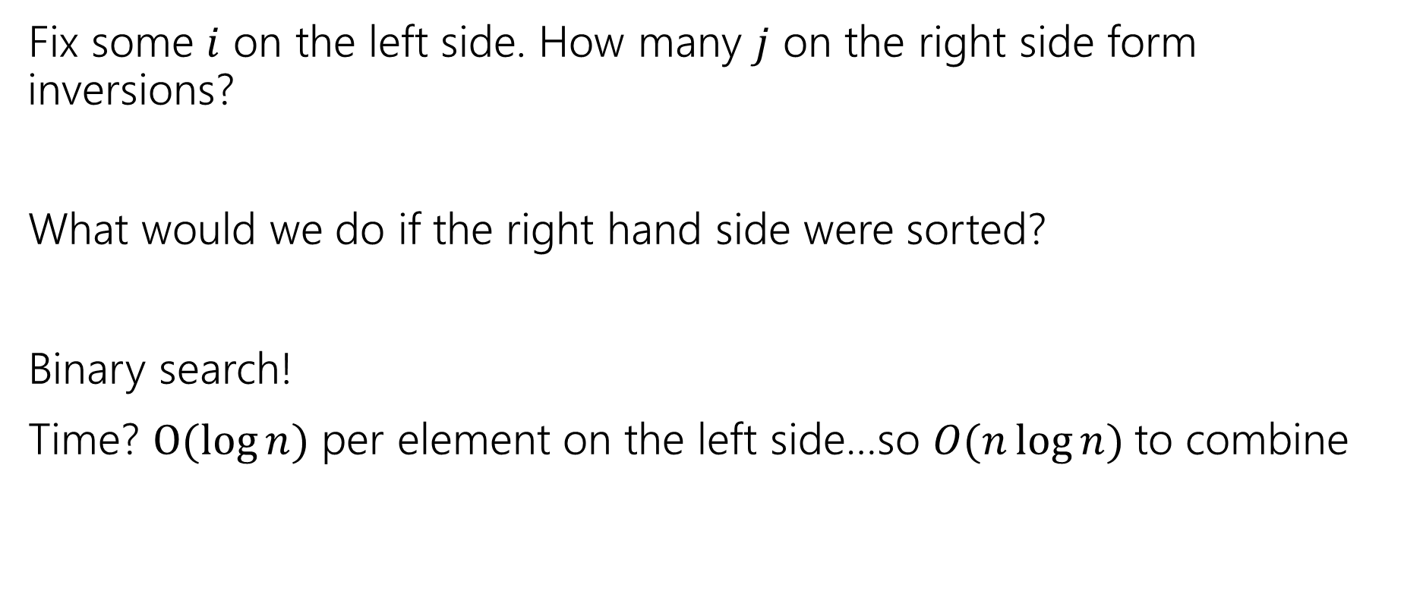
Counting Across the Middle
Fix some $i$ on the left side. How many $j$ on the right side form inversions?
What would we do if the right hand side were sorted?
Binary search!
Time? $O(\log{n})$ per element on the left side…so $O(n\log{n)}$to combine

Slide 19

Analyze, round 2.
$T\left(n\right)=\left\{\begin{aligned}2T\left(\frac{n}{2}\right)+O\left(n\log{n}\right) if n≥2 \\ O\left(1\right) othwerwise\end{aligned}\right.$
Master Theorem says:
$\log_{2}\left(2\right)=1 ?ummm$

Slide 20
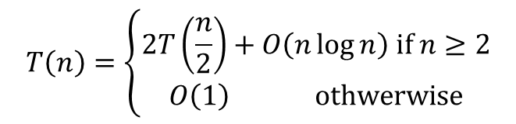
Master Theorem
Given a recurrence of the following form, where $a,b,c,$ and $d$ are constants:
$$T\left(n\right)=\left\{\begin{aligned}d if n is at most some constant \\ aT\left(\frac{n}{b}\right)+f\left(n\right) otherwise \end{aligned}\right.$$
$$T\left(n\right)=\left\{\begin{aligned}2T\left(\frac{n}{2}\right)+O\left(n\log{n}\right) if n≥2 \\ O\left(1\right) othwerwise\end{aligned}\right.$$
Where $f\left(n\right)$ is $Θ\left(n^{c}\right)$
If
$$\log_{b}{a}<c$$
then
$$T\left(n\right)∈Θ\left(n^{c}\right)$$
If
$$\log_{b}{a}=c$$
then
$$T\left(n\right)∈Θ\left(n^{c}\log{n}\right)$$
If
$$\log_{b}{a}>c$$
then
$$T\left(n\right)∈Θ\left(n^{\log_{b}{a}}\right)$$

Slide 21

Pause
Lets get some intuition
$O(n\log{n)}$is closest to which of these:
$O(n)$
$O\left(n^{1.1}\right)$
$O\left(n\sqrt{n}\right)$
$O(n^{2})$

Slide 22
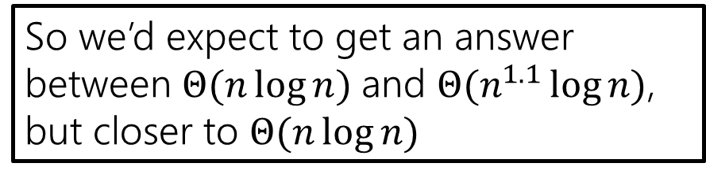
Pause
Lets get some intuition
$O(n\log{n)}$is closest to which of these:
$O(n)$
$O\left(n^{1.1}\right)$
$O\left(n\sqrt{n}\right)$
$O(n^{2})$
So we’d expect to get an answer between $Θ(n\log{n)}$and $Θ(n^{1.1}\log{n)}$, but closer to $Θ(n\log{n)}$

Slide 23
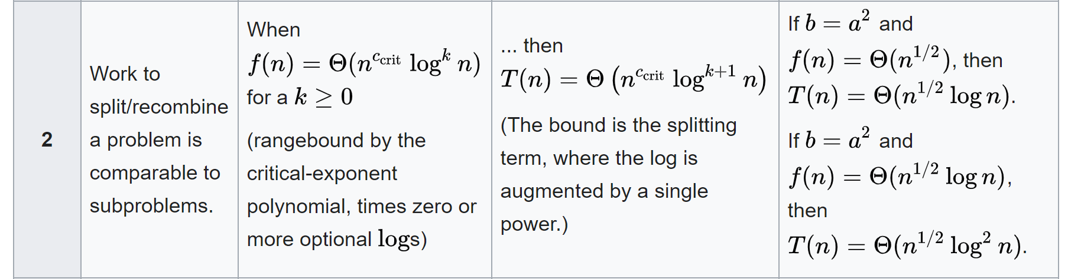
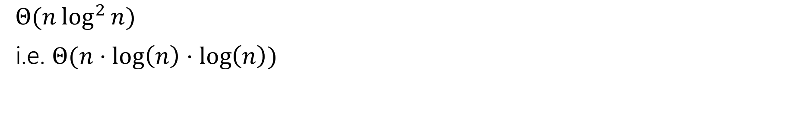
Master Theorem, v2
$Θ(n\log^{2}{n})$
i.e. $Θ(n⋅\log\left(n\right)⋅\log\left(n\right))$
https://en.wikipedia.org/wiki/Master_theorem_(analysis_of_algorithms)

Slide 24
Counting Across the Middle
So sort the array first! As a preprocessing step
Then count the inversions.
What’s the problem?
Ok, sort as part of the process.
When you sort, the inversions disappear

Slide 25
Almost there…
int CountInversions(A, int start, int stop)
inversions = 0
if(start >= stop)
return 0
int midpoint = (stop-start)/2 + start
inversions += CountInversions(A, start, midpoint)
inversions += CountInversions(A, midpoint+1, end)
sort(A, midpoint+1, end)
for(int i=start; i <= midpoint; i++)
int k = binarySearch(A, midpoint+1, end, i)
inversions += k-(midpoint+1)+1
return inversions

Slide 26
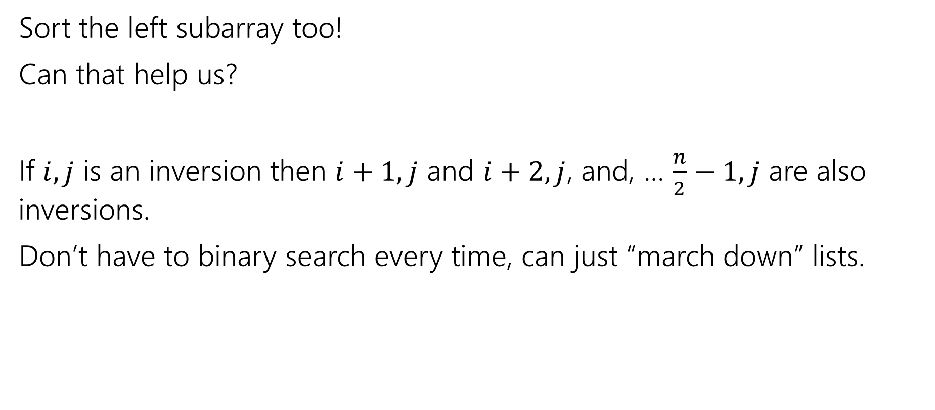
Just a liiiiiittle better
Sort the left subarray too!
Can that help us?
If $i,j$ is an inversion then $i+1,j$ and $i+2, j$, and, … $\frac{n}{2}−1,j$ are also inversions.
Don’t have to binary search every time, can just “march down” lists.

Slide 27
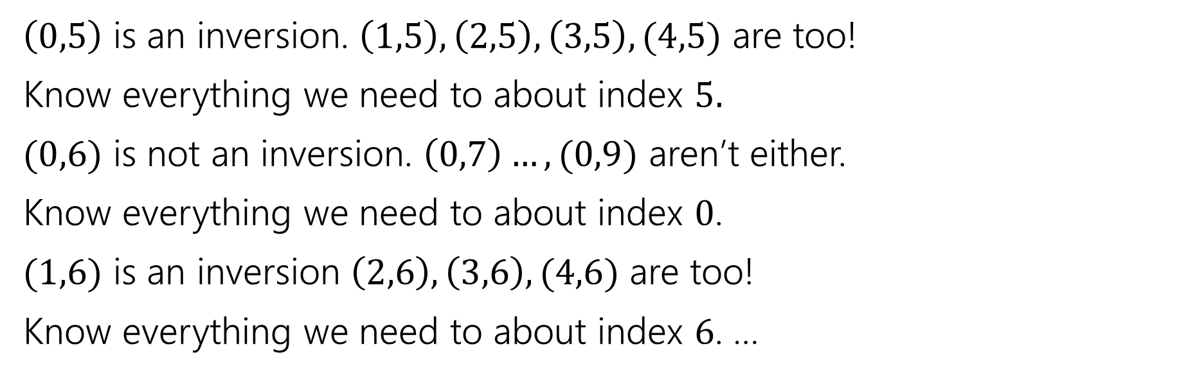
Sorted example
0 | 1 | 2 | 3 | 4
2 | 8 | 22 | 57 | 91
5 | 6 | 7 | 8 | 9
1 | 4 | 6 | 7 | 10
$\left(0,5\right)$ is an inversion. $\left(1,5\right), \left(2,5\right), \left(3,5\right), (4,5)$ are too!
Know everything we need to about index $5.$
$(0,6)$ is not an inversion. $\left(0,7\right)…,(0,9)$ aren’t either.
Know everything we need to about index $0$.
$(1,6)$ is an inversion $\left(2,6\right),\left(3,6\right),(4,6)$ are too!
Know everything we need to about index $6$. …

Slide 28
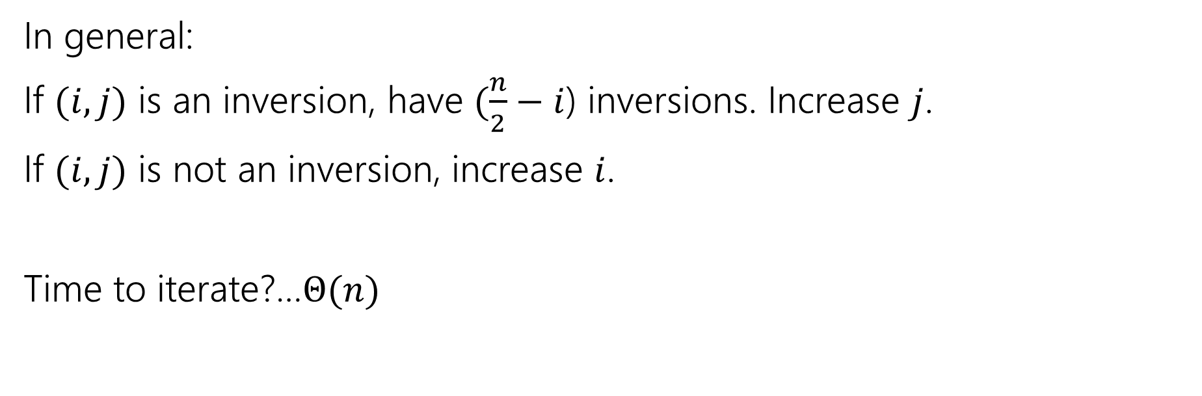
In general
0 | 1 | 2 | 3 | 4
2 | 8 | 22 | 57 | 91
5 | 6 | 7 | 8 | 9
1 | 4 | 6 | 7 | 10
In general:
If $(i,j)$ is an inversion, have $(\frac{n}{2}−i$) inversions. Increase $j$.
If $(i,j)$ is not an inversion, increase $i$.
Time to iterate?…$Θ(n)$

Slide 29
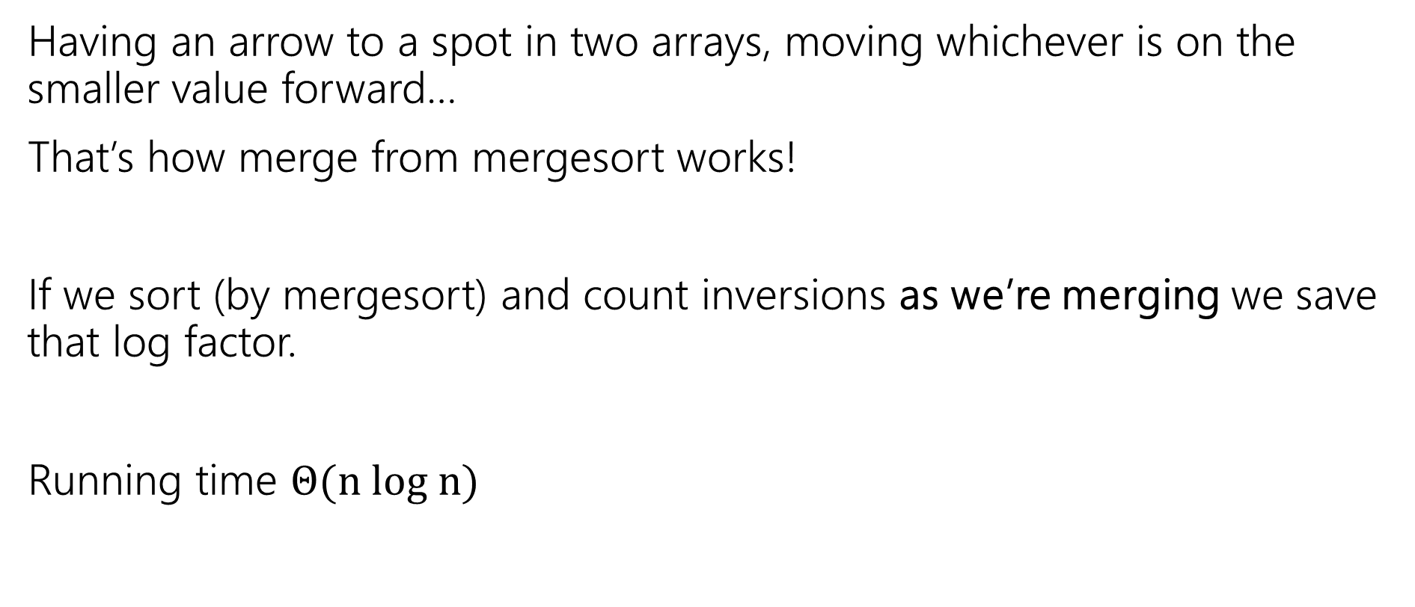
Does this…look familiar
Having an arrow to a spot in two arrays, moving whichever is on the smaller value forward…
That’s how merge from mergesort works!
If we sort (by mergesort) and count inversions as we’re merging we save that log factor.
Running time $Θ(n log n)$

Slide 30
Final Pseudocode
int CountInversions(A, int start, int stop)
inversions = 0
if(start >= stop)
return 0
int midpoint = (stop-start)/2 + start
inversions += CountInversions(A, start, midpoint)
inversions += CountInversions(A, midpoint+1, end)
invsersions += mergeAndCount(A, start, stop)
return inversions

Slide 31
int mergeAndCount(A, start, stop)
int inv = 0
int[] temp = new int[A.length]
int left=start; int mid=start+(stop-start)/2; int right=mid+1;
int curr = start;
while(left <= mid && right <= stop)
if(A[left] < A [right])
temp[curr++] = A[left++];
else
temp[curr++] = A[right++];
inv += (mid – left)+1;
while(left <= mid)
temp[curr++] = A[left++];
while(right <= stop)
temp[curr++]= A[right++];
inv += (mid – left)+1; //can skip. mid-left+1 is 0 here.
for(int i=start; i<=stop; i++) //copy back into A, now sorted
A[i]=temp[i];
return inv
For an actual implementation, think about how you’re using temporary space.
There are more efficient options than this one! Though you won’t avoid $Θ(n)$ space.

Slide 32
Maximum Subarray Sum

Slide 33

Another divide and conquer
Maximum subarray sum
Given: an array of integers (positive and negative), find the indices that give the maximum contiguous subarray sum.
0 | 1 | 2 | 3 | 4 | 5 | 6 | 7
-3 | 2 | 4 | -1 | 3 | -10 | 6 | -4
Sum: $8$

