Slide 1
Contrapositives
CSE 417 24WI
Lecture 4

Slide 2
Announcements
HW1 is out! OH start today.
There are two types of problems:
“mechanical” usually: execute an algorithm, come up with an example of something or a very short proof.
“long-form” usually: design an algorithm, write code for an algorithm, think about an algorithm in the real world, or write a longer proof.
The directions include how many of each count. You can submit extras, we count the best ones.
Notes:
Prog question is a lot of code this week.
Last problem is “in the real world” – looks like a lot; there’s a good amount of writing, but probably not as much as it looks at first glance.

Slide 3
Announcements
We try to keep the problems in each category approximately the same difficulty, but that isn’t always possible. It’s a good idea to read all of them.
For coding questions, you can upload code to gradescope to get a fresh run of the tests; grade is recorded at the deadline.
Otherwise, on each later homework, you can submit up to two old problems to be (re-)graded. If you pick a coding problem, we’ll update the score to the higher of your previous, and what’s on gradescope now.
You don’t need an “initial” submission to resubmit.

Slide 4
Announcements
Collaboration policy (in brief)
PLEASE collaborate!
  The types of questions in this course really benefit from bouncing ideas off of others.
But you must submit your own independent writeup
  That means waiting 30 minutes between discussing with others and producing your writeup.
  And not relying on notes/pictures, etc. from the discussion (more details on the webpage).
  If you can’t solve it after 30 minutes, then you couldn’t solve it if you get a similar problem later.

Slide 5
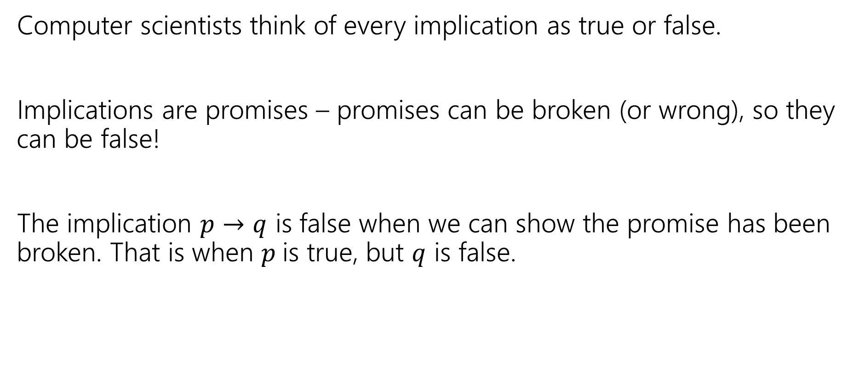
When is an implication false?
Computer scientists think of every implication as true or false.
Implications are promises – promises can be broken (or wrong), so they can be false!
The implication $p→q$ is false when we can show the promise has been broken. That is when $p$is true, but $q$ is false.

Slide 6
True or False?
For the purposes of this slide, Alice always carries an umbrella, Bob never carries an umbrella, and it is sunny out right now.
If it is sunny right now, then Alice has her umbrella.
If it is raining right now, then Alice has her umbrella.
If Bob has his umbrella, then it is raining right now.
If it is sunny right now, then Bob has his umbrella.

Slide 7
True or False?
For the purposes of this slide, Alice always carries an umbrella, Bob never carries an umbrella, and it is sunny out right now.
If it is sunny right now, then Alice has her umbrella.
If it is raining right now, then Alice has her umbrella.
If Bob has his umbrella, then it is raining right now.
If it is sunny right now, then Bob has his umbrella.
True
True
True
False

Slide 8
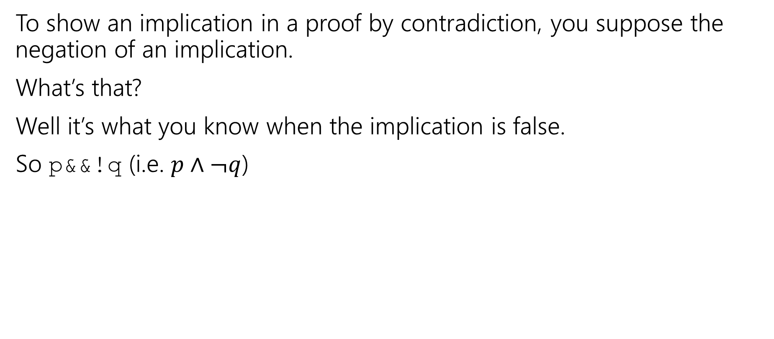
If you’re doing a proof by contradiction
To show an implication in a proof by contradiction, you suppose the negation of an implication.
What’s that?
Well it’s what you know when the implication is false.
So p&&!q (i.e. $p∧¬q$)

Slide 9
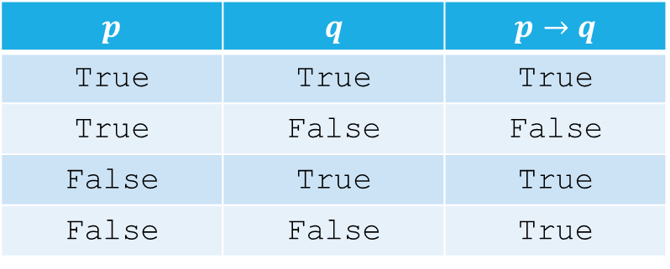
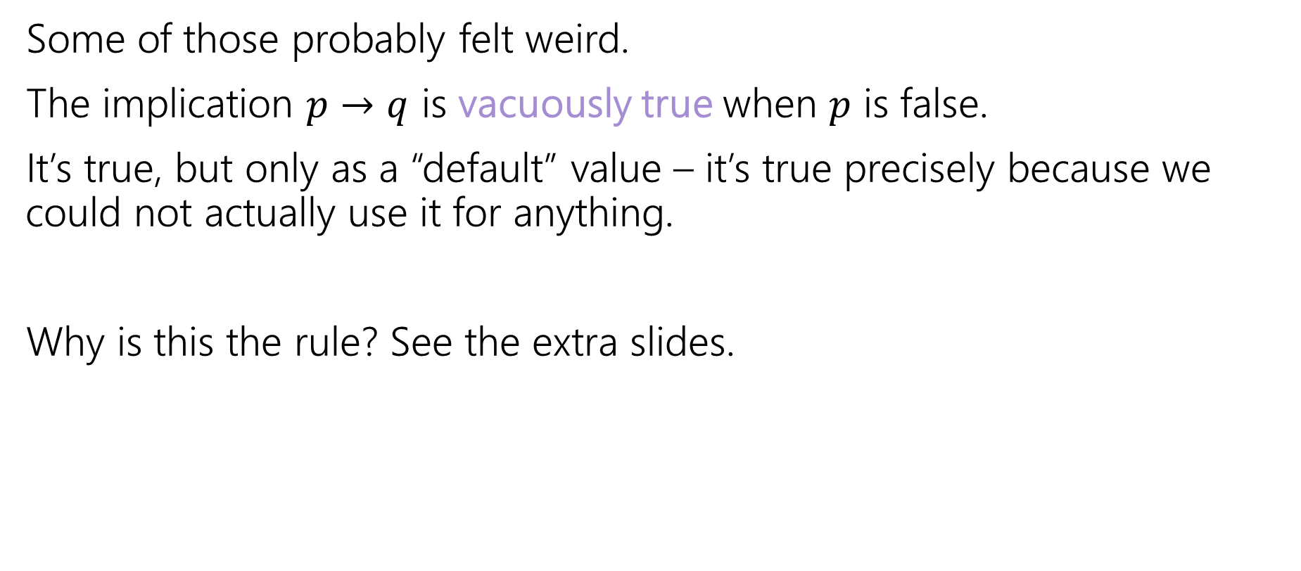
Vacuous Truth
Some of those probably felt weird.
The implication $p→q$ is vacuously true when $p$ is false.
It’s true, but only as a “default” value – it’s true precisely because we could not actually use it for anything.
Why is this the rule? See the extra slides.
$$p$$ | $$q$$ | $$p→q$$
True | True | True
True | False | False
False | True | True
False | False | True

Slide 10
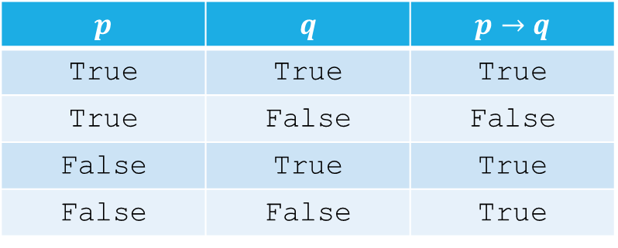

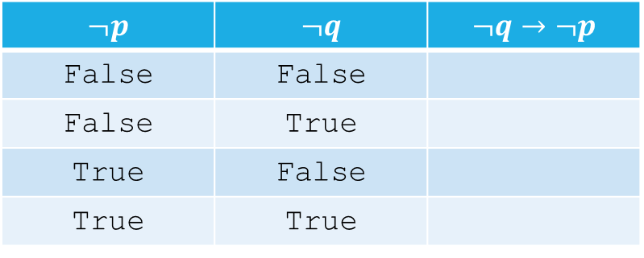
Contrapositives
There are two equivalent ways to write an implication
$p→q$ and $¬q→¬p$
How do I know they’re equivalent?
$$p$$ | $$q$$ | $$p→q$$
True | True | True
True | False | False
False | True | True
False | False | True
$$¬p$$ | $$¬q$$ | $$¬q→¬p$$
False | False
False | True
True | False
True | True

Slide 11
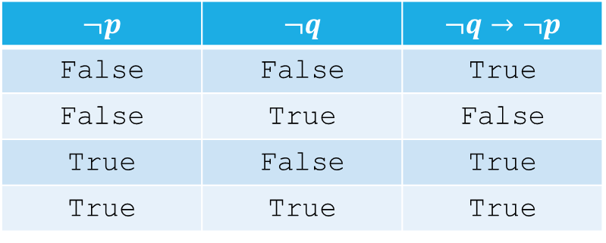
Contrapositives
There are two equivalent ways to write an implication
$p→q$ and $¬q→¬p$
How do I know they’re equivalent?
$$p$$ | $$q$$ | $$p→q$$
True | True | True
True | False | False
False | True | True
False | False | True
$$¬p$$ | $$¬q$$ | $$¬q→¬p$$
False | False | True
False | True | False
True | False | True
True | True | True

Slide 12
Contrapositives
To take a contrapositive, switch the “if-part” and “then-part” and negate them both.
If it is raining, then I have my umbrella.
If I do not have my umbrella, then it is not raining
Try it yourself:
If I’m on campus, then I have my Husky card.

Slide 13
Why take contrapositives?
Some implications are easier to prove in their contrapositive form.
Let’s practice some more direct proofs.

Slide 14

Even/Odd
Let $a$ be an integer. If$a^{2}$ if even, then $a$ is even.
$a^{2}=2k$ for some integer $k$.

Slide 15

Even/Odd
Let $a$ be an integer. If$a^{2}$ if even, then $a$ is even.
Try taking the contrapositive and proving that instead!

Slide 16

Even/Odd
Let $a$ be an integer. If $a^{2}$ if even, then $a$ is even.
What’s the contrapositive?
If $a$ is odd, then $a^{2}$ is odd.
$a=2k+1$ for some integer $k$,
$a^{2}={\left(2k+1\right)}^{2}=4k^{2}+4k+1=2\left(2k^{2}+2k\right)+1$

Slide 17
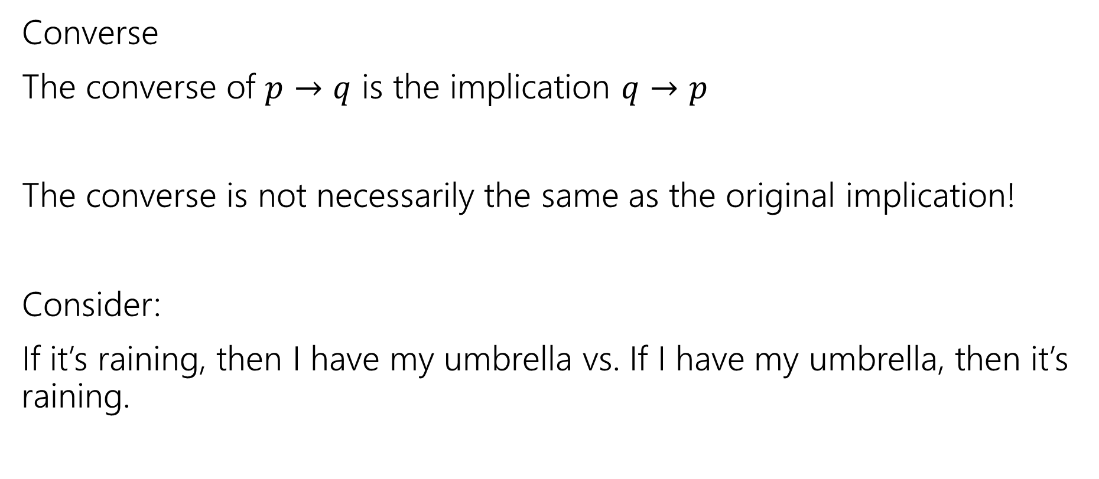
One more vocab word
Converse
The converse of $p→q$ is the implication $q→p$
The converse is not necessarily the same as the original implication!
Consider:
If it’s raining, then I have my umbrella vs. If I have my umbrella, then it’s raining.

Slide 18

Gale-Shapley
If $r$ is not matched to $h$ by Gale-Shapley, then at least one of $h$ or $r$ does not have the other as their first choice.

Slide 19

Sums
Let $a,b$ be integers.
If $a+b≥15$ then $a≥8$ or $b≥8$

Slide 20
Optional: Extra slides

Slide 21
Why vacuous truth?
Why do we call vacuous implications true? Why not call them “false”? Or “neither true nor false”?
Answer 1: It’s the convention. Everyone else does it; if you try to call it something else, everyone else will be very confused.
Answer 2: Implications can be general enough to be sometimes vacuous and sometimes not. Consider
“If a number is even and prime, then it is equal to 2”
Depending on what you choose for “number” the implication might be vacuous or not!
We’d really rather not think of the implication as “sometimes true, and sometimes neither true nor false” or worse yet “sometimes true and sometimes false” – “true” is the only realistic choice.

