Slide 1
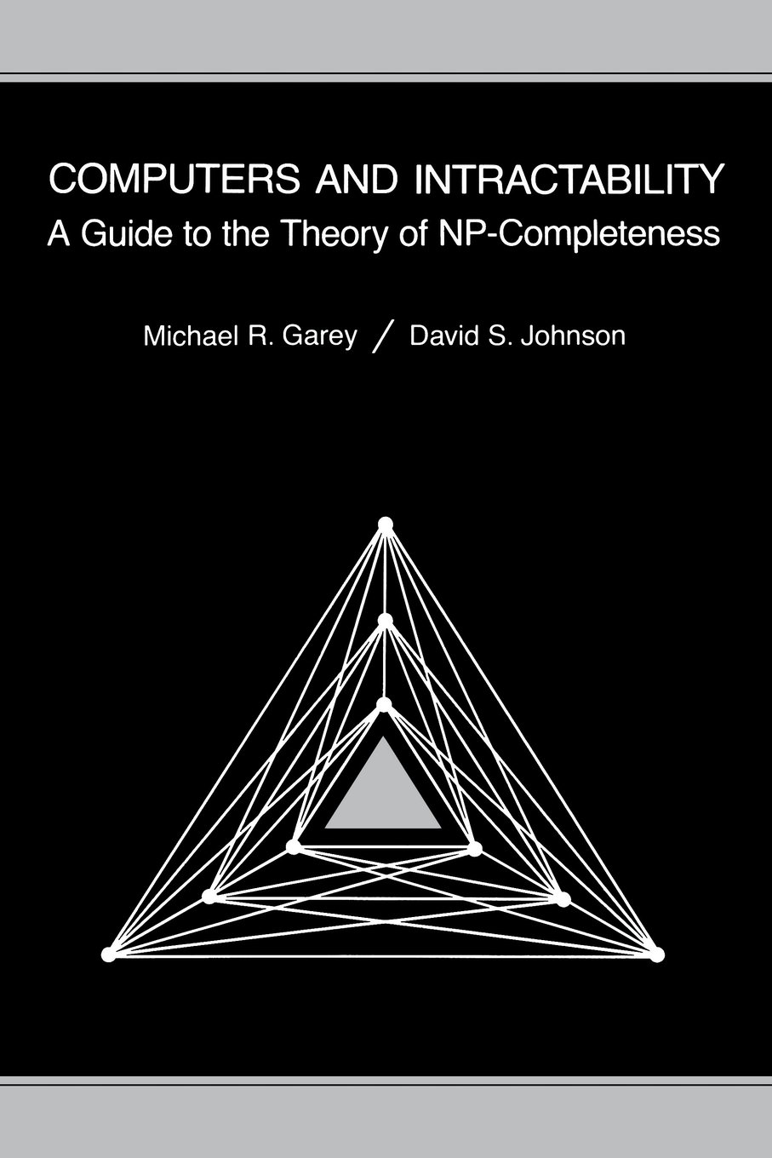
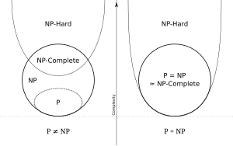
CSE 417 Algorithms and Complexity
Autumn 2024
Lecture 27
NP-Completeness I

Slide 2
Announcements
Homework 9
Exam practice problems on course homepage
Final Exam: Monday, December 9, 8:30 AM
One Hour Fifty Minutes
Closed book, no notes
Mon, Dec 2 | NP-Completeness
Wed, Dec 4 | NP-Completeness
Fri, Dec 6 | Last Lecture: NP-Completeness and Beyond
Mon, Dec 9 | Final Exam

Slide 3
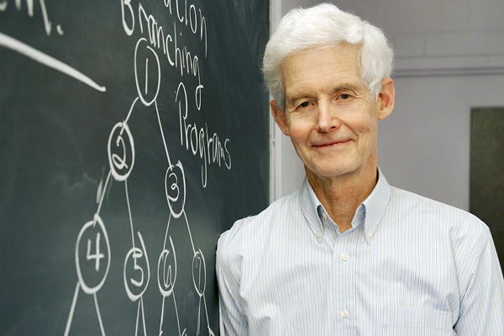
NP-Completeness

Slide 4
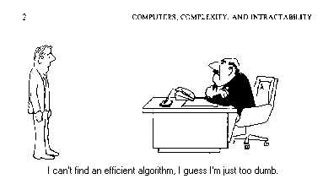
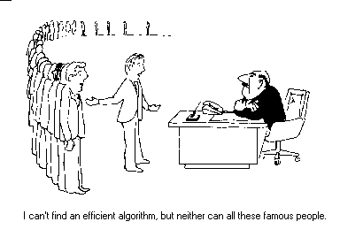
NP Completeness

Slide 5
Algorithms vs. Lower bounds
Algorithmic Theory
What we can compute
I can solve problem X with resources R
Proofs are almost always to give an algorithm that meets the resource bounds
Lower bounds
How do we show that something can’t be done?

Slide 6
Theory of NP Completeness
Most significant mathematical theory associated with computing

Slide 7
The Universe
NP-Complete
NP
P

Slide 8
Polynomial Time
P: Class of problems that can be solved in polynomial time
Corresponds with problems that can be solved efficiently in practice
Right class to work with “theoretically”

Slide 9
Decision Problems
Theory developed in terms of yes/no problems
Independent set
Given a graph G and an integer K, does G have an independent set of size at least K
Shortest Path
Given a graph G with edge lengths, a start vertex s, and end vertex t, and an integer K, does the graph have a path between s and t of length at most K

Slide 10
What is NP?
Problems solvable in non-deterministic polynomial time . . .
Problems where “yes” instances have polynomial time checkable certificates

Slide 11
Certificate examples
Independent set of size K
The Independent Set
Satifisfiable formula
Truth assignment to the variables
Hamiltonian Circuit Problem
A cycle including all of the vertices
K-coloring a graph
Assignment of colors to the vertices

Slide 12
Certifiers and Certificates: 3-Satisfiability
SAT: Does a given CNF formula have a satisfying formula
Certificate: An assignment of truth values to the n boolean variables
Certifier: Check that each clause has at least one true literal,
instance s
certificate t

Slide 13
Certifiers and Certificates: Hamiltonian Cycle
HAM-CYCLE. Given an undirected graph G = (V, E), does there exist a simple cycle C that visits every node?
Certificate. A permutation of the n nodes.
Certifier. Check that the permutation contains each node in V exactly once, and that there is an edge between each pair of adjacent nodes in the permutation.
instance s
certificate t

Slide 14
Polynomial time reductions
Y is Polynomial Time Reducible to X
Solve problem Y with a polynomial number of computation steps and a polynomial number of calls to a black box that solves X
Notations: Y <_{P} X
Usually, this is converting an input of Y to an input for X, solving X, and then converting the answer back

Slide 15
Composability Lemma
If X <_{P} Y and Y <_{P} Z then X <_{P} Z

Slide 16
Lemmas
Suppose Y <_{P} X. If X can be solved in polynomial time, then Y can be solved in polynomial time.
Suppose Y <_{P} X. If Y cannot be solved in polynomial time, then X cannot be solved in polynomial time.

Slide 17
NP-Completeness
A problem X is NP-complete if
X is in NP
For every Y in NP, Y <_{P} X
X is a “hardest” problem in NP
If X is NP-Complete, Z is in NP and X <_{P} Z
Then Z is NP-Complete

Slide 18
Cook’s Theorem
There is an NP Complete problem
The Circuit Satisfiability Problem
NP-Complete
NP
P

Slide 19
Circuit SAT
AND
Satisfying assignment
x₁ = T, x₂ = F, x₃ = F
x₄ = T, x₅ = T
OR
OR
Find a satisfying assignment
AND
AND
AND
AND
NOT
OR
NOT
OR
AND
NOT
OR
AND
AND
NOT
OR
NOT
AND
x₁
x₂
x₃
x₄
x₅

Slide 20
Populating the NP-Completeness Universe
NP-Complete
Circuit Sat <_{P} 3-SAT
3-SAT <_{P} Independent Set
3-SAT <_{P} Vertex Cover
Independent Set <_{P} Clique
3-SAT <_{P} Hamiltonian Circuit
Hamiltonian Circuit <_{P} Traveling Salesman
3-SAT <_{P} Integer Linear Programming
3-SAT <_{P} Graph Coloring
3-SAT <_{P} Subset Sum
Subset Sum <_{P} Scheduling with Release times and deadlines
NP
P

Slide 21
Graph Coloring
NP-Complete
Graph 3-coloring
Polynomial
Graph 2-Coloring

Slide 22
Graph 4-Coloring
Given a graph G, can G be colored with 4 colors?
Prove 4-Coloring is NP Complete
Proof: 3-Coloring <_{P} 4-Coloring
Show that you can 3-Color a graph if you have an algorithm to 4-Color a graph

Slide 23
3-Coloring <_{P} 4-Coloring

Slide 25
Garey and Johnson

Slide 26
P vs. NP Question
NP-Complete
NP
P NP
P

