Slide 1
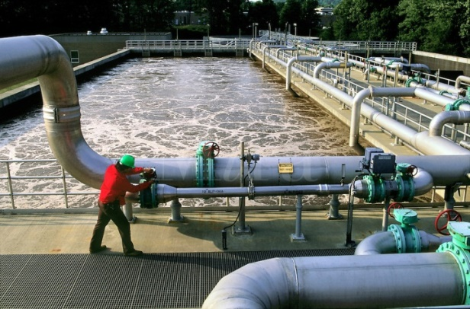
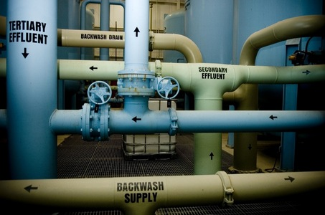
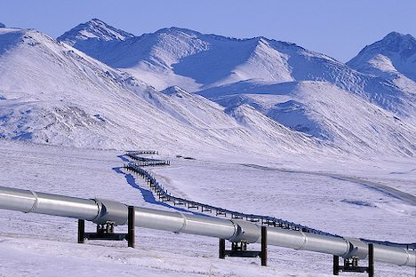
CSE 417
Algorithms and Complexity
Autumn 2024
Lecture 26
Network Flow Applications

Slide 2
Announcements
Homework 9
Exam practice problems on course homepage
Final Exam: Monday, December 9, 8:30 AM
  One Hour Fifty Minutes
Wed, Nov 26 | Net Flow Applications
Mon, Dec 2 | Net Flow Applications + NP-Completeness
Wed, Dec 4 | NP-Completeness
Fri, Dec 6 | NP-Completeness
Mon, Dec 9 | Final Exam

Slide 3
Outline
Network flow definitions
Flow examples
Augmenting Paths
Residual Graph
Ford Fulkerson Algorithm
Cuts
Maxflow-MinCut Theorem
Maxflow Algorithms
Simple applications of Max Flow
Non-simple applications of Max Flow

Slide 4
Cuts in a graph
Cut: Partition of V into disjoint sets S, T with s in S and t in T.
Cap(S,T): sum of the capacities of edges from S to T
Problem: Find the s-t Cut with minimum capacity
s
t

Slide 5
Max Flow / Min Cut
Review
20/20
20/30
a
d
g
0/5
0/5
20/20
20/30
5/5
0/5
0/5
5/5
0/20
s
25/30
b
20/20
e
h
30/30
t
20/20
0/5
5/5
20/25
0/5
0/5
15/20
15/25
c
f
i
20/20
10/10

Slide 6
Max Flow - Min Cut Theorem
There exists a cut S, T such that Flow(S,T) = Cap(S,T)
Proof also shows that Ford Fulkerson algorithm finds a maximum flow

Slide 7
Ford Fulkerson Runtime
Cost per phase X number of phases
Phases
  Capacity leaving source: C
  Add at least one unit per phase
Cost per phase
  Build residual graph: O(m)
  Find s-t path in residual: O(m)

Slide 8
Network flow performance
Ford-Fulkerson algorithm
  O(mC)
Find the maximum capacity augmenting path
  O(m²log(C)) time algorithm for network flow
Find the shortest augmenting path
  O(m²n) time algorithm for network flow
Find a blocking flow in the residual graph
  O(mnlog n) time algorithm for network flow
Interior Point Methods
  O(m + n)

Slide 9
Problem Reduction
Reduce Problem A to Problem B
  Convert an instance of Problem A to an instance of Problem B
  Use a solution of Problem B to get a solution to Problem A

Slide 10
Undirected Network Flow
Undirected graph with edge capacities
Flow may go either direction along the edges (subject to the capacity constraints)
u
10
20
s
5
t
20
10
v
Construct an equivalent flow problem

Slide 11
Bipartite Matching
A graph G=(V,E) is bipartite if the vertices can be partitioned into disjoints sets X,Y
A matching M is a subset of the edges that does not share any vertices
Find a matching as large as possible

Slide 12
Application
A collection of teachers
A collection of courses
And a graph showing which teachers can teach which courses
RA
143
PB
373
ME
414
DG
415
AK
417

Slide 13
Converting Matching to Network Flow
s
t

Slide 14
Multi-source network flow
Multi-source network flow
  Sources s₁, s₂, . . ., s_{k}
  Sinks t₁, t₂, . . . , t_{j}
Solve with Single source network flow

Slide 15
Resource Allocation: Assignment of reviewers
A set of papers P₁, . . ., P_{n}
A set of reviewers R₁, . . ., R_{m}
Paper P_{i} requires A_{i} reviewers
Reviewer R_{j} can review B_{j} papers
For each reviewer R_{j}, there is a list of paper L_{j1}, . . ., L_{jk} that R_{j} is qualified to review

Slide 16
Baseball elimination
Can the Dinosaurs win the league?
Remaining games:
  AB, AC, AD, AD, AD, BC, BC, BC, BD, CD
 | W | L
Ants | 4 | 2
Bees | 4 | 2
Cockroaches | 3 | 3
Dinosaurs | 1 | 5
A team wins the league if it has strictly more wins than any other team at the end of the season
A team ties for first place if no team has more wins, and there is some other team with the same
number of wins

Slide 17
Baseball elimination
Can the Fruit Flies win or tie the league?
Remaining games:
  AC, AD, AD, AD, AF, BC, BC, BC, BC, BC, BD, BE, BE, BE, BE, BF, CE, CE, CE, CF, CF, DE, DF, EF, EF
 | W | L
Ants | 17 | 12
Bees | 16 | 7
Cockroaches | 16 | 7
Dinosaurs | 14 | 13
Earthworms | 14 | 10
Fruit Flies | 12 | 15

Slide 18
Assume Fruit Flies win remaining games
Fruit Flies are tied for first place if no team wins more than 19 games
Allowable wins
  Ants (2)
  Bees (3)
  Cockroaches (3)
  Dinosaurs (5)
  Earthworms (5)
18 games to play
  AC, AD, AD, AD, BC, BC, BC, BC, BC, BD, BE, BE, BE, BE, CE, CE, CE, DE
 | W | L
Ants | 17 | 13
Bees | 16 | 8
Cockroaches | 16 | 9
Dinosaurs | 14 | 14
Earthworms | 14 | 12
Fruit Flies | 19 | 15

Slide 19
Remaining games
  AC, AD, AD, AD, BC, BC, BC, BC, BC, BD, BE, BE, BE, BE, CE, CE, CE, DE
s
AC
AD
BC
BD
BE
CE
DE
A
B
C
D
E
t

Slide 20
Minimum Cut Applications
Image Segmentation
Open Pit Mining / Task Selection Problem
Reduction to Min Cut problem
S, T is a cut if S, T is a partition of the vertices with
s in S and t in T
The capacity of an S, T cut is the sum of the capacities of
all edges going from S to T

Slide 21
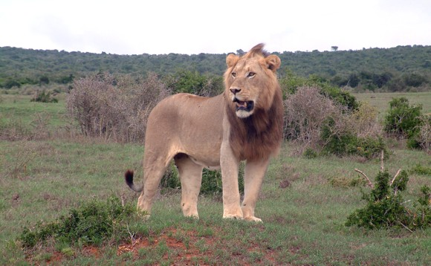
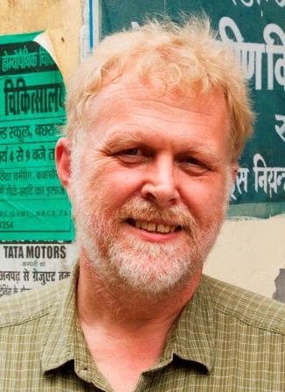

Image Segmentation
Separate foreground from background

Slide 22
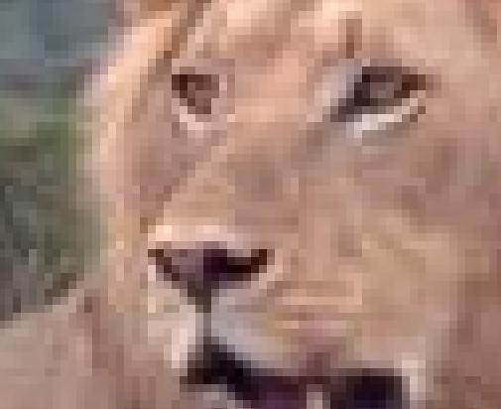

Slide 23
Image analysis
a_{i}: value of assigning pixel i to the foreground
b_{i}: value of assigning pixel i to the background
p_{ij}: penalty for assigning i to the foreground, j to the background or vice versa
A: foreground, B: background
Q(A,B) = Σ_{{i in A}}a_{i} + Σ_{{j in B}}b_{j} - Σ_{{(i,j) in E, i in A, j in} _{B}}p_{ij}

Slide 24
Pixel graph to flow graph
s
t

Slide 25
Mincut Construction
s
a_{v}
p_{vu}
u
v
p_{uv}
b_{v}
t

Slide 26
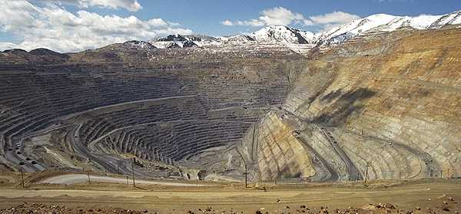
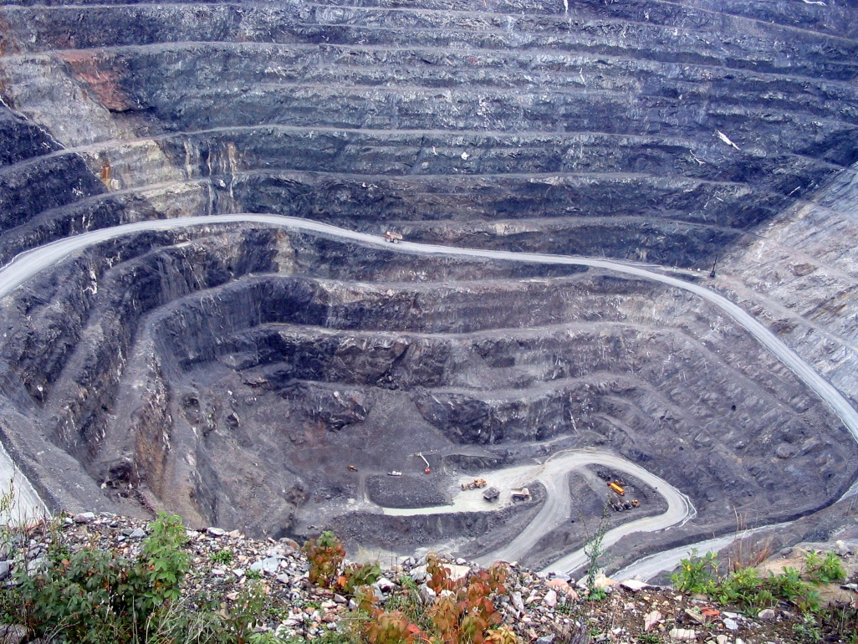
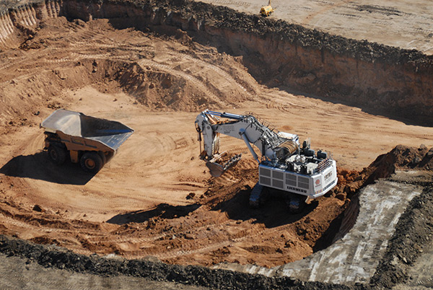
Open Pit Mining
(Task selection)

Slide 27
Open Pit Mining
Each unit of earth has a profit (possibly negative)
Getting to the ore below the surface requires removing the dirt above
Test drilling gives reasonable estimates of costs
Plan an optimal mining operation

Slide 28
Mine Graph
-4
-3
-2
-1
-1
-3
3
-1
4
-7
-10
-2
8
3
-10

Slide 29
Determine an optimal mine
-5
-3
-4
-4
2
-4
3
-1
-7
-10
-1
-3
-3
3
4
4
-3
-10
-10
-10
4
7
-2
-10
3
-10
-10
-10
-10
6
8
6
-3
-10
-10
-10
-10
-10
-10
1
4
4
-10
-10
-10
-10
-10
-10
-10
-10
-10
-10
-10
-10

Slide 30
Generalization
Precedence graph G=(V,E)
Each v in V has a profit p(v)
A set F is feasible if when w in F, and (v,w) in E, then v in F.
Find a feasible set to maximize the profit
6
-4
-2
-3
5
-1
-10
4

Slide 31
Min cut algorithm for profit maximization
Construct a flow graph where the minimum cut identifies a feasible set that maximizes profit

Slide 32
Precedence graph construction
Precedence graph G=(V,E)
Each edge in E has infinite capacity
Add vertices s, t
Each vertex in V is attached to s and t with finite capacity edges

Slide 33
Find a finite value cut with at least two vertices on each side of the cut
s
Infinite
Finite
t

Slide 34
The sink side of a finite cut is a feasible set
No edges permitted from S to T
If a vertex is in T, all of its ancestors are in T

Slide 35
Setting the costs
s
If p(v) > 0,
  cap(v,t) = p(v)
  cap(s,v) = 0
If p(v) < 0
  cap(s,v) = -p(v)
  cap(v,t) = 0
If p(v) = 0
  cap(s,v) = 0
  cap(v,t) = 0
3
3
1
1
-3
-3
-1
0
2
3
2
1
3
t

Slide 36
Minimum cut gives optimal solution
Why?
s
2
2
-2
1
2
-2
1
1
2
1
t

Slide 37
Computing the Profit
Cost(W) = Σ_{{w in W; p(w) < 0}}-p(w)
Benefit(W) = Σ_{{w in W; p(w) > 0}} p(w)
Profit(W) = Benefit(W) – Cost(W)
Maximum cost and benefit
  C = Cost(V)
  B = Benefit(V)

Slide 38
Express Cap(S,T) in terms of B, C, Cost(T), Benefit(T), and Profit(T)
Cap(S,T) = Cost(T) + Ben(S) = Cost(T) + Ben(S) + Ben(T) – Ben(T)
= B + Cost(T) – Ben(T) = B – Profit(T)

