Slide 1
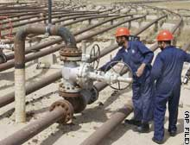
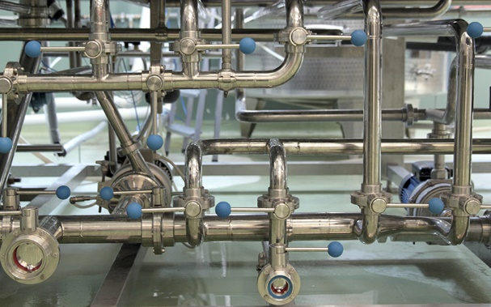
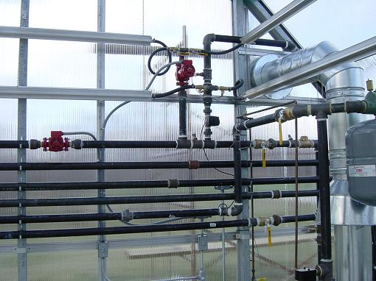
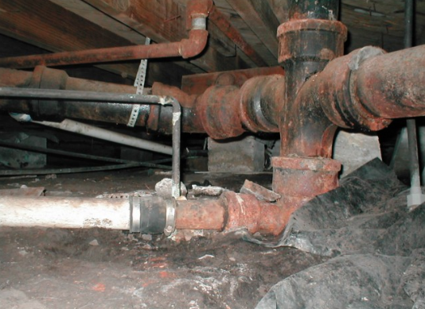
CSE 417 Algorithms and Complexity
Lecture 25
Autumn 2024
Network Flow, Part 2

Slide 2
Outline
Network flow definitions
Flow examples
Augmenting Paths
Residual Graph
Ford Fulkerson Algorithm
Cuts
Maxflow-MinCut Theorem
Simple applications of Max Flow

Slide 3
Network Flow Definitions
Flowgraph: Directed graph with distinguished vertices s (source) and t (sink)
Capacities on the edges, c(e) ≥ 0
Problem, assign flows f(e) to the edges such that:
0 ≤ f(e) ≤ c(e)
Flow is conserved at vertices other than s and t
Flow conservation: flow going into a vertex equals the flow going out
The flow leaving the source is a large as possible

Slide 4
Residual Graph
Flow graph showing the remaining capacity
Flow graph G, Residual Graph G_{R}
G: edge e from u to v with capacity c and flow f
G_{R}: edge e’ from u to v with capacity c – f
G_{R}: edge e’’ from v to u with capacity f
u
u
15/20
0/10
5
10
15
s
15/30
t
s
15
15
t
5
5/10
20/20
5
20
v
v

Slide 5
Augmenting Path Algorithm
Augmenting path in residual graph
Vertices v₁,v₂,…,v_{k}
v₁ = s, v_{k} = t
Possible to add b units of flow between v_{j} and v_{j+1} for j = 1 … k-1
u
u
15/20
0/10
5
10
15
s
15/30
t
s
15
15
t
5
5/10
20/20
5
20
v
v

Slide 6
Adding flow along a path in the residual graph
Let P be an s-t path in the residual graph with capacity b
b units of flow can be added along P in the graph G
Need to show:
new flow satisfies capacity constraints
new flow satisfies conservation constraints

Slide 7
Ford-Fulkerson Algorithm (1956)
while not done
Construct residual graph G_{R}
Find an s-t path P in G_{R} with capacity b > 0
Add b units of flow along path P in G
If the sum of the capacities of edges leaving S is at most C, then the algorithm takes at most C iterations

Slide 8
Flow Example I
20
15
a
d
g
5
20
5
5
10
5
10
5
20
s
20
b
15
e
h
30
t
10
10
5
5
20
5
20
20
c
f
i
15
20

Slide 9
Flow Example II
20
20
a
d
g
5
20
5
5
20
5
5
5
20
s
30
b
20
e
h
30
t
20
5
5
5
20
5
25
20
c
f
i
20
10

Slide 10
Cuts in a graph
Cut: Partition of V into disjoint sets S, T with s in S and t in T.
Cap(S,T): sum of the capacities of edges from S to T
Flow(S,T): net flow out of S
Sum of flows out of S minus sum of flows into S
Flow(S,T) ≤ Cap(S,T)

Slide 11
What is Cap(S,T) and Flow(S,T)
S={s, a, b, e, h}, T = {c, f, i, d, g, t}
20/20
20/20
a
d
g
0/5
0/5
20/20
20/20
5/5
0/5
0/5
5/5
0/20
s
25/30
b
20/20
e
h
30/30
t
20/20
0/5
5/5
20/20
0/5
0/10
15/20
15/25
c
f
i
20/20
10/10

Slide 12
What is Cap(S,T) and Flow(S,T)
S={s, a, b, e, h}, T = {c, f, i, d, g, t}
20/20
20/20
a
d
g
0/5
0/5
20/20
20/20
5/5
0/5
0/5
5/5
0/20
s
25/30
b
20/20
e
h
30/30
t
20/20
0/5
5/5
20/20
0/5
0/10
15/20
15/25
c
f
i
20/20
10/10
Cap(S,T) = 95, Flow(S,T) = 80 – 15 = 65

Slide 13
Minimum value cut
u
40
10
s
10
t
10
40
v

Slide 14
Find a minimum value cut
6
6
5
8
10
3
6
s
7
2
t
4
5
3
8
5
4

Slide 15
Find a minimum value cut
6
6
5
8
10
3
6
s
7
2
t
4
5
3
8
5
4

Slide 16
Find a minimum value cut
6:5
6:5
5:5
8
10:3
3:3
6:5
s
7:6
2:2
t
4:4
5:4
3:3
8:3
5
4:3

Slide 17
MaxFlow – MinCut Theorem
There exists a flow which has the same value of the minimum cut
Proof: Consider a flow where the residual graph has no s-t path with positive capacity
Let S be the set of vertices in G_{R} reachable from s with paths of positive capacity
s
t

Slide 18
Let S be the set of vertices in G_{R} reachable from s with paths of positive capacity
s
u
v
t
S
T
Cap(u,v) = 0 in G_{R}
Cap(u,v) = Flow(u,v) in G
Flow(v,u) = 0 in G
What can we say about the flows and capacity
between u and v?

Slide 19
Max Flow - Min Cut Theorem
Ford-Fulkerson algorithm finds a flow where the residual graph is disconnected, hence FF finds a maximum flow.
If we want to find a minimum cut, we begin by looking for a maximum flow.

Slide 20
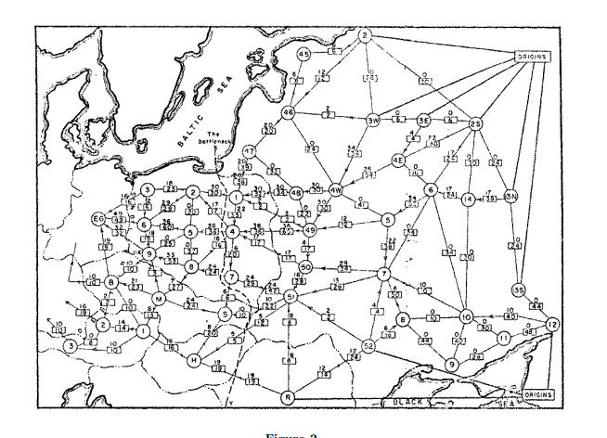
History
Ford / Fulkerson studied network flow in the context of the Soviet Rail Network

Slide 21
Ford Fulkerson Runtime
Cost per phase X number of phases
Phases
Capacity leaving source: C
Add at least one unit per phase
Cost per phase
Build residual graph: O(m)
Find s-t path in residual: O(m)

Slide 22
Performance
The worst case performance of the Ford-Fulkerson algorithm is horrible
u
1000
1000
s
1
t
1000
1000
v

Slide 23
Better methods of finding augmenting paths
Find the maximum capacity augmenting path
O(m²log(C)) time algorithm for network flow
Find the shortest augmenting path
O(m²n) time algorithm for network flow
Find a blocking flow in the residual graph
O(mnlog n) time algorithm for network flow

Slide 24
Problem Reduction
Reduce Problem A to Problem B
Convert an instance of Problem A to an instance of Problem B
Use a solution of Problem B to get a solution to Problem A
Practical
Use a program for Problem B to solve Problem A
Theoretical
Show that Problem B is at least as hard as Problem A

Slide 25
Problem Reduction Examples
Reduce the problem of finding the Maximum of a set of integers to finding the Minimum of a set of integers
Find the maximum of: 8, -3, 2, 12, 1, -6
Construct an equivalent minimization problem

Slide 26
Undirected Network Flow
Undirected graph with edge capacities
Flow may go either direction along the edges (subject to the capacity constraints)
u
10
20
s
5
t
20
10
v
Construct an equivalent flow problem

Slide 27
Bipartite Matching
A graph G=(V,E) is bipartite if the vertices can be partitioned into disjoints sets X,Y
A matching M is a subset of the edges that does not share any vertices
Find a matching as large as possible

Slide 28
Application
A collection of teachers
A collection of courses
And a graph showing which teachers can teach which courses
RA
143
PB
373
ME
414
DG
415
AK
417

Slide 29
Converting Matching to Network Flow
s
t

Slide 30
Multi-source network flow
Multi-source network flow
Sources s₁, s₂, . . ., s_{k}
Sinks t₁, t₂, . . . , t_{j}
Solve with Single source network flow

Slide 31
Resource Allocation: Assignment of reviewers
A set of papers P₁, . . ., P_{n}
A set of reviewers R₁, . . ., R_{m}
Paper P_{i} requires A_{i} reviewers
Reviewer R_{j} can review B_{j} papers
For each reviewer R_{j}, there is a list of paper L_{j1}, . . ., L_{jk} that R_{j} is qualified to review

