Slide 1
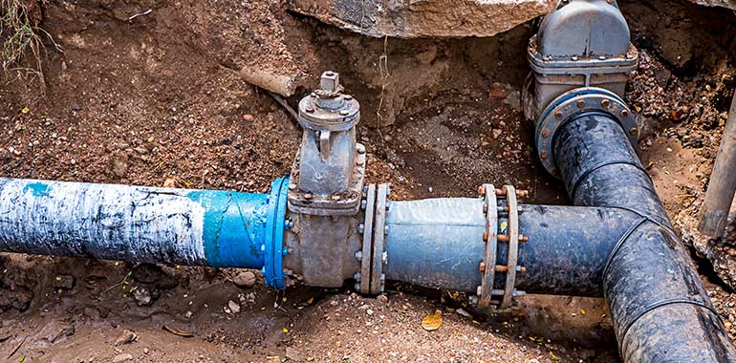
CSE 417 Algorithms and Complexity
Autumn 2024
Lecture 24
Network Flow, Part 1

Slide 2
Announcements
Homework 8, Due Wednesday, Nov 29
Homework 9, Due Friday, Dec 6
Final Exam,
Monday, December 9, 8:30-10:20 AM

Slide 3
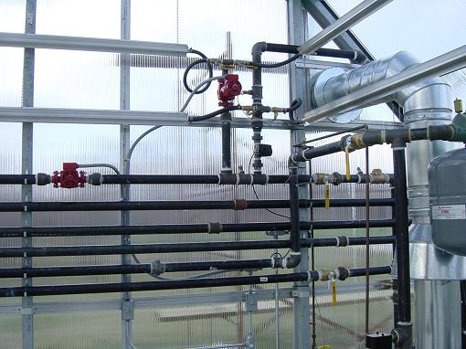
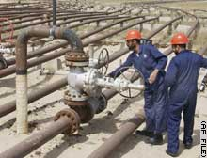
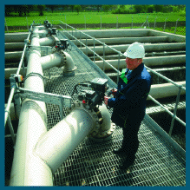
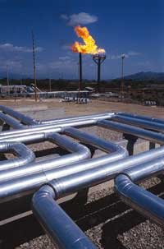
Network Flow

Slide 4
Outline
Network flow definitions
Flow examples
Augmenting Paths
Residual Graph
Ford Fulkerson Algorithm
Cuts
Maxflow-MinCut Theorem

Slide 5
Network Flow Definitions
Capacity
Source, Sink
Capacity Condition
Conservation Condition
Value of a flow

Slide 6
Flow Example
u
20
10
s
30
t
10
20
v

Slide 7
Network Flow Definitions
Flowgraph: Directed graph with distinguished vertices s (source) and t (sink)
Capacities on the edges, c(e) ≥ 0
Problem, assign flows f(e) to the edges such that:
0 ≤ f(e) ≤ c(e)
Flow is conserved at vertices other than s and t
Flow conservation: flow going into a vertex equals the flow going out
The flow leaving the source is a large as possible

Slide 8
Find a maximum flow
15
20
a
d
g
5
5
20
5
5
20
5
10
20
s
30
b
20
e
h
30
t
20
5
5
20
5
5
20
25
c
f
i
20
10

Slide 9
Find a maximum flow
15/15
15/20
a
d
g
0/5
0/5
20/20
15/20
5/5
0/5
0/5
10/10
0/20
s
25/30
b
20/20
e
h
30/30
t
20/20
0/5
5/5
20/20
0/5
0/5
15/20
15/25
c
f
i
20/20
10/10

Slide 10
Flow Example
u
u
20
10
20
10
s
30
t
s
30
t
10
20
10
20
v
v

Slide 11
Residual Graph
Flow graph showing the remaining capacity
Flow graph G, Residual Graph G_{R}
G: edge e from u to v with capacity c and flow f
G_{R}: edge e’ from u to v with capacity c – f
G_{R}: edge e’’ from v to u with capacity f

Slide 12
Flow assignment and the residual graph
u
u
15/20
0/10
5
10
15
s
15/30
t
15
15
s
t
5
5/10
20/20
5
20
v
v

Slide 13
Augmenting Path Algorithm
Augmenting path
Vertices v₁,v₂,…,v_{k}
v₁ = s, v_{k} = t
Possible to add b units of flow between v_{j} and v_{j+1} for j = 1 … k-1
u
10/20
0/10
s
10/30
t
5/10
15/20
v

Slide 14
Build the residual graph
3/5
d
g
2/4
3/3
s
1/5
1/5
1/1
t
3/3
e
h
2/5
1/1
Residual graph:
d
g
s
t
e
h

Slide 15
Find two augmenting paths
2/5
2/2
0/1
2/4
3/4
3/4
3/3
1/3
1/3
3/3
s
t
3/3
2/2
3/3
1/3
3/3
1/3
2/2
1/3

Slide 16
Augmenting Path Lemma
Let P = v₁, v₂, …, v_{k} be a path from s to t with minimum capacity b in the residual graph.
b units of flow can be added along the path P in the flow graph.
u
u
5
10
15/20
0/10
15
s
15
15
t
s
15/30
t
5
5
20
5/10
20/20
v
v

Slide 17
Proof
Add b units of flow along the path P
What do we need to verify to show we have a valid flow after we do this?

Slide 18
Ford-Fulkerson Algorithm (1956)
while not done
Construct residual graph G_{R}
Find an s-t path P in G_{R} with capacity b > 0
Add b units along in G
If the sum of the capacities of edges leaving S is at most C, then the algorithm takes at most C iterations

