Slide 1
CSE 417 Algorithms and Complexity
Lecture 20, Autumn 2024
Dynamic Programming, Part II

Slide 2
Announcements
Dynamic Programming Reading:
6.1-6.2, Weighted Interval Scheduling
6.4 Knapsack and Subset Sum
6.6 String Alignment
6.7* String Alignment in linear space
6.8 Shortest Paths (again)
6.9 Negative cost cycles
How to make an infinite amount of money

Slide 3
Key Ideas for Dynamic Programming
Give a recursive solution for the problem in terms of optimizing an objective function
Order sub-problems to avoid duplicate computation
Determine the elements that form the solution

Slide 4
Weighted Interval Scheduling
Intervals sorted by end time
Given a collection of intervals I₁,…,I_{n} with weights w₁,…,w_{n}, choose a maximum weight set of non-overlapping intervals
2
P[I₁] = 0
4
P[I₂] = 0
Sorted by finish times
7
P[I₃] = 1
4
P[I₄] = 2
6
P[I₅] = 1
7
P[I₆] = 4
6
P[I₇] = 3

Slide 5
Recursive Solution
Intervals sorted by end time
Express the solution to a problem of size n in terms of solutions to problems of size k, where k < n
2
4
7
4
6
7
6

Slide 6
Optimality Condition
Intervals sorted by end time
Opt[ j ] is the maximum weight independent set of intervals I₁, I₂, . . ., I_{j}
Opt[ j ] = max( Opt[ j – 1], w_{j} + Opt[ p[ j ] ])
Where p[ j ] is the index of the last interval which finishes before I_{j} starts
Convert to iterative algorithm to compute: Opt[1], Opt[2], Opt[3],…, Opt[n-1], Opt[n]

Slide 7
Iterative Algorithm
MaxValue(n){
int[ ] M = new int[n+1];
M[0] = 0;
for (int i = 1; i <= n; i++){
M[ j ] = max(M[j-1], w_{j} + M[p[ j ]]);
}
return M[n];
}

Slide 8
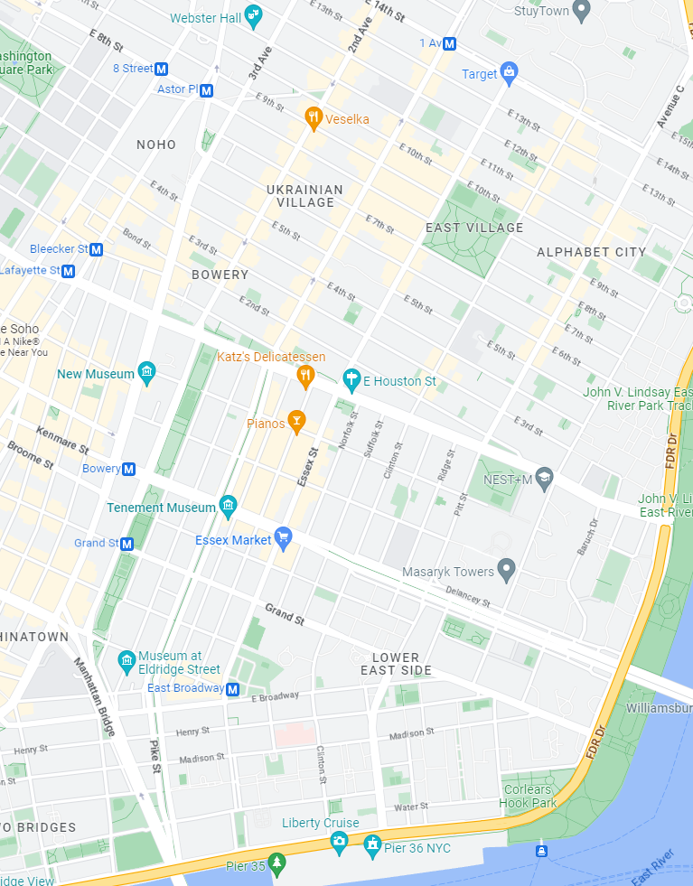
How many different ways can I walk to work?
Only taking “efficient” routes
Make the problem discrete
Directed Graph model: Intersections and streets
Assume the graph is a directed acyclic graph (DAG)
Problem: compute the number of paths from vertex h to vertex w

Slide 9
P[v]: Number of paths from v to v₀
How do you compute P[v] if you know P[x], P[y], and P[z]?
v
x
y
z

Slide 10
Recursive Algorithm
v₆
PC(v){
if (v == v₀)
return 1;
count = 0;
foreach (w in N⁺(v)){
count = count + PC(w);
}
return count;
}
v₅
v₄
v₃
v₂
v₁
v₀

Slide 11
Ordering the vertices
How do you order the vertices of a DAG such that if there is an edge from v to w, w comes before v in the ordering?

Slide 12
Path Counting
G=(V,E) is an n node directed acyclic graph, with v_{n-1}, v_{n-2}, . . ., v₁, v₀ a topological order of the vertices. An array is computed giving the number of paths from each vertex to v₀.
CountPaths(G, P){
P[0] = 1;
for (i = 1 to n-1){
P[i] = 0;
foreach (w in N⁺(v_{i})){
P[i] = P[i] + P[w];
}
}

Slide 13
Typesetting
Layout text on a page to optimize readability and aesthetic measures
Skilled profession replaced by computing
Goal – give text a uniform appearance which is primarily done by choosing line breaks to balance white space
Interword spacing can stretch or shrink
Hyphenation is sometimes available

Slide 14
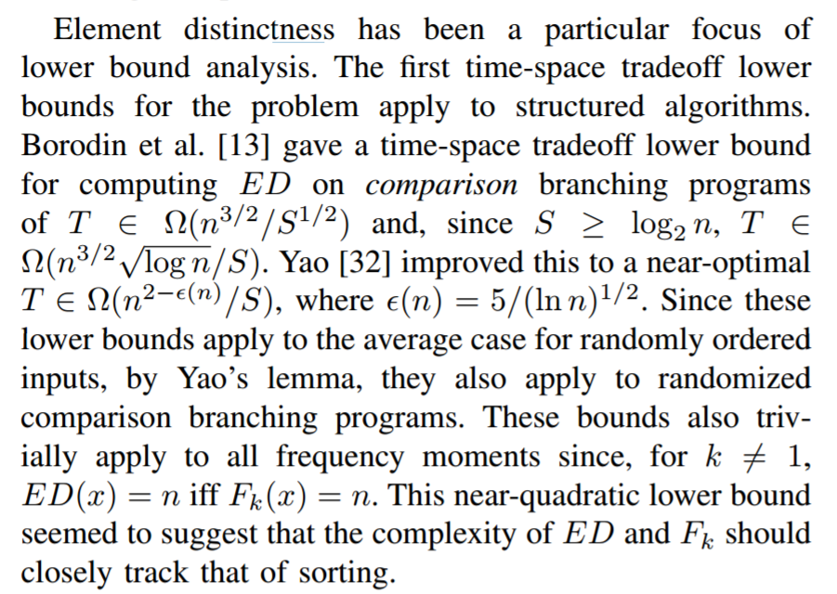
Optimal line breaking

Slide 15
Optimal Line Breaking
Words have length w_{i}, line length L
Penalty related to white space or overflow of the line
Quadratic measure often used
Pen(i, j): Penalty for putting w_{i}, w_{i+1},…,w_{j} on the same line
Opt[m]: minimum penalty for ending a line with w_{m}

Slide 16
The quick brown fox jumped over the lazy dog.
The quick brown fox jumped over the lazy dog.
Pen(“The quick brown”) = 1
Pen(“fox jumped over”) = 2
Pen(“fox jumped”) = 8
Pen(“the lazy dog”) = 6
Pen(“over the lazy dog.”) = 4
Pen(i, j): Penalty for putting w_{i}, w_{i+1},…,w_{j} on the same line

Slide 17
Optimal Line Breaking
Optimal score for ending a line with w_{m}
Opt[m] = min _{i} { Opt [ i ] + Pen(i+1,m)} for 0 < i < m
For words w₁, w₂, . . . , w_{n}, we compute Opt[n] to find the optimal layout

Slide 18
Optimal Line Breaking
Opt[0] = 0;
for m = 1 to n {
Find i that minimizes Opt [ i ] + Pen(i+1,m);
Opt[m] = Opt [ i ] + Pen(i+1,m);
Pred[m] = i;
}

