Slide 1
CSE 417 Algorithms
Richard Anderson
Autumn 2024
Lecture 4

Slide 2
Announcements
Reading
Chapter 2.1, 2.2
Chapter 3 (Mostly review)
Start on Chapter 4
Homework Guidelines
Submit homework with Gradescope
Describing an algorithm
Clarity is most important
Pseudocode generally preferable to just English
But sometimes both methods combined work best
Prove that your algorithm works
A proof is a “convincing argument”
Give the run time for your algorithm
Justify that the algorithm satisfies the runtime bound
You may lose points for style
Homework assignments will (probably) be worth the same amount

Slide 3
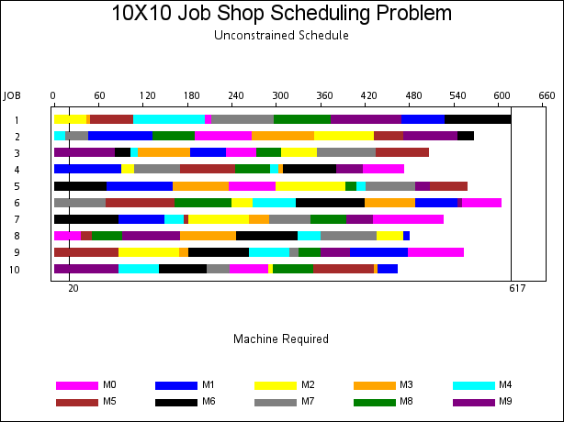
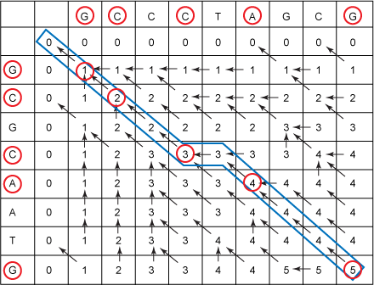
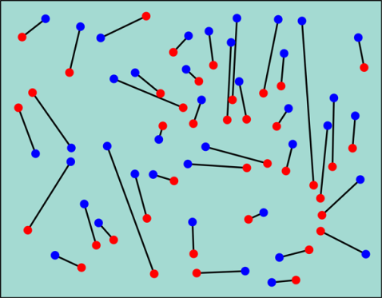
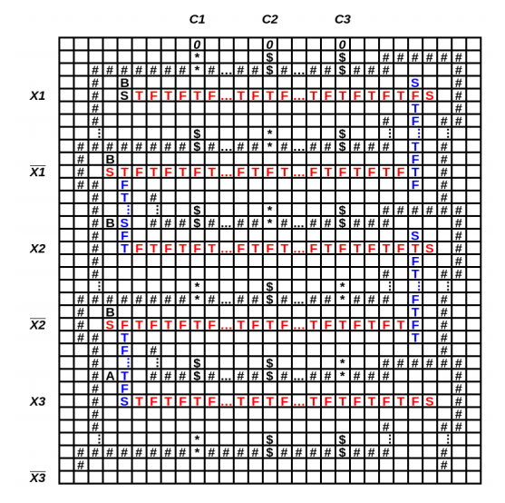
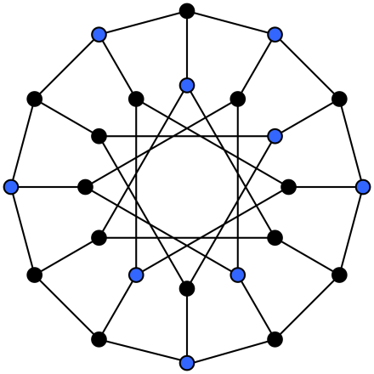
Five Problems
Scheduling
Weighted Scheduling
Bipartite Matching
Maximum Independent Set
Competitive Facility Location

Slide 4
Summary – Five Problems
Scheduling
Weighted Scheduling
Combinatorial Optimization
Maximum Independent Set
Competitive Scheduling

Slide 5
What does it mean for an algorithm to be efficient?

Slide 6
Definitions of efficiency
Fast in practice
Qualitatively better worst case performance than a brute force algorithm

Slide 7
Polynomial time efficiency
An algorithm is efficient if it has a polynomial run time
Run time as a function of problem size
Run time: count number of instructions executed on an underlying model of computation
T(n): maximum run time for all problems of size at most n

Slide 8
Polynomial Time
Algorithms with polynomial run time have the property that increasing the problem size by a constant factor increases the run time by at most a constant factor (depending on the algorithm)

Slide 9
Why Polynomial Time?
Generally, polynomial time seems to capture the algorithms which are efficient in practice
The class of polynomial time algorithms has many good, mathematical properties

Slide 10
Polynomial vs. Exponential Complexity
Suppose you have an algorithm which takes n! steps on a problem of size n
If the algorithm takes one second for a problem of size 10, estimate the run time for the following problems sizes:
12 14 16 18 20
10: 1 second
12: 2 minutes
14: 6 hours
16: 2 months
18: 50 years
20: 20K years

Slide 11
Ignoring constant factors
Express run time as O(f(n))
Emphasize algorithms with slower growth rates
Fundamental idea in the study of algorithms
Basis of Tarjan/Hopcroft Turing Award

Slide 12
Why ignore constant factors?
Constant factors are arbitrary
Depend on the implementation
Depend on the details of the model
Determining the constant factors is tedious and provides little insight

Slide 13
Why emphasize growth rates?
The algorithm with the lower growth rate will be faster for all but a finite number of cases
Performance is most important for larger problem size
As memory prices continue to fall, bigger problem sizes become feasible
Improving growth rate often requires new techniques

Slide 14
Formalizing growth rates
T(n) is O(f(n)) [T : Z⁺ → R⁺]
If n is sufficiently large, T(n) is bounded by a constant multiple of f(n)
Exist c, n₀, such that for n > n₀, T(n) < c f(n)
T(n) is O(f(n)) will be written as: T(n) = O(f(n))
Be careful with this notation

Slide 15
Prove 3n² + 5n + 20 is O(n²)
Let c =
Let n₀ =
Choose c = 6, n₀ = 5
T(n) is O(f(n)) if there exist c, n₀, such that for n > n₀, T(n) < c f(n)

Slide 16
Order the following functions in increasing order by their growth rate
n log⁴n
2n² + 10n
2^{n/100}
1000n + log⁸ n
n¹⁰⁰
3^{n}
1000 log¹⁰n
n^{1/2}

Slide 17
Lower bounds
T(n) is Ω(f(n))
T(n) is at least a constant multiple of f(n)
There exists an n₀, and ε > 0 such that T(n) > εf(n) for all n > n₀
Warning: definitions of Ω vary
T(n) is Θ(f(n)) if T(n) is O(f(n)) and T(n) is Ω(f(n))

Slide 18
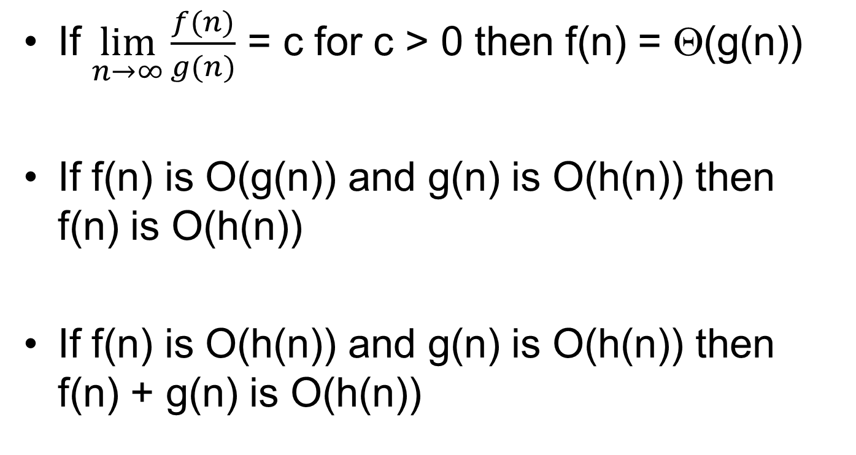
Useful Theorems
If $\lim_{n→∞}{\frac{f(n)}{g(n)}}$ = c for c > 0 then f(n) = Θ(g(n))
If f(n) is O(g(n)) and g(n) is O(h(n)) then f(n) is O(h(n))
If f(n) is O(h(n)) and g(n) is O(h(n)) then f(n) + g(n) is O(h(n))

Slide 19
Ordering growth rates
For b > 1 and x > 0
log^{b}n is O(n^{x})
For r > 1 and d > 0
n^{d} is O(r^{n})

