Slide 1
CSE 417 Algorithms and Complexity
NP-Complete
P
Winter 2023
Lecture 26
NP-Completeness and Beyond

Slide 2
Announcements
Final Exam: Monday, March 13, 8:30 AM
CSE2 G10, 1 hour 50 minutes, Closed Book
Comprehensive (but roughly 2/3rds post midterm)
Topics will include: recurrences, dynamic programming, graph algorithms, NP-Completeness
Fri, March 3 | NP-Completeness: Overview, Definitions
Mon, March 6 | NP-Completeness: Reductions
Wed, March 8 | NP-Completeness: Problem Survey
Fri, March 10 | Theory and Beyond NP-Completeness
Mon, March 13 | Final Exam

Slide 3
NP-Completeness Proofs
Prove that problem X is NP-Complete
Show that X is in NP (usually easy)
Pick a known NP complete problem Y
Show Y <_{P} X

Slide 4
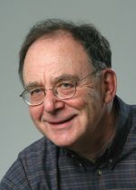
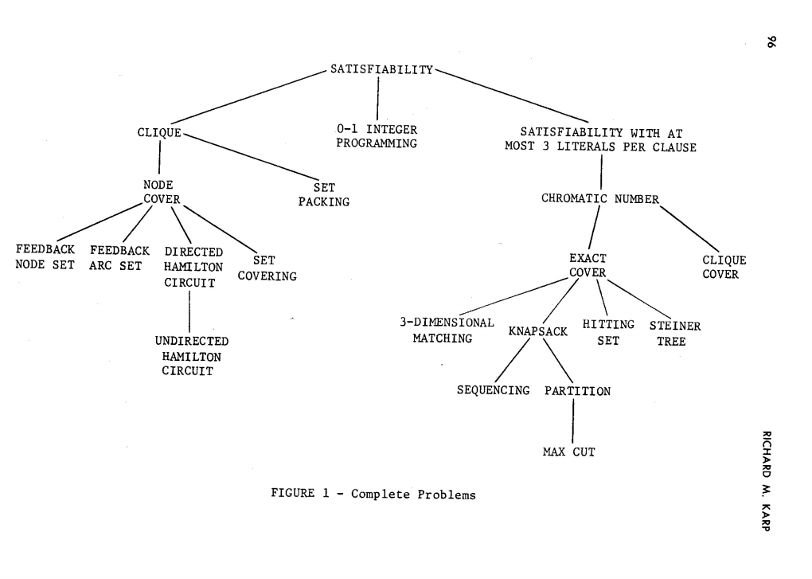
Reducibility Among Combinatorial Problems

Slide 5
Populating the NP-Completeness Universe
NP-Complete
Circuit Sat <_{P} 3-SAT
3-SAT <_{P} Independent Set
3-SAT <_{P} Vertex Cover
Independent Set <_{P} Clique
3-SAT <_{P} Hamiltonian Circuit
Hamiltonian Circuit <_{P} Traveling Salesman
3-SAT <_{P} Integer Linear Programming
3-SAT <_{P} Graph Coloring
3-SAT <_{P} Subset Sum
Subset Sum <_{P} Scheduling with Release times and deadlines
NP
P

Slide 6
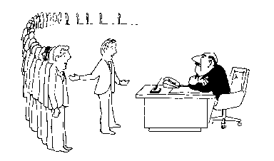
Coping with NP-Completeness
Approximation Algorithms
Exact solution via Branch and Bound
Local Search
I can’t find an efficient algorithm, but neither can all these famous people.

Slide 7
Multiprocessor Scheduling
Unit execution tasks
Precedence graph
K-Processors
Polynomial time for k=2
Open for k = constant
NP-complete is k is part of the problem

Slide 8
Highest level first is 2-Optimal
Choose k items on the highest level
Claim: number of rounds is at least twice the optimal.

Slide 9
Christofides TSP Algorithm
Undirected graph satisfying triangle inequality
Find MST
Add additional edges so that all vertices have even degree
Build Eulerian Tour
4
3
4
1
2
5
5
3/2 Approximation
3
6
4
3
4
3
2
5
6

Slide 10
Christofides Algorithm
4
3
4
3
4
1
4
1
2
2
5
5
5
3
5
3
6
6
4
4
3
3
4
3
4
3
2
2
5
6
5
6
3
4
1
2
5
3
4
4
3
2
6

Slide 11
Branch and Bound
Brute force search – tree of all possible solutions
Branch and bound – compute a lower bound on all possible extensions
Prune sub-trees that cannot be better than optimal

Slide 12
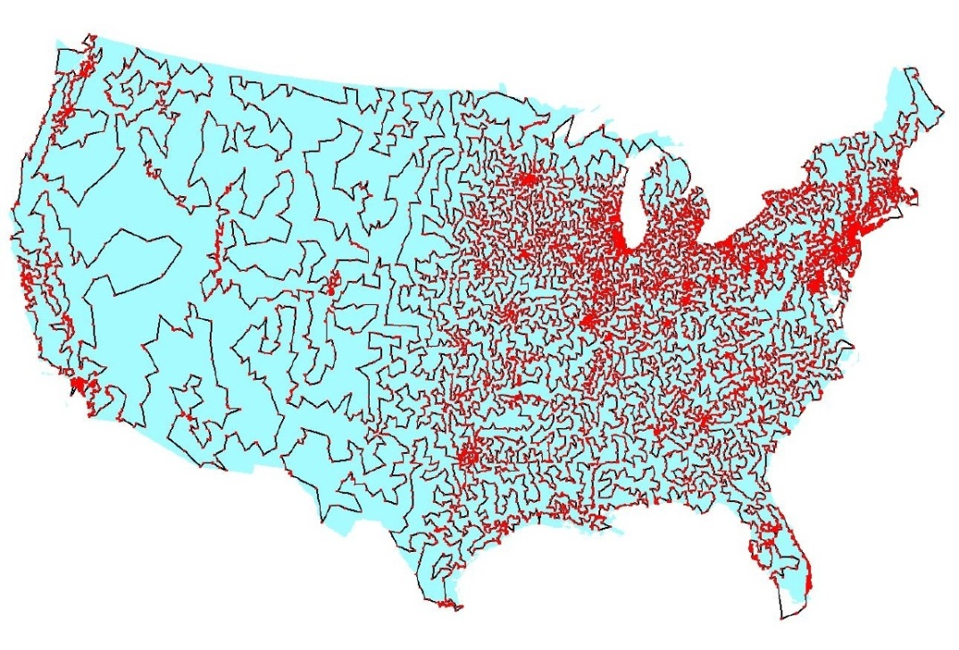
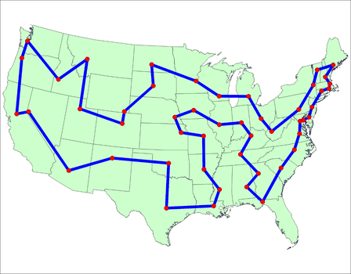
Branch and Bound for TSP
Enumerate all possible paths
Lower bound, Current path cost plus MST of remaining points
Euclidean TSP
Points on the plane with Euclidean Distance
Sample data set: State Capitals

Slide 13
Local Optimization
Improve an optimization problem by local improvement
Neighborhood structure on solutions
Travelling Salesman 2-Opt (or K-Opt)
Independent Set Local Replacement

Slide 14
What we don’t know
P vs. NP
NP-Complete
P = NP
P

Slide 15
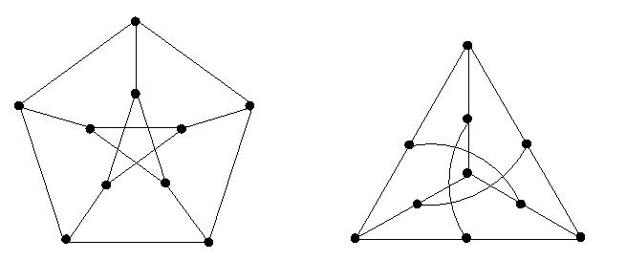
If P ≠ NP, is there anything in between
Yes, Ladner [1975]
Problems not known to be in P or NP Complete
Factorization
Discrete Log
Graph Isomorphism
Solve g^{k} = b over a finite group

Slide 16
Complexity Theory
Computational requirements to recognize languages
Models of Computation
Resources
Hierarchies
All Languages
Decidable Languages
Context Free Languages
Regular Languages

Slide 17
Time complexity
P: (Deterministic) Polynomial Time
NP: Non-deterministic Polynomial Time
EXP: Exponential Time

Slide 18
Space Complexity
Amount of Space (Exclusive of Input)
L: Logspace, problems that can be solved in O(log n) space for input of size n
Related to Parallel Complexity
PSPACE, problems that can be required in a polynomial amount of space

Slide 19
So what is beyond NP?

Slide 20
NP vs. Co-NP
Given a Boolean formula, is it true for some choice of inputs
Given a Boolean formula, is it true for all choices of inputs

Slide 21
Problems beyond NP
Exact TSP, Given a graph with edge lengths and an integer K, does the minimum tour have length K
Minimum circuit, Given a circuit C, is it true that there is no smaller circuit that computes the same function a C

Slide 22
Polynomial Hierarchy
Level 1
∃X₁ Φ(X₁), ∀X₁ Φ(X₁)
Level 2
∀X₁∃X₂ Φ(X₁,X₂), ∃X₁∀X₂ Φ(X₁,X₂)
Level 3
∀X₁∃X₂∀X₃ Φ(X₁,X₂,X₃), ∃X₁∀X₂∃X₃ Φ(X₁,X₂,X₃)

Slide 23
Polynomial Space
Quantified Boolean Expressions
∃X₁∀X₂∃X₃...∃X_{n-1}∀X_{n} Φ(X₁,X₂,X₃…X_{n-1}X_{n})
Space bounded games
Competitive Facility Location Problem
N x N Chess
Counting problems
The number of Hamiltonian Circuits
PSpace-Complete
Log Space
P

Slide 24
N X N Chess

Slide 25
Even Harder Problems
public int[] RecolorSwap(int[] coloring) {
int k = maxColor(coloring);
for (int v = 0; v < nVertices; v++) {
if (coloring[v] == k) {
int[] nbdColorCount = ColorCount(v, k, coloring);
List<Edge> edges1 = vertices[v].Edges;
foreach (Edge e1 in edges1) {
int w = e1.Head;
if (nbdColorCount[coloring[w]] == 1)
if (RecolorSwap(v, w, k, coloring))
break;
}
}
}
return coloring;
}
Is this code correct?

Slide 26
Halting Problem
Given a program P that does not take any inputs, does P eventually exit?

Slide 27
Impossibility of solving the Halting Problem
Suppose Halt(P) returns true if P halts, and false otherwise
Consider the program G:
What is Halt(G)?
Define G {
if (Halt(G)){
while (true) ;
}
else {
exit();
}
}

Slide 28
Undecidable Problems
The Halting Problem is undecidable
Impossible problems are hard . . .

