Slide 1
CSE 417 Algorithms and Complexity
Winter 2023
Lecture 21
Longest Common Subsequence

Slide 2
Announcements
Lecture plans
Monday: Longest Common Subsequence
Wednesday: Shortest Paths
Rest of the course: NP-Completeness

Slide 3
Longest Common Subsequence
C=c₁…c_{g} is a subsequence of A=a₁…a_{m} if C can be obtained by removing elements from A (but retaining order)
LCS(A, B): A maximum length sequence that is a subsequence of both A and B
ocurranec
occurrence
attacggct
tacgacca

Slide 4
Determine the LCS of the following strings
BARTHOLEMEWSIMPSON
KRUSTYTHECLOWN

Slide 5
String Alignment Problem
Align sequences with gaps
Charge δ_{x} if character x is unmatched
Charge γ_{xy} if character x is matched to character y
CAT TGA AT
CAGAT AGGA
Note: the problem is often expressed as a minimization problem,
with γ_{xx} = 0 and δ_{x} > 0

Slide 6
Recursive Version
LCS(a₁a₂…a_{m}, b₁b₂…b_{n}){
if (a_{m} == b_{n})
return LCS(a₁a₂…a_{m-1}, b₁b₂…b_{n-1}) + 1;
else
return max(LCS(a₁a₂…a_{m-1}, b₁b₂…b_{n}),
LCS(a₁a₂…a_{m}, b₁b₂…b_{n-1});
}

Slide 7
LCS Optimization
A = a₁a₂…a_{m}
B = b₁b₂…b_{n}
Opt[ j, k] is the length of LCS(a₁a₂…a_{j}, b₁b₂…b_{k})

Slide 8
Optimization recurrence
If a_{j} = b_{k}, Opt[ j,k ] = 1 + Opt[ j-1, k-1 ]
If a_{j} ≠ b_{k}, Opt[ j,k] = max(Opt[ j-1,k], Opt[ j,k-1])

Slide 9
Give the Optimization Recurrence for the String Alignment Problem
Charge δ_{x} if character x is unmatched
Charge γ_{xy} if character x is matched to character y
Opt[ j, k] =
Let a_{j} = x and b_{k} = y
Express as minimization
Opt[j,k] = max(γ_{xy} + Opt[j-1,k-1], δ_{x} + Opt[j-1, k], δ_{y} + Opt[j, k-1])

Slide 10
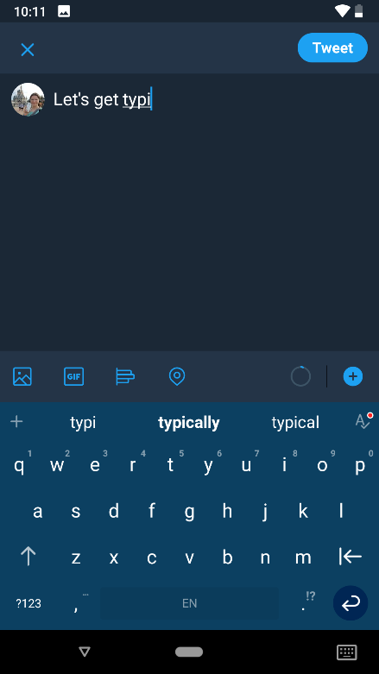
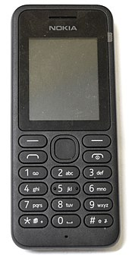
String edit with Typo Distance
Find closest dictionary word to typed word
Dist(‘a’, ‘s’) = 1
Dist(‘a’, ‘u’) = 6
Capture the likelihood of mistyping characters

Slide 11
Dynamic Programming Computation

Slide 12
Code to compute Opt[ n, m]
for (int i = 0; i < n; i++)
for (int j = 0; j < m; j++)
if (A[ i ] == B[ j ] )
Opt[ i,j ] = Opt[ i-1, j-1 ] + 1;
else if (Opt[ i-1, j ] >= Opt[ i, j-1 ])
Opt[ i, j ] := Opt[ i-1, j ];
else
Opt[ i, j ] := Opt[ i, j-1];

Slide 13
Storing the path information
A[1..m], B[1..n]
for i := 1 to m Opt[i, 0] := 0;
for j := 1 to n Opt[0,j] := 0;
Opt[0,0] := 0;
for i := 1 to m
for j := 1 to n
if A[i] = B[j] { Opt[i,j] := 1 + Opt[i-1,j-1]; Best[i,j] := Diag; }
else if Opt[i-1, j] >= Opt[i, j-1]
{ Opt[i, j] := Opt[i-1, j], Best[i,j] := Left; }
else { Opt[i, j] := Opt[i, j-1], Best[i,j] := Down; }
b₁…b_{n}
a₁…a_{m}

Slide 14
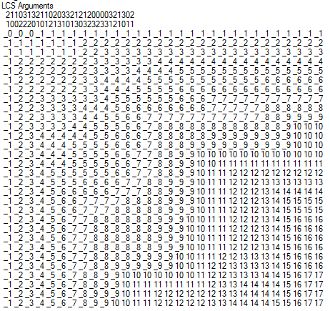
Reconstructing Path from Distances

Slide 15
How good is this algorithm?
Is it feasible to compute the LCS of two strings of length 300,000 on a standard desktop PC? Why or why not.

Slide 16
Implementation 1
public int ComputeLCS() {
int n = str1.Length;
int m = str2.Length;
int[,] opt = new int[n + 1, m + 1];
for (int i = 0; i <= n; i++)
opt[i, 0] = 0;
for (int j = 0; j <= m; j++)
opt[0, j] = 0;
for (int i = 1; i <= n; i++)
for (int j = 1; j <= m; j++)
if (str1[i-1] == str2[j-1])
opt[i, j] = opt[i - 1, j - 1] + 1;
else if (opt[i - 1, j] >= opt[i, j - 1])
opt[i, j] = opt[i - 1, j];
else
opt[i, j] = opt[i, j - 1];
return opt[n,m];
}

Slide 17
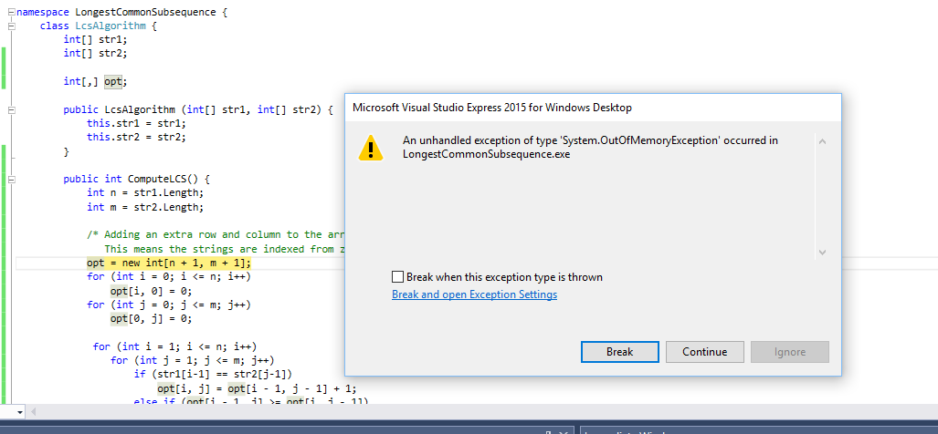
N = 17000
Runtime should be about 5 seconds*
* Personal PC, 10 years old

Slide 18
Implementation 2
public int SpaceEfficientLCS() {
int n = str1.Length;
int m = str2.Length;
int[] prevRow = new int[m + 1];
int[] currRow = new int[m + 1];
for (int j = 0; j <= m; j++)
prevRow[j] = 0;
for (int i = 1; i <= n; i++) {
currRow[0] = 0;
for (int j = 1; j <= m; j++) {
if (str1[i - 1] == str2[j - 1])
currRow[j] = prevRow[j - 1] + 1;
else if (prevRow[j] >= currRow[j - 1])
currRow[j] = prevRow[j];
else
currRow[j] = currRow[j - 1];
}
for (int j = 1; j <= m; j++)
prevRow[j] = currRow[j];
}
return currRow[m];
}

Slide 19
N = 300000
N: 10000 Base 2 Length: 8096 Gamma: 0.8096 Runtime:00:00:01.86
N: 20000 Base 2 Length: 16231 Gamma: 0.81155 Runtime:00:00:07.45
N: 30000 Base 2 Length: 24317 Gamma: 0.8105667 Runtime:00:00:16.82
N: 40000 Base 2 Length: 32510 Gamma: 0.81275 Runtime:00:00:29.84
N: 50000 Base 2 Length: 40563 Gamma: 0.81126 Runtime:00:00:46.78
N: 60000 Base 2 Length: 48700 Gamma: 0.8116667 Runtime:00:01:08.06
N: 70000 Base 2 Length: 56824 Gamma: 0.8117715 Runtime:00:01:33.36
N: 300000 Base 2 Length: 243605 Gamma: 0.8120167 Runtime:00:28:07.32

Slide 20
Observations about the Algorithm
The computation can be done in O(m+n) space if we only need one column of the Opt values or Best Values
The computation requires O(nm) space if we store all of the string information

Slide 21
Computing LCS in O(nm) time and O(n+m) space
Divide and conquer algorithm
Recomputing values used to save space
Section 6.7 of the text, but we will not have time to cover in detail (so you are not responsible for section 6.7)

Slide 22
Divide and Conquer Algorithm
Where does the best path cross the middle column?
For a fixed i, and for each j, compute the LCS that has a_{i} matched with b_{j}

Slide 23
Algorithm Analysis
T(m,n) = T(m/2, j) + T(m/2, n-j) + cnm
Solution: T(m,n) <= 2cnm

