Slide 1
CSE 417 Algorithms and Complexity
Winter 2023
Lecture 16
Divide and Conquer and Recurrences

Slide 2
Divide and Conquer
Recurrences, Sections 5.1 and 5.2
Algorithms
Median (Selection)
Fast Matrix Multiplication
Counting Inversions (5.3)
Multiplication (5.5)

Slide 3
Divide and Conquer : Merge Sort
Array MSort(Array a, int n){
if (n <= 1) return a;
return Merge(MSort(a[0 .. n/2], n/2), MSort(a[n/2+1 .. n-1], n/2);
}
T(n) = 2T(n/2) + n; T(1) = 1;

Slide 4
Unrolling the recurrence

Slide 5
A better mergesort (?)
Divide into 3 subarrays and recursively sort
Apply 3-way merge
What is the recurrence?

Slide 6
Unroll recurrence for T(n) = 3T(n/3) + n

Slide 7
T(n) = aT(n/b) + f(n)

Slide 8
T(n) = T(n/2) + cn
Where does this recurrence arise?

Slide 9
Solving the recurrence exactly

Slide 10
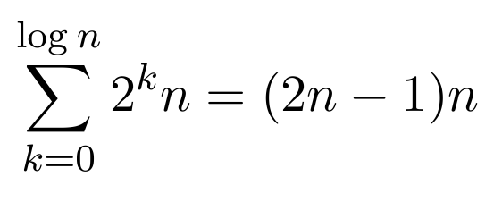
T(n) = 4T(n/2) + n
Total Work
n
n/2
n/2
n/2
n/2
n/4
n/4
n/4
n/4
n/4
n/4
n/4
n/4
n/4
n/4
n/4
n/4
n/4
n/4
n/4
n/4

Slide 11
T(n) = 2T(n/2) + n²

Slide 12
T(n) = 2T(n/2) + n^{1/2}

Slide 13
Recurrences
Three basic behaviors
Dominated by initial case
Dominated by base case
All cases equal – we care about the depth

Slide 14
What you really need to know about recurrences
Work per level changes geometrically with the level
Geometrically increasing (x > 1)
The bottom level wins
Geometrically decreasing (x < 1)
The top level wins
Balanced (x = 1)
Equal contribution

Slide 15
Classify the following recurrences (Increasing, Decreasing, Balanced)
T(n) = n + 5T(n/8)
T(n) = n + 9T(n/8)
T(n) = n² + 4T(n/2)
T(n) = n³ + 7T(n/2)
T(n) = n^{1/2} + 3T(n/4)

Slide 16
Recursive Matrix Multiplication
Multiply 2 x 2 Matrices:
| r s | | a b| |e g|
| t u | | c d| | f h|
r = ae + bf
s = ag + bh
t = ce + df
u = cg + dh
A N x N matrix can be viewed as a 2 x 2 matrix with entries that are (N/2) x (N/2) matrices.
The recursive matrix multiplication algorithm recursively multiplies the (N/2) x (N/2) matrices and combines them using the equations for multiplying 2 x 2 matrices
=

Slide 17
Recursive Matrix Multiplication
How many recursive calls are made at each level?
How much work in combining the results?
What is the recurrence?

Slide 18
What is the run time for the recursive Matrix Multiplication Algorithm?
Recurrence:

Slide 19
Strassen’s Algorithm
Where:
p₁ = (b – d)(f + h)
p₂= (a + d)(e + h)
p₃= (a – c)(e + g)
p₄= (a + b)h
p₅= a(g – h)
p₆= d(f – e)
p₇= (c + d)e
Multiply 2 x 2 Matrices:
| r s | | a b| |e g|
| t u| | c d| | f h|
=
r = p₁ + p₂ – p₄ + p₆
s = p₄ + p₅
t = p₆ + p₇
u = p₂ - p₃ + p₅ - p₇
From AHU 1974

Slide 20
Recurrence for Strassen’s Algorithms
T(n) = 7 T(n/2) + cn²
What is the runtime?
log₂ 7 = 2.8073549221

Slide 21
BFPRT Recurrence
T(n) ≤ T(3n/4) + T(n/5) + 20 n
What bound do you expect?

