Slide 1
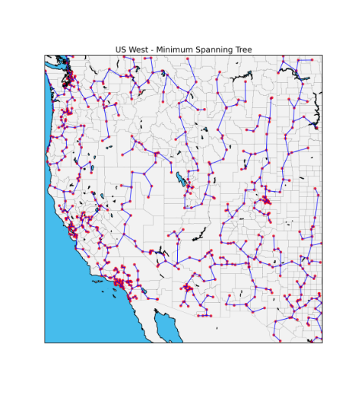
CSE 417 Algorithms and Complexity
Winter 2023
Lecture 13
Minimum Spanning Trees

Slide 2
Announcements
Midterm, Wednesday, Feb 8
Topics: Material Presented in Lecture
Stable Matching
Graphs and simple graph algorithms
Breadth First Search
Topological Sort
Greedy Algorithms
Interval Scheduling Problems
Shortest Paths Algorithms
Minimum Spanning Tree Algorithms

Slide 3
Minimum Spanning Tree
15
t
a
6
9
14
3
4
e
10
13
c
s
21
20
15
17
2
7
g
b
8
u
f
22
1
12
16
v

Slide 4
Greedy Algorithms for Minimum Spanning Tree
Prim’s Algorithm: Extend a tree by including the cheapest out going edge
Kruskal’s Algorithm: Add the cheapest edge that joins disjoint components
4
b
c
20
5
11
8
a
d
7
22
e

Slide 5
Greedy Algorithm 1 Prim’s Algorithm
Extend a tree by including the cheapest out going edge
15
t
a
6
14
3
9
4
e
10
13
c
s
11
20
5
Construct the MST with Prim’s algorithm starting from vertex a
Label the edges in order of insertion
17
2
7
g
b
8
u
f
22
1
12
16
v

Slide 6
Greedy Algorithm 2 Kruskal’s Algorithm
Add the cheapest edge that joins disjoint components
15
t
a
6
14
3
9
4
e
10
13
c
s
11
20
5
17
2
7
Construct the MST with Kruskal’s algorithm
Label the edges in order of insertion
g
b
8
u
f
22
1
12
16
v

Slide 7
Why do the greedy algorithms work?
For simplicity, assume all edge costs are distinct

Slide 8
Edge inclusion lemma
Let S be a subset of V, and suppose e = (u, v) is the minimum cost edge of E, with u in S and v in V-S
e is in every minimum spanning tree of G
Or equivalently, if e is not in T, then T is not a minimum spanning tree
e
S
V - S

Slide 9
Proof
e is the minimum cost edge between S and V-S
Suppose T is a spanning tree that does not contain e
Add e to T, this creates a cycle
The cycle must have some edge e₁ = (u₁, v₁) with u₁ in S and v₁ in V-S
T₁ = T – {e₁} + {e} is a spanning tree with lower cost
Hence, T is not a minimum spanning tree
e₁
S
V - S
e

Slide 10
Optimality Proofs
Prim’s Algorithm computes a MST
Kruskal’s Algorithm computes a MST
Show that when an edge is added to the MST by Prim or Kruskal, the edge is the minimum cost edge between S and V-S for some set S.

Slide 11
Prim’s Algorithm
S = { }; T = { };
while S != V
choose the minimum cost edge e = (u,v), with u in S, and v in V-S
add e to T
add v to S

Slide 12
Prove Prim’s algorithm computes an MST
Show an edge e is in the MST when it is added to T

Slide 13
Kruskal’s Algorithm
Let C = {{v₁}, {v₂}, . . ., {v_{n}}}; T = { }
while |C| > 1
Let e = (u, v) with u in C_{i} and v in C_{j} be the minimum cost edge joining distinct sets in C
Replace C_{i} and C_{j} by C_{i} U C_{j}
Add e to T

Slide 14
Prove Kruskal’s algorithm computes an MST
Show an edge e is in the MST when it is added to T

Slide 15
MST Implementation and runtime
Prim’s Algorithm
Implementation, runtime: just like Dijkstra’s algorithm
Use a heap, runtime O(m log n)
Kruskal’s Algorithm
Sorting edges by cost: O(m log n)
Managing connected components uses the Union-Find data structure
Amazing, pointer based data structure
Very interesting mathematical result

Slide 16
Disjoint Set ADT
Data: set of pairwise disjoint sets.
Required operations
Union – merge two sets to create their union
Find – determine which set an item appears in
Check Find(v) ≠ Find(w) to determine if (v,w) joins separate components
Do Union(v,w) to merge sets
16

Slide 17
Up-Tree for DS Union/Find
Observation: we will only traverse these trees upward from any given node to find the root.
Idea: reverse the pointers (make them point up from child to parent). The result is an up-tree.
Initial state
1
2
3
4
5
6
7
Intermediate
state
1
3
7
2
5
4
Roots are the names of each set.
6

Slide 18
Application: Clustering
Given a collection of points in an r- dimensional space and an integer K, divide the points into K sets that are closest together

Slide 19
Distance clustering
Divide the data set into K subsets to maximize the distance between any pair of sets
dist (S₁, S₂) = min {dist(x, y) | x in S₁, y in S₂}

Slide 20
Divide into 2 clusters

Slide 21
Divide into 3 clusters

Slide 22
Divide into 4 clusters

Slide 23
Distance Clustering Algorithm
Let C = {{v₁}, {v₂},. . ., {v_{n}}}; T = { }
while |C| > K
Let e = (u, v) with u in C_{i} and v in C_{j} be the minimum cost edge joining distinct sets in C
Replace C_{i} and C_{j} by C_{i} U C_{j}

Slide 24
K-clustering

Slide 25
Shortest paths in directed graphs vs undirected graphs
2
d
2
d
a
1
a
1
4
5
4
5
4
4
4
e
4
e
1
c
1
c
s
2
s
2
3
3
3
3
2
2
6
g
6
g
b
b
7
3
7
3
f
f

Slide 26
What about the minimum spanning tree of a directed graph?
Must specify the root r
Branching: Out tree with root r
2
d
2
d
1
a
1
a
5
4
5
4
4
4
4
4
e
e
1
1
c
c
r
2
r
2
3
3
3
3
2
2
6
g
6
g
b
b
3
7
3
7
f
f
Assume all vertices reachable from r
Also called an arborescence

Slide 27
Finding a minimum branching
r
r
10
2
10
2
1
4
4
2
2
2
2
8
4
4

Slide 28
Another MST Algorithm
Choose minimum cost edge into each vertex
Merge into components
Repeat until done
15
t
a
6
9
14
3
4
e
10
13
c
s
11
20
5
17
2
7
g
b
8
u
f
22
1
12
16
v

Slide 29
Idea for branching algorithm
Select minimum cost edge going into each vertex
If graph is a branching then done
Otherwise collapse cycles and repeat
r

