Slide 1
CSE 417 Algorithms and Complexity
Autumn 2023
Lecture 14
Finishing Minimum Spanning Trees

Slide 2
Announcements
Midterm, Monday, October 30
Closed book, closed notes, no calculators
Time limit: 50 minutes
Answer the problems on the exam paper.
If you need extra space use the overflow page (and the back of a page if necessary)
Problems are not of equal difficulty, if you get stuck on a problem, move on.
``Justify your answer'' means give a short and convincing explanation. Depending on the situation, justifications can involve counter examples, or cite results established in the text or in lecture.
Homework 5, Available, Due November 3
Homework 5 is OPTIONAL

Slide 3
Minimum Spanning Tree
15
t
a
6
9
14
3
4
e
10
13
c
s
21
20
15
17
2
7
g
b
8
u
f
22
1
12
16
v

Slide 4
Greedy Algorithms for Minimum Spanning Tree
Prim’s Algorithm: Extend a tree by including the cheapest out going edge
Kruskal’s Algorithm: Add the cheapest edge that joins disjoint components
4
b
c
20
5
11
8
a
d
7
22
e

Slide 5
Application: Clustering
Given a collection of points in an r- dimensional space and an integer K, divide the points into K sets that are closest together

Slide 6
Distance clustering
Divide the data set into K subsets to maximize the distance between any pair of sets
dist (S₁, S₂) = min {dist(x, y) | x in S₁, y in S₂}

Slide 7
Divide into 2 clusters

Slide 8
Divide into 3 clusters

Slide 9
Divide into 4 clusters

Slide 10
Distance Clustering Algorithm
Let C = {{v₁}, {v₂},. . ., {v_{n}}}; T = { }
while |C| > K
Let e = (u, v) with u in C_{i} and v in C_{j} be the minimum cost edge joining distinct sets in C
Replace C_{i} and C_{j} by C_{i} U C_{j}

Slide 11
K-clustering

Slide 12
Shortest paths in directed graphs vs undirected graphs
2
d
2
d
a
1
a
1
4
5
4
5
4
4
4
e
4
e
1
c
1
c
s
2
s
2
3
3
3
3
2
2
6
g
6
g
b
b
7
3
7
3
f
f

Slide 13
What about the minimum spanning tree of a directed graph?
Must specify the root r
Branching: Out tree with root r
2
d
2
d
1
a
1
a
5
4
5
4
4
4
4
4
e
e
1
1
c
c
r
2
r
2
3
3
3
3
2
2
6
g
6
g
b
b
3
7
3
7
f
f
Assume all vertices reachable from r
Also called an arborescence

Slide 14
Finding a minimum branching
r
r
10
2
10
2
1
4
4
2
2
2
2
8
4
4

Slide 15
Another MST Algorithm
Choose minimum cost edge into each vertex
Merge into components
Repeat until done
15
t
a
6
9
14
3
4
e
10
13
c
s
11
20
5
17
2
7
g
b
8
u
f
22
1
12
16
v

Slide 16
Idea for branching algorithm
Select minimum cost edge going into each vertex
If graph is a branching then done
Otherwise collapse cycles and repeat
r

Slide 17
Homework 5: Create a program for coloring random graphs
Optional – this assignment is Just for fun!
Problem 1: Generate Random Graphs
Problem 2: Greedy coloring algorithm – first available color
Problem 3: Low degree first and high degree first heuristics
Problem 4: Can you find a better coloring algorithm

Slide 18
Random Graphs
What is a random graph?
Choose edges at random
Interesting model of certain phenomena
Mathematical study
Useful inputs for graph algorithms

Slide 19
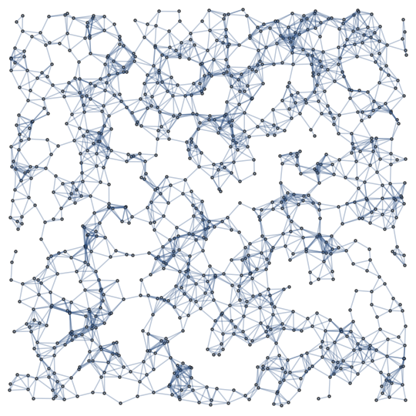
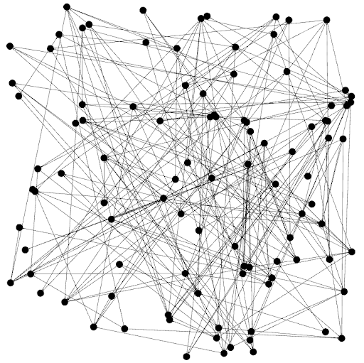
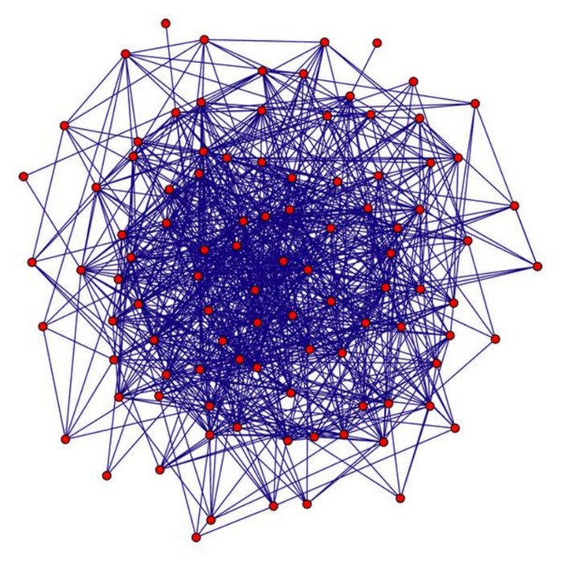
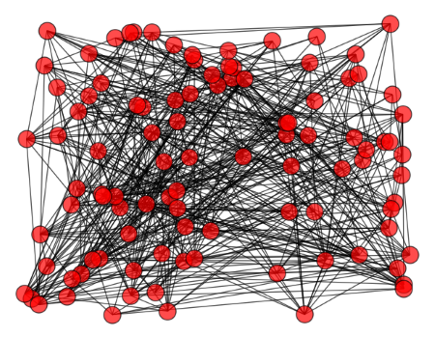

Slide 20
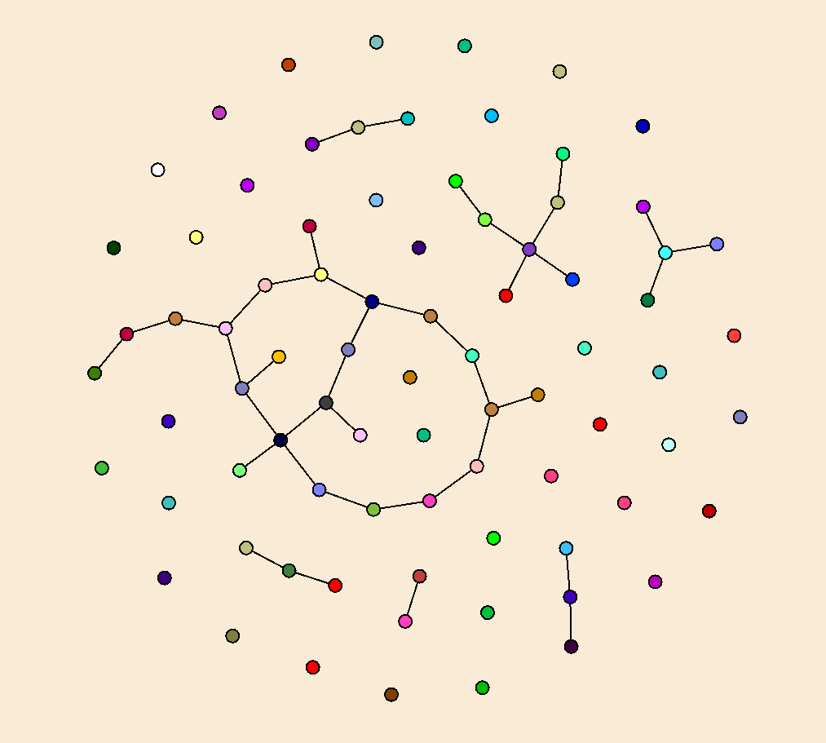
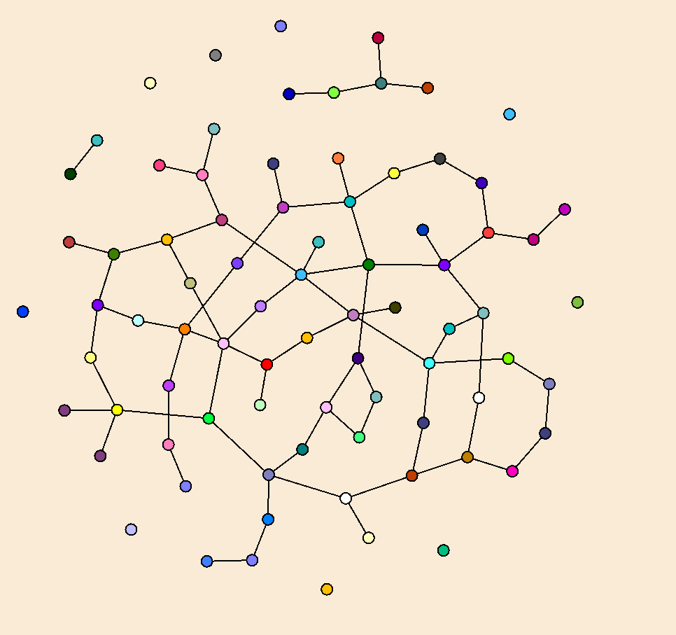
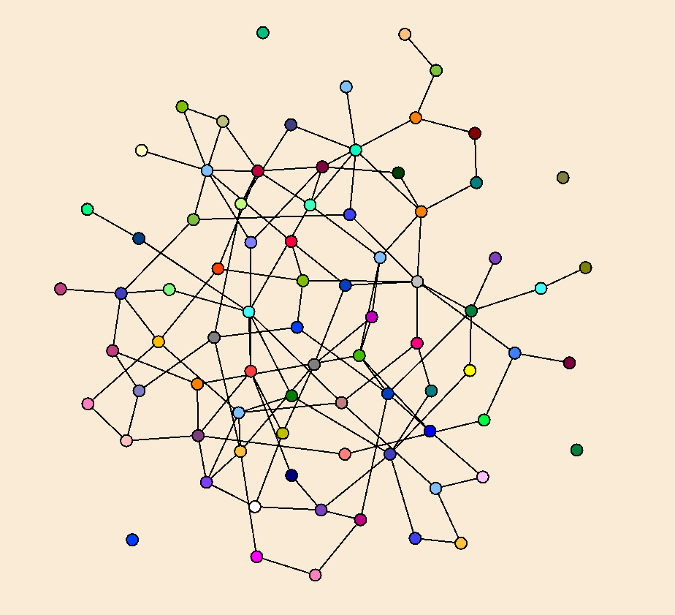
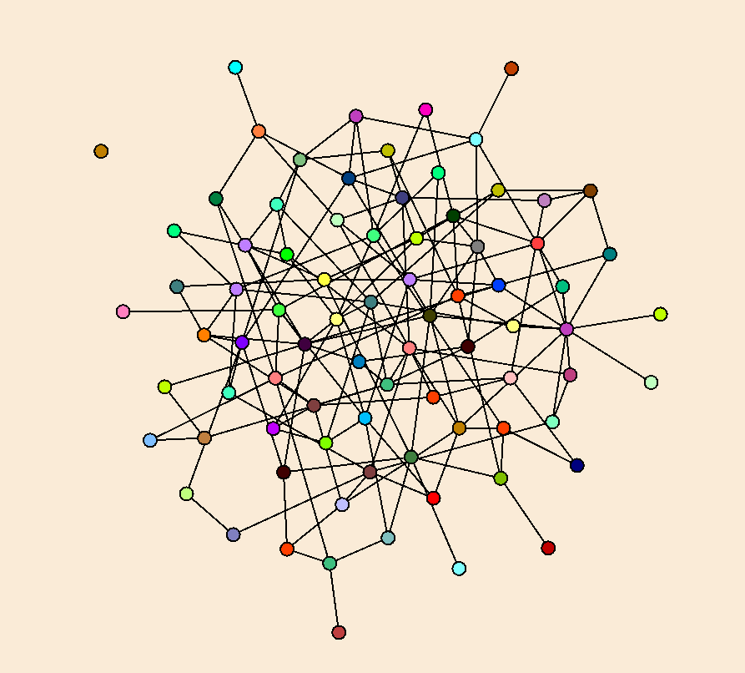

Slide 21
Model of Random Graphs
Undirected Graphs
Random Graph with n vertices and m edges, G_{m}
Random Graph with n vertices where each edge has probability p, G_{p}
Models are similar when p = 2m / (n * (n – 1))
for (int i = 0; i < n - 1; i++)
for (int j = i + 1; j < n; j++)
if (random.NextDouble() < p)
AddEdge(i, j);

Slide 22
Coloring Random Graphs
Chromatic index of a graph G, χ(G) – minimum number of colors needed to color G
Mathematical question, given a graph g chosen at random from G_{p}(n), what is the expected value of χ(g)
Graph coloring is NP complete – suggesting that it may be hard to determine χ(g)
There is a fairly large gap between the heuristic results and the theoretical value
There are a number of ties with theoretical physics

