Slide 1
CSE 417 Algorithms and Computational Complexity
Richard Anderson
Autumn 2023
Lecture 1

Slide 2
CSE 417 Course Introduction
CSE 417, Algorithms and Computational Complexity
MWF 10:30-11:20 AM
CSE2 G10
Instructor
Richard Anderson, anderson@cs.washington.edu
Office hours:
Office hours: Monday 2-3 pm, Thursday 4-5pm, CSE2 344
Teaching Assistants
Megh Bhalerao, Tiernan Kennedy, Alex Li, Kaiyuan Liu, Sravani Nanduri, Albert Weng

Slide 3
Announcements
It’s on the course website
https://courses.cs.washington.edu/courses/cse417/23au/
Homework weekly
Usually due Fridays
HW 1, Due Friday, October 6.
It’s on the website
Homework is to be submitted electronically
Due at 11:59 pm, Fridays. Five late days.
Edstem Discussion Board

Slide 4
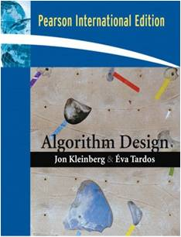
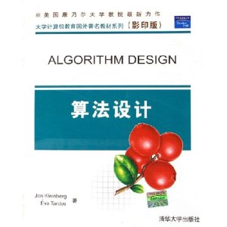
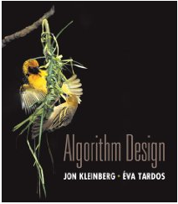
Textbook
Algorithm Design
Jon Kleinberg, Eva Tardos
Only one edition
Read Chapters 1 & 2
Expected coverage:
Chapter 1 through 7
Book available at:
UW Bookstore ($197.50/$74.99)
Ebay ($8.87 to $181.70)
Amazon ($159.99/$24.90)
Electronic ($74.99)
PDF

Slide 5
Course Mechanics
Homework
Due Fridays
Mix of written problems and programming
Target: 1-week turnaround on grading
Exams
Midterm, Monday, October 30
Final, Monday, December 11, 8:30-10:20 AM
Approximate grade weighting:
HW: 50, MT: 15, Final: 35
Course web
Slides, Handouts, Discussion Board
Canvas
Panopto videos

Slide 6
All of Computer Science is the Study of Algorithms

Slide 7
How to study algorithms
Zoology
Mine is faster than yours is
Algorithmic ideas
Where algorithms apply
What makes an algorithm work
Algorithmic thinking
Algorithm practice

Slide 8
Introductory Problem: Stable Matching
Setting:
Assign TAs to Instructors
Avoid having TAs and Instructors wanting changes
E.g., Prof A. would rather have student X than her current TA, and student X would rather work for Prof A. than his current instructor.
Purpose of the example: new, interesting problem, show how different ideas apply

Slide 9
Formal notions
Perfect matching
Ranked preference lists
Stability
m₁
w₁
m₂
w₂

Slide 10
Example (1 of 3)
m₁: w₁ w₂
m₂: w₂ w₁
w₁: m₁ m₂
w₂: m₂ m₁
m₁
w₁
m₂
w₂

Slide 11
Example (2 of 3)
m₁: w₁ w₂
m₂: w₁ w₂
w₁: m₁ m₂
w₂: m₁ m₂
m₁
w₁
m₂
w₂

Slide 12
Example (3 of 3)
m₁: w₁ w₂
m₂: w₂ w₁
w₁: m₂ m₁
w₂: m₁ m₂
m₁
w₁
m₂
w₂

Slide 13
Formal Problem
Input
Preference lists for m₁, m₂, …, m_{n}
Preference lists for w₁, w₂, …, w_{n}
Output
Perfect matching M satisfying stability property:
∀ m’, w’’, (m’, w’’) is NOT an instability
If (m’, w’) ∈ M and (m’’, w’’) ∈ M then
(m’ prefers w’ to w’’) or (w’’ prefers m’’ to m’)

Slide 14
Idea for an Algorithm
m proposes to w
If w is unmatched, w accepts
If w is matched to m₂
If w prefers m to m₂ w accepts m, dumping m₂
If w prefers m₂ to m, w rejects m
Unmatched m proposes to the highest w on its preference list that it has not already proposed to

Slide 15
Algorithm
Initially all m in M and w in W are free
While there is a free m
w highest on m’s list that m has not proposed to
if w is free, then match (m, w)
else
suppose (m₂, w) is matched
if w prefers m to m₂
unmatch (m₂, w)
match (m, w)

Slide 16
Example
m₁: w₁ w₂ w₃
m₂: w₁ w₃ w₂
m₃: w₁ w₂ w₃
w₁: m₂ m₃ m₁
w₂: m₃ m₁ m₂
w₃: m₃ m₁ m₂
m₁
w₁
m₂
w₂
m₃
w₃
Order: m₁, m₂, m₃, m₁, m₃, m₁

Slide 17
Does this work?
Does it terminate?
Is the result a stable matching?
Begin by identifying invariants and measures of progress
m’s proposals get worse (have higher m-rank)
Once w is matched, w stays matched
w’s partners get better (have lower w-rank)

Slide 18
Claim: If an m reaches the end of its list, then all the w’s are matched

Slide 19
Claim: The algorithm stops in at most n² steps
Each m asks each w at most once

Slide 20
When the algorithms halts, every w is matched
Why?
Hence, the algorithm finds a perfect matching
Invariant: partial matching
What happens when some m reaches its last choice?
exactly n-1 w’s much be matched
last choice must be available

Slide 21
The resulting matching is stable
Suppose
(m₁, w₁) ∈ M, (m₂, w₂) ∈ M
m₁ prefers w₂ to w₁
How could this happen?
m₁
w₁
m₂
w₂
m₁ proposed to w₂ before w₁
w₂ rejected m₁ for m₃
w₂ prefers m₃ to m₁
w₂ prefers m₂ to m₃

Slide 22
Result
Simple, O(n²) algorithm to compute a stable matching
Corollary
A stable matching always exists

