Slide 1
Minimum Spanning Trees and Greedy Algorithms
CSE 417 Winter 21
Lecture 28

Slide 2
Greedy Algorithms
What’s a greedy algorithm?
An algorithm that builds a solution by:
Considering objects one at a time, in some order.
Using a simple rule to decide on each object.
Never goes back and changes its mind.

Slide 3
Greedy Algorithms
Pros
Cons
Simple
Rarely correct
Often multiple equally intuitive options
Hard to prove correct
Usually need a fancy “structural result”
Or complicated proof by contradiction
Need to focus on proofs!

Slide 4
Your Takeaways
Greedy algorithms are great when they work.
But it’s hard to tell when they work – the proofs are subtle.
And you can often invent 2-3 different greedy algorithms; it’s rare that 1 works, extremely rare that all would work.
So you have to be EXTREMELY careful.
This will be a crash course in greedy algorithms.
If you have a lot of experience with proofs, I’ll be highlighting the general patterns in the proofs.
If you don’t, just appreciate the proofs are hard, and promise not to write a greedy algorithm unless someone has proven it correct.

Slide 5
Three Proof Techniques
“Structural result” – the best solution must look like this, and the algorithm produces something that looks like this.
Greedy stays ahead – at every step of the algorithm, the greedy algorithm is at least as good as anything else could be.
Exchange – Contradiction proof, suppose we swapped in an element from the (hypothetical) “better” solution.
Where to start? With some greedy algorithms you’ve already seen.
Minimum Spanning Trees!

Slide 6

Minimum Spanning Trees
It’s the 1920’s. Your friend at the electric company needs to choose where to build wires to connect all these cities to the plant.
B
6
3
E
2
1
C
A
10
9
5
7
4
D
8
She knows how much it would cost to lay electric wires between any pair of cities, and wants the cheapest way to make sure electricity from the plant to every city.

Slide 7
Minimum Spanning Trees
What do we need? A set of edges such that:
Every vertex touches at least one of the edges. (the edges span the graph)
The graph on just those edges is connected.
The minimum weight set of edges that meet those conditions.
Given: an undirected, weighted graph G
Find: A minimum-weight set of edges such that you can get from any vertex of G to any other on only those edges.
Minimum Spanning Tree Problem

Slide 8
Greedy MST algorithms
You’ve seen two algorithms for MSTs
Kruskal’s Algorithm:
Order: Sort the edges in increasing weight order
Rule: If connect new vertices (doesn’t form a cycle), add the edge.
Prim’s Algorithm:
Order: lightest weight edge that adds a new vertex to our current component
Rule: Just add it!

Slide 9
Kruskal’s Algorithm
KruskalMST(Graph G)
initialize each vertex to be its own component
sort the edges by weight
foreach(edge (u, v) in sorted order){
if(u and v are in different components){
add (u,v) to the MST
Update u and v to be in the same component
}
}

Slide 10
Try It Out
B
3
6
E
KruskalMST(Graph G)
initialize each vertex to be its own component
sort the edges by weight
foreach(edge (u, v) in sorted order){
if(u and v are in different components){
add (u,v) to the MST
Update u and v to be in the same component
}
}
2
1
C
A
10
5
9
7
4
D
F
8
Edge | Include? | Reason
(A,C)
(C,E)
(A,B)
(A,D)
(C,D)
Edge (cont.) | Inc? | Reason
(B,F)
(D,E)
(D,F)
(E,F)
(C,F)

Slide 11
Try It Out
B
3
6
E
2
KruskalMST(Graph G)
initialize each vertex to be its own component
sort the edges by weight
foreach(edge (u, v) in sorted order){
if(u and v are in different components){
add (u,v) to the MST
Update u and v to be in the same component
}
}
1
C
A
10
5
9
7
4
D
F
8
Edge | Include? | Reason
(A,C) | Yes
(C,E) | Yes
(A,B) | Yes
(A,D) | Yes
(C,D) | No | Cycle A,C,D,A
Edge (cont.) | Inc? | Reason
(B,F) | Yes
(D,E) | No | Cycle A,C,E,D,A
(D,F) | No | Cycle A,D,F,B,A
(E,F) | No | Cycle A,C,E,F,D,A
(C,F) | No | Cycle C,A,B,F,C

Slide 12
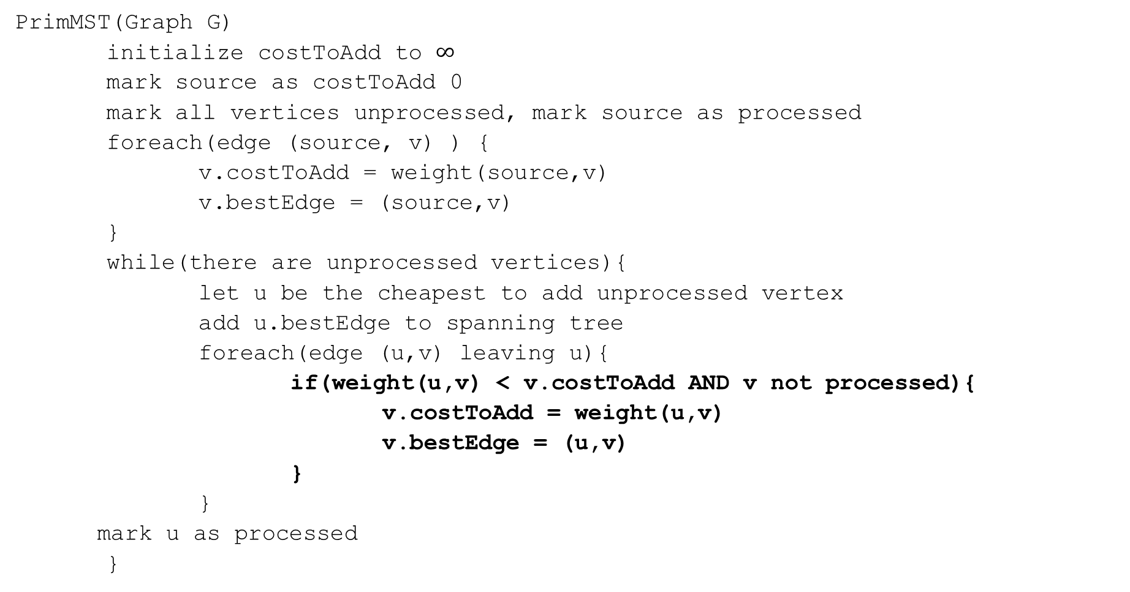
Code
PrimMST(Graph G)
initialize costToAdd to $∞$
mark source as costToAdd 0
mark all vertices unprocessed, mark source as processed
foreach(edge (source, v) ) {
v.costToAdd = weight(source,v)
v.bestEdge = (source,v)
}
while(there are unprocessed vertices){
let u be the cheapest to add unprocessed vertex
add u.bestEdge to spanning tree
foreach(edge (u,v) leaving u){
if(weight(u,v) < v.costToAdd AND v not processed){
v.costToAdd = weight(u,v)
v.bestEdge = (u,v)
}
}
mark u as processed
}

Slide 13
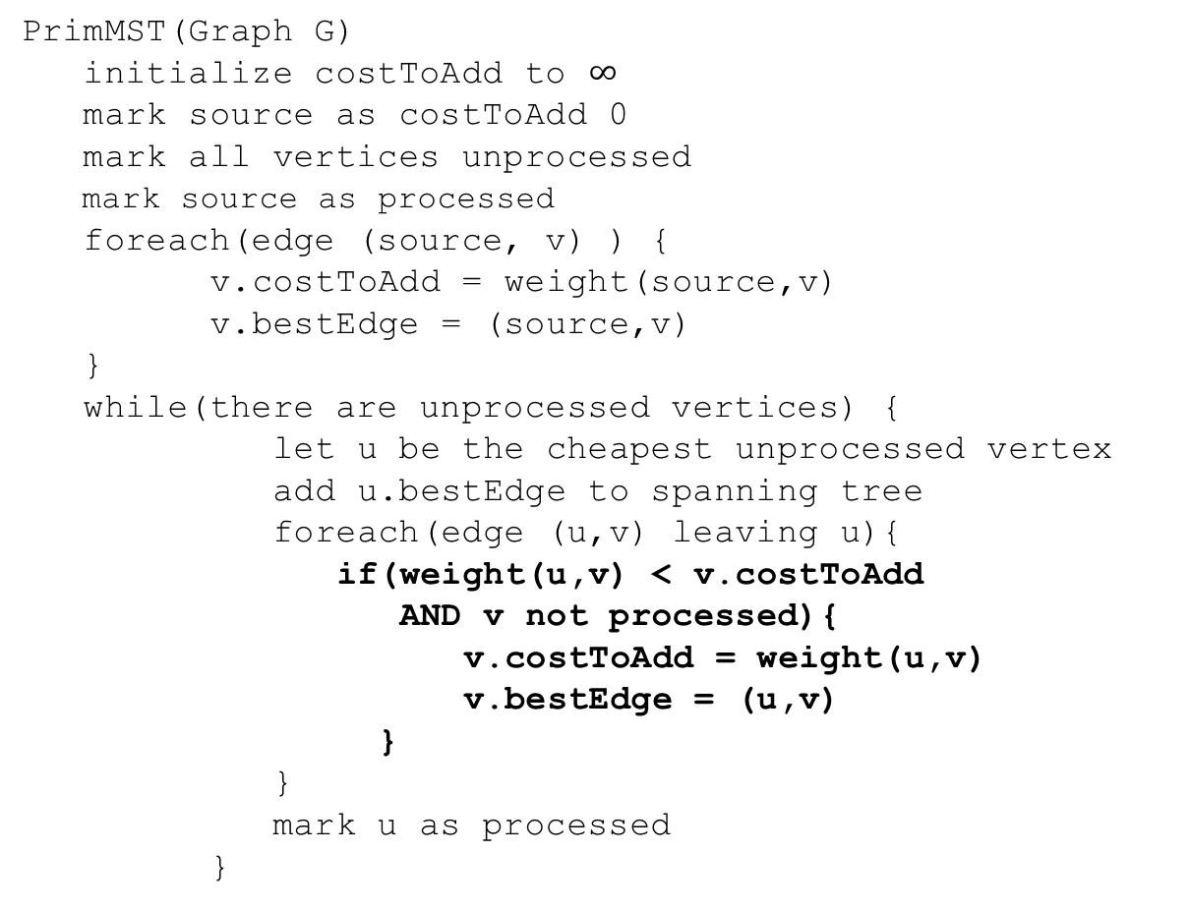
Try it Out
50
G
6
B
2
3
E
PrimMST(Graph G)
initialize costToAdd to $∞$
mark source as costToAdd 0
mark all vertices unprocessed
mark source as processed
foreach(edge (source, v) ) {
v.costToAdd = weight(source,v)
v.bestEdge = (source,v)
}
while(there are unprocessed vertices) {
let u be the cheapest unprocessed vertex
add u.bestEdge to spanning tree
foreach(edge (u,v) leaving u){
if(weight(u,v) < v.costToAdd
AND v not processed){
v.costToAdd = weight(u,v)
v.bestEdge = (u,v)
}
}
mark u as processed
}
4
C
5
A
9
2
7
7
F
D
8
Vertex | costToAdd | Best Edge | Processed
A
B
C
D
E
F
G

Slide 14
Try it Out
50
G
6
B
2
3
E
PrimMST(Graph G)
initialize costToAdd to $∞$
mark source as costToAdd 0
mark all vertices unprocessed
mark source as processed
foreach(edge (source, v) ) {
v.costToAdd = weight(source,v)
v.bestEdge = (source,v)
}
while(there are unprocessed vertices) {
let u be the cheapest unprocessed vertex
add u.bestEdge to spanning tree
foreach(edge (u,v) leaving u){
if(weight(u,v) < v.costToAdd
AND v not processed){
v.costToAdd = weight(u,v)
v.bestEdge = (u,v)
}
}
mark u as processed
}
4
C
5
A
9
2
7
7
F
D
8
Vertex | costToAdd | Best Edge | Processed
A | -- | -- | Yes
B | 2 | (A,B) | Yes
C | 4 | (A,C) | Yes
D | 7 2 | (A,D)(C,D) | Yes
E | 6 5 | (B,E)(C,E) | Yes
F | 3 | (B,F) | Yes
G | 50 | (B,G) | Yes

Slide 15
Correctness
You’re already familiar with the algorithms.
We’ll use this problem to practice the proof techniques.
We’ll do both structural and exchange

Slide 16
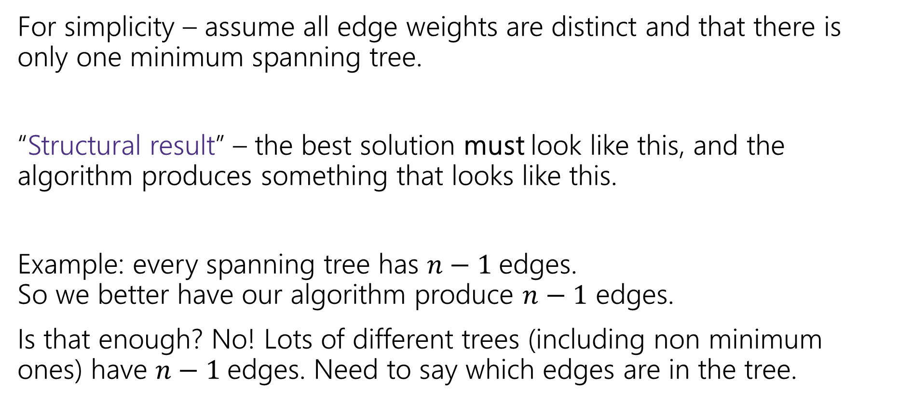
Structural Proof
For simplicity – assume all edge weights are distinct and that there is only one minimum spanning tree.
“Structural result” – the best solution must look like this, and the algorithm produces something that looks like this.
Example: every spanning tree has $n−1$edges. So we better have our algorithm produce $n−1$ edges.
Is that enough? No! Lots of different trees (including non minimum ones) have $n−1$edges. Need to say which edges are in the tree.

Slide 17


Safe Edge
A “cut” $\left(S,V∖S\right)$ is a split of the vertices into a subset $S$ and the remaining vertices $V∖S$.
Edges in red “span” or “cross” the cut (go from $S$ to $V∖S$).
50
G
6
B
2
3
E
4
5
C
A
9
2
7
7
F
D
$$S=\{A,C,D,G\}$$
8

Slide 18

Safe Edge
Call an edge, $e$, a “safe edge” if there is some cut $(S,V∖S)$ where $e$ is the minimum edge spanning that cut
(C,D) is a safe edge
50
50
G
G
6
6
B
B
2
3
E
2
3
E
4
5
5
C
4
C
A
9
A
9
2
2
7
7
7
F
7
F
D
D
8
8
(A,B) is a safe edge

Slide 19

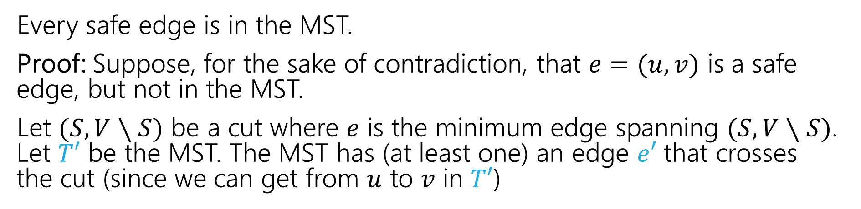



MSTs and Safe Edges
Every safe edge is in the MST.
Proof: Suppose, for the sake of contradiction, that $e=(u,v)$ is a safe edge, but not in the MST.
Let $(S,V∖S)$ be a cut where $e$ is the minimum edge spanning $(S,V∖S)$. Let $T′$ be the MST. The MST has (at least one) an edge $e′$ that crosses the cut (since we can get from $u$ to $v$ in $T′$)
$$e$$
$$V∖S$$
$$S$$
$$e′$$

Slide 20
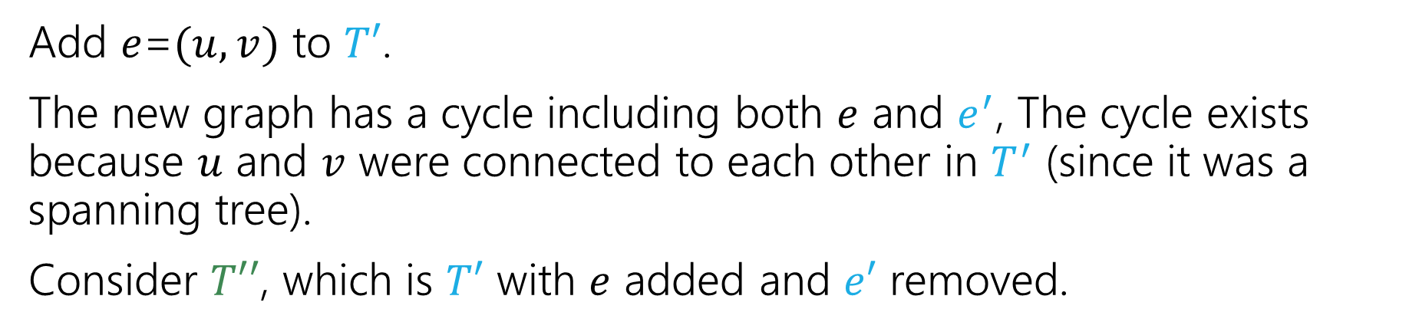
MSTs and Safe Edges
Add $e$=$(u,v)$ to $T′$.
The new graph has a cycle including both $e$ and $e^{′}$, The cycle exists because $u$ and $v$ were connected to each other in $T^{′}$ (since it was a spanning tree).
Consider $T′′$, which is $T′$ with $e$ added and $e′$ removed.
$$e$$
$$V∖S$$
$$S$$
$$e′$$

Slide 21

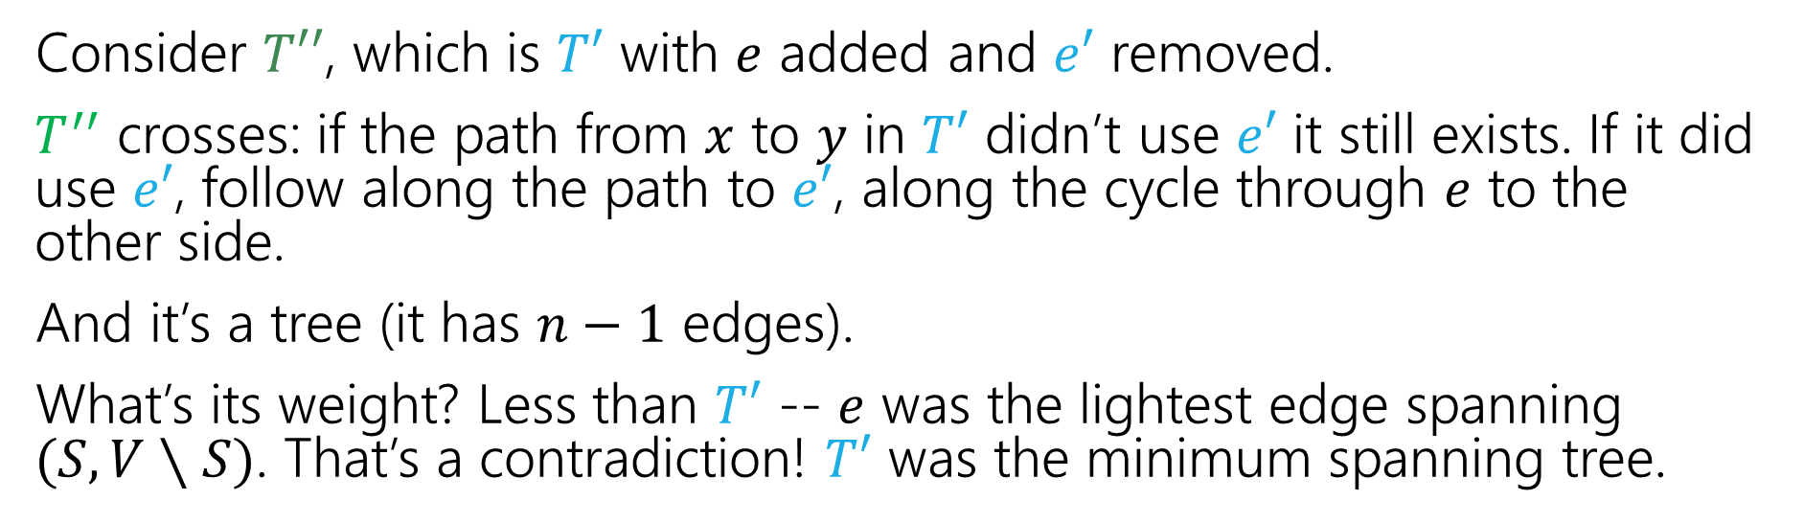



MSTs and Safe Edges
Consider $T′′$, which is $T′$ with $e$ added and $e′$ removed.
$T^{′′}$ crosses: if the path from $x$ to $y$ in $T′$ didn’t use $e′$ it still exists. If it did use $e′$, follow along the path to $e′$, along the cycle through $e$ to the other side.
And it’s a tree (it has $n−1$ edges).
What’s its weight? Less than $T′$ -- $e$ was the lightest edge spanning $(S,V∖S)$. That’s a contradiction! $T′$ was the minimum spanning tree.
$$e$$
$$V∖S$$
$$S$$
$$e′$$

Slide 22
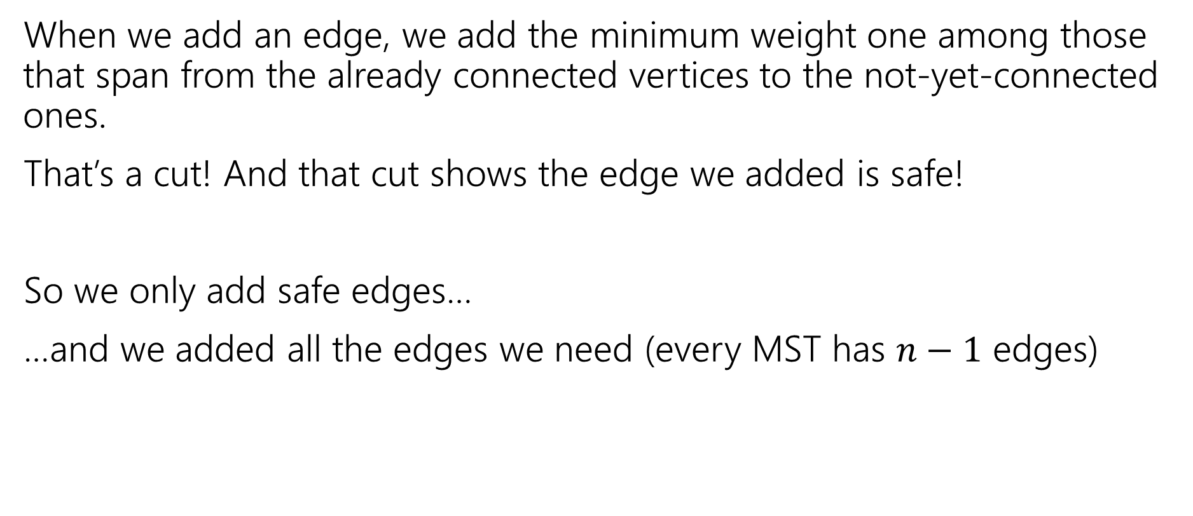
Prim’s only adds safe edges
When we add an edge, we add the minimum weight one among those that span from the already connected vertices to the not-yet-connected ones.
That’s a cut! And that cut shows the edge we added is safe!
So we only add safe edges…
…and we added all the edges we need (every MST has $n−1$ edges)

Slide 23
What about Kruskal’s?
Exchange argument:
General outline:
Suppose, you didn’t find the best one.
Suppose there’s a better MST
Then there’s something in the algorithm’s solution that doesn’t match OPT. (an edge that isn’t a safe edge/that’s heavier than it needs to be)
Swap (exchange) them, and finish the proof (arrive at a contradiction or show that your solution is equal in quality)!

Slide 24
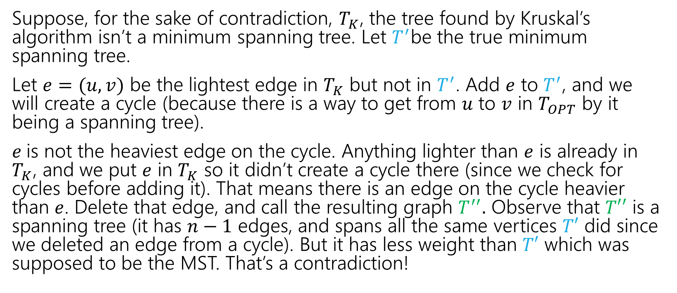
Kruskal’s Proof
Suppose, for the sake of contradiction, $T_{K}$, the tree found by Kruskal’s algorithm isn’t a minimum spanning tree. Let $T^{′}$be the true minimum spanning tree.
Let $e=(u,v)$ be the lightest edge in $T_{K}$ but not in $T^{′}$. Add $e$ to $T^{′}$, and we will create a cycle (because there is a way to get from $u$ to $v$ in $T_{OPT}$ by it being a spanning tree).
$e$is not the heaviest edge on the cycle. Anything lighter than $e$ is already in $T_{K}$, and we put $e$ in $T_{K}$ so it didn’t create a cycle there (since we check for cycles before adding it). That means there is an edge on the cycle heavier than $e$. Delete that edge, and call the resulting graph $T^{′′}.$ Observe that $T′′$ is a spanning tree (it has $n−1$ edges, and spans all the same vertices $T′$ did since we deleted an edge from a cycle). But it has less weight than $T′$ which was supposed to be the MST. That’s a contradiction!

Slide 25
Hey…Wait a minute
Those arguments were pretty similar. They both used an “exchange” idea.
The boundaries between the proof principles are a little blurry…
They’re meant to be useful for you for thinking about “where to start” with a proof, not be a beautiful taxonomy of exactly what technique is which.

Slide 26
More Greedy Problems

Slide 27
Trip Planning
Your goal is to follow a pre-set route from New York to Los Angeles.
You can drive 500 miles in a day, but you need to make sure you can stop at a hotel every night (all possibilities premarked on your map)
You’d like to stop for the fewest number of nights possible – what should you plan?
Greedy: Go as far as you can every night.
Is greedy optimal?
Or is there some reason to “stop short” that might let you go further the next night?

Slide 28
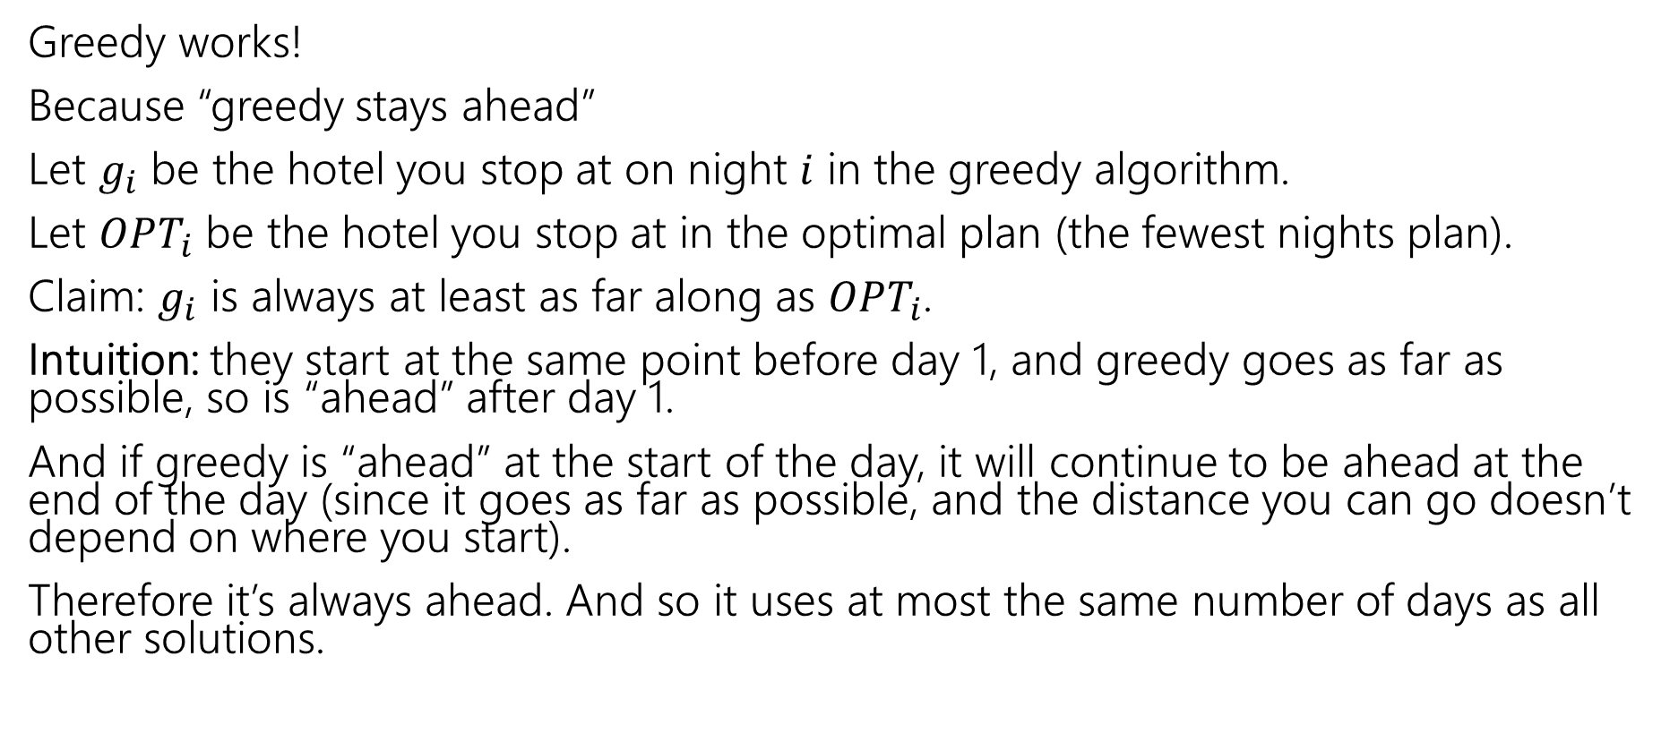
Trip Planning
Greedy works!
Because “greedy stays ahead”
Let $g_{i}$ be the hotel you stop at on night $i$ in the greedy algorithm.
Let $OPT_{i}$ be the hotel you stop at in the optimal plan (the fewest nights plan).
Claim: $g_{i}$ is always at least as far along as $OPT_{i}$.
Intuition: they start at the same point before day 1, and greedy goes as far as possible, so is “ahead” after day 1.
And if greedy is “ahead” at the start of the day, it will continue to be ahead at the end of the day (since it goes as far as possible, and the distance you can go doesn’t depend on where you start).
Therefore it’s always ahead. And so it uses at most the same number of days as all other solutions.

Slide 29
Induction
A formal version of the intuition on the last slide is a proof by induction.
The next two slides contain the formal version if you’re curious

Slide 30
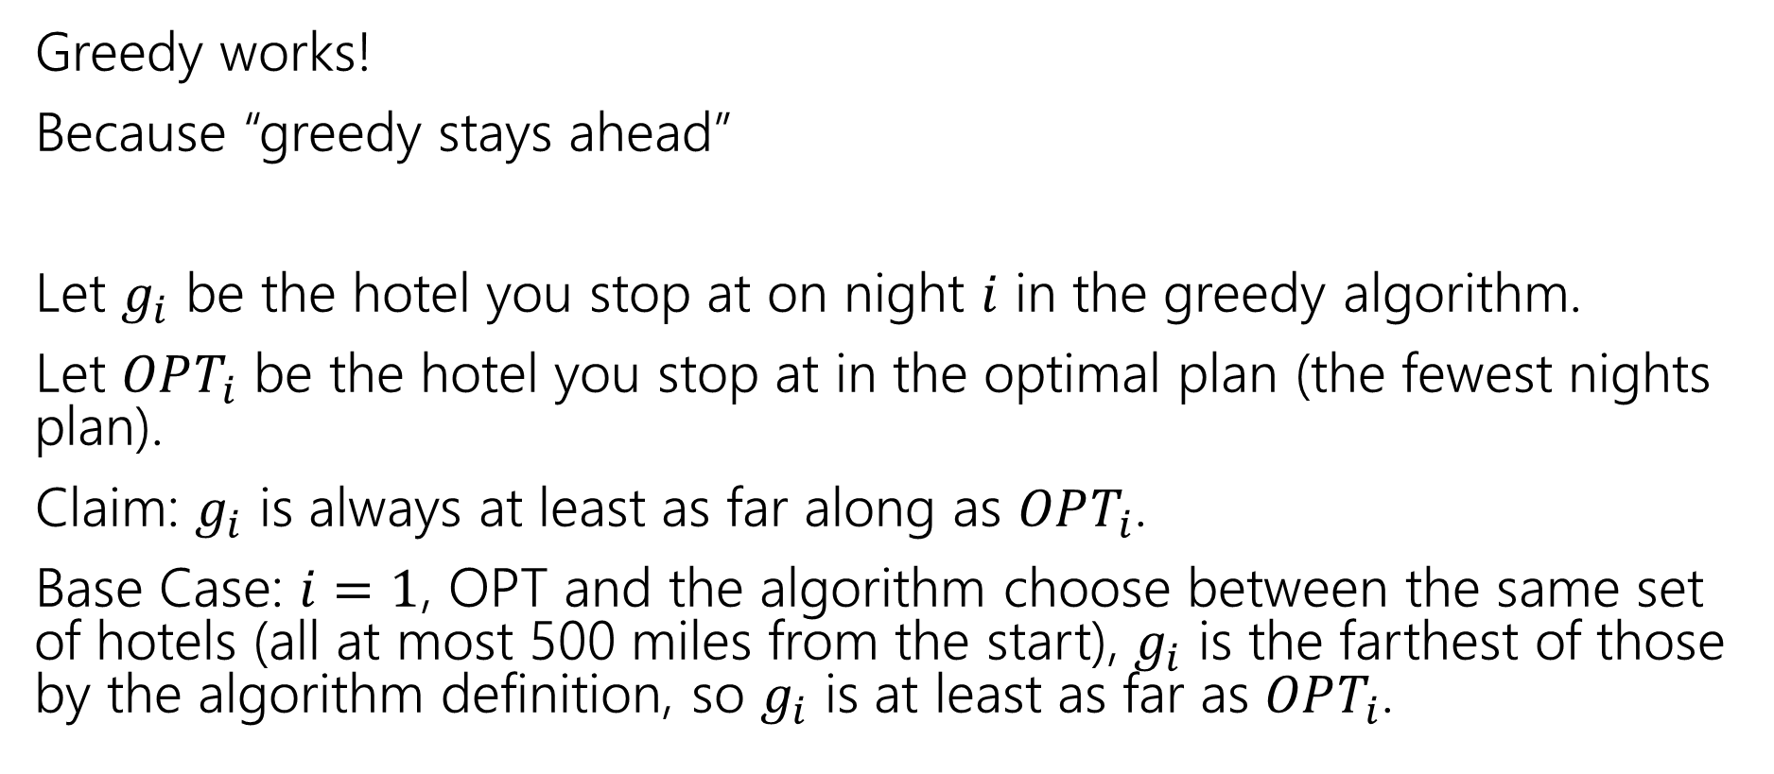
Trip Planning
Greedy works!
Because “greedy stays ahead”
Let $g_{i}$ be the hotel you stop at on night $i$ in the greedy algorithm.
Let $OPT_{i}$ be the hotel you stop at in the optimal plan (the fewest nights plan).
Claim: $g_{i}$ is always at least as far along as $OPT_{i}$.
Base Case: $i=1$, OPT and the algorithm choose between the same set of hotels (all at most 500 miles from the start), $g_{i}$ is the farthest of those by the algorithm definition, so $g_{i}$ is at least as far as $OPT_{i}$.

Slide 31
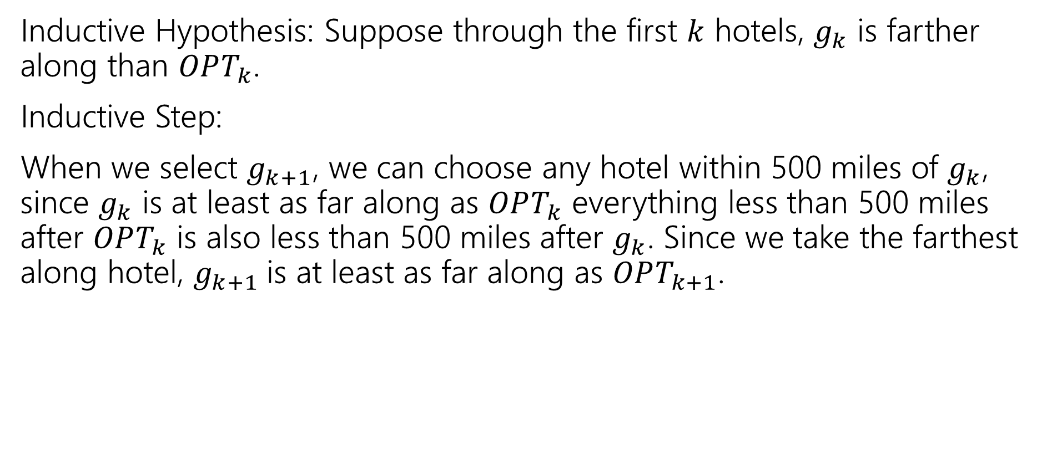
Trip Planning
Inductive Hypothesis: Suppose through the first $k$ hotels, $g_{k}$ is farther along than $OPT_{k}$.
Inductive Step:
When we select $g_{k+1}$, we can choose any hotel within 500 miles of $g_{k}$, since $g_{k}$ is at least as far along as $OPT_{k}$ everything less than 500 miles after $OPT_{k}$ is also less than 500 miles after $g_{k}$. Since we take the farthest along hotel, $g_{k+1}$is at least as far along as $OPT_{k+1}$.

Slide 32
More Greedy

Slide 33
Change-Making
Suppose you need to “make change” with the fewest number of coins possible.
Greedy algorithm:
Take the biggest coin less than the change remaining.
Is the greedy algorithm optimal if you have
1 cent coins, 10 cent coins, and 15 cent coins?

Slide 34
Change-Making
The greedy algorithm doesn’t always work!
We made you explain this on the homework problem during the DP section.
But there are times where it does
For “standard” US coinage, the greedy algorithm works
And it also always works if your coins always exactly double in value.
Another reason to be very careful with greedy algorithms!
Also a good example of how you can sometimes avoid greedy if you can’t figure out a proof – maybe there’s a way to write a DP instead!

Slide 35
Interval Scheduling
You have a single processor, and a set of jobs with fixed start and end times.
Your goal is to maximize the number of jobs you can process.
I.e. choose the maximum number of non-overlapping intervals.

Slide 36
Interval Scheduling
You have a single processor, and a set of jobs with fixed start and end times.
Your goal is to maximize the number of jobs you can process.
I.e. choose the maximum number of non-overlapping intervals.
3 non-overlapping intervals

Slide 37
Interval Scheduling
You have a single processor, and a set of jobs with fixed start and end times.
Your goal is to maximize the number of jobs you can process.
I.e. choose the maximum number of non-overlapping intervals.
3 other non-overlapping intervals

Slide 38
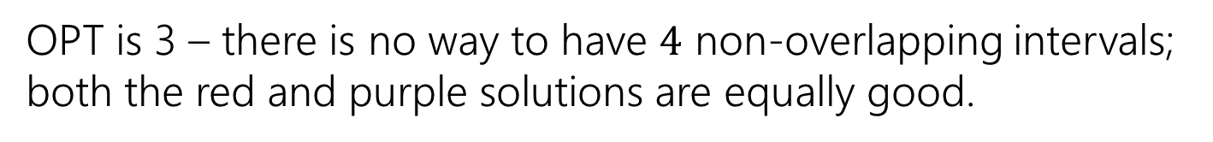
Interval Scheduling
You have a single processor, and a set of jobs with fixed start and end times.
Your goal is to maximize the number of jobs you can process.
I.e. choose the maximum number of non-overlapping intervals.
OPT is 3 – there is no way to have $4$ non-overlapping intervals; both the red and purple solutions are equally good.

Slide 39
Greedy Ideas
To specify a greedy algorithm, we need to:
Order the elements (intervals)
Choose a rule for deciding whether to add. Rule: Add interval as long as it doesn’t overlap with those we’ve already selected.
What ordering should we use?
Think of at least two orderings you think might work.

Slide 40
Greedy Algorithm
Some possibilities
Earliest end time (add if no overlap with previous selected)
Latest end time
Earliest start time
Latest start time
Shortest interval
Fewest overlaps (with remaining intervals)

Slide 41
Greedy
That list slide is the real difficulty with greedy algorithms.
All of those look at least somewhat plausible at first glance.
With MSTs that was fine – those ideas all worked!
It’s not fine here.
They don’t all work.
As a first step – try to find counter-examples to narrow down

Slide 42
Greedy Algorithm
Earliest end time
Latest end time
Earliest start time
Latest start time
Shortest interval
Fewest overlaps (with remaining intervals)

Slide 43
Take Earliest Start Time – Counter Example

Slide 44
Take Earliest Start Time – Counter Example
Algorithm finds
Optimum
Taking the one with the earliest start time doesn’t give us the best answer.

Slide 45
Shortest Interval

Slide 46
Shortest Interval
Algorithm finds
Optimum
Taking the shortest interval first doesn’t give us the best answer

Slide 47
Greedy Algorithm
Earliest end time
Latest end time
Earliest start time
Latest start time
Shortest interval
Fewest overlaps (with remaining intervals)

Slide 48
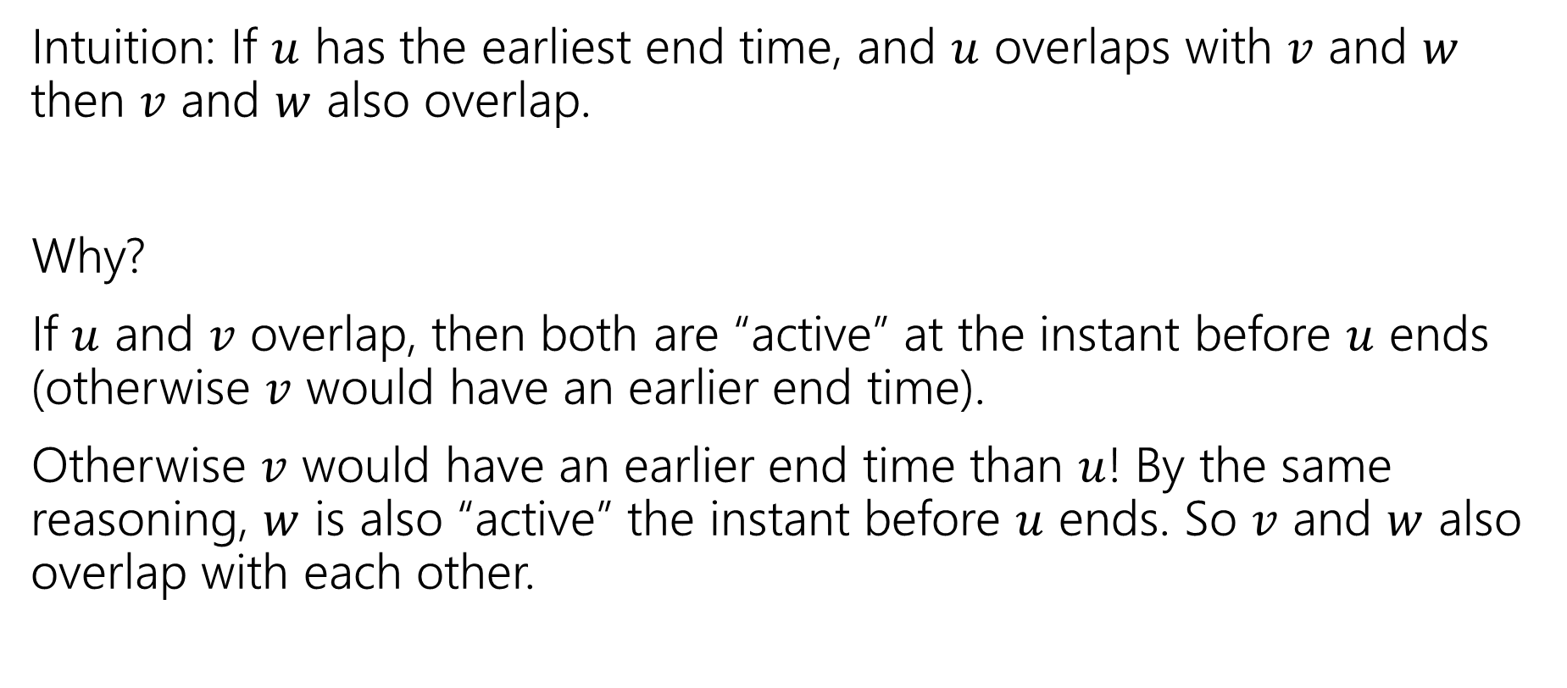
Earliest End Time
Intuition: If $u$ has the earliest end time, and $u$ overlaps with $v$ and $w$ then $v$ and $w$ also overlap.
Why?
If $u$ and $v$ overlap, then both are “active” at the instant before $u$ ends (otherwise $v$ would have an earlier end time).
Otherwise $v$ would have an earlier end time than $u$! By the same reasoning, $w$ is also “active” the instant before $u$ ends. So $v$ and $w$ also overlap with each other.

Slide 49
Earliest End Time
Can you prove it correct?
Do you want to use
Structural Result
Exchange Argument
Greedy Stays Ahead

Slide 50
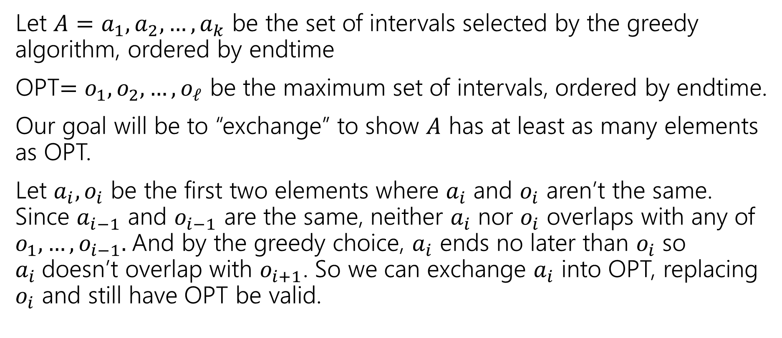
Exchange Argument
Let $A=a_{1},a_{2},…,a_{k}$ be the set of intervals selected by the greedy algorithm, ordered by endtime
OPT$=o_{1},o_{2},…,o_{ℓ}$ be the maximum set of intervals, ordered by endtime.
Our goal will be to “exchange” to show $A$ has at least as many elements as OPT.
Let $a_{i},o_{i}$ be the first two elements where $a_{i}$ and $o_{i}$ aren’t the same. Since $a_{i−1}$ and $o_{i−1}$ are the same, neither $a_{i}$ nor $o_{i}$ overlaps with any of $o_{1},…,o_{i−1}.$And by the greedy choice, $a_{i}$ ends no later than $o_{i}$ so $a_{i}$doesn’t overlap with $o_{i+1}$. So we can exchange $a_{i}$ into OPT, replacing $o_{i}$ and still have OPT be valid.

Slide 51
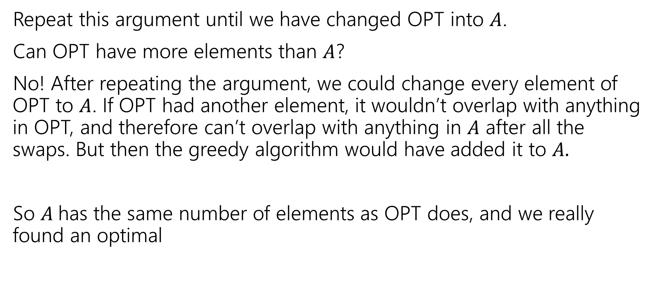
Exchange Argument
Repeat this argument until we have changed OPT into $A$.
Can OPT have more elements than $A$?
No! After repeating the argument, we could change every element of OPT to $A$. If OPT had another element, it wouldn’t overlap with anything in OPT, and therefore can’t overlap with anything in $A$ after all the swaps. But then the greedy algorithm would have added it to $A.$
So $A$has the same number of elements as OPT does, and we really found an optimal

Slide 52
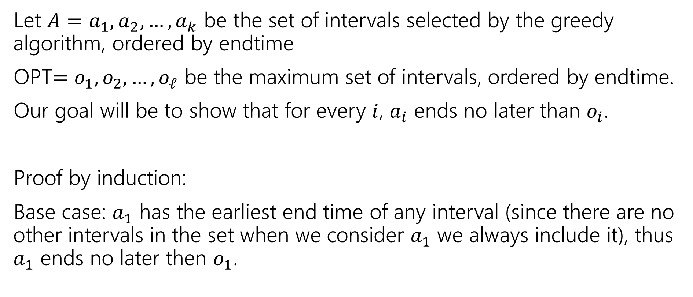
Greedy Stays Ahead
Let $A=a_{1},a_{2},…,a_{k}$ be the set of intervals selected by the greedy algorithm, ordered by endtime
OPT$=o_{1},o_{2},…,o_{ℓ}$ be the maximum set of intervals, ordered by endtime.
Our goal will be to show that for every $i$, $a_{i}$ ends no later than $o_{i}$.
Proof by induction:
Base case: $a_{1}$ has the earliest end time of any interval (since there are no other intervals in the set when we consider $a_{1}$ we always include it), thus $a_{1}$ ends no later then $o_{1}$.

Slide 53
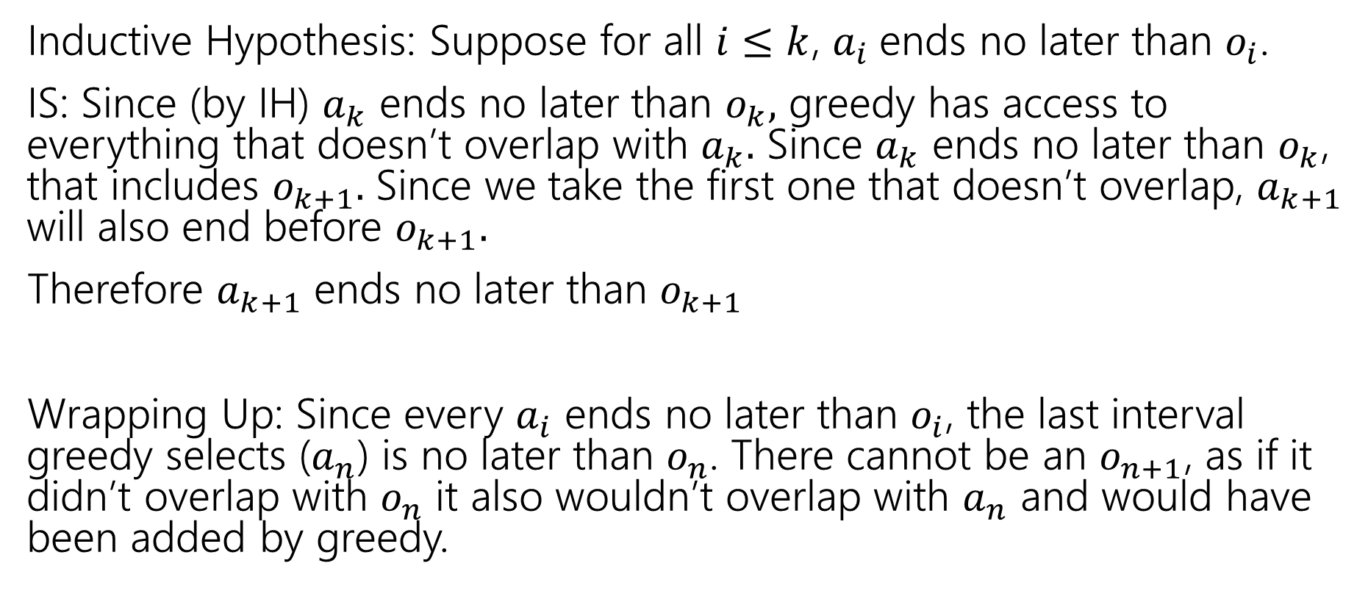
Greedy Stays Ahead
Inductive Hypothesis: Suppose for all $i≤k$, $a_{i}$ends no later than $o_{i}$.
IS: Since (by IH) $a_{k}$ ends no later than $o_{k},$ greedy has access to everything that doesn’t overlap with $a_{k}.$ Since $a_{k}$ ends no later than $o_{k}$, that includes $o_{k+1}.$ Since we take the first one that doesn’t overlap, $a_{k+1}$ will also end before $o_{k+1}.$
Therefore $a_{k+1}$ ends no later than $o_{k+1}$
Wrapping Up: Since every $a_{i}$ ends no later than $o_{i}$, the last interval greedy selects ($a_{n}$) is no later than $o_{n}$. There cannot be an $o_{n+1}$, as if it didn’t overlap with $o_{n}$ it also wouldn’t overlap with $a_{n}$ and would have been added by greedy.

Slide 54

Greedy Algorithm
Earliest end time
Latest end time
Earliest start time
Latest start time
Shortest interval
Fewest overlaps (with remaining intervals)

Slide 55
Fewest Overlaps counter-example
ALG
OPT
The top middle item will be selected first, eliminating the chance of getting the 4 intervals in OPT.

Slide 56
Other Greedy Algorithms
It turns out latest start time and fewest overlaps also work.
Latest start time is actually the same as earliest end time (imagine “reflecting” all the jobs along the time axis – the one with the earliest end time ends up having the last start time).
What about fewest overlaps?
Doesn’t work!

Slide 57
Greedy Algorithm
Earliest end time
Latest end time
Earliest start time
Latest start time
Shortest interval
Fewest overlaps (with remaining intervals)

Slide 58
Summary
Greedy algorithms
You’ll probably have 2 (or 3…or 6) ideas for greedy algorithms. Check some simple examples before you implement! Greedy algorithms rarely work.
When they work AND you can prove they work, they’re great!
Proofs are often tricky
Structural results are the hardest to come up with, but the most versatile.
Greedy stays ahead usually use induction
Exchange start with the first difference between greedy and optimal.

Slide 59
Which Technique

Slide 60
Which Technique?
When I see a new problem, how do I know which option to use?
Try modeling first – use the problems we’ve already solved
Preferences? Try stable matching.
Assignments? Try network flow.
Etc.

Slide 61
Which Technique?
Modeling Didn’t work?
What does this remind you of?
Then try: recursive thinking (will lead to DP or D&C)
Ask how you would represent the problem visually (might lead to graphs)
Finally: remember your problem might be hard!

