Slide 1
Coping With NP-Completeness
CSE 417 Fall 22
Lecture 26

Slide 2
Announcements
We spammed your inbox last night (sorry) via Canvas.
We wrote a script to count up your E and S scores.
It should show the state of gradescope as of about 9 PM last night.
This is the first time we’ve used this script! It might be buggy; if you see something you think is wrong, please ask us (private post on ed).
Suggested use: look for the 4 “total” columns on canvas; see if that matches your count. If not, then use the homework-by-homework columns to see where the discrepancy is.

Slide 3
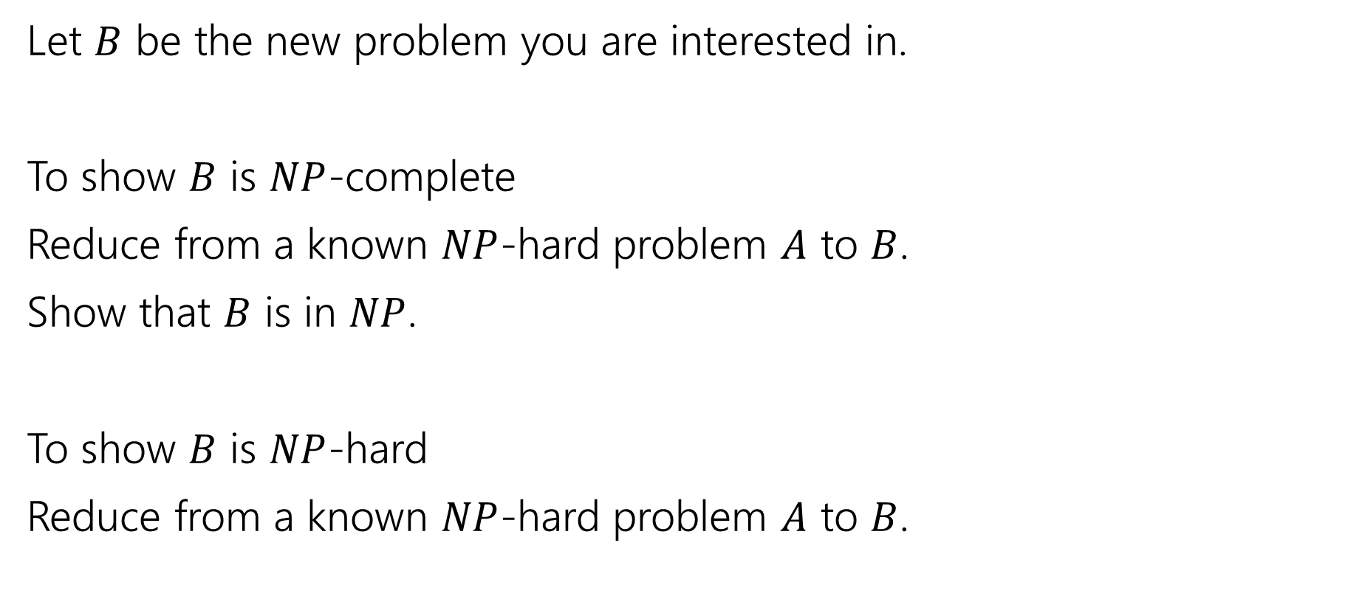
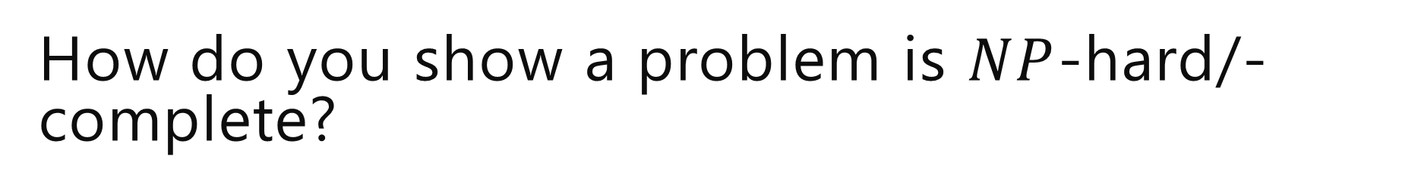
How do you show a problem is $NP$-hard/-complete?
Let $B$ be the new problem you are interested in.
To show $B$ is $NP$-complete
Reduce from a known $NP$-hard problem $A$ to $B$.
Show that $B$ is in $NP$.
To show $B$ is $NP$-hard
Reduce from a known $NP$-hard problem $A$ to $B$.

Slide 4
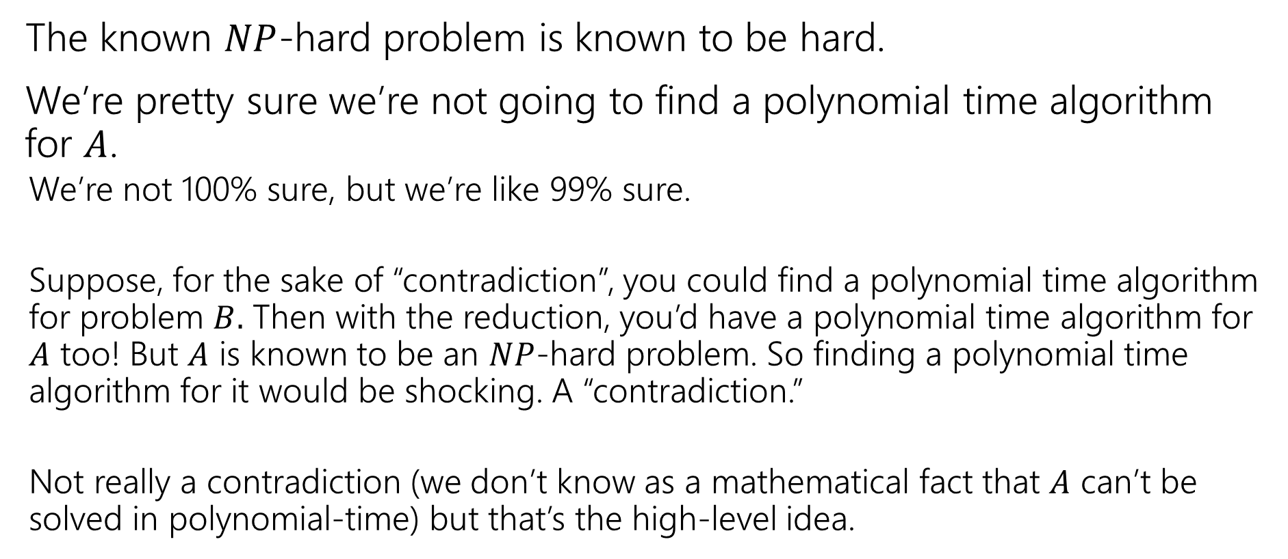
Why that direction?
The known $NP$-hard problem is known to be hard.
We’re pretty sure we’re not going to find a polynomial time algorithm for $A$.
We’re not 100% sure, but we’re like 99% sure.
Suppose, for the sake of “contradiction”, you could find a polynomial time algorithm for problem $B.$ Then with the reduction, you’d have a polynomial time algorithm for $A$ too! But $A$ is known to be an $NP$-hard problem. So finding a polynomial time algorithm for it would be shocking. A “contradiction.”
Not really a contradiction (we don’t know as a mathematical fact that $A$ can’t be solved in polynomial-time) but that’s the high-level idea.

Slide 5
Double check the direction!!
Seriously.
It’s the easiest way to solve the wrong problem.
If both problems really are NP-complete, then both reductions exist! You won’t even notice anything is amiss.

Slide 6
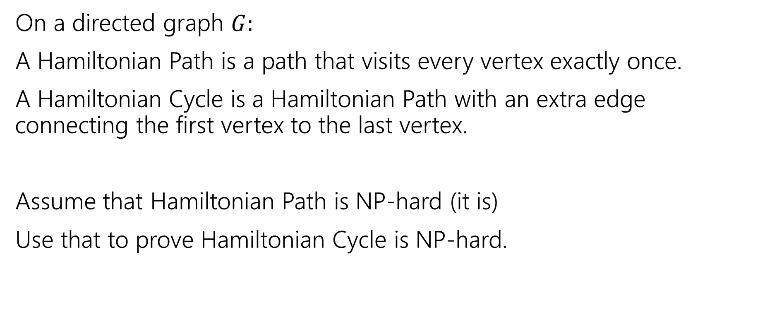
Hamilton
On a directed graph $G:$
A Hamiltonian Path is a path that visits every vertex exactly once.
A Hamiltonian Cycle is a Hamiltonian Path with an extra edge connecting the first vertex to the last vertex.
Assume that Hamiltonian Path is NP-hard (it is)
Use that to prove Hamiltonian Cycle is NP-hard.
Pollev.com/robbie

Slide 7

Which direction?
Reduce FROM the known hard problem TO the new problem.
Want to show Hamiltonian Path $≤$ Hamiltonian Cycle.

Slide 8
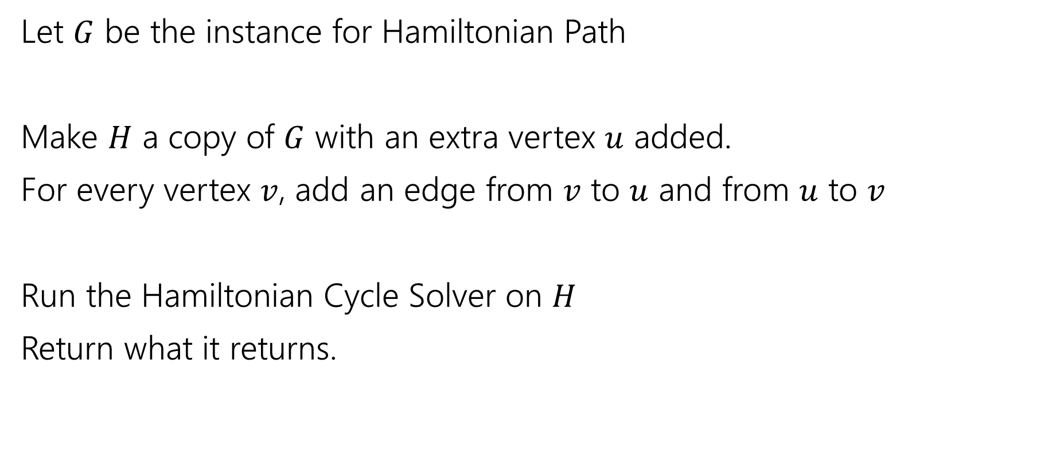
Reduction
Let $G$ be the instance for Hamiltonian Path
Make $H$ a copy of $G$ with an extra vertex $u$ added.
For every vertex $v$, add an edge from $v$ to $u$ and from $u$ to $v$
Run the Hamiltonian Cycle Solver on $H$
Return what it returns.

Slide 9

Correctness
If $G$ has a Hamiltonian Path,
Then there is a Hamiltonian Cycle in $H$ by following the path in $G$ going to $u$ and going back to the start.
So we correctly return YES.

Slide 10
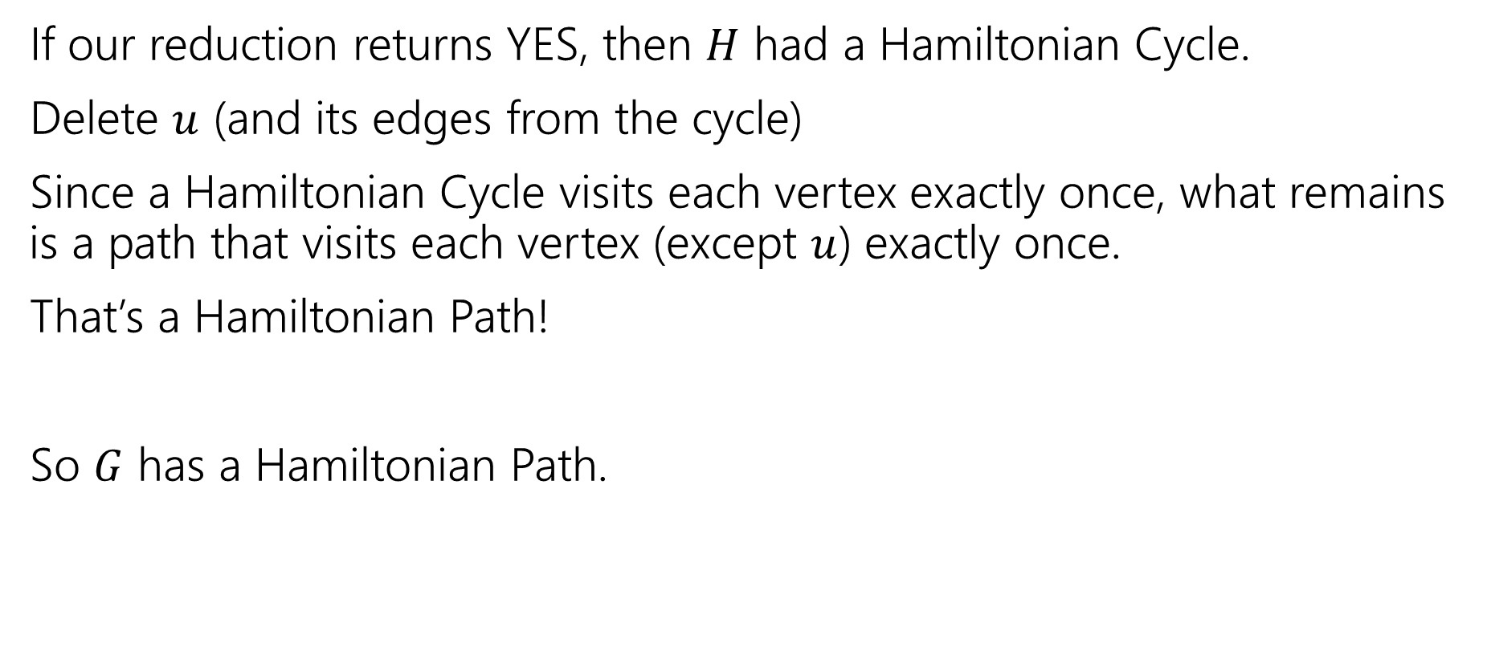
Correctness
If our reduction returns YES, then $H$ had a Hamiltonian Cycle.
Delete $u$ (and its edges from the cycle)
Since a Hamiltonian Cycle visits each vertex exactly once, what remains is a path that visits each vertex (except $u$) exactly once.
That’s a Hamiltonian Path!
So $G$ has a Hamiltonian Path.

Slide 11
Reductions
We saw a reduction between two very similar (on the surface) problems when we reduced from 2-coloring to 3-coloring.
The real power of reductions is when problems look very different on the surface but you can still reduce from one to the other.
We’re going to do a couple more reductions with varying levels of differences between the problems.

Slide 12
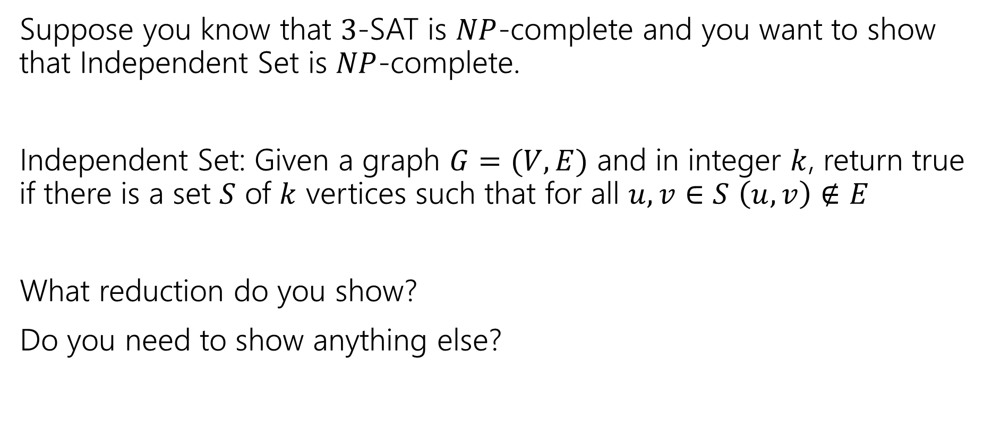
More Practice
Suppose you know that $3$-SAT is $NP$-complete and you want to show that Independent Set is $NP$-complete.
Independent Set: Given a graph $G=(V,E)$ and in integer $k$, return true if there is a set $S$ of $k$ vertices such that for all $u,v∈S$ $\left(u,v\right)∉E$
What reduction do you show?
Do you need to show anything else?

Slide 13
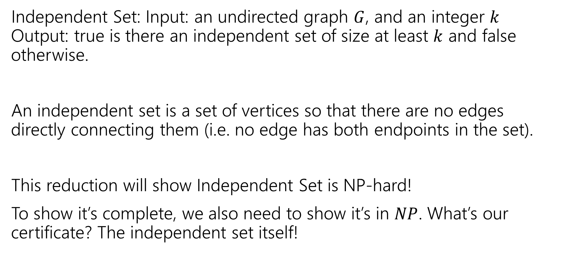
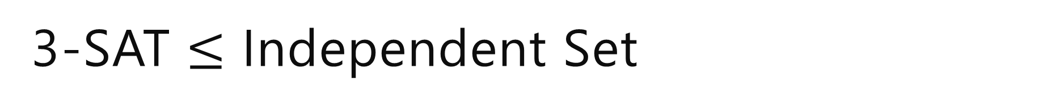
3-SAT $≤$ Independent Set
Independent Set: Input: an undirected graph $G$, and an integer $k$ Output: true is there an independent set of size at least $k$ and false otherwise.
An independent set is a set of vertices so that there are no edges directly connecting them (i.e. no edge has both endpoints in the set).
This reduction will show Independent Set is NP-hard!
To show it’s complete, we also need to show it’s in $NP$. What’s our certificate? The independent set itself!

Slide 14
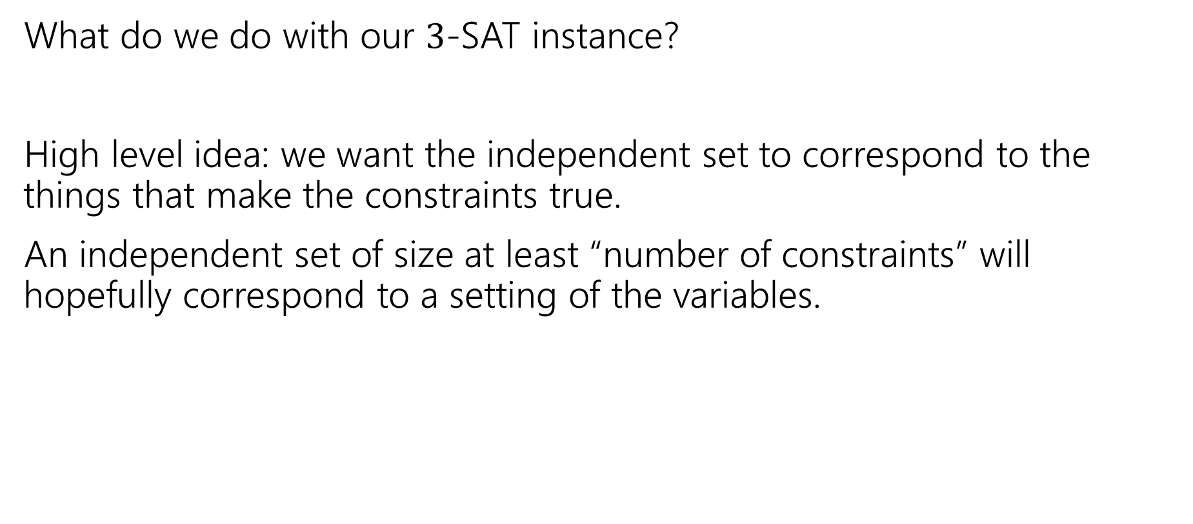
The Reduction
What do we do with our $3$-SAT instance?
High level idea: we want the independent set to correspond to the things that make the constraints true.
An independent set of size at least “number of constraints” will hopefully correspond to a setting of the variables.

Slide 15
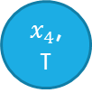
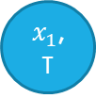
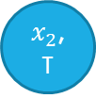
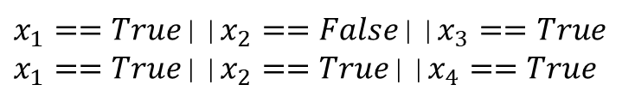
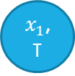

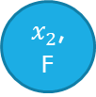
Reduction Idea
Connecting two vertices by an edge means we can have at most one in our independent set.
Have the vertices correspond to the pieces of the constraints.
$x_{1}$, T
$x_{3}$, T
$x_{1}==True$||$x_{2}==False$||$x_{3}==True$
$x_{1}==True$||$x_{2}==True$||$x_{4}==True$
$x_{2}$, F
Which Booleans can’t we have both of?
I.e. which pairs don’t make sense together?
$x_{1}$, T
$x_{4}$, T
Add edges between the same variable set to opposite values.
$x_{2}$, T

Slide 16
Reduction Idea Step 2
Connecting two vertices by an edge means we can have at most one in our independent set.
How big of an independent set do we want? Would be nice to count how many constraints are satisfied…need to make sure we take only one vertex per constraint.
$x_{1}$, T
$x_{3}$, T
$x_{1}==True$||$x_{2}==False$||$x_{3}==True$
$x_{1}==True$||$x_{2}==True$||$x_{4}==True$
$x_{2}$, F
Need only one vertex per constraint.
$x_{1}$, T
$x_{4}$, T
Add edges between all vertices coming from one constraint.
$x_{2}$, T

Slide 17
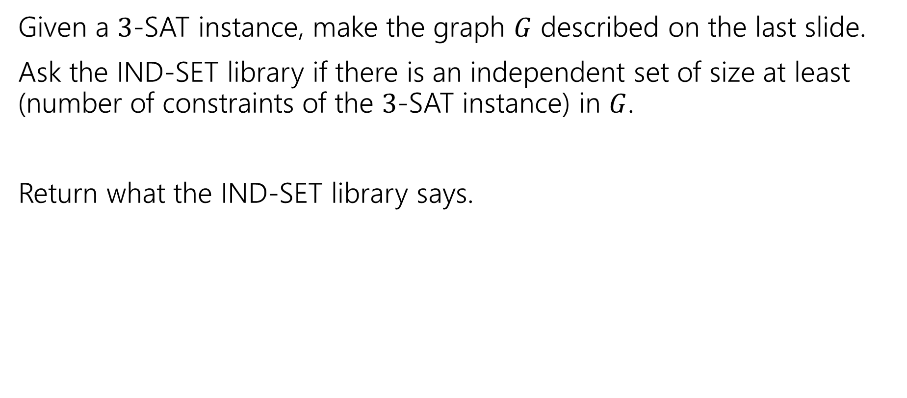
Reduction
Given a $3$-SAT instance, make the graph $G$ described on the last slide.
Ask the IND-SET library if there is an independent set of size at least (number of constraints of the $3$-SAT instance) in $G$.
Return what the IND-SET library says.

Slide 18
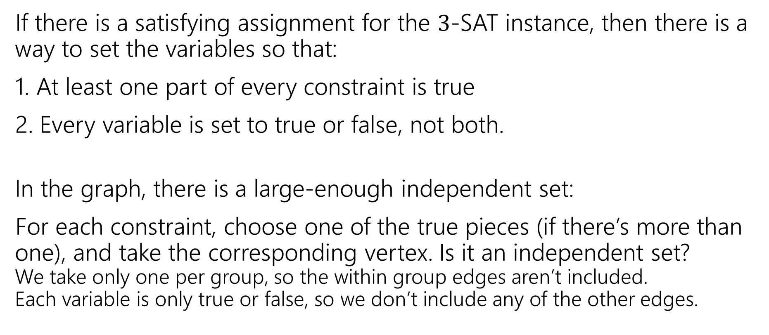
Correctness
If there is a satisfying assignment for the $3$-SAT instance, then there is a way to set the variables so that:
1. At least one part of every constraint is true
2. Every variable is set to true or false, not both.
In the graph, there is a large-enough independent set:
For each constraint, choose one of the true pieces (if there’s more than one), and take the corresponding vertex. Is it an independent set? We take only one per group, so the within group edges aren’t included. Each variable is only true or false, so we don’t include any of the other edges.

Slide 19
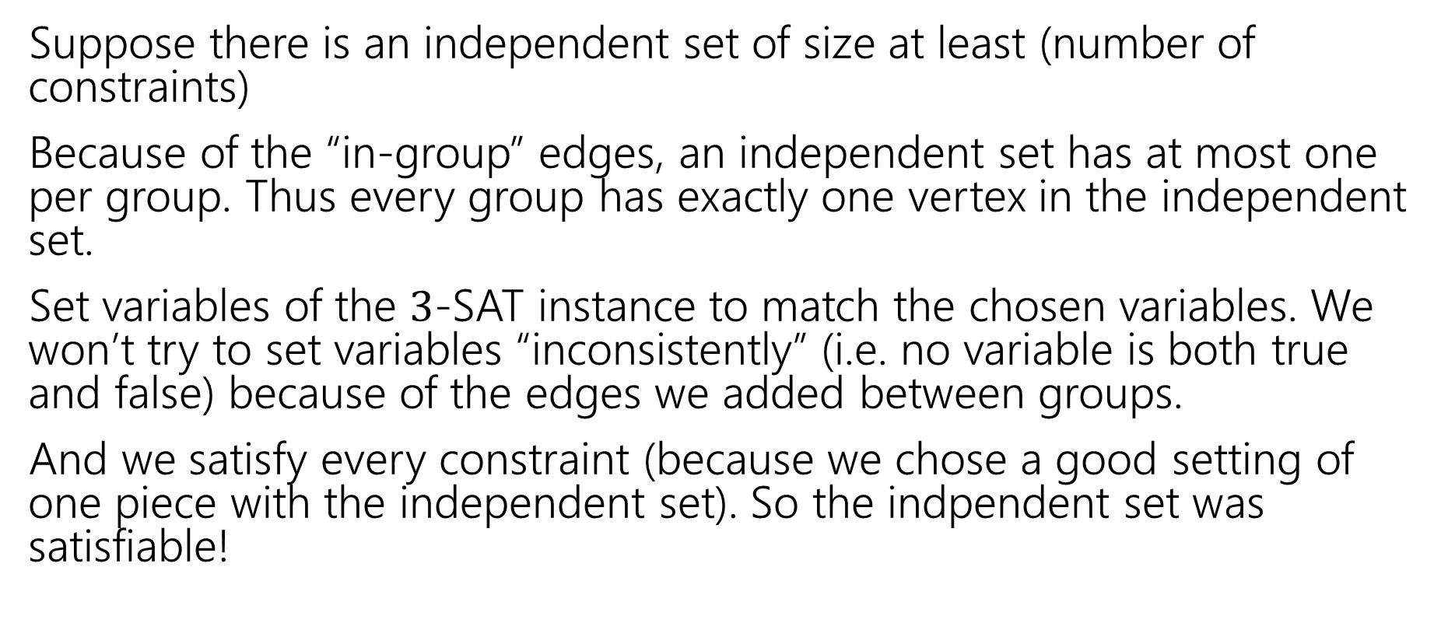
Correctness, Part 2
Suppose there is an independent set of size at least (number of constraints)
Because of the “in-group” edges, an independent set has at most one per group. Thus every group has exactly one vertex in the independent set.
Set variables of the $3$-SAT instance to match the chosen variables. We won’t try to set variables “inconsistently” (i.e. no variable is both true and false) because of the edges we added between groups.
And we satisfy every constraint (because we chose a good setting of one piece with the independent set). So the indpendent set was satisfiable!

Slide 20
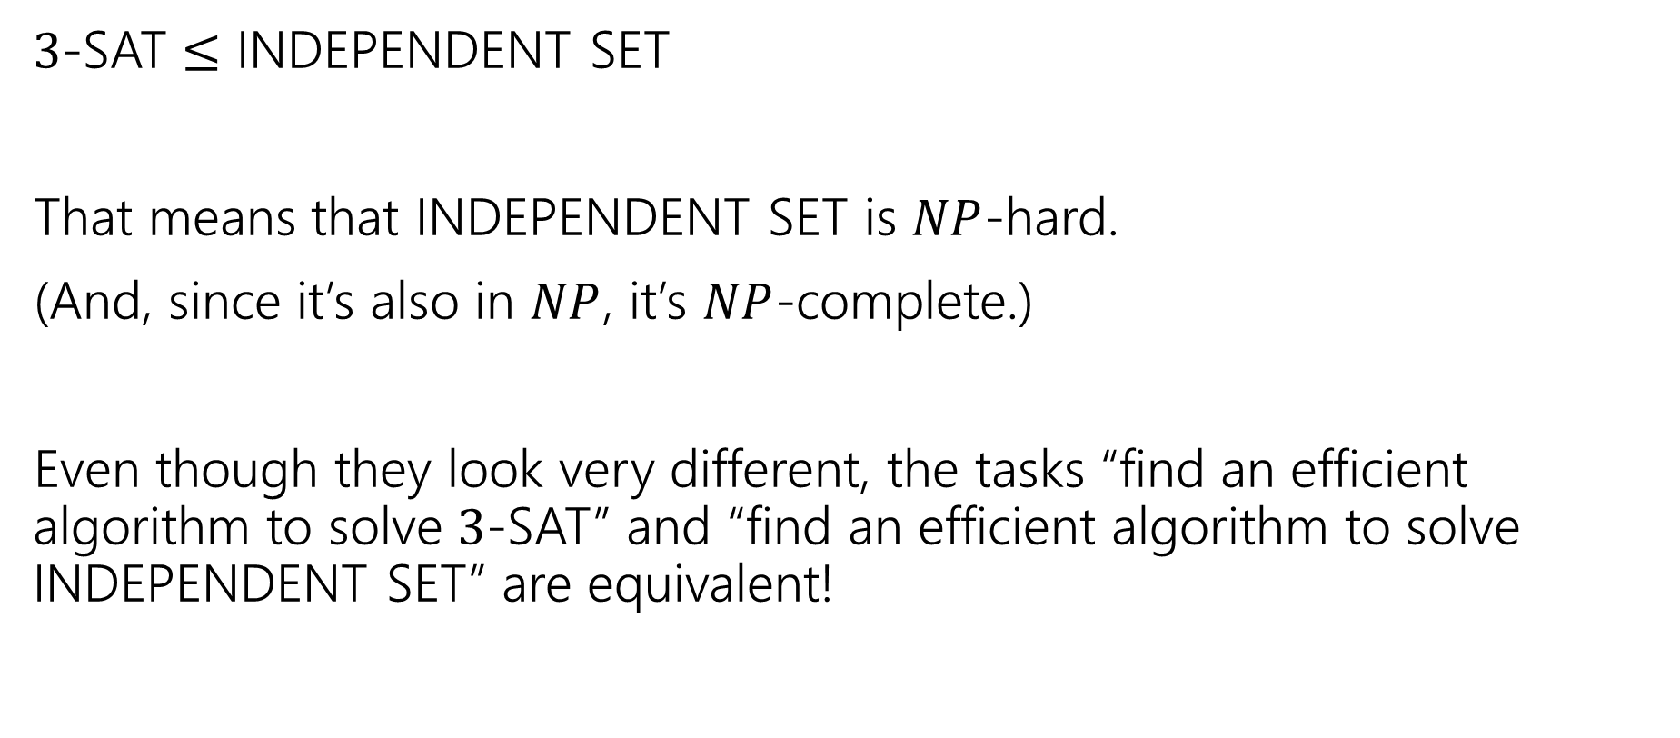
So…
$3$-SAT $≤$ INDEPENDENT SET
That means that INDEPENDENT SET is $NP$-hard.
(And, since it’s also in $NP$, it’s $NP$-complete.)
Even though they look very different, the tasks “find an efficient algorithm to solve $3$-SAT” and “find an efficient algorithm to solve INDEPENDENT SET” are equivalent!

Slide 21
More Context; Coping

Slide 22
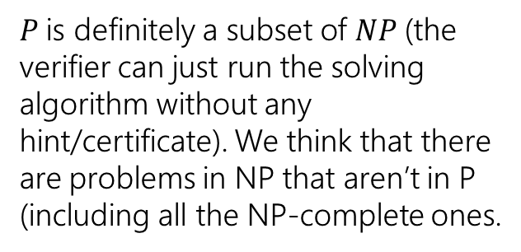

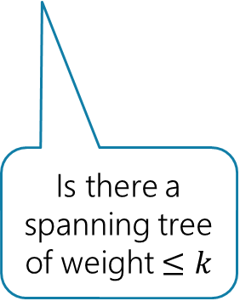
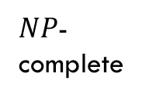


What (we think) the world looks like
Assuming $P≠NP$
3-coloring (the decision version)
Is this list sorted?
Given a program, if I run it will it halt (or infinitely loop/recurse)
$$NP$$
$NP$-hard
$NP$-complete
$$P$$
Finding an MST (not a decision problem)
$P$is definitely a subset of $NP$(the verifier can just run the solving algorithm without any hint/certificate). We think that there are problems in NP that aren’t in P (including all the NP-complete ones.
3-SAT
3-color a graph (return the coloring itself -- not a decision problem)
Is there a spanning tree of weight $≤k$

Slide 23
Examples
There are literally thousands of NP-complete problems.
And some of them look weirdly similar to problems we do know efficient algorithms for.
In P
NP-Complete
Given a directed graph, report if there is a path from s to t of length at most $k$.
Short Path
Given a directed graph, report if there is a path from s to t of length at least$k$.
Long Path

Slide 24
Examples
In P
NP-Complete
Given a weighted graph, find a spanning tree (a set of edges that connect all vertices) of weight at most $k$.
Light Spanning Tree
Given a weighted graph, find a tour (a walk that visits every vertex and returns to its start) of weight at most $k$.
Traveling Salesperson
The electric company just needs a greedy algorithm to lay its wires.
Amazon doesn’t know a way to optimally route its delivery trucks.

Slide 25
Examples
In P
NP-Complete
Given an undirected graph, can the vertices be labeled red and blue with no edge having the same colors on both endpoints?
2-Coloring
Given an undirected graph, can the vertices be labeled red, blue, and green with no edge having the same colors on both endpoints?
3-Coloring
Just changing a number by one takes us from one of the first problems we solved (and one of the fastest algorithms we’ve seen) to something we don’t know how to solve efficiently at all.

Slide 26
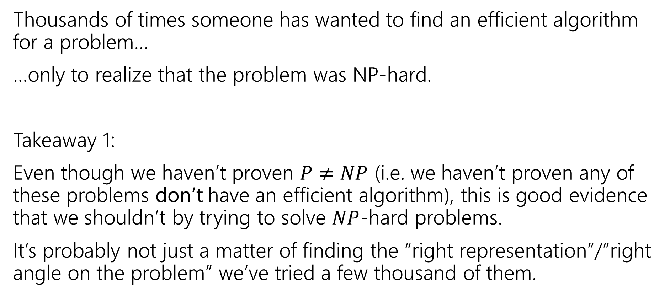
Dealing with NP-hardness
Thousands of times someone has wanted to find an efficient algorithm for a problem…
…only to realize that the problem was NP-hard.
Takeaway 1:
Even though we haven’t proven $P≠NP$ (i.e. we haven’t proven any of these problems don’t have an efficient algorithm), this is good evidence that we shouldn’t by trying to solve $NP$-hard problems.
It’s probably not just a matter of finding the “right representation”/”right angle on the problem” we’ve tried a few thousand of them.

Slide 27
Why Should you care?

Slide 28
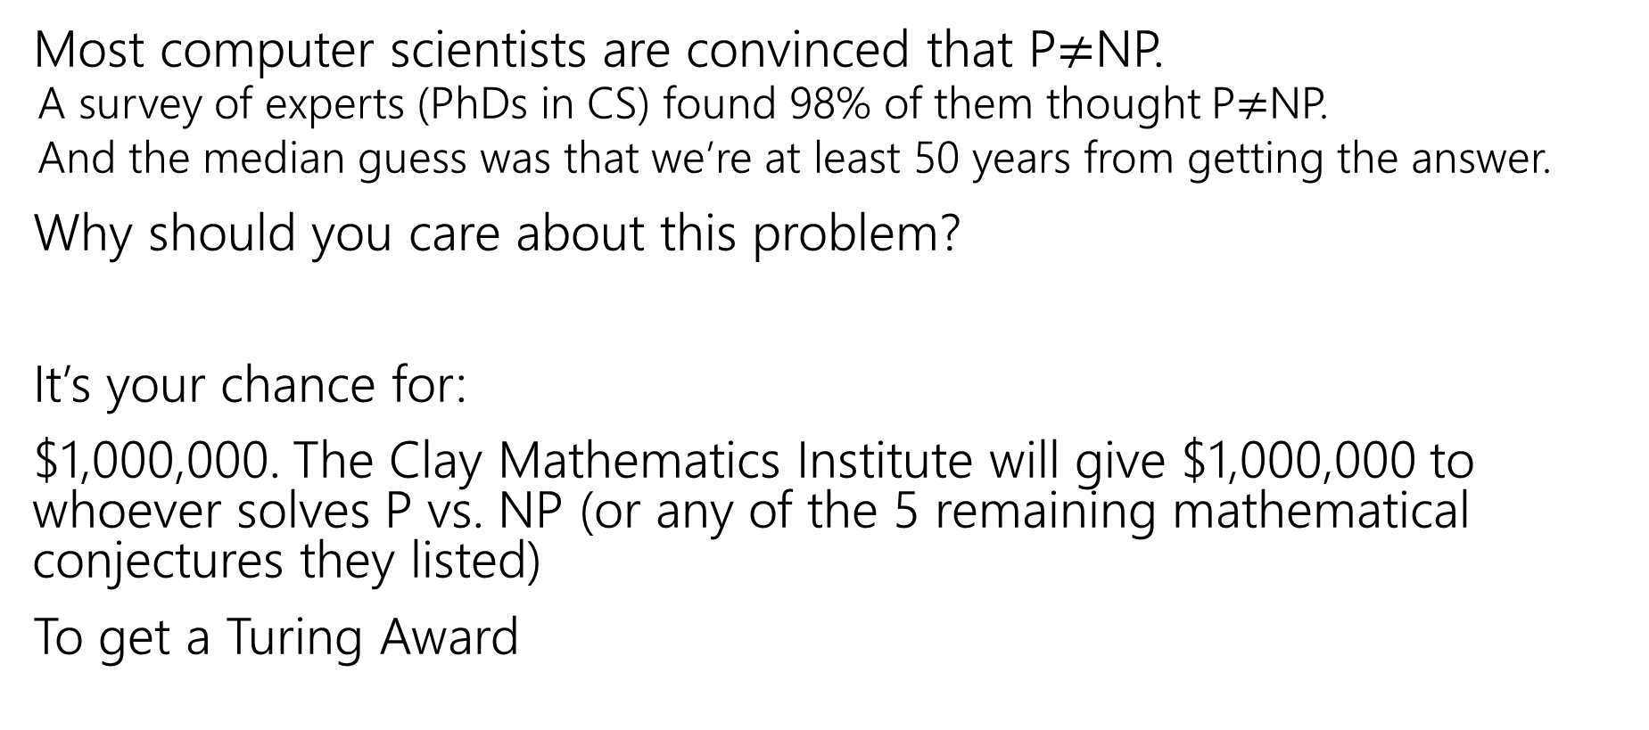
Why should you care about P vs. NP
Most computer scientists are convinced that P$≠$NP.
A survey of experts (PhDs in CS) found 98% of them thought P$≠$NP.
And the median guess was that we’re at least 50 years from getting the answer.
Why should you care about this problem?
It’s your chance for:
$1,000,000. The Clay Mathematics Institute will give $1,000,000 to whoever solves P vs. NP (or any of the 5 remaining mathematical conjectures they listed)
To get a Turing Award

Slide 29
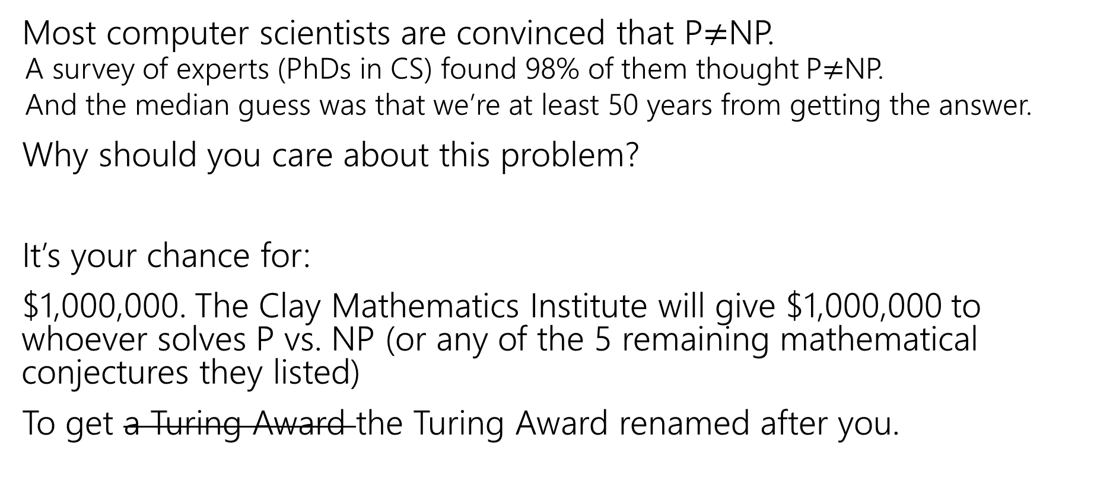
Why should you care about P vs. NP
Most computer scientists are convinced that P$≠$NP.
A survey of experts (PhDs in CS) found 98% of them thought P$≠$NP.
And the median guess was that we’re at least 50 years from getting the answer.
Why should you care about this problem?
It’s your chance for:
$1,000,000. The Clay Mathematics Institute will give $1,000,000 to whoever solves P vs. NP (or any of the 5 remaining mathematical conjectures they listed)
To get a Turing Award the Turing Award renamed after you.

Slide 30
Why Should You Care if P=NP?
Suppose P=NP.
Specifically that we found a genuinely in-practice efficient algorithm for an NP-complete problem. What would you do?
$1,000,000 from the Clay Math Institute obviously, but what’s next?

Slide 31
Why Should You Care if P=NP?
We found a genuinely in-practice efficient algorithm for an NP-complete problem. What would you do?
Another $5,000,000 from the Clay Math Institute
Put mathematicians out of work?
Decrypt (essentially) all current internet communication. See the real world question.
A world where P=NP is a very very different place from the world we live in now.

Slide 32
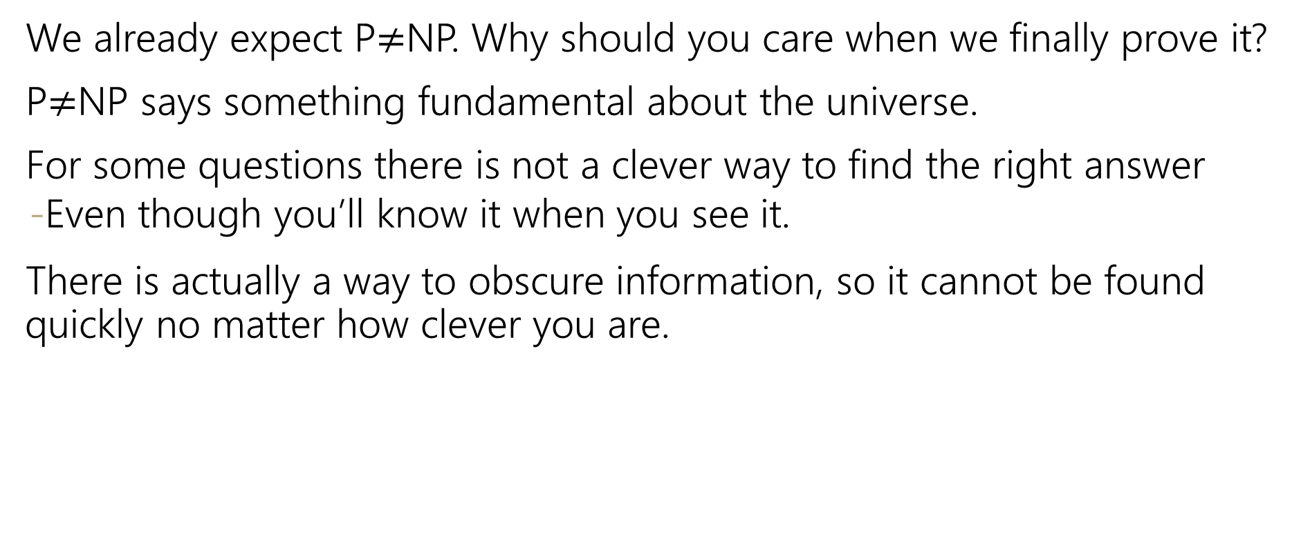
Why Should You Care if P$≠$NP?
We already expect P$≠$NP. Why should you care when we finally prove it?
P$≠$NP says something fundamental about the universe.
For some questions there is not a clever way to find the right answer
Even though you’ll know it when you see it.
There is actually a way to obscure information, so it cannot be found quickly no matter how clever you are.

Slide 33
Why Should You Care if P$≠$NP?
To prove P$≠$NP we need to better understand the differences between problems.
Why do some problems allow easy solutions and others don’t?
What is the structure of these problems?
We don’t care about P vs NP just because it has a huge effect about what the world looks like.
We will learn a lot about computation along the way.

Slide 34
Dealing With NP-hardness

Slide 35
Dealing with NP-hardness
Thousands of times someone has wanted to find an efficient algorithm for a problem…
…only to realize that the problem was NP-hard.
Takeaway 2:
Sooner or later it will happen to one of you.
What do you do if you think your problem is NP-complete?

Slide 36

Dealing with NP-completeness
You just started your new job at Amazon. Your boss asks you to look into the following problem
You have a graph, each vertex is where a specific truck has to do a delivery. Starting from the warehouse, how do you make all the deliveries and return to the warehouse using the minimum amount of gas.
Given a weighted graph, find a tour (a walk that visits every vertex and returns to its start) of weight at most $k$.
Traveling Salesperson

Slide 37
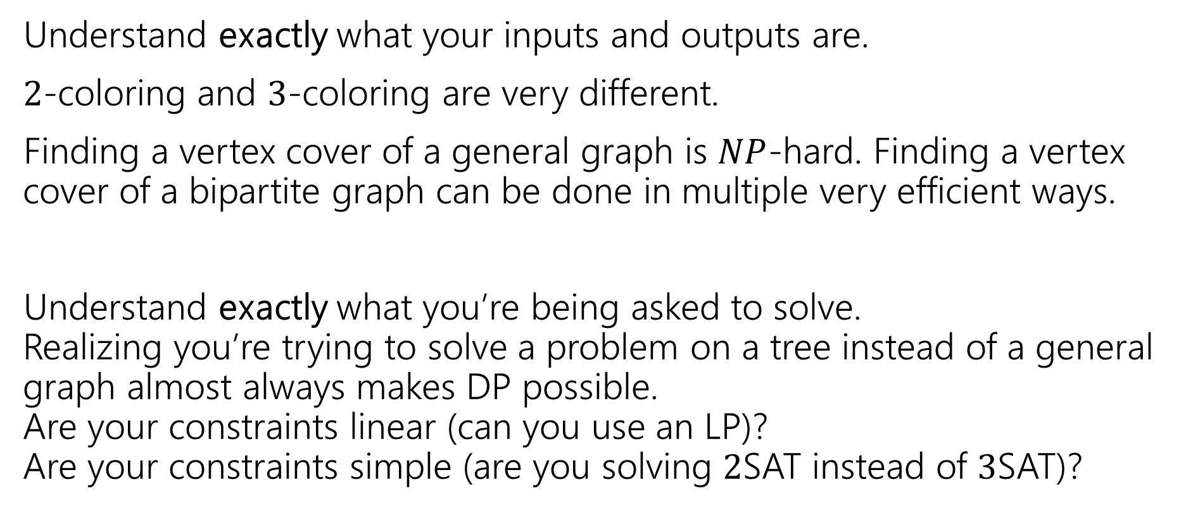
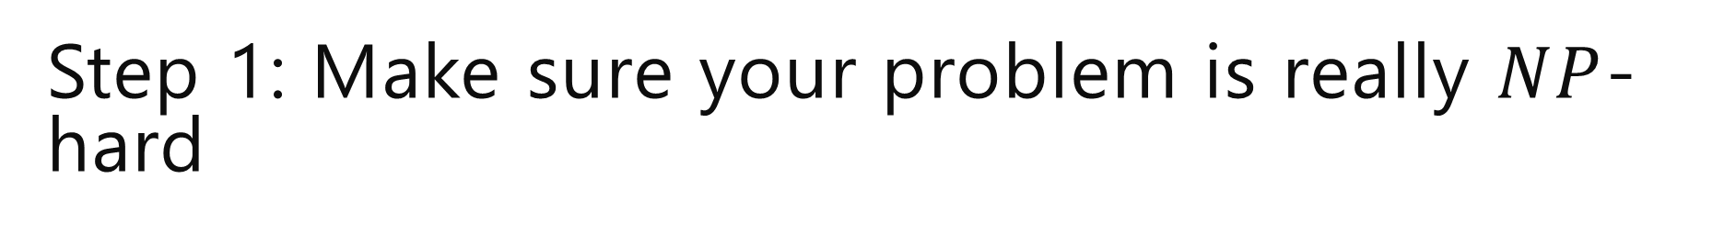
Step 1: Make sure your problem is really $NP$-hard
Understand exactly what your inputs and outputs are.
$2$-coloring and $3$-coloring are very different.
Finding a vertex cover of a general graph is $NP$-hard. Finding a vertex cover of a bipartite graph can be done in multiple very efficient ways.
Understand exactly what you’re being asked to solve. Realizing you’re trying to solve a problem on a tree instead of a general graph almost always makes DP possible. Are your constraints linear (can you use an LP)? Are your constraints simple (are you solving $2$SAT instead of $3$SAT)?

Slide 38
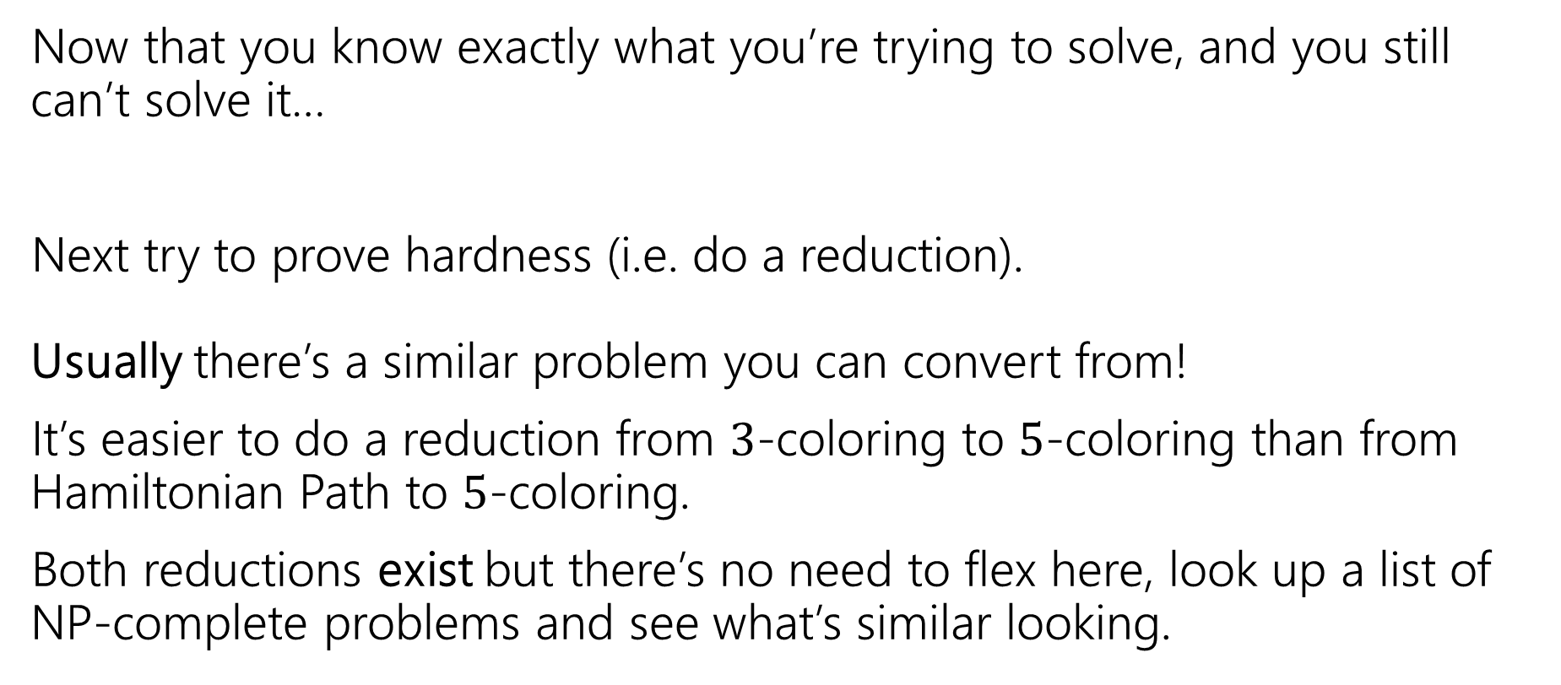
Step 2: It still looks hard
Now that you know exactly what you’re trying to solve, and you still can’t solve it…
Next try to prove hardness (i.e. do a reduction). Usually there’s a similar problem you can convert from!
It’s easier to do a reduction from $3$-coloring to $5$-coloring than from Hamiltonian Path to $5$-coloring.
Both reductions exist but there’s no need to flex here, look up a list of NP-complete problems and see what’s similar looking.

Slide 39
Step 3: ???
So you go to your boss and say
“Sorry, problem’s NP-hard. I proved it.”
And your boss says:
“that’s a cool proof and all, but really. We need to tell the drivers where to go tomorrow…and we need to use less gas.

Slide 40
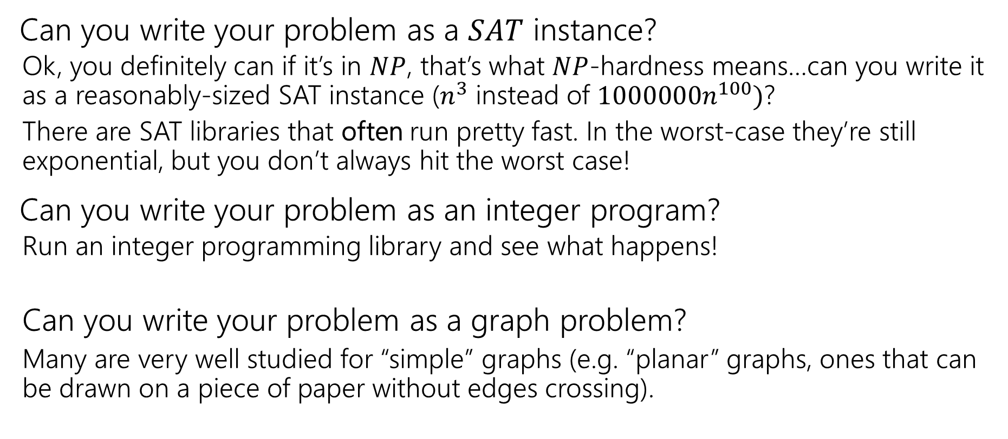

Step $3:$ Bandaids
Can you write your problem as a $SAT$ instance?
Ok, you definitely can if it’s in $NP$, that’s what $NP$-hardness means…can you write it as a reasonably-sized SAT instance ($n^{3}$ instead of $1000000n^{100})$?
There are SAT libraries that often run pretty fast. In the worst-case they’re still exponential, but you don’t always hit the worst case!
Can you write your problem as an integer program?
Run an integer programming library and see what happens!
Can you write your problem as a graph problem?
Many are very well studied for “simple” graphs (e.g. “planar” graphs, ones that can be drawn on a piece of paper without edges crossing).

Slide 41
Step 4 – Permanent Solutions
Those exponential time algorithms are great as band-aids.
If it’s a one-time thing, or just a “we’ll run this about once a week, if it takes too long once in a while no big deal” these are fine.
But what if you need a guarantee!
Your code is running every night, and you need an answer by 6 AM or the delivery trucks don’t go out.

Slide 42
Step 4 – Permanent Solutions
Two good options:
Exponential algorithms that aren’t-as-slow-as-others
Give you an exact answer; won’t take polynomial time but will be guaranteed take you less time than brute force.
Approximation algorithms
Don’t give you the best answer, but guarantees a reasonable amount of time, and a guaranteed-pretty-good-answer.

Slide 43
Dealing with NP-hardness
Thousands of times someone has wanted to find an efficient algorithm for a problem…
…only to realize that the problem was NP-hard.
Takeaway 2:
Sooner or later it will happen to one of you.
What do you do if you think your problem is NP-complete?

Slide 44
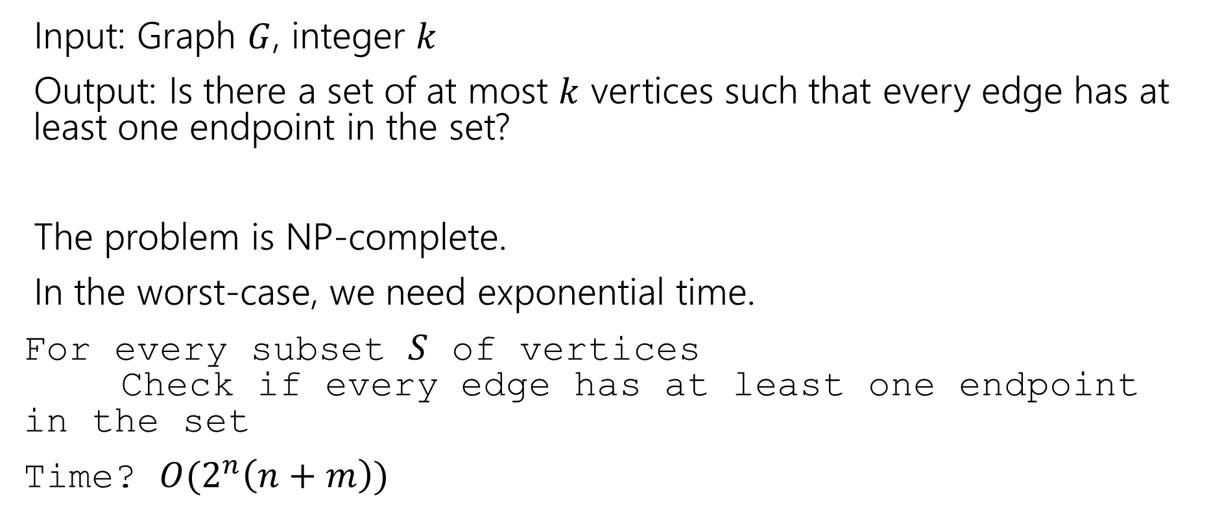
Vertex Cover
Input: Graph $G$, integer $k$
Output: Is there a set of at most $k$ vertices such that every edge has at least one endpoint in the set?
The problem is NP-complete.
In the worst-case, we need exponential time.
For every subset $S$ of vertices Check if every edge has at least one endpoint in the set
Time? $O(2^{n}\left(n+m\right))$

Slide 45
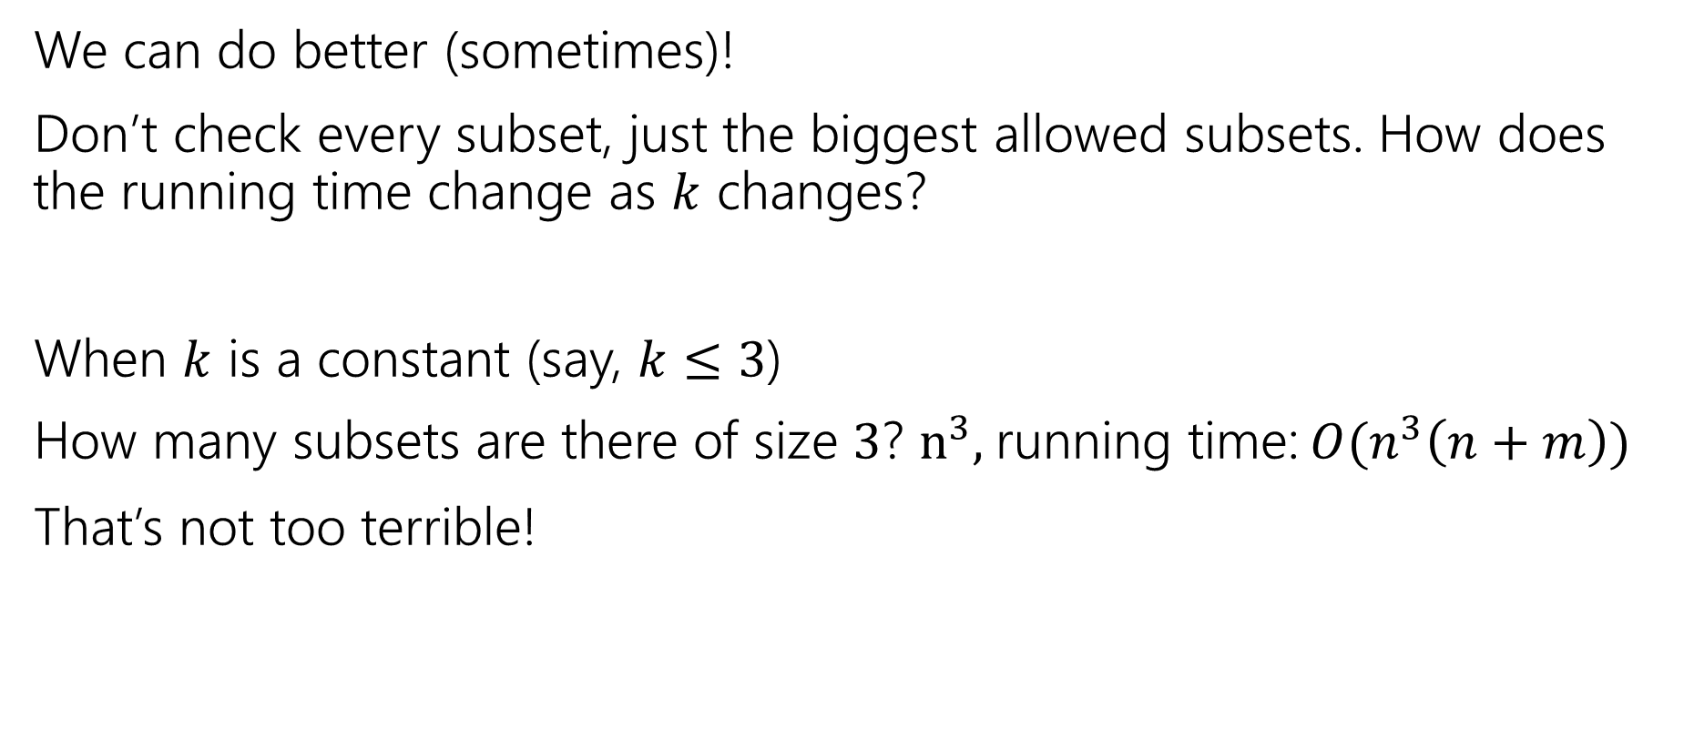
Vertex Cover
We can do better (sometimes)!
Don’t check every subset, just the biggest allowed subsets. How does the running time change as $k$ changes?
When $k$ is a constant (say, $k≤3$)
How many subsets are there of size $3$? $n^{3},$running time: $O(n^{3}\left(n+m\right))$
That’s not too terrible!

Slide 46
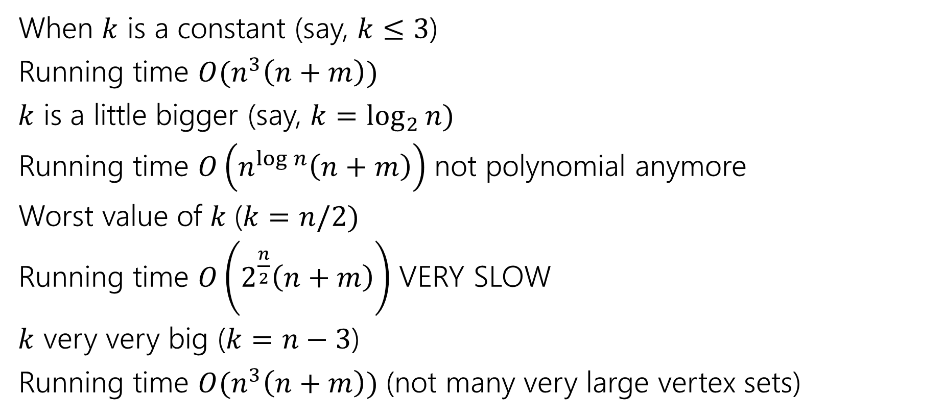
Vertex Cover
When $k$ is a constant (say, $k≤3$)
Running time $O(n^{3}\left(n+m\right))$
$k$ is a little bigger (say, $k=\log_{2}{n)}$
Running time $O\left(n^{\log{n}}\left(n+m\right)\right)$ not polynomial anymore
Worst value of $k$($k=n/2)$
Running time $O\left(2^{\frac{n}{2}}\left(n+m\right)\right)$ VERY SLOW
$k$ very very big ($k=n−3$)
Running time $O(n^{3}\left(n+m\right))$ (not many very large vertex sets)

Slide 47
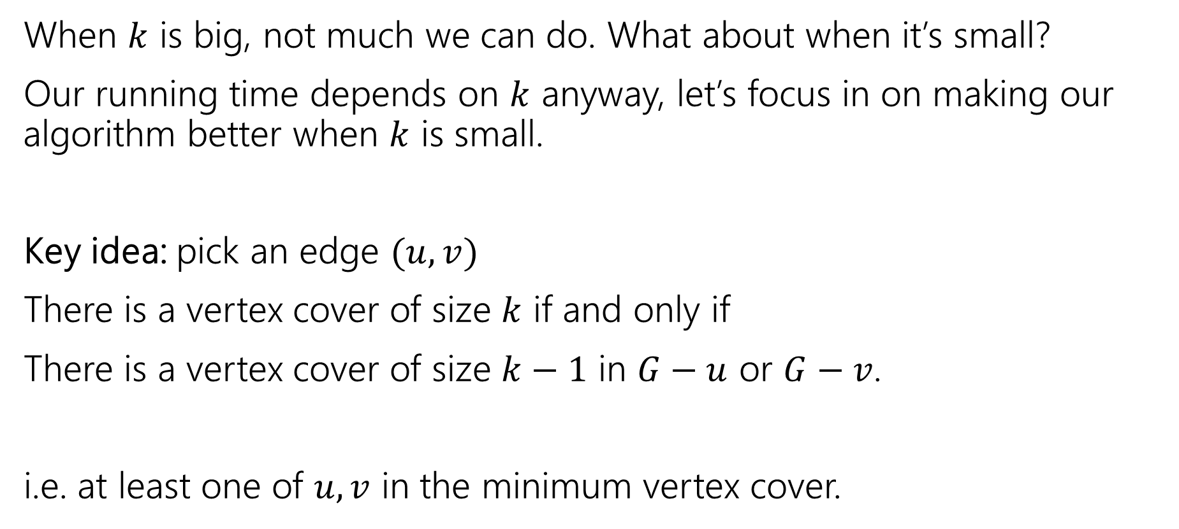
We can do better
When $k$ is big, not much we can do. What about when it’s small?
Our running time depends on $k$ anyway, let’s focus in on making our algorithm better when $k$ is small.
Key idea: pick an edge $(u,v)$
There is a vertex cover of size $k$ if and only if
There is a vertex cover of size $k−1$ in $G−u$ or $G−v$.
i.e. at least one of $u,v$ in the minimum vertex cover.

Slide 48
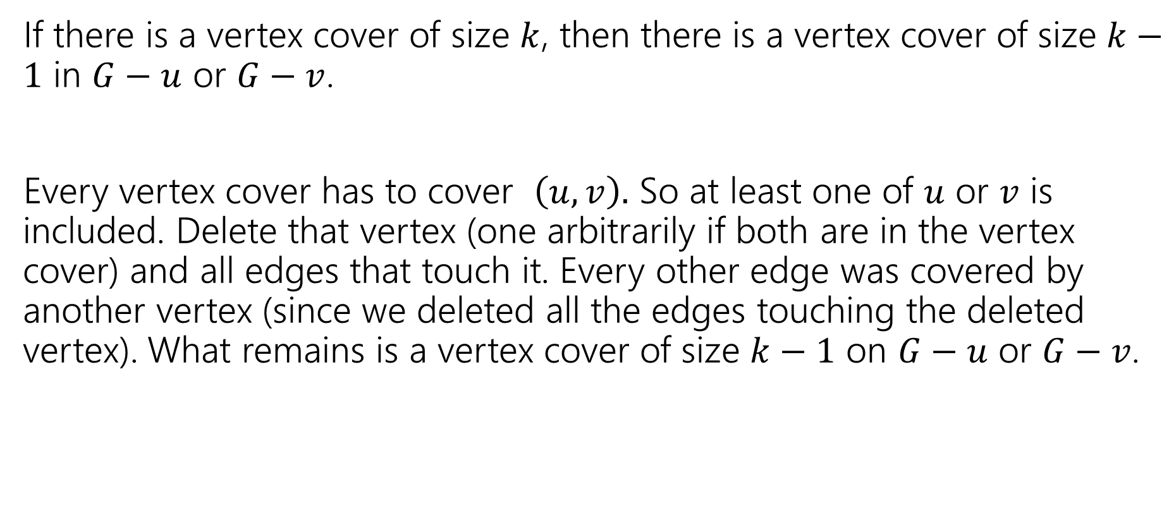
Key Idea – Let’s Prove it!
If there is a vertex cover of size $k$, then there is a vertex cover of size $k−1$ in $G−u$ or $G−v$.
Every vertex cover has to cover $\left(u,v\right).$ So at least one of $u$ or $v$ is included. Delete that vertex (one arbitrarily if both are in the vertex cover) and all edges that touch it. Every other edge was covered by another vertex (since we deleted all the edges touching the deleted vertex). What remains is a vertex cover of size $k−1$ on $G−u$ or $G−v$.

Slide 49
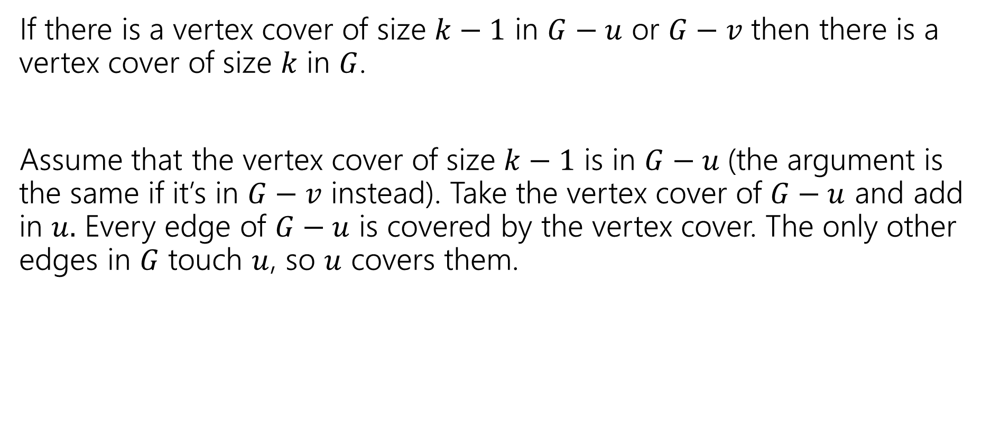
Key Idea – Let’s Prove it!
If there is a vertex cover of size $k−1$ in $G−u$ or $G−v$ then there is a vertex cover of size $k$ in $G$.
Assume that the vertex cover of size $k−1$ is in $G−u$(the argument is the same if it’s in $G−v$ instead). Take the vertex cover of $G−u$ and add in $u.$ Every edge of $G−u$ is covered by the vertex cover. The only other edges in $G$ touch $u$, so $u$ covers them.

Slide 50
Algorithm
VertexCover(graph G, int k)
if(G has no edges) //we’ve covered them all!
return true
if(k < 0)
return false
H1 = copy of G
H2 = copy of G
pick any edge (u,v)
H1 = H1.remove(u) //removes u and all edges with u as an endpoint
H2 = H2.remove(v) //removes u and all edges with u as an endpoint
return VertexCover(H1,k-1) || VertexCover(H2, k-1)

Slide 51

Running Time
Recurrence: $T\left(k\right)=\left\{\begin{aligned}2T\left(k−1\right)+O\left(n+m\right) if k≥1 \\ O\left(1\right) if k<0\end{aligned} \right.$
Running time? Unroll or use recursion tree
Pollev.com/robbie

Slide 52

Running Time
Recurrence: $T\left(k\right)=\left\{\begin{aligned}2T\left(k−1\right)+O\left(n+m\right) if k≥1 \\ O\left(1\right) if k<0\end{aligned} \right.$
Running time? Unroll or use recursion tree
$$O\left(\left(n+m\right)⋅2^{k}\right)$$

Slide 53
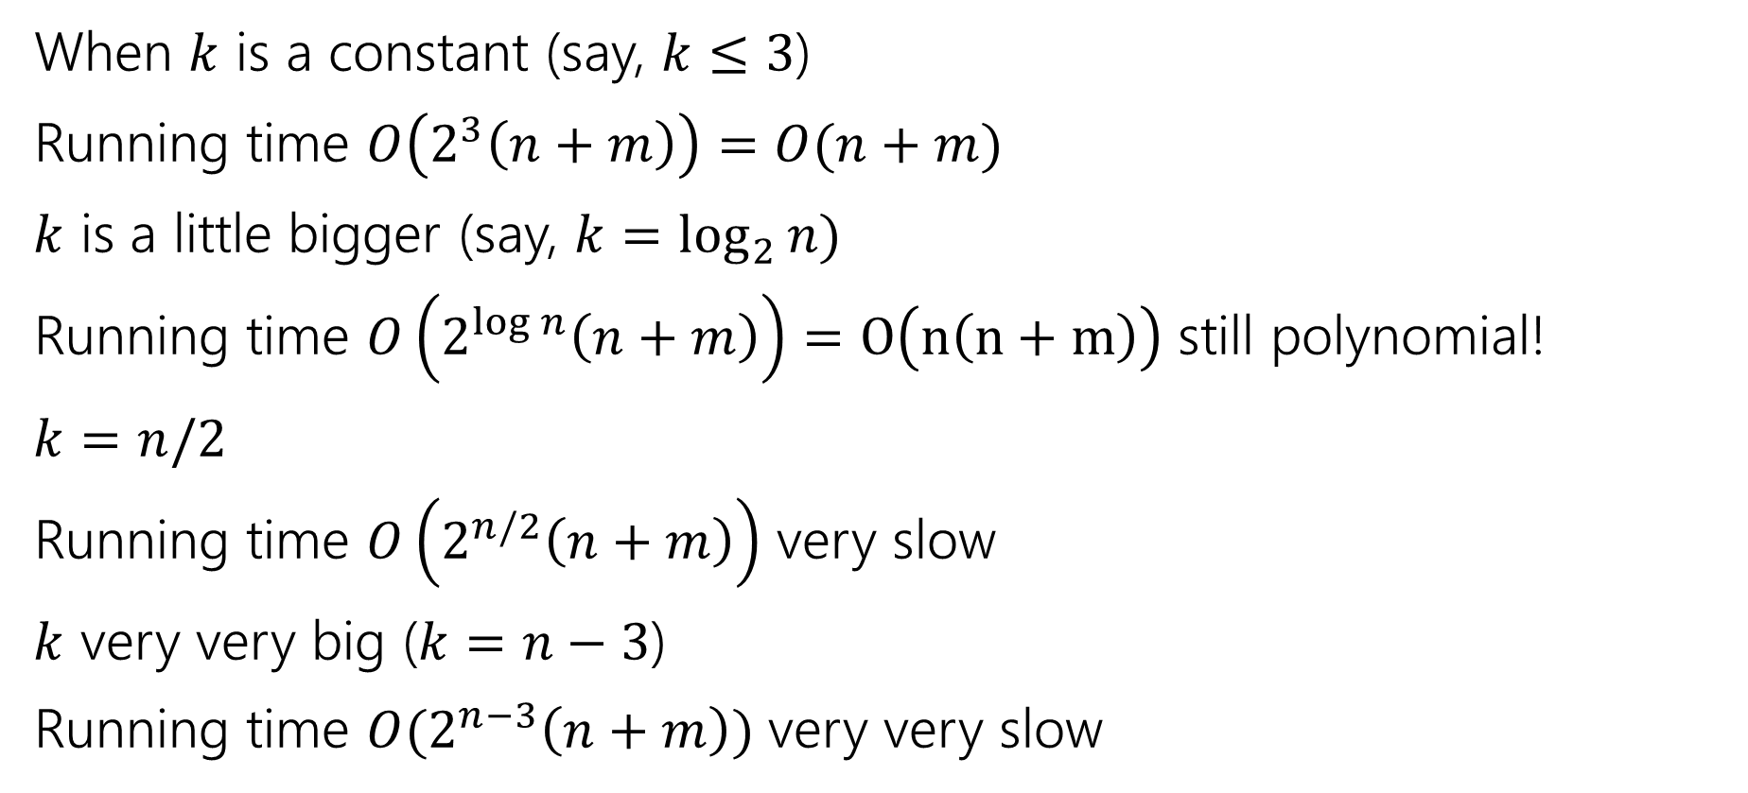
Vertex Cover
When $k$ is a constant (say, $k≤3$)
Running time $O\left(2^{3}\left(n+m\right)\right)=O(n+m)$
$k$ is a little bigger (say, $k=\log_{2}{n)}$
Running time $O\left(2^{\log{n}}\left(n+m\right)\right)=O\left(n\left(n+m\right)\right)$ still polynomial!
$k=n/2$
Running time $O\left(2^{n/2}\left(n+m\right)\right)$ very slow
$k$ very very big ($k=n−3$)
Running time $O(2^{n−3}\left(n+m\right))$ very very slow

Slide 54
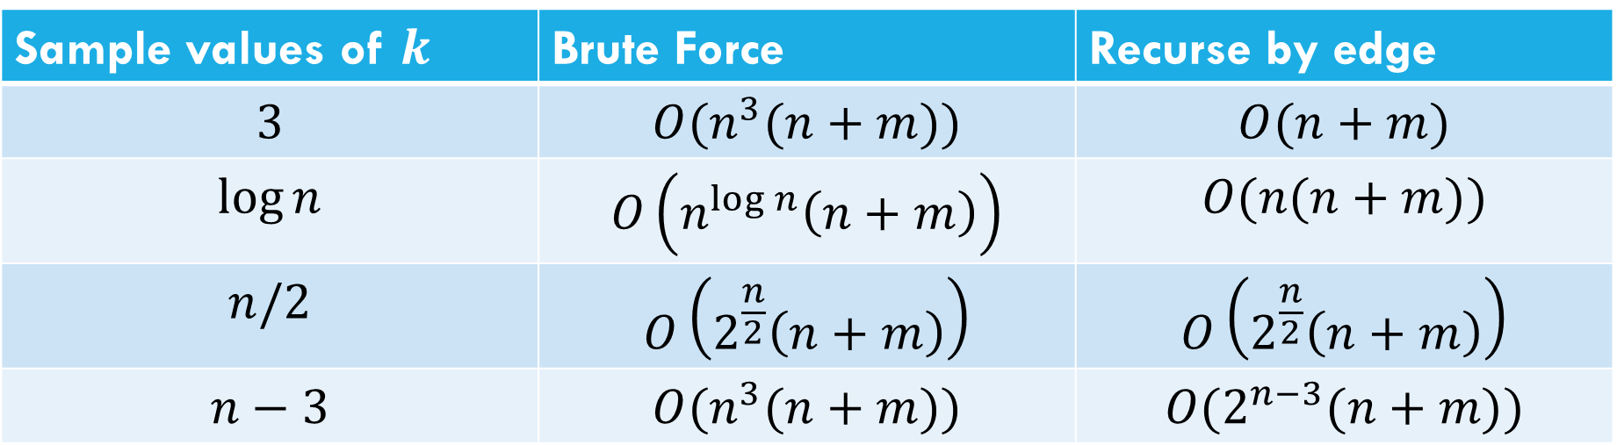
Comparison
Sample values of $k$ | Brute Force | Recurse by edge
$$3$$ | $$O(n^{3}(n+m))$$ | $$O(n+m)$$
$$\log{n}$$ | $$O\left(n^{\log{n}}\left(n+m\right)\right)$$ | $$O(n(n+m))$$
$$n/2$$ | $$O\left(2^{\frac{n}{2}}\left(n+m\right)\right)$$ | $$O\left(2^{\frac{n}{2}}\left(n+m\right)\right)$$
$$n−3$$ | $$O(n^{3}(n+m))$$ | $$O(2^{n−3}(n+m))$$

Slide 55

Takeaway
If your vertex cover is small you can get a pretty efficient algorithm.
For $k$ at most $O(\log{n) }$it even becomes polynomial.
A “simple case” you can carve off.

Slide 56
More Generally
Measuring the complexity in terms of something other than the size of the input is called “parameterized complexity”
Common parameters:
The answer (like Ford-Fulkerson! And vertex cover)
How “complicated” the input is (e.g. for graphs, do you have a tree, something very close to a tree, or nothing like a tree).
Another example: SAT – an instance with few variables and many constraints is very different from an instance with many variables and few constraints.

Slide 57
Approximation Algorithms

Slide 58

Decision Problems
Putting away decision problems, we’re now interested in optimization problems.
Problems where we’re looking for the “biggest” or “smallest” or “maximum” or “minimum” or some other “best”
Much more like the problems we’re used to!
Given a graph $G$ find the smallest set of vertices such that every edge has at least one endpoints in the set.
Vertex Cover (Optimization Version)

Slide 59
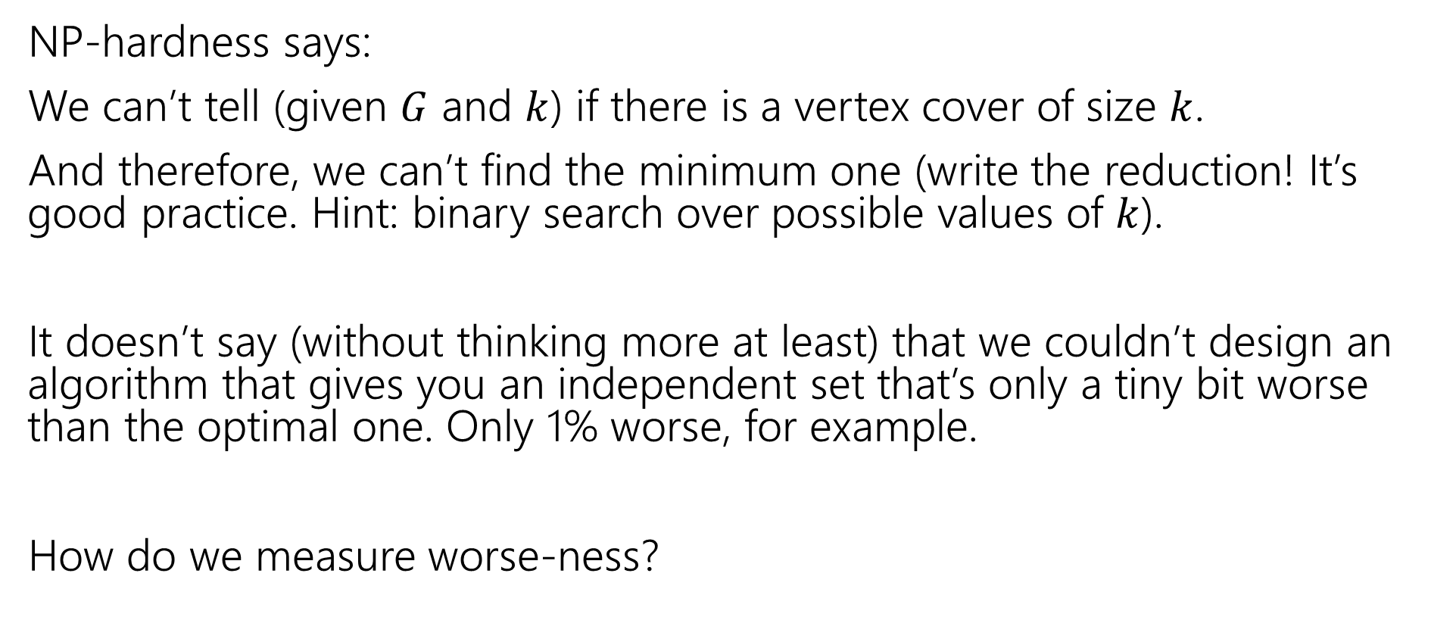
What does NP-hardness say?
NP-hardness says:
We can’t tell (given $G$ and $k$) if there is a vertex cover of size $k$.
And therefore, we can’t find the minimum one (write the reduction! It’s good practice. Hint: binary search over possible values of $k$).
It doesn’t say (without thinking more at least) that we couldn’t design an algorithm that gives you an independent set that’s only a tiny bit worse than the optimal one. Only 1% worse, for example.
How do we measure worse-ness?

Slide 60
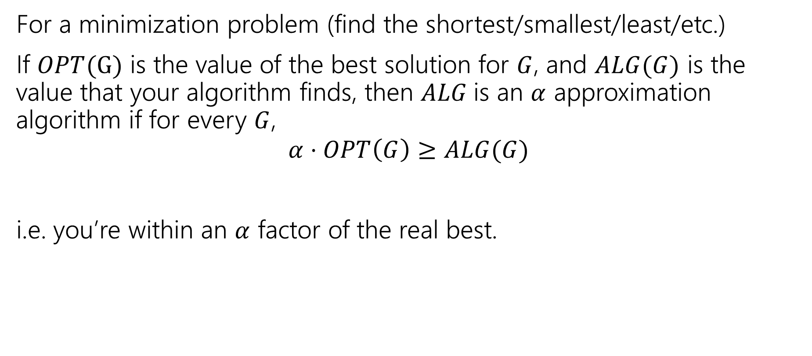
Approximation Ratio
For a minimization problem (find the shortest/smallest/least/etc.)
If $OPT(G)$ is the value of the best solution for $G$, and $ALG(G)$ is the value that your algorithm finds, then $ALG$is an $α$ approximation algorithm if for every $G$,
$$α⋅OPT\left(G\right)≥ALG(G)$$
i.e. you’re within an $α$ factor of the real best.

Slide 61
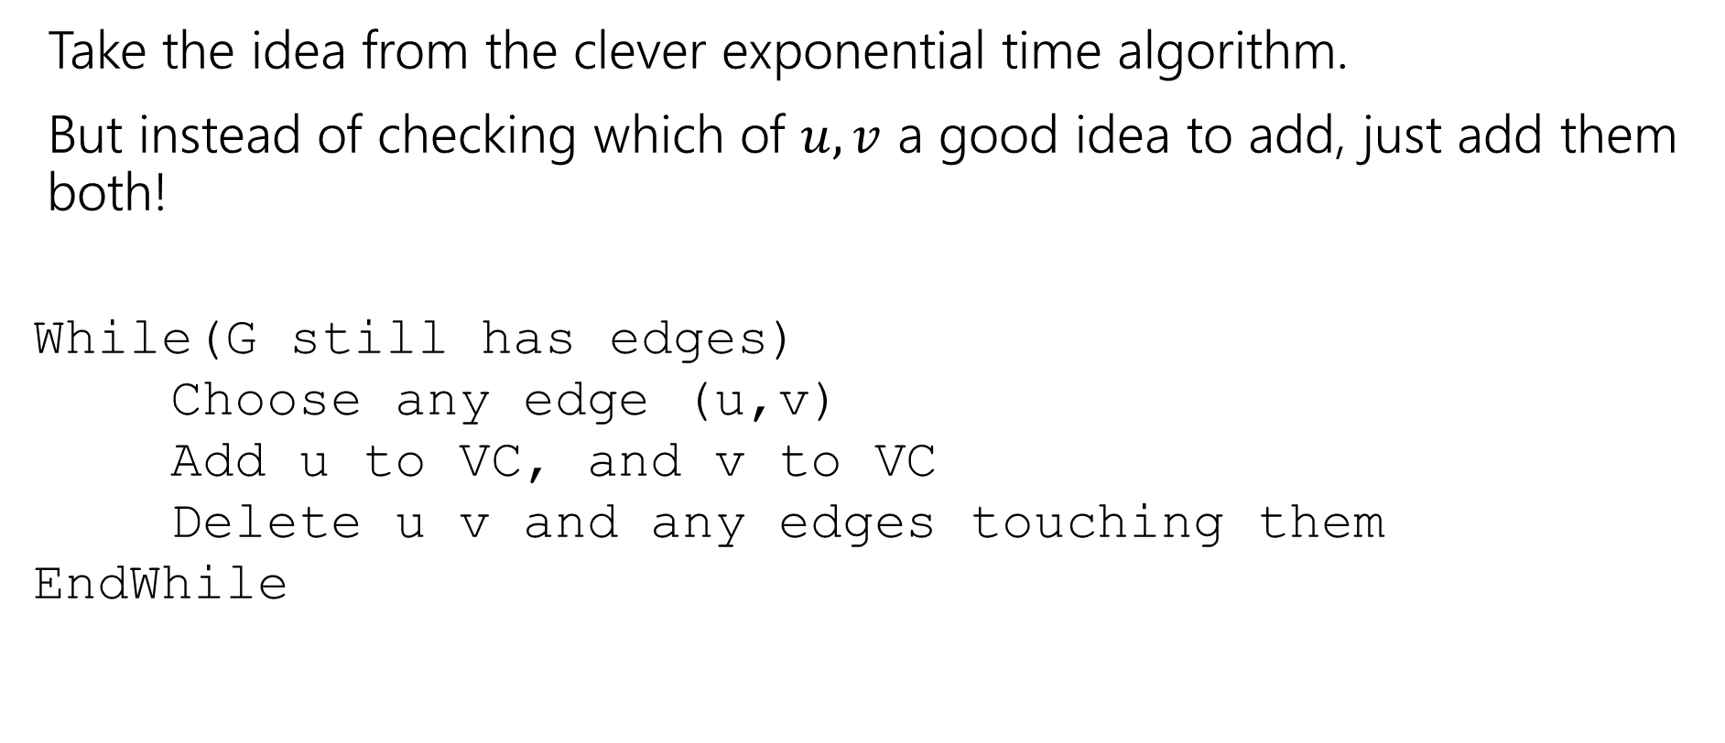
Finding an approximation for Vertex Cover
Take the idea from the clever exponential time algorithm.
But instead of checking which of $u,v$ a good idea to add, just add them both!
While(G still has edges)
Choose any edge (u,v)
Add u to VC, and v to VC
Delete u v and any edges touching them
EndWhile

Slide 62
Does it work?
Do we find a vertex cover?
Is it close to the smallest one?
But first, let’s notice – we’re back to polynomial time algorithms!
If we’re going to take exponential time, we can get the exact answer. We want something fast if we’re going to settle for a worse answer.

Slide 63

Do we find a vertex cover?
When we delete an edge, it is covered (because we added both $u$ and $v$. And we only stop the algorithm when every edge has been deleted. So every edge is covered (i.e. we really have a vertex cover.

Slide 64
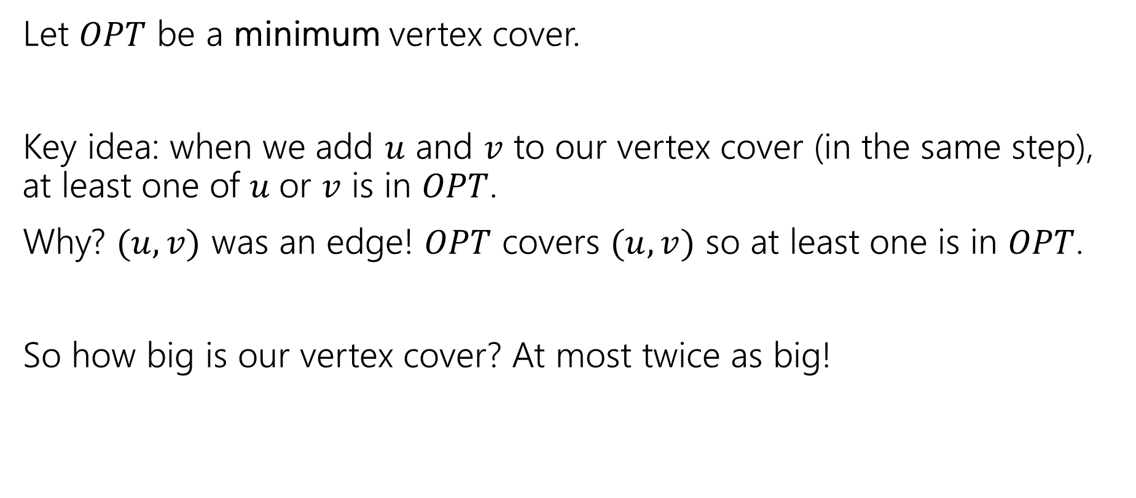
How big is it?
Let $OPT$ be a minimum vertex cover.
Key idea: when we add $u$ and $v$ to our vertex cover (in the same step), at least one of $u$or $v$ is in $OPT$.
Why? $(u,v)$ was an edge! $OPT$ covers $(u,v)$ so at least one is in $OPT$.
So how big is our vertex cover? At most twice as big!

